Slide 1

OPINION MINING AND ANALYSIS
1081310142-VIBHOR SINGH 1081310140-PRIYANSH SAXENA 1081310158-SIDDHARTH SINGH
GUIDE-PROF S.RAJENDRAN

Slide 2
Introduction
The project defines the latest methods for extracting data from the web application that takes reviews from various people about the latest movies released . The project uses simple user interface for a common user to easily give his feedback about the movies. The project uses dictionary based analysis to extract the data and use the algorithm to find out the review about the movie.

Slide 3
Issues in existing methodology
Rating is not given on the basis of the review written by the user.
No statistical analysis in the current methodology.
Real time update on the current reviews couldn’t be done.

Slide 4
Need for new methodology
Graphical representation o the analysis.
Review can be given easily with short comments for better understanding.
Analysis can be made easy with the application with real time reviews and updates.

Slide 5
Problem definition
In this project we will be able to mine the data to do analysis on the latest movies using various methods
Module 1- It takes the data stored in the backend webpage and then analyze the comments of people.
Module 2-in this the application we scrap the data from webpage directly using html tags and then do the analysis.

Slide 6
Requirement analysis
FUNCTIONAL REQ:
The need for the data to be extracted from the website and then perform analysis.
The final review of the movie should be available on the website.
NON FUNCTIONAL REQ:
Multiple reviews from single user should not be considered.
The word limit for the review should not exceed the limit that is set.

Slide 7
SOFTWARE:
NET BEANS
PHP
JAVA
HARDWARE:
Web server
computer or smart phone with internet access

Slide 8
ALGORITHM AND IMPLEMENTATION
Dictionary based algorithm with the help of Set container in java
MODULE 1- Website to store and clean the data using PHP.
MODULE 2- Taking transformed data and then implementing the analysis.
MODULE 3- Taking data directly from website using html tags and then implementing the analysis.

Slide 9
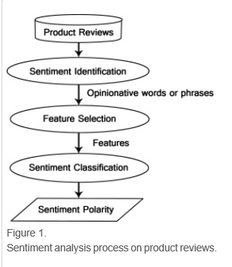
System Design

Slide 10
