Slide 1

OPINION MINING AND ANALYSIS
1081310142-VIBHOR SINGH 1081310140-PRIYANSH SAXENA 1081310158-SIDDHARTH SINGH
GUIDE-PROF S.RAJENDRAN

Slide 2
Introduction
We are creating a tool that can perform review analysis based on the reviews given by the user on a set of movies. The updates in the analysis are real time since the data is extracted and then the algorithm is applied to get the reviews of the people regarding the movie.

Slide 3
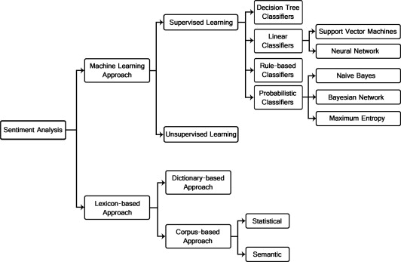
ALGORITHM

Slide 4
Our Tasks so far
Algorithm has been created.
Method to store data in backend using php.
Creation of the basic website with UI in progress.
Testing of the algorithm.
Implementation of algorithm in the GUI.

Slide 5
Social and ethical issues
The reviews given in now days are from invalid users. We are trying to create a method so that a verification link is sent to the email address so that spamming can be avoided.
The good movies get bad reviews due to less popularity and we will get the real time review from the user.

Slide 6
Split up of the project
Our project will have 2 modules.
In the first module we will extract the data from the website and then put it into a txt file where we perform the analysis based on the dictionary algorithm and then display the reviews with a pie chart as well as image based so that it becomes more attractive to the user.

Slide 7
The second module consists of the extraction of data from another website where we can review the data from their website.

Slide 8
Impact of the solution
The project will guide the people as to watch movie should actually be watched so that their money is not wasted.
The project not only performs review analysis for movies but can also be used by professionals to get an analysis about their products as well as their company from the users who actually use their product

Slide 9
Supporting papers for the project
http://www.sciencedirect.com/science/article/pii/S1018363916300071
http://ieeexplore.ieee.org/document/6858011/
http://dl.acm.org/citation.cfm?id=2840099
https://pdfs.semanticscholar.org/8aba/3210964e44b6b1aef5c472a3ae9671d24cf8.pdf

Slide 10
Distribution of work among team members
Creation of algorithm –Vibhor,Priyansh,Siddharth
Implementation of the algorithm-Vibhor ,Priyansh
Creation of front end-Siddharth

Slide 11
Plans for the next review
We would be creating a fully developed website that would implement the tool and perform analysis from the reviews given by the user.
The website would send an activation link to the email address to avoid unrecognized registration
Including the images in the sentiments to make it more attractive.

Slide 12
Thank You

