Slide 1

Opinion Mining and analysis of Movie Reviews
By
Vibhor Singh
Priyansh Saxena
Siddharth Singh

Slide 2
Objective
The objective of the project is to analyse the sentiments of the movie reviews. Thus, for accurate results we decided to extract data from various sources like Twitter, own website and a third party website (Flixster) available on internet to predict the rating of the movie based on various criteria using machine learning. This project performs following things
1. Analysis using our own website
2. Analysis via a third party website
3. Twitter Analysis
4. In-depth analysis
5. Rating prediction Using Naive Bayes, Decision tree & K nearest neighbour
6. Accuracy of classifier used

Slide 3
Introduction to the project
The project concentrates on sentiment analysis of movie reviews using dictionary based algorithm. The reviews are stored in a text file and from the text file the analysis on the data is done to find out how the movie did at the box office.
We also give the rating of the movie based on its performance using a train set of data. We use machine learning algorithms like KNN, decision Tree, Naive Bayes for finding out the rating. We also find the accuracy of each algorithm to find out which algorithm has the best accuracy.

Slide 4
Data Sources
Our own Website (Reviewstr)
Flixster
Twitter

Slide 5
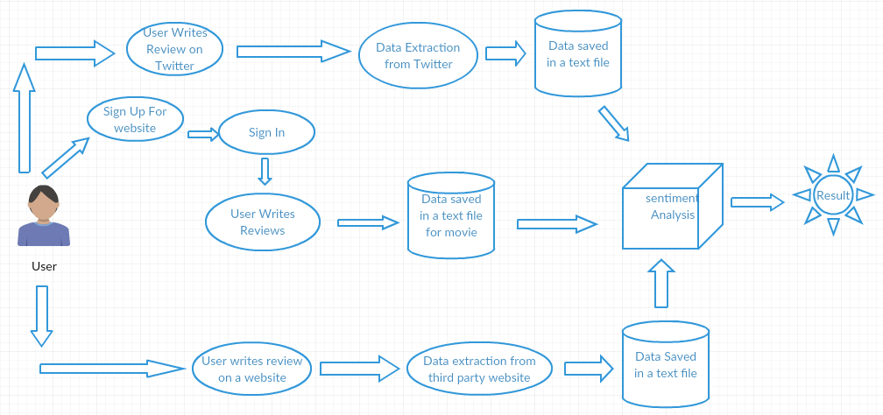
System Architecture

Slide 6
Dictionary Based Algorithm
This algorithm analyse sentiment from semantic orientation of words that occur in a text by manually defining dictionary for positive ,negative and intensifier words stored in different text file.
The algorithm works as follows:
1. We have used intensifiers like very good , very bad, so bad, so good etc
2. There are negation words like not good, not bad which totally change the meaning of the review.
3. The reviews of the movies are stored in a text file from the data extraction done from different sources.

Slide 7
The file containing the reviews are attached to our application and then we count the number of positive and negative words in the reviews for that movie.
Based on the reviews and the count of the positive and negative words in our dictionary we calculate whether you should watch the movie or not.
Thus the animated GIF’s show how the movie actually is.

Slide 8
The dictionary
We have three dictionaries from which the reviews are compared
1. Positive.txt
2. Negative.txt
3. Intensifier.txt
These dictionaries contains lots of words which define the positivity and the negativity of the reviews by comparing with the reviews of the people.

Slide 9
Intensifiers
For intensifier words like very good, very bad it calculates the positivity and negativity as follows
if(intensifier.contains(word))//
{ String word1=word;
word1=sc.next();
if (positive.contains(word1)) {
positiveCount+=2;p++;
}
if (negative.contains(word1)) {
negativeCount+=2;n++;
}
}

Slide 10
Negation words like not good, not bad
if (negative.contains(word2)) {
n++;positiveCount+=1;
}
else
{ do
{ word3=sc.next();c++;
if (positive.contains(word3))
{
negativeCount+=1;n++;
break;
}
if( negative.contains(word3) )
{
positiveCount+=1;p++;
break;
}
}while((!positive.contains(word3)&&c<3)||(!positive.contains(word3)&&d<3));}
}

Slide 11
Our website- Reviewstr
This website is designed to store the collaborated review of a movie given by various user which is updated and can be downloaded in form of text file and can be analysed later. It converts the reviews given in lower case because the dictionary contains lower case words. The reviews are stored using file handling in PHP

Slide 12
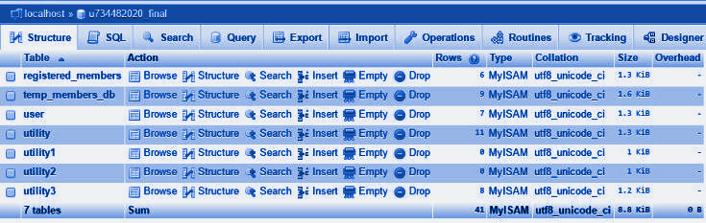
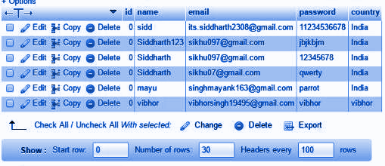
Screenshot of the website Backend
First image shows all MYSQL databases.
Second image shows account details of all users.

Slide 13
Web Scraping from Flixster
This module uses JSOUP API to extract the reviews in HTML pages and store it in the text file . It enable user to copy and paste the URL of a movie from Flixster and extract the data to get analysed .

Slide 14
Twitter Analysis
1)In twitter analysis we are extracting the reviews of the movie via twitter .
2)It takes #moviename as input and it will extract the tweets from twitter via Twitter4j(API) and then analysis is done .
3)It calculates the movie popularity which is specified by given range, calculated
Using formula ((positiveCount+negativeCount)*100)/no of tweets.

Slide 15
Classification
1)First step is to find movie’s positive%, negative% of reviews and its popularity using
sentiment analysis.
2)popularity of movie is represented by either (TRUE or FALSE).
3)These data are stored in a test.arff file manually in format(positive%, negative%, popularity,?).The
character "?" represent rating that has to predicted for a movie.
4)For each Machine Learning algorithm used ,three classifier are formed by training
data from file movies.numeric.arff file.
5)Each classifier then predicts rating range for the data stored in second step.

Slide 16
In-Depth Analysis
1)The in-depth analysis takes you more deeper into the analysis. A user can get an overview not only about the movie but also about specific things like acting, music, cast, etc.
2)Select the review file and type the specific term like acting, cast, direction etc. It will filter the data related to that particular keyword and perform analysis on it.
3)As output you will get the reviews about the particular keyword.

Slide 17
Demo of the Project
Now we will showcase the full working of the project.

Slide 18
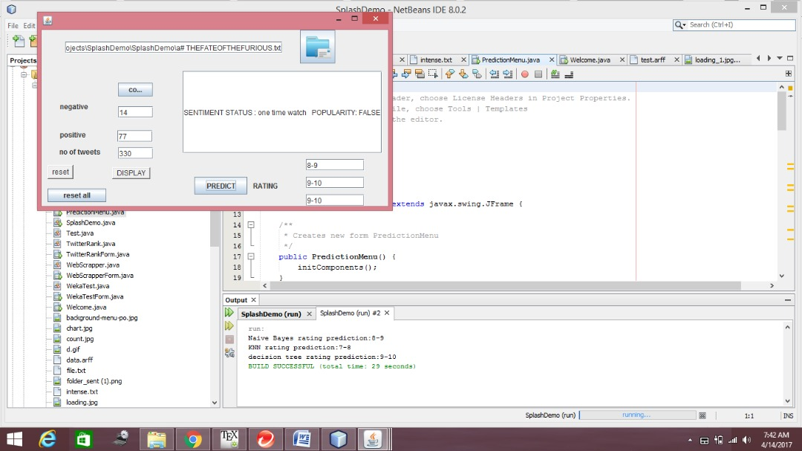
Results and Discussion
The polarity of the reviews are a key factor in determining the overall sentiment . The project not only concentrates on the sentiment of reviews but also predicts the rating of the movie using Machine learning classifier.

Slide 19
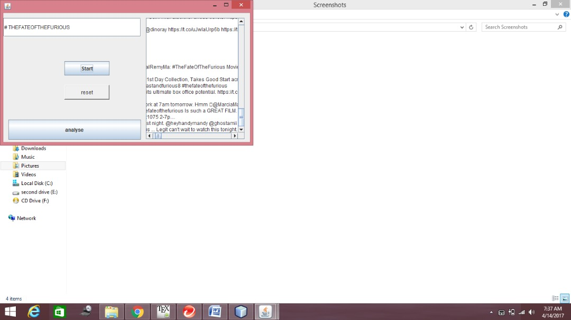

Slide 20
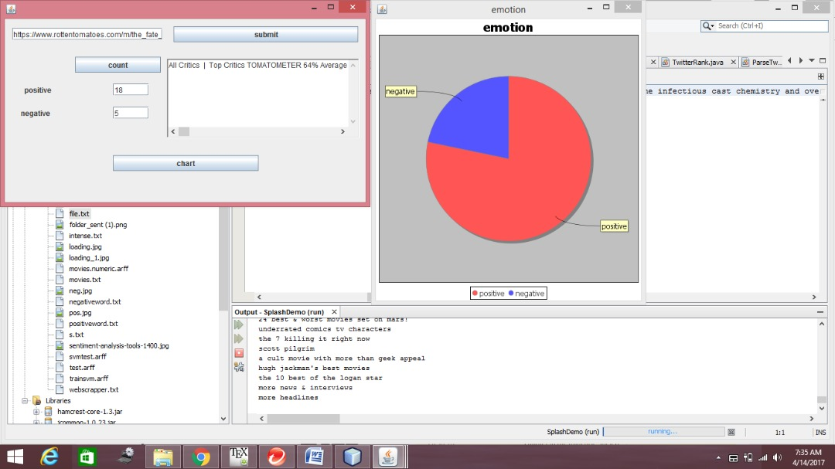

Slide 21
Accuracy
We also find the accuracy for the classifier to understand which gives the most accurate results.
Accuracy : Closeness to a standard value
=(TP+TN)/(TP+TN+FP+FN).
Precision: fraction of true positive upon total predicted positive
=TP/(TP+FP)

Slide 22
Paper Publishion
We have submitted the paper on this project to INDJST(Indian Journal of Science and Technology) and they have reverted back with no plagiarism.
The paper is under final screening before getting published.

Slide 23
Thank You
We would like to thank our guide Prof. S.Rajendran who has guided us very well in the course of this project. We would also like to thank DR Maragatham ma'am and HOD ma’am for their continuous support.
Thank you all for being so patient and listening to us.

