Slide 1


Ensemble Learning with Exploratory Data Analysis for Predicting COVID-19 Epidemic Trend
Course Title: Final Year Design Project- II
Course Code: CSE 400B
Department: Computer Science and Engineering, United International University
Supervisor: Dr. Dewan Md Farid
(Assoc. Professor, CSE Dept., UIU)
Course Teacher: Dr. A.K.M Muzahidul Islam (Professor, CSE Dept., UIU)
NAME | ID
Sufi Aurangzeb Hossain | 011172125
Md. Mottasin Lemon | 011171082
Md Robiul Islam Sakib | 011162004
Ehsan Jahin Rishat | 011162079
Md Shahbaz Anwar | 011162098
Notes:
Greetings, Introduce yourself, team members, faculty and supervisor.

Slide 2
Outline
Introduction
Dataset Description and EDA
Methodology
Results
Conclusion
References
Ensemble Learning with Exploratory Data Analysis for Predicting COVID-19 Epidemic Trend
Department of Computer Science and Engineering, UIU
Notes:
Amra ai jinish cover kortesi

Slide 3
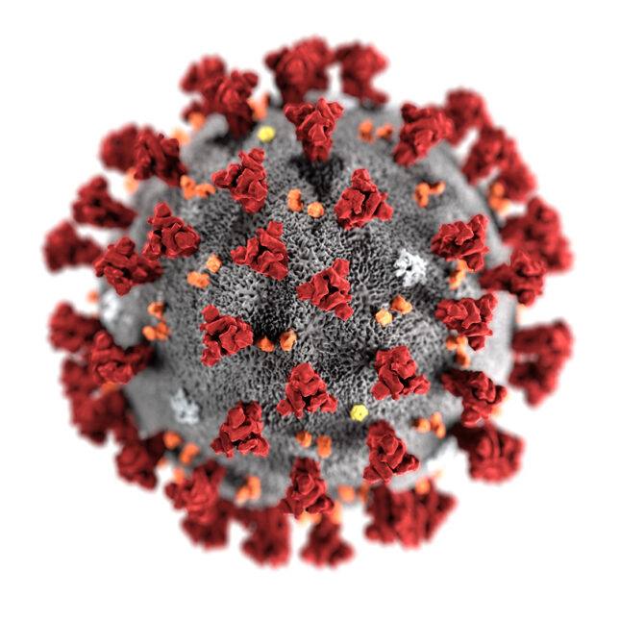
Introduction
Why did we choose Covid-19 as our research topic?
Global Crisis
Availability of Open Data Sources
Higher possibility of publishing a paper
Learn The Trend of The Pandemic
Help Decision Makers
Figure 1: Coronavirus
Ensemble Learning with Exploratory Data Analysis for Predicting COVID-19 Epidemic Trend
Department of Computer Science and Engineering, UIU
Notes:
Motivation

Slide 4
Introduction
Objective
Collect and prepare the datasets
Use the datasets in different ML models
Propose a model
Predict Covid-19 trend
Evaluate the models’ performances
Ensemble Learning with Exploratory Data Analysis for Predicting COVID-19 Epidemic Trend
Department of Computer Science and Engineering, UIU
Notes:
Objective

Slide 5
Introduction
Outcome
Data visualization
Proposed a model
Prepared a draft for publication
Ensemble Learning with Exploratory Data Analysis for Predicting COVID-19 Epidemic Trend
Department of Computer Science and Engineering, UIU
Notes:
Data visualization korsi using eda methods

Slide 6
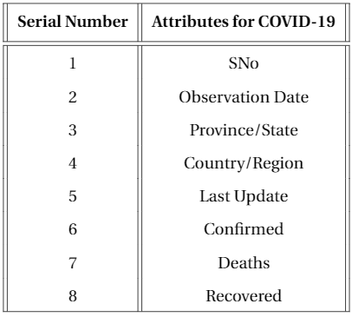
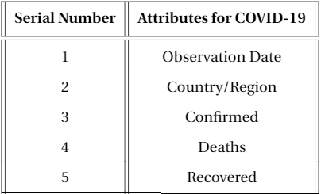
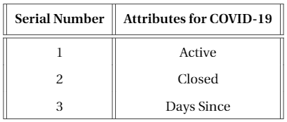
Datasets Description
Datasets Resources
John Hopkins University Github repository
World Health Organization (WHO)
Kaggle
Table 2: Primary Attributes considered for this project (Independent Attributes)
Table 1: Primary Attributes present after collecting the Datasets.
Table 3: Secondary Attributes considered for this project (Dependent Attributes)
Ensemble Learning with Exploratory Data Analysis for Predicting COVID-19 Epidemic Trend
Department of Computer Science and Engineering, UIU

Slide 7
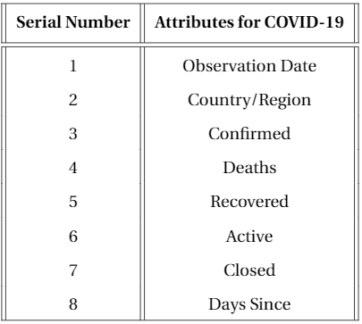
Datasets Description
Datasets Pre-processing
Partial Data Inserting (Time series data of Bangladesh & Worldwide)
Data Reduction ( Removing irrelevant attributes)
Data Cleaning (Filling null/missing values)
Data Integration (Creating new columns)
Table 4: Attributes considered in this project
Ensemble Learning with Exploratory Data Analysis for Predicting COVID-19 Epidemic Trend
Department of Computer Science and Engineering, UIU

Slide 8
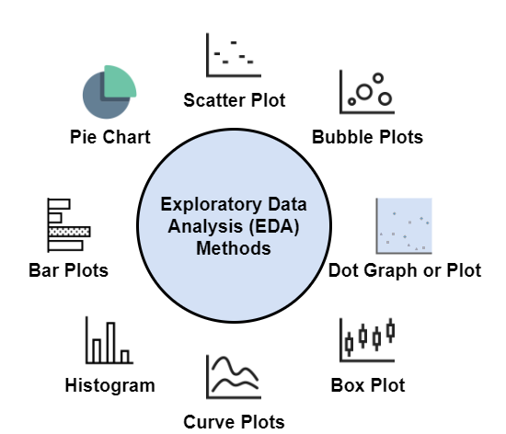
Exploratory Data Analysis (EDA)
What is EDA?
An approach of analyzing datasets
Summarize the main characteristics of datasets
Statistical graphics are used
Data visualization methods are used
Figure 2: Different EDA Methods
Ensemble Learning with Exploratory Data Analysis for Predicting COVID-19 Epidemic Trend
Department of Computer Science and Engineering, UIU

Slide 9
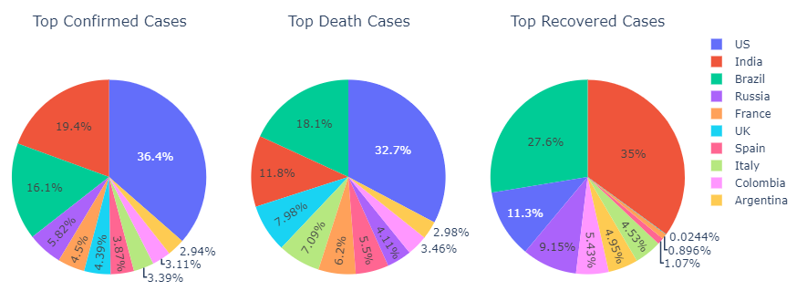
Figure 3: Top 10 Countries with Different Covid-19 Cases using Pie Charts
Ensemble Learning with Exploratory Data Analysis for Predicting COVID-19 Epidemic Trend
Department of Computer Science and Engineering, UIU

Slide 10
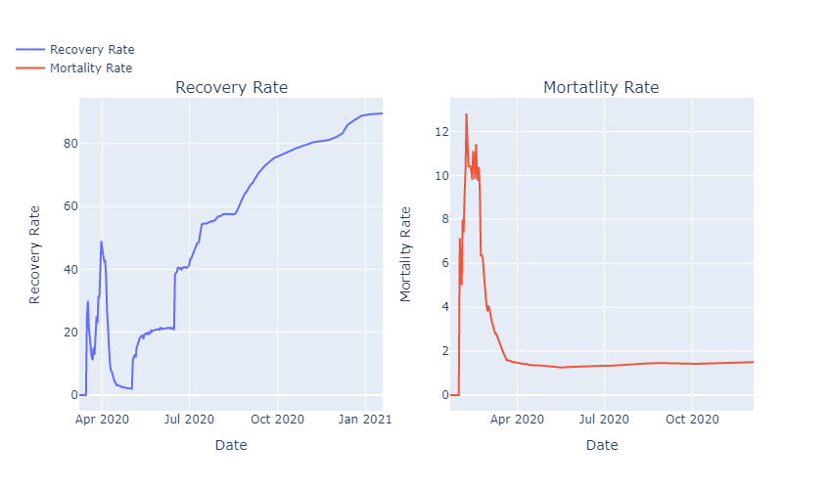
Figure 4: Comparison between daily Recovery Rate & Mortality Rate
Ensemble Learning with Exploratory Data Analysis for Predicting COVID-19 Epidemic Trend
Department of Computer Science and Engineering, UIU

Slide 11
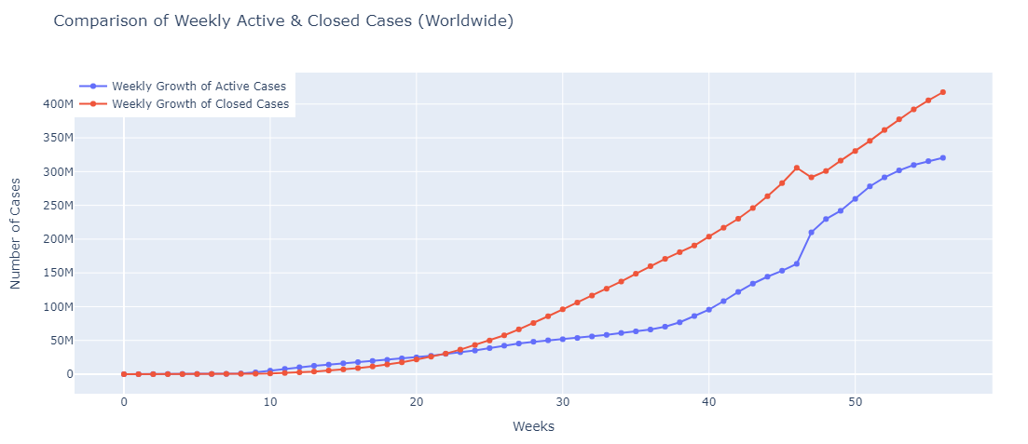
Figure 5: Weekly Active and Closed Covid-19 Cases using Scatter Plots
Ensemble Learning with Exploratory Data Analysis for Predicting COVID-19 Epidemic Trend
Department of Computer Science and Engineering, UIU

Slide 12
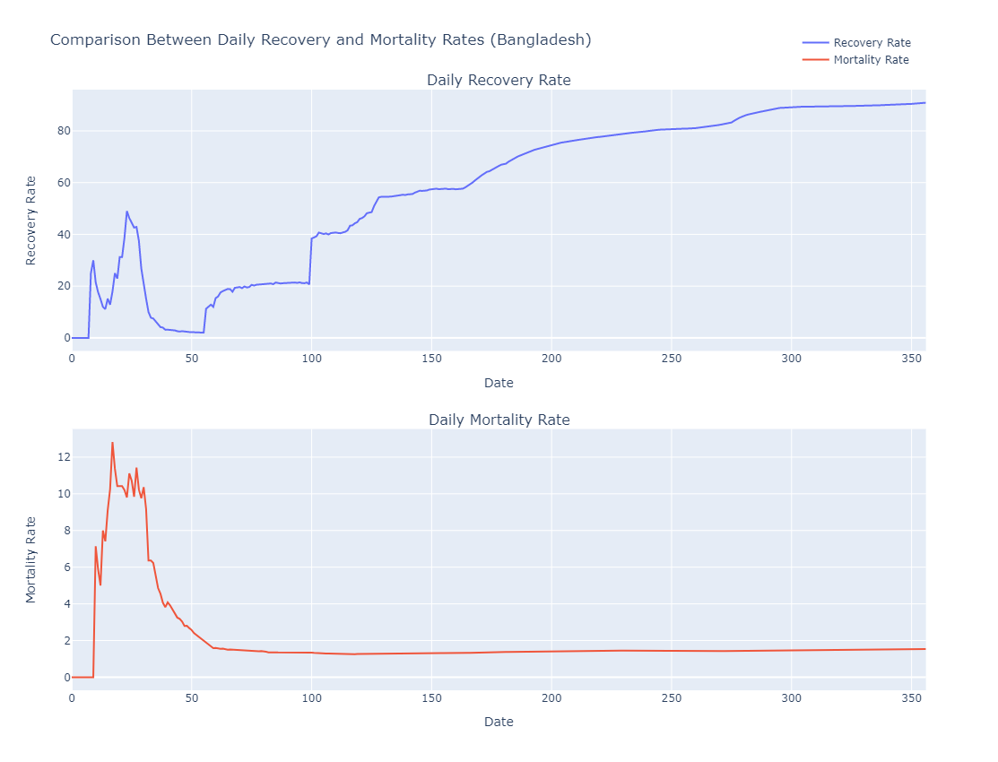
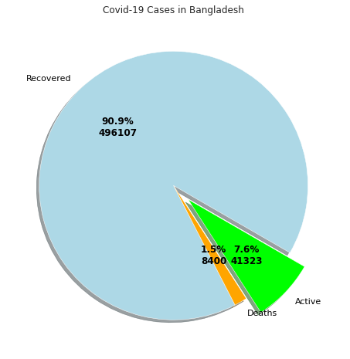
Figure 6: Similar Methods used to Visualize Covid-19 data for Bangladesh
Ensemble Learning with Exploratory Data Analysis for Predicting COVID-19 Epidemic Trend
Department of Computer Science and Engineering, UIU

Slide 13
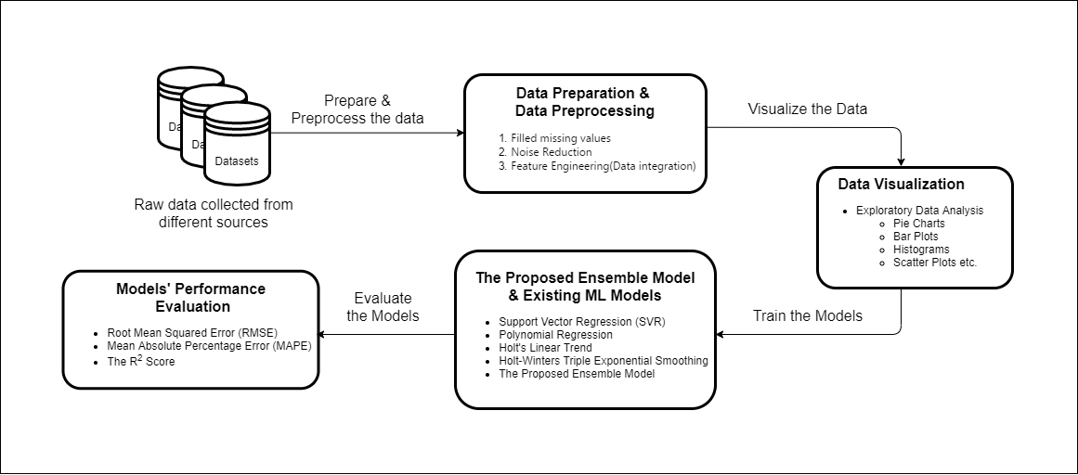
Methodology
The Full Methodology
4. Splitting Data (70/30)
Figure 7: Project's Methodology
Ensemble Learning with Exploratory Data Analysis for Predicting COVID-19 Epidemic Trend
Department of Computer Science and Engineering, UIU

Slide 14
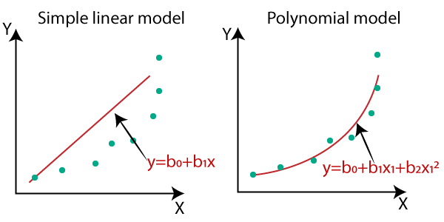
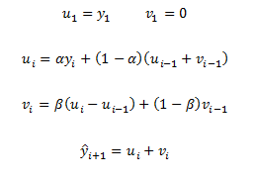

Methodology
Polynomial Regression, Holt Linear (Double exponential smoothing)
y_{i} = present data
y_{i+1} = next predicted value
𝛂, 𝛃 = hyperparameter
Figure 8 : Polynomial Regression
Figure 9 : Holt Linear (Double Exponential Smoothing)
Ensemble Learning with Exploratory Data Analysis for Predicting COVID-19 Epidemic Trend
Department of Computer Science and Engineering, UIU

Slide 15
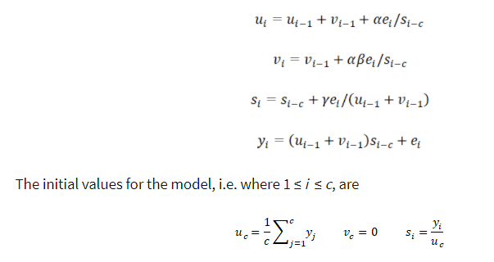
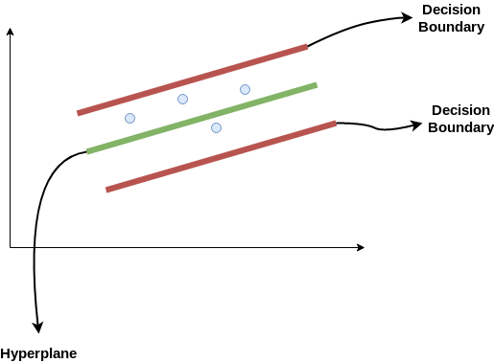

Methodology
Holt Winter (Triple exponential smoothing), Support Vector Regression(SVR)
y_{i} = present data
y_{i+1} = next predicted value
𝛂, 𝛃 , γ= hyperparameter
Decision Boundary:
wx+b= + a
wx+b= -a
a = 𝛆
Y = wx+b (equation of hyperplane)
-a < Y- wx-b < +a
Figure 10 : Holt Winter (Triple Exponential Smoothing)
Figure 11: Support Vector Regression (SVR)
Ensemble Learning with Exploratory Data Analysis for Predicting COVID-19 Epidemic Trend
Department of Computer Science and Engineering, UIU

Slide 16
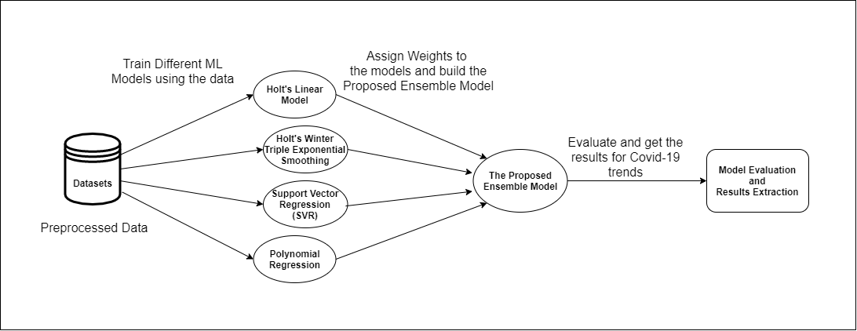
Methodology
The Proposed Ensemble Model
Ref: Holt Linear [1], Holt Winter [1], SVR [2], Polynomial Regression[2]
Figure 12: Project's Methodology
Ensemble Learning with Exploratory Data Analysis for Predicting COVID-19 Epidemic Trend
Department of Computer Science and Engineering, UIU

Slide 17
Results
(Bangladesh)
Model Name | Covid-19 Cases | RMSE | MAPE | R Square Score
Holt’s Linear Model | Confirmed | 0.005 | 0.03 | 0.74
 | Recovered | 0.003 | 0.03 | 0.84
 | Deaths | 0.003 | 0.03 | 0.83
Model Name | Covid-19 Cases | RMSE | MAPE | R Square Score
Polynomial Model | Confirmed | 0.02 | 0.09 | 1.74
 | Recovered | 0.007 | 0.09 | 0.19
 | Deaths | 0.004 | 0.04 | 0.65
Model Name | Covid-19 Cases | RMSE | MAPE | R Square Score
Holt's Winter Model | Confirmed | 0.007 | 0.35 | 0.42
 | Recovered | 0.003 | 0.03 | 0.83
 | Deaths | 0.002 | 0.03 | 0.85
Model Name | Covid-19 Cases | RMSE | MAPE | R Square Score
Support Vector Regression Model | Confirmed | 0.06 | 0.39 | 41.34
 | Recovered | 0.04 | 0.48 | 24.38
 | Deaths | 0.005 | 0.07 | 0.38
Table 5: Result Bangladesh
Ensemble Learning with Exploratory Data Analysis for Predicting COVID-19 Epidemic Trend
Department of Computer Science and Engineering, UIU
Notes:
& Confirmed & 0.06 & 0.39 & -41.34 \\
Support Vector Regression & Recovered & 0.04 & 0.48 & -24.38 \\
(Bangladesh) & Deaths & 0.005 & 0.07 & 0.38 \\

Slide 18
Results
(Bangladesh)
Model Name | Covid-19 Cases | RMSE | MAPE | R Square score
Proposed | Confirmed | 0.005 (0.006 - Holt’s Linear) | 0.02 (0.03 - Holt’s Linear) | 0.75
 | Recovered | 0.003 (0.004 - Holt’s Linear) | 0.03 (0.03 - Holt’s Linear) | 0.84
 | Deaths | 0.002 (0.002 - Holt’s Winter) | 0.03 (0.03 - Holt’s Linear) | 0.89
Table 6: Result of Proposed Model for Bangladesh
Ensemble Learning with Exploratory Data Analysis for Predicting COVID-19 Epidemic Trend
Department of Computer Science and Engineering, UIU

Slide 19
Results
(Worldwide)
Model Name | Covid-19 Cases | RMSE | MAPE | R Square Score
Holt’s Linear Model | Confirmed | 1.08 | 0.04 | 0.96
 | Recovered | 0.19 | 0.02 | 0.99
 | Deaths | 2.08 | 0.08 | 0.70
Model Name | Covid-19 Cases | RMSE | MAPE | R Square Score
Polynomial Model | Confirmed | 2.74 | 0.11 | 0.77
 | Recovered | 0.65 | 0.06 | 0.82
 | Deaths | 0.99 | 0.03 | 0.93
Model Name | Covid-19 Cases | RMSE | MAPE | R Square Score
Holt's Winter Model | Confirmed | 1.34 | 0.04 | 0.95
 | Recovered | 0.20 | 0.02 | 0.98
 | Deaths | 2.49 | 0.10 | 0.57
Model Name | Covid-19 Cases | RMSE | MAPE | R Square Score
Support Vector Regression Model | Confirmed | 2.65 | 0.08 | 0.79
 | Recovered | 0.58 | 0.06 | 0.86
 | Deaths | 1.33 | 0.08 | 0.88
Table 7: Result Worldwide
Ensemble Learning with Exploratory Data Analysis for Predicting COVID-19 Epidemic Trend
Department of Computer Science and Engineering, UIU
Notes:
Confirmed & 2.65 & 0.08 & 0.79 \\
Support Vector Regression & Recovered & 0.58 & 0.06 & 0.86 \\
(Worldwide) & Deaths & 1.33 & 0.08 & 0.88 \\

Slide 20
Results
(Worldwide)
Model Name | Covid-19 Cases | RMSE | MAPE | R Square score
Proposed | Confirmed | 0.94 (1.08 - Holt’s Linear) | 0.03 (0.04 - Holt’s Linear) | 0.97
 | Recovered | 0.19 (0.19 - Holt’s Linear) | 0.02 (0.02 - Holt’s Linear) | 0.98
 | Deaths | 0.38 (0.99 - Polynomial) | 0.02 (0.03 - Polynomial) | 0.99
Table 8: Result of Proposed Model Worldwide
Ensemble Learning with Exploratory Data Analysis for Predicting COVID-19 Epidemic Trend
Department of Computer Science and Engineering, UIU
Notes:
Polynomial Model

Slide 21
    Conclusion
    Summary
        Visualised data using EDA to investigate nature & pattern of data
        Preprocessed data to achieve precise output
        Used several ML models to find out the best performing one
        Proposed an Ensemble Model using those four ML models
    Limitations
        Machines used are not powerful enough
    Future Works
        Analyze the effects of lockdowns and vaccines
        Search correlation between the spread of the virus with other factors in Bangladesh
Ensemble Learning with Exploratory Data Analysis for Predicting COVID-19 Epidemic Trend
Department of Computer Science and Engineering, UIU

Slide 22
    References
[1] Satpathy, S., Mangla, M., Sharma, N. et al. Predicting mortality rate and associated risks in COVID-19 patients. Spat. Inf. Res. 29, 455–464 (2021). https://doi.org/10.1007/s41324-021-00379-5
[2] M. Yadav, M. Perumal, M. Srinivas, “Analysis on novel coronavirus (COVID-19) using machine learning methods”, Chaos, Solit Fractals, 139 (2020),
p. 110050
[Figure 8] https://www.javatpoint.com/machine-learning-polynomial-regression
[Figure 11] https://www.analyticsvidhya.com/blog/2020/03/support-vector-regression-tutorial-for-machine-learning/
Ensemble Learning with Exploratory Data Analysis for Predicting COVID-19 Epidemic Trend
Department of Computer Science and Engineering, UIU

Slide 23

Any Questions
Ensemble Learning with Exploratory Data Analysis for Predicting COVID-19 Epidemic Trend
Department of Computer Science and Engineering, UIU

