Slide 1





Code Meets Capital
How Technology Has Revolutionized Finance
Presented By: Mayur Raiturkar
Founder, CEO at Rescape Technologies

Slide 2

About Me
  B.E in Electronics/Telecomm - Goa Engineering College.
  Software Engineer with 8 years of industrial work experience.
  Worked on-site in Goa, Bangalore, Bahrain and Toronto.
  Specialsed in Systems and Site Reliability Engineering.
  Financial Technology and Blockchain ecosystem.

Slide 3











About Rescape
Blockchain API integration
Blockchain On-Ramping/Off-Ramping
API
Neo-Banking
Decentralized Finance
OUR VISION:
To build a more secure, efficient, and accessible financial world through cutting-edge technology.
AI
Notes:
About Rescape
Rescape Technologies, established in 2021 in Goa, India, is positioned as a fintech infrastructure company focused on bridging traditional finance with cutting-edge blockchain and AI technologies. Their vision centers on building a more secure, efficient, and accessible financial ecosystem
The Four Core Innovation Areas:
1. Blockchain Integration APIs
These serve as the critical bridge connecting legacy banking systems with modern blockchain networks. Think of them as translators that allow traditional banks to communicate with cryptocurrency networks seamlessly. Real-world applications include JPMorgan's JPM Coin for institutional transfers and HSBC's blockchain-based trade finance solutions.
2. Blockchain On-Ramping/Off-Ramping
This represents the entry and exit points for cryptocurrency adoption. On-ramping converts traditional currency (like rupees or dollars) into cryptocurrency, while off-ramping does the reverse. Companies like Coinbase process over 150 cryptocurrencies across 100+ countries, while Indian platforms like OneSafe offer zero gas fees for local users.
3. AI-Powered Fraud Detection
Modern fraud detection has evolved from simple rule-based systems to sophisticated AI models that can analyze millions of transactions in real-time. These systems can reduce fraud losses by up to 50% according to McKinsey research, while processing transactions in under 100 milliseconds compared to traditional methods that take minutes or hours.
4. AI-Driven Financial Forensic Analysis
This involves using machine learning and blockchain analytics to investigate financial crimes. Tools can trace cryptocurrency transactions across multiple blockchains, identify money laundering patterns, and provide evidence for legal proceedings. Companies like Chainalysis and Elliptic have helped law enforcement recover billions in stolen cryptocurrency.
Integration and Business Value
The power of Rescape's approach lies in combining these four technologies into a unified platform. This creates synergies where blockchain APIs provide the infrastructure, on/off-ramping enables accessibility, AI fraud detection ensures security, and forensic analysis maintains compliance - all working together to create a comprehensive fintech ecosystem.

Slide 4



Case Study 1 :
Neo Banks
Notes:
Traditional Banking Pain Points (Explained)
1. Long Wait Times
Branch visits often involve waiting in queues, waiting for staff, or waiting for manual approvals.
Example: Opening a new account or processing a loan in a legacy bank may take several days of in-person visits and follow-ups, resulting in customer frustration.
2. Paperwork Overload
Traditional banks rely heavily on stacks of physical forms, signatures, and document verification for even basic services.
Example: Applying for a credit card, changing an address, or initiating a large transfer may require filling out multiple paper forms and visiting a branch repeatedly, making the experience tedious.
3. Geographic Dependence
Services or certain facilities are only available locally or at specific branches. Customers must visit a physical location for key transactions.
Example: Moving to a new city might require closing and opening accounts or visiting a branch for signature verification; rural and remote customers are especially affected by limited accessibility.
4. Location Dependency
Physical presence is mandatory for major transactions (KYC, notarization, or in-person problem resolution).
Example: If an account is frozen or flagged, the resolution may require appearing at a branch, regardless of urgency or distance, delaying access to money.
5. Limited Banking Hours
Legacy banking operates only during business hours, with no support on weekends or holidays.
Example: Urgent fund transfers, stop payments, or loan processing are halted after hours or during holidays, creating bottlenecks for businesses and individuals who need flexible access.
6. High Fees
Traditional banks often charge various maintenance, transfer, and miscellaneous fees, many of which are hidden or poorly disclosed.
Example: ATM withdrawal charges, account maintenance, monthly minimum balance penalties, and international transfer fees can add substantial cost for everyday users.
Engaging Questions for the Audience
“How many have waited in line or filled out endless forms to accomplish something that should be instant?”
“Should managing money in 2025 take longer than sending a WhatsApp message or a UPI payment?”
Example: Real-World Scenario
A user applies for a savings account at a neo bank:
They complete onboarding and e-KYC through an app in 10 minutes.
No paperwork, no need to visit any branch.
The account is ready instantly, with debit card integrated into their mobile wallet.
They get instant transaction alerts, customizable spending limits, bill payments, and can chat with support 24/7 from home.
In contrast, a traditional bank customer spends hours filling forms, producing documents in person, and waiting days for activation.

Slide 5













Traditional Banking System
Neo-Banking System
Rahul Initiate the Process
Rahul Initiate the Process
In-Person Visit
Via mobile app
Mobile App
Phone banking
Core
Banking System
Partner Bank/Fintech Infra
Net banking
Core banking & licensing specialised digital services
Services Provided
Services Provided
Instant
Takes 1-2 Days
Completion
of
process
Completion
of
process
Loans
Payments
Deposits
Loans
Payments
Deposits
Notes:
Traditional Banking System (Left Side)
User Experience Flow:
User Initiates the Process:
Customers must go to a bank branch to open an account, apply for a loan, or conduct other financial operations.
This often involves waiting in line and working around bank operating hours.
In-Person Visit Required:
Physical presence is mandatory; identity verification, paperwork, and in-person signatures are part of the onboarding or transaction process.
Legacy Core Banking System:
Staff process documentation by hand: reviewing physical forms, manually entering data into the bank’s legacy IT systems.
Prone to errors, duplications, and slow turnarounds due to dependency on batch processing and manual checks.
Services Provided (Loans, Payments, Deposits):
Once processed, users may receive banking services but typically only after several hours or days—particularly for new account approvals, loan disbursements, or large deposits.
Total Process Time:
Each operation (like loan approval) commonly takes 1–2 days or even longer, as manual audits, compliance reviews, and inter-department approvals introduce friction.
Example:
A customer applying for a savings account is required to visit a branch, complete physical forms, present documents, and wait 2 days before the account becomes active and usable.
Neo-Banking System (Right Side)
User Experience Flow:
User Initiates the Process:
Begins anytime, anywhere, by downloading the neo bank’s mobile app or accessing the web portal.
No need to travel or wait in queues.
Mobile Interface App:
Intuitive, user-friendly dashboard enables customers to upload documents, complete e-KYC, and submit requests in minutes.
Digital onboarding uses automated compliance checks, document verification, and even facial/biometric authentication.
Partner Bank / Fintech Infra:
Neo banks seamlessly connect with licensed partner banks’ core systems using modern APIs.
All standard offerings (loans, deposits, payments, investments) are delivered through an integrated, largely automated digital stack.
Services Provided (Loans, Payments, Deposits):
Services are enabled instantly or within seconds—for example, loans disbursed to a digital wallet after automated eligibility checks, or savings accounts instantly active after successful e-KYC.
Total Process Time:
The entire customer journey, from registration to service completion, is completed instantly—significantly improving convenience and reducing operational delays.
Example:
A user signs up with a neo bank during lunch break, completes online verification in 10 minutes, and can immediately deposit, transfer, or receive funds—all without speaking to staff or filling out a single form.

Slide 6

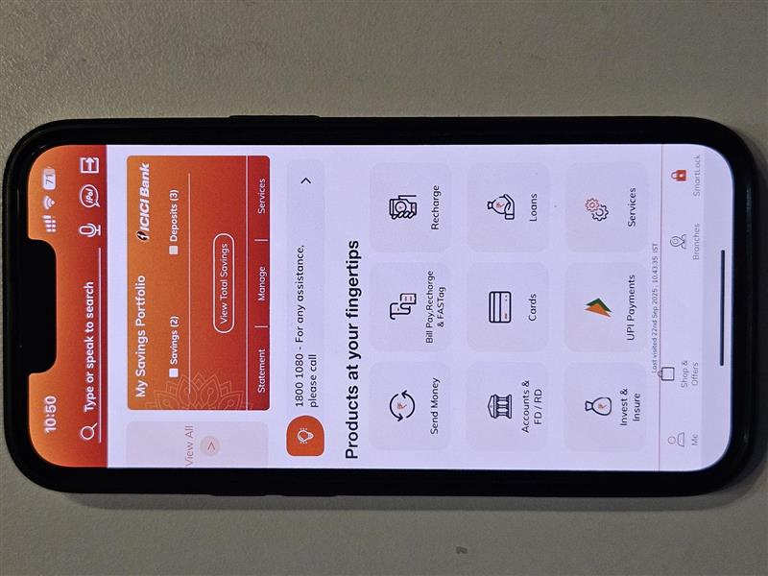
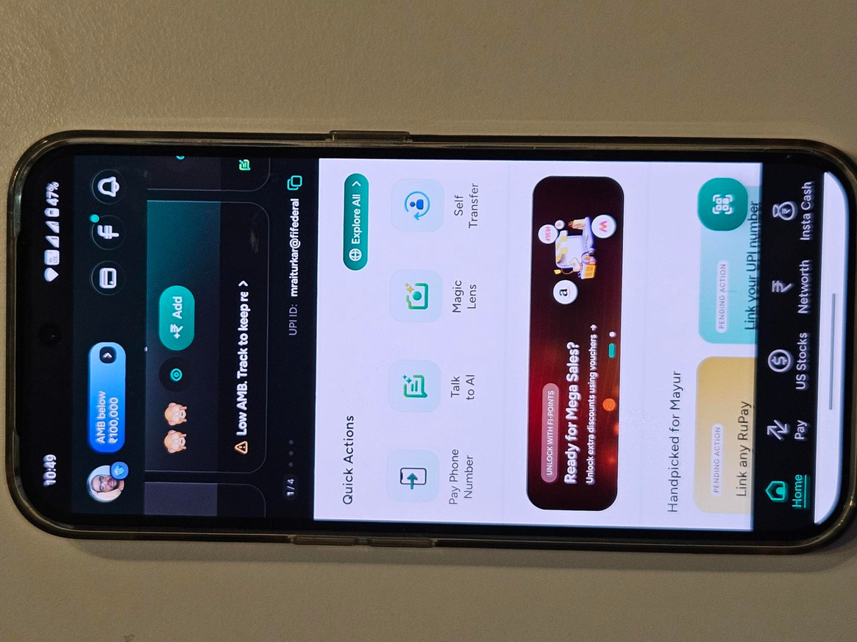
ICICI Bank App
Fi-Money
Notes:
Traditional Banking System (Left Side)
User Experience Flow:
User Initiates the Process:
Customers must go to a bank branch to open an account, apply for a loan, or conduct other financial operations.
This often involves waiting in line and working around bank operating hours.
In-Person Visit Required:
Physical presence is mandatory; identity verification, paperwork, and in-person signatures are part of the onboarding or transaction process.
Legacy Core Banking System:
Staff process documentation by hand: reviewing physical forms, manually entering data into the bank’s legacy IT systems.
Prone to errors, duplications, and slow turnarounds due to dependency on batch processing and manual checks.
Services Provided (Loans, Payments, Deposits):
Once processed, users may receive banking services but typically only after several hours or days—particularly for new account approvals, loan disbursements, or large deposits.
Total Process Time:
Each operation (like loan approval) commonly takes 1–2 days or even longer, as manual audits, compliance reviews, and inter-department approvals introduce friction.
Example:
A customer applying for a savings account is required to visit a branch, complete physical forms, present documents, and wait 2 days before the account becomes active and usable.
Neo-Banking System (Right Side)
User Experience Flow:
User Initiates the Process:
Begins anytime, anywhere, by downloading the neo bank’s mobile app or accessing the web portal.
No need to travel or wait in queues.
Mobile Interface App:
Intuitive, user-friendly dashboard enables customers to upload documents, complete e-KYC, and submit requests in minutes.
Digital onboarding uses automated compliance checks, document verification, and even facial/biometric authentication.
Partner Bank / Fintech Infra:
Neo banks seamlessly connect with licensed partner banks’ core systems using modern APIs.
All standard offerings (loans, deposits, payments, investments) are delivered through an integrated, largely automated digital stack.
Services Provided (Loans, Payments, Deposits):
Services are enabled instantly or within seconds—for example, loans disbursed to a digital wallet after automated eligibility checks, or savings accounts instantly active after successful e-KYC.
Total Process Time:
The entire customer journey, from registration to service completion, is completed instantly—significantly improving convenience and reducing operational delays.
Example:
A user signs up with a neo bank during lunch break, completes online verification in 10 minutes, and can immediately deposit, transfer, or receive funds—all without speaking to staff or filling out a single form.

Slide 7







ICICI Bank vs FiMoney
Physical Branch
required/Physical ATM
100% Digital
Account Opening Takes 1-3 days
Opening Account takes
less than 10 min
Requires balance of ₹2,500 to ₹10,000
Zero Balance Account
Low interest rates
upto 2-3%
High interest rates
upto 4-6%
Forex fees on cards is 3-5% markup
Forex fees on cards
0 or <1% markup
Notes:
1. Physical Branch Required vs. 100% Digital
Traditional Banking: Requires customers to visit a physical branch for most core services—account opening, KYC, cheque deposits, issue resolution, and more. This means users are limited by geography, branch hours, and availability of staff.
Neo Banking: Entirely online; every service (onboarding, fund transfer, investments, KYC updates) is accessible via desktop or mobile app, anywhere, anytime.
Example: A working parent can open a new savings account from home via a neo bank app late at night, instead of taking time off to visit a branch during business hours.
2. Account Opening Takes Days with Paperwork vs. Instant Online Account Opening
Traditional Banking: Initiating an account often requires extensive paperwork, physical document checks, and in-person validation, causing days of delays before an account is activated.
Neo Banking: Digital onboarding is instantaneous, with e-KYC, document upload, and verification done in minutes using biometrics or verified API connections.
Example: A student who needs a new account for a scholarship deposit receives their IBAN, debit card, and app login instantly after a quick video KYC process with a neo bank (no physical forms needed).
3. Fees and Charges are Higher vs. Fees and Charges are Lower/Almost Zero
Traditional Banking: Monthly maintenance, ATM, transfer, and hidden service fees add up, eating away at customer savings—especially for those with low balances.
Neo Banking: Streamlined tech operations and lack of physical branches allow most neo banks to offer fee-free models or very transparent, low-cost alternatives.
Example: A freelancer is charged $0 by their neo bank for receiving international payments, compared to a $15 incoming wire fee at a traditional bank.
4. Customer Service is In Person/Call vs. 24/7 Support via Chat/AI
Traditional Banking: Helpdesk queries, transaction disputes, and most support must occur in person at the branch, or over the phone during working hours, leading to long waits and follow-ups.
Neo Banking: Automated chatbots, in-app messaging, and AI-powered support provide instant, always-on assistance for everything from card blocks to budgeting tips.
Example: Late at night, a traveller in another country can block a lost card and chat with support within seconds through the neo banking app, while a traditional bank user would have to wait till the call center opens.

Slide 8

Case Study 2:
Cross-Border Settlement using Blockchain
Notes:
Pain Points in Traditional Systems (QUESTIONS → RESULTS)
1. Transfer Delays: “Why do international transfers take DAYS?”
Problem: Traditional cross-border payments (SWIFT, wire transfers) often take 1–5 business days due to multiple intermediaries (correspondent banks) involved in processing, approval, and settlement.
Example: Sending $1,000 from India to the US involves routing through several banks, each adding delay.
2. High Fees: “Why are cross-border payments so EXPENSIVE?”
Problem: Each intermediary adds fees (transaction, conversion, handling), resulting in $25–$50+ per transaction. Some fees may be hidden as currency conversion markups or compliance charges.
Example: A migrant worker remitting $500 may lose $30+ to fees along the route.
3. Lack of Transparency: “Where is my money right now during a transfer?”
Problem: Users rarely have real-time tracking as payments move through opaque bank networks. Both sender and receiver rely on periodic, delayed bank notifications.
Example: A business awaiting payment to release goods gets anxious due to vague “in-process” updates with no precise status.
4. Operational Drag: “How do banks manage all those currencies?”
Problem: Banks must keep large amounts of money (“pre-funded” or Nostro accounts) locked up worldwide to guarantee liquidity for foreign payouts. This ties up capital, hurts efficiency, and makes reconciliation complex.
Example: Bank holds $2M in various currencies across partner banks just to ensure fast payouts, earning no interest on these idle funds.
How Blockchain Solves These Problems
1. Near-Instant Settlement
Blockchain enables peer-to-peer settlement, cutting out intermediaries and allowing funds to move in seconds or minutes, 24/7. Unlike SWIFT, there are no “banking hours” or international holidays.
Example: Using Ripple/XRP, a transfer from India to the US completes in under 5 minutes regardless of time zone.
2. Significant Cost Reduction
By eliminating multiple banks, blockchain cuts transaction fees dramatically—often to just a few cents or less than $1 (plus minor network fees).
Example: Remittance platforms using stablecoins let diaspora workers send money home for $1, vs. $40+ with traditional routes.
3. End-to-End Transparency
Every transaction is recorded on a transparent, immutable ledger. Both parties can track payment status in real time, reducing errors, fraud, and anxiety for senders/receivers.
Example: The sender tracks progress on a blockchain explorer, seeing exactly when funds arrive at the recipient wallet.
4. No Need for Nostro Accounts
Digital assets/cryptocurrencies enable on-demand conversion, so banks don’t have to tie up capital globally. Smart contracts can also automate currency swaps.
Example: Using USDC or USDT, banks convert instantly at the point of transfer, dramatically improving working capital efficiency.
5. Programmability and 24/7 Availability
Smart contracts can automate compliance, payouts, and reporting, reducing operational drag and making transfers available at all hours.
Example: An insurance payout triggered by blockchain proof of delivery reduces delay and manual intervention.

Slide 9






SWIFT Based Wire Settlement
Blockchain based Settlement
JP Morgan Chase NY Branch(USD)
Mason Miller transfers money to Neha Sharma’s
Bank account
JP Morgan Chase NY Branch(USD)
Mason Miller transfers money to Neha Sharma’s
Bank account
Messaging(SWIFT)
(from jp morgan to Icici)
}
}
Convert USD
to USDC
(Bridge.xyz)
Fedwire system
Bank of America
(Holds Nostro Account of Icici Bank)
1-5 days of delay
Messaging(SWIFT)
(from Bank of America to Icici)
5 min
Currency Conversion at ICICI bank
Convert USDC to INR
(Rail.io)
ICICI Bank Mumbai Branch
(INR)
Neha Sharma’s
Bank account in India
Neha Sharma’s
Bank account in India
ICICI Bank Mumbai Branch
(INR)
Notes:
Traditional Payment System – Detailed Workflow and Explanation
Step 1: Sender Bank Initiates Payment
The sender bank starts the international transfer on behalf of its customer.
It debits the sender’s account in the local currency and generates an instruction to transfer funds to the beneficiary overseas.
Step 2: Routing via Correspondent Banks and SWIFT Messaging
The payment is routed through multiple correspondent banks. For example:
Correspondent Bank A holds USD accounts and acts as a bridge between the sender's currency and US dollar transactions.
Correspondent Bank B holds EUR accounts and handles Euro transactions and conversions.
These correspondent banks communicate instructions with the SWIFT messaging system, which is primarily a secure message relay, not a settlement layer.
Each intermediary introduces latency and fees:
Funds typically move in batches, processed during banking hours.
Settlement and currency conversion are done via manual reconciliation among the banks.
Settlement finality is delayed until all counterparties confirm receipt and accounts are reconciled.
Step 3: Intermediary Bank(s)
Additional intermediary banks may further process or convert currency depending on the route, increasing complexity.
Step 4: Receiver Bank Credits Beneficiary
After all clearing processes, the receiver bank receives settlement credit and deposits funds into the recipient's account.
Due to the layered process and reconciliations, this final step can happen 1 to 5 business days after initiation.
Ripple Payment System – Detailed Workflow and Explanation
Step 1: Sender Bank Initiates Payment
The sender bank still interfaces with its customer the same way but instructs payment via RippleNet rather than legacy correspondent channels.
Step 2: RippleNet Messaging & Settlements
RippleNet is an integrated payment network combining:
A unified messaging layer for payment instructions and compliance data.
XRP Ledger, a public decentralized blockchain, which acts as a shared, immutable ledger providing real-time settlement finality across participants.
Step 3: On-Demand Liquidity (ODL)
Rather than holding massive pre-funded Nostro accounts, participants use digital assets such as XRP or other stablecoins as bridge currencies.
Liquidity is provisioned dynamically and on-demand. When a transaction is initiated, RippleNet sources the required liquidity instantly to complete cross-currency conversion and payment.
This process drastically reduces the need to lock up capital globally.
Step 4: Receiver Bank is Credited Instantly
Once the XRP Ledger confirms the payment, the receiver bank credits the beneficiary account typically seconds after initiation.
The distributed ledger provides an auditable, transparent transaction record accessible by all parties, enabling end-to-end tracking with tamper-proof security.

Slide 10






SWIFT VS Blockchain
SWIFT Based Wire Transfers
Ethereum Blockchain Wire Transfer
SPEED
SPEED
Takes around 1-5 Business days
Takes around 1 Business days
COST
COST
Fees can range from $10 to $50 per transaction
Fees can range from $5 to $10 per transaction
SCALABILTY
SCALABILTY
Only 5-7 Transaction Per second
and slow
1500 Transactions Per second
Foreign Exchange
Foreign Exchange
High FX markups, typically 3-5% per transaction
Low FX markups, typically 0.5-1.5% per transaction
Notes:
Dimension-by-Dimension Analysis
SPEED
Traditional Payment System: Transfers generally take 1–5 business days. Delays occur due to multiple intermediaries (correspondent banks), batch processing, banking hours/restrictions, and anti-fraud checks along the route. Cross-border remittance feels slow—for example, an Indian user sending USD to the UK may face three or more days of uncertainty.
Ripple Payment System: Near-instant settlement, typically completing in 3–5 seconds. RippleNet directly connects financial institutions using distributed ledger technology, thereby removing middlemen and settlement lags. Users can transfer value across borders almost as quickly as sending an email.
COST
Traditional System: Costs are high—often $25–$50+ per transaction—driven by layers of transfer/intermediary/FX fees. Unexpected and hidden charges are common.
Ripple System: Transaction fees are reduced by up to 95% or more. On average, sending payments via Ripple may cost less than a cent, regardless of amount or destination. This opens new use cases for micro-payments and frequent, global transactions.
SCALABILITY
Traditional System: Can process just 5–7 transactions per second. Growth is constrained by central server architectures and manual verification steps, making the system prone to bottlenecks as volumes rise.
Ripple System: Processes up to 1,500+ transactions per second on-chain, supporting high-throughput scenarios (remittance, payroll, B2B settlements) without congestion. Ripple’s architecture makes global scaling feasible without significant infrastructure cost.
TRANSPARENCY
Traditional System: Centralized ledgers mean users and even banks often lack real-time visibility into payment status. Funds can disappear into an “in process” void, leading to confusion, customer support calls, and reconciliation headaches.
Ripple System: The decentralized ledger records every transaction end-to-end. Both sender and receiver have real-time access to payment status and immutable records for auditing. This eliminates the classic “where is my money now?” problem for users, corporates, and regulators.
Example to Illustrate the Impact
Imagine a small business in India that exports software to Germany.
With SWIFT (Traditional)
Invoice paid on Monday is received by Thursday.
$38 in trace and FX fees deducted.
Vendor gets daily calls: “Funds were sent, but not yet received.”
With Ripple
Payment is received and settled in under 5 seconds, at a cost of a few cents.
Real-time proof of payment available to both parties.
No delayed deliveries or trust issues; full financial visibility.

Slide 11

Case Study 3:
Decentralized Finance (DeFi)

Slide 12
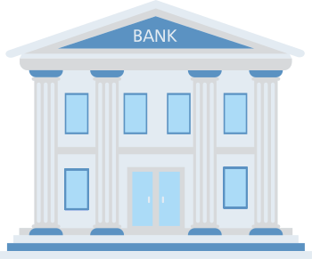



Centralised Finance
Decentralized Finance (DeFi)
John
John’s Ethereum wallet
Zerodha Demat Account
Uniswap
(dApp)
API calls
API calls
Decentralized Autonomous Organization
Stock Exchange (BSE/NSE)
DAO
Ethereum
Smart Contracts
Verification
Updating ledger
API calls
API calls
Zerodha Demat Account
Uniswap
(dApp)
Bob
Bob’s Ethereum wallet
Notes:
Left Side: Traditional Workflow (Without AI)
Flow Explanation:
User Initiates Transaction: The process begins with a user action, such as submitting a payment request through digital banking APIs.
Bank System Processing: Transaction data is passed to the core banking system.
Manual Review & Rule-Based System:
Static Rule Engine: Checks fixed, well-defined triggers (e.g., “Flag payments above $10,000,” “Block foreign transactions after midnight”).
Human Analyst: Any unclear cases are halted for manual investigation, extending approval time significantly.
Customer Call Verification: The bank might call the customer to confirm the transaction, causing friction and delays.
Decision Orchestrator: Combines static rule outcome or analyst review into a final approve/deny call.
Outcome:
Transaction Successful: Approved by rules or after manual/phone verification (which can be slow).
Potential Fraud: Suspicious or unresolved cases are flagged, require investigation, or result in rejected transactions.
Example:
A customer tries to pay $2000 while traveling abroad. The static engine flags it due to “foreign location,” holds the payment, and an analyst must call the customer. The process can take hours or longer, frustrating the user and often blocking legitimate activity.
Right Side: AI-Driven Workflow
Flow Explanation:
User Initiates Transaction: As before, the process starts with a user’s payment request via APIs.
Bank System Processing: The request quickly reaches advanced analytics.
Transaction Analysis Services:
KYC & Authentication: Automated, real-time identity and device checks.
Rules Engine & Pattern Analysis: AI reviews hundreds of dynamic variables (behavioral trends, device data, location, transaction history) to determine authenticity.
Real-Time Log Analysis: Each transaction is logged and cross-referenced instantly to uncover emerging fraud trends.
Decision Orchestrator: Integrates AI risk scoring to render a fast, explainable approve/reject decision.
Outcome:
Transaction Successful: Genuine transactions are identified and approved within milliseconds.
Transaction Rejected: Fraudulent or high-risk attempts are blocked instantly, often before funds ever leave the account.
Example:
A regular user makes a large purchase on a business trip. AI cross-references their past travel, device use, spending patterns, and even recent flight info to authenticate instantly—so the transaction succeeds in under a second without any manual delay. But if someone tries using the same card an hour later from another country, the system detects the anomaly and rejects the fraud attempt automatically.

Slide 13





Decentralized Finance VS Traditional Finance
Strengths
Weakness
  Instant settlement
(3–5 sec)
  Low fees (up to 95% less)
  Global access 24/7
  1500+ transaction/sec
  Tech knowledge needed
  Limited regulations
  Volatile assets
  Limited customer support
  Cross-border demand
  Lower remittance costs (90% cut)
  Inclusion for unbanked (1.4B people)
  Govt regulations
  Market volitality
  Scams & hacks
  Competition from banks
Opportunites
Threats

Slide 14


Case Study 4:
Financial Fraud Detection with AI
"What do you think happens in those few seconds when you swipe your card?"
"How many of you have ever received a fraud alert from your bank?"
"Can you guess how many fraudulent transactions banks prevent daily?"
Notes:
Interactive Questions to Start With:
"What do you think happens in those few seconds when you swipe your card?"
Answer: In 100-300 milliseconds, multiple AI systems analyze your transaction, check your behavior patterns, assess risk, and make approval/decline decisions
"How many of you have ever received a fraud alert from your bank?"
Follow up: "That alert was likely generated by AI systems similar to what we'll discuss today"
"Can you guess how many fraudulent transactions banks prevent daily?"
Major banks like JPMorgan Chase process millions of transactions daily and prevent thousands of fraudulent attempts in real-time
Key Statistics to Share:
Over 151,000 cases of credit card fraud were reported in Q1 2025 alone
25% increase in consumer fraud losses in 2024, totaling $12.5 billion
60% of financial organizations report increased fraudulent activity in the last 12 months
AI systems can analyze transactions in milliseconds vs. traditional methods taking minutes or hours
Case Study A: JPMorgan Chase – 60% Fraud Reduction
Background:
One of the largest banks in the US with millions of daily transactions
Facing sophisticated card-not-present fraud and account takeover attempts
Traditional rule-based systems generating too many false positives
Implementation:
Deployed machine learning algorithms analyzing transaction patterns and customer behavior
Integrated behavioral biometrics and device fingerprinting
Real-time processing of customer's complete transaction history
Results Achieved:
60% reduction in credit card fraud within 6 months
20% reduction in false positives (fewer legitimate transactions blocked)
Sub-100ms decision making for real-time transaction processing
Multi-layered approach combining ML algorithms with human review for edge cases
Technical Details:
System trained on dataset of millions of transactions (both legitimate and fraudulent)
Implemented two-factor authentication and device fingerprinting as additional security layers
Continuous learning system that adapts to new fraud patterns automatically
Case Study B: DBS Bank – 90% False Positive Reduction
Background:
Leading Asian bank processing over 1.8 million transactions per hour
High false positive rates causing customer friction and operational costs
Need for real-time compliance with multiple regulatory frameworks
AI Implementation:
Advanced behavioral analysis algorithms
Cross-border transaction pattern recognition
Real-time risk scoring system
Automated compliance reporting
Measurable Outcomes:
90% reduction in false positives (dramatic decrease in legitimate transactions flagged)
60% improvement in detection accuracy for genuine threats
75% faster investigation times for suspicious activities
Enhanced regulatory reporting with automated compliance checks
Case Study C: European Bank AML Success
Focus Area: Anti-Money Laundering (AML) Detection
30% reduction in false positives for AML alerts
25% increase in identification of genuine suspicious activities
Processing of vast transactional data to identify money laundering patterns
Multi-layered approach combining ML with behavioral biometrics
Section 6: Integration with Rescape's Platform
How This Connects to Rescape's Vision:
Unified Fraud Detection:
Real-time monitoring across all transaction types
Integration with blockchain on/off-ramping processes
Seamless connection to forensic analysis tools
Cross-platform risk assessment
API-First Architecture:
Easy integration with existing banking systems
RESTful APIs for real-time fraud scoring
Webhook notifications for immediate alerts
Scalable cloud-native deployment
Compliance and Reporting:
Automated regulatory compliance (BSA, AML, KYC)
Real-time suspicious activity reporting
Audit trail generation
Multi-jurisdiction regulatory support
Section 7: Anticipated Questions and Answers
Q: How does the system handle false positives?
A: Modern AI systems achieve 90% reduction in false positives through:
Continuous learning from feedback loops
Multi-layered decision making (not just binary approve/decline)
Contextual analysis considering user behavior patterns
Step-up authentication instead of immediate blocking
Q: What about privacy and data protection?
A:
All systems comply with GDPR, CCPA, and other privacy regulations
Data anonymization and masking in feature stores
Federated learning techniques preserve customer privacy
Minimal data retention policies with automatic purging
Q: How quickly can this be implemented?
A:
Typical implementation: 3-6 months for full deployment
Proof of concept: 2-4 weeks
Initial results visible within first month
Full optimization achieved within 6-12 months
Q: What happens if fraudsters adapt to the AI?
A:
Continuous learning systems automatically adapt to new patterns
Ensemble methods make t harder for fraudsters to game the system
Regular model retraining with latest fraud data
Human-in-the-loop for complex edge cases

Slide 15









AI in Action: Tangible Results
Fraud detection
Without AI
With AI
Manual Rule-Based Systems: Fixed simple rules; easily bypassed by new fraud tactics.
Intelligent Anomaly Detection: Learns complex, evolving patterns to spot new threats.
Slow & Reactive:
Relies on human review, fraud often detected after the loss.
Real-Time & Proactive:
Processes transactions instantly, often preventing fraud.
High False Positives:
Flags right transactions, frustrating customers and increasing costs.
Low False Positives:
Detections focus on real fraud, improving customer experience.
Limited Scalability:
Struggles with massive data; patterns in large datasets are missed.
Massive Scalability:
Processes datasets; uncovers hidden patterns for superior accuracy.
Success Metrics
Notes:
Manual Rule-Based Systems vs. Intelligent Anomaly Detection
Traditional systems operate on basic, fixed rules (such as flagging all transactions above a set amount). These rules are static, easy for fraudsters to circumvent, and fail to keep up with evolving attack strategies.
AI-based systems leverage machine learning to recognize complex and dynamic fraud patterns across transaction data. For instance, while a rule-based system might only look at transaction amount, an AI solution can analyze behavioral patterns, device fingerprints, and timing to distinguish between genuine outliers and actual fraud attempts, adapting as new tactics emerge.
Slow & Reactive vs. Real-Time & Proactive
Without AI: Fraud is often detected after the fact, relying on slow human review and batch processing that delays intervention and results in financial losses.
With AI: Machine learning models can score each transaction in under 100 milliseconds, blocking or verifying suspicious activity before money ever leaves the account. For example, a digital wallet using AI can stop a stolen credit card from being drained—even before the thief completes one purchase—by learning real transaction behavior in real time.
High False Positives vs. Low False Positives
Legacy systems tend to block a significant percentage (20–30%) of legitimate transactions, frustrating users and raising support costs.
AI solutions reduce false positives by up to 90% by analyzing greater context and customer history. For instance, if a long-time customer suddenly spends more than usual while traveling, AI integrates travel data and recent spending to avoid wrongly declining a legitimate purchase—improving trust and satisfaction.
Limited Scalability vs. Massive Scalability
Traditional approaches buckle under high transaction volumes, failing to identify hidden patterns in big datasets. Scaling up means proportionally growing the manual review team and infrastructure.
AI-powered detection excels as transaction volume increases, processing millions of transactions per second while uncovering subtle, multi-faceted attack patterns. For example, a fintech startup leveraging AI can scale from thousands to millions of transactions almost instantly, keeping fraud detection accuracy high even as business grows.
Example: Bank Implementation Impact
Before AI: A major bank was losing millions to undetected fraud, with thousands of customer complaints monthly due to legitimate transactions being blocked.
After AI adoption: Fraud detection accuracy improved from 75% to 93%. False positives dropped by 80%, saving $1.2M per year in operational costs and improving NPS (Net Promoter Score) by 35 points.

Slide 16









High Level Diagram
High Level Diagram
User Initiate Transaction
User Initiate Transaction
APIs
APIs
Bank System
Bank System
Manual Review &
Rule Based System
Transaction Analysis Services
Static Rule Engine:
checks for predefined rules
Transaction Logs
KYC and Authentication
Transaction Logs
Human Analyst:
Held for manual review
Rules Engine & Patterns
check
Customer Call Verification:
Contact customer for conformation
Decision Orchestrator
Decision Orchestrator
Potential
Fraud
Transaction Successful
Transaction Rejected
Transaction Successful
Notes:
Left Side: Traditional Workflow (Without AI)
Flow Explanation:
User Initiates Transaction: The process begins with a user action, such as submitting a payment request through digital banking APIs.
Bank System Processing: Transaction data is passed to the core banking system.
Manual Review & Rule-Based System:
Static Rule Engine: Checks fixed, well-defined triggers (e.g., “Flag payments above $10,000,” “Block foreign transactions after midnight”).
Human Analyst: Any unclear cases are halted for manual investigation, extending approval time significantly.
Customer Call Verification: The bank might call the customer to confirm the transaction, causing friction and delays.
Decision Orchestrator: Combines static rule outcome or analyst review into a final approve/deny call.
Outcome:
Transaction Successful: Approved by rules or after manual/phone verification (which can be slow).
Potential Fraud: Suspicious or unresolved cases are flagged, require investigation, or result in rejected transactions.
Example:
A customer tries to pay $2000 while traveling abroad. The static engine flags it due to “foreign location,” holds the payment, and an analyst must call the customer. The process can take hours or longer, frustrating the user and often blocking legitimate activity.
Right Side: AI-Driven Workflow
Flow Explanation:
User Initiates Transaction: As before, the process starts with a user’s payment request via APIs.
Bank System Processing: The request quickly reaches advanced analytics.
Transaction Analysis Services:
KYC & Authentication: Automated, real-time identity and device checks.
Rules Engine & Pattern Analysis: AI reviews hundreds of dynamic variables (behavioral trends, device data, location, transaction history) to determine authenticity.
Real-Time Log Analysis: Each transaction is logged and cross-referenced instantly to uncover emerging fraud trends.
Decision Orchestrator: Integrates AI risk scoring to render a fast, explainable approve/reject decision.
Outcome:
Transaction Successful: Genuine transactions are identified and approved within milliseconds.
Transaction Rejected: Fraudulent or high-risk attempts are blocked instantly, often before funds ever leave the account.
Example:
A regular user makes a large purchase on a business trip. AI cross-references their past travel, device use, spending patterns, and even recent flight info to authenticate instantly—so the transaction succeeds in under a second without any manual delay. But if someone tries using the same card an hour later from another country, the system detects the anomaly and rejects the fraud attempt automatically.

Slide 17
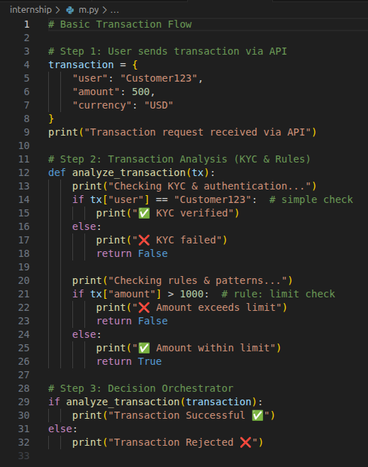
High Level Diagram
Code Snippet
APIs
Transaction Analysis Services
KYC and Authentication
Transaction Logs
Rules Engine & Patterns
check
Decision Orchestrator
Transaction Rejected
Transaction Successful

Slide 18
Q & A

Slide 19

THANK
YOU
Email ID : mayur@rescape.io
Telegram ID : @mayurkr

