Slide 1
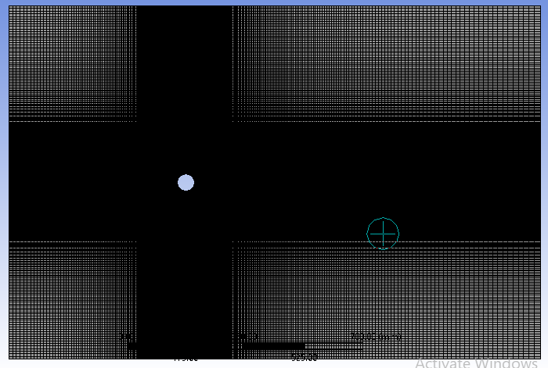
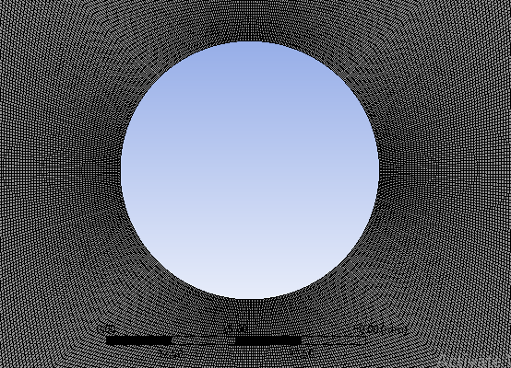
Validation for fluid flow past a circular cylinder
Diameter of cylinder = 0.05 m
Material Medium is air
Density = 1.225 kg/(m³)
Viscosity = 1.7894e-05 kg/(ms)

Slide 2
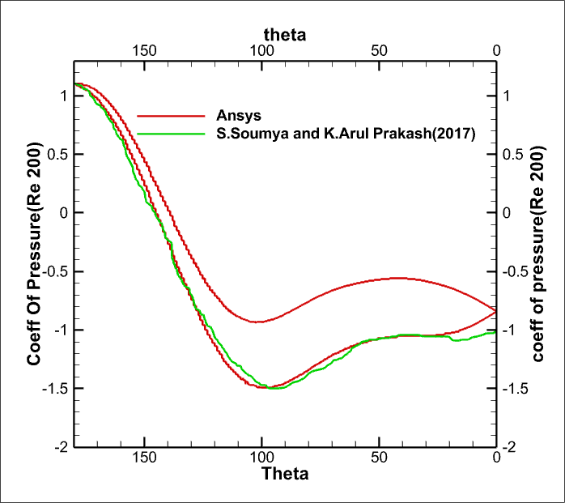
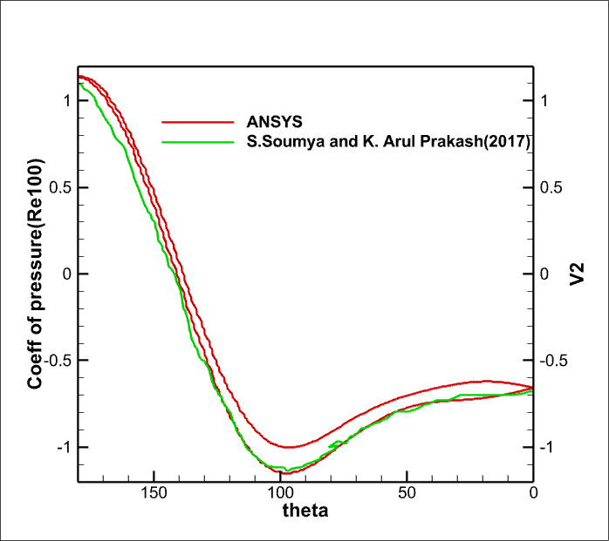
COEFFICIENT OF PRESSURE VALIDATION
Cp distribution around cylinder

Slide 3
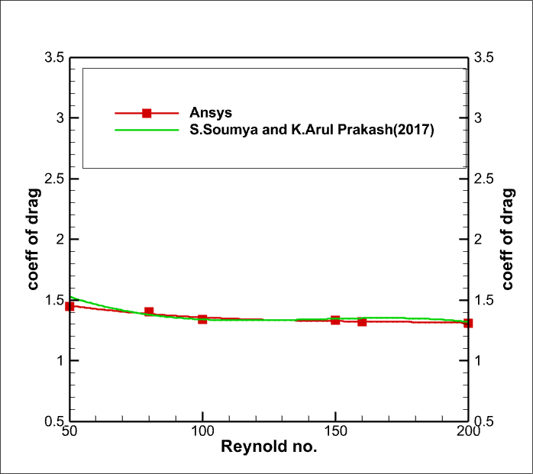
COEFFICIENT OF DRAG VALIDATION
Time averaged total drag (Cd_avg) variation with Reynolds no.

Slide 4
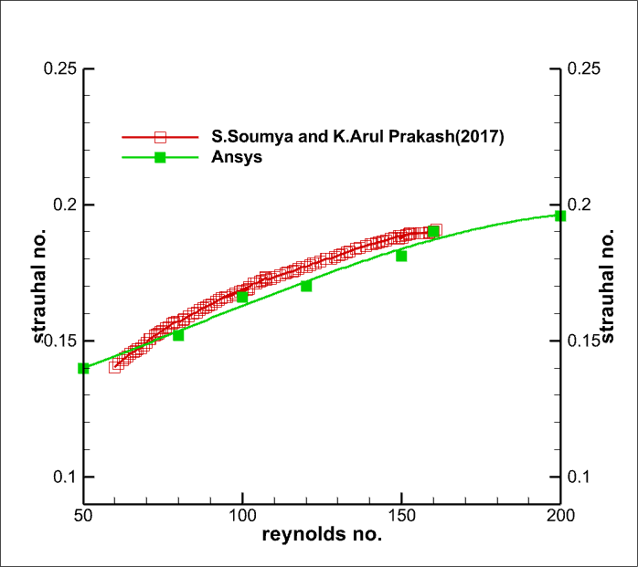
STRAUHAL NUMBER VALIDATION
Strouhal no. (St) variation with Reynolds no.

