Slide 1
SafeHaven Multi-Brand MVP: Developer Approach
Built as a mobile-first MVP using Next.js 14 (App Router), React, and Tailwind CSS.
Handles multiple security brands across states via a centralized configuration.
Designed for speed, ZIP routing, CRM integration, and analytics tracking.
Core focus: scalability, reusability, and fast lead conversion.

Slide 2
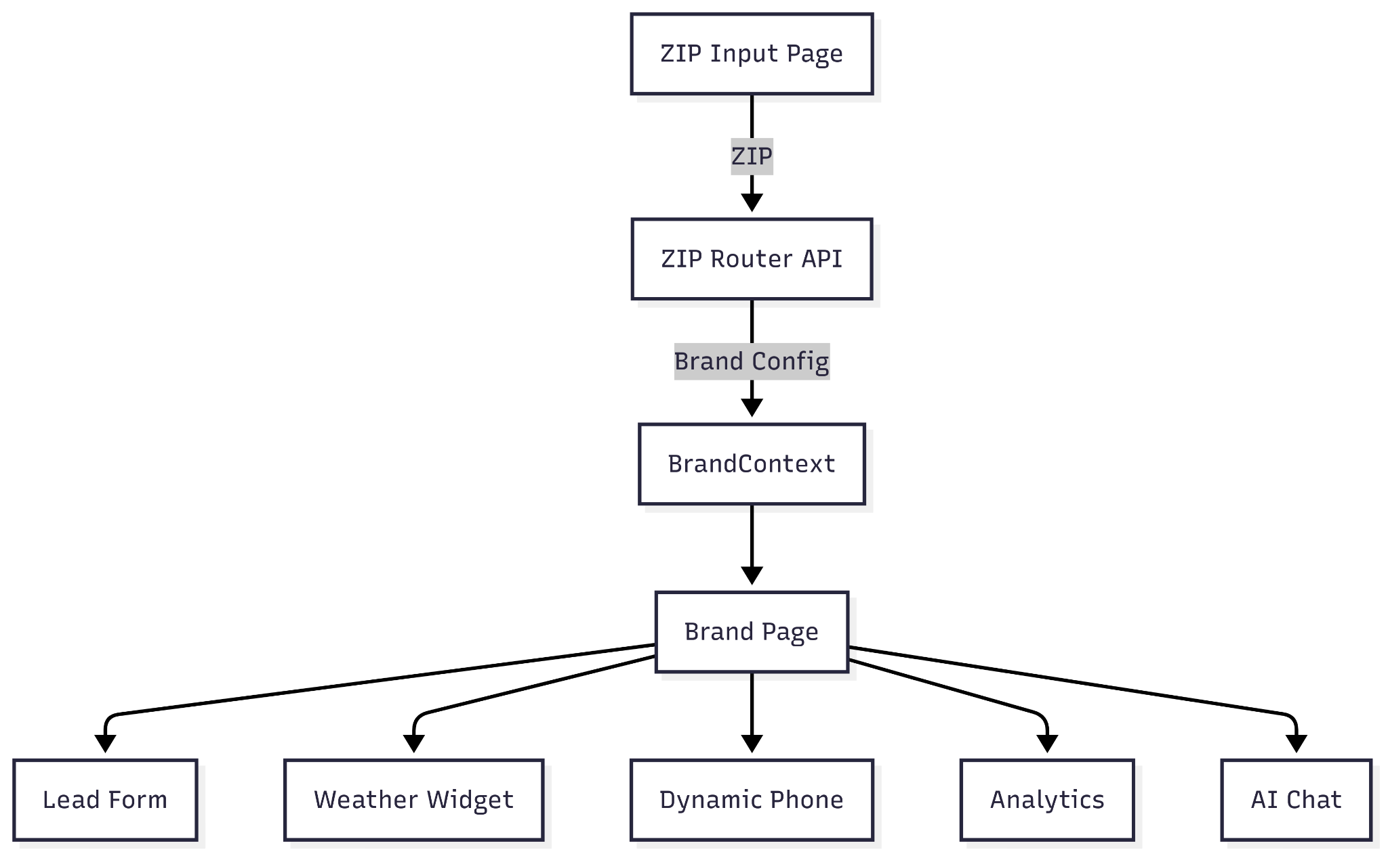
Architecture Overview
Notes:
This architecture supports clean separation of shared vs brand-specific logic. It makes onboarding new brands low-effort by extending brand config only.

Slide 3
Key Features & Tools
Progressive Lead Form with Google Maps Autocomplete
Weather Widget using OpenWeather API
Dynamic phone number insertion via UTM/`?source`
AI Chat component scaffolded for future lead engagement
Libraries: React Hook Form, Tailwind, Google Maps API

Slide 4
Lead Attribution & Analytics
UTM tracking stored in `sessionStorage` for consistent attribution
Form submission logs data to `/api/lead` and mocks CRM push
GA4 dataLayer support for events like `lead_submitted`
Supports dynamic phone logic via source query param
Notes:
Tracking is designed to be extended easily to Segment, GA4, or any CRM platform with event hooks.

Slide 5
Code Structure & Brand Routing
`app/(router)/zip-router/page.jsx`: handles ZIP entry + redirects
`app/(main)/[brand]/page.jsx`: renders brand-specific pages
`BrandContext.jsx`: global state manager for theme and branding
`brands.json`: central config for all brands (colors, CTA text, etc.)
Notes:
File structure separates routing logic, shared components, brand configuration, and utilities for clean scalability.

Slide 6
Key Assumptions & Design Priorities
ZIP-to-brand logic is hardcoded for MVP but abstracted for future DB/API
SessionStorage used over cookies for simplicity and privacy compliance
No user auth (public-facing site); analytics assumes anonymous users
Analytics is mocked; CRM and UTM pipeline are extendable
Accessibility and SMS retargeting planned as @todo for post-MVP

Slide 7
Performance Strategy & Future Scale
Dynamic imports for non-critical components (Lead Form, Weather)
Tailwind purge + minimal JS = fast, optimized delivery
Scales to 30+ brands by extending `brands.json` only
AI, SMS re-engagement, and subdomain routing planned for future

