Slide 1

moneBOT
TradeBot and Stock Price Predictor
Ayushree Ghoshal 19BAI10022
Dev Singh 19BAI10093
Akshat Bhardwaj 19BAI10188
P. Yash Reddy 19BAI10190
SCSE - spl. Artificial Intelligence and Machine Learning (B.Tech)

Slide 2
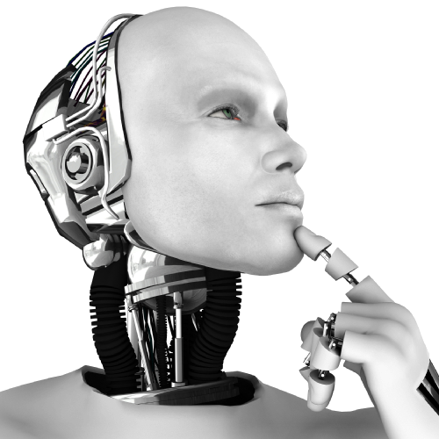
Objective
TRADING BOT’s purpose is to automate actions that are either too complex, time-consuming, or difficult for humans to execute manually. The sophistication of these tasks ranges from automating a single trading strategy on a single trading pair to intelligently routing trades between any asset for a diverse portfolio.
STOCK MARKET PREDICTION, the objective is to predict the future value of financial stocks of a company. The recent trend in the stock market prediction technologies is the use of machine learning which makes the prediction based on the values of the current stock market indice by training on their previous values .

Slide 3
Need and Purpose
24/7 Trading
Unlike the human trader who is time restrained, a trading robot doesn’t take lunch breaks; go for frequent nature calls or sleep. In addition to this, they have no responsibilities to family and friends. This means that trading robots are able to trade for 24 straight hours, something that is impossible with human traders. This makes it possible to take advantage of the entry and exit opportunities that are available in different time sessions.

Slide 4
Need and Purpose
Trading Robots Are Quick To Act on Opportunities
The speed of the computer determines how fast the trading robot is able to identify an opportunity and execute it. This cannot be compared to the human trader who has to manually enter an order. This means that it would take so many great minds to achieve what a trading robot can in a single trading session.

Slide 5
Need and Purpose
Multitasking
Trading robots are able to monitor multiple currency pairs at a go. It eliminates the physical aspect of being glued to your screen tracking your currencies. You have the power to effortlessly monitor more currencies at once.
Trading robots have now made it possible to hold and run multi-account trading fund whenever you’d wish to do so. Automated trading has made it possible for traders to overcome trading challenges that result from time limitations, speed, diligence, and consist

Slide 6
Need and Purpose
Better, Faster and More Accurate
Stock market prediction is the act of trying to determine the future value of a company stock or other financial instrument traded on an exchange. The successful prediction of a stock's future price could yield significant profit. The efficient-market hypothesis suggests that stock prices reflect all currently available information and any price changes that are not based on newly revealed information thus are inherently unpredictable. Others disagree and those with this viewpoint possess myriad
Prediction methodologies fall into three broad categories which can (and often do) overlap. They are fundamental analysis, technical analysis (charting) and technological methods.

Slide 7
Steps To Be Followed
Step 1: To choose a language to write code for the bot
Some languages like Python could be helpful if you want to later expand your bot to use Machine Learning, for example, but the main goal here is that you pick a language you’re comfortable with
Step 2: To choose a platform on which to make the trade bot
There are various platforms to choose from when working on the trading bot like Quantopian, QuantConnect, Backtrader. To choose from these platforms becomes a necessity as per the usage of the bot.

Slide 8
Steps To Be Followed
Step 3: Choosing servers and APIs
You need a server to send requests to the exchange’s API. For testing purposes, you can obviously run the server from your own computer. However, if you want your bot to be operating constantly, your computer is definitely not a good choice.
Step 4: Understanding the basic concepts of a trading bot
When building a trading bot one should know the workarounds of such a sophisticated system. The bot basically acts one the users behalf to trade and gain substantial profits and save time.

Slide 9
Steps To Be Followed
Step 5: Getting hold of some knowledge in the stock markets
To make an optimized trading bot one needs much information about the works of a stock market without this crucial aspect we cannot optimize our bot.
Step 6: Understanding objective and capabilities of the bot
This is also one of the most crucial aspects of our bot as the user should be clear about what can it do and what the bot is made to do. One of the main objectives of the trade bot is to gain profit and save time.

Slide 10
Steps To Be Followed
Step 7: Coding
Goal in this should be to keep the code simple and concise so that it is easier to optimize and traverse. While building the bot make sure that the correct servers and APIs are used with all the databases (historical and live) are installed and good decision making flow is implemented.
Step 8: Optimizing the bot
Keeping logs is a fantastic way to keep your bot updated any kind of errors can be identified easily by the timestamps in the log file. Also identifying trends in the charts is one of the goals for a good trade bot as it should buy at a low price and sell and high price.

Slide 11

Dr. Nilamadhav Mishra

