Slide 1


Digit recognition using tensorflow
Name – Dev abhaykumar shah
Roll no. – 5
Enrollment no. – 21002170110169
Division – a1
Branch - ce

Slide 2
introduction
My project, "Digit Recognition," leverages TensorFlow to develop a robust machine learning model capable of accurately identifying handwritten digits. Utilizing the widely-recognized MNIST dataset, which contains thousands of labeled digit images, this project explores various neural network architectures and optimization techniques to enhance the model's performance.
The primary objective is to create a highly accurate and efficient digit recognition system that can be applied to various real-world applications, such as automated data entry and digit-based authentication systems. Through this project, I aim to deepen my understanding of neural networks, TensorFlow, and the broader field of machine learning, while also contributing to the advancement of automated digit recognition technologies.

Slide 3
Applications of “digit recognition” project
1. "Automated Data Entry": Digit recognition can streamline data entry processes by automatically extracting numerical information from handwritten forms, reducing the need for manual input and minimizing errors.
2. "Banking and Finance": Banks can use digit recognition to process checks, bank slips, and other handwritten financial documents, enabling faster and more accurate transactions.
3. "Postal Services": Postal services can utilize digit recognition to automatically read and sort handwritten postal codes on envelopes and packages, enhancing the efficiency of mail sorting.
4. "Education": In educational settings, digit recognition can be employed for grading handwritten exams and assignments, saving time for educators and ensuring consistent and unbiased grading.
5. "Healthcare": Digit recognition can assist in digitizing handwritten medical records, prescriptions, and notes, improving record-keeping accuracy and facilitating better data management in healthcare facilities.
6. "Retail": Retailers can use digit recognition for inventory management by recognizing handwritten numbers on labels, tags, or invoices, thus improving stock tracking and inventory control.
7. "Digital Archiving": Historical documents and manuscripts containing handwritten digits can be digitized and made searchable, preserving valuable information and making it accessible for research and analysis.
8. "Authentication Systems": Digit recognition can be used in authentication systems that require handwritten digit input, such as digital signature verification and secure login processes.

Slide 4
Libraries used
Numpy: Provides support for large, multi-dimensional arrays and matrices, along with a collection of mathematical functions to operate on these arrays.
Tensorflow: An open-source machine learning framework used for building and training deep learning models.
Matplotlib: A plotting library used for creating static, interactive, and animated visualizations in Python.
Seaborn: A data visualization library based on Matplotlib that provides a high-level interface for drawing attractive statistical graphics.
Open-cv: An open-source computer vision and machine learning software library for real-time computer vision applications.
PIL (Pillow): A Python Imaging Library that adds image processing capabilities to your Python interpreter.
Fastapi: A modern, fast (high-performance), web framework for building APIs with Python 3.7+ based on standard Python type hints.
Joblib: A set of tools to provide lightweight pipelining in Python, particularly for loading and saving data efficiently.

Slide 5
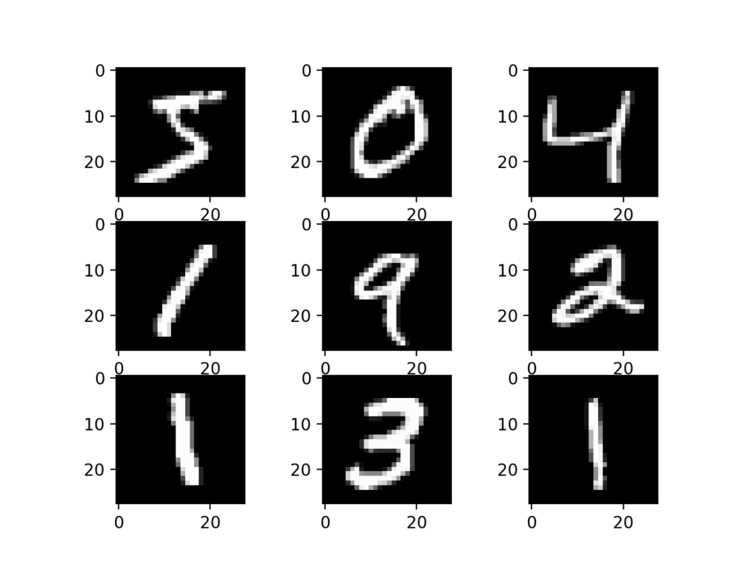
MNIST dataset (70000 Grayscale images)

Slide 6
Image pre-processing(while training)
In the digit recognition project, image preprocessing plays a crucial role in enhancing the performance and accuracy of the model. The process begins with converting the images to grayscale using libraries like OpenCV or PIL, which simplifies the data and reduces computational complexity. Next, the images are resized to a uniform dimension, typically 28x28 pixels, to maintain consistency in the input data.
Normalization is then applied to scale the pixel values between 0 and 1, facilitating faster and more efficient training. Additionally, noise reduction techniques are employed to clean the images, and data augmentation methods, such as rotation, shifting, and zooming, are used to increase the diversity of the training dataset. These preprocessing steps ensure that the neural network receives high-quality, standardized input, ultimately leading to more accurate digit recognition.

Slide 7
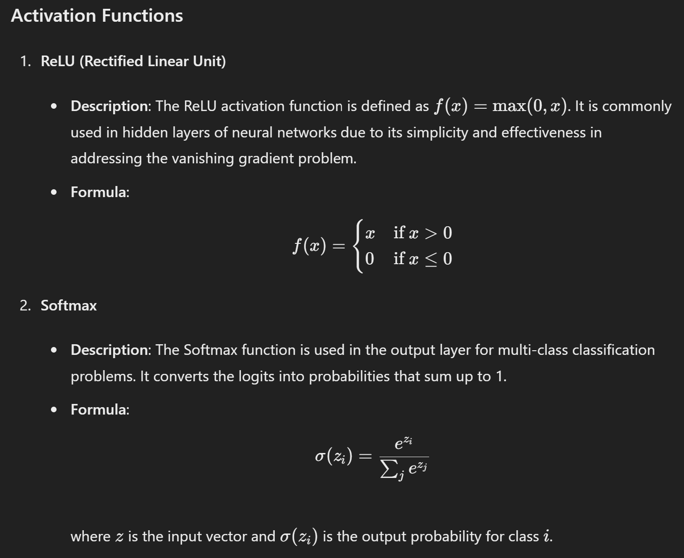
Activation functions used in building model

Slide 8
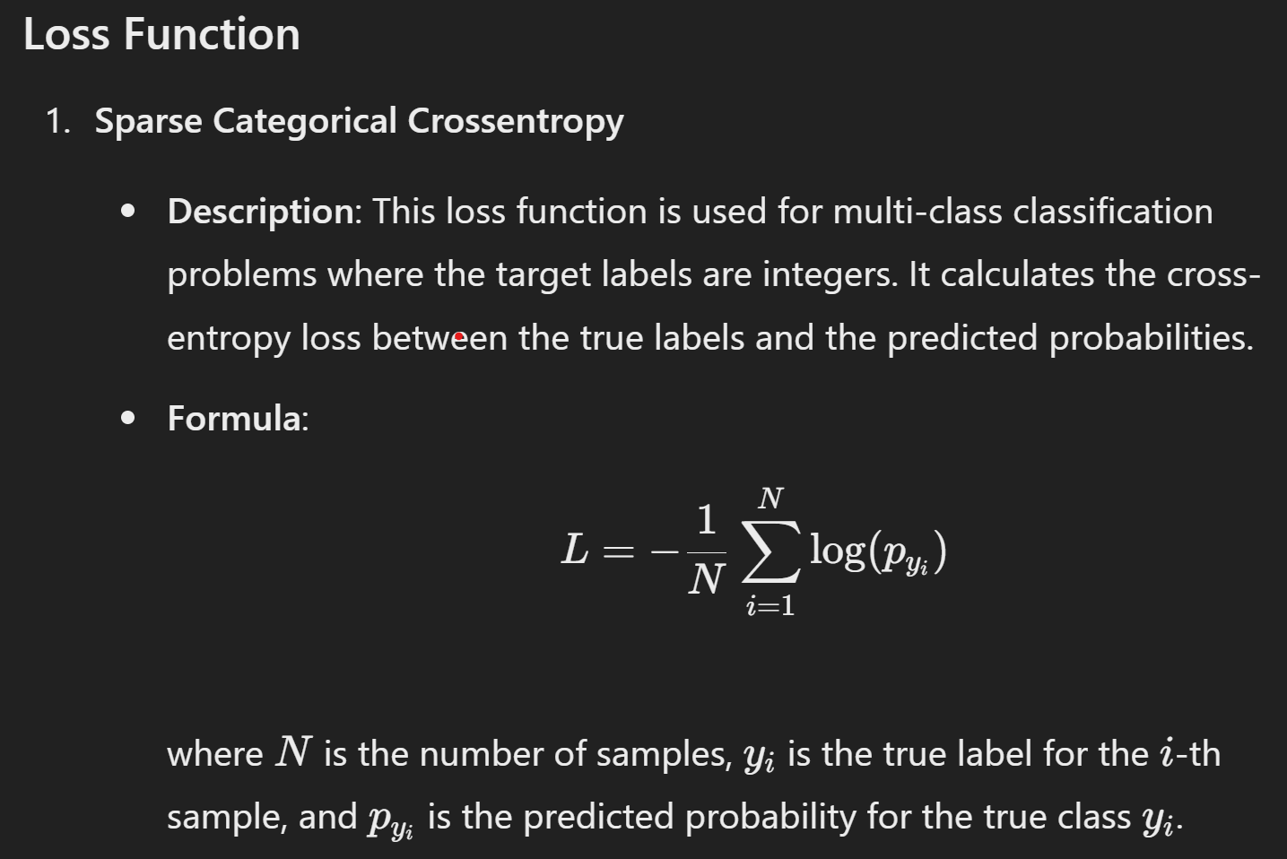
Loss function used in building model

Slide 9
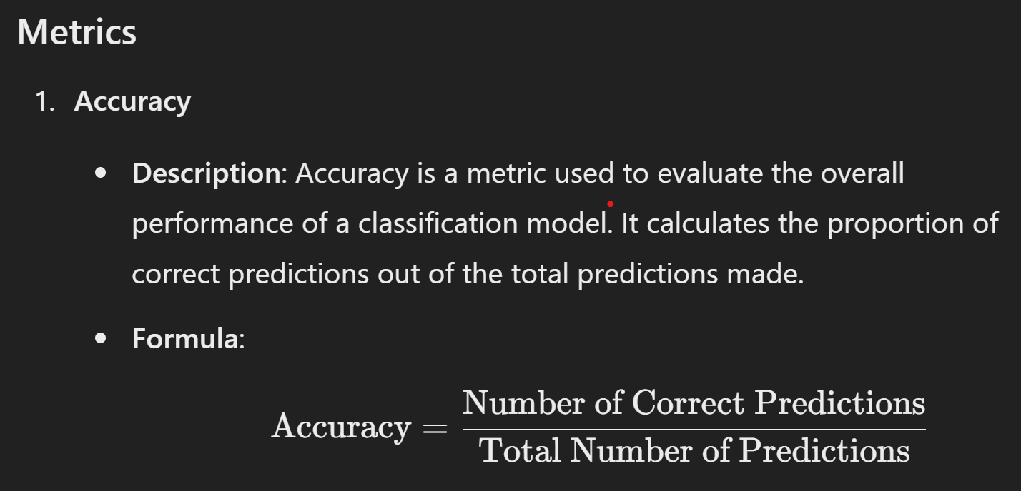
Accuracy metrics used in building model

Slide 10
Artificial neural network
In this digit recognition project, the artificial neural network (ANN) is constructed using TensorFlow's Keras API.
The model is a Sequential neural network that begins with a Flatten layer, transforming the 28x28 pixel input images into a 784-element vector.
This is followed by 4 Dense (fully connected) layers, each with 32, 64, 64 and 64 neurons and ReLU (Rectified Linear Unit) activation functions, which introduce non-linearity and allow the network to learn complex patterns in the data.
The final Dense layer has 10 neurons with a softmax activation function, producing a probability distribution over the 10 digit classes (0-9).
The model is compiled with the Adam optimizer and sparse categorical cross-entropy loss function, aiming to minimize the error during training.
It is trained on the training dataset for 10 epochs, iteratively adjusting the weights to improve accuracy in recognizing handwritten digits.

Slide 11
Image pre-processing(while testing)
This code snippet implements a digit recognition function for an image of a handwritten digit using a pre-trained machine learning model.
The "detect_and_invert" function first converts the input image to a binary image using a thresholding technique and checks if the image needs to be inverted based on the number of white pixels.
If the image is deemed inverted, it inverts the pixel values.
The “digit_recognizer_function” then loads the image from the specified path, converts it to grayscale, resizes it to 28x28 pixels, and converts it to a numpy array.
The image is processed using the "detect_and_invert" function before being fed into the pre-trained model loaded with Joblib.
The model predicts the digit in the image, and the predicted number is printed and displayed using Matplotlib.

Slide 12
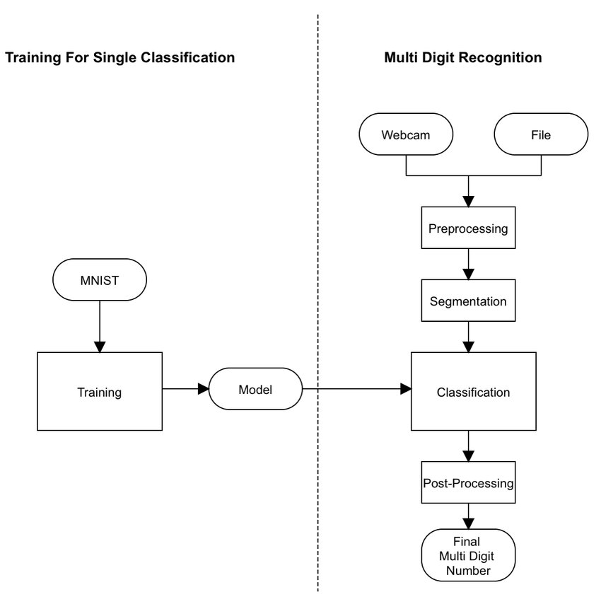
Flowchart for single & multi classification for "digit recognition" project
Single Digit Recognition

Slide 13
Challenges that can be faced
1. "Variability in Handwriting": Handwritten digits can vary significantly between individuals due to differences in writing styles, slants, and pressure, making it challenging to develop a model that generalizes well across diverse handwriting.
2. "Image Quality": The quality of the input images can vary, with issues such as noise, blurriness, and varying lighting conditions potentially impacting the model's performance. Ensuring consistent image preprocessing is crucial.
3. "Inverted and Rotated Digits": Handling inverted or rotated digits requires additional preprocessing steps, such as detecting and correcting the orientation of the digits, which adds complexity to the pipeline.
4. "Data Imbalance": The MNIST dataset, while comprehensive, may still have imbalances in the distribution of different digit classes, leading to biased model performance. Addressing this requires careful data augmentation and sampling strategies.
5. "Overfitting": During training, the model may become too specialized to the training data and perform poorly on new, unseen data. Techniques such as regularization, dropout, and cross-validation are needed to mitigate overfitting.
6. "Computational Resources": Training deep learning models, especially with large datasets, can be resource-intensive, requiring significant computational power and memory. Efficient use of resources and potential use of cloud services may be necessary.

Slide 14
Thank you for considering my project

