Slide 1


Canteen management system
Name : Shah Dev AbhayKumar
Enrollment Number : 21002170110169
Roll Number : 5
Branch : CE
Batch : A1

Slide 2
Introduction:--
This project is a Canteen Management System implemented in Java with a graphical user interface (GUI) using the Swing library. The system allows users to interact with a menu of food items, add them to a cart, and manage the cart by performing operations such as adding, removing, replacing, and editing items.

Slide 3
Gui Methods and classes:--
Jframe : The main window of the application. It's titled "Canteen Management System" and has a size of 900x500 pixels.
Jpanel : Used to group components together. There are several panels used for different parts of the application, such as the menu panel, cart panel, and button panel.
Jbutton : Represents buttons that users can click. There are different buttons for each menu item, as well as buttons for removing, replacing, and editing items in the cart, and a button to show the total bill.
JTextArea : A multi-line area that displays text. It's used to display the items in the cart.
JScrollPane : Provides a scrollable view of its contents. It's used for both the menu and the cart, allowing the user to scroll through the items if there are more than can fit in the visible area.
Jdialog : A top-level window with a title and a border that is typically used to take some form of input from the user. It's used for removing, replacing, and editing items in the cart.
JOptionPane : Used to create standard dialog boxes for informing the user, warning the user, or prompting user input. It's used for various purposes, such as asking the user for the quantity of an item to add to the cart, showing error messages, and displaying the total bill.
GridLayout and FlowLayout : These are layout managers used to arrange components in a particular layout. GridLayout is used for the menu and FlowLayout is used for the button panel.
ActionListener : An interface for receiving action events. It's used to define what happens when buttons are clicked.

Slide 4
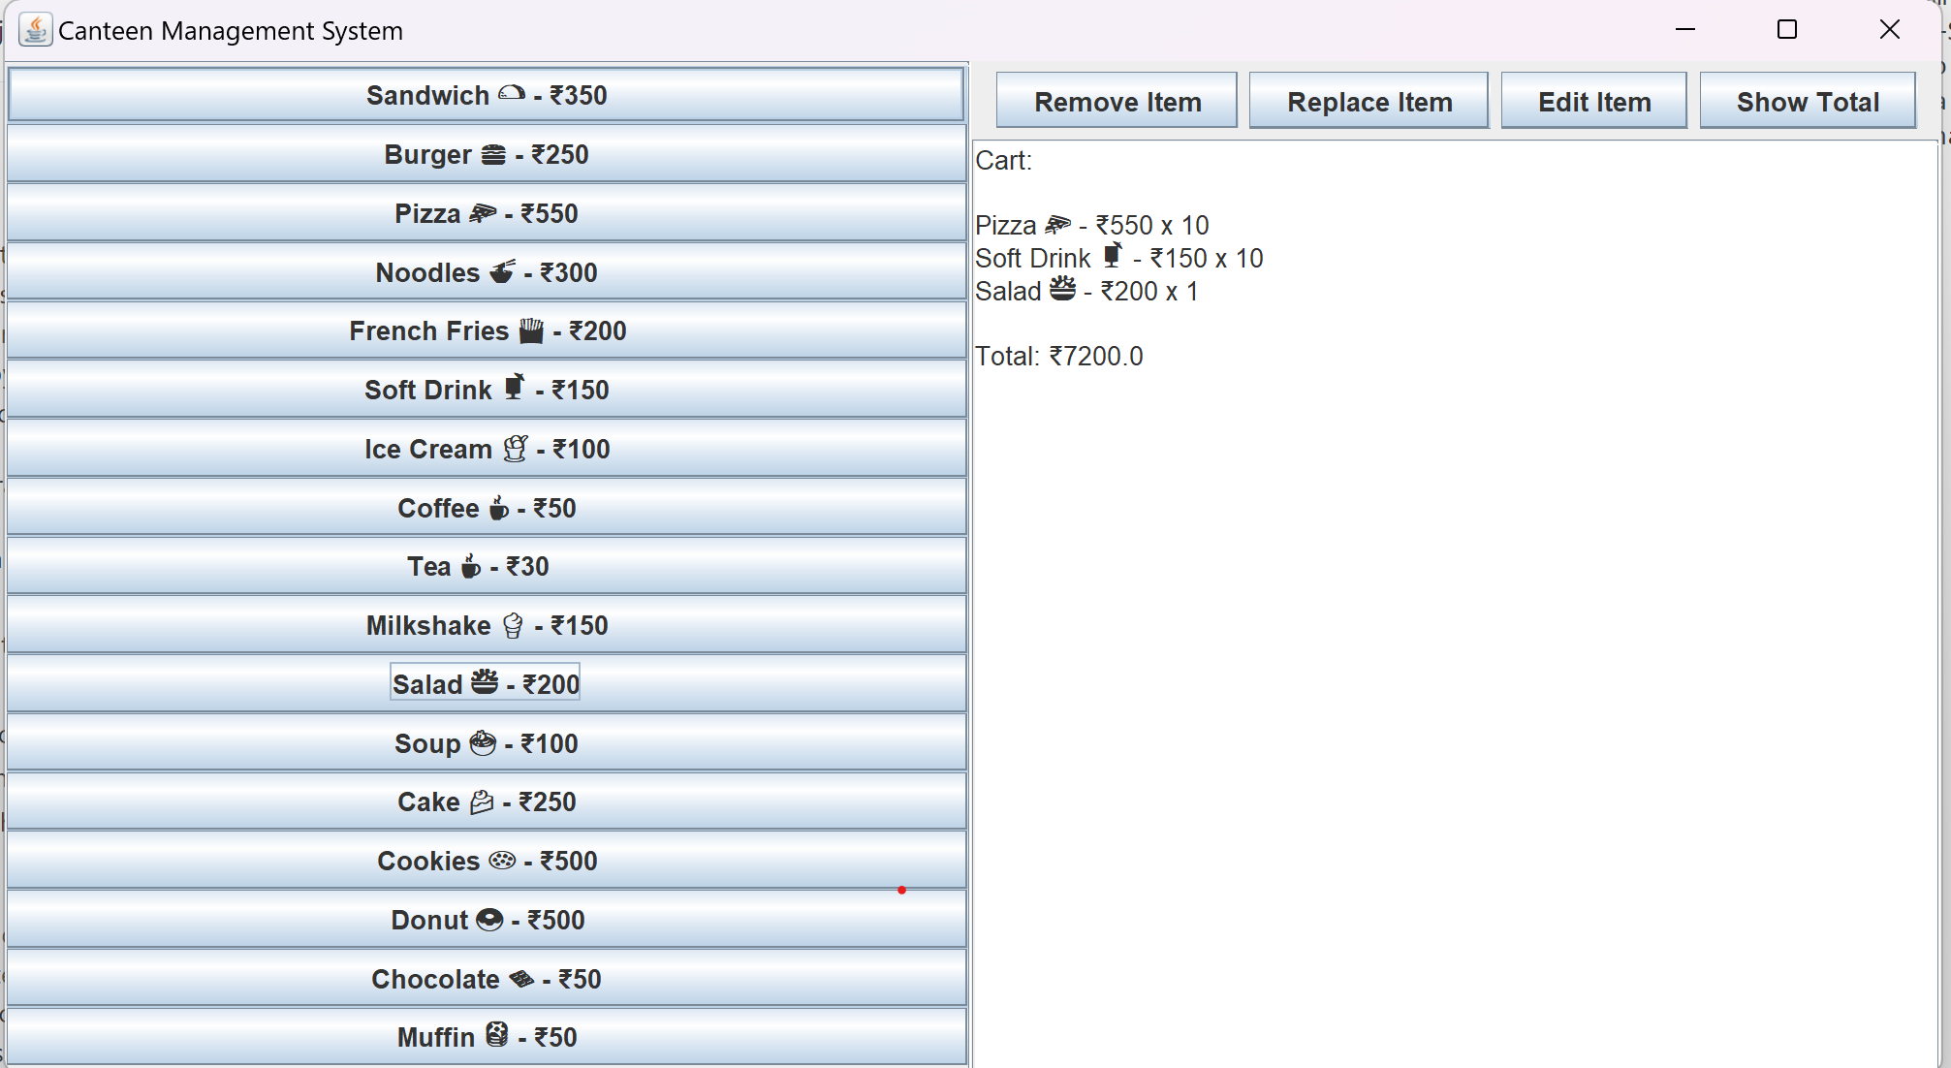
General Ui of our project:--

Slide 5
Main features of this project:--
Menu Display: The system displays a menu of food items. Each item is represented by a button. When a button is clicked, the corresponding item is added to the cart.
Cart Management: The cart displays the items added, their quantities, and the total price. It also provides buttons for managing the cart items.
Add to Cart: Users can add items to the cart by clicking on the corresponding button in the menu. They are then prompted to enter the quantity of the item they want to add.
Remove Item: Users can remove items from the cart. When the "Remove Item" button is clicked, a dialog box appears with buttons for each item in the cart. Clicking on a button removes the corresponding item from the cart.
Replace Item: Users can replace items in the cart. When the "Replace Item" button is clicked, a dialog box appears with buttons for each item in the cart. Clicking on a button removes the corresponding item from the cart and prompts the user to select a replacement item from the menu.
Edit Item: Users can edit the quantity of items in the cart. When the "Edit Item" button is clicked, a dialog box appears with buttons for each item in the cart. Clicking on a button prompts the user to enter a new quantity for the corresponding item.
Show Total: Users can view the total price of the items in the cart. When the "Show Total" button is clicked, a message box appears displaying the total price.

Slide 6
Thank you!!!

