Slide 1
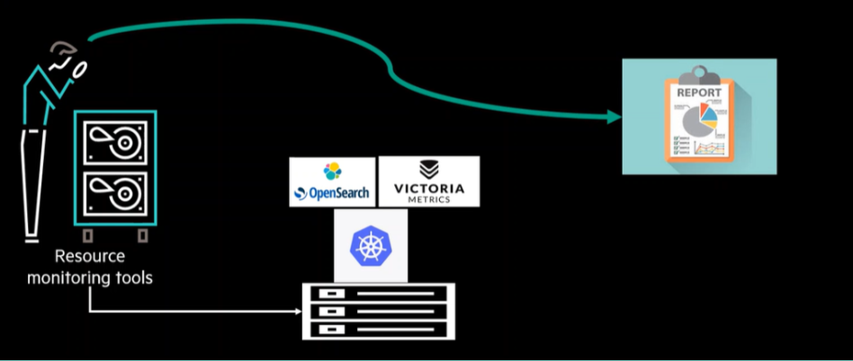
HPE CTY: TEAM-3
CAPACITY ADVISOR FOR MONITORING RESOURCES

Slide 2
What is the Project About? The project focuses on developing a Capacity Advisor Tool that helps in monitoring and managing system resources efficiently. The tool will analyze and provide insights on the required capacity for various monitoring services and infrastructure. Objectives: 1. Develop an algorithm that advises on resource or capacity needs based on the types of monitoring services. 2. Build a monitoring framework to capture the utilization of resources such as disk space, memory, and CPU usage, integrating various monitoring solutions like. Technologies Used: The project utilizes the following technologies and tools for development and deployment: Programming Languages: Python, Bash scripting Cloud Platforms: AWS Streaming & Monitoring Platforms: Apache Kafka (real-time event streaming) Node Exporter (collects system metrics such as CPU, memory, disk usage, and network statistics for Prometheus) Victoria Metrics (high-performance time-series database for storing monitoring data) Prometheus (powerful metrics monitoring and alerting system)

Slide 3
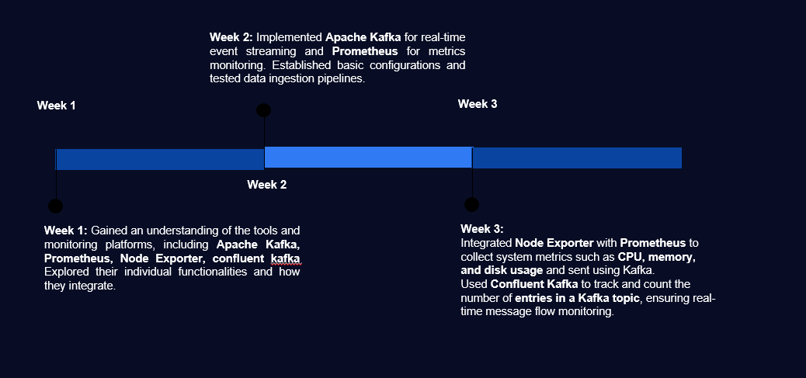
PROGRESS:

Slide 4

What is Apache Kafka?
Apache Kafka is a distributed streaming platform designed for high-throughput data pipelines. It features publish- subscribe messaging, fault tolerance, and scalability. Kafka processes trillions of events daily across industries.
Publish and Subscribing messages
Enables real-time data streaming.
Fault Tolerance
Ensures data reliability.
Scalability
Handles large data volumes.

Slide 5
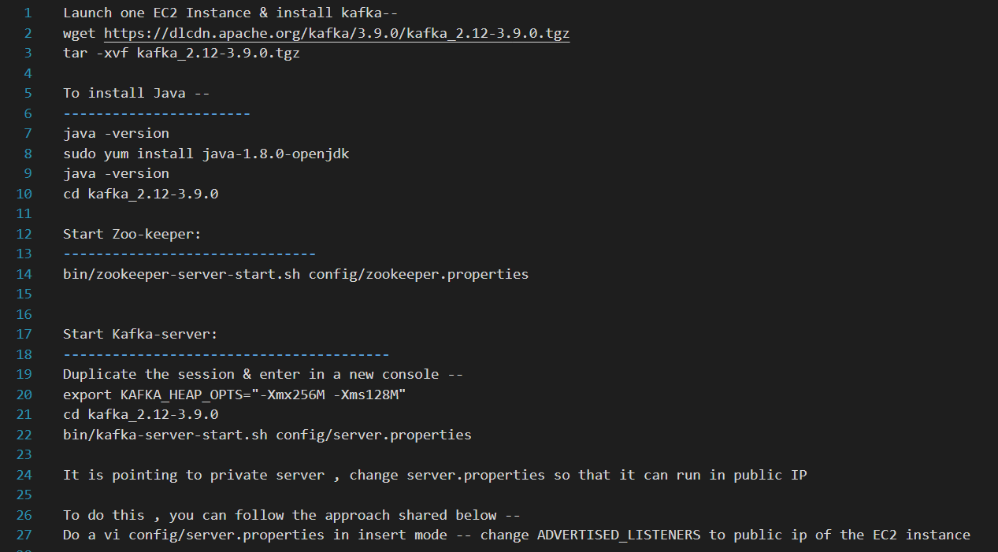
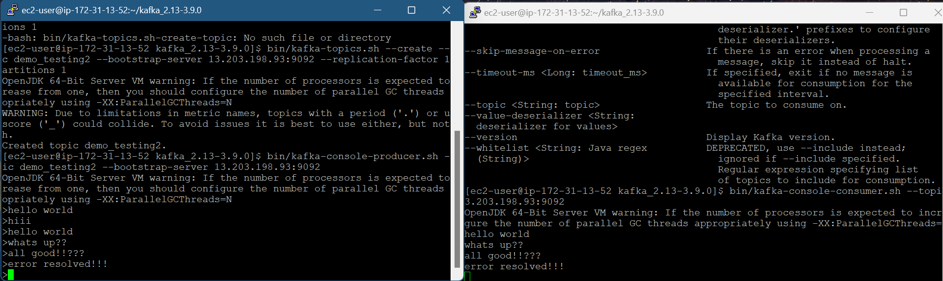
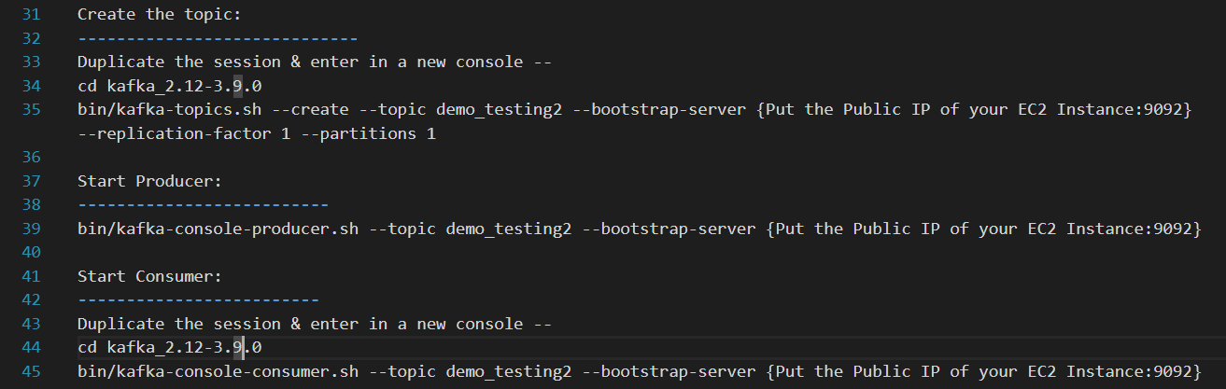
Steps to implement Kafka on AWS EC2 Instances
1. Launch one EC2 Instance & install kafka
2. install Java
3. Start Zoo-keeper
4. Start Kafka-server
5. Create the topic
6. Start Producer
7. Start Consumer
OUTPUT:

Slide 6

What is Prometheus?
Prometheus is an open-source monitoring and alerting system designed for high-availability and scalability. It efficiently collects, stores, and analyzes time-series data, making it ideal for real-time system monitoring.
Time-Series Data Collection
Stores metrics as time-stamped data for analysis
Real-Time Monitoring
Continuously collects system and application metrics.
Pull-Based Model
Fetches data from exporters instead of relying on external push methods.

Slide 7
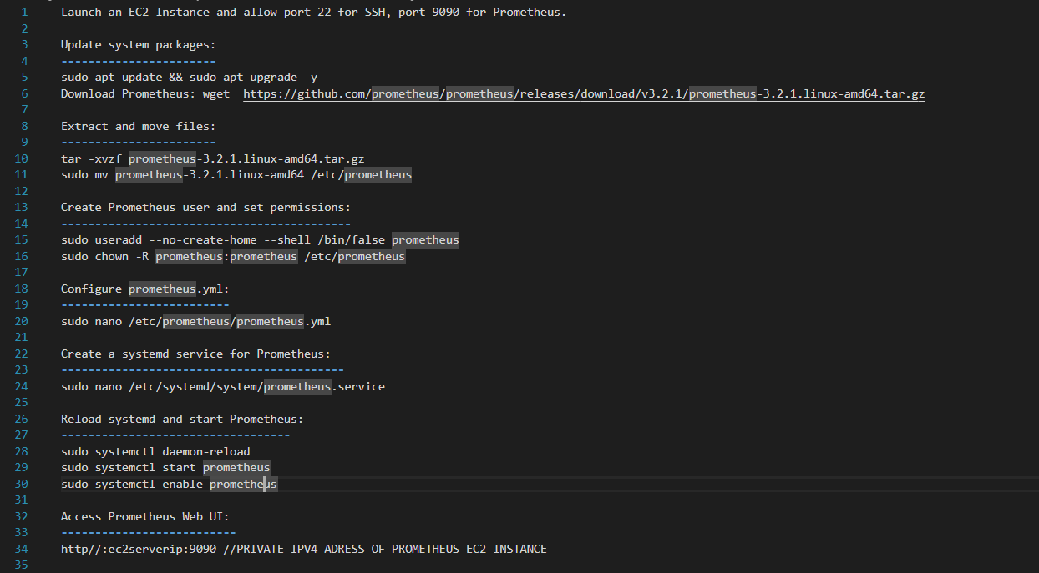
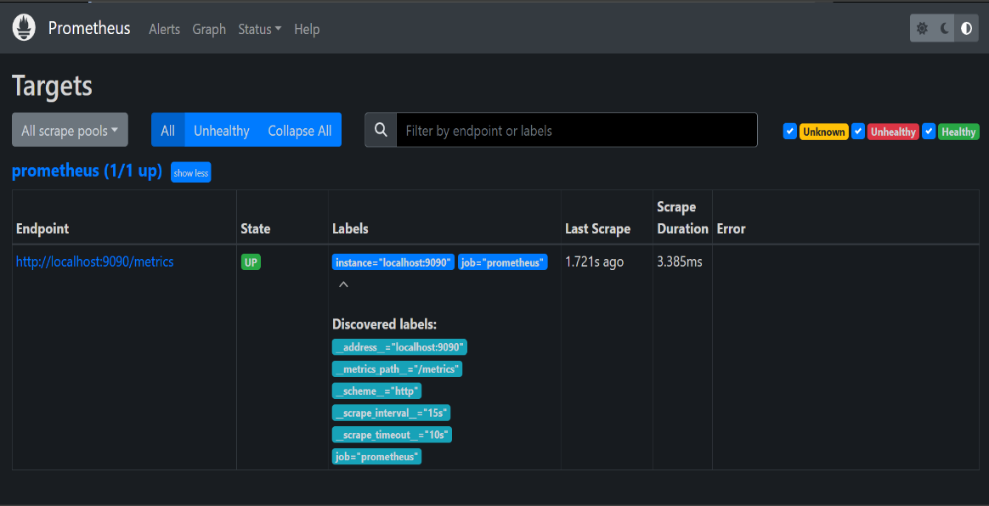
Steps to implement Prometheus on AWS EC2 Instance
1. Launch EC2 Linux instance
2. Create user for Prometheus
3. Download and install Prometheus
4. Configure Prometheus as a service
5. Explore Prometheus GUI
OUTPUT:

Slide 8

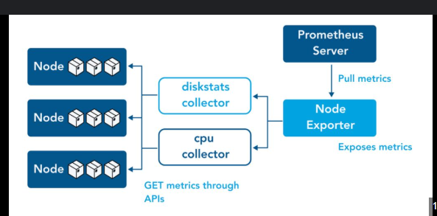
Prometheus Node Exporter
Download Node Exporter from the Prometheus downloads page (e.g., `node_exporter-1.7.0.linux-amd64.tar.gz`). Run Node Exporter using `./node_exporter`. Configure Prometheus to scrape metrics by adding Node Exporter as a scrape target in `prometheus.yml`.
Download
1
Run
2
Configure
3

Slide 9
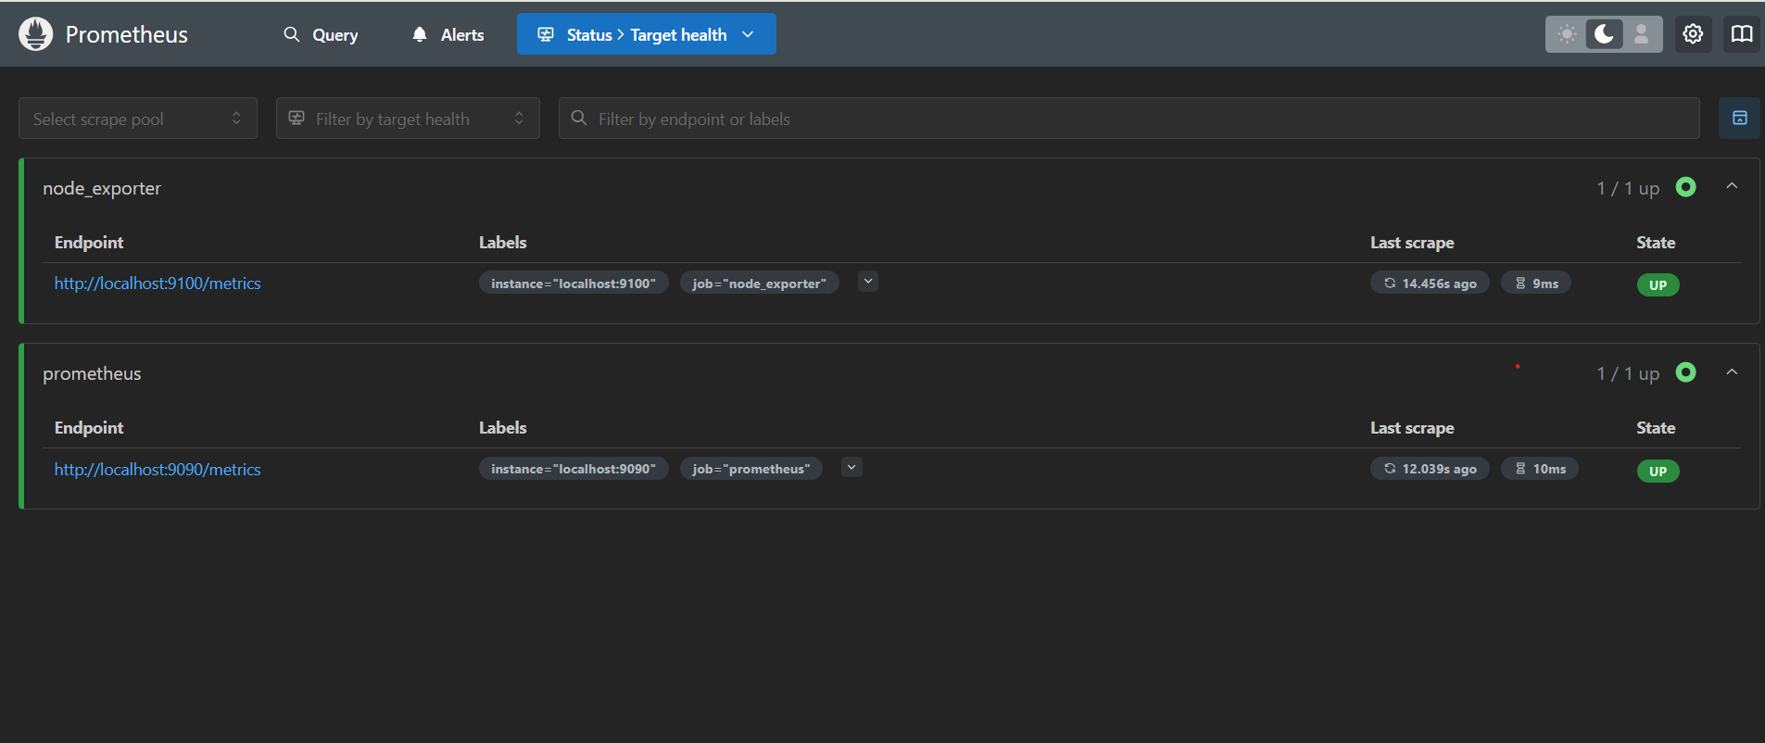

Prometheus Node Exporter
Why is Node Exporter used?
Node Exporter is used in Prometheus to collect system-level metrics from a machine. It helps monitor the hardware and operating system, providing essential insights into system performance.
Starting the node exporter:

Slide 10
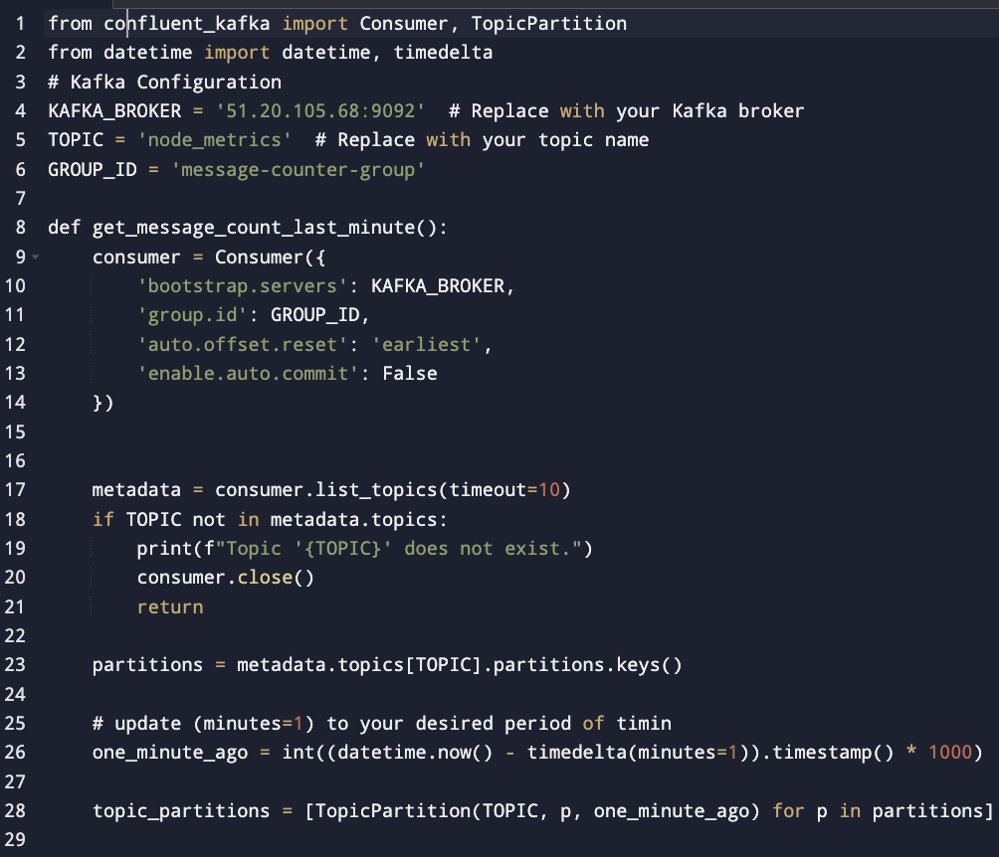
Confluent Kafka
Confluent Kafka is a cloud-native, enterprise-ready event streaming platform built on Apache Kafka. It enhances Kafka with additional tools for governance, monitoring, security, and scalability.

Slide 11
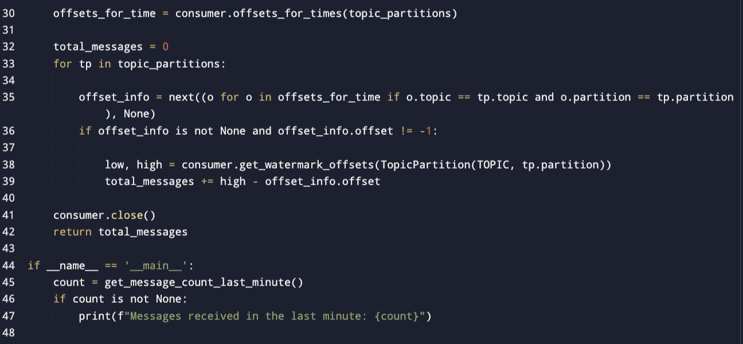
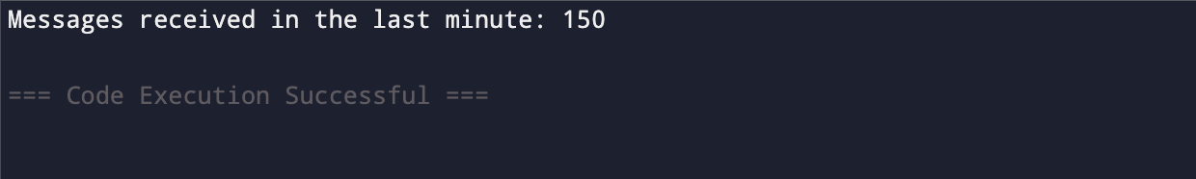
Output

Slide 12
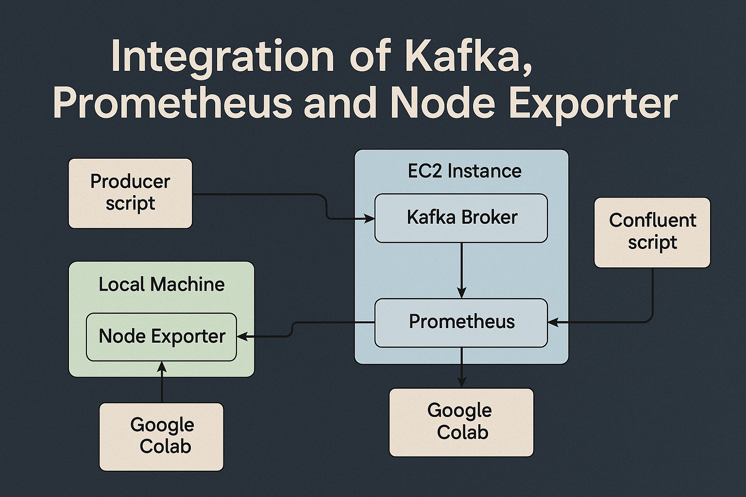
Integration of Node Exporter, Kafka and Prometheus
Overview:
Kafka handles data streaming and topic management, with producer and consumer scripts running on Google Colab.
Prometheus collects and stores system performance metrics from Node Exporter.
Node Exporter is running on the local machine, exposing system metrics (e.g., CPU usage, memory usage) for Prometheus to scrape.
Kafka and Prometheus are hosted on an EC2 instance to manage and monitor data efficiently.
Key Components & Flow:
Kafka:
Producer and consumer scripts are running on Google Colab, generating and consuming data from Kafka topics.
Kafka broker is running on the EC2 instance.
Prometheus:
Prometheus is running on the EC2 instance, scraping metrics from Node Exporter.
It monitors the performance metrics like CPU, memory, and disk usage.
Node Exporter:
Running locally, it exposes metrics that Prometheus scrapes periodically.
Helps monitor system health on the local machine.

Slide 13
Conclusion and Future Directions
In the end, our critical focus will be on tracing the flow of Kafka data streams to identify their destinations and impact across different components. Understanding the growth trajectory of data over time is essential for optimizing resource utilization, ensuring system stability, and preventing bottlenecks. To achieve this, we need to develop a predictive algorithm that leverages historical data trends, real-time analytics, and machine learning models to forecast future usage patterns. This will enable proactive scaling, efficient capacity planning, and cost-effective infrastructure management, ensuring seamless data processing and system performance.

Slide 14
THANKYOU

