Slide 1
Classifying Bacteria from Raman Spectra
STEC · harmless E. coli · Salmonella · water — a confocal-Raman classifier
87 samples • 7,122 spectra • 9 strains • evaluated leave-one-strain-out
NomadX take-home · 2026

Slide 2
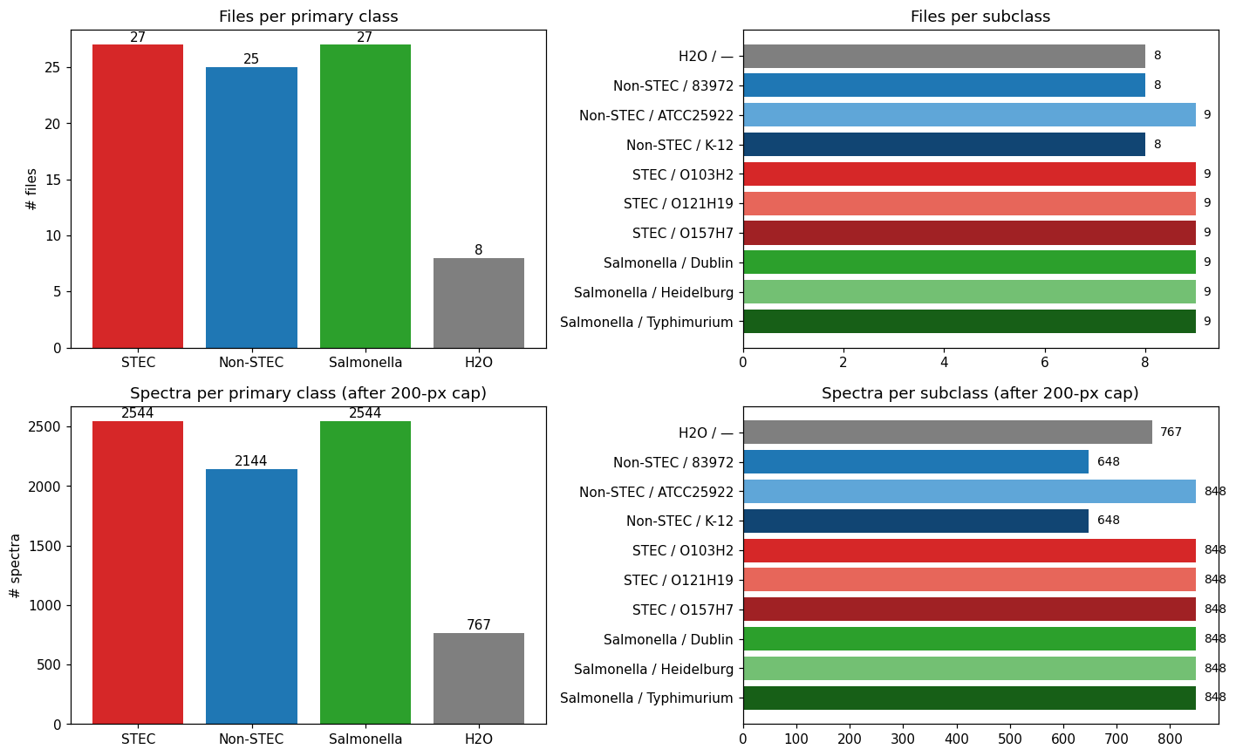
THE PROBLEM
The Problem & The Data
• The task: from one bacterium's Raman spectrum, decide which of 4 classes it is — STEC, harmless E. coli, Salmonella, or water (blank).
• Why it matters: STEC (e.g. O157:H7) is the food-poisoning pathogen — telling it from harmless E. coli fast is real food-safety value.
• What we got: 87 confocal-Raman maps from one lab (86 .xls + 1 .txt), ~72 pixel-spectra each, across 9 strains + water.
• Quality control: 7,999 raw pixels → drop 6 low-signal + 871 background → 7,122 kept (89%). Each spectrum cropped 2,048 → 987 informative points.
• Honest headline up front: best classifier ≈ 60% per-class recall on unseen strains (chance = 25%). Strong where biology allows; near-chance where it doesn't.
87 files / 7,122 spectra · 4 classes · 9 strains + water
Atlas · Raman bacterial classifier
2

Slide 3
WHY IT'S HARD · BIOLOGY
Why It's Hard — The One-Gene Crux
• STEC and harmless E. coli are the same species. What makes one deadly is a single Shiga-toxin gene, delivered by a bacteriophage (a virus that infects bacteria) — essentially one functional addition to an ordinary E. coli genome.
• The boundary is virulence-defined, not phylogenetic: the two organisms are nearly identical; only the acquired toxin gene differs.
• Raman reads bulk molecular composition — the average protein, lipid, nucleic-acid and sugar content of the cell. The toxin protein is a tiny fraction of the total.
• So separating STEC from Non-STEC asks Raman to see the bulk-chemistry shadow of one gene. Near-chance on this split is the biologically expected result — not a failure of effort.
• Two hard characters: K-12 — a 100-year-old lab strain with deleted surface genes that no longer looks like wild E. coli; and Salmonella — a different genus, so genuinely easier.
Where we DO see between-strain signal, it lives in the cell-wall sugar (LPS) region — serogroup architecture, not the toxin itself. → next slide.
Atlas · Raman bacterial classifier
3

Slide 4
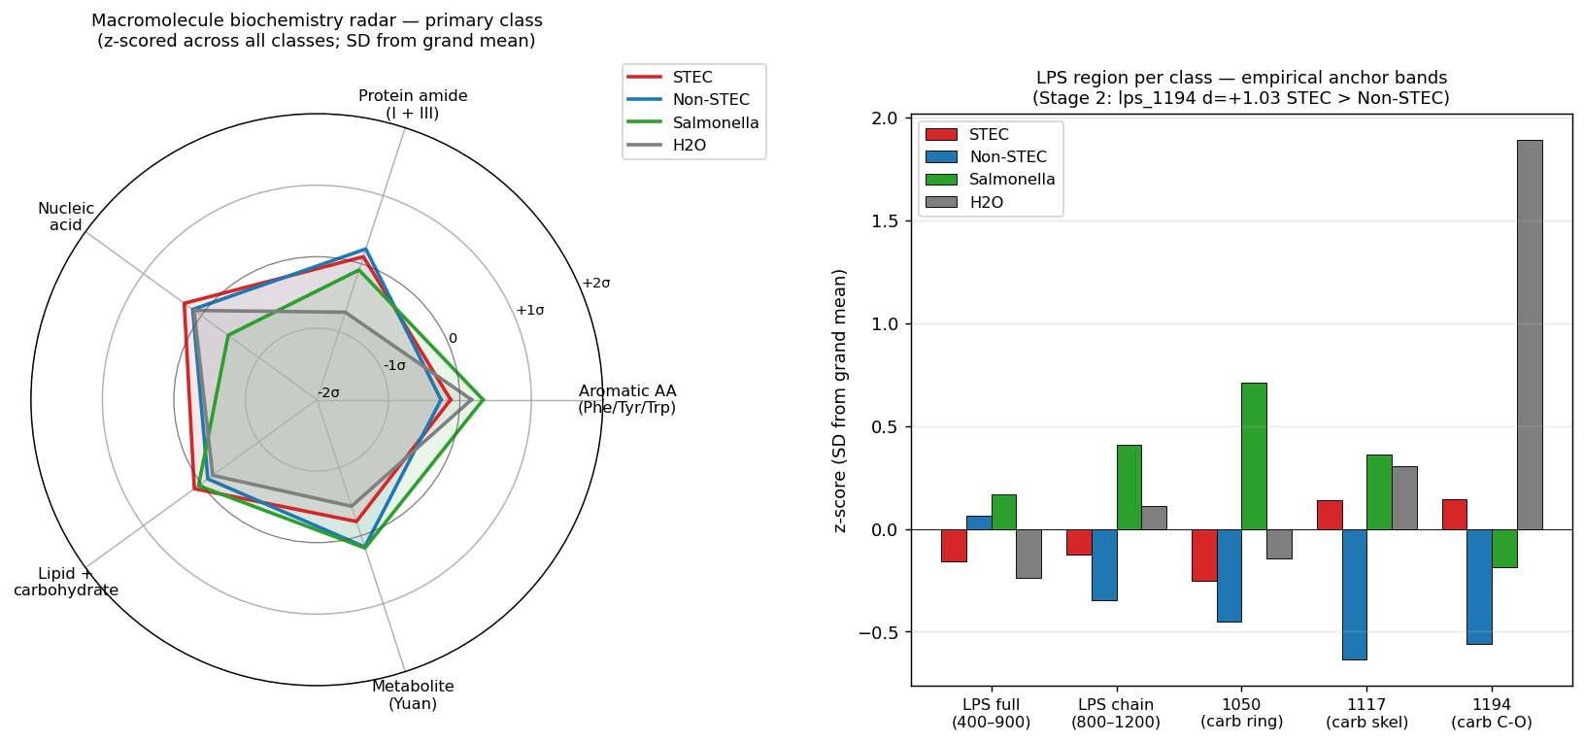
BIOLOGY · WHERE THE SIGNAL LIVES
What the Spectra Are Made Of — Macromolecules & LPS
Every Raman peak belongs to a chemistry family. Five matter here (example peak):
– Aromatic amino acids — 1004 cm⁻¹ (phenylalanine): the total-protein anchor
– Protein amide / backbone — 1242 (β-sheet), 1658 (α-helix): protein secondary structure
– Nucleic acid (DNA/RNA) — 786, 1338
– Lipid / carbohydrate — 1080, 1450, 2850–2930: membrane & sugars
– LPS (cell-wall sugar) — 1050, 1117, 1194: the real discriminator
• LPS = lipopolysaccharide, the sugar-and-fat coat on the outer membrane. Its O-antigen sugar chains differ by serogroup (O157 vs O121 vs O103), so the 800–1200 cm⁻¹ LPS region is where genuine between-strain signal lives.
• Biology-grounded feature confirms it: bio_alpha_helix_score d = −0.986 — Non-STEC carries more α-helix protein than STEC.
• The trap: LPS separates serogroups, not virulence → a feature can ace trained strains and fail on a held-out strain with a different O-antigen.
Macromolecule profile per class (left) and the LPS bands (right): lps_1194 d=+1.03, STEC > Non-STEC.
Atlas · Raman bacterial classifier
4

Slide 5
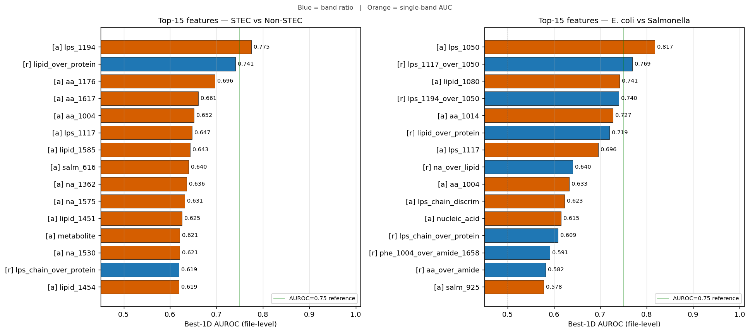
THE PLAN · 1 OF 2
The Plan ① — Survey the Field, Then Let the Data Talk
Step 1 — survey what's known:
– Two papers worked this exact problem: Cisek 2013 (STEC vs E. coli) and Yuan 2024 (Salmonella).
– We didn't borrow their spectra — Raman is instrument-dependent, so it would teach the machine, not the microbe.
Step 2 — let the data talk (exploratory data analysis):
– Class mean spectra are nearly identical → the signal is subtle (shape & ratios, not gross peaks).
– Ranking bands by how well they separate classes → the LPS sugar region wins (lps_1194 AUROC 0.775, d = +1.03).
– The published Cisek bands came out null / sign-reversed here → don't trust literature bands blindly.
Best single-band separation per task — LPS bands lead both; everything sits below the 0.75 line.
Atlas · Raman bacterial classifier
5

Slide 6
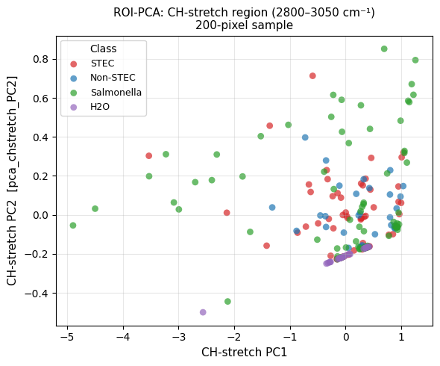
THE PLAN · 2 OF 2
The Plan ② — The Honest Test, Priorities & Hypothesis
• The most important decision was not a model — it was the test. Within-strain files share an acquisition session, so ordinary cross-validation would put near-replicates in train AND test and leak batch effects, flattering the score.
• So we use Leave-One-Strain-Out (LOSO): train on some strains, test on a strain never seen. That is the number we trust. (It is a 9-point statistic → wide error bars, stated honestly.)
• Where to look — priority by macromolecule (from the EDA): carbohydrate / LPS first (best surface signature) → protein → lipid → nucleic acid last (broadly conserved, so it looks the same across these bacteria).
• Hypothesis: cell-surface sugar (LPS) chemistry carries enough signal to separate same-species strains — even though the toxin gene itself is invisible to bulk Raman.
• Success criterion: beat 25% chance under LOSO, and report honestly where it can't.
PCA of the C–H region: water (purple) splits off cleanly; bacteria overlap — real but subtle signal.
Atlas · Raman bacterial classifier
6

Slide 7
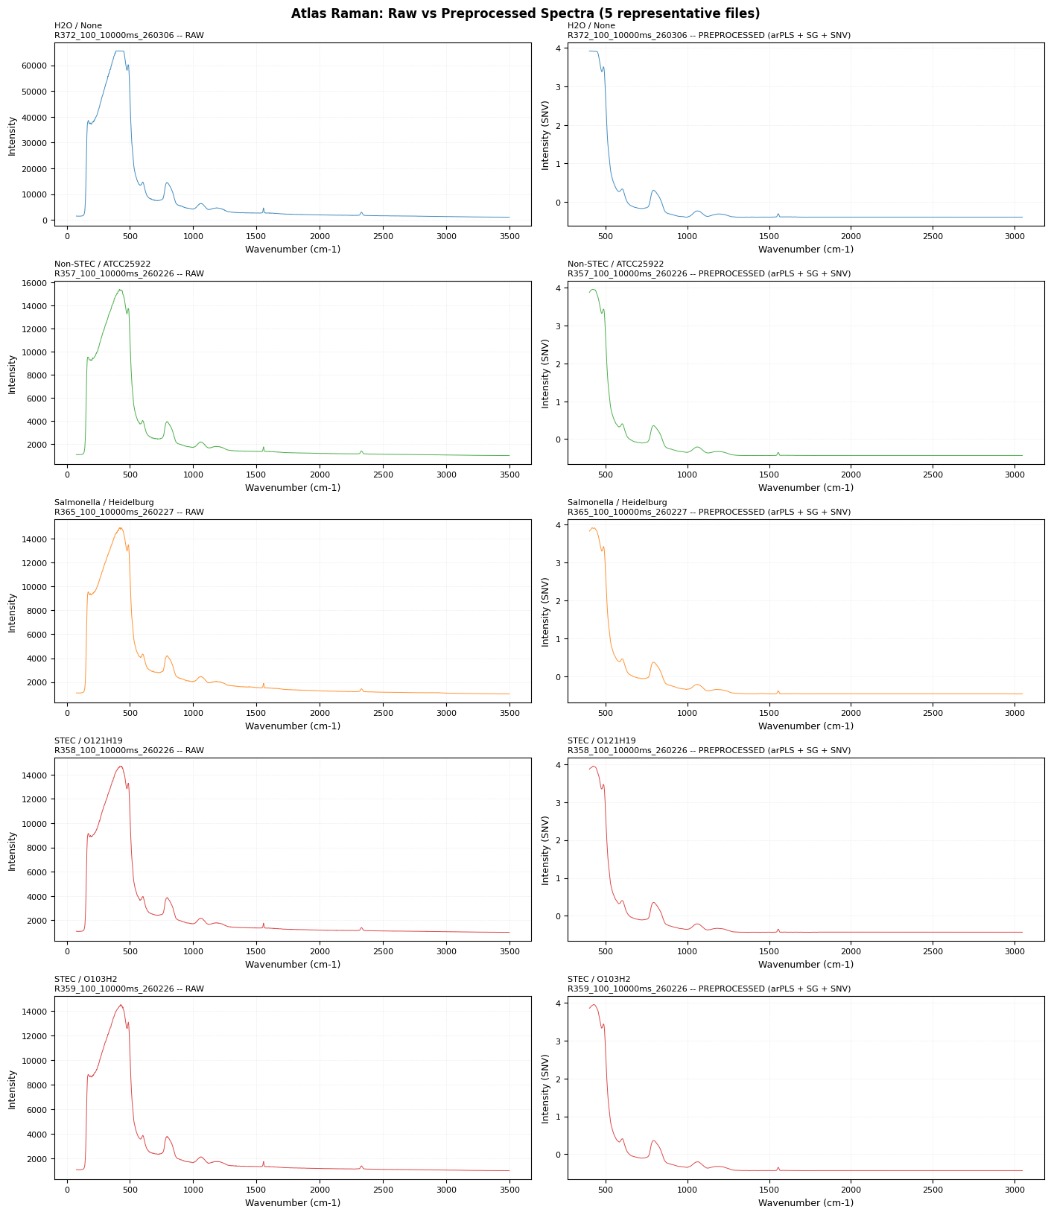
METHODS · DATA PIPELINE
From Messy Files to Trustworthy Data
• 87 messy instrument files → one clean dataset. The .xls files mislabel their grid size, mix separators, and include partial scans — all surfaced as metadata, not hidden.
• Clean every spectrum (5 steps): de-spike cosmic rays → subtract the fluorescence baseline (arPLS) → smooth (Savitzky–Golay) → crop to informative bands (2,048 → 987) → normalize (SNV).
• Predict per pixel, then average a sample's ~72 pixels into one per-file decision — a file is what you actually want to classify.
• Built as a contract: blocking quality gates halt the pipeline if the data is bad, so nothing broken ever reaches the modeling step.
Raw (fluorescent, spiky) → cleaned, normalized 987-point spectrum.
Atlas · Raman bacterial classifier
7

Slide 8
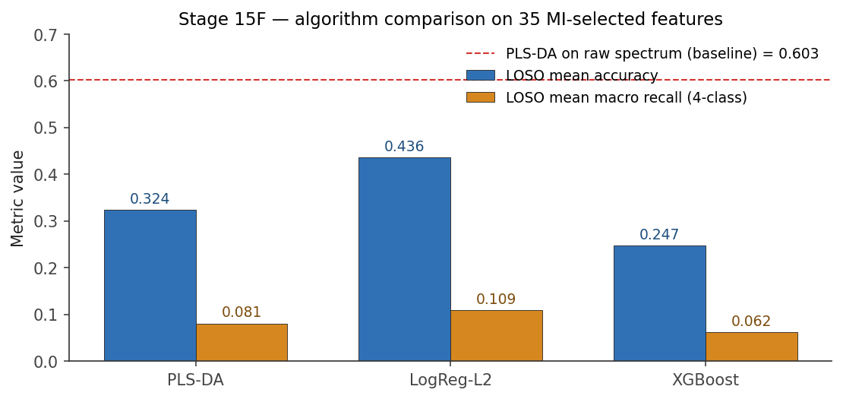
METHODS · MODELS
We Swept the Toolbox — Classical Won
• Swept the whole toolbox against the honest LOSO bar: PLS-DA, logistic regression, SVM, random forest, XGBoost (classical); 1D-CNN, 1D-Transformer, domain-adversarial net (deep); plus 5 ensemble schemes.
• Winner: PLS-DA on the raw cleaned spectrum — LOSO 0.603. Nothing beat it.
• Why classical won: 87 files is tiny. Deep nets overfit the training strains — the wide-patch Transformer literally blurred the narrow Raman peaks (LOSO 0.19). PLS-DA's low-rank projection is a built-in regularizer that generalizes to unseen strains.
• Lesson: for narrow-peak spectroscopy at small N, classical low-rank methods beat flexible deep models.
On engineered features LogReg (0.436) beats PLS-DA (0.324) — but raw-spectrum PLS-DA (0.603, dashed) beats them all.
Atlas · Raman bacterial classifier
8

Slide 9
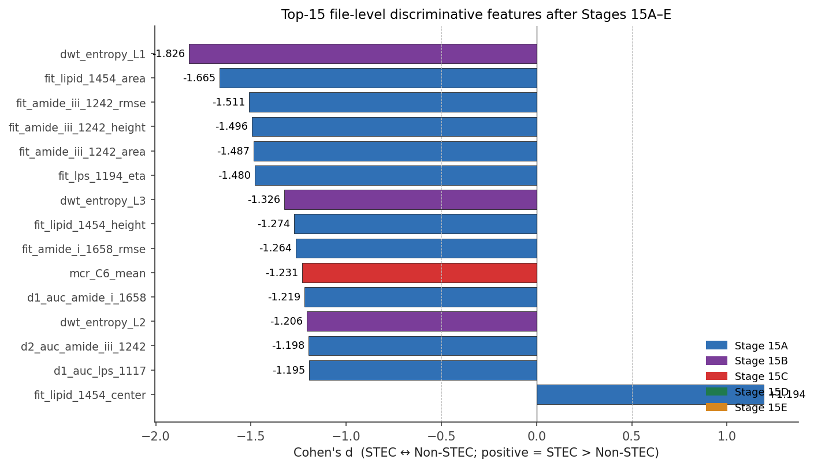
METHODS · FEATURE ENGINEERING
Going Deeper — 259 Engineered Features
To try to beat the raw spectrum, we built 259 chemistry-grounded features in 5 families:
– 15A · Pseudo-Voigt peak fits (height / width / area per band) — highest-yield; dominates the final model
– 15B · wavelets, region-PCA, spectral-angle template matching
– 15C · MCR-ALS unmixing — see next slide
– 15D · biology ratios — bio_alpha_helix_score d = −0.986 (Non-STEC more α-helix); first K-12-specific axis
– 15E · spatial moments — null for STEC↔Non-STEC; gives an E. coli↔Salmonella signal (spat_skew_lps_1117 d=+0.725)
• Inside each fold, pick the top 35 features by mutual information — with only ~3 features per file, aggressive selection is mandatory.
• Honest punchline: the best engineered model (LogReg 0.448) still lost to raw-spectrum PLS-DA (0.603). The information was already in the spectrum shape.
Top features by effect size — peak-fits and LPS bands lead.
Atlas · Raman bacterial classifier
9

Slide 10
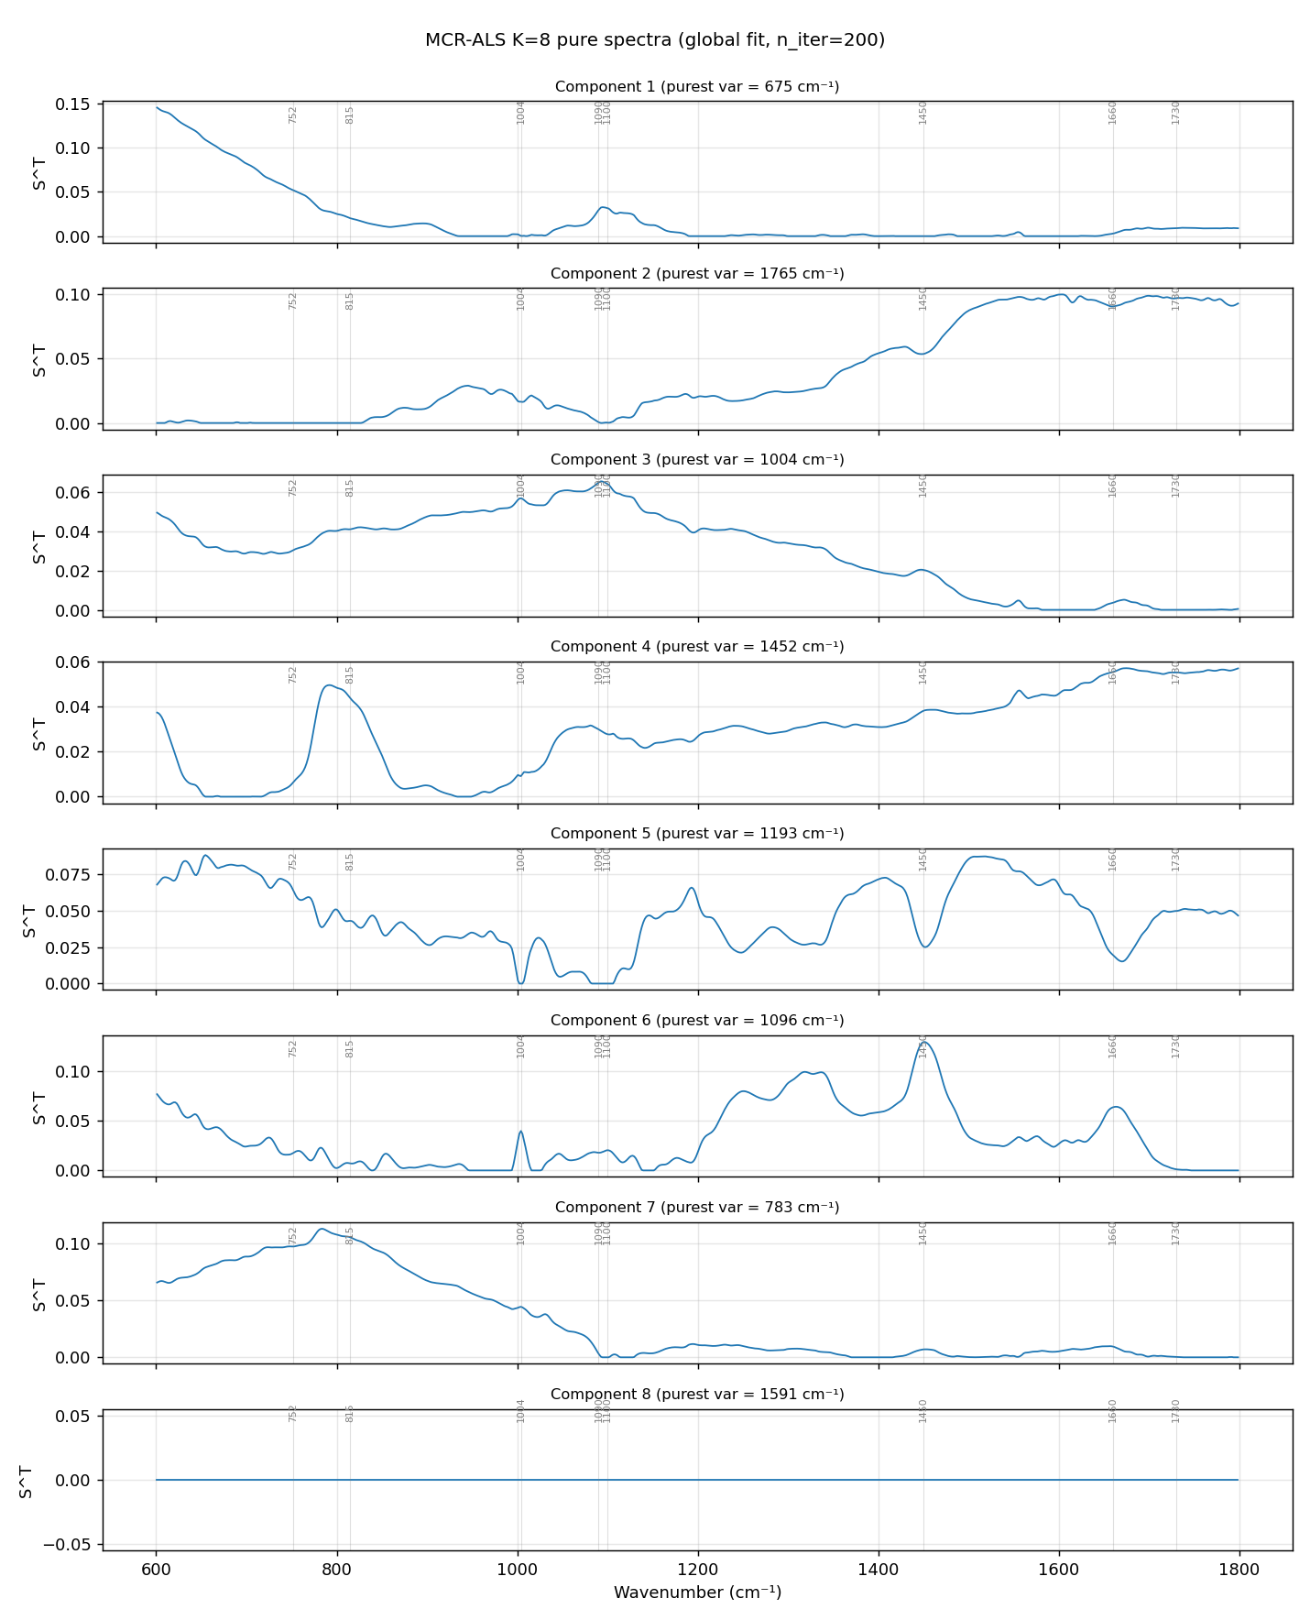
METHODS · MCR-ALS
MCR-ALS — Unmixing, and the Leakage Lesson
• MCR-ALS (Multivariate Curve Resolution) un-mixes the whole pile of spectra into a few “pure-ingredient” spectra plus how much of each sits in every pixel — like reversing a smoothie back into its ingredients.
all spectra (N pixels × wavenumbers) ≈ C · Sᵀ [ S = K pure-component spectra ; C = abundance per pixel ]
• We found K = 7 meaningful components — one captured the substrate / fluorescence artifact, which usefully isolates the instrument signal away from the biology.
• The crown-jewel lesson: the strongest single feature in the whole project, mcr_C6_mean, had Cohen's d = −1.23 — but it came from fitting MCR on ALL the data at once (a global fit).
• Re-fit MCR INSIDE each fold on training pixels only (the leakage-safe way) and the components reorder — MCR has rotational / label ambiguity — so “C6” isn't stable and the feature did NOT survive per-fold selection. The −1.23 was partly a leakage artifact, and proper cross-validation demoted it.
Global-fit components. Re-fit per fold, these reorder — which is exactly why the d=−1.23 feature isn't reproducible.
Atlas · Raman bacterial classifier
10

Slide 11
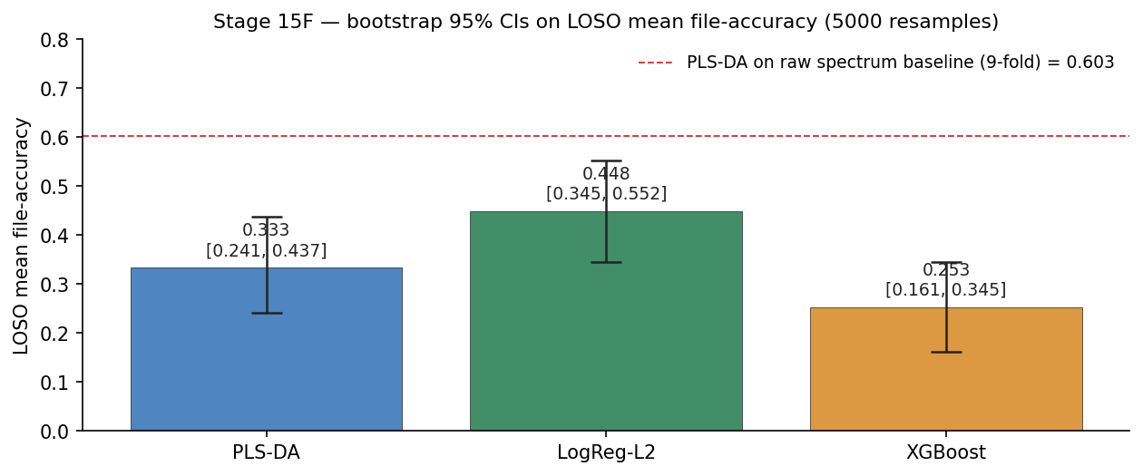
RESULTS
The Results — The Numbers That Matter
• The funnel: 87 files → 7,122 spectra → 987 bins → 259 features → 35 selected.
Two recipes — do not mix them up:
HEADLINE raw 987-bin spectrum → PLS-DA → LOSO 0.603
DEPLOYED 35 features → LogReg-L2 → 0.448 (CI 0.345–0.552)
PLS-DA on those features collapses to 0.324 — it needs the full spectrum.
• The engineered track plateaued just below raw — and we report that honestly.
• Statistics done right: 5,000-sample bootstrap for the error bar; McNemar test (LogReg beats PLS-DA, p = 0.002 — but only on the same 35 features, NOT a claim against the 0.603 raw headline).
• Context: chance is 25%. 0.448 ≈ 1.8× chance, 0.603 ≈ 2.4× chance.
Bootstrap distribution of LOSO accuracy → 95% CI [0.345, 0.552].
Atlas · Raman bacterial classifier
11

Slide 12
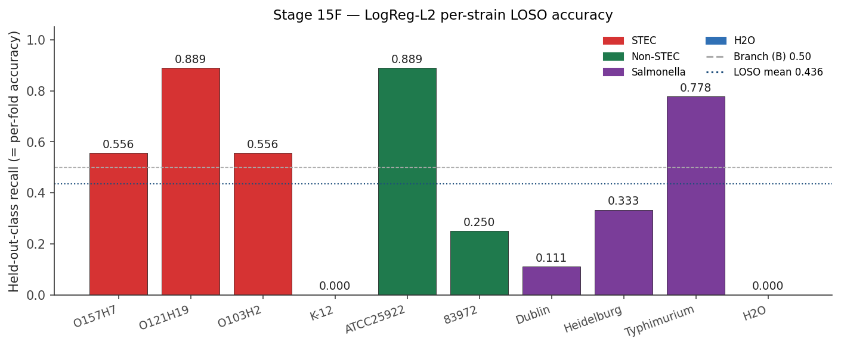
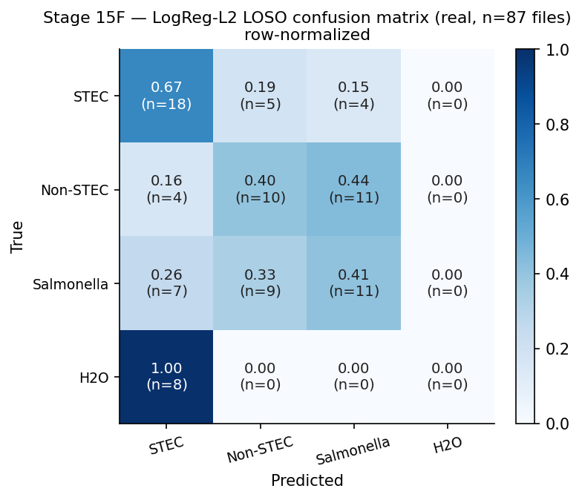
RESULTS · BREAKDOWN
Where It Works, and Where It Fails
• The whole-task number hides a split — easy decisions are strong; the biologically-thin one is near chance.
• Wins: ATCC25922 0.889, O121:H19 0.889, Typhimurium 0.778. Water-vs-bacteria ≈ AUROC 1.0 in deployment.
• Failures: K-12 0.00 (atypical lab strain), Dublin 0.111. The held-out water fold scores 0.00 under LOSO — a protocol artifact (no water in training), not a real defect.
• The consistent bias: under uncertainty the model defaults to STEC — all 8 held-out water files were called STEC. Conservative for food safety, but inflates false positives.
Per-strain LOSO recall — wins and zeros.
Confusion matrix — the water row defaults to STEC.
Atlas · Raman bacterial classifier
12

Slide 13
WHAT WE LEARNED
Three Scientific Findings
1. A published discriminator did not replicate.
– Cisek 2013's three bands (1338 / 1454 / 1658) came out null / sign-reversed on our data (one band flipped sign). Reported as non-replication under different conditions — not “they're wrong.”
2. The real signal is cell-wall sugar (LPS).
– Best single band auc_lps_1194, d = +1.03 — surface serogroup architecture in the 800–1200 cm⁻¹ region, exactly where the biology predicted.
3. Our strongest feature was a leakage artifact — and we caught it.
– mcr_C6_mean (d = −1.23) vanished under per-fold refitting. It is the best evidence that the whole workflow can be trusted: it demotes its own too-good-to-be-true numbers.
Atlas · Raman bacterial classifier
13

Slide 14
RIGOR
Rigor — How We Avoided Fooling Ourselves
• The real risk in an AI-accelerated workflow isn't bad code — it's confident, plausible, wrong results. Every step was built to catch exactly that.
• Per-fold refitting of MCR / PCA / SAM — exposes leakage (it killed our own d = −1.23 feature).
• Bootstrap confidence intervals, not point estimates. McNemar tests, not eyeballing.
• Leave-one-strain-out, not flattering k-fold. Pinned-dependency, reproducible notebooks.
• A literature-falsification track — we tested the Cisek claim instead of assuming it.
“Treat every result — AI-generated or not — like a finding from a collaborator you don't fully trust: verify everything. The leakage I caught in my own strongest feature is the proof.”
Atlas · Raman bacterial classifier
14

Slide 15
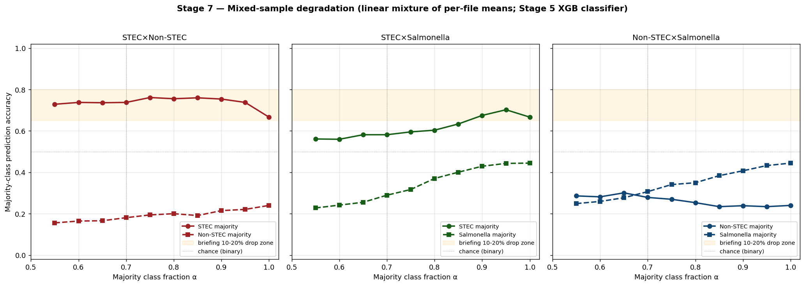
LIMITATIONS
Honest Limitations & Deployment Behaviour
• STEC ↔ Non-STEC is near chance — biology, not effort (one phage-encoded gene).
• LPS separates serogroups, not virulence → a held-out strain with a new O-antigen (e.g. O157) fails. The “serogroup-specificity trap.”
• Tiny N: only 9 strains, one lab, one instrument → wide CI and batch confounding (a probe still reads file-identity at ~14% vs 1.15% chance).
• Mixed-sample stress test: ~10–20% accuracy drop at 10–20% contamination, and the model leans toward STEC under uncertainty.
• No cross-instrument or open-set test yet — every number is within our own corpus.
Synthetic contamination → accuracy degrades; predictions lean STEC.
Atlas · Raman bacterial classifier
15

Slide 16
NEXT STEPS
How to Improve It
• Re-measure each specimen multiple times, in different spectral windows, in triplicate — turns 1 scan into ~12 datasets per sample and controls mechanical / acquisition error.
• Separate lab strains from fresh field isolates so the model learns biology, not lab adaptation.
• The real bottleneck is strain diversity, not pixel count → add more strains + a second instrument.
• Free next step: run our model on public ATCC25922 spectra (Zhu 2022, Ho 2019) — the same strain in another lab. The sharpest cross-lab test, at zero cost.
Proposed acquisition protocol (all scans in triplicate → 12 datasets / sample)
Sample A ──► full scan 400–1800 cm⁻¹ ×3
──► window 1 400–700 cm⁻¹ ×3
──► window 2 600–1300 cm⁻¹ ×3
──► window 3 1000–1800 cm⁻¹ ×3
Atlas · Raman bacterial classifier
16

Slide 17
PRODUCT
An AI-Integrated Dashboard
• A web dashboard so a non-specialist can use the model: drop in a spectrum → live identification in seconds.
• Runs both models side by side — raw-spectrum PLS-DA and engineered-feature LogReg — with class probabilities for every call.
• Easy comparison across many parameters in one place:
– annotated spectra with the chemistry bands marked · the LPS region
– top discriminating features · the 7 MCR components
– confusion matrix · an honest uncertainty / limitations panel
• Goal: turn the analysis into a tool — identification + interpretation together, with the model's limits shown openly rather than hidden.
Built with a Next.js front-end and serverless (Modal) inference running the real pipeline.
Atlas · Raman bacterial classifier
17

Slide 18
APPENDIX · 1 OF 2
Questions to Expect — Numbers & Models
Q “You have two different best numbers?”
0.603 = PLS-DA on the raw spectrum (headline). 0.448 = LogReg on engineered features (deployed). The engineered features plateaued below raw — and we say so.
Q “LogReg beats PLS-DA, p = 0.002 — so you beat your baseline?”
No. That test is engineered-vs-engineered features only. Raw-spectrum PLS-DA (0.603) was never beaten.
Q “Isn't the LogReg 0.488?”
≈ 0.448, not 0.488 — the best model of the feature-engineering track. It still lost to raw-spectrum PLS-DA (0.603).
Q “Same model for water and Salmonella?”
One multiclass model with four outputs — a spectrum scores all four classes and we take the highest. Not one model per class.
Q “Why not an ensemble?”
We tried five ensemble schemes plus the deep nets. None beat the single PLS-DA — the added complexity didn't improve generalization.
Q “What is PLS-DA, in one breath?”
It squashes the 987-point spectrum into ~30 label-aware directions that best separate the four classes, then classifies there — like PCA, but supervised.
Atlas · Raman bacterial classifier
18

Slide 19
APPENDIX · 2 OF 2
Questions to Expect — Methods & Rigor
Q “Why did deep learning lose to a classical method?”
87 files is tiny — CNNs / Transformers overfit, and wide patches blur the narrow Raman peaks. At small N, classical low-rank wins.
Q “Did you really falsify Cisek 2013?”
Careful wording: it didn't transfer to file level under our replicate structure — not “they are wrong.”
Q “Is your strongest feature real?”
No — mcr_C6_mean d = −1.23 came from a global MCR fit (leakage). It was killed by re-fitting MCR inside each fold.
Q “Why not generate synthetic data?”
The bottleneck is real strains, not spectra — synthetic data can't invent an unseen strain, would inflate LOSO, and risks teaching artifacts. Even a WGAN tops out ~94%.
Q “Why not use the reference papers' data?”
Raman is instrument-dependent — another lab's spectra teach the instrument, not the microbe (a batch confound). We used their methods; running our model on public ATCC25922 is the free #1 next step.
Q “Did you actually have cosmic rays?”
Yes — 99.7% of spectra had ≥1 flagged point, the tallest ~6,000σ. But the z>5 threshold also trims ordinary noise; the genuine hits are the extreme tail above z>50.
Atlas · Raman bacterial classifier
19

