Slide 1
Final Review Human resource management with python
Guided by
P. Sree Laskshmi
-2010030151 K S Satyavarsan
2010030071 Jyothin Movva
2010030040 Devaraj Acharya
2010030341 Snehith Kamepally
2010030329 Karthik

Slide 2
Abstract
The field of human resources analysis, which can be understood as an approach to human recourses management focused on data and analytical thinking.
Human resources analysis an optimal use of human resources to ensure that the human resources of an organization remain an asset and not a liability.
The project analyzes the data of the employees working in the organization.

Slide 3
Literature review
S.NO | Authors | Title | Publishing | Techniques
1 | AMAN KHARWAL | Human Resource Analysis with Python | Agronomy for Sustainable Development volume (2015) | The field of human resources analysis, which can be understood as an approach to human resources management focused on data and analytical thinking, is quickly becoming an indispensable part of organizational configurations.
2 | JOHN-PAUL HATALA | Social Network Analysis in Human Resource Development: A New Methodology | Louisiana State University (2018) | Through an exhaustive review of the literature, this article looks at the applicability of social network analysis (SNA) in the field of human resource development
3 | John W. Boudreau | Utility Analysis for Decisions in Human Resource Management | Cornell University (2017) | This chapter will discuss utility analysis (VA), which attempts to answer such questions by focusing on decisions about human resources. Utility analysis refers to the process that describes, predicts and/or explains what determines the usefulness or desirability of decision options, and examines how that information affects decisions

Slide 4
Existing system
Human resources management works through dedicated HR professionals, who are responsible for the day-to-day execution of HR-related functions. Typically, human resources will comprise an entire department within each organization.
HR departments across different organizations can vary in size, structure and nature of their individual positions.

Slide 5
Proposed system
Creating a python application to assist the human resourse managers.
The applications key features
1. Visualize the data
2. create a list of candidates from the dataset who match the needed constraints

Slide 6
Algorithm
The project is coded in python
The dependencies that are used are
Numpy – mathematical functions
Pandas – data analysis and manipulation
Ploty – plot 2d data and color scaling functionality
Flask - website hosting

Slide 7
implementation

Slide 8
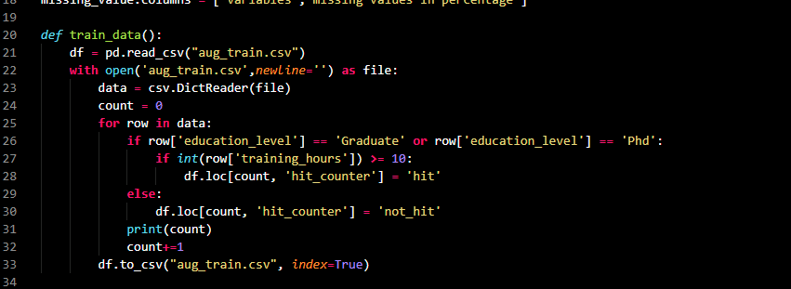
Generating new result

Slide 9
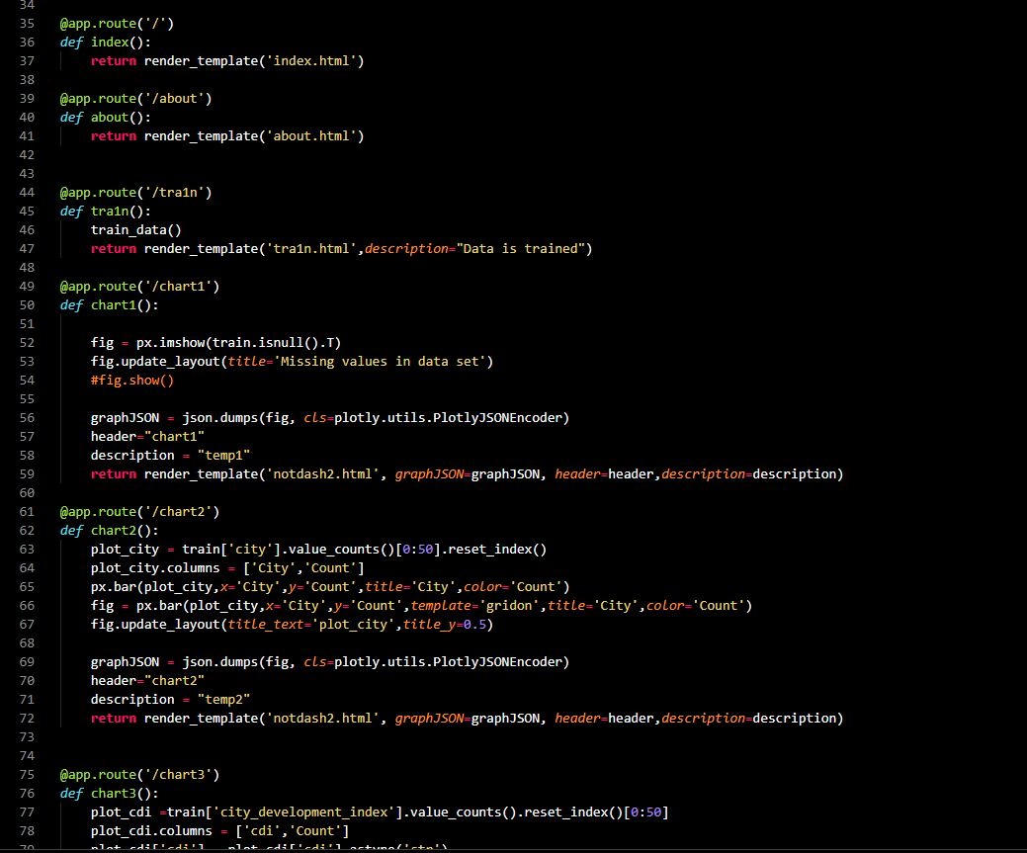
Flask links and chart plotting

Slide 10
Results
Flask environment for the project is functional
Generating plots from the given data is functional
Using data to create a new field, and plotting a graph from the generated data

Slide 11
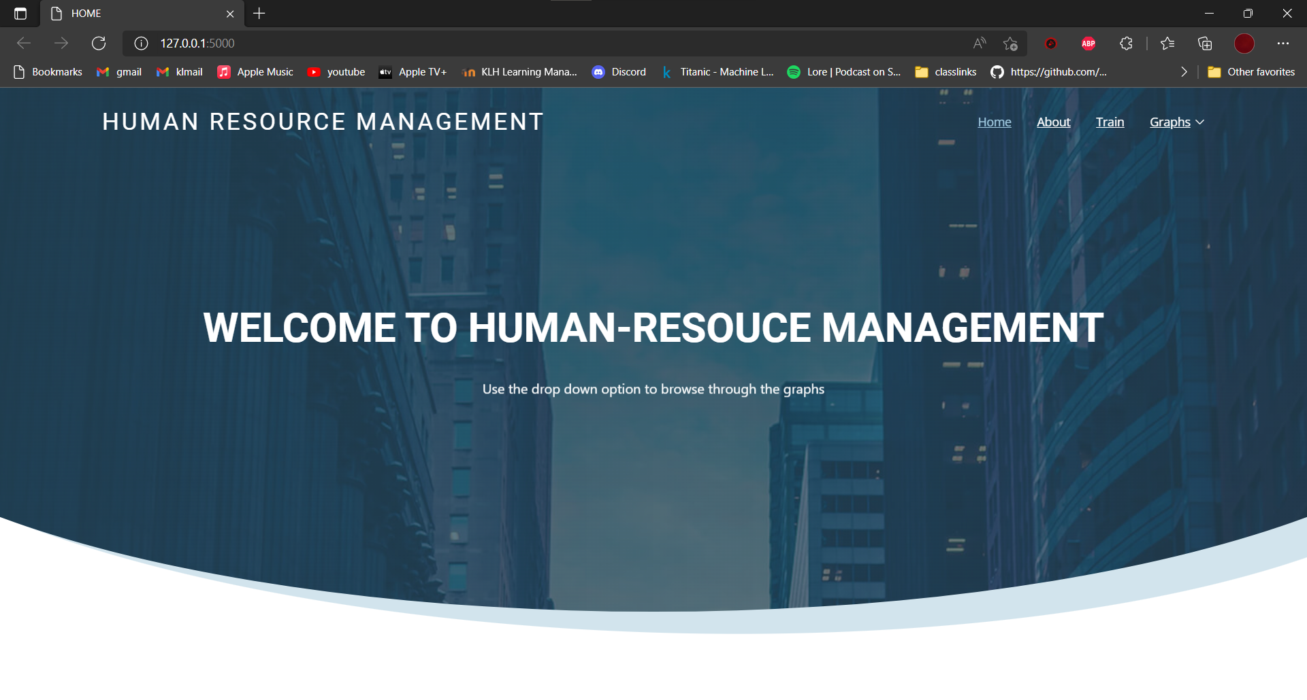
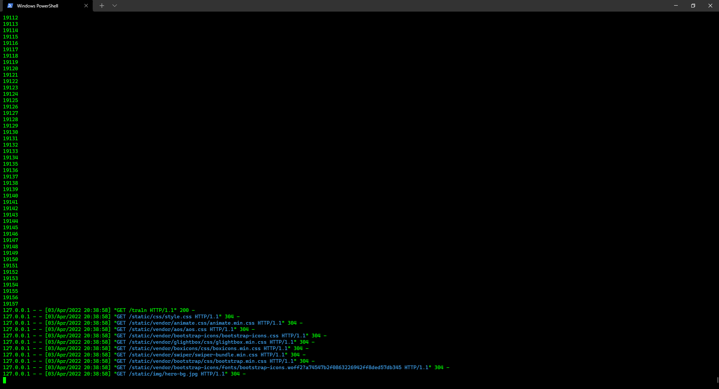
(Home page)
(Terminal during training )

Slide 12
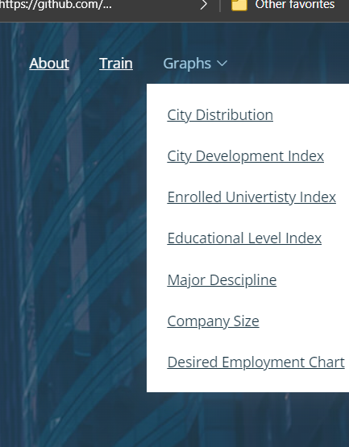
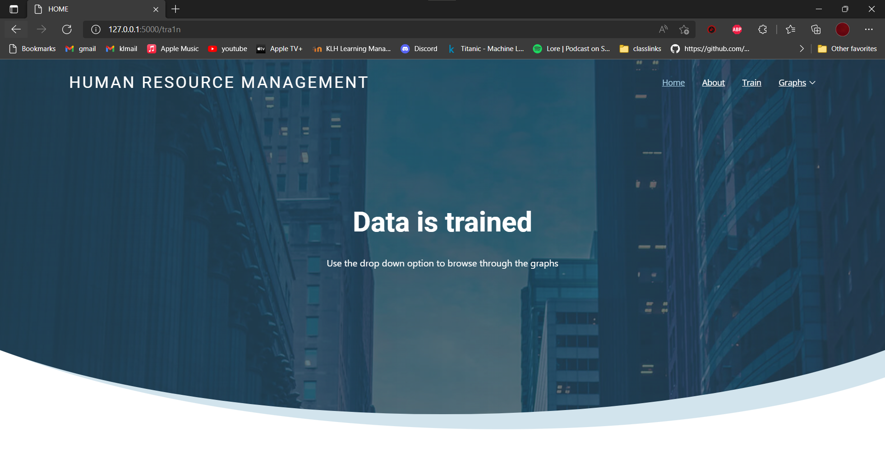
(training page)
(drop down option)

Slide 13
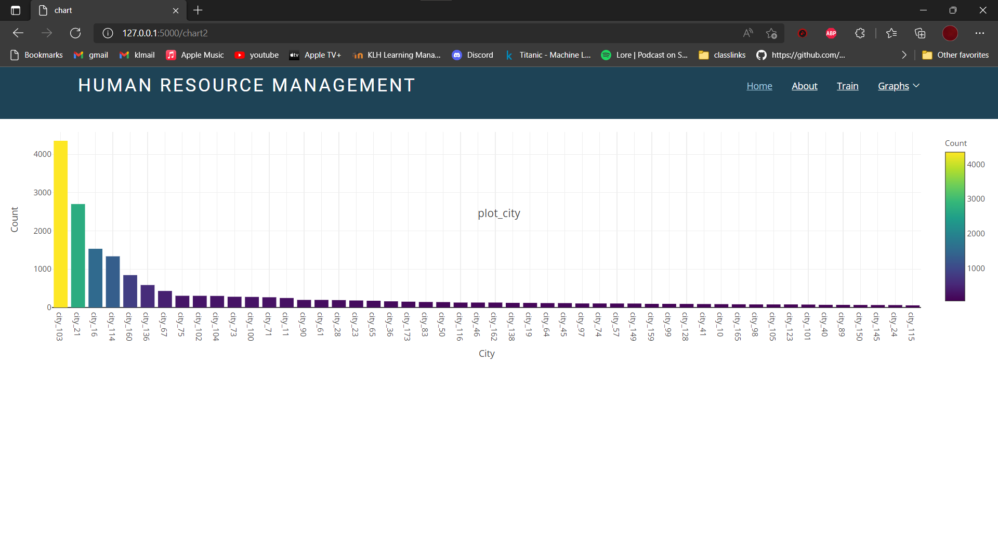
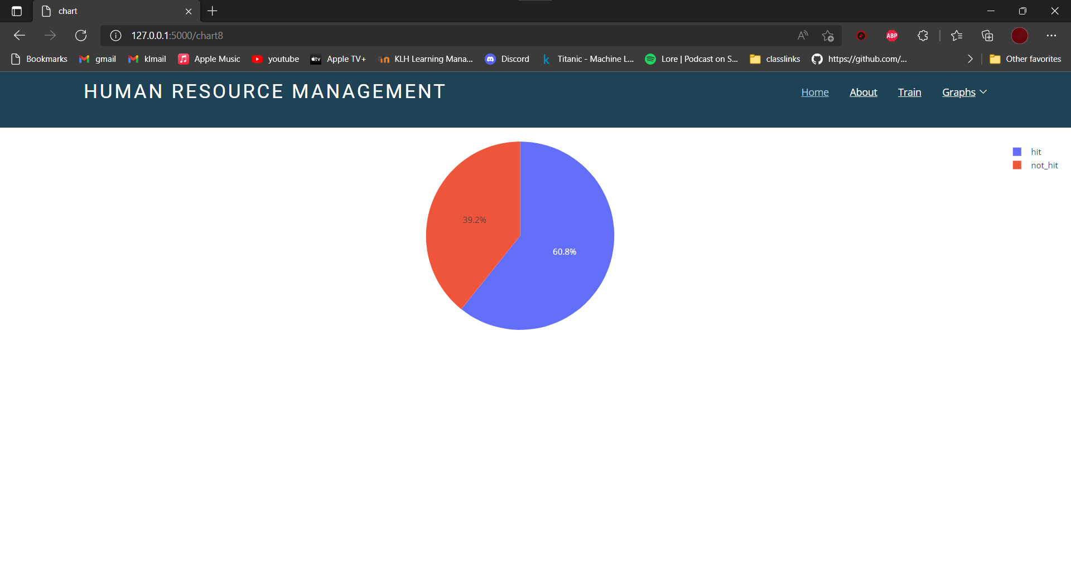
(city index plot)
(city index plot)

Slide 14
applications
HR analytics is the process of collecting and analyzing Human Resource (HR) data in order to improve an organization’s workforce performance.
This project can be applied in any organization that requires their workforce to be analyzed .
The results from this analysis identify trends and patterns that may have an organizational impact.

Slide 15
Conclusion and future scope
The project portal is fully functional and predicts with desirable accuracy
Adding more variables to generate the data for the targeted characteristics.
Moving the web hosting service to Django or hosting it in a web server for testing will be appropriate representation of the intended real-life use

Slide 16
demonstration

Slide 17
Suggestions

Slide 18
Thank you

