Slide 1
EchoGesture
Offline, on-device recognition of isolated ASL signs
Track 02 — Sign Language on Edge Device
Samsung XR Hackathon 2026
Team and college: CollegeName_TeamName
Fill from the registered Google Form entry — do not guess the string.

Slide 2
The problem
WHAT IS ACTUALLY BROKEN
OUR READING OF THE BRIEF
A deaf signer in a conversation is expected to interpret in real time, for people who do not sign.
Cloud translation is the obvious answer and the wrong one: it means uploading bystanders to a server.
The constraint is therefore not accuracy alone — it is accuracy that fits on the device that is already in the room.
Fully on-device
no cloud streaming, no network at inference
Exocentric camera
a phone watching a signer at conversational distance
Real constraints
≤20 MB quantised model, ≤50 ms latency budget

Slide 3
Our solution
Record a complete sign, then classify the interval you recorded.
1
2
3
4
Tap Start sign
Perform the sign
Tap Finish sign
Read the caption
The app begins buffering timestamped hand landmarks — not photographs.
One isolated sign, one or two hands, any comfortable speed.
The recorded interval is trimmed to where motion actually is.
A gloss appears on screen, with alternatives and a model score.
Everything after the camera runs on the phone. The app has no internet permission to upload anything with.

Slide 4
Architecture
Camera → landmarks → a recorded interval → features → an ensemble of nine classifiers → text.
CameraX
MediaPipe
Sign interval
Features
9-model ensemble
Caption
→
→
→
→
→
camera frames
2 hands × 21 points
trimmed recording
24 × 255 / 381
masked FP16
gloss + top-5
THE PART THAT MATTERS
SHIPPED ON DEVICE
The classifier never sees pixels. It sees hand geometry, so it cannot memorise who was signing.
A pixel model on the same split scored 1.47% on unseen signers. The landmark path is why this works at all.
· CameraX · MediaPipe HandLandmarker · LiteRT
· Kotlin, nine TFLite interpreters
· Chosen at launch from the model sidecar

Slide 5
Technical innovation
Attention masking
Mixed feature widths
The model was always trained with a hand-presence mask — and every export omitted it. Supplying it made the shipped artifact finally match the trained one: +4.24 points.
Four members take x,y (255 wide); five take x,y,z (381 wide). Width is read per member from the sidecar, never guessed from a filename.
Record the interval, not a photo
Parity you can check
The user marks Start and Finish. The app classifies that interval and trims idle motion, instead of sliding a window over whatever the camera last saw.
Android and Python agree to 0.000000 on features and 5e-6 on logits across nine clips, both widths, five signers — including one clip both get wrong.

Slide 6
Evaluation
Measured on ASL Citizen, signer-disjoint. These are corpus results, not phone results.
77.02%
92.79%
8.51 MB
110 / 110
top-1, test
top-5, test
nine members
Android unit tests
1,249 clips, 11 unseen signers
same clips
15.57 MB with detector
0 failures
READ THIS CORRECTLY
WHERE IT STILL FALLS SHORT
77.02% is a corpus figure from the model owner's re-run over the shipped files. We do not claim it as phone accuracy.
A separate A/B/C study covered 72 unique clips across 184 evaluations including synthetic idle. That is not 184 independent signs.
· Pixel-level robustness
FAIL — 10.0 pp worst drop
· Latency ≤50 ms
FAIL — MediaPipe dominates
· INT8 quantisation
FP16 shipped — clarification open

Slide 7
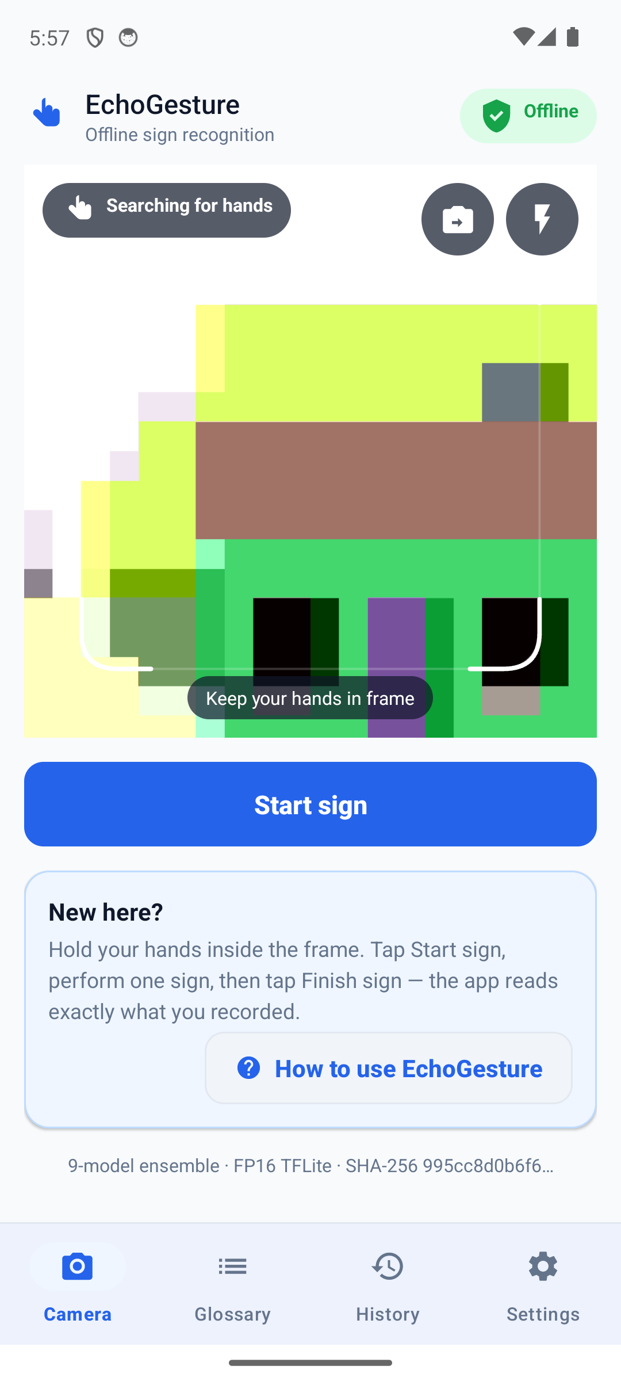
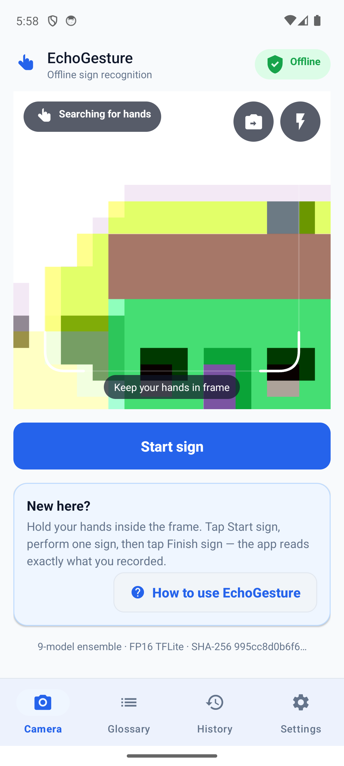
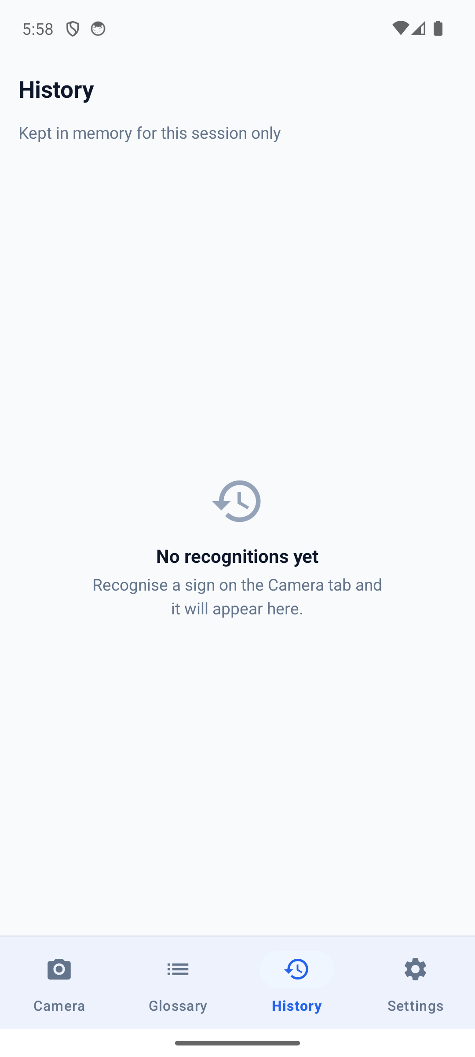
The app, running
Captured from the shipped build on an Android 14 emulator. Real UI, real model identity.
OFFLINE, VERIFIED
· CAMERA is the only permission granted.
· INTERNET is explicitly removed in the manifest and absent from the built APK.
· No raw camera frame is written to disk or sent anywhere.
· Footer shows the live ensemble SHA-256.
Camera — nine-model identity in the footer
Glossary — the 100 supported signs
History — stored on device only

Slide 8
Impact, limits and what comes next
WHAT THIS IS
ROADMAP, IN ORDER
A working offline recogniser for 100 isolated ASL signs, running on Android.
It runs with no network, stores nothing, and shows the model it is actually running.
1
Physical-device validation across lighting, distance and signers
2
INT8 export that holds accuracy, to meet the stated quantisation budget
3
Robustness to occlusion and real camera conditions, not synthetic scaling
WHAT IT IS NOT
Not a sign-language translator. It recognises isolated signs from a fixed 100-word vocabulary.
Not validated on a physical phone. Not robust to heavy occlusion or extreme low light.
4
Continuous signing — the research problem this does not solve

