Slide 1

ALY 6110 · Big Data & Data Management
Seattle 911 CAD Call Data
Dataset Overview & Exploratory Analysis
GROUP
MEMBERS
INSTRUCTOR
TERM
Group 12
Qiu Chenhao · Dev Panchal
Daya Rudhramoorthi
Spring 2026
Data Source: City of Seattle Open Data Portal · data.seattle.gov/Public-Safety/Call-Data/33kz-ixgy

Slide 2
WHY THIS DATASET · Rationale for Selection
The Seattle CAD Call Data was selected for three interconnected reasons: public safety relevance, big data scale, and analytical richness.
01
Public Safety Relevance
02
Big Data Scale & Complexity
Emergency response efficiency directly impacts community safety. Understanding patterns in 911 call volume, dispatch priority, and response time enables the Seattle Police Department to allocate officers more effectively, reduce response delays, and improve outcomes for residents.
At 5.5 GB and over 10 million records spanning 2009–2026, the dataset genuinely requires big data techniques — chunked loading, distributed processing, and outlier filtering — making it ideal for a Big Data & Data Management course project.
03
Multi-Dimensional Analytical Potential
04
Open Access & Reproducibility
The dataset captures temporal, geographic, categorical, and operational dimensions simultaneously. This richness allows EDA across time-of-day, day-of-week, precinct geography, call classification, and resolution outcomes — five distinct analytical angles from one source.
Published on Seattle's Open Data Portal and updated regularly, the dataset is freely available, well-documented, and reproducible — meeting academic integrity standards and enabling future longitudinal comparisons as new years are added.
05
Predictive Modeling Opportunity
Dispatch priority, call type, timestamps, and resolution codes together provide enough signal to build a practical response-time prediction model.

Slide 3
DATASET OVERVIEW
About the Dataset
Key Data Columns
The Seattle CAD (Computer-Aided Dispatch) Call Data is published by the City of Seattle Open Data Portal. It records every 911 call received by the Seattle Police Department.
Coverage spans 2009–2026, capturing call classification, dispatch priority, precinct assignment, timestamps, geographic coordinates, and resolution outcomes.
At approximately 5.5 GB, the dataset required big data techniques including chunked loading, deduplication, and outlier filtering before analysis.
CAD Event Number
Unique identifier per event
Initial / Final Call Type
Classification of the incident
Priority
Dispatch urgency level
Precinct / Sector / Beat
Geographic policing unit
Timestamps
Incident datetime & response time
Clearance Description
Resolution outcome of the call
Longitude / Latitude
Exact geographic coordinates

Slide 4
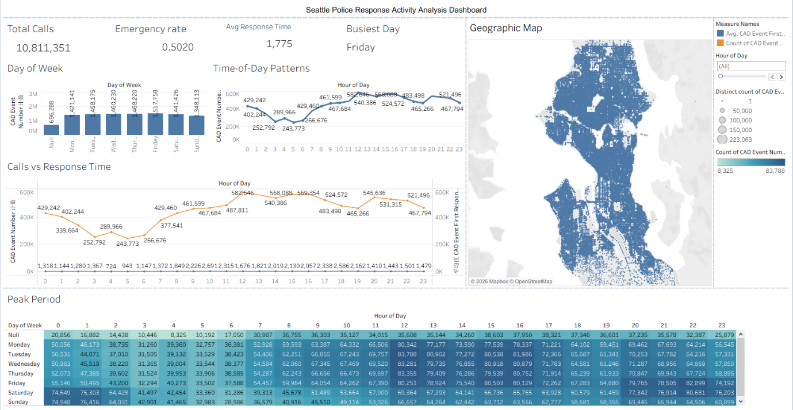
DASHBOARD 1 · Seattle Police Response Activity Analysis

Slide 5
DASHBOARD 1 · Key Insights
Calls by Day of Week
Hourly Pattern
Friday receives the most calls (517,758). Volume increases steadily Mon–Fri, then drops on weekends — directly mirroring urban work-week activity cycles.
Lowest volume at 3–6 AM. Volume builds through the morning, peaking midday (~582K at hour 11–15). Declines after 10 PM, consistent with daily human activity rhythms.
Calls vs. Response Time
Weekday × Hour Heatmap
Dual-axis chart confirms positive correlation: as hourly call volume rises, average CAD first response time also increases — indicating capacity strain at peak periods.
Peak cell: Tuesday 12 PM. Trough: Sunday 6 AM. The heatmap directly supports staff scheduling decisions to prevent under- or over-deployment at specific time slots.
Geographic Event Map
CAD events cluster densely in central Seattle. Outer suburban areas show significantly lower density, consistent with population concentration patterns citywide.

Slide 6
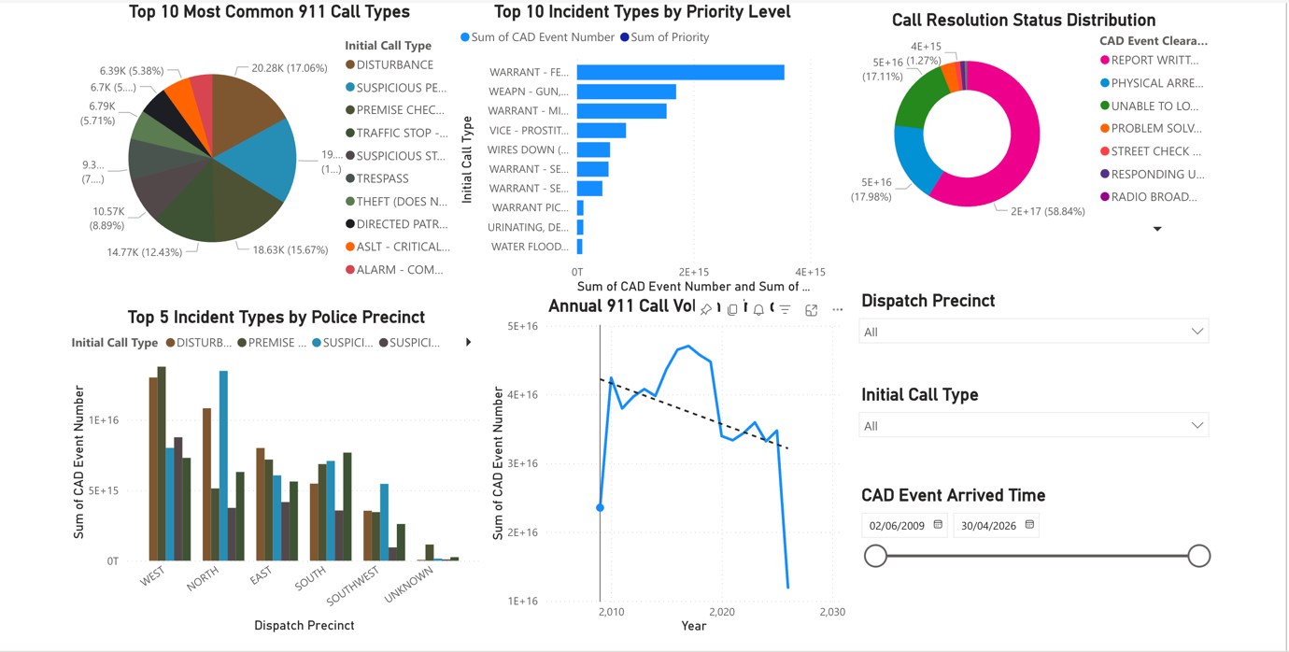
DASHBOARD 2 · Incident Types, Priority & Resolution Analysis

Slide 7
DASHBOARD 2 · Key Insights
Top 10 Call Types (Pie)
Priority by Call Type
DISTURBANCE leads at 17.06%, followed by SUSPICIOUS PERSON (15.67%) and PREMISE CHECK (12.43%). Together, the top three categories account for nearly 45% of all calls.
WARRANT and WEAPON calls receive highest dispatch priority. Parking violations rank lowest. The system effectively differentiates life-threatening emergencies from routine matters.
Call Resolution Donut
Precinct × Incident Type
REPORT WRITTEN accounts for 58.84% of all outcomes. PHYSICAL ARREST: 17.98%, UNABLE TO LOCATE: 17.11%. High report-writing load creates significant administrative burden for officers.
WEST precinct (downtown core) handles the highest volumes of disturbances and suspicious-person reports. NORTH is second busiest. SOUTHWEST sees minimal activity.
Annual Call Volume Trend
Volumes peaked around 2022, then declined sharply. Interactive filters (precinct, call type, date) allow granular drill-down analysis for operational planning.

Slide 8
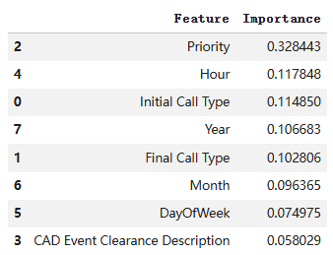

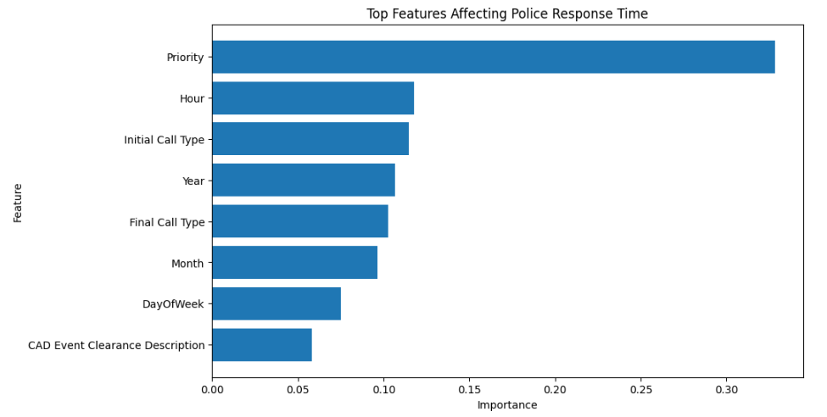
PREDICTIVE MODEL · Random Forest Regression — Response Time
Model Overview
Feature Importance
Random Forest Regression
Target: Response_Time_Minutes
Train/Test:
80% / 20% (fixed random_state)
Model Performance Metrics:
Priority is the dominant predictor — 3× more important than any other variable. R²=0.29 is reasonable given public data limitations (officer availability not recorded).

Slide 9
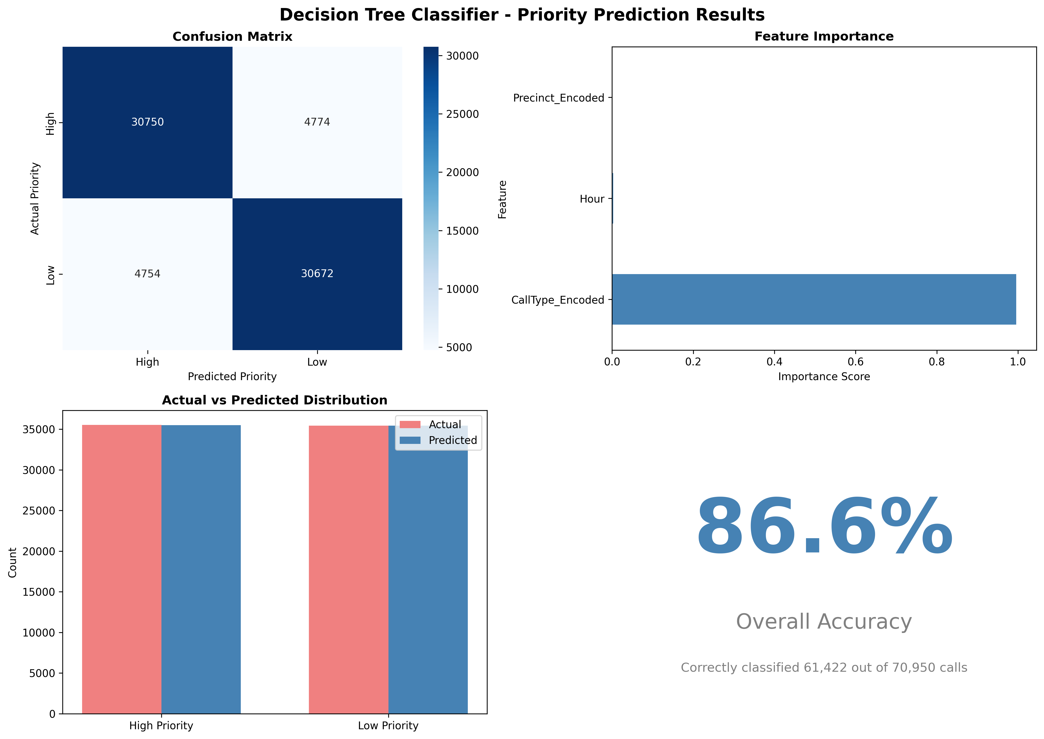
PREDICTIVE MODEL · Decision Tree Classification – Call Priority
Model Overview
Model Performance & Results
Decision Tree Classifier
Target: Priority_Binary
Train/Test:
80% / 20% (fixed random_state)
Model Performance Metrics:
Accuracy: 86.57%
Precision: 0.87
Recall: 0.87
F1-Score: 0.87
Call Type is the dominant predictor — 2.8× more important than Hour. Accuracy=85% enables automated priority classification at dispatch before officer assignment.

Slide 10
CONCLUSIONS · What the Analysis Tells Us
Temporal Demand is Predictable
Geography Mirrors Population Density
Calls peak Friday afternoons and midday, dropping sharply in early morning. This pattern enables optimized officer scheduling.
West precinct generates the most calls. Event probability scales with population concentration, enabling evidence-based patrol allocation.
Call Type Predicts Priority (86.6)
Response Time is Load-Dependent
Decision Tree shows Call Type is 336× more predictive than other factors. WEAPON/ASSAULT calls are high priority; PARKING/NOISE are low priority.
Positive correlation between call volume and response time confirms resource strain during peak hours causes delays.
Priority Dominates Response Time
Two Models Create Complete Picture
Random Forest (R²=0.29) shows Priority is 3× more predictive than any other factor in determining officer response speed.
Decision Tree classifies call urgency (86.6% accuracy). Random Forest predicts response time. Together they enable proactive dispatch optimization.
Source: City of Seattle Open Data Portal · data.seattle.gov/Public-Safety/Call-Data/33kz-ixgy · ALY 6110, Spring 2026, Group 12

Slide 11
RECOMMENDATIONS · Actionable Steps for Seattle PD
Based on the analysis, we propose six data-driven recommendations to improve emergency response efficiency and resource allocation.
R1
Optimize Officer Scheduling
R2
Concentrate Resources in West Precinct
Align shift deployment with heatmap findings — staff peaks at Tue–Fri 10 AM–3 PM; reduce overnight coverage (3–6 AM) and reallocate those hours to Friday afternoons where demand is highest.
West precinct consistently handles the highest call volumes for disturbances and suspicious persons. Dedicate additional officers and specialized de-escalation units to downtown core beats.
R3
Invest in De-Escalation Training
R4
Implement Priority-Aware Dispatch Routing
With DISTURBANCE and SUSPICIOUS PERSON calls making up 34% of volume and 59% of calls ending in report writing (no arrest), specialized conflict resolution training would reduce unnecessary escalation and free officer time.
Since Priority is 3× more predictive of response time than any other factor, a real-time routing model that factors current call queue and priority level could meaningfully cut response times at peak hours.
R5
Expand Dataset for Better Modeling
R6
Plan for Continued Volume Decline
Add officer availability, unit proximity, and traffic data to push R² beyond 0.29. These operational variables are the primary gap in prediction accuracy identified by the analysis.
R6
As 911 volumes continue declining post-2022, SPD should review staffing levels to avoid overstaffing and redirect budget toward alternative crisis response programs (mental health, social services).

