Slide 1
Group Discussion 4
Proposed RNN Architecture for Language Detection
Character-Level BiGRU Sentence Classifier
Bilal Khan • Jason Durrance • Sang-Yong Oh • Timothy Meyer
AI 574 - Natural Language Processing | Tatoeba Top-10 Languages

Slide 2
Language Detection as Sentence Classification
The core difference from sentiment analysis is the input representation:
Task | Input Unit | Why
Sentiment analysis | Word tokens | Semantic meaning lives in words and phrases; polarity is a function of word-level features
Language detection | Characters | Language identity is encoded in character distributions, diacritical marks, script choice, and subword morphology — not in word-level semantics
100,000
10,000
10
train sentences (10K/lang)
dev sentences (1K/lang)
balanced language classes
Lesson 6 frames this as an RNN-acceptor problem, where the recurrent encoder reads the full input sequence, produces a fixed-dimensional representation, and passes it to an MLP classifier with softmax output. Because there is no sequential output to generate, encoder/decoder architectures (Lessons 8 to 9) and beam search are out of scope. The correct formulation is a 10-class single label classification over the full input sequence.
Notes:
The dataset contains 100,000 train and 10,000 dev sentences, perfectly balanced at 10K and 1K per language respectively. Lesson 6 defines the RNN-acceptor pattern for sentence classification, where the encoder reads the sequence, pooling collapses it to a fixed vector, and MLP with softmax produces the label distribution.

Slide 3

Key Design Decision: Character-Level Input
Languages have distinctive character inventories
French uses é, è, ê, ç, and frequent apostrophes; Hungarian uses ő and ű which appear in no other Tatoeba language; Turkish uses ğ, ı, and ş alongside agglutinative suffix chains; Berber may include Tifinagh script characters entirely absent from the Latin-alphabet languages.
A single character vocabulary (~150–200 unique chars) covers all 10 languages
No shared cross-lingual word vocabulary is needed, eliminating the OOV problem that plagues word-level models on multilingual corpora. A character-level model remains robust on short inputs, partial words, and unseen lexical items.
Morphology and spelling patterns are visible at the character level
Turkish agglutination (-yor, -dı, -lar), German compound nouns, Spanish -ción/-mente suffixes, and Portuguese -ão endings are all captured by character sequences. A word-level model would need to segment and recognize each of these as separate vocabulary entries.
Our dataset EDA confirms orthographic dominance
The Tatoeba sentences are short (median ≈33 chars, 95th percentile ≈75 chars) and right-skewed. The main confusion frontier is Spanish vs. Portuguese, where the distinguishing cues are character-level (ão vs. ón, ê vs. ie). A word-level model adds vocabulary overhead without addressing this.
Notes:
A word-level model would require a massive shared vocabulary across 10 languages and would fail on unseen words. Character-level input is both more compact and more informative for this task because language identity is primarily an orthographic property.

Slide 4
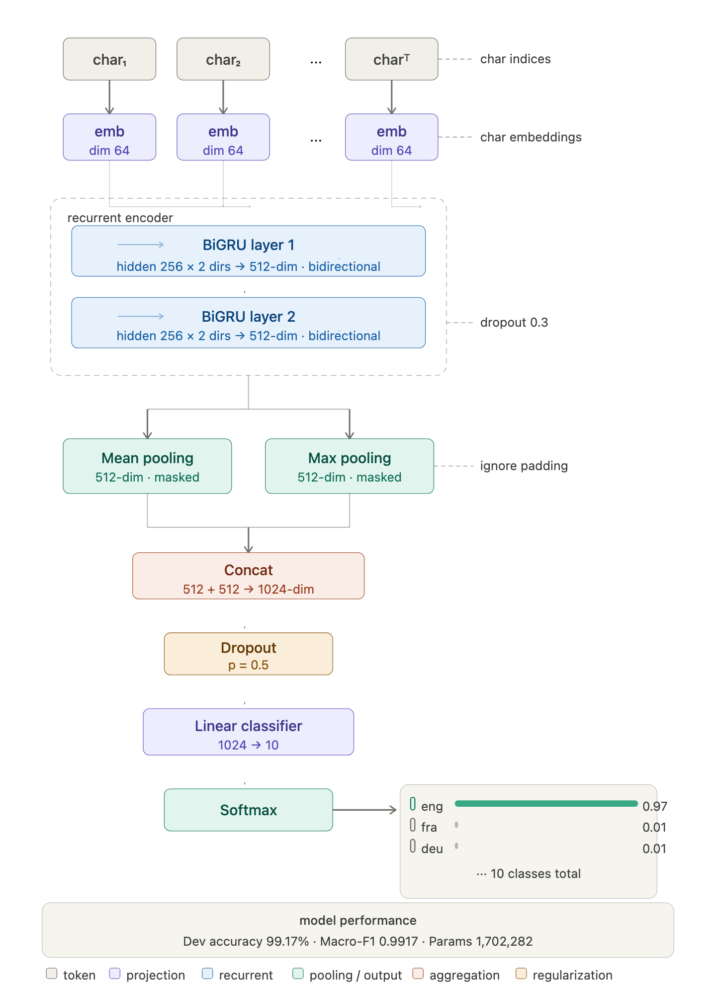
Architecture

Slide 5
Component Justifications
GRU over LSTM
GRU uses two gates (reset and update) instead of LSTM’s three (input, forget, output) and has no separate cell state, reducing the parameter count by ~25% per recurrent layer. On short sequences (mean 5 to 8 words ≈ 20 to 50 chars), empirical differences between GRU and LSTM are negligible for classification accuracy, so the simpler architecture is preferred since the GRU is faster to train per epoch because fewer matrix multiplications are required at each timestamp, thereby reducing the computation resource load requirements. Given ~95% of the sentences in our dataset application are short sentences, the GRU is the natural best fit.
Bidirectional Encoding
A unidirectional RNN encodes only left-to-right context at each position. For language detection, the suffix of a word is often as informative as its prefix (e.g., Turkish -yor, -dı; French -tion, -ment; Spanish -ción). Bidirectionality lets both the forward and backward pass contribute evidence at every timestep. The forward hidden state captures prefix and positional context, where the backward hidden state captures suffix and trailing context. Their concatenation at each position yields a richer representation for pooling than either direction alone for our application.
2-Layer Stacking
Layer 1 operates on raw character embeddings and learns local character n-gram features at digraphs (th, qu, sz, gy), trigraphs (sch, tch, ıyor), and short orthographic motifs. Layer 2 receives Layer 1’s hidden states as input and captures longer range compositional patterns (morpheme boundaries, word-shape signatures, and sentence-level orthographic rhythm). More than 2 layers rarely improves accuracy on sequences as short as those in our application and introduces overfitting risk, because the effective receptive field of a 2-layer BiGRU already spans the full 128-character window.
Notes:
GRU reduces parameters ~25% vs LSTM with no separate cell state. On short sequences (20 to 50 chars) like in our use case, GRU and LSTM perform comparably. Layer 1 learns digraphs/trigraphs, where Layer 2 learns morpheme boundaries and word shapes.

Slide 6
Component Justifications (continued)
Masked Max With Mean Pooling (not last hidden state)
Using only the final hidden state is the simplest sequence-to-vector reduction, but it over-emphasizes the last few characters in the sentence and under-weights evidence appearing earlier. Mean pooling alone is better - it aggregates evidence from all timesteps - but it can dilute rare, highly discriminative cues such as a single ñ (Spanish), ç (French/Turkish), or ő (Hungarian) that appears once in an otherwise ambiguous string.
Max pooling selects the strongest activation in each hidden dimension across all timesteps, capturing the single most decisive signal anywhere in the sequence. Mean pooling captures the overall distributional style of the character sequence. Concatenating both produces a 4h-dimensional (512-d) sentence vector that preserves both sparse critical evidence and global orthographic texture. Masking is applied to both operations so that padded positions (which exist because sentences are shorter than the 128-char cap) contribute zero signal to the pooled representation.
Pooling Strategy Comparison
Strategy | Captures | Misses | Output dim
Last hidden state | End-of-sequence context | Early position cues, dilutes mid-sentence signals | 2h = 256
Mean pooling only | Global distributional style | Rare decisive characters are averaged away | 2h = 256
Max with Mean (ours) | Both sparse critical cues and global style | (minimal - strictly dominates the above strategies) | 4h = 512
Notes:
Max pooling captures sparse decisive cues, where mean pooling captures global orthographic style. Concatenating both is strictly better than either alone. Masking prevents padded positions from polluting the pooled representation.

Slide 7
Component Justifications (continued)
Character Embedding (dim=64)
Small embedding is sufficient: character vocabulary is tiny (~200 items compared to word vocabularies (50k+)
The embedding learns e.g., é, è, ê are French-associated, ő, ű are Hungarian, etc.

Slide 8

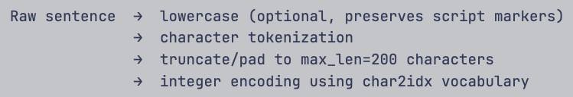
Input Pipeline and Training Configuration
Input Pipeline
Training Configuration
Build character vocabulary from train set only; map each Unicode codepoint to an integer index. Reserve index 0 for <PAD> and index 1 for <UNK>. Expected vocabulary size: ~150–200 unique characters across all 10 languages.
Hyperparameter | Value | Rationale
Optimizer | AdamW | Decoupled weight decay for better generalization
Learning rate | 1e-3 | Standard for RNNs; reduce on plateau
Batch size | 64 to 128 | Good gradient estimates; fits GPU memory
Loss | CrossEntropy | 10-class single-label classification
Epochs | 10 to 20 | With early stopping on dev accuracy
Gradient clip | max_norm=1.0 | Prevents exploding gradients in RNNs
Class weighting | None | Dataset is perfectly balanced (10K/class)
Preserve all language informative characters: diacritics (é, ü, ç, ő), punctuation (inverted ¿¡ in Spanish), apostrophes (French l’, Turkish ’), and script specific symbols.
Apply conservative formatting normalization only: NFC Unicode normalization, collapse non-standard whitespace to regular spaces, remove invisible formatting characters, trim leading/trailing whitespace.
Pad or truncate all sequences to a fixed length of 128 characters. Apply a binary mask tensor so that masked max-pooling and masked mean-pooling operate only on real character positions, not padding.
Notes:
Vocabulary is built from train only. NFC normalization standardizes equivalent Unicode representations. Binary mask tensor ensures pooling ignores padding. No class weighting needed because dataset is perfectly balanced.

Slide 9

Input Pipeline and Training Configuration (continued)
Input Pipeline (continued)
Label encoding:

Slide 10
Evaluation Plan and Expected Confusion Patterns
Evaluation Methodology
Expected Confusion Patterns
Primary Metric: overall accuracy on the balanced 10,000 sentence dev set. Because classes are equally weighted, the accuracy is an unbiased estimator of per-class performance.
Hardest Pair: Spanish vs. Portuguese
Closely related Romance languages with overlapping Latin-alphabet inventories. Distinguishing cues are subtle, where Portuguese ão/ê vs. Spanish ón/ie, and frequency differences in common function words. Very short ASCII-only inputs between these two languages may be near ambiguous.
Secondary Metric: macro-averaged F1 to confirm that no individual language is being systematically neglected even if overall accuracy is high.
Secondary Risk: Romance-language block
Full 10×10 confusion matrix to identify which language pairs collapse into each other, with particular attention to the Romance-language block (spa, por, fra, ita).
French, Italian, Spanish, and Portuguese share Latin roots and similar orthographic patterns. Short sentences without distinctive diacritics may confuse the classifier across this group.
Ablation Experiments: compare last-hidden-state only, mean-only pooling, max-only pooling, and concatenated max with mean pooling to empirically validate the pooling design choice.
Easiest Classes: distinctive orthographies
Hungarian (ő, ű), Turkish (ğ, ı, ş), German (ß, umlauts), and Berber (Tifinagh/distinct Latinization) have character inventories that are largely unique in this 10-language set.
Baseline comparison: character n-gram logistic regression classifier as a non-neural reference point to quantify the value added by the recurrent architecture.
Error Analysis Focus
Short inputs (<20 chars) and ASCII-only sentences are expected to produce the highest error rates. Length stratified evaluation will be important.
Notes:
Spanish vs Portuguese is the hardest pair based on EDA. Ablation experiments will empirically validate max with mean over mean-only. Char n-gram baseline quantifies the value of the recurrent architecture.

Slide 11
Expected Performance Baseline
Language detection is a relatively easy task. With the proposed architecture:
Expected dev accuracy: >95% (character-level RNNs routinely achieve 97–99% on similar benchmarks)
Main confusion pairs: spa/por/ita (related Romance languages), eng/epo (Esperanto borrows heavily from European languages)

Slide 12
Pooling Strategy Experiment
Evaluates whether augmenting the proposed BiGRU architecture's mean pooling
Masked max pooling (concatenated) yields a meaningful improvement in language detection accuracy
Keeping all other hyperparameters fixed

Slide 13
Pooling Variants Tested
Variant | Description | Output Dim
mean | Masked mean pooling over all time steps | 512
mean_max | Masked mean + masked max, concatenated | 1,024
Masked pooling excludes padding positions from both mean and max computations, ensuring only valid character positionscontribute to the representation.

Slide 14
Results
Pooling | Best Epoch | Dev Loss | Dev Accuracy | Dev Macro-F1 | Parameters
mean | 3 | 0.0302 | 0.9907 | 0.9907 | 1,697,162
mean_max | 4 | 0.0323 | 0.9917 | 0.9917 | 1,702,282
Delta: mean_max gains +0.10% accuracy and +0.0010 macro-F1 over mean, at the cost of +5,120 parameters (~0.3% increase) and one additional training epoch.

Slide 15
Key Observations
Both models substantially exceed the 95% baseline
Mean pooling alone is already very strong (99.07% accuracy), validating the original architecture choice.
Mean+Max pooling provides a consistent, small improvement across both accuracy and macro-F1.
The higher dev loss for mean_max (0.0323 vs 0.0302) suggests the model is slightly more confident on the correct class while being more uncertain on hard examples.

Slide 16
Recommendation
Adopt mean_max pooling (masked mean + masked max concatenated) as the final architecture.
The improvement is consistent (both accuracy and macro-F1 improve).
Max pooling adds a linguistically meaningful inductive bias, while mean pooling captures overall distributional patterns.
The final classifier input becomes Linear(1,024 → 10) instead of Linear(512 → 10).

Slide 17
How Lessons 8 to 10 Inform the Decision
These extensions are acknowledged but are not the correct first submission for our sentence-classification application.
Seq2Seq / Beam Search (Lessons 8 to 9)
Encoder/decoder architectures produce variable length output sequences, which is the correct formulation for machine translation and abstractive summarization. Language detection requires a single discrete label, not a generated sequence. Introducing a decoder and beam search would add unnecessary architectural complexity without improving classification performance.
Attention Mechanisms
Attention is most valuable when a decoder must selectively attend to different source positions at each generation step. For classification, the pooling layer already reduces the full sequence to a single fixed dimensional vector. Self-attention over the encoder could be explored as an enhancement, but it is not necessary to justify the core RNN-based architecture for this assignment.
Transfer Learning / Pretrained Representations (Lesson 10)
Multilingual pretrained encoders (e.g., mBERT, XLM-R) could provide strong initialization. However, they are transformer-based and would shift the assignment away from the RNN framing that Lesson 6 establishes. A future iteration could compare a pretrained multilingual model against our character-level BiGRU as an upper-bound reference, but the RNN architecture stands on its own merits for our use case scope.
Notes:
Seq2seq is for generation, not classification. Attention helps decoders and not pooled encoders. Transfer learning (mBERT/XLM-R) could be an upper-bound comparison but shifts away from the RNN framing in Lesson 6.

