Slide 1
NLP — RNN PROJECT
Tatoeba Language
Detection
Exploratory Data Analysis
10 Languages · 99,863 Train · 10,000 Dev · 178 Unique Characters
Tatoeba Project · Character-Level Analysis · Statistical & Visual Methods

Slide 2
AGENDA
What We Cover
Dataset Overview
Language Distribution
Sentence Length Analysis
01
02
03
Sizes, 10 languages, format, class balance
Train (99,863) vs Dev (10,000) counts
Box plot & histogram of char lengths
Character N-gram Fingerprinting
Language Similarity Heatmap
t-SNE Visualization
04
05
06
Top bigrams per language — train set
Cosine similarity of N-gram vectors
2D cluster separation — train & dev
Character Entropy
Unique Characters & Unicode
Baseline: Logistic Regression
07
08
09
Average entropy per language (2.54–2.69 bits)
Exclusive chars & script block analysis
99.30% accuracy + confusion matrix

Slide 3
DATASET OVERVIEW
Tatoeba Project — 10 Languages
99,863
10,000
10
178
Training Sentences
Dev Sentences
Languages
Unique Characters
⚠ Portuguese (por) has only 9,863 training sentences vs 10,000 for all other 9 languages — slight imbalance in train set only.
Languages in the Dataset
BER
DEU
ENG
EPO
FRA
Berber
German
English
Esperanto
French
HUN
ITA
POR
SPA
TUR
Hungarian
Italian
Portuguese
Spanish
Turkish
TSV format · No header row · Columns: [lang_code] [text] · 95th pct length: ~74 chars (train) / ~75 chars (dev)
Balanced for evaluation: Dev set: exactly 1,000 per language. Accuracy is a fair metric.
Character vocabulary: 178: All scripts combined: Latin, Tifinagh, Cyrillic variants.
RNN sequence length: ~74–100: 95th percentile at 74 chars guides max input length.
por train imbalance: -137: Only affects train set. Dev set remains perfectly balanced.

Slide 4
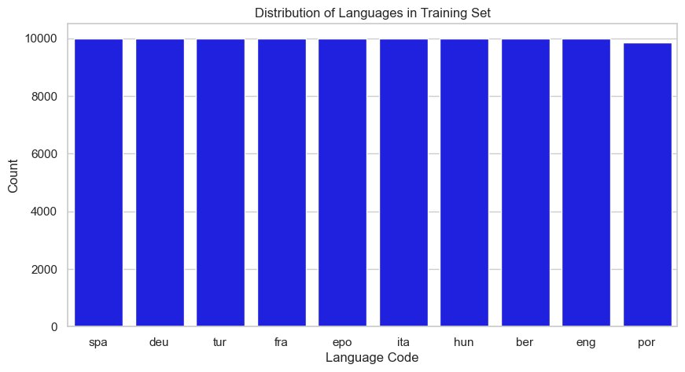
LANGUAGE DISTRIBUTION
Train: Nearly Balanced (por=9,863) · Dev: Perfectly Balanced (1,000 each)
Key Findings
9 × 10,000 sentences
All languages except Portuguese have exactly 10,000 training sentences.
por = 9,863 (train only)
137 fewer sentences. Dev set is perfectly balanced at 1,000 each.
Balanced → fair metric
Class balance means accuracy on the dev set is fully unbiased.
95th pct: ~74 chars
Sets the recommended max sequence length for RNN input.
Note: Dev set distribution identical — all 10 languages exactly 1,000 sentences.

Slide 5
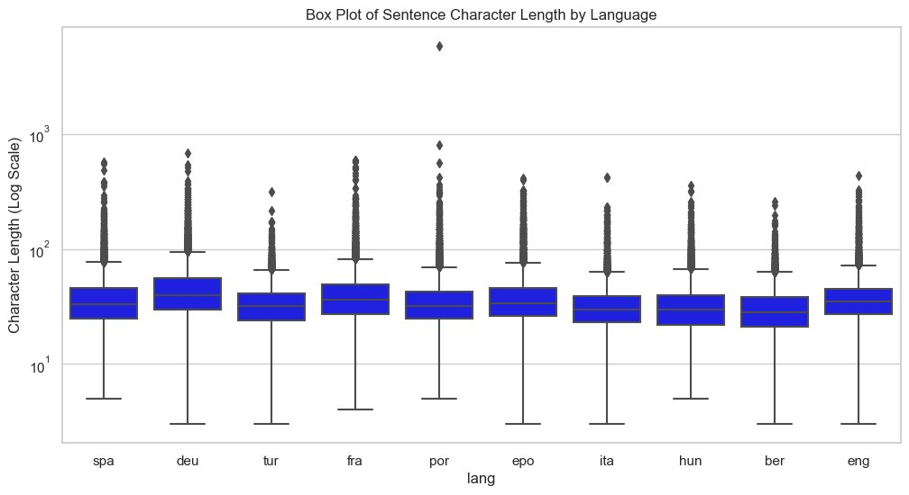
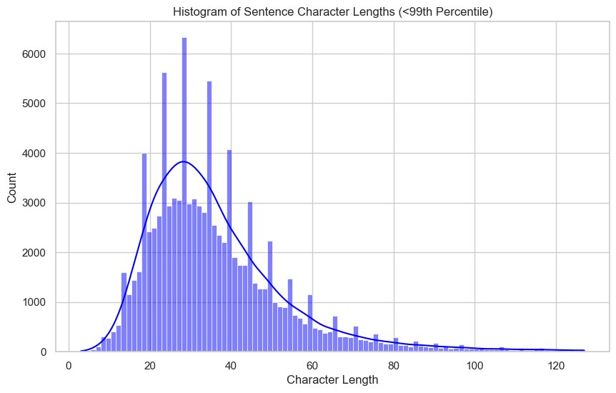
SENTENCE LENGTH ANALYSIS
Box Plot (Log Scale) & Histogram of Character Lengths
Train Set Statistics (exact values from notebook)
Language | Mean Chars | Median | Std Dev | Max Chars | Mean Words
ber | 30.9 | 28 | 15.0 | 257 | 4.98
deu | 48.1 | 40 | 32.7 | 690 | 8.00
eng | 38.5 | 35 | 20.8 | 437 | 7.60
epo | 40.0 | 34 | 26.1 | 412 | 7.05
fra | 42.3 | 36 | 30.6 | 597 | 7.69
hun | 33.8 | 30 | 19.7 | 361 | 5.26
ita | 33.3 | 30 | 18.0 | 425 | 5.84
por | 38.1 | 32 | 63.5 ⚠ | 5,833 ⚠ | 6.98
spa | 38.6 | 33 | 25.0 | 576 | 7.01
tur | 34.5 | 32 | 15.1 | 313 | 4.99

Slide 6
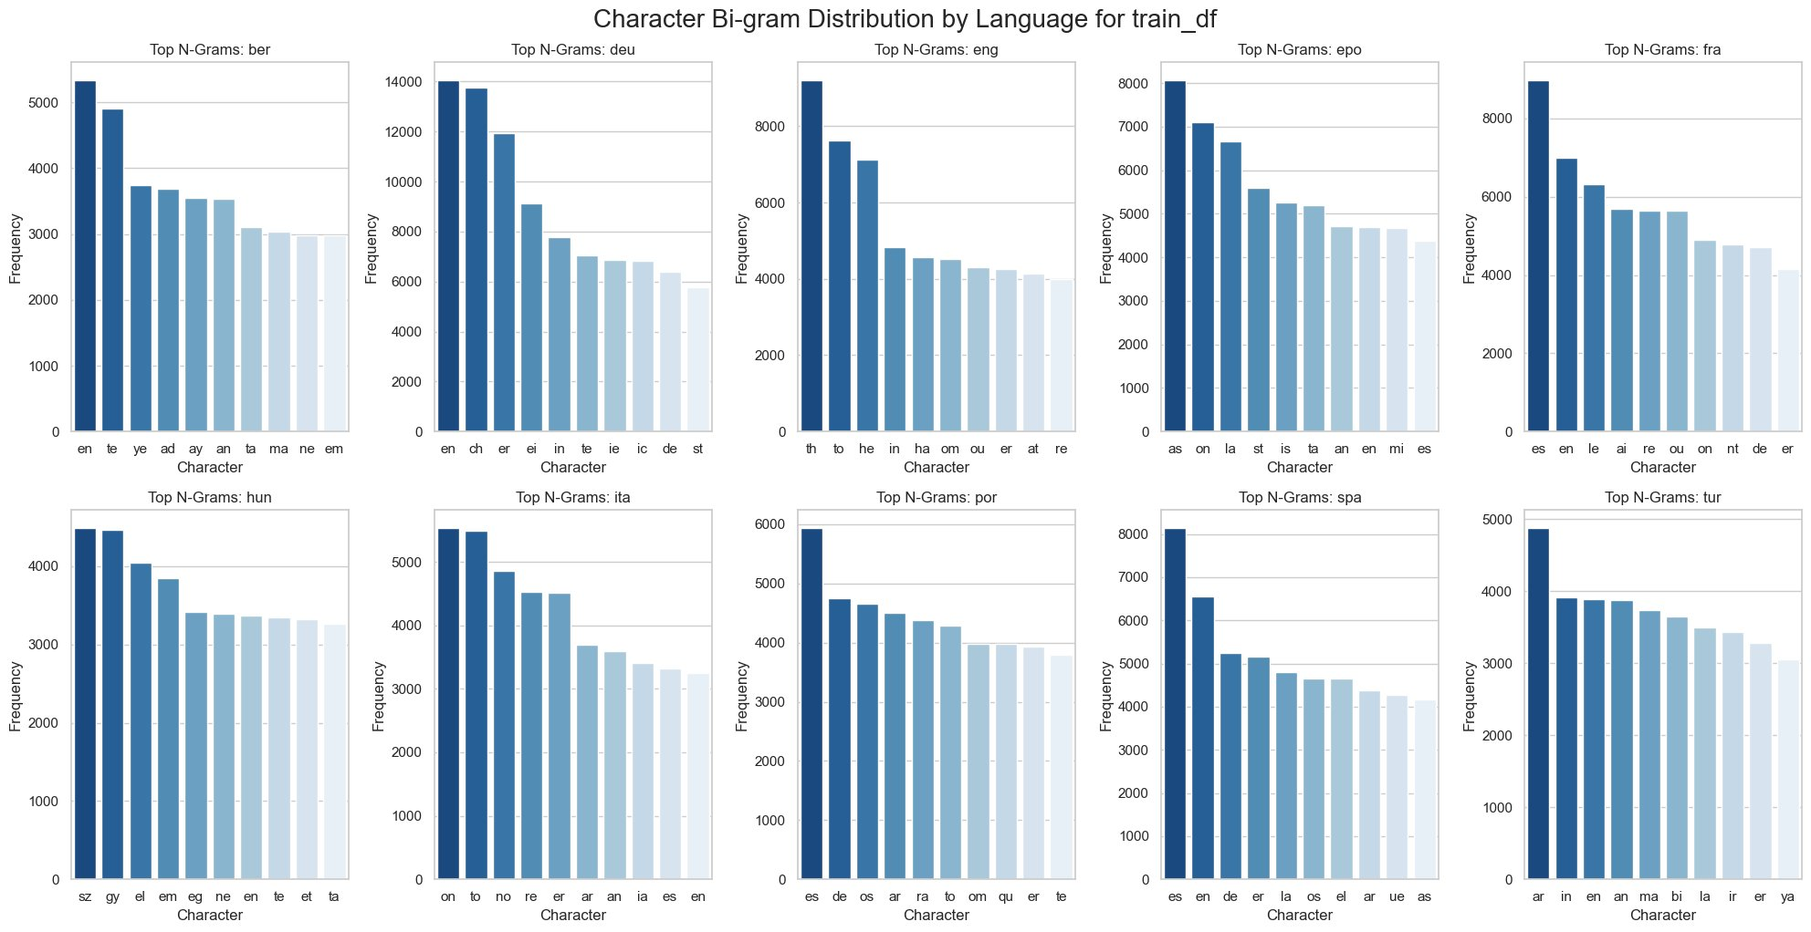
CHARACTER N-GRAM FINGERPRINTING
Top Bigrams per Language — Train Set

Slide 7
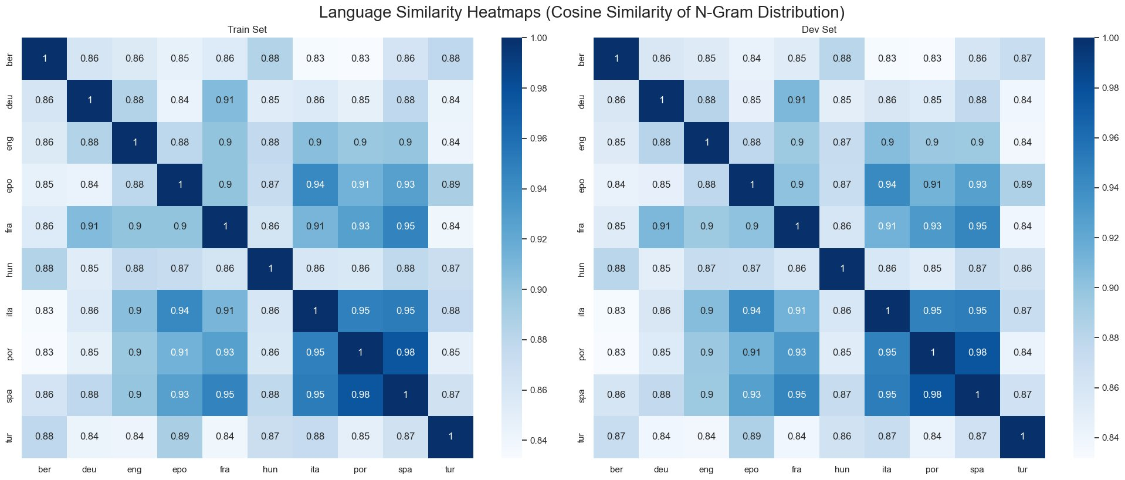
LANGUAGE SIMILARITY HEATMAP
Cosine Similarity of Character N-gram Vectors (1–3 grams)
Left: Train Set · Right: Dev Set · Values are consistent across both splits
Key: spa–por=0.98 & ita–por/spa=0.95 are the highest-similarity pairs (Romance confusion zone). ber is the most distinct language across all pairs. All Latin-script languages share ≥0.83 similarity — sequential RNN context is essential to separate them.

Slide 8
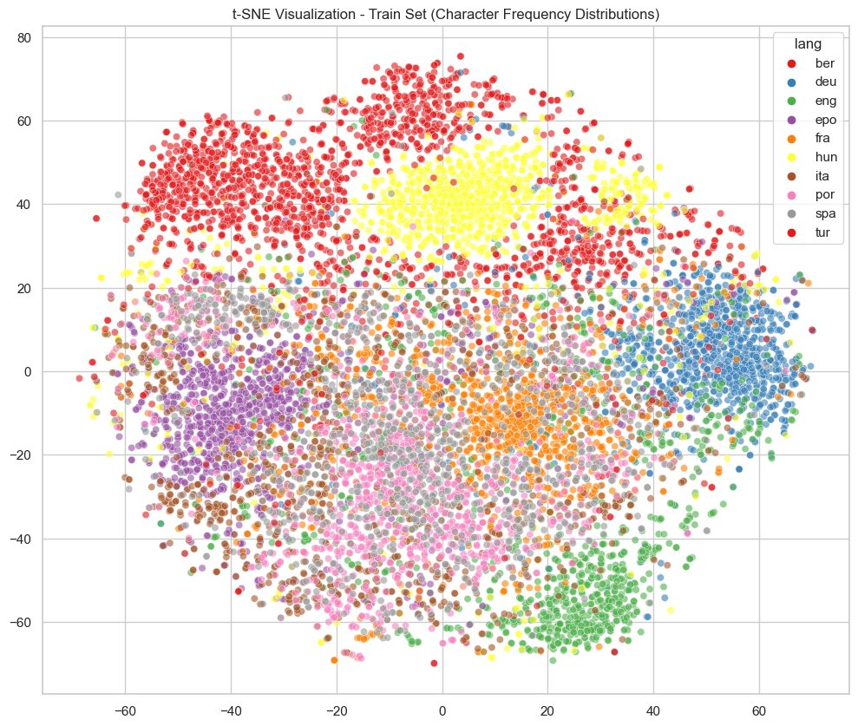
t-SNE VISUALIZATION — TRAIN SET
2D Language Clusters · 1,000 Sentences per Language · Perplexity=30
Observation: ber (red/top) and hun (yellow) form well-separated clusters. deu (blue) isolates on the right. The centre shows heavy overlap of Romance languages (spa/por/ita/fra) and epo — sequence-level context is needed to separate them.

Slide 9
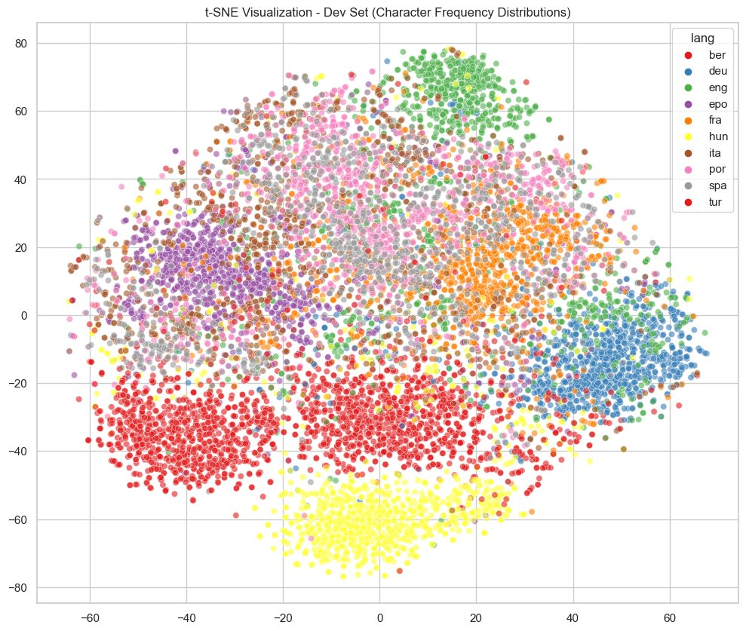
t-SNE VISUALIZATION — DEV SET
2D Language Clusters · 1,000 Sentences per Language · Perplexity=30
Observation: Dev cluster structure mirrors the train set — confirming dataset consistency. tur (red/bottom) is well-separated. eng (green) and deu (blue) cluster distinctly on the right. Romance languages remain interleaved in the centre.

Slide 10
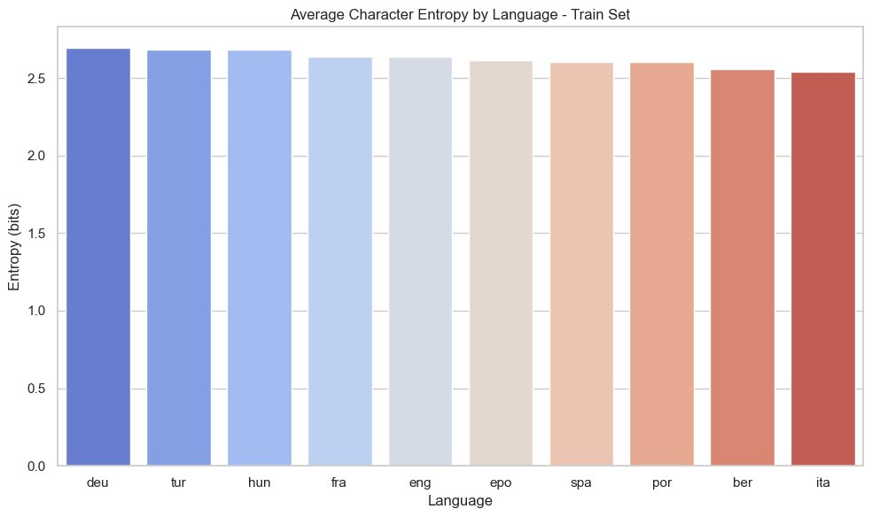

CHARACTER ENTROPY
Average Character Entropy per Language — Range: 2.54 to 2.69 bits
Train Set
Dev Set
Narrow range: 2.54–2.69 bits: Entropy alone is NOT a reliable discriminator — differences are tiny across all 10 languages.
deu, tur, hun rank highest: More diverse character usage — wider unique character sets and more varied text structures.
ber, ita rank lowest: Consistent character patterns. Consistent with their Romance/Berber frequency profiles.
Train ≈ Dev distributions: Nearly identical ordering — confirms the train set is representative of the dev set.

Slide 11
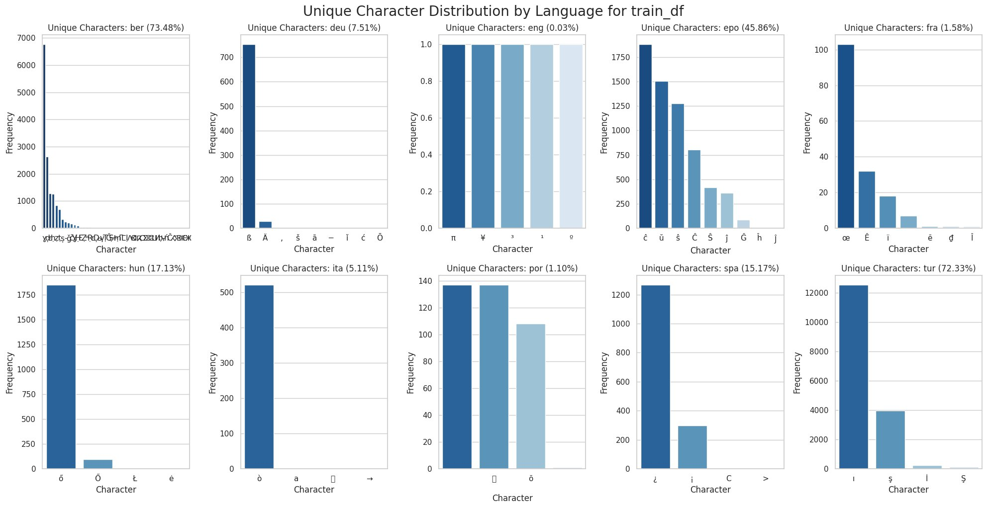
UNIQUE CHARACTERS
Language-Exclusive Character Frequency (Train Set)
% texts with ≥1 unique char: ber=73.5% tur=72.3% epo=45.9% hun=17.1% spa=15.2% deu=7.5% ita=5.1% fra=1.6% por=1.1% eng=0.03%

Slide 12
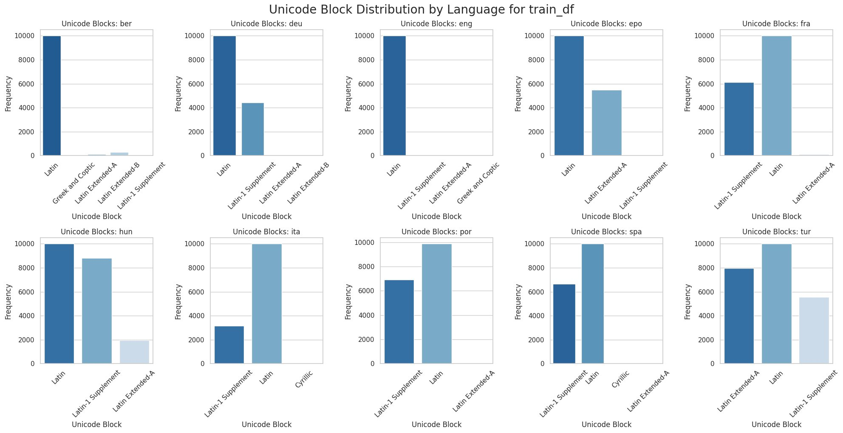
UNICODE BLOCK DISTRIBUTION
Script Block Analysis per Language (Train Set)
Key: ber uses Greek/Coptic + Latin Extended (Tifinagh). deu/eng/epo/fra/hun: Latin + Latin-1. ita/por/spa: Latin-1 Supplement dominant. tur: unique Latin Extended-A (ş, ğ, ı). Script block alone can only cleanly isolate ber.

Slide 13
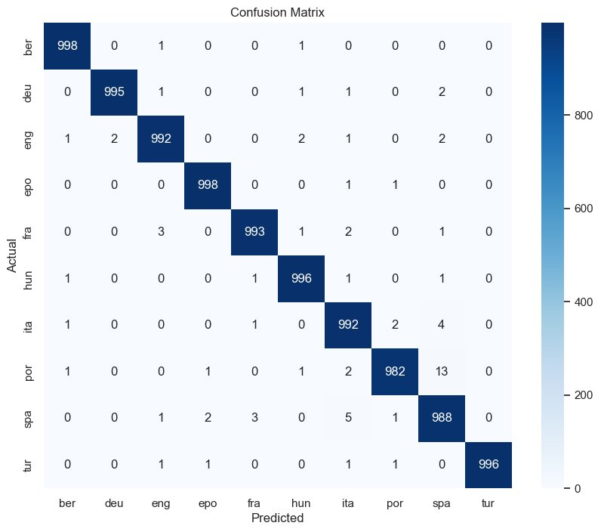
BASELINE MODEL
Logistic Regression on Char N-grams (1–3) · Dev Accuracy: 99.30%
Classification Report (Dev Set)
Language | Prec | Recall | F1
ber | 1.00 | 1.00 | 1.00
deu | 1.00 | 0.99 | 1.00
eng | 0.99 | 0.99 | 0.99
epo | 1.00 | 1.00 | 1.00
fra | 0.99 | 0.99 | 0.99
hun | 0.99 | 1.00 | 1.00
ita | 0.99 | 0.99 | 0.99
por | 0.99 | 0.98 | 0.99
spa | 0.98 | 0.99 | 0.98
tur | 1.00 | 1.00 | 1.00
ber, epo, tur — perfect 1.00 F1: Unique scripts/diacritics make these trivially classifiable.
por: 13 errors → predicted as spa: Highest confusion pair. Similarity = 0.98.
ita: 4→spa, 2→por — Romance triple: spa/por/ita account for almost the entire error budget.
Config: CountVectorizer(char, 1–3 grams) + LogisticRegression(max_iter=1000)

Slide 14
CONCLUSIONS
Key EDA Takeaways &
RNN Design Implications
1
ber (73.5%) & tur (72.3%) trivially classifiable via unique characters:
Tifinagh script and Turkish diacritics (ı, ş, İ) act as immediate class signals — no sequence model needed for these two.
2
spa–por similarity = 0.98 — the core classification challenge:
Only 13 mutual errors from logistic regression. The RNN must exploit sequential patterns to push this lower.
3
Baseline: 99.30% exact dev accuracy (char 1–3 grams + LogReg):
The performance bar. RNN target: match or exceed, specifically improving the Romance language confusion.
4
Entropy range 2.54–2.69 bits — nearly uniform across all languages:
Frequency features have limited power for similar languages. Sequence context matters more than character counts.
5
Architecture: char embeddings + RNN, vocab=178, seq length ~74–100 chars:
Character-level input captures script and bigram signals. 95th pct at 74 chars sets the practical input length.

Slide 15
WEEK 4 -- RNN ARCHITECTURE PROPOSAL
Proposed RNN
Architecture
Character-Level BiLSTM for 10-Class Language Classification
PyTorch BiLSTM
Char-Level Input
10 Languages

Slide 16
RNN ARCHITECTURE
Input Formulation: Char-Level vs. Word-Level
The critical design decision -- why characters, not words, are the right input for this task
Sentiment Analysis
Word-Level Input
Language Detection
Character-Level Input (our approach)
Input unit: Full words (tokens)
Embeddings: Word2Vec / GloVe (dim 300)
Signal: Semantic meaning (happy, terrible)
Vocab size: Tens of thousands of words
OOV risk: High -- typos or rare words unseen
Input unit: Individual characters
Embeddings: Learned char vectors (dim 32)
Signal: Script patterns, morphology, n-grams
Vocab size: Only ~178 unique characters (EDA)
OOV risk: Minimal -- robust to typos and new words
VS

Slide 17
BILSTM ARCHITECTURE -- MOTIVATION
Why BiLSTM? Unidirectional LSTM vs. Bidirectional LSTM
Current LSTM reads left-to-right only -- BiLSTM captures context from both directions simultaneously
LSTM (Current)
Unidirectional -- Left to Right
BiLSTM (Proposed)
Bidirectional -- Both Directions
Direction: Left-to-right only
Hidden state: 128-dim output
Limitation: Decides class before seeing suffix context
Romance problem: spa-por similarity 0.98, needs both ends
Result: 98.12% -- below 99.30% baseline
Direction: Forward + Backward simultaneously
Hidden state: 256-dim (128 fwd + 128 bwd concatenated)
Context: Sees prefix AND suffix before classifying
Romance fix: Turkish diacritics and Tifinagh fully captured
Target: Exceed 99.30% LogReg baseline
VS

Slide 18
RNN ARCHITECTURE -- HYPERPARAMETERS & MODEL DESIGN
Model Architecture: Char Embedding → BiLSTM → Linear Classifier
INPUT
Character sequence
max_len=150 chars
EMBEDDING
nn.Embedding
vocab=150, dim=32
BiLSTM LAYER
nn.LSTM
bidirectional=True
OUTPUT
nn.Linear
256 → 10 classes
150
Char Vocab Size
150
Max Seq. Length
32
Embedding Dim
128
Hidden per Direction
256
Output to Linear
Code Changes (3 lines only)
LSTM layer: nn.LSTM(input_size=32, hidden_size=128, batch_first=True, bidirectional=True)
Linear layer: nn.Linear(256, 10) -- input doubles from 128 to 256
Forward pass: torch.cat((hidden[-2], hidden[-1]), dim=1) -- concat fwd + bwd

Slide 19
RNN ARCHITECTURE -- MODEL DESIGN SUMMARY
What We Did — Tatoeba BiLSTM Project
Input Design
Chose character-level input over word-level for language detection
Vocab size only 178 unique characters vs. tens of thousands for word-level
Minimal OOV risk, robust to typos and morphological variation
BiLSTM Architecture
Built character-level BiLSTM: Char Embedding → BiLSTM → Linear Classifier
Bidirectional LSTM captures context from both directions simultaneously
Hidden size 128 per direction → concatenated output 256-dim
Only 3 code changes from unidirectional:
bidirectional=True,
nn.Linear(256, 10),
torch.cat((hidden[-2], hidden[-1]), dim=1)
Target
Exceed 99.30% LogReg baseline
Specifically improve F1 on Romance language trio (spa / por / ita)

