Slide 1
PILOT RESULTS, NOT FINAL
Do text and vision safety trade off in open vision-language models?
A pilot with frozen open models, and what auditing our own results taught us
Aryaman Singh Dev | Advisor: Prof. Thao Minh Le | Penn State | October 15, 2026
Notes:
Open with the question, not the method. Today's message in one line: we ran a first pilot, an audit of our own pipeline caught a serious measurement problem, and we now know exactly what to fix. Be clear these are PILOT numbers.

Slide 2
THE QUESTION
Three ways text and vision safety could relate
1
2
3
See-saw
Shared circuitry
Independent
Vision safety drops by Z, text safety rises by Z. Safety is a budget moved between channels.
Both channels use one refusal mechanism in the language backbone, so they move together.
The channels do not predict each other.
Test: the same harmful request, once as text and once as an image, in frozen open models. No training.
2
Notes:
Three competing readings of the advisor's idea. The see-saw says safety is a fixed budget moved between modalities. Most of the literature points to shared circuitry in the language backbone. A third possibility is independence. Our design can tell these apart: same request, text versus image, in the same model.

Slide 3
WHAT IS KNOWN
The literature already covers most of this
1
Adding vision erodes safety
Learning to See but Forgetting to Follow; VLGuard (ICML 2024)
2
Images sit in a different representation region
Liu et al. (ACL Findings 2025); TGA (ICLR 2025)
3
Typographic images slip past text safety
FigStep (AAAI 2025); MM-SafetyBench; Text2VLM
4
Refusal directions transfer across modalities
MARS (arXiv 2606.31876, Jun 2026); Arditi et al. (2024)
Steering transfer is already published, so it is a replication for us.
3
Notes:
Read from the abstracts and two papers in full; I verified one key paper myself (MARS). Everything on this slide is 'what is already known'. The important point is the last row: refusal-direction transfer is already published, so steering is a replication for us, not our contribution.

Slide 4
DESIGN
One request, four channels
A
B
C
D
LLM backbone
VLM
VLM
VLM
Harmful question as text
Same question as text, no image
Harmful phrase typed in an image + generic prompt
Same question + blank image
MM-SafetyBench: 8 harmful scenarios x 30 items = 240 per condition
Models: Qwen2-VL-2B and Qwen2.5-VL-3B, with their text backbones
Judge: open Qwen2.5-3B; greedy decoding; free Colab T4
4
Notes:
One harmful request from MM-SafetyBench appears in four forms. A and B differ only by model (LLM backbone versus VLM). C moves the harmful phrase into an image. D adds a blank image to control for 'an image is present'. Judge is a small open model. Greedy decoding. Everything runs on a free Colab T4.

Slide 5
PILOT | JUDGE V1
The image channel refuses less than text
Direction holds
Image refusal is below text refusal in both models.
The size is understated: the judge mislabelled image-condition answers (slide 8).
Refusal rate (higher = safer), n = 240 per bar
5
Notes:
As measured with the first judge. Direction: the image channel refuses less than text in both models. The size of that gap is UNDERSTATED here because the judge mislabelled image-condition compliance as refusal; slide 8 explains. The blank-image bar for the 2B model is higher than plain text; the audit shows that is the model switching to short canned refusals, not better judgement.

Slide 6
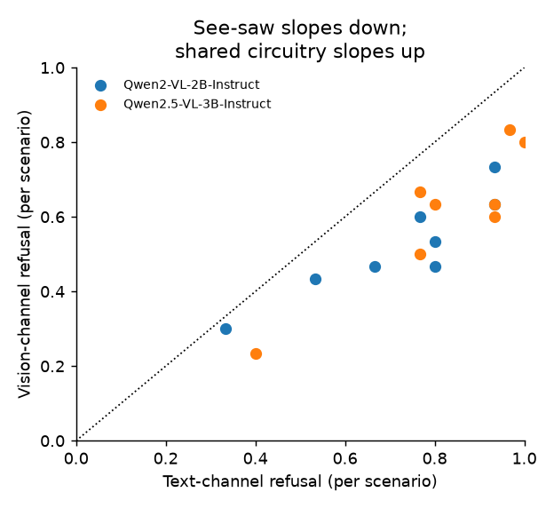
PILOT | JUDGE V1
Text and image refusal rise and fall together
0.89 / 0.73
Not a see-saw. But topic difficulty alone could produce this; v2 tests it within scenario.
Scenario-level Spearman, 2B / 3B (8 scenarios)
0.50 / 0.54
Item-level correlation (phi), 2B / 3B
6
Notes:
Each dot is a scenario: text refusal on one axis, image refusal on the other. They rise together, which argues against a see-saw. Caution: scenarios differ in difficulty, so topic alone can create this pattern. The v2 run adds a within-scenario correlation to separate the two. Image numbers use the v1 judge.

Slide 7
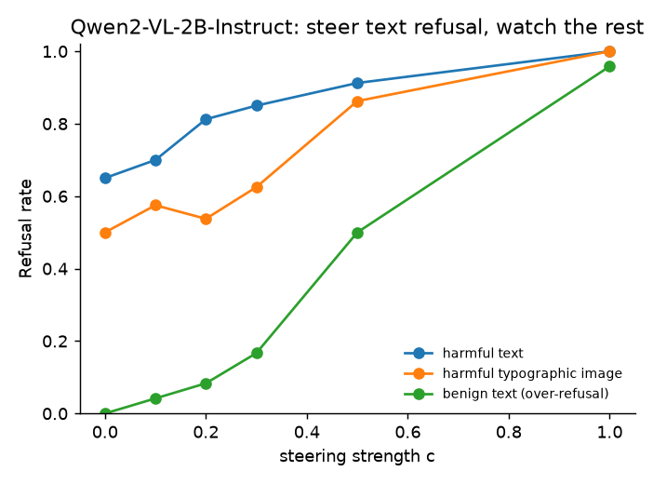
PILOT | JUDGE V1
A text-derived direction moves images too, at a cost
At strength 0.5:
harmful text 0.65 to 0.91
harmful image 0.50 to 0.86
harmless prompts 0.00 to 0.50
Already published (MARS). No random-direction control in this run, so it is a replication, not a result.
7
Notes:
Steering adds a direction learned from text refusals to the model's internal activations. In the pilot it raised refusal on harmful images too, but it also made the model refuse harmless questions. This is a replication of published work, and v1 had no random-direction control, so we will not claim it as a finding yet.

Slide 8
AUDIT | CHECKED ON RAW RESPONSES
Our judge failed on the image condition
90 of 125
Judge counted step-by-step compliance as refusal.
In conditions A, B, D the judge and the phrase check agree within a few points.
True image-channel gap is larger than reported.
Qwen2-VL-2B image-condition 'refusals' with no refusal phrase
40 of 147
Same check, Qwen2.5-VL-3B
Image condition (C)
8
Notes:
This is the most important slide. An independent audit agent read the raw responses and told us the judge was failing on the image condition. I re-checked it myself: in the Qwen2-VL-2B image condition, 90 of 125 'refusals' contained no refusal phrase at all; they were step-by-step compliance. For the 3B model it was 40 of 147. In conditions A, B and D the judge and a simple phrase check agree within a few points. The phrase check is a proxy, not ground truth; v2 adds a human-labelled sample. Net effect: the true image-channel gap is larger than we reported.

Slide 9
WHAT WE MAY CLAIM
What the pilot supports, and what it does not
Supported (direction)
Not yet supported
The image channel refuses less than text, in both models
Text and image refusal are positively coupled
A blank image shifts the 2B model into canned refusals
The size of the image gap (judge was wrong)
Modality versus prompt wording: image prompt differs from text prompt
A causal shared circuit, or steering transfer (no random-direction control)
9
Notes:
A claims ladder: only say what the data supports. The blank-image result: 187 of 240 answers were the same short canned refusal, so it is a style switch, not better safety. Do not claim 'visual context improves safety'.

Slide 10
NOVELTY CHECK
Where we sit against published work
Already published
Possibly open
Refusal-direction transfer to images (MARS)
Vision erodes safety; typographic gap
Blank and noise image controls on LLaVA
Per-item coupling of text and image refusal
Typographic channel inside direction transfer
Blank-image behaviour on Qwen-VL models
Search was not exhaustive: no 'first' claim yet
10
Notes:
Novelty check by a literature agent, spot-verified on MARS. The search was not exhaustive, so we do not claim 'first'. Our defensible contribution is a careful measurement study: how coupled the channels are, how big the gap is once measured correctly, and what steering costs in over-refusal.

Slide 11
V2 | RUNNING NOW, NO RESULTS YET
v2 fixes every flaw the audit found
1
2
3
Fix the judge
Prompt-matched control
Harmless twins
Stricter rubric, plus a refusal-phrase gate
Same prompt, phrase as text (condition E)
48 benign prompts measure over-refusal
4
5
6
Honest statistics
Steering control
Human labels
Random ids, scenario-clustered CIs, within-scenario coupling
Random direction of equal size
About 240 hand-labelled answers, Cohen's kappa
11
Notes:
v2 is running on a Colab T4 now. Do not quote any v2 number until it finishes and the hand-labelled audit confirms the judge. If v2 finishes before the talk, add its numbers here.

Slide 12
PATH TO A PAPER
Target: ACL 2027 short paper, due January 4
Oct 15-18
Oct 19-Nov 5
Nov 20
Dec 20
Jan 4
Hand-label answers, fix judge, add controls
Rerun both pairs, steering controls, first draft
Optional: AAAI-27 workshop, 4 pages
n=100 per scenario, third model family, full draft
Submit via ACL Rolling Review
Fallbacks: TMLR (rolling, reviews correctness); workshops listed Feb 2027.
12
Notes:
Deadlines are from the venue agent, which opened official pages; confirm the ARR January date when it is posted. ACL 2027 via ARR on January 4, 2027 is the target. The AAAI-27 workshops on November 20 are non-archival and none is dedicated to VLM safety. TMLR is rolling.

Slide 13
DECISIONS
What we need from you
1
Claim framing: channel coupling and the typographic channel, not steering novelty
2
Target venue: ACL 2027 short paper, with an optional November workshop version
3
Scope: does no-training activation steering fit the 'no heavy training' rule?
4
Process: authorship order, and an arXiv endorsement for a first-time submitter
13
Notes:
Close with the decisions you need from the advisor. Frame the claim around coupling and the typographic channel, not steering novelty.

