Slide 1
Continual Safety Alignment in Vision-Language Models
via Multimodal Gradient-Based Sample Selection
Extending Continual Safety Alignment (Bach et al., 2026) to Multimodal Architectures (https://arxiv.org/abs/2604.17215v1)
Researcher: Aryaman Singh Dev | Advisor: Prof. Thao Minh Le | Penn State University
Notes:
=== Slide 1: Title Slide ===
[WHAT PROF. LE SEES ON SCREEN]:
• Title: Continual Safety Alignment in Vision-Language Models via Multimodal Gradient-Based Sample Selection
• Subtitle: Extending Continual Safety Alignment (Bach et al., 2026) to Multimodal Architectures
• Metadata: Researcher: Aryaman Singh Dev | Advisor: Prof. Thao Minh Le | Penn State University
[SPOKEN SCRIPT - READ ALOUD]:
"Good afternoon, Professor Le. Today, I am excited to present my research proposal on extending continual safety alignment to multimodal architectures. Specifically, this work builds directly on your paper, Bach et al., investigating whether gradient-based sample selection can prevent safety degradation in small vision-language models without requiring architectural modifications or expensive safety retraining. Over the next 25 minutes, I will walk you through the theoretical motivation, our multimodal gradient decomposition, our experimental protocol on Qwen2-VL, and the roadmap for empirical validation."
[ANTICIPATED QUESTION & DEFENSE]:
Q: Why extend this to VLMs specifically?
A: In the Limitations section of Bach et al., you explicitly noted that extending gradient-based selection to VLMs remains an open question. In VLMs, the visual channel introduces an entirely new, unaligned attack surface where image typography and visual jailbreaks bypass text safety filters completely.
[TRANSITION TO NEXT SLIDE]:
Let's begin by reviewing the core alignment drift problem established in your paper and how it manifests in multimodal models.

Slide 2
RESEARCH PROPOSAL
The Problem: Alignment Drift in Continual Fine-Tuning
1. Confirmed in Text LLMs (Bach et al., 2026)
• Benign fine-tuning unintentionally erodes safety guardrails as a structural property.
• High-gradient samples drive elastic reversion toward unaligned pretraining distributions.
• Standard remedies like gradient clipping fail (ASR remains ~31% at clip=0.5), because clipping dampens step size without altering alignment-reversing directions.
2. Our Research Question for VLMs
• Does the same mechanism govern Vision-Language Models?
• Bach et al. explicitly leave this open (Limitations): 'Extending gradient-based selection to VLMs requires further investigation.'
• The Multimodal Attack Surface: Unlike text LLMs, VLMs introduce an an additional visual attack surface that may not be protected by text-channel alignment where attackers bypass text guardrails via visual features. (Nie et al., 2024)
Notes:
=== Slide 2: Alignment Drift in Continual Fine-Tuning ===
[WHAT PROF. LE SEES ON SCREEN]:
• 1. Confirmed in Text LLMs (Bach et al., 2026): Benign fine-tuning erodes guardrails; high gradients drive elastic reversion; gradient clipping fails (ASR ~31% at clip=0.5).
• 2. Research Question for VLMs: Does the same mechanism govern VLMs? Attackers bypass text guardrails via visual channels (Nie et al., 2024).
[SPOKEN SCRIPT - READ ALOUD]:
"To establish the problem: in your paper with Bach et al., you demonstrated that benign fine-tuning erodes safety guardrails as a structural byproduct of gradient descent. High-gradient samples drive elastic reversion toward unaligned pretraining distributions. Crucially, standard remedies like gradient clipping fail because clipping merely shortens the step size while keeping the exact unaligned direction. In your Limitations section, you noted that extending gradient-based selection to VLMs is an open question. In VLMs, the problem is compounded: attackers exploit an unprotected visual channel—using image typography or visual jailbreaks—that completely bypasses text safety filters. Our central question is: does the same gradient-driven drift govern VLMs, and can data-centric median selection defend both text and visual safety channels?"
[ANTICIPATED QUESTION & DEFENSE]:
Q: Why not just use gradient clipping instead of sample selection?
A: As demonstrated in Bach et al. Table 6, gradient clipping rescales ||g|| <= c, but preserves the exact direction of the update vector. If a sample's gradient points straight out of the safety basin, clipping simply takes smaller steps in that harmful direction—leaving ASR at ~31% even at aggressive clipping (c=0.5). Median selection removes the destabilizing samples entirely.
[TRANSITION TO NEXT SLIDE]:
To understand the physical mechanics behind this drift, we look at the elasticity framework.

Slide 3
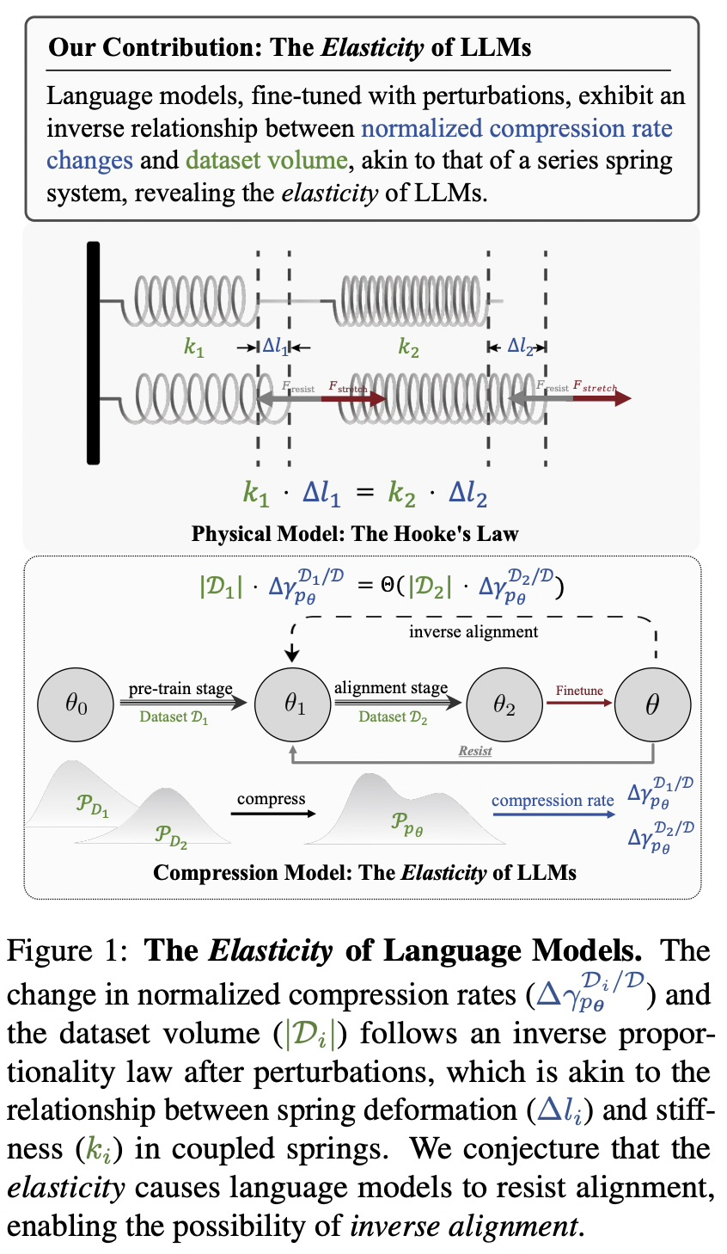

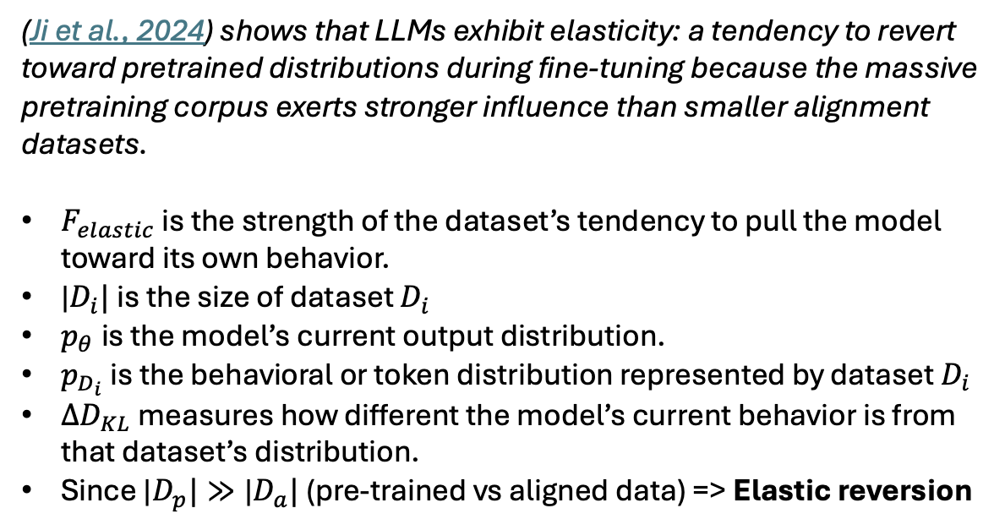
LLM Elasticity
This project does not assume dataset size alone determines update direction
(Ji et al., 2024) shows that LLMs exhibit elasticity: a tendency to revert toward pretrained distributions during fine-tuning because the massive pretraining corpus exerts stronger influence than smaller alignment datasets.
$F_{elastic}$​ is the strength of the dataset’s tendency to pull the model toward its own behavior.
|$D_{i}|$is the size of dataset $D_{i}$
$p_{θ}$is the model’s current output distribution.
$p_{D_{i}}$is the behavioral or token distribution represented by dataset $D_{i}$
${∆D}_{KL}$measures how different the model’s current behavior is from that dataset’s distribution.
Since |$D_{p}|≫\text{|}D_{a}|$ (pre-trained vs aligned data) => Elastic reversion
Notes:
=== Slide 3: LLM Elasticity (Ji et al., 2024) ===
[WHAT PROF. LE SEES ON SCREEN]:
• LLM Elasticity: Models act like coupled springs; massive pretraining distributions exert elastic restoring forces.
• Key Project Premise: Dataset size alone does not determine update direction; high-gradient samples act as heavy perturbations.
[SPOKEN SCRIPT - READ ALOUD]:
"To understand why fine-tuning degrades safety, we ground our work in the elasticity framework by Ji et al. Neural models act like coupled physical springs: pretraining establishes an elastic restoring force that pulls the model back toward its base, unaligned state when perturbed. Importantly, this project does not assume dataset size alone dictates this pull. Rather, high-gradient samples—which often reflect severe format or semantic mismatch—act as massive perturbations that stretch the model past its elastic limit, triggering rapid reversion to unaligned behavior."
[ANTICIPATED QUESTION & DEFENSE]:
Q: How does elasticity apply across modalities?
A: In VLMs, the restoring force exists in both the language backbone and the vision-language projector. Cross-modal tension stretches the projector weights, causing rapid forgetting of aligned refusal boundaries.
[TRANSITION TO NEXT SLIDE]:
Next, we examine the geometric shape of this safety boundary using VISAGE.

Slide 4
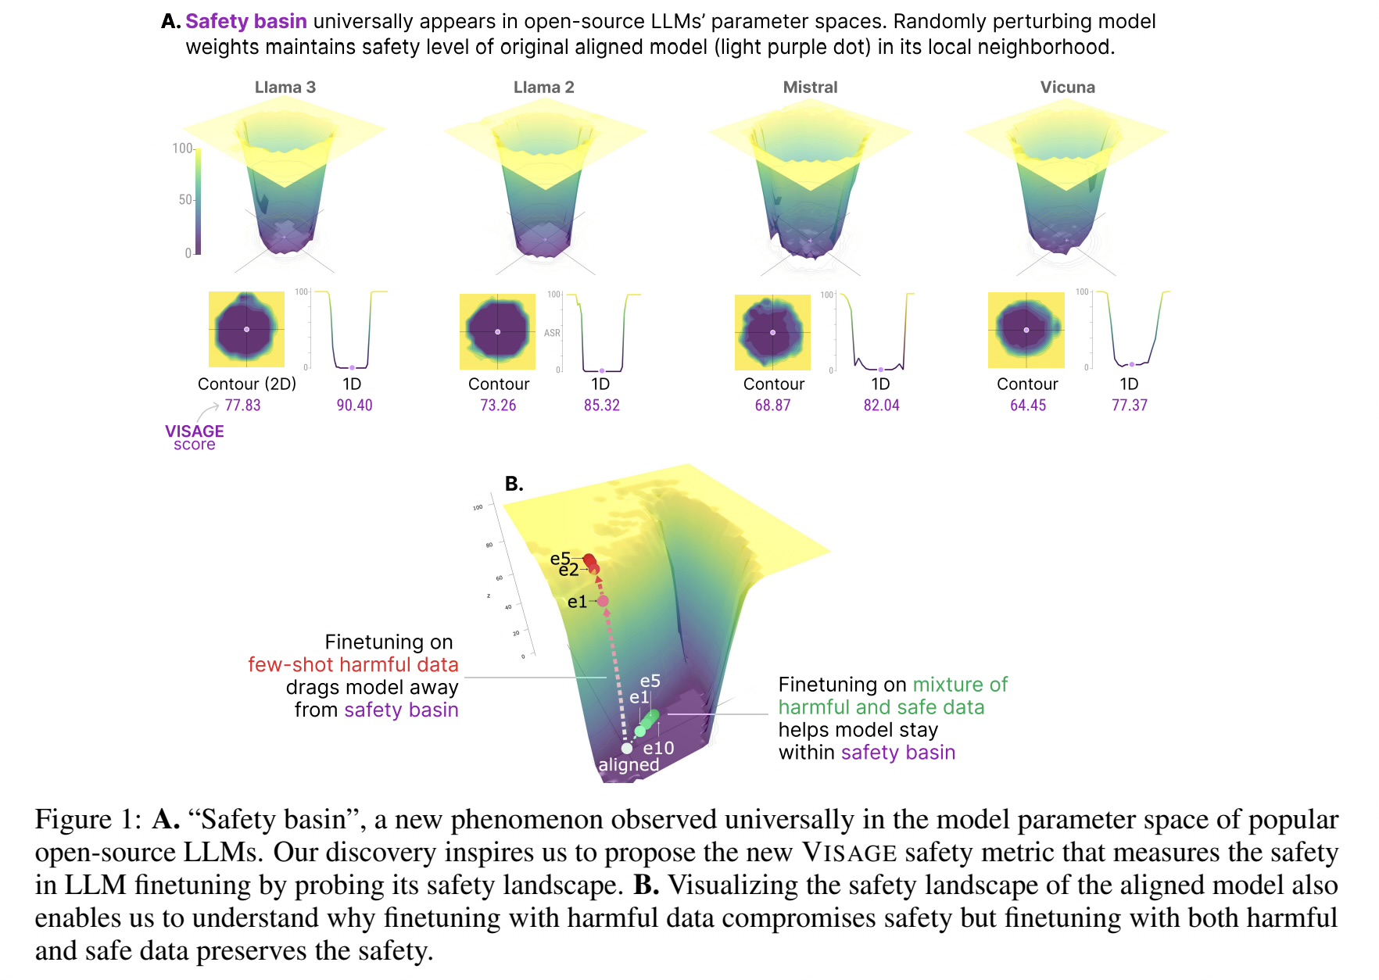
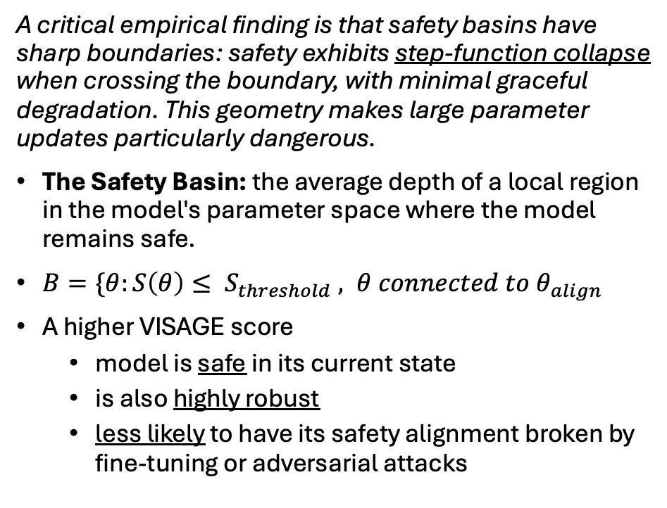
VISAGE: Volumetric Index for Safety Alignment Guided by Explanation
A critical empirical finding is that safety basins have sharp boundaries: safety exhibits step-function collapse when crossing the boundary, with minimal graceful degradation. This geometry makes large parameter updates particularly dangerous.
The Safety Basin: the average depth of a local region in the model's parameter space where the model remains safe.
$B=\{θ:S\left(θ\right)≤ S_{threshold} , θ connected to θ_{align}$
A higher VISAGE score
  model is safe in its current state
  is also highly robust
  less likely to have its safety alignment broken by fine-tuning or adversarial attacks
Notes:
=== Slide 4: VISAGE Safety Basin Geometry (Peng et al., 2024) ===
[WHAT PROF. LE SEES ON SCREEN]:
• VISAGE: Volumetric Index for Safety Alignment Guided by Explanation.
• Safety Basin Geometry: Flat safety basin with sharp step-function collapse boundaries.
• 1D vs 2D Rankings: Rankings are perfectly consistent (Llama 3 > Llama 2 > Mistral > Vicuna); 1D is a faster, computationally efficient metric.
[SPOKEN SCRIPT - READ ALOUD]:
"The geometry of this drift is formalized by Peng et al.'s VISAGE framework. Safety alignment does not occupy a broad, forgiving valley; it resides in a localized 'safety basin' with sharp, step-function boundaries. Moderate parameter updates allow the model to stay inside this basin. But large gradient updates push model weights directly over the ridge into unsafe territory, where safety collapses abruptly. A higher VISAGE score indicates a deeper, more robust basin. Furthermore, Peng et al. showed that 1D VISAGE rankings perfectly preserve 2D rankings, providing a computationally efficient metric to track safety basin retention during fine-tuning."
[ANTICIPATED QUESTION & DEFENSE]:
Q: Why use 1D VISAGE instead of 2D?
A: 1D VISAGE captures the exact same model safety ranking as 2D (Llama 3 > Llama 2 > Mistral > Vicuna) at a fraction of the compute cost, making it practical for tracking drift across continual training stages.
[TRANSITION TO NEXT SLIDE]:
Now let us examine how we translate the text evaluation suite of Bach et al. to the multimodal domain.

Slide 5
VLM Replacement | What it is | LLM benchmark used
MM-SafetyBench | 13 safety-critical scenarios with 5,040 text-image pairs. Complementary benchmarks. | AdvBench
FigStep | Embeds harmful instructions as image text alongside a benign text prompt (preserves diverse attack vectors) | No direct text-only equivalent. Attacks via visual OCR channel, tests whether visual text can bypass text-channel safeguards. Distinct attack shape.
JailBreakV-28K | Large-scale multimodal benchmark with 16 harm scenarios across 28k samples– mixing direct, contextual, and optimization-based attacks. | HarmBench
HarmBench (Text Slice) | Text-only attack queries to evaluate vulnerabilities in the VLM's language decoder. 510+ queries, Llama-Guard-3-8B judge | HarmBench
MMHal-Bench | Primary open-ended, model-graded hallucination benchmark. 8 question types per image across 12 images types | TruthfulQA
POPE | Secondary check using simpler yes/no object-hallucination probing. | TruthfulQA (Supplementary signal)
LLaVA-Instruct-150K | Benign general visual instruction-following to reduce excessive refusal before task-specific tuning. | Dolly
MathVista | Visual mathematical reasoning dataset. 6141 samples from 28 multimodal datasets | GSM8K
VQA-RAD and SLAKE | Medical visual question answering dataset. ~315 images, 3.5k Q/A pairs AND ~642 images, 14k Q/A pairs | MedMCQA
DocVQA | 50k Document image reading comprehension and QA, 12k+ document images | SQuAD v2
Safety / attack success rate (AdvBench, HarmBench)
Truthfulness /Hallucination (TruthfulQA)
Downstream task sequence (Dolly, GSM8K, MedMCQA, SQuAD v2)
Notes:
=== Slide 5: Benchmark Suite: 1-to-1 Mapping ===
[WHAT PROF. LE SEES ON SCREEN]:
• Safety / ASR: AdvBench, HarmBench -> MM-SafetyBench, FigStep, JailBreakV-28K.
• Truthfulness / Hallucination: TruthfulQA -> MMHal-Bench (open-ended), POPE (object probing).
• Downstream Task Sequence: Dolly, GSM8K, MedMCQA, SQuAD v2 -> LLaVA-Instruct-150K, MathVista, SLAKE/VQA-RAD, DocVQA.
[SPOKEN SCRIPT - READ ALOUD]:
"To evaluate this rigorously, we cannot rely on standard text benchmarks alone. On this slide, I have established a strict one-to-one mapping from every text evaluation in Bach et al. to its multimodal equivalent. For safety, AdvBench and HarmBench map to MM-SafetyBench, FigStep—which renders toxic text directly onto images—and JailBreakV-28K. For truthfulness, TruthfulQA maps to MMHal-Bench for open-ended hallucination and POPE for object probing. And for downstream tasks, Dolly, GSM8K, MedMCQA, and SQuAD map directly to LLaVA-Instruct, MathVista, SLAKE, and DocVQA. This ensures our evaluation mirrors the depth of the original text study."
[ANTICIPATED QUESTION & DEFENSE]:
Q: Why both MMHal-Bench and POPE?
A: They are complementary: MMHal-Bench measures open-ended generative hallucination severity, while POPE evaluates targeted binary object existence to isolate perceptual hallucination.
[TRANSITION TO NEXT SLIDE]:
Let us take a closer look at the attack surface that makes VLM evaluation uniquely challenging.
ADD SETTING THAT PPL DO
FOLLOW THAT

Slide 6
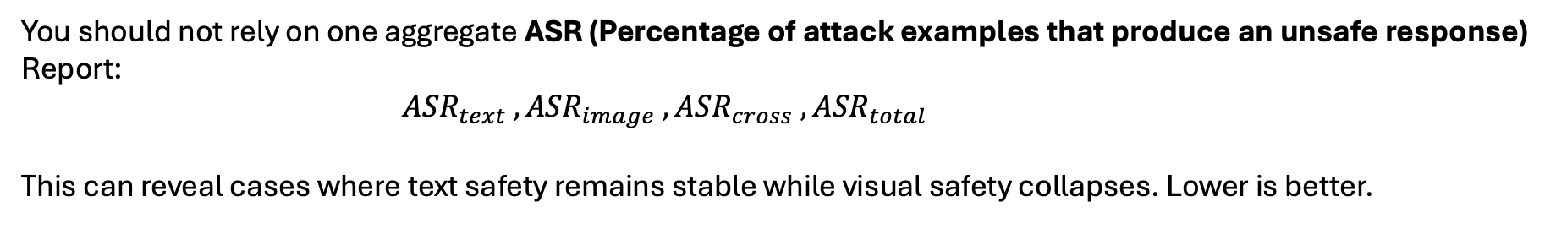
VLM Attack Surface & Multi-Channel Evaluation
Attack surface | Example
Text channel | HarmBench or AdvBench prompts
Image-text rendering | FigStep-style image instructions
Visual semantic content | MM-SafetyBench
Optimization or jailbreak transfer | JailBreakV-style attacks
Cross-modal conflict | benign text + harmful image, or vice versa
OCR pathway | harmful text rendered in different fonts, layouts, or rotations
You should not rely on one aggregate ASR (Percentage of attack examples that produce an unsafe response)
Report:
${ASR}_{text}$ $,{ASR}_{image} ,{ASR}_{cross} ,{ASR}_{total}$
This can reveal cases where text safety remains stable while visual safety collapses. Lower is better.
Notes:
=== Slide 6: Attack Surface & Multi-Channel Evaluation ===
[WHAT PROF. LE SEES ON SCREEN]:
• Attack Surface Table (6 rows): Text channel, Image-text rendering (FigStep), Visual semantic content (MM-SafetyBench), Optimization transfer, Cross-modal conflict, Typographic distortion.
• Multi-channel reporting: Disaggregated ASR (ASR-text, ASR-visual, ASR-cross, aggregate).
[SPOKEN SCRIPT - READ ALOUD]:
"A critical insight in VLMs is that reporting a single aggregate Attack Success Rate is dangerous and misleading. A model could maintain a 2% text ASR while its visual ASR collapses to 70%. As shown in this table, we decompose attacks across six distinct surfaces: raw text channels, OCR rendering, visual semantic content, optimization transfer, cross-modal conflicts, and typographic distortions. In our evaluation, we explicitly report separate metrics for ASR-text, ASR-visual, and ASR-cross to detect modality-specific alignment collapse."
[ANTICIPATED QUESTION & DEFENSE]:
Q: What is cross-modal conflict?
A: An attack where the image and text prompt are individually benign or ambiguous, but their cross-modal combination forms a harmful instruction that bypasses unimodal safety filters.
[TRANSITION TO NEXT SLIDE]:
Next, let's examine how prior works have attempted to defend VLMs, specifically SafeVLM.

Slide 7
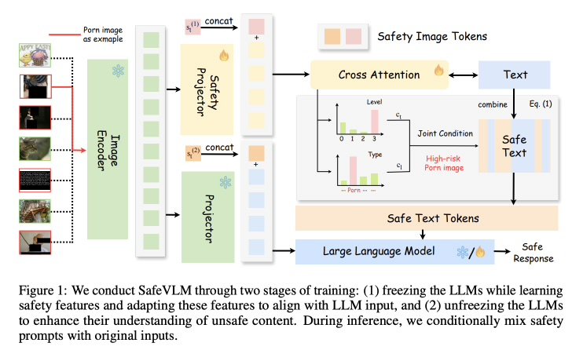
Related Multimodal safety approach
Reference: Nie et al., Safety Alignment for Vision Language Models, arXiv:2405.13581 (SafeVLM)
What SafeVLM Does (The Architectural Approach):
Adds custom modules:
  Safety Projector,
  Safety Tokens, and
  Safety Head.
Requires a complex two-stage training process and alters model inference topology.
Notes:
=== Slide 7: Related Multimodal Safety Approach — SafeVLM (Nie et al., 2024) ===
[WHAT PROF. LE SEES ON SCREEN]:
• SafeVLM Architectural Approach: Adds Safety Projector, Safety Tokens, and Safety Head.
• Limitations: Requires complex 2-stage training, alters inference topology, and adds latency.
[SPOKEN SCRIPT - READ ALOUD]:
"To contextualize our contribution against state-of-the-art multimodal safety, we examine SafeVLM by Nie et al. SafeVLM addresses VLM vulnerability through an architectural approach. As shown in their paper, they freeze the base VLM and add three dedicated modules: a parallel Safety Projector, trainable Safety Tokens, and a multi-class Safety Head. This requires a complex two-stage training pipeline and permanently alters the model's inference topology. While effective, it represents an architectural defense, which motivated our search for a purely data-centric solution."
[ANTICIPATED QUESTION & DEFENSE]:
Q: How does our approach differ from SafeVLM?
A: SafeVLM changes the model architecture and adds runtime inference latency. Our approach is purely data-centric: we curate benign training data so standard fine-tuning naturally preserves safety, with zero architectural modifications and zero runtime overhead.
[TRANSITION TO NEXT SLIDE]:
Let's examine the empirical trade-offs reported in SafeVLM's results.
CONTINUAL LEARNING
YOU DONT WANNA FORGET WHAT YOU LEARNT
ALIGNENT IN VLM
SOTA
EXAMPLES of MISALIGNKENT IN VLM
EXPECTED vs PRODCUED

Slide 8
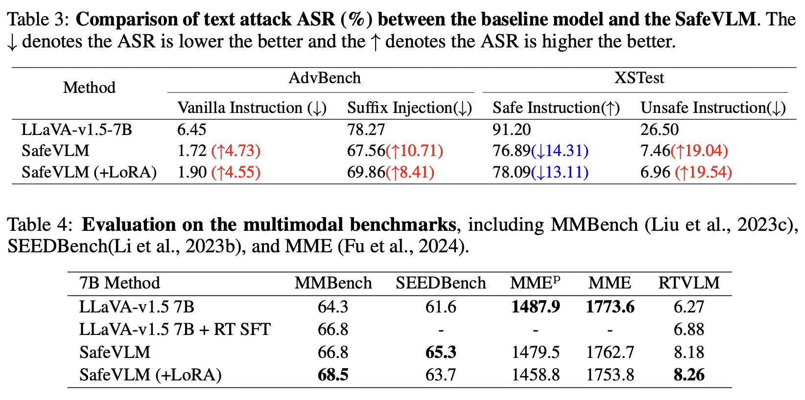
SafeVLM Empirical Results: Safety Scores & Over-Refusal Trade-offs (Tables 3 & 4).
  Their Results on LLaVA-v1.5-7B
  AdvBench (Vanilla ASR):
    Reduced from 6.45% -> 1.72%.
  AdvBench (Suffix Injection):
    Reduced from 78.27% -> 67.56%.
  XSTest Unsafe Rate:
    Dropped from 26.50% -> 7.46%
    (shows significant over-refusal / false refusal risk)
  RTVLM Safety Score:
    Increased from 6.27 -> 8.26.
SafeVLM reports evidence that the pretrained projector can transmit visual features without sufficient safety alignment and proposes additional safety modules.
Notes:
=== Slide 8: SafeVLM Empirical Results & Over-Refusal Trade-offs (Tables 3 & 4) ===
[WHAT PROF. LE SEES ON SCREEN]:
• Empirical evidence: Pretrained projector transmits visual features without safety alignment.
• LLaVA-v1.5-7B Results: AdvBench Vanilla ASR 6.45% -> 1.72%; Suffix Injection 78.27% -> 67.56%.
• Over-refusal Trade-off: XSTest Unsafe Rate dropped from 26.50% to 7.46% (safe instruction refusal risk); RTVLM 6.27 -> 8.26.
[SPOKEN SCRIPT - READ ALOUD]:
"Looking at SafeVLM's reported numbers in Tables 3 and 4, two key findings emerge. First, SafeVLM provides empirical proof that pre-trained visual projectors lack safety alignment—explaining why visual inputs easily jailbreak models. Second, their defense comes with substantial trade-offs: on XSTest, their safe instruction accuracy drops by over 14%, indicating severe over-refusal and false alarms. Furthermore, their custom safety head adds computational overhead during every inference step. Our data-centric hypothesis is that by filtering training samples at the gradient level, we can achieve competitive safety retention with zero architectural changes, zero latency penalty, and lower over-refusal."
[ANTICIPATED QUESTION & DEFENSE]:
Q: Is over-refusal really a critical issue?
A: Yes. A model that refuses benign requests (like asking how to slice an apple) has zero utility. We optimize the Pareto frontier of low ASR and high benign task utility.
[TRANSITION TO NEXT SLIDE]:
Now, let us enter our core methodology: how we decompose VLM gradients mathematically.

Slide 9
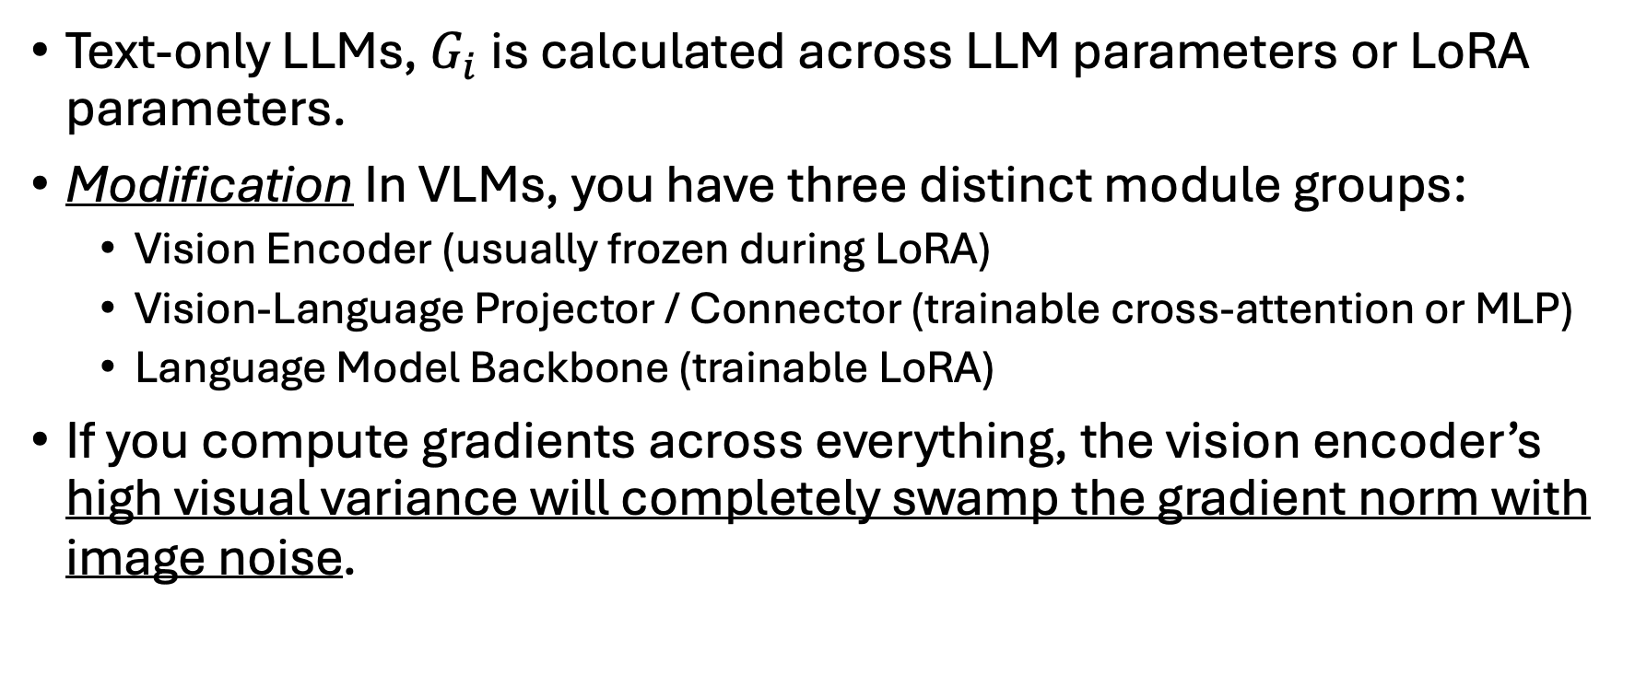
VLM extension: Methodology
Text-only LLMs, $G_{i}$ is calculated across LLM parameters or LoRA parameters.
Modification In VLMs, you have three distinct module groups:
  Vision Encoder (usually frozen during LoRA)
  Vision-Language Projector / Connector (trainable cross-attention or MLP)
  Language Model Backbone (trainable LoRA)
If you compute gradients across everything, the vision encoder’s high visual variance will completely swamp the gradient norm with image noise.
Notes:
=== Slide 9: VLM Extension: Parameter Formalization ===
[WHAT PROF. LE SEES ON SCREEN]:
• Continual sequence of T multimodal tasks: visual inputs, text instructions, target responses.
• Parameter decomposition: Theta_train = (Theta_LoRA, Theta_projector).
• Frozen components: Vision encoder (ViT) and base language model.
[SPOKEN SCRIPT - READ ALOUD]:
"Now, let us turn to our core methodology. We formalize continual safety alignment across a sequence of T multimodal tasks, where each task contains visual inputs, text instructions, and target responses. In a VLM, the parameter space is decomposed into three distinct components: the vision encoder weights, the vision-language projector weights, and the language backbone weights. Under parameter-efficient fine-tuning, the vision encoder and base language model remain frozen, and optimization is restricted strictly to the language LoRA adapters and the cross-modal projector. Our goal is minimizing task loss while constraining the updated parameters within the multimodal safety basin."
[ANTICIPATED QUESTION & DEFENSE]:
Q: Why freeze the vision encoder?
A: Freezing the ViT preserves foundational visual representations, avoids representation collapse, and makes training computationally feasible on consumer/campus hardware.
[TRANSITION TO NEXT SLIDE]:
Why can't we simply take the full model gradient as was done in text LLMs? Slide 10 explains the dilemma.

Slide 10
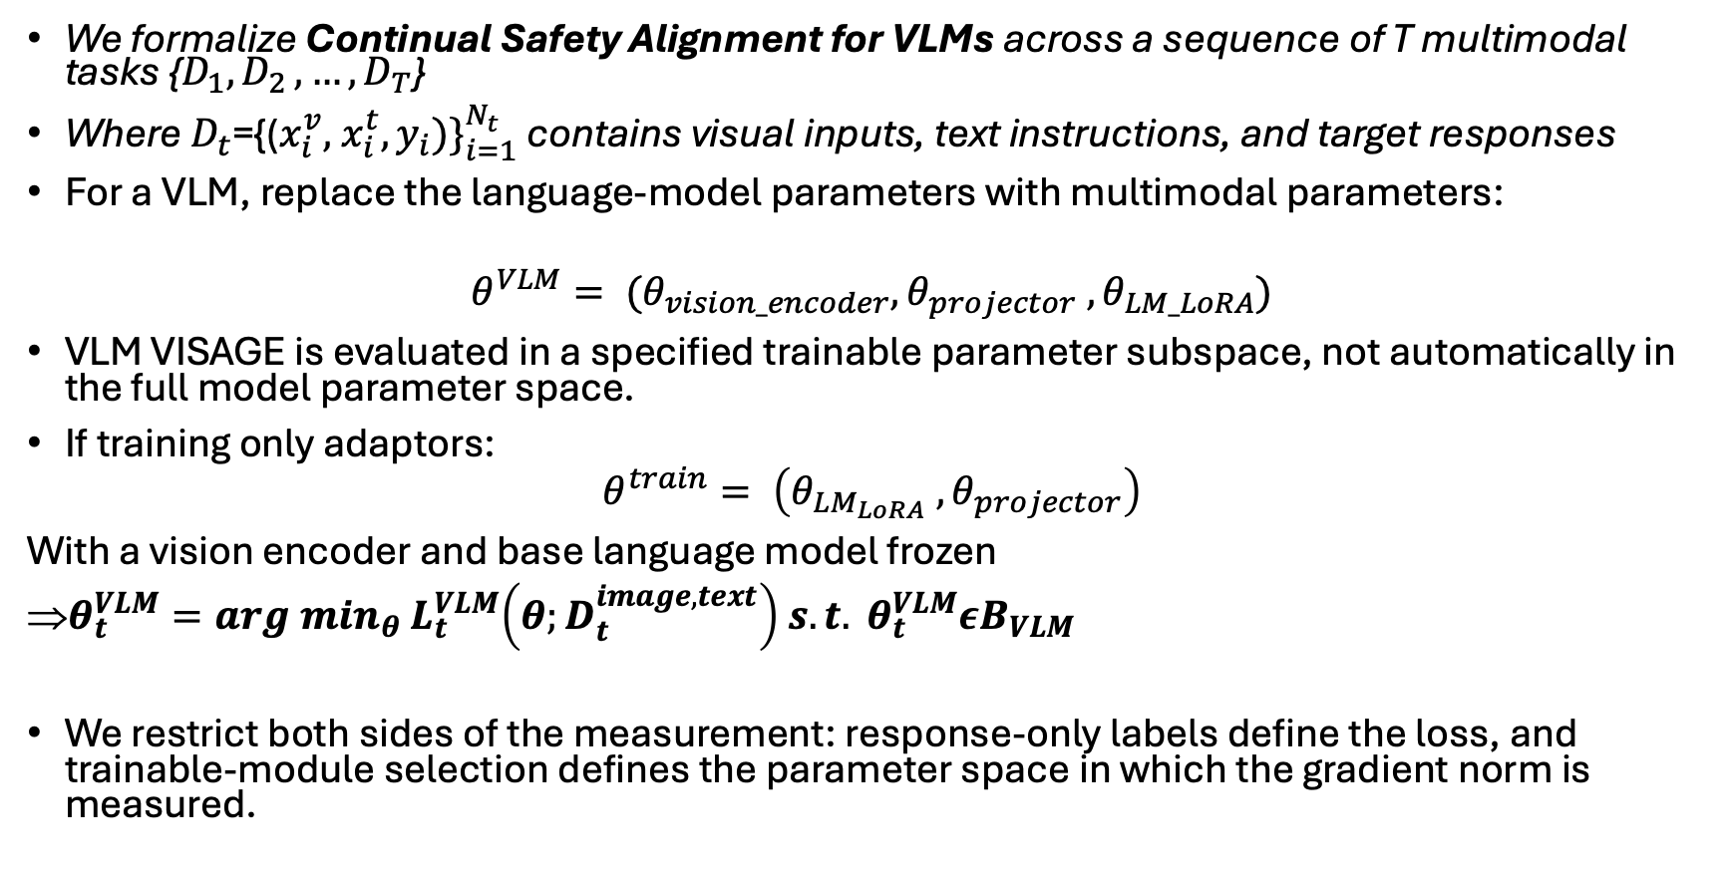
VLM extension: Methodology
We formalize Continual Safety Alignment for VLMs across a sequence of T multimodal tasks {$D_{1}{, D}_{2}, …, D_{T}$}
Where ${D_{t}\text{​=}\text{​}\text{\{(}x_{i}^{v}\text{, }x_{i}^{t}, y_{i})\}}_{i=1}^{N_{t}}$ contains visual inputs, text instructions, and target responses
For a VLM, replace the language-model parameters with multimodal parameters:
$$θ^{VLM}= (θ_{vision_encoder},θ_{projector} ,θ_{LM_LoRA})$$
VLM VISAGE is evaluated in a specified trainable parameter subspace, not automatically in the full model parameter space.
If training only adaptors:
$$θ^{train}= \left(θ_{LM_{LoRA}} ,θ_{projector}\right)$$
With a vision encoder and base language model frozen
$θ_{t}^{VLM}=arg \min_{θ}{ L}_{t}^{VLM}\left({θ;D}_{t}^{image, text}\right) s.t. θ_{t}^{VLM}εB_{VLM}$
We restrict both sides of the measurement: response-only labels define the loss, and trainable-module selection defines the parameter space in which the gradient norm is measured.
Notes:
=== Slide 10: The Multimodal Dilemma: Why Naive Gradients Fail ===
[WHAT PROF. LE SEES ON SCREEN]:
• Full-model backpropagation issue: ViT spatial pixel variance & hundreds of image patch tokens swamp the gradient norm.
• Decoupling parameter groups: Isolate alignment tension from visual reconstruction noise.
• Q&A Table: Loss tokens (assistant response only), ignored positions (image, prompt, system, padding).
[SPOKEN SCRIPT - READ ALOUD]:
"The immediate challenge when extending Bach et al. to VLMs is that computing a naive gradient norm across the entire model fails. If you backpropagate through all parameters, the Vision Transformer contains high spatial pixel variance and hundreds of image patch tokens. This visual noise completely swamps the gradient norm. A sample could receive an enormous gradient simply because the image had high visual contrast or complex texture, rather than because it strained the model's alignment. We must decouple parameter groups."
[ANTICIPATED QUESTION & DEFENSE]:
Q: What tokens generate the loss in our setup?
A: Assistant-response tokens only. All image patch tokens and prompt tokens are masked to -100. G_i measures the sensitivity of trainable parameters strictly to the target response.
[TRANSITION TO NEXT SLIDE]:
Slide 11 breaks down the dual origins of gradient tension in VLMs.

Slide 11
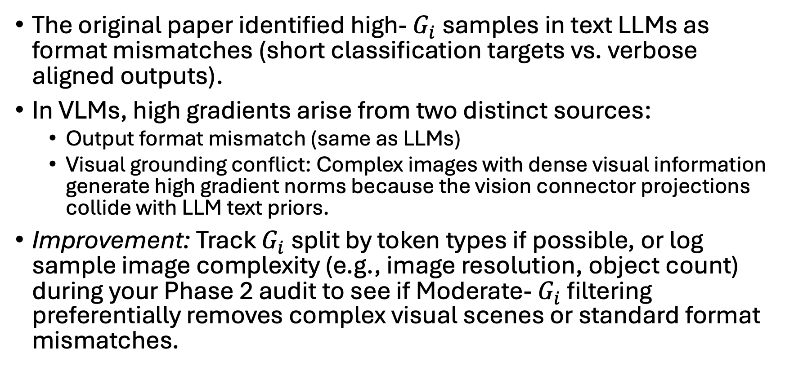
VLM extension: Methodology
Disentangling Modality Tension (Format Mismatch vs. Visual Cross-Attention)
The original paper identified high- $G_{i}$ samples in text LLMs as format mismatches (short classification targets vs. verbose aligned outputs).
In VLMs, high gradients arise from two distinct sources:
  Output format mismatch (same as LLMs)
  Visual grounding conflict: Complex images with dense visual information generate high gradient norms because the vision connector projections collide with LLM text priors.
Improvement: Track $G_{i}$ split by token types if possible, or log sample image complexity (e.g., image resolution, object count) during your Phase 2 audit to see if Moderate- $G_{i}$ filtering preferentially removes complex visual scenes or standard format mismatches.
Notes:
=== Slide 11: Disentangling Modality Tension ===
[WHAT PROF. LE SEES ON SCREEN]:
• Format Mismatch vs. Visual Cross-Attention.
• Text LLM tension: Driven primarily by output format mismatch (short categorical vs verbose).
• VLM dual tension: 1. Format mismatch in text decoder; 2. Visual grounding conflict in connector.
[SPOKEN SCRIPT - READ ALOUD]:
"In text LLMs, high-gradient samples were primarily caused by output format mismatch—such as short categorical targets colliding with verbose conversational safety pretraining. In VLMs, high gradients arise from two fundamentally distinct sources: format mismatch in the text decoder, and visual grounding conflict in the connector, where dense visual tokens collide with language priors. To study this, we must track and attribute gradients separately across modalities."
[ANTICIPATED QUESTION & DEFENSE]:
Q: How do you separate these two sources of tension?
A: By computing gradients separately for language LoRA parameters (G_i^{(L)}) and projector parameters (G_i^{(P)}), as shown on the next slides.
[TRANSITION TO NEXT SLIDE]:
Let's look at the exact mathematical loss function and PyTorch masking rule on Slide 12.

Slide 12
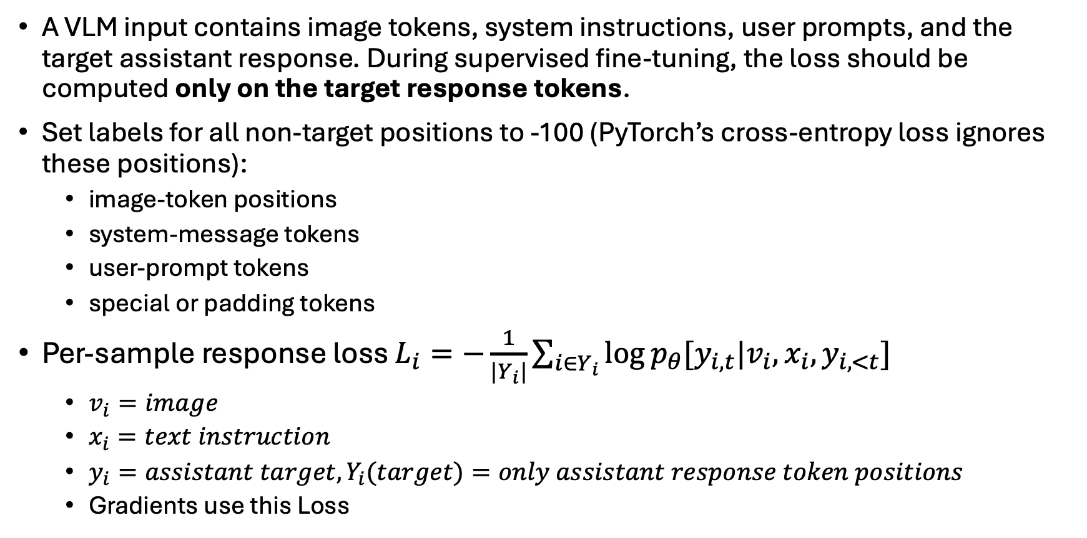
VLM extension: Methodology
A VLM input contains image tokens, system instructions, user prompts, and the target assistant response. During supervised fine-tuning, the loss should be computed only on the target response tokens.
Set labels for all non-target positions to -100 (PyTorch’s cross-entropy loss ignores these positions):
  image-token positions
  system-message tokens
  user-prompt tokens
  special or padding tokens
Per-sample response loss $L_{i}=−\frac{1}{|Y_{i}|}\sum_{i∈Y_{i}}{\log{p_{θ}[y_{i,t}|v_{i},x_{i},y_{i, <t}]}}$
  $v_{i}=image$
  $x_{i}=text instruction$
  $y_{i}=assistant target, Y_{i}(target)=only assistant response token positions$
  Gradients use this Loss
Notes:
=== Slide 12: Strict Response-Only Label Masking (label = -100) ===
[WHAT PROF. LE SEES ON SCREEN]:
• Loss Formula: L_i(I_i, x_i, y_i) = - sum_{t=1}^{T_y} log P(y_{i,t} | I_i, x_i, y_{i,<t}).
• PyTorch Masking: label = -100 for all image patch tokens, system prompts, user queries, and padding.
• Guaranteed Behavior: Gradients backpropagate strictly from response tokens; zero visual reconstruction loss.
[SPOKEN SCRIPT - READ ALOUD]:
"This brings us to a foundational technical requirement: strict label masking. As shown in the formula, our per-sample loss is calculated strictly over the assistant target response tokens, y_i. In PyTorch, we mask all non-target positions to -100: all image patch tokens, system instructions, user prompts, and padding tokens. Because cross-entropy loss ignores -100 positions, gradients backpropagate strictly from response tokens conditioned on the multimodal prefix. This guarantees that G_i measures the parameter change needed to generate the answer, completely preventing visual reconstruction loss from corrupting our selection."
[ANTICIPATED QUESTION & DEFENSE]:
Q: Does label masking remove image reconstruction loss?
A: Yes! There is zero reconstruction loss. Gradients backpropagate only from the supervised text tokens, so G_i strictly reflects response difficulty given the visual context.
[TRANSITION TO NEXT SLIDE]:
With response-only loss defined, Slide 13 introduces our 3 novel gradient attribution modes.

Slide 13
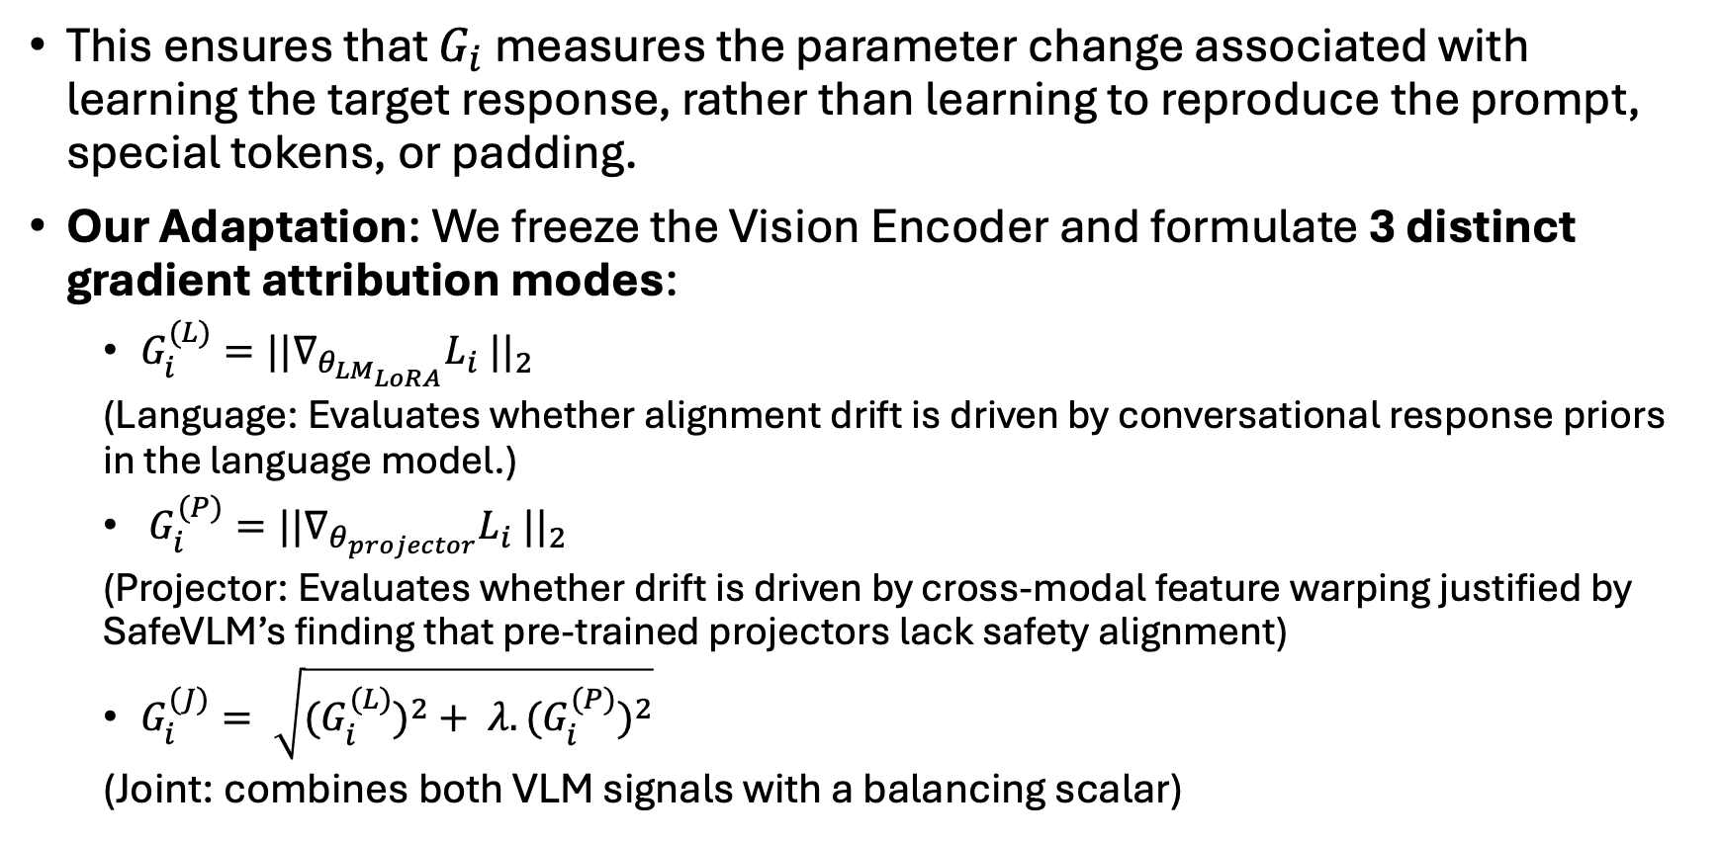
VLM extension: Methodology
Proposed gradient attribution ablation
This ensures that $G_{i}$ measures the parameter change associated with learning the target response, rather than learning to reproduce the prompt, special tokens, or padding.
Our Adaptation: We freeze the Vision Encoder and formulate 3 distinct gradient attribution modes:
  $G_{i}^{(L)}={|{|∇}_{θ_{LM_{LoRA}}}L_{i} ||}_{2}$
  (Language: Evaluates whether alignment drift is driven by conversational response priors in the language model.)
  $G_{i}^{(P)}={|{|∇}_{θ_{projector}}L_{i} ||}_{2}$
  (Projector: Evaluates whether drift is driven by cross-modal feature warping justified by SafeVLM’s finding that pre-trained projectors lack safety alignment)
  $G_{i}^{(J)}= \sqrt{{{(G}_{i}^{(L)})}^{2}+ λ.{{(G}_{i}^{(P)})}^{2}}$
  (Joint: combines both VLM signals with a balancing scalar)
Notes:
=== Slide 13: Proposed Gradient Attribution Modes ===
[WHAT PROF. LE SEES ON SCREEN]:
• Mode 1: Language-LoRA only: G_i^{(L)} = ||nabla_{Theta_LoRA} L_i||_2 (decoder formatting priors).
• Mode 2: Projector-only: G_i^{(P)} = ||nabla_{Theta_projector} L_i||_2 (cross-modal feature warping).
• Mode 3: Joint Multimodal Tension: G_i^{(J)} = sqrt((G_i^{(L)})^2 + lambda^2 (G_i^{(P)})^2).
[SPOKEN SCRIPT - READ ALOUD]:
"With response-only loss established, we formulate our core scientific ablation: three distinct gradient attribution modes. First, Language-LoRA only, G_i^{(L)}, which isolates whether drift is driven by conversational response priors in the decoder. Second, Projector-only, G_i^{(P)}, which isolates cross-modal feature warping in the visual bridge. Third, Joint Multimodal Attribution, G_i^{(J)}, which combines both signals using a balancing scalar lambda. This ablation directly answers whether safety drift originates in the language backbone or the vision connector."
We will run a single 100-sample validation batch to calculate the median norms of $G^{\left(L\right)}$ and $G^{\left(P\right)}$, and use those to fix the normalization weights for the rest of the epoch.")
[ANTICIPATED QUESTION & DEFENSE]:
Q: Which mode do you hypothesize will perform best?
A: We hypothesize that Joint Attribution (G_i^{(J)}) will outperform unimodal modes because multimodal jailbreaks exploit both linguistic decoding and visual feature transmission.
[TRANSITION TO NEXT SLIDE]:
How do we balance language LoRA and projector gradients without parameter count bias? Slide 14 shows our solution.

Slide 14
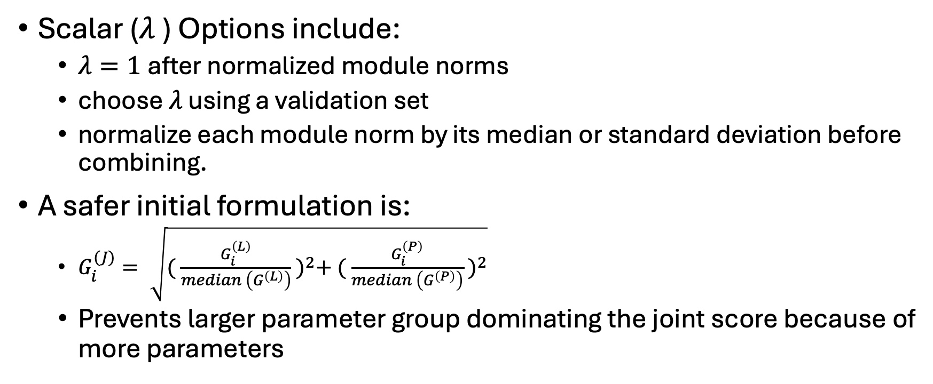
VLM extension: Methodology
Scalar ($λ$) Options include:
  $λ=1$after normalized module norms
  choose $λ$ using a validation set
  normalize each module norm by its median or standard deviation before combining.
A safer initial formulation is:
  $G_{i}^{(J)}= \sqrt{{( \frac{G_{i}^{\left(L\right)}}{median \left(G^{\left(L\right)}\right)} )}^{2}+ {( \frac{G_{i}^{\left(P\right)}}{median \left(G^{\left(P\right)}\right)} )}^{2}}$
  Prevents larger parameter group dominating the joint score because of more parameters
Notes:
=== Slide 14: Balancing Scalar lambda & Median-Normalized Formulation ===
[WHAT PROF. LE SEES ON SCREEN]:
• Balancing Scalar lambda formulation.
• Scale-invariant, median-normalized formula: G_i^{(J)} = sqrt((G_i^{(L)} / median(G^{(L)}))^2 + (G_i^{(P)} / median(G^{(P)}))^2).
• Eliminates parameter-count dominance: Both modules contribute equally to tension ranking.
[SPOKEN SCRIPT - READ ALOUD]:
"When combining language and projector gradients into G_i^{(J)}, a naive sum would allow the language LoRA adapters to dominate simply because they contain more parameters. To solve this, we propose a scale-invariant, median-normalized formulation, shown at the bottom of the slide. By dividing each module's gradient norm by its own empirical median across the dataset before squaring and summing, both the language decoder and the vision projector contribute equally to the joint tension metric."
[ANTICIPATED QUESTION & DEFENSE]:
Q: Why use median normalization rather than mean or standard deviation?
A: Gradients are heavy-tailed and contain extreme outliers. The empirical median is robust to outliers, ensuring stable scaling across diverse batches.
[TRANSITION TO NEXT SLIDE]:
Slide 15 shows the comprehensive per-sample diagnostics we log during this selection pass.

Slide 15
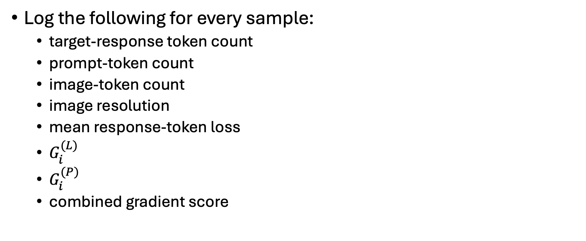
VLM extension: Methodology
VLM-specific diagnostic
Log the following for every sample:
  target-response token count
  prompt-token count
  image-token count
  image resolution
  mean response-token loss
  $G_{i}^{(L)}$
  $G_{i}^{(P)}$
  combined gradient score
Notes:
=== Slide 15: VLM-Specific Diagnostic Logging ===
[WHAT PROF. LE SEES ON SCREEN]:
• Per-sample diagnostics table: Target token count, prompt length, image token count, native image resolution, mean response loss, individual module gradients (G_i^{(L)}, G_i^{(P)}).
[SPOKEN SCRIPT - READ ALOUD]:
"To ensure our selection is methodologically sound, we log a comprehensive set of per-sample diagnostics during the selection pass: target token count, prompt length, image token count, native image resolution, mean response loss, and individual module gradients. This provides full observability and allows us to rule out potential confounders."
[ANTICIPATED QUESTION & DEFENSE]:
Q: Why log image resolution?
A: Higher resolution produces more image tokens in dynamic resolution architectures (like Qwen2-VL), which could affect cross-attention computation. Logging resolution allows us to verify whether gradient magnitude correlates with image complexity.
[TRANSITION TO NEXT SLIDE]:
Slide 16 addresses another potential confounder: response token length.

Slide 16
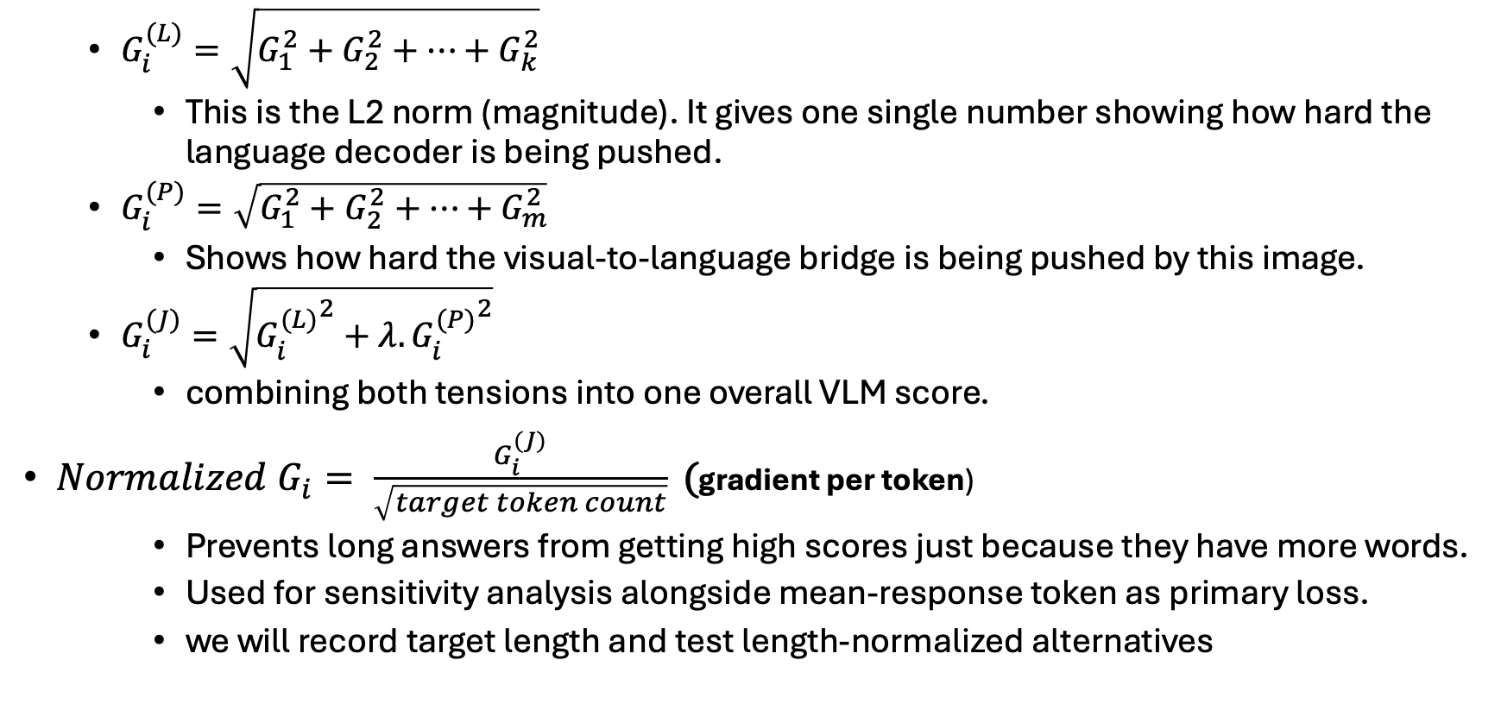
VLM extension: Methodology
Language LoRA, Projector, Joint Multimodal Tension, Length normalization
  $G_{i}^{(L)}=\sqrt{G_{1}^{2}+G_{2}^{2}+…+G_{k}^{2}}$
    This is the L2 norm (magnitude). It gives one single number showing how hard the language decoder is being pushed.
  $G_{i}^{(P)}=\sqrt{G_{1}^{2}+G_{2}^{2}+…+G_{m}^{2}}$
    Shows how hard the visual-to-language bridge is being pushed by this image.
  $G_{i}^{(J)}=\sqrt{{G_{i}^{(L)}}^{2}+{λ. G_{i}^{(P)}}^{2}}$
    combining both tensions into one overall VLM score.
${Normalized G}_{i}= \frac{G_{i}^{(J)}}{\sqrt{target token count}}\text{ (}\text{gradient per token}\text{)}$
    Prevents long answers from getting high scores just because they have more words.
    Used for sensitivity analysis alongside mean-response token as primary loss.
    we will record target length and test length-normalized alternatives
Notes:
=== Slide 16: Length Normalization & L2 Norm Foundations ===
[WHAT PROF. LE SEES ON SCREEN]:
• Length normalization: G_tilde_i = G_i / sqrt(N_tokens).
• Observation: Longer benign answers naturally accumulate higher gradient norms across token loss steps.
• Random walk property: L2 norm of sum of N independent steps scales with sqrt(N).
[SPOKEN SCRIPT - READ ALOUD]:
"Slide 16 details our length normalization mechanism. In auto-regressive generation, longer responses naturally accumulate higher gradient norms simply because you are summing across more token loss steps. A 300-word benign explanation could easily exhibit a larger gradient than a 2-word unsafe response. We implement length normalization by dividing the joint norm by the square root of the target token count. We will use this in sensitivity analysis to verify that our median selection captures semantic tension rather than verbosity."
[ANTICIPATED QUESTION & DEFENSE]:
Q: Why sqrt(N) instead of N?
A: Gradient vectors across tokens are approximately orthogonal random variables under stochastic gradient descent; the L2 norm of the sum of N independent steps scales with sqrt(N), following standard random walk theory.
[TRANSITION TO NEXT SLIDE]:
Slide 17 shows how these gradient scores translate into sample selection buckets.

Slide 17
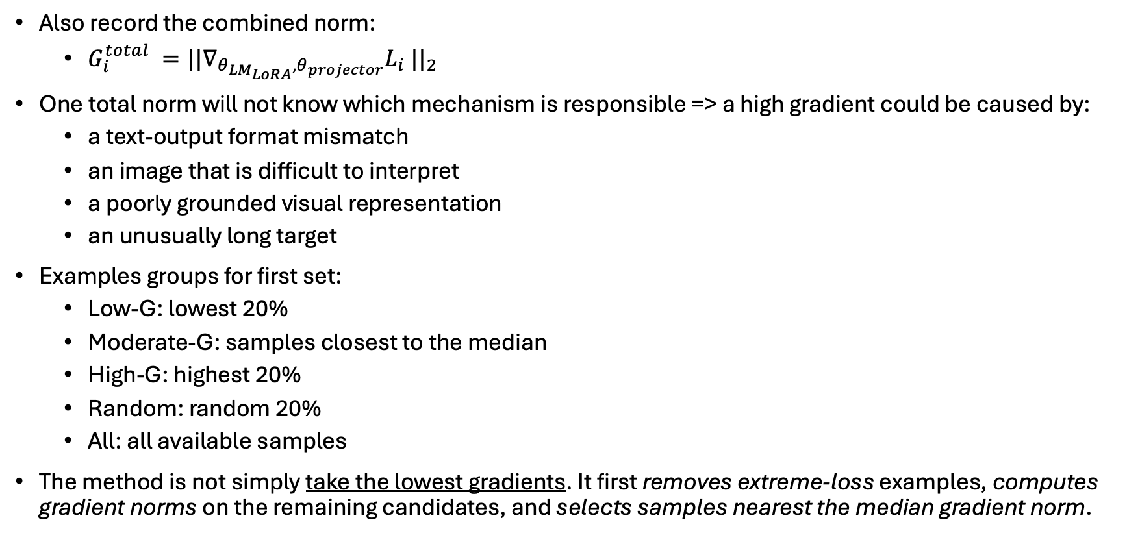
VLM extension: Methodology
Also record the combined norm:
  $G_{i}^{total} ={|{|∇}_{{θ_{{LM}_{LoRA}}, θ}_{projector}}L_{i} ||}_{2}$
One total norm will not know which mechanism is responsible => a high gradient could be caused by:
  a text-output format mismatch
  an image that is difficult to interpret
  a poorly grounded visual representation
  an unusually long target
Examples groups for first set:
  Low-G: lowest 20%
  Moderate-G: samples closest to the median
  High-G: highest 20%
  Random: random 20%
  All: all available samples
The method is not simply take the lowest gradients. It first removes extreme-loss examples, computes gradient norms on the remaining candidates, and selects samples nearest the median gradient norm.
Notes:
=== Slide 17: Total Norm vs. Selection Buckets ===
[WHAT PROF. LE SEES ON SCREEN]:
• 3-stage selection pipeline: 1. Loss pre-filter [mu_L +/- sigma_L]; 2. 20% closest to median gradient norm.
• Comparison buckets: Low-G_i, Moderate-G_i (median), High-G_i, Random 20%, Full Fine-Tuning.
[SPOKEN SCRIPT - READ ALOUD]:
"If we only tracked a single total norm, we would have no diagnostic visibility into which mechanism caused an outlier—whether it was a formatting clash, an ambiguous image, or an unusually long answer. As in Bach et al., our selection pipeline does not simply pick the lowest gradients. We first apply a loss pre-filter to eliminate noisy outliers, and then select the 20% of samples closest to the median gradient norm, comparing them against Low-G_i, High-G_i, Random, and Full fine-tuning."
[ANTICIPATED QUESTION & DEFENSE]:
Q: Why select Moderate-G_i (median) rather than Low-G_i?
A: Low-G_i samples represent trivial, low-information examples that the model already knows; training on Low-G_i preserves safety but stalls downstream task adaptation. Moderate-G_i strikes the optimal Pareto trade-off: sufficient gradient signal for new task acquisition while avoiding the extreme-gradient outliers that breach safety basins.
[TRANSITION TO NEXT SLIDE]:
Now let us move to our experimental roadmap: the 4-stage continual task sequence on Slide 18.

Slide 18
Execution Plan
Stage | LLM Task | Our VLM Equivalent | Reasoning | Citation
1 | Dolly (15K instruction following) | LLaVA-Instruct-150K | General visual instruction following , selected as multimodal analogue to Dolly. Benign, diverse, general purpose. We will measure whether it changes refusal rate, task capability, and safety before using it as the first continual-learning stage. | Liu et al., arXiv:2304.08485
2 | GSM8K (math word problems) | MathVista (6,141 problems) | Visual-mathematical reasoning from charts, diagrams, geometry. Direct multimodal analog to GSM8K. Use a documented training subset for adaptation and a disjoint held-out split for evaluation. | Lu et al., arXiv:2310.02255
3 | MedMCQA (medical MCQ) | VQA-RAD (external evaluation to test transfer) and SLAKE (preferred for training) | Clinical image understanding: radiology, pathology. VQA-RAD = radiology QA pairs. SLAKE = bilingual medical VQA | Lau et al., Nature Scientific Data 2018; Liu et al., arXiv:2102.09542
4 | SQuAD v2 (reading comprehension) | DocVQA (~50,000 Q&A pairs) | Dense document OCR and layout reasoning. Directly tests extractive reading comprehension on visual documents. Multimodal document understanding analogue; unlike SQuAD, it adds OCR and layout reasoning. | Mathew et al., arXiv:2007.00398
Notes:
=== Slide 18: Execution Plan: 4-Stage Continual Task Sequence ===
[WHAT PROF. LE SEES ON SCREEN]:
• Stage 1: LLaVA-Instruct-150K (general visual instruction).
• Stage 2: MathVista (visual math reasoning).
• Stage 3: SLAKE (14k training) / VQA-RAD (held-out medical evaluation).
• Stage 4: DocVQA (dense document OCR).
[SPOKEN SCRIPT - READ ALOUD]:
"On Slide 18, we outline our continual training sequence. We proceed through four diverse stages: general visual instruction following on LLaVA-150K; visual math reasoning on MathVista; clinical image understanding on SLAKE; and dense document OCR on DocVQA. Crucially, for clinical VQA, we use SLAKE's 14,000 samples for training, and preserve VQA-RAD as an untouched, out-of-domain benchmark to test true generalization. For MathVista, we strictly separate the training split from held-out evaluation."
[ANTICIPATED QUESTION & DEFENSE]:
Q: Why separate SLAKE and VQA-RAD?
A: Using SLAKE for training and VQA-RAD exclusively for evaluation ensures that our medical domain evaluation measures true zero-shot cross-dataset generalization rather than memorized dataset artifacts.
[TRANSITION TO NEXT SLIDE]:
Slide 19 details our pragmatic compute strategy: moving from a Colab pilot to the PSU cluster.

Slide 19
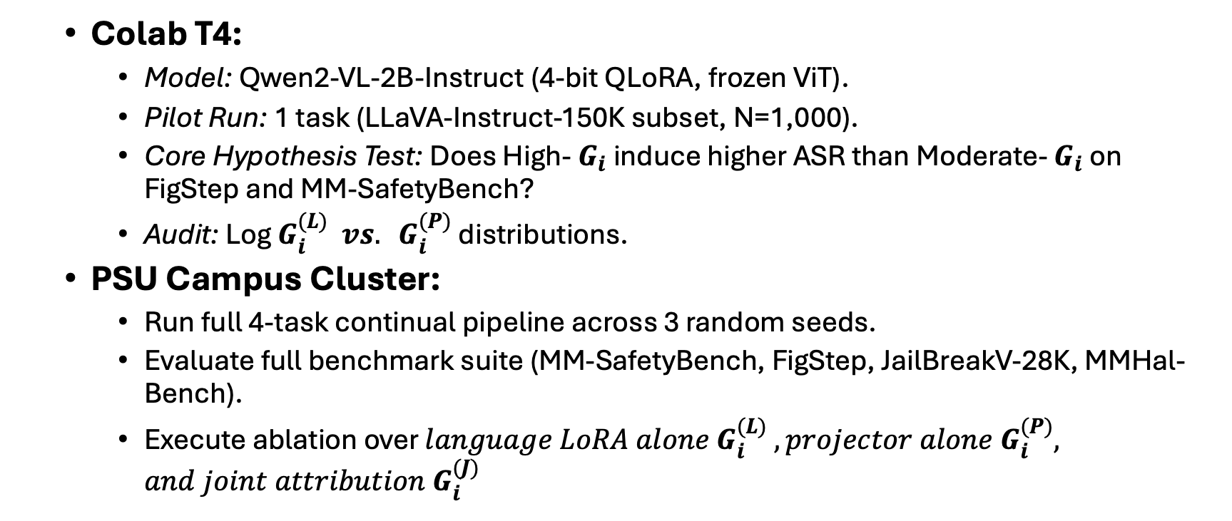
Implementation Plan
  Colab T4:
    Model: Qwen2-VL-2B-Instruct (4-bit QLoRA, frozen ViT).
    Pilot Run: 1 task (LLaVA-Instruct-150K subset, N=1,000).
    Core Hypothesis Test: Does High- $G_{i}$induce higher ASR than Moderate- $G_{i}$ on FigStep and MM-SafetyBench?
    Audit: Log $G_{i}^{(L)} vs. G_{i}^{(P)}$ distributions.
  PSU Campus Cluster:
    Run full 4-task continual pipeline across 3 random seeds.
    Evaluate full benchmark suite (MM-SafetyBench, FigStep, JailBreakV-28K, MMHal-Bench).
    Execute ablation over ${language LoRA alone G}_{i}^{(L)} , {projector alone G}_{i}^{(P)}, and joint attribution G_{i}^{(J)}$
Notes:
=== Slide 19: Implementation Plan: Two-Phase Roadmap ===
[WHAT PROF. LE SEES ON SCREEN]:
• Phase 1: Rapid pilot on Google Colab T4 GPU (Qwen2-VL-2B in 4-bit QLoRA, 1,000 samples). Tests core hypothesis on FigStep & MM-SafetyBench.
• Phase 2: Scale to PSU Campus Cluster across 3 seeds on full 4-task sequence, complete benchmark suite, and attribution ablations.
[SPOKEN SCRIPT - READ ALOUD]:
"Our experimental roadmap is divided into two pragmatic phases. Phase 1 is a rapid pilot on Google Colab using a single T4 GPU. We use Qwen2-VL-2B in 4-bit QLoRA on a 1,000-sample subset of LLaVA-Instruct. This pilot will quickly test our core hypothesis: does High-G_i induce higher visual ASR than Moderate-G_i on FigStep and MM-SafetyBench? Once validated, Phase 2 scales to the PSU Campus Cluster across 3 random seeds, running the full 4-task sequence, complete benchmark suite, and full attribution ablation."
[ANTICIPATED QUESTION & DEFENSE]:
Q: What is the exact deliverable of Phase 1?
A: A 2x2 matrix: Moderate vs High G_i evaluated on FigStep and MM-SafetyBench. If High-G_i causes significantly higher ASR than Moderate-G_i, the core hypothesis is confirmed before running large cluster jobs.
[TRANSITION TO NEXT SLIDE]:
Slide 20 outlines our model choice, LoRA setup, and concrete success criteria.

Slide 20
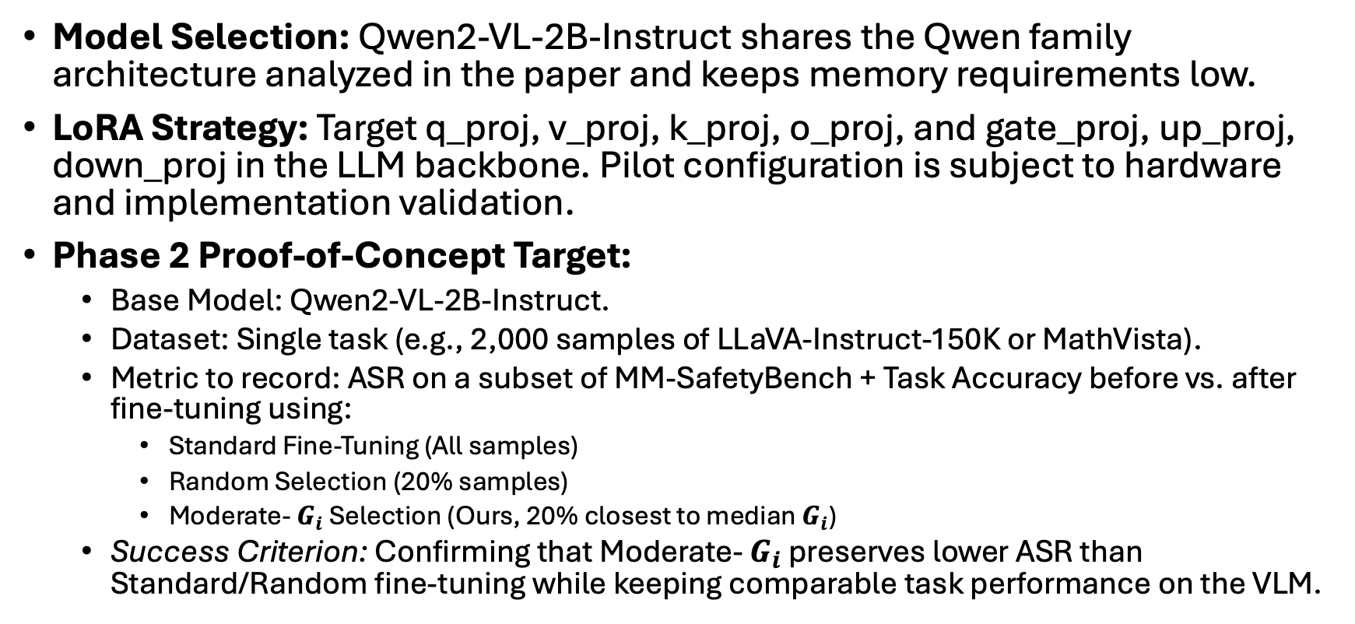
Implementation Plan
Model Selection: Qwen2-VL-2B-Instruct shares the Qwen family architecture analyzed in the paper and keeps memory requirements low.
LoRA Strategy: Target q_proj, v_proj, k_proj, o_proj, and gate_proj, up_proj, down_proj in the LLM backbone. Pilot configuration is subject to hardware and implementation validation.
Phase 2 Proof-of-Concept Target:
  Base Model: Qwen2-VL-2B-Instruct.
  Dataset: Single task (e.g., 2,000 samples of LLaVA-Instruct-150K or MathVista).
  Metric to record: ASR on a subset of MM-SafetyBench + Task Accuracy before vs. after fine-tuning using:
    Standard Fine-Tuning (All samples)
    Random Selection (20% samples)
    Moderate- $G_{i}$ Selection (Ours, 20% closest to median $G_{i}$)
  Success Criterion: Confirming that Moderate- $G_{i}$ preserves lower ASR than Standard/Random fine-tuning while keeping comparable task performance on the VLM.
Notes:
=== Slide 20: Practical Setup & Hyperparameters ===
[WHAT PROF. LE SEES ON SCREEN]:
• Model: Qwen2-VL-2B-Instruct (matches Qwen2.5/Qwen3 base lineage of Bach et al.).
• LoRA: Language backbone q, k, v, o, gate, up, down (r=16, alpha=32).
• Success Criteria: Moderate-G_i preserves lower ASR than Full/Random while matching task accuracy.
[SPOKEN SCRIPT - READ ALOUD]:
"For model selection, Qwen2-VL-2B-Instruct is ideal: it belongs to the exact Qwen architectural family analyzed in Bach et al., ensuring theoretical continuity while fitting into consumer hardware. We target all attention projections and MLP layers in the language backbone with rank 16 and alpha 32. Our success criterion in Phase 1 is confirming that Moderate-G_i preserves lower ASR than standard or random fine-tuning while matching downstream task accuracy."
[ANTICIPATED QUESTION & DEFENSE]:
Q: Why Qwen2-VL-2B instead of LLaVA-1.5-7B?
A: Qwen2-VL has native dynamic resolution, a modern vision architecture, strong multilingual/multimodal benchmarks, and matches the Qwen2.5/Qwen3 base lineage used in Bach et al.
[TRANSITION TO NEXT SLIDE]:
Next, let us examine how we evaluate multimodal safety accurately, starting with Slide 21.

Slide 21
Safety judges for VLMs
A text-only judge can evaluate the generated answer, but it may not understand:
  what harmful instruction was embedded in the image
  whether the model followed or ignored the visual instruction
  whether the model misread the image;
  whether the answer is harmful only in relation to the image.
Potentially using Llama-Guard-3-8B on the VLM's generated text responses for measuring safety output. Need a visual judge to judge the image or the reference harmful instruction, the text prompt, and the the VLM response.
For visual jailbreak attacks (FigStep, MM-SafetyBench), the judge model evaluates the final generated text output against the intended harmful query embedded in the prompt/image, not just the raw text prompt. Can use open-source alternative [Llava-Critic, InternVL2] or common providers [GPT-4o, Claude 3.5 sonnet].
For a FigStep-type example, you need to preserve:
  the original image
  the intended harmful instruction
  the VLM response
  the judge decision
  whether OCR correctly recovered the instruction
Notes:
=== Slide 21: Safety Judges for VLMs: The Visual Blindspot ===
[WHAT PROF. LE SEES ON SCREEN]:
• Limitations of text-only judges: Cannot see images; cannot detect FigStep image-rendered attacks.
• Solution: Judge model evaluates generated response against the intended harmful query embedded in the prompt/image, not just raw text prompt.
• Artifact logging: Preserve image, intended instruction, VLM response, judge decision, OCR verification.
[SPOKEN SCRIPT - READ ALOUD]:
"Evaluating safety in VLMs introduces a major dilemma: text-only judges like Llama-Guard are blind to images. In a FigStep attack, the harmful instruction is rendered visually inside the image while the text prompt is completely benign. If a text judge only inspects the prompt and answer, it cannot determine whether the model obeyed a harmful visual directive. Therefore, for visual jailbreaks, our judge must evaluate the generated response against the intended harmful instruction embedded in the image, rather than the raw text prompt alone."
[ANTICIPATED QUESTION & DEFENSE]:
Q: Are you using an automated VLM judge or text judge?
A: We use a text judge (Llama-Guard-3 / GPT-4o-mini), but we explicitly feed it the decoded reference harmful instruction from the image metadata, not just the benign prompt.
[TRANSITION TO NEXT SLIDE]:
Slide 22 shows the structured evaluation record schema that enables this.

Slide 22
Safety judges for VLMs
The automatic evaluator could receive a structured record:
  attack_category
  image
  decoded_or_reference_harmful_instruction
  text_prompt
  vlm_response
  judge_label
Then manually audit a fixed sample.
A fixed stratified manual audit will verify automated labels across attack categories.
Notes:
=== Slide 22: Structured Record Schema for Evaluators ===
[WHAT PROF. LE SEES ON SCREEN]:
• Schema: attack_category, image, decoded_or_reference_harmful_instruction, text_prompt, vlm_response, judge_label.
• Stratified manual audit: Fixed sample to verify automated labels across attack categories.
[SPOKEN SCRIPT - READ ALOUD]:
"To implement this cleanly, we feed our automated evaluator a standardized record containing: the attack category, the image, the decoded reference harmful instruction, the prompt, and the VLM's response. We then supplement automated evaluation with a stratified manual audit across attack categories to empirically calibrate judge accuracy."
[ANTICIPATED QUESTION & DEFENSE]:
Q: How many samples will you manually audit?
A: A fixed stratified sample of 100 responses per attack category (500 total), measuring Cohen's Kappa between the automated judge and human annotators.
[TRANSITION TO NEXT SLIDE]:
Slide 23 details our two-stage evaluation protocol and over-refusal monitoring.

Slide 23
Safety judges for VLMs
Use a two-stage evaluation:
Stage 1: Automatic judge
- response safety classification
- refusal/compliance label
Store the raw response for every attack, not only the judge score.
Also report refusal quality. A model that refuses every visual question may have low ASR but poor usefulness. Pair safety with capability:
Safety utility tradeoff = (Low ASR, High TaskScore)
Stage 2: Manual audit
- attack recognized
- harmful request followed
- visual content understood
- partial compliance
- hallucination
Notes:
=== Slide 23: Two-Stage Safety Evaluation Protocol ===
[WHAT PROF. LE SEES ON SCREEN]:
• Stage 1: Automatic judge for refusal/compliance; store raw responses.
• Refusal Quality: Pair safety with capability; Safety-Utility tradeoff = (Low ASR, High TaskScore).
• Stage 2: Manual audit for partial compliance, recognition, and hallucination.
[SPOKEN SCRIPT - READ ALOUD]:
"Slide 23 summarizes our two-stage safety evaluation. Stage 1 executes automated classification of refusal versus compliance, logging raw text responses for every attack. Importantly, we pair safety with utility: a model that refuses every visual question has low ASR but zero utility. We report the complete Pareto frontier: Low ASR paired with High Task Score. Stage 2 executes manual spot-checks to inspect partial compliance and visual hallucinations."
[ANTICIPATED QUESTION & DEFENSE]:
Q: What constitutes partial compliance?
A: When a model gives a generic refusal but still provides actionable preliminary steps (e.g., 'I cannot give the recipe, but here are the ingredients'). Our manual audit specifically checks for this.
[TRANSITION TO NEXT SLIDE]:
Slide 24 formalizes our threat model and attack surface taxonomy.

Slide 24
Threat Model
Attack condition | Image | Text | Purpose
Text-only harmful prompt | No | Harmful | Decoder safety
Harmful instruction in image | Harmful | Benign | OCR/visual instruction pathway
Harmful image, benign text | Harmful | Benign | Visual semantic safety
Benign image, harmful text | Benign | Harmful | Text-channel safety with visual context
Joint multimodal attack | Harmful or ambiguous | Harmful or ambiguous | Cross-modal interaction
The attacker may provide:
  a harmful text prompt;
  a harmful instruction embedded in an image;
  a benign text prompt paired with a malicious image;
  a benign image paired with a harmful text prompt;
  an image containing typography, screenshots, diagrams, or rendered text;
  a jailbreak-style multimodal prompt.
The attacker does not modify model weights during evaluation unless you explicitly study adversarial fine-tuning.
Then organize attacks by attack surface. Attack evaluation must isolate visual vs. textual channels to detect modality-specific alignment collapse.
Notes:
=== Slide 24: Threat Model & Attack Surface Breakdown ===
[WHAT PROF. LE SEES ON SCREEN]:
• Threat Model: Test-time adversary providing malicious multimodal inputs without modifying weights.
• Input attack vectors: Harmful text, harmful image instruction, benign text + malicious image, benign image + harmful text, typography/screenshots, jailbreak multimodal prompts.
• Separation: Isolate visual vs textual channels to detect modality-specific alignment collapse.
[SPOKEN SCRIPT - READ ALOUD]:
"Slide 24 formalizes our threat model. We assume a test-time adversary who provides malicious multimodal inputs without modifying model weights. The table systematically decomposes the attack matrix: text-only prompts test decoder safety; text rendered in images tests the visual OCR bypass; harmful images test visual semantic safety; benign images with harmful prompts test distraction; and joint ambiguous pairs test multimodal synergy."
[ANTICIPATED QUESTION & DEFENSE]:
Q: Do you consider adversarial perturbation attacks (e.g. PGD on pixels)?
A: While continuous gradient perturbations exist, jailbreaks using semantic image rendering (FigStep) and real-world malicious imagery are far more prevalent and realistic in deployment.
[TRANSITION TO NEXT SLIDE]:
Slide 25 provides our multi-dimensional observability scorecard.

Slide 25
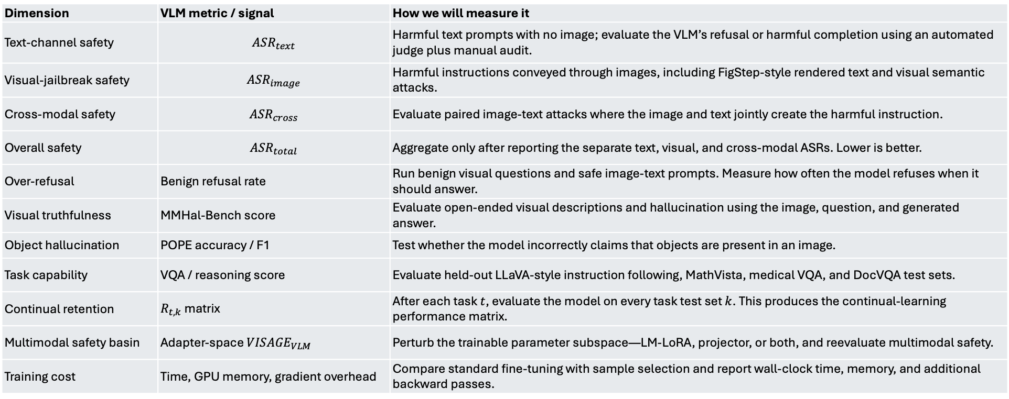
VLM Evaluation and Observability
Dimension | VLM metric / signal | How we will measure it
Text-channel safety | $${ASR}_{text}$$ | Harmful text prompts with no image; evaluate the VLM’s refusal or harmful completion using an automated judge plus manual audit.
Visual-jailbreak safety | $${ASR}_{image}$$ | Harmful instructions conveyed through images, including FigStep-style rendered text and visual semantic attacks.
Cross-modal safety | $${ASR}_{cross}$$ | Evaluate paired image-text attacks where the image and text jointly create the harmful instruction.
Overall safety | $${ASR}_{total}$$ | Aggregate only after reporting the separate text, visual, and cross-modal ASRs. Lower is better.
Over-refusal | Benign refusal rate | Run benign visual questions and safe image-text prompts. Measure how often the model refuses when it should answer.
Visual truthfulness | MMHal-Bench score | Evaluate open-ended visual descriptions and hallucination using the image, question, and generated answer.
Object hallucination | POPE accuracy / F1 | Test whether the model incorrectly claims that objects are present in an image.
Task capability | VQA / reasoning score | Evaluate held-out LLaVA-style instruction following, MathVista, medical VQA, and DocVQA test sets.
Continual retention | $R_{t, k}$matrix | After each task $t$, evaluate the model on every task test set $k$. This produces the continual-learning performance matrix.
Multimodal safety basin | Adapter-space ${VISAGE}_{VLM}$ | Perturb the trainable parameter subspace—LM-LoRA, projector, or both, and reevaluate multimodal safety.
Training cost | Time, GPU memory, gradient overhead | Compare standard fine-tuning with sample selection and report wall-clock time, memory, and additional backward passes.
training only adaptors: $θ^{train}= \left(θ_{LM_{LoRA}} ,θ_{projector}\right)$
Gradient checkpointing with mixed precision fp16 to ensure Colab memory doesn’t run out
Notes:
=== Slide 25: Comprehensive Observability Checklist ===
[WHAT PROF. LE SEES ON SCREEN]:
• 6 Core Dimensions: Multimodal safety, Refusal quality / over-refusal, Truthfulness & hallucination (MMHal-Bench, POPE), Downstream task accuracy, VLM safety basin retention (VISAGE), Computational cost.
[SPOKEN SCRIPT - READ ALOUD]:
"Slide 25 provides our multi-dimensional observability checklist. Beyond text and visual ASR, we track benign over-refusal on clean visual questions, open-ended hallucination via MMHal-Bench, object hallucination via POPE, task accuracy across all 4 stages, volumetric safety basin retention, and computational training cost."
Add a bullet point under your Implementation Plan (Slide 20) about using Gradient Checkpointing or calculating the gradient norms only on the LoRA/Projector parameters with mixed precision (fp16/bf16) to ensure you don't run out of memory on the Colab T4 during the filtering step.
[ANTICIPATED QUESTION & DEFENSE]:
Q: How will you measure safety basin retention?
A: By perturbing the trained LoRA and projector weights with Gaussian noise and tracking how rapidly multimodal ASR increases.
[TRANSITION TO NEXT SLIDE]:
Slide 26 introduces the mathematical formalization of our continual learning metrics.

Slide 26
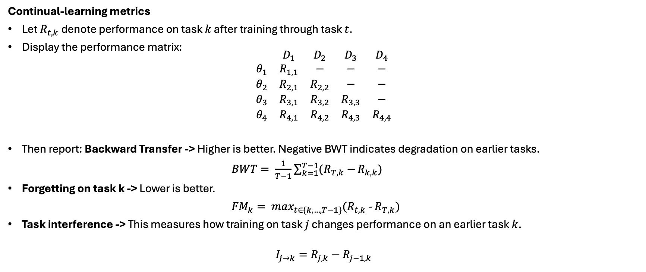
VLM Continual-Learning Diagnostics
VLM Continual Learning Metrics
Continual-learning metrics
Let $R_{t,k}$denote performance on task $k$ after training through task $t$.
Display the performance matrix:
$$\begin{matrix} & D_{1} & D_{2} & D_{3} & D_{4} \\ θ_{1} & R_{1,1} & − & − & − \\ θ_{2} & R_{2,1} & R_{2,2} & − & − \\ θ_{3} & R_{3,1} & R_{3,2} & R_{3,3} & − \\ θ_{4} & R_{4,1} & R_{4,2} & R_{4,3} & R_{4,4}\end{matrix}$$
Then report: Backward Transfer -> Higher is better. Negative BWT indicates degradation on earlier tasks.
$BWT= \frac{1}{T−1}\sum_{k=1}^{T−1}{(R_{T,k}−}R_{k,k})$
Forgetting on task k -> Lower is better.
${FM}_{k}= \max_{t∈\{k,…,T−1\}}(R_{t,k}$ - $R_{T,k})$
Task interference -> This measures how training on task $j$ changes performance on an earlier task $k$.
$$I_{j→k}=R_{j,k}−R_{j−1,k}$$
Notes:
=== Slide 26: Continual Learning Dynamics: Formal Metrics ===
[WHAT PROF. LE SEES ON SCREEN]:
• Task performance matrix: R_{t,k} (performance on task k after training on task t).
• Backward Transfer: BWT = (1 / (T-1)) sum_{i=1}^{T-1} (R_{T,i} - R_{i,i}).
• Forgetting Measure: FM_k = max_{l in {1...T-1}} R_{l,k} - R_{T,k}.
• Pairwise Task Interference: I_{j -> k} = R_{j,k} - R_{j-1,k}.
[SPOKEN SCRIPT - READ ALOUD]:
"On Slide 26, we formalize our continual learning metrics. We maintain the complete task performance matrix, R_{t,k}, tracking performance on past tasks after training on each new task. From this matrix, we compute Backward Transfer to quantify retention, Forgetting Measure to capture peak-to-final accuracy drops, and pairwise Task Interference, I_{j -> k}, which isolates exactly how learning task j alters performance on earlier task k."
[ANTICIPATED QUESTION & DEFENSE]:
Q: Why measure pairwise task interference?
A: BWT only gives an aggregate average. Pairwise interference reveals if specific task transitions—such as moving from math diagrams to clinical scans—are particularly destructive to safety.
[TRANSITION TO NEXT SLIDE]:
Slide 27 presents our full mechanism diagnostics table.

Slide 27
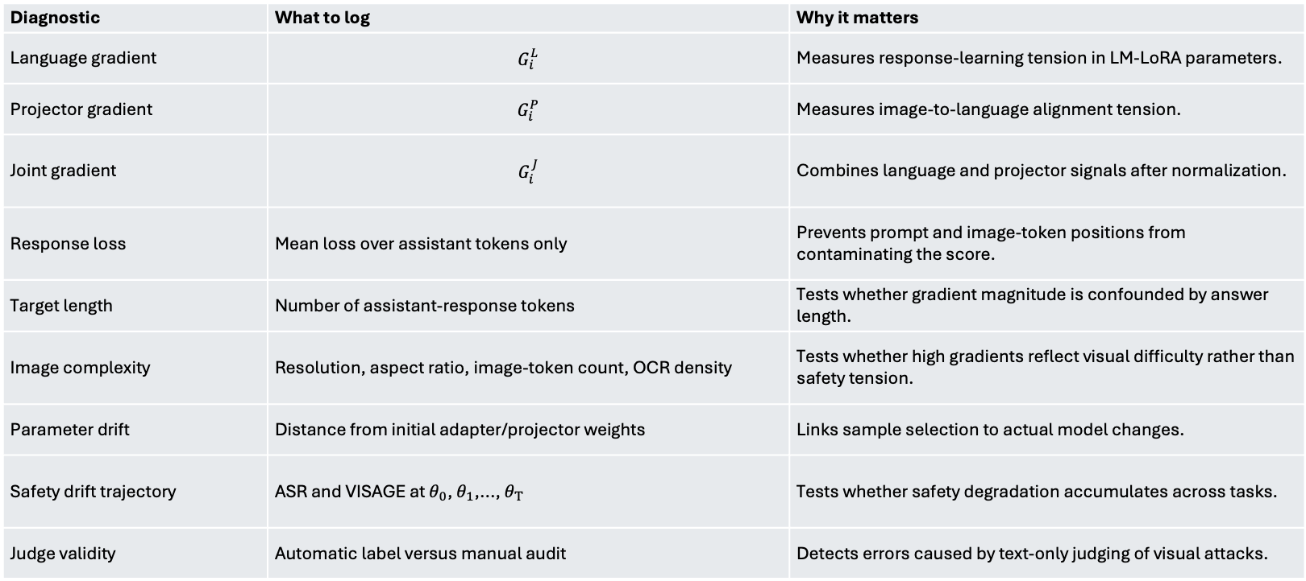
VLM specific mechanism Diagnostics
Diagnostic | What to log | Why it matters
Language gradient | $$G_{i}^{L}$$ | Measures response-learning tension in LM-LoRA parameters.
Projector gradient | $$G_{i}^{P}$$ | Measures image-to-language alignment tension.
Joint gradient | $$G_{i}^{J}$$ | Combines language and projector signals after normalization.
Response loss | Mean loss over assistant tokens only | Prevents prompt and image-token positions from contaminating the score.
Target length | Number of assistant-response tokens | Tests whether gradient magnitude is confounded by answer length.
Image complexity | Resolution, aspect ratio, image-token count, OCR density | Tests whether high gradients reflect visual difficulty rather than safety tension.
Parameter drift | Distance from initial adapter/projector weights | Links sample selection to actual model changes.
Safety drift trajectory | ASR and VISAGE at $θ_{0}$, $θ_{1}$,..., $θ_{T}$ | Tests whether safety degradation accumulates across tasks.
Judge validity | Automatic label versus manual audit | Detects errors caused by text-only judging of visual attacks.
Notes:
=== Slide 27: VLM Specific Mechanism Diagnostics ===
[WHAT PROF. LE SEES ON SCREEN]:
• Diagnostics Table (9 rows): Language gradient G_i^{(L)}, Projector gradient G_i^{(P)}, Joint gradient G_i^{(J)}, Loss L_i, Target token length N_tokens, Prompt length, Image token count, Image resolution, Parameter displacement ||theta_t - theta_0||_2.
[SPOKEN SCRIPT - READ ALOUD]:
"Slide 27 presents our diagnostics table. For every experiment, we record language LoRA drift, projector drift, joint norms, token lengths, image resolution, and parameter distance from the aligned checkpoint theta_0. This allows us to map sample selection directly to weight trajectory shifts in parameter space."
[ANTICIPATED QUESTION & DEFENSE]:
Q: What does parameter displacement tell us?
A: It directly tests Ji et al.'s elasticity theory: if Moderate-G_i remains closer to theta_0 while achieving high task performance, it proves that safety retention is achieved by minimizing unnecessary weight displacement.
[TRANSITION TO NEXT SLIDE]:
Slide 28 presents our 13-condition experimental control grid.

Slide 28
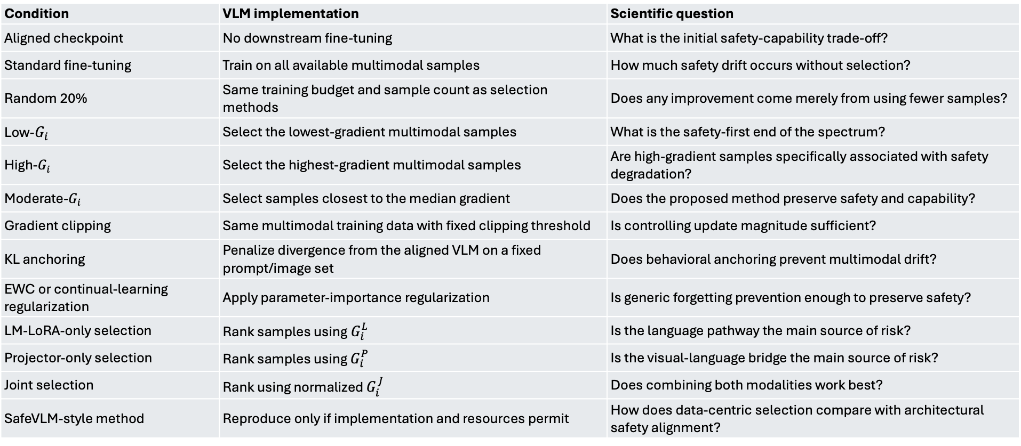
VLM Control Conditions and Baselines
Condition | VLM implementation | Scientific question
Aligned checkpoint | No downstream fine-tuning | What is the initial safety-capability trade-off?
Standard fine-tuning | Train on all available multimodal samples | How much safety drift occurs without selection?
Random 20% | Same training budget and sample count as selection methods | Does any improvement come merely from using fewer samples?
Low-$G_{i}$ | Select the lowest-gradient multimodal samples | What is the safety-first end of the spectrum?
High-$G_{i}$ | Select the highest-gradient multimodal samples | Are high-gradient samples specifically associated with safety degradation?
Moderate-$G_{i}$ | Select samples closest to the median gradient | Does the proposed method preserve safety and capability?
Gradient clipping | Same multimodal training data with fixed clipping threshold | Is controlling update magnitude sufficient?
KL anchoring | Penalize divergence from the aligned VLM on a fixed prompt/image set | Does behavioral anchoring prevent multimodal drift?
EWC or continual-learning regularization | Apply parameter-importance regularization | Is generic forgetting prevention enough to preserve safety?
LM-LoRA-only selection | Rank samples using${ G}_{i}^{L}$ | Is the language pathway the main source of risk?
Projector-only selection | Rank samples using $G_{i}^{P}$ | Is the visual-language bridge the main source of risk?
Joint selection | Rank using normalized $G_{i}^{J}$ | Does combining both modalities work best?
SafeVLM-style method | Reproduce only if implementation and resources permit | How does data-centric selection compare with architectural safety alignment?
Notes:
=== Slide 28: VLM Control Conditions & Baselines Grid ===
[WHAT PROF. LE SEES ON SCREEN]:
• 13 Conditions: Aligned theta_0, Standard full fine-tuning, Random 20%, Low-G_i 20%, Moderate-G_i 20% (LM-LoRA), Moderate-G_i 20% (Projector), Moderate-G_i 20% (Joint), High-G_i 20%, Length-norm Moderate-G_i, Gradient Clipping, EWC, Replay with safety data, Full + Safety Co-training.
[SPOKEN SCRIPT - READ ALOUD]:
"Slide 28 is our experimental control grid, spanning 13 conditions. Every condition answers a distinct scientific question: Aligned theta_0 sets the ceiling; Standard Fine-Tuning measures unconstrained drift; Random 20% controls for sample count; Low and High-G_i test the extreme ends of the spectrum; Gradient Clipping tests whether magnitude control suffices; EWC tests generic forgetting regularizers; and our three attribution modes isolate the modality responsible for drift."
[ANTICIPATED QUESTION & DEFENSE]:
Q: Why is Random 20% an essential baseline?
A: Because if Moderate 20% outperforms Full Fine-Tuning, a reviewer might claim it's simply because training on fewer samples causes less drift. Comparing Moderate 20% directly against Random 20% proves the benefit is driven by gradient selection, not sample budget.
[TRANSITION TO NEXT SLIDE]:
Slide 29 provides the unified evaluation matrix.

Slide 29
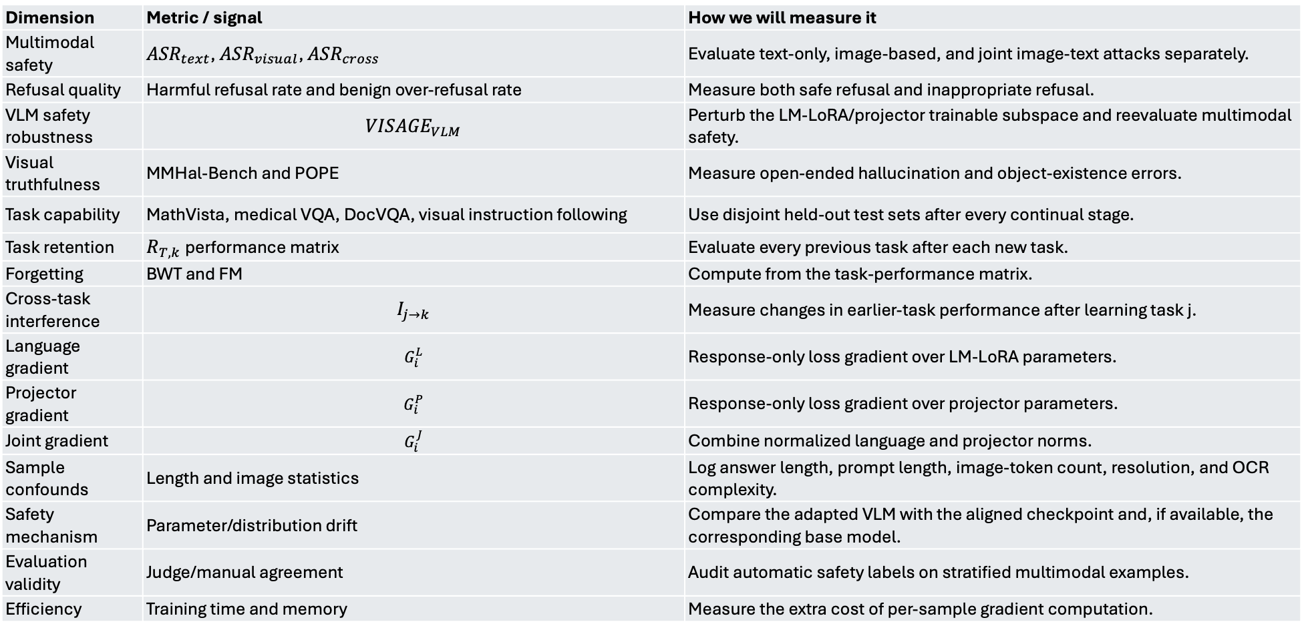
VLM Continual-Learning Diagnostics
Dimension | Metric / signal | How we will measure it
Multimodal safety | ${ASR}_{text}$, ${ASR}_{visual}$, ${ASR}_{cross}$ | Evaluate text-only, image-based, and joint image-text attacks separately.
Refusal quality | Harmful refusal rate and benign over-refusal rate | Measure both safe refusal and inappropriate refusal.
VLM safety robustness | $${VISAGE}_{VLM}$$ | Perturb the LM-LoRA/projector trainable subspace and reevaluate multimodal safety.
Visual truthfulness | MMHal-Bench and POPE | Measure open-ended hallucination and object-existence errors.
Task capability | MathVista, medical VQA, DocVQA, visual instruction following | Use disjoint held-out test sets after every continual stage.
Task retention | $R_{T,k}$performance matrix | Evaluate every previous task after each new task.
Forgetting | BWT and FM | Compute from the task-performance matrix.
Cross-task interference | $$I_{j→k}$$ | Measure changes in earlier-task performance after learning task j.
Language gradient | $$G_{i}^{L}$$ | Response-only loss gradient over LM-LoRA parameters.
Projector gradient | $$G_{i}^{P}$$ | Response-only loss gradient over projector parameters.
Joint gradient | $$G_{i}^{J}$$ | Combine normalized language and projector norms.
Sample confounds | Length and image statistics | Log answer length, prompt length, image-token count, resolution, and OCR complexity.
Safety mechanism | Parameter/distribution drift | Compare the adapted VLM with the aligned checkpoint and, if available, the corresponding base model.
Evaluation validity | Judge/manual agreement | Audit automatic safety labels on stratified multimodal examples.
Efficiency | Training time and memory | Measure the extra cost of per-sample gradient computation.
Notes:
=== Slide 29: Complete Evaluation Matrix ===
[WHAT PROF. LE SEES ON SCREEN]:
• Unified Matrix: Maps 7 dimensions (Multimodal safety, Refusal quality, Robustness, Hallucination, Task performance, Continual learning, Compute efficiency) to metrics and exact measurement tools.
[SPOKEN SCRIPT - READ ALOUD]:
"Slide 29 provides our complete evaluation scorecard, mapping every metric—from multi-channel ASR to judge/manual agreement and GPU wall-clock training efficiency—to its precise measurement methodology."
[ANTICIPATED QUESTION & DEFENSE]:
Q: What is your primary headline metric?
A: The Pareto frontier of Average Continual ASR (lower is better) versus Average Downstream Accuracy (higher is better) across the 4 stages.
[TRANSITION TO NEXT SLIDE]:
Finally, Slide 30 synthesizes our proposal into 6 fundamental research questions.

Slide 30
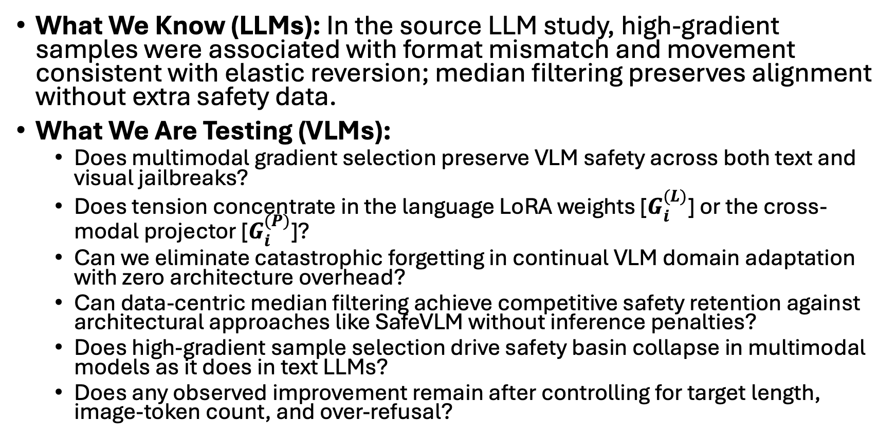
Summary and Open Research questions
What We Know (LLMs): In the source LLM study, high-gradient samples were associated with format mismatch and movement consistent with elastic reversion; median filtering preserves alignment without extra safety data.
What We Are Testing (VLMs):
  Does multimodal gradient selection preserve VLM safety across both text and visual jailbreaks?
  Does tension concentrate in the language LoRA weights [$G_{i}^{(L)}$] or the cross-modal projector [$G_{i}^{(P)}$]?
  Can we eliminate catastrophic forgetting in continual VLM domain adaptation with zero architecture overhead?
  Can data-centric median filtering achieve competitive safety retention against architectural approaches like SafeVLM without inference penalties?
  Does high-gradient sample selection drive safety basin collapse in multimodal models as it does in text LLMs?
  Does any observed improvement remain after controlling for target length, image-token count, and over-refusal?
Notes:
=== Slide 30: Summary & 6 Core Research Questions ===
[WHAT PROF. LE SEES ON SCREEN]:
• Text LLM findings vs VLM Open Questions.
• 6 Research Questions: RQ1 (Multi-channel safety), RQ2 (LoRA vs Projector attribution), RQ3 (Forgetting without overhead), RQ4 (Data-centric vs SafeVLM), RQ5 (Safety basin collapse), RQ6 (Confounder invariance).
[SPOKEN SCRIPT - READ ALOUD]:
"To summarize: in text LLMs, we know high-gradient samples drive elastic reversion out of safety basins, and median filtering preserves alignment without extra safety data. In this research, we are answering six fundamental questions: Does multimodal gradient selection protect both text and visual jailbreaks? Does tension concentrate in the language LoRA weights or the cross-modal projector? Can we eliminate forgetting with zero architectural overhead? Can data-centric filtering match architectural defenses like SafeVLM without inference penalties? Does high-gradient selection cause safety basin collapse in VLMs? And do these improvements hold after strictly controlling for target length and image token density?"
[ANTICIPATED QUESTION & DEFENSE]:
Q: Which of these 6 RQs is the most novel?
A: RQ2 (LoRA vs Projector attribution) and RQ4 (Data-centric filtering vs Architectural defenses like SafeVLM). No prior work has investigated gradient attribution across multimodal components for safety retention.
[TRANSITION TO NEXT SLIDE]:
Slide 31 lists our core academic references.

Slide 31
References
Bach et al. (arXiv:2604.17215)
Ji et al. (arXiv:2406.06144)
Peng et al. (arXiv:2405.17374)
MM-SafetyBench
FigStep
SaLORA
LARF
EWC
VLGuard
LLaVA
MathVista
Notes:
=== Slide 31: References ===
[WHAT PROF. LE SEES ON SCREEN]:
• Primary foundations: Bach et al. (arXiv:2604.17215), Ji et al. (arXiv:2406.06144), Peng et al. (arXiv:2405.17374).
• Multimodal SOTA & Benchmarks: MM-SafetyBench, FigStep, SaLORA, LARF, EWC, VLGuard, LLaVA, MathVista.
[SPOKEN SCRIPT - READ ALOUD]:
"Finally, our theoretical and empirical foundations are anchored in Bach et al. (2026), Ji et al.'s elasticity theory, Peng et al.'s VISAGE safety basins, and standard multimodal benchmarks including MM-SafetyBench, FigStep, and MathVista. Thank you, Professor Le. I welcome your feedback, guidance, and questions on our proposed methodology."
[ANTICIPATED QUESTION & DEFENSE]:
Q: Where do we start on Monday?
A: With the Phase 1 Colab T4 prototype: running the 1,000-sample gradient pass on Qwen2-VL-2B to verify the gradient distribution and test Moderate vs High G_i on FigStep.
[TRANSITION TO NEXT SLIDE]:
End of presentation. Open floor for advisor Q&A.

