Slide 1
LLM-Assisted Customer Support Triage System
Final Project Presentation (Evidence-Backed, 50 Slides)

Slide 2
Agenda
Problem
Architecture
Implementation
Results
Evaluation
Alignment
Roadmap

Slide 3
Problem Statement
Support queues are noisy and high-volume
Manual triage is slow and inconsistent
Need explainable AI-assisted routing

Slide 4
Project Objectives
Automate triage and quality monitoring
Provide summarization and policy grounding
Deliver reproducible demo-ready stack

Slide 5
System Scope
Endpoints: triage, quality, pipeline, summarize, rag/context
Inference-first architecture with optional training paths
Production-style API + tests + docs

Slide 6
Core NLP Tasks
Intent/category classification
Priority and sentiment estimation
Response quality scoring
Thread summarization

Slide 7
High-Level Architecture
Notebook/API client -> FastAPI -> services
LLM client shared by triage/quality/summarization
Pipeline runs triage and quality concurrently

Slide 8
Data Assets
Golden eval set: data/golden/eval_set.jsonl
Policy snippets for RAG: data/policy_snippets.json
Demo transformer data: artifacts/demo_tickets.csv

Slide 9
Configuration Strategy
Environment-driven settings via app/core/config.py
Provider profiles: ollama/openrouter/nvidia/manual
Feature flags for optional components

Slide 10
API Contract Design
Pydantic models as source of truth
Strict schema validation and explicit error handling
Deterministic routing matrix outside LLM

Slide 11
Triage Service
LLM returns structured JSON
Priority/category/intents normalized and validated
Routing determined by matrix + sentiment escalation

Slide 12
Quality Service
Rubric-based scoring (empathetic/actionable/safety/resolution)
Pass/fail threshold from config
Coaching feedback and flagged phrases

Slide 13
Pipeline Service
Runs triage + quality in parallel
Computes SLA recommendation
Returns workflow_passed aggregate decision

Slide 14
Summarization Service
Multi-turn thread summarization
Returns summary, key_points, confidence
Schema-validated output

Slide 15
RAG Service
Default lexical retrieval over policy snippets
Optional embedding retrieval backend
Used for grounding quality/triage prompts

Slide 16
LLM Client
Provider-agnostic OpenAI-compatible + Anthropic support
Retries, timeout handling, JSON parse safeguards
Metrics labels include prompt_version

Slide 17
Reliability Issue Encountered
Hosted model output drift produced invalid labels (e.g., refund)
Pipeline could fail with 422 on strict enum validation
Needed deterministic recovery layer

Slide 18
Reliability Fix Implemented
Synonym normalization for common off-schema labels
Embedding-similarity fallback mapping
Strict final validation preserved

Slide 19
Intent Fallback Service
File: app/services/intent_fallback_service.py
Maps invalid labels into allowed taxonomy
Feature-gated with config flags

Slide 20
Fallback Config Flags
TRIAGE_EMBEDDING_FALLBACK_ENABLED
TRIAGE_EMBEDDING_MODEL
TRIAGE_EMBEDDING_MIN_SIMILARITY

Slide 21
Testing Strategy
Unit tests for services and fallback
Integration tests for API and full pipeline
Deterministic e2e tests for demo reliability

Slide 22
Verification Sweep
Core tests passed
JSON/TOML/YAML syntax validated
Notebook endpoint flow validated

Slide 23
Operational Readiness
README + alignment docs updated
Notebook warm-up + retry guidance added
Cleanup performed for generated clutter

Slide 24
Repository Structure Overview
app/: runtime services and API
scripts/: training/evaluation tooling
tests/: verification
docs/: evidence/presentation assets

Slide 25
Demo Flow
Start uvicorn
Warm-up triage call
Run 5 endpoint showcase
Inspect structured outputs

Slide 26
Security and Secrets
.env local-only, .env.example template
Do not commit provider keys
API key middleware optional

Slide 27
Observability
Prometheus metrics available
Structured logs with service context
Prompt version labeling for regression tracking

Slide 28
Evaluation Methodology
Offline eval using golden set
Category + priority accuracy
Quality mean score + summarization ROUGE-L

Slide 29
Transformer Fine-Tune Path
Optional script: train_triage_transformer.py
Produces checkpoint under artifacts/
Can be used as triage hint

Slide 30
Baseline Classifier Path
Optional TF-IDF + Logistic Regression
Used as lightweight hint in triage prompt
Supports ablation-style demos

Slide 31
Notebook Coverage
EDA
Offline evaluation
Optional transformer training
Live API endpoint checks

Slide 32
Presentation Risk Controls
Claims-vs-evidence matrix prepared
Optional features clearly labeled
Future work explicitly separated

Slide 33
Cleanup Summary
Removed only generated cache/metadata
Preserved source, tests, docs, artifacts
Cleaner repo for final presentation

Slide 34
Lecture Alignment - Overview
End-to-end NLP pipeline
Embeddings + transfer learning
Evaluation methodology
Production engineering practice

Slide 35
Lecture Alignment - Embeddings
Semantic similarity fallback
Optional embedding RAG backend
Connects to representation learning concepts

Slide 36
Lecture Alignment - Transformers
Optional BERT/RoBERTa fine-tuning script
Inference-time hint integration
Transfer learning from pretrained models

Slide 37
Lecture Alignment - Evaluation
Classification metrics
Quality scoring metrics
Summarization ROUGE-L
Regression-focused evaluation

Slide 38
Current Limitations
NER standalone module not shipped
Large-corpus training remains optional
External integrations are partial/stubbed

Slide 39
Roadmap
NER extraction module
Expanded dataset experiments
Richer analytics dashboards
Deeper connector automation

Slide 40
Contribution Summary
Reliable production-style NLP stack
Robustness fix for real-world label drift
Reproducible demo and verification artifacts

Slide 41
Appendix: Key Files
app/services/triage_service.py
app/services/intent_fallback_service.py
tests/integration/test_pipeline_label_recovery.py

Slide 42
Appendix: Core Commands
pytest ... --no-cov
python scripts/run_offline_eval.py ...
uvicorn app.main:app --host 127.0.0.1 --port 8000

Slide 43
Appendix: Demo Checklist
Correct .env profile/model
Restart uvicorn after env changes
Run notebook warm-up before full endpoint cell

Slide 44
Offline Evaluation Snapshot
Triage category accuracy: N/A
Triage category micro F1: N/A
Triage category macro F1: N/A
Triage priority accuracy: N/A
Quality mean score: N/A
Summarization ROUGE-L F1: N/A

Slide 45
Transformer Demo Metrics
Eval loss: 1.6039255857467651
Eval accuracy: 0.5
Eval runtime: 0.7725
Epochs: 1.0

Slide 46
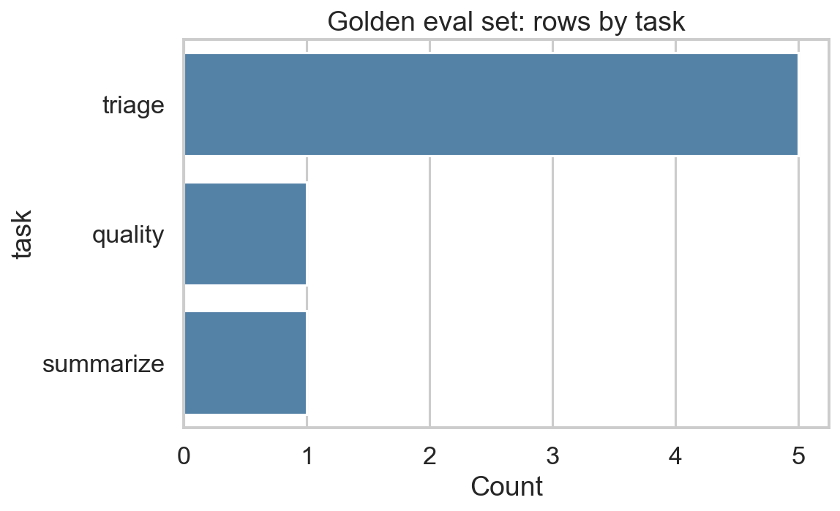
EDA: Golden Task Counts
Distribution of golden-set tasks used in offline analysis.

Slide 47
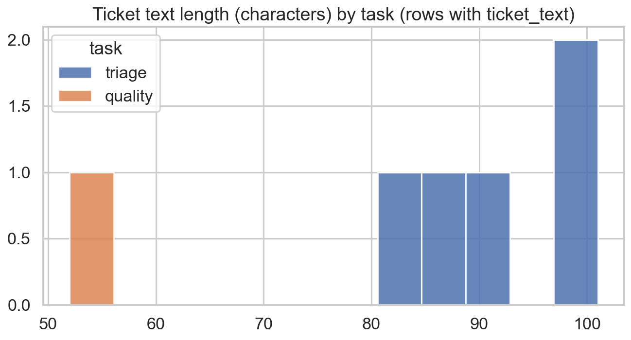
EDA: Text Length by Task
Text length spread by task type for coverage sanity check.

Slide 48
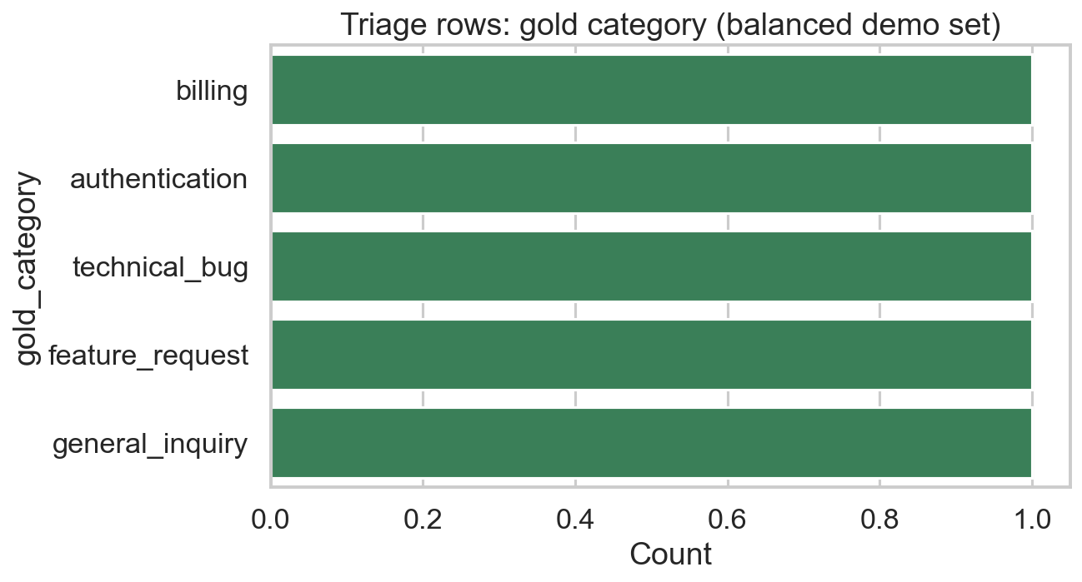
EDA: Triage Category Distribution
Category distribution in the golden set.

Slide 49
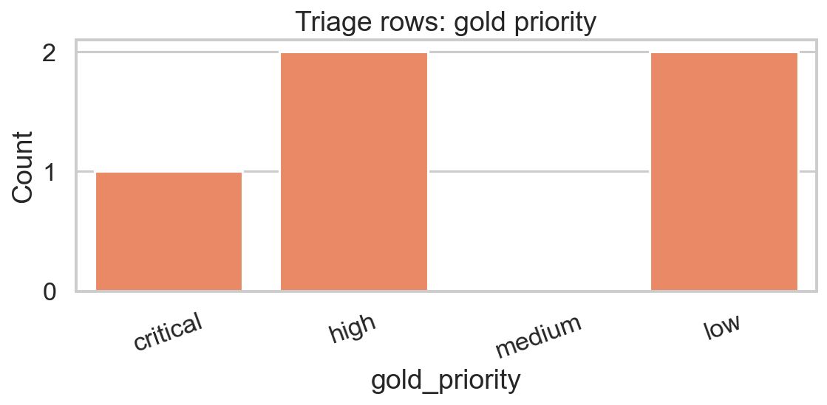
EDA: Triage Priority Distribution
Priority distribution in the golden set.

Slide 50
Backup Slide 50
Additional Q&A support material.
Use this slot for live demo observations.
Map answers back to docs/claims-evidence matrix.

