Slide 1
Lab 3

Slide 2
Purpose of lab
Understanding of dynamic test scope and how it can be implemented
Understanding of smart testing and how it can be implemented
Remember that you have the cheatsheets if you need help or you can send a message to us. Labs and cheatsheets
NOTE: All exercises assume that you have gone through the presentation by David

Slide 3
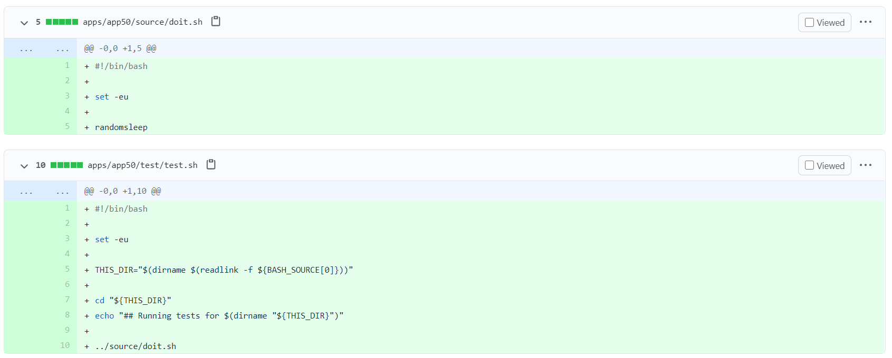
Note about lab
The pull request you will trigger in these labs is a pull request that creates a new product “app50” which contains a test
Don’t forget that you have the cheatsheet. This lab can be a bit advanced even with Davids slides.

Slide 4
list changed files
Create a Pipeline job called “Lab 3_1 <your name>”
The job should trigger on the pull request comment “rebuild”
The job should be possible to run manually as well as by pull request
Run job "Rebuild Pull Request 5" to trigger a pull request.
The pipeline should have 3 stages:
Setup
Clone the repository https://github.com/dev4242/project-x/
Checkout the incoming pull request
Build
Print the files that has been modified by the pull request
Cleanup
Clean the workspace

Slide 5
Dynamic test scope
Create a Pipeline job called “Lab 3_2 <your name>”
The job should trigger on the pull request comment “rebuild”
The job should be possible to run manually as well as by pull request
When you run it manually, you should select with a parameter which tests will be run
Run job "Rebuild Pull Request 5" to trigger a pull request.
The pipeline should have 3 stages:
Setup
Clone the repository https://github.com/dev4242/project-x/
Checkout the incoming pull request
Build
Source the script “ci/setup.sh”
Make sure that the test.sh added by the pull request is run when the job is triggered
Cleanup
Clean the workspace

Slide 6
Smart testing
Create a Pipeline job called “Lab 3_2 <your name>”
The job should trigger on the pull request comment “rebuild”
The job should be possible to run manually as well as by pull request
When you run it manually, you should select with a parameter which tests will be run
Run job Rebuild Pull Request 5 to trigger a pull request.
The pipeline should have 3 stages:
Setup
Clone the repository https://github.com/dev4242/project-x/
Checkout the incoming pull request
Build
Source the script “ci/setup.sh”
Run “/apps/appXX/test/test.sh” of the product(s) that has been affected by the pull request
Cleanup
Clean the workspace

