Slide 1


Natural Language Processing Application Investigation Report
Debasis Chatterjee SUID: 233176962
Human Computer Interfaces / Conversational Agents, including “chatbots”

Slide 2
Introduction
Human-Computer Interaction (HCI) researches the design and use of computer technology, focused on the interfaces between people (users) and computers. The flow of information between the human and computer has several aspects: visual based, audio based, machine environment, input flow, output flow and feedback. This is exactly what is achieved in the chatbot by taking mental illness as a use case and building a conversation with the user (patient).
A dialog system or conversational agent (CA) is a computer system intended to converse with a human, with a coherent structure. Chatbots are typically used in dialog systems for various practical purposes and use sophisticated NLP systems to impersonate a human in a real-time written conversation with a human.
Dialogflow is Google-owned HCI technologies based on NL conversations. Dialogflow helps to build natural and rich conversational experiences that gives users new ways to interact with the product by building engaging voice and text- based conversational interfaces powered by AI.
Achelois built using Dialogflow to understand the mental health of a patient and have a conversation with them by understanding their problems, suggesting remedies and trying to make them happy.

Slide 3
NLP Techniques and Research
Natural Language Understanding (NLU) involves the process of extracting meanings from text inputs. In this direction, the basic design steps include
Syntactic Parsing - determines the function of each word (part-of-speech), the way words are related to each other, how they are grouped into phrases and how they can modify each other. The context-free grammar (CFG) definition and parsers implementation are the common NLP techniques used in this step.
Semantic Parsing - The role of a semantic parser is to extract the context-independent meaning of a written sentence. The discriminative methods such as support vector machines (SVM) and statistical methods such as decision trees and classification and regression trees (CART) are used to find the most probable parse tree that fits the sentence.
Contextual Interpretation - refines the semantic interpretation by taking advantage of information at the discourse level and, removing remaining ambiguities such as anaphors, pronouns and ellipses. Discourse entity (DE) list maintains a set of constants referring to objects that have been evoked in previous sentences and can subsequently be referred implicitly.

Slide 4
Natural Language Generation (NLG)
NLG involves the building of responses for the chatbots based on the processing done in the NLU step. (Sameera A. Abdul-Kader, 2015)
Artificial Intelligence Markup Language (AIML) – an XML-compliant language designed to develop the AI flows in dialogue systems. Its purpose is to simplify the job of conversation modelling. The general structure of the AIML objects looks as follows:
<category>
<pattern> User input </pattern>
<template> Corresponding response to the user input </template>
</category>
The important elements of AIML are:
Categories – basic units of knowledge consisting of patterns and templates
Recursion – used to recursively match the other categories and thereby, simplify the complex grammatical forms. It is represented as <srai> tag
Context – the category tag uses the context <that> tag to refer to the previous input of the user
Variables – used to support the getting and setting of commonly used texts using <get> and <set>
tags that are generally used to store proper nouns.
Pronoun Swapping – used for replacement of pronouns such as ‘you’re’ with ‘I’m’ and ‘your’ with ‘my’ etc.

Slide 5
Natural Language Generation (NLG)
Pattern matching – mainly used in question-answering chatbot systems for simple statements and natural language enquiring.
Response generation (Woudenberg, 2014)
Document planning – brakes the high-level communicative goals into structured representations of atomic communicative goals
Microplanning (Sentence planning) – is the phase where the number of generated clauses is decided in order to produce language with improved naturalness. Methods such as semantic grammars – reverse parsing are used in generation of unnatural proto-phrases.
Surface realization – the process of transforming the abstract structure obtained in the microplanning stage into surface linguistic structures by adding function words, inflecting words, determining word order etc.

Slide 6
Natural Language Generation (NLG)
Chat script - the technique that helps when no matches occur in AIML. It concentrates on the best syntax to build a sensible default answer.
Markov chain - used to build responses that are more probabilistically applicable and consequently are more correct. The idea of Markov chains is that there is a fixed probability of occurrences for each letter or word in the same textual data set.
Language tricks - includes the sentences, phrases, paragraphs available in chatbots in order to add variety to the knowledge base and make it more convincing. The types of language tricks are: canned responses, typing errors and simulating key strokes, model of personal history and Non-Sequitur (not a logical conclusion). Each of these language tricks is used to satisfy a specific purpose and to provide alternative answers to questions.
Ontologies/Semantic networks – consists of set of relationally and hierarchically interrelated concepts. The aim of using ontologies in a chatbot is to compute the relation to synonyms, hyponyms and other relations which are natural language concept names. The interconnection between these concepts can be represented in a graph enabling the computer to search by using particular rules for reasoning.

Slide 7
Dialogue Processing
Aims at building a man-machine dialog based on turn-taking process wherein the information is transferred from one participant – the user and the other participant – dialog manager (DM). The process of dialogue management involves implementation of the interaction strategy to organize the sequence of system dialogues to achieve the common goal of the user and chatbot. The level of user satisfaction of a chatbot is heavily influenced by the concept of “Degree of Initiative” –
System-Led – an initiative that is completely controlled by the system wherein it asks precise questions to the user and expects information or answers from the user
User-Led – an initiative that is led by the user while the system is expected to provide information to the user queries without asking for more details
Mixed-Initiative – an initiative in which both the participants interact cooperatively to achieve the conversation goal. For example, health chatbot shares the control between the user and system.
Relational databases enable the chatbot to remember past conversations and make the conversation more continuous and meaningful by building knowledge bases. The Structured Query Language (SQL) allows generation of queries and query block nesting to save the conversation history. This mainly makes the search of a word and phrase match easier.

Slide 8
Types of chatbot models
There are two types of chatbot models
 | Retrieval - Based | Generator - Based
Description | Simple and pre-defined heuristic model | Smart model generating new response from scratch
Grammatical errors in responses | Rarely involves errors in grammar | Can be prone to grammatical errors
Behavior towards unseen cases | Not handled | Handles efficiently
Contextual responses | Not considered | Considers context for response generation
Length of conversation | Long | Short
Domain | Open | Closed

Slide 9
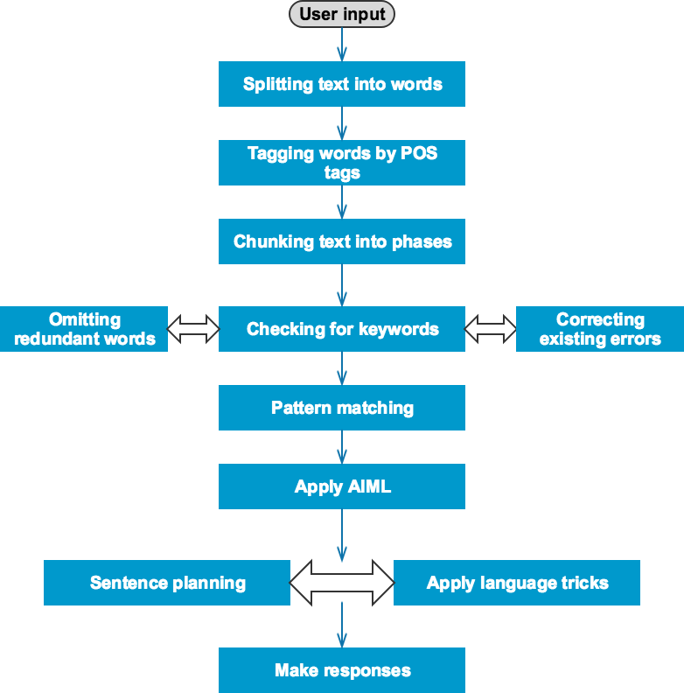
Chatbot processing mechanism

Slide 10
Various Chatbots, Pros and Cons
Platforms | wit.ai | luis.ai | Dialogflow
Description | Allows to easily create text or voice-based bots that humans can chat with on their preferred messaging platform. It allows to understand user input after certain training, identify intents, extract entities, and predict what the bot should do based on the current context and user query. | Introduced by Microsoft. The Microsoft Bot framework helps us to build, test and deploy bots for many well- known platforms such as Facebook, Slack etc. There are some pre-built domains that we can import to the chatbot together with its entities, intents and utterances. | Formerly known as api.ai, this Google acquired platform is popular for building conversational interfaces. Offers more than 30 pre- built agents such as navigation, hotel booking, small talk, weather, news etc.
Pros | The concept of story is really powerful and allows controlling the conversation flow using branches and conditions on actions. An “Inbox” exists, where the requests that could not be processed by the chatbot are listed, so the developers can train the bot. | More feasible for professional purposes and .NET developers. The enterprise version can be integrated with other application provided by Microsoft Azure to enhance functionalities. | One-click integration with several platforms like Slack, Telegram, Facebook Messenger, Twitter, Amazon Alexa, Google Assistant etc. Built-in voice interface and support for Node.js, Ruby, Android, iOS, Python etc. SDKs.
Cons | wit.ai has integration with Facebook messenger only. Stories are in beta. There are cases where it is difficult to control the flow of the conversation and the bot tends to misunderstand the user requests. | luis.ai has 10,000 transactions for each month and is priced after that. | Priced for enterprises requiring high utilization of Dialogflow It is impossible to block the matching of an intent if a context is present. The training section is still in beta

Slide 11
Healthcare Chatbots
WHY HEALTHCARE?
Technical advancements in the healthcare domain are growing at a rapid pace. Numerous chatbots are already available in the areas of hotel management, travel, food delivery and home automation.
Development of chatbots that are customized to individual needs will make healthcare widely available. Some chatbots already being used for general healthcare services like Your.MD, Florence and GYANT

Slide 12
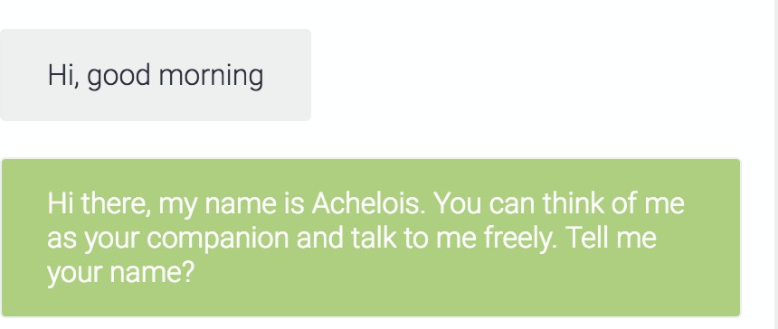
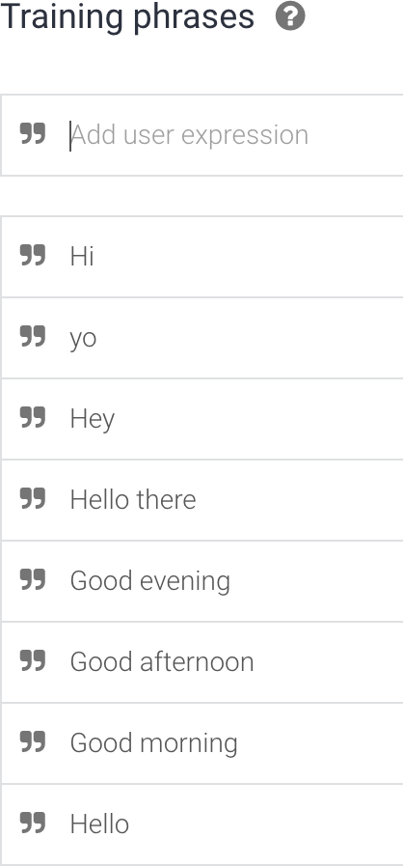
Dialogflow
https://nlp-debasis-research.herokuapp.com/ is leveraged most of what Dialogflow has to offer to build Achelois. It understands the feelings and problems of a patient struggling with their mental health and provides suggestions to make their life better and happy.
Achelois conversasion, Training phase for welcome intent respectively (snaps):
The agent is trained using NLP and machine learning techniques such as word embedding, user data, lexical synonyms, bag- of-words, synonym detection, regular expressions, tokenization, tags, supervised learning etc. and hence was able to detect what the user said.
It does not need to input all possible user inputs, but only need to put in few sentences or words and the powerful algorithms in Dialogflow takes care of the rest. It is observed a lot of other techniques here in this small example. The case of the words is not taken into consideration, but punctuation and special characters are. The Dialogflow agent needs to know what information is useful for answering the user’s request.

Slide 13
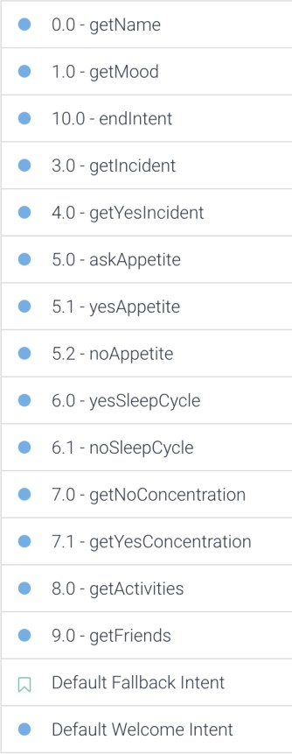
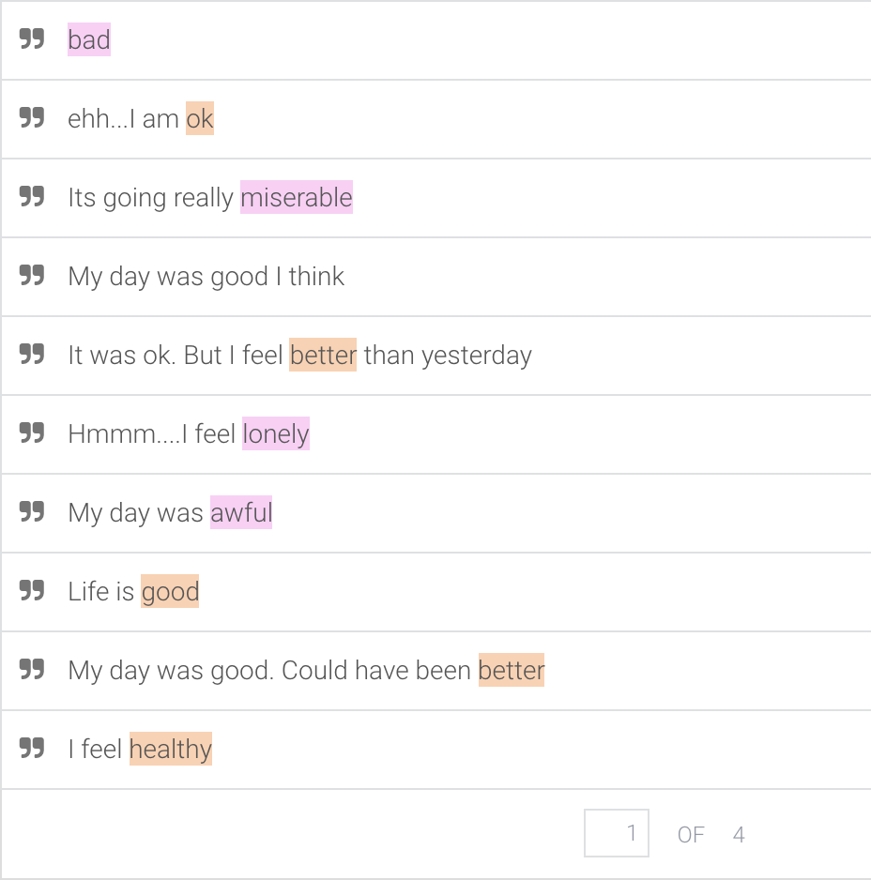
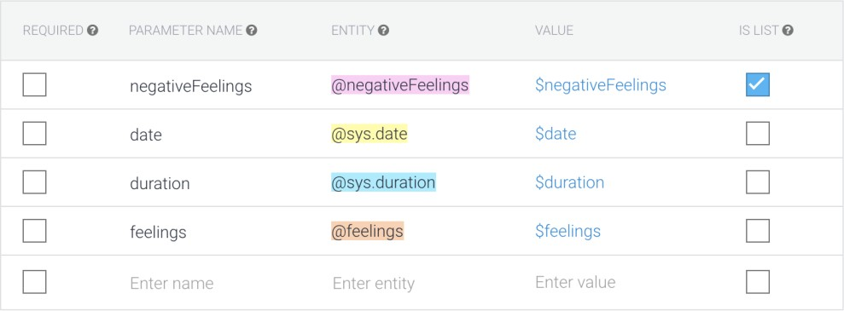
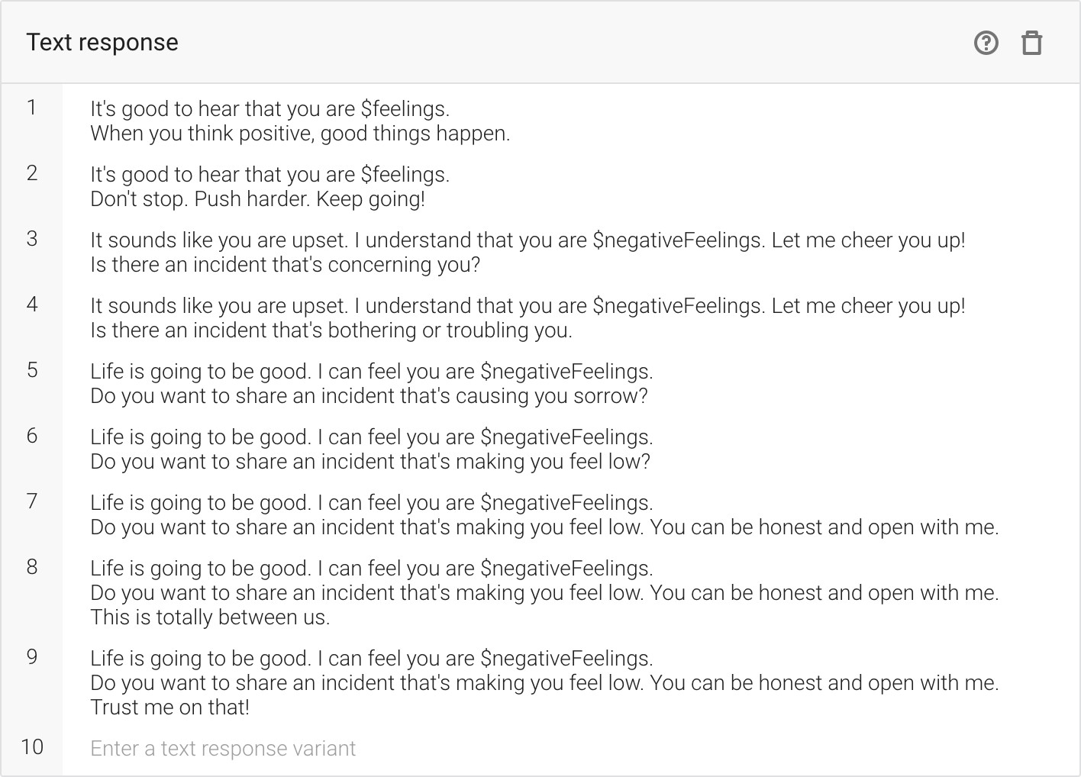
Agent & Intent
Agents: can be designed to manage a conversation flow in a specific way
Intent: represents a mapping between what a user says and what action should be taken.
Figure-1 shows the intents in the agent and Figure-2 shows training phrases for “1.0 – getMood” intent. There are around 40 training phrases for this intent. The reason is, getting the mood of a person is a very diverse question. And the possibilities on how a user might respond depends on each individual. Figure-3 shows the action and parameters for getMood intent. The colors in Figure-1.6 correspond to the entities shown in Figure-. For example, the word awful is negative and is tagged with negativeFeelings entity. Figure-4 shows the agent’s responses which will be provided by the agent when the intent is triggered.

Slide 14
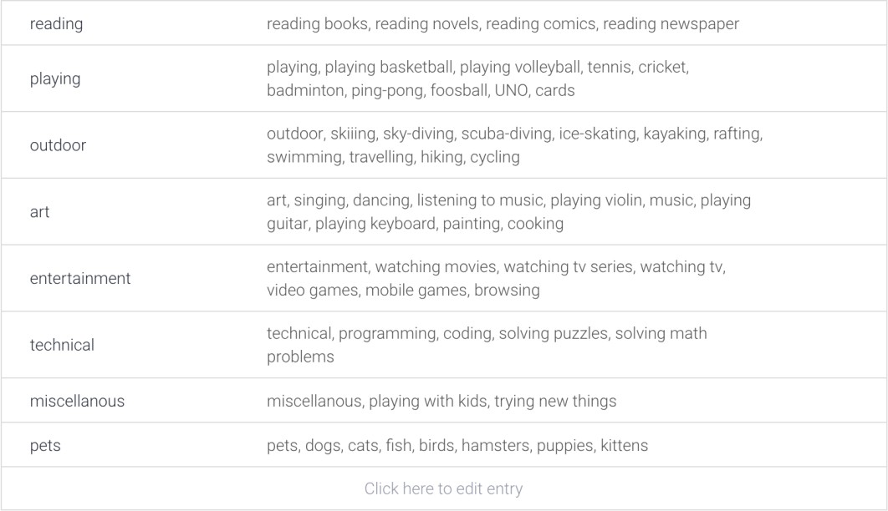
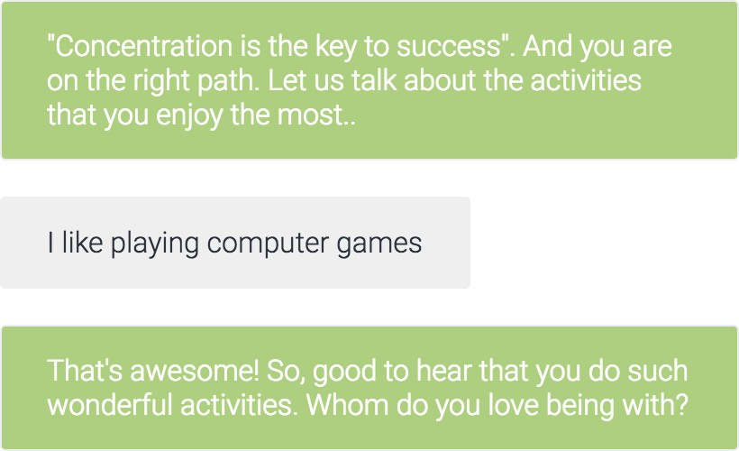
Entities
Entities are powerful tools used for extracting parameter values from natural language inputs. Any important data that is intended to get from a user’s request, will have a corresponding entity. There are three types of entities: system (defined by Dialogflow. Example: given names, address, phone numbers, color, temperature etc.), developer (defined by a developer), and user (built for each individual end-user). Figure-
Figure-1 shows the entities for “activities”. When the bot wants to learn about the activities that the user likes to do, there are innumerable possibilities and have been defined a few as shown in the figure. But, Dialogflow is intelligent enough to understand all the synonyms and continuously learns more synonyms.
Figure-2 shows the “activities” entity usage in the conversation. Although, there is no such activity as “I like playing computer games” in this entity list, Dialogflow recognizes that “playing computer games” is an activity that a person would like to do.

Slide 15
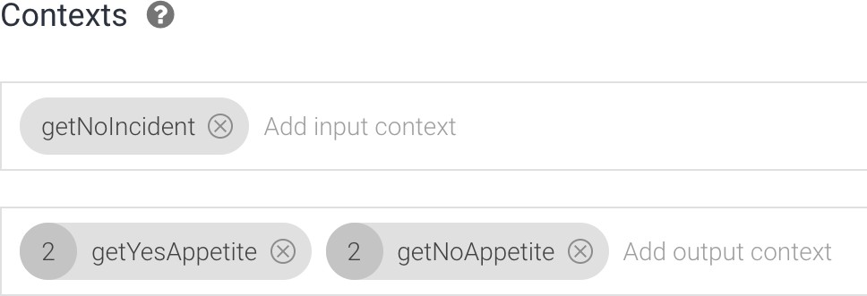
Contexts
Contexts represent the current context of a user’s request. This is helpful for differentiating phrases which may be vague or have different meanings depending on the user’s preferences, location or the topic of conversation. Contexts are designed for passing on information from previous conversations and can be used to manage the conversation flow. Each intent can have several input and output contexts. The output contexts from an intent will act as an input context to another intent. Figure-1 shows an example of the context for “5.0 – askAppetite” intent. Based on the user’s response, the decision tree can branch in different ways and go to respective intents based on the output context.

Slide 16
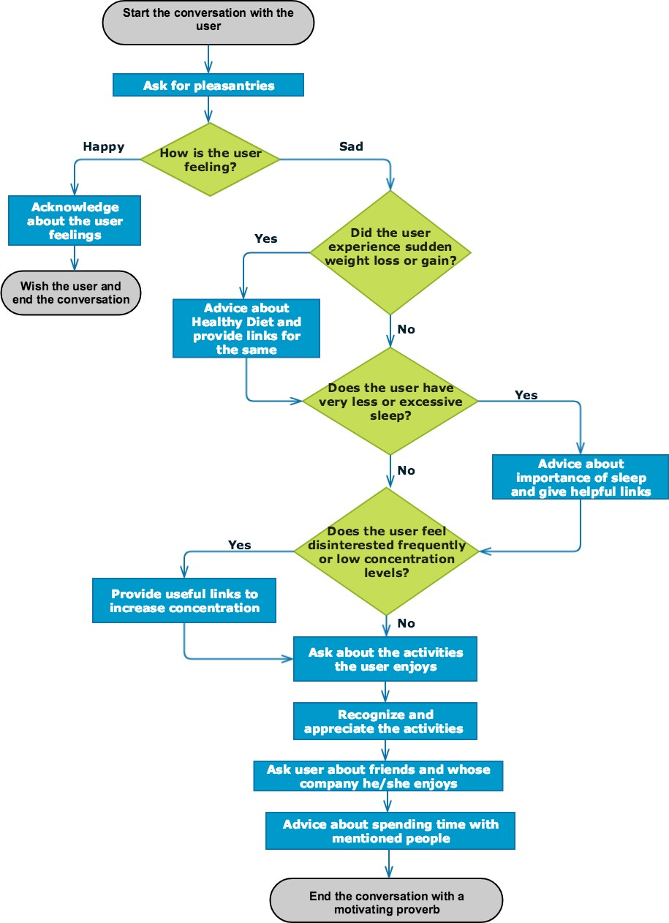
Decision tree for Achelois
Agents work based on decision trees and at each step of the conversation flow, it can have multiple paths to proceed and determines the best path based on the previous outcome and input. Figure-1 shows a small part of the decisions taken by Achelois. This figure covers a portion of the illness such as weight loss, excessive sleep and interested activities

Slide 17
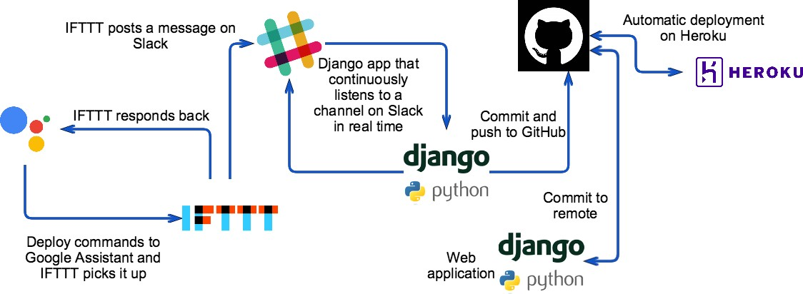
Ingenious web application with Achelois
Just say “Deploy NLP app” to Google Assistant on the phone (Google Assistant can figure out similar sentences as well!).
IFTTT has plenty of integrations and we have integrated Google Assistant and Slack to IFTTT. When there is a deploy command to Google Assistant, IFTTT intervenes and posts a message on Slack. This can be any channel or the Slack bot.
Two very simple Django applications are developed. The first application just listens to a channel or the Slack bot in real-time.
When there is a deploy post on Slack, the application picks it up and performs an empty commit of the other Django application to GitHub repository.
The second Django application hosted at https://nlp-debasis-research.herokuapp.com/, is the web application that has Achelois in it and few other things. This web application is deployed on Heroku.

Slide 18
Future of Chabots in Healthcase
The most challenging aspect of advancement in the development of chatbots is that, tools in healthcare must meet the basic technology expectations, informing and connecting, but they must also comfort us in the time of need. They must make things bearable, hopeful
Another challenge with respect to healthcare domain in general is that the data is sparse. Even if large datasets are available, it is difficult to feed them to the bot as the responses from patients are unpredictable

Slide 19
References
(n.d.). Retrieved from https://dialogflow.com/ Abdul-Kader, S. A. (n.d.).
Build natural and rich conversational experiences. (n.d.). Retrieved from Google DialogFlow: https://dialogflow.com/
Javier. (2015). Building a Chatbot: analysis & limitations of modern platforms. Retrieved from tryo labs: https://tryolabs.com/blog/2017/01/25/building-a-chatbot-analysis--limitations-of-modern- platforms/
Sameera A. Abdul-Kader, D. J. (2015). Survey on Chatbot Design Techniques in Speech Conversation Systems. International Journal of Advanced Computer Science and Applications.
Woudenberg, A. v. (2014). Chatbots and Dialogue Systems: A Hybrid Approach. Open University of the Netherlands.
https://docs.microsoft.com/en-us/azure/bot-service/dotnet/bot-builder-dotnet-manage-conversation-flow https://blog.algorithmia.com/introduction-natural-language-processing-nlp/
https://wit.ai/ https://www.luis.ai/home
http://medicalfuturist.com/chatbots-health-assistants/ https://www.techemergence.com/chatbots-for-healthcare-comparison/
The source code of the web application is available on GitHub: https://github.com/dev5680/nlp-debasis-research
The website URL is:
https://nlp-debasis-research.herokuapp.com/
The following video demonstrates Achelois in action: https://www.dropbox.com/home?preview=Achelois_video_demo.mov

