Slide 1

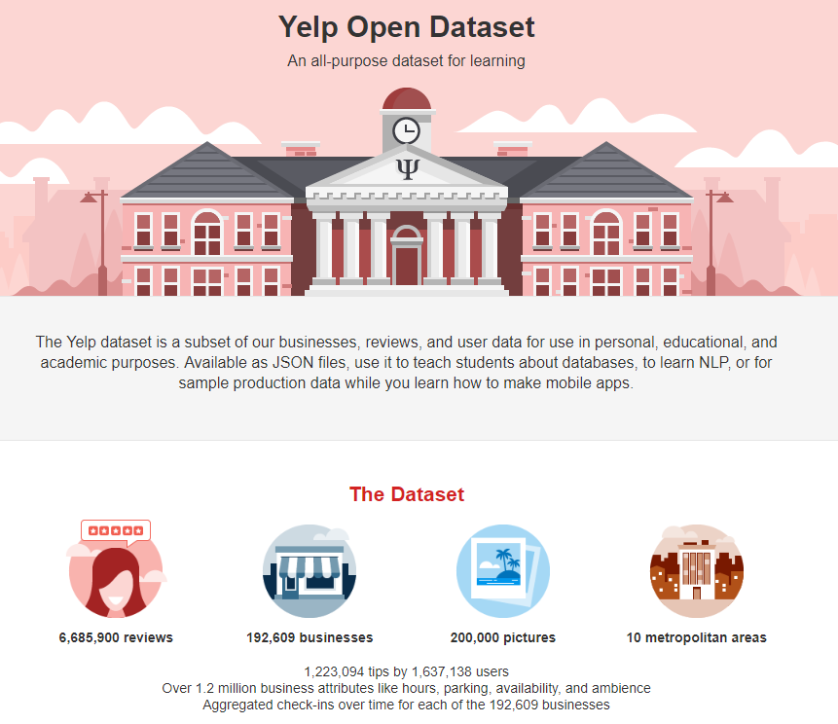
ist718 project checkin #2

Slide 2




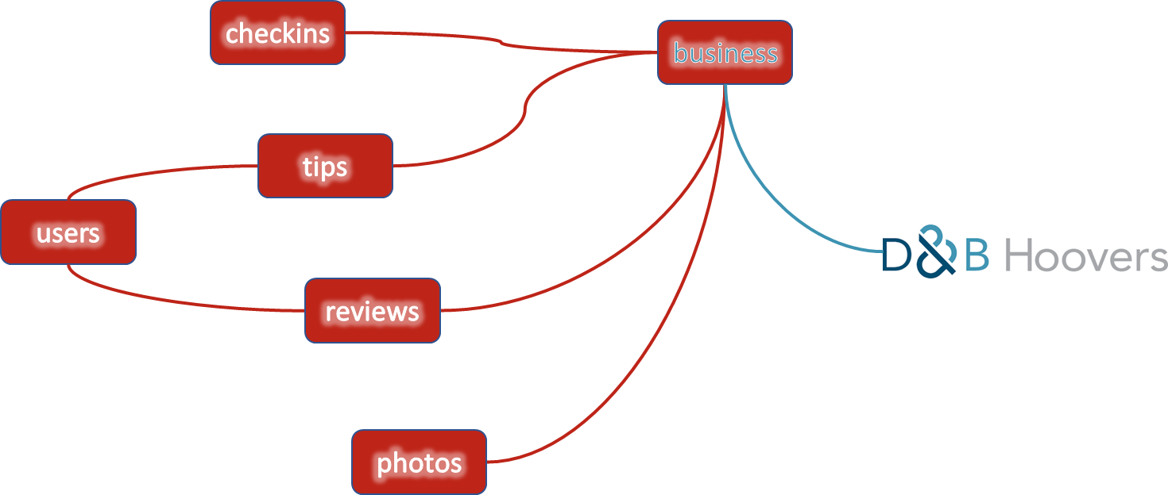
ist718 project checkin #2
do we have data?
x
x
can we access it?
?
what models?

Slide 3
can we access the data?
source | datasets | Yelp count
yelp | businesses | 192,609
 | checkins | 161,950
 | reviews | 6,685,900
 | users | 1,637,138
 | photos | 200,000
 | tips | 1,223,094
D&B Hoovers | financial and category info | 27,524 (NV, AZ – Restaurants)
Census/Tax Data | population, wealth, growth | 179,796

Slide 4

conceptual data model
address
1
categories
checkins
attributes
business
geolocation
ratings
tips
3
users
2
reviews
financial
classification
photos
financial
wealth
growth

Slide 5
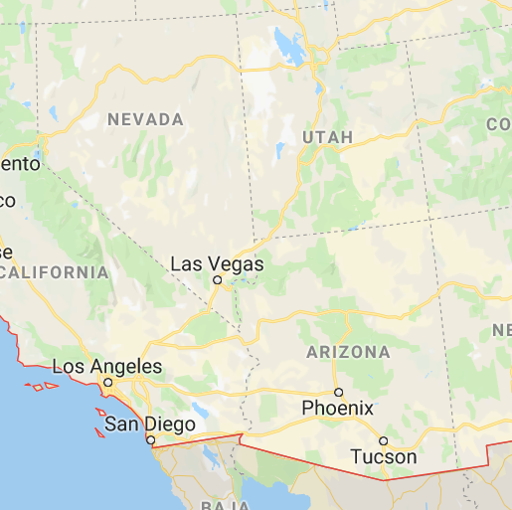
our geographic area of interest

Slide 6
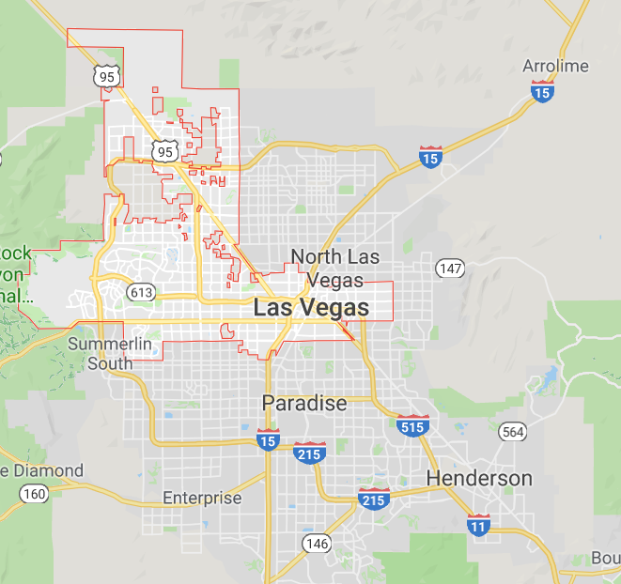
metro map with business opportunities

Slide 7
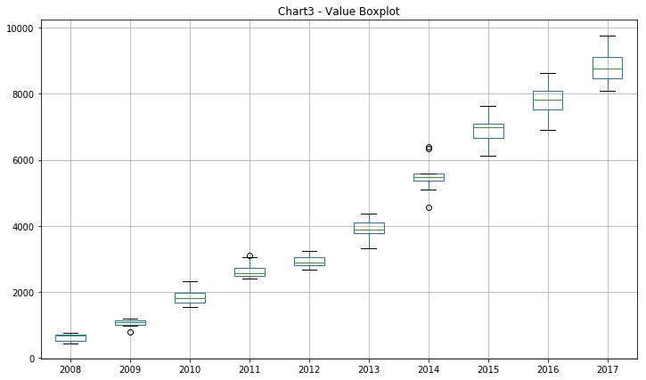
boxplot of restaurant reviews NV; AZ

Slide 8
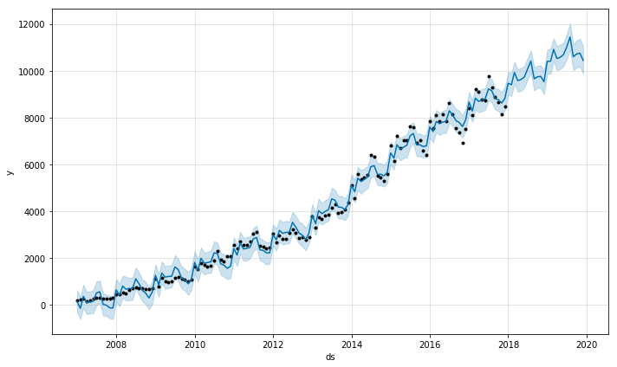
forecast # restaurant reviews NV; AZ

Slide 9
model execution
predict sentiment by review
SVM
verify authenticity of reviews
Naïve Bayes
Topic modeling
LDA (Jensen)
quality and consistency of reviewer
predict quality of photos (Chinese or Italian)
Multilayer Perceptron
predict star ratings from reviews
opportunities for business improvement
association rules
AR; apriori
forecast number of reviews
Prophet; ARIMA

Slide 10
appendix
https://www.yelp.com/dataset
https://www.kaggle.com/iarunava/imdb-movie-reviews-dataset
https://medium.com/@catherinelegros/yelp-profile-redesign-case-study-5d15f40235f3
https://nlpforhackers.io/topic-modeling/

