Slide 1

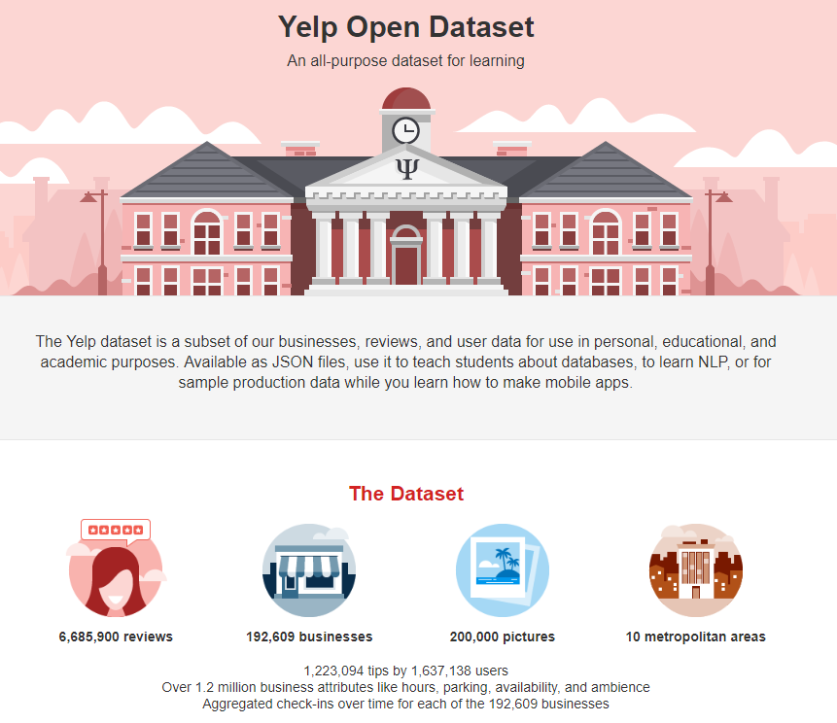
ist718 project presentation

Slide 2
model execution
predict sentiment by review
SVM
verify authenticity of reviews
Naïve Bayes
Topic modeling
LDA (Jensen)
quality and consistency of reviewer
predict quality of photos (Chinese or Italian)
Multilayer Perceptron
predict star ratings from reviews
opportunities for business improvement
association rules
AR; apriori
forecast number of reviews
Prophet; ARIMA

Slide 3


conceptual data model
address
categories
checkins
attributes
business
geolocation
ratings
tips
users
reviews
financial
classification
photos
financial
wealth
growth

Slide 4
Still to do:
Our count
can we access the data?
source | datasets | Yelp count | Our count
yelp | businesses | 192,609
 | checkins | 161,950
 | reviews | 6,685,900
 | users | 1,637,138
 | photos | 200,000
 | tips | 1,223,094
D&B Hoovers | financial and category info | 27,524 (NV, AZ – Rest.)
Census/Tax Data | population, wealth, growth | 179,796

Slide 5
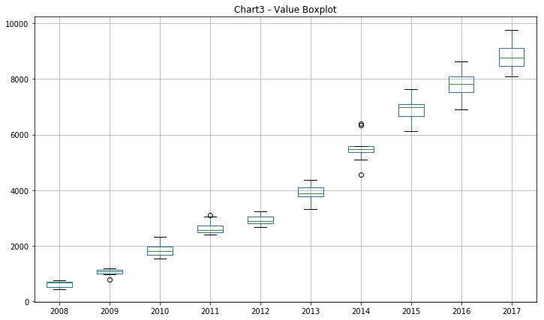
Still to do:
Wording/explain
boxplot of restaurant reviews NV; AZ

Slide 6
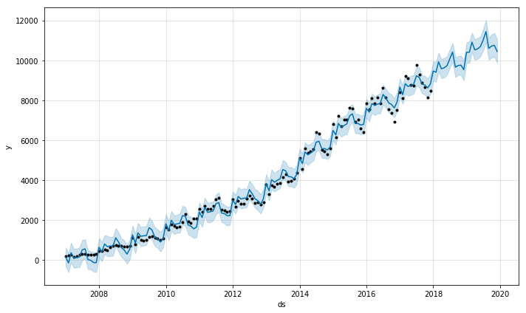
Still to do:
Wording/explain
forecast # restaurant reviews NV; AZ

Slide 7
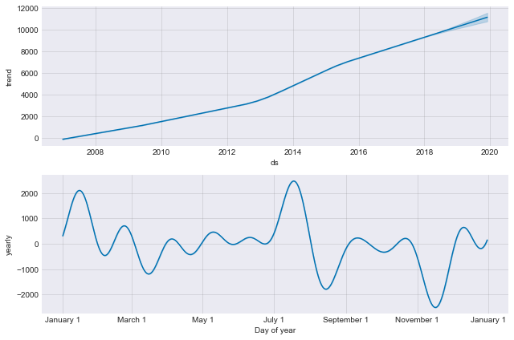
Still to do:
Wording/explain
forecast # restaurant reviews NV; AZ

Slide 8
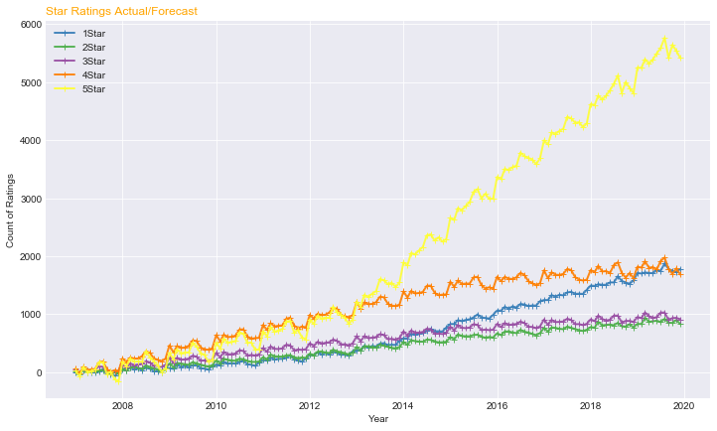
Still to do:
Wording/explain
forecast # restaurant reviews NV; AZ

Slide 9
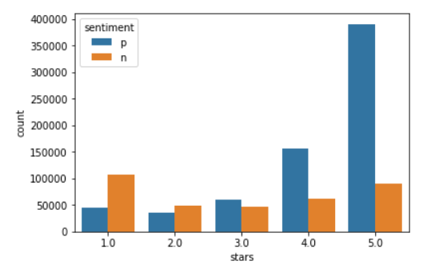
Still to do:
Wording/explain
sentiment of reviews

Slide 10
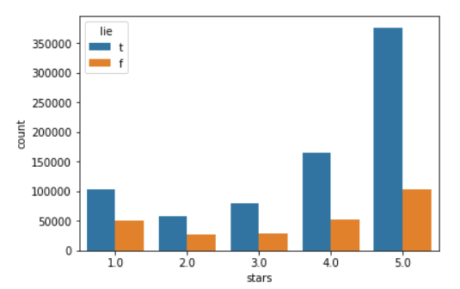
Still to do:
Wording/explain
authenticity of reviews

Slide 11
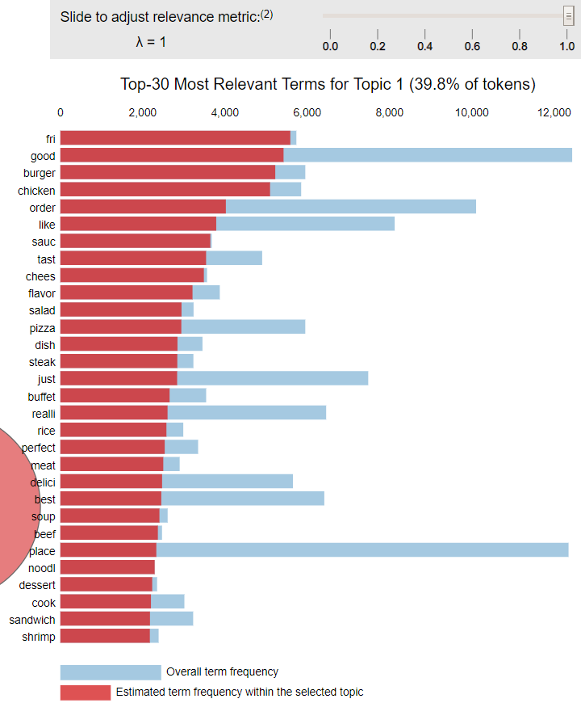
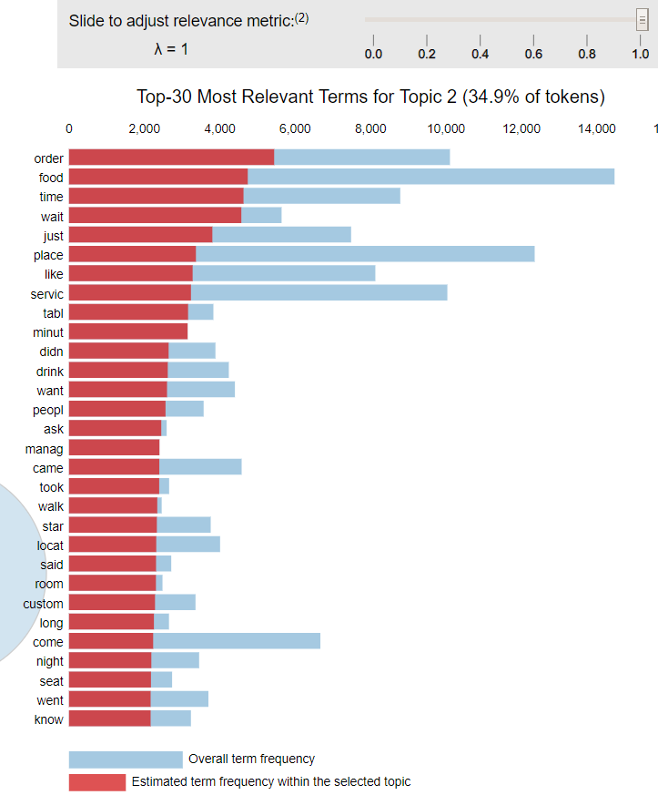
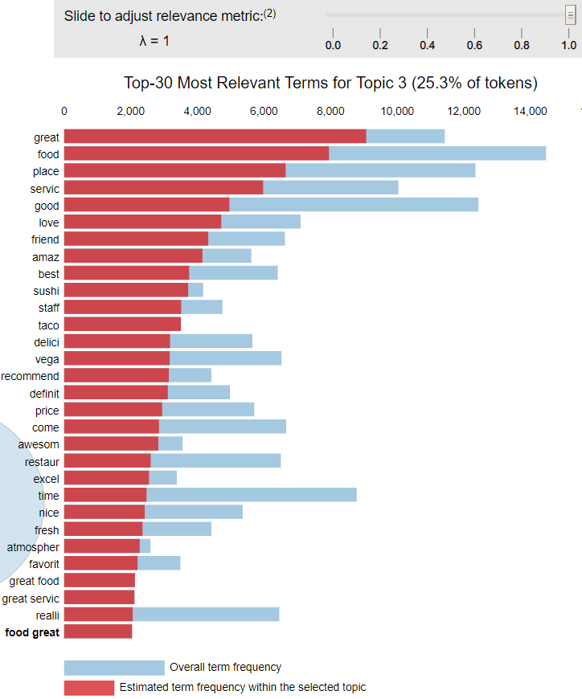
Still to do:
Wording/explain
topic modeling of reviews
topic 1: food
topic 2: service
topic 3: experience

Slide 12
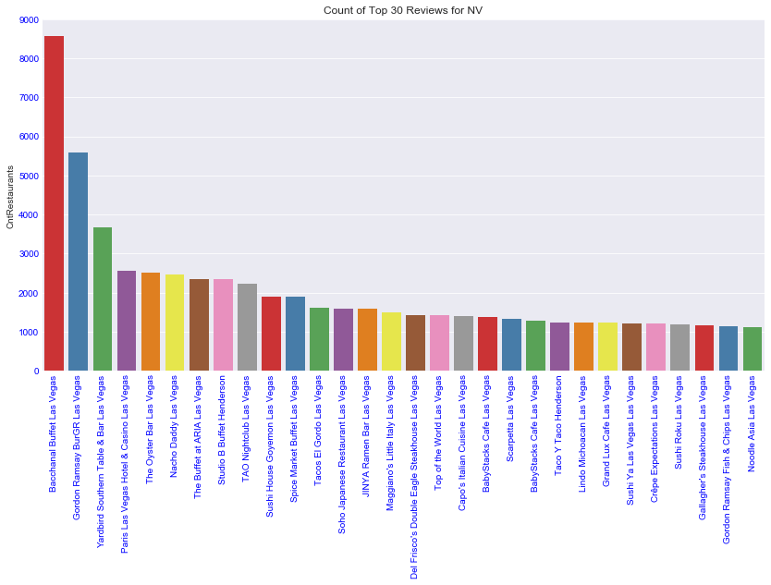
Still to do:
Wording/explain
Top 30 reviews for Nevada

Slide 13
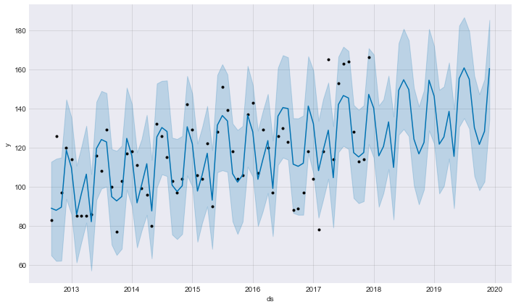
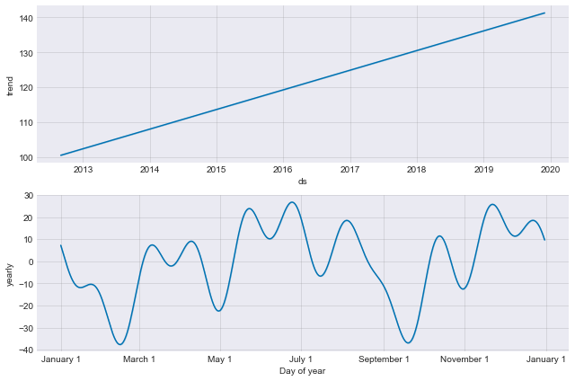
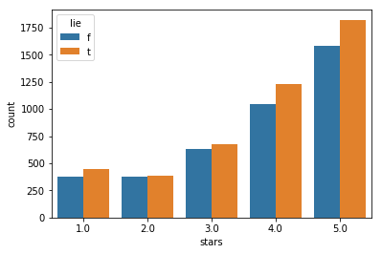
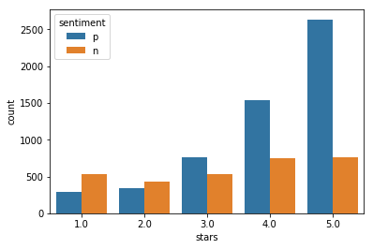
review dashboard for Bacchanal Buffet
Bacchanal Buffet is a buffet located at Caesars Palace in Las Vegas. The buffet consists of nine show kitchens and over 500 daily dishes.
3
6
Review topic and rating vs average
1
food
service
experience
4
7
Reviews 5 star
4 star
3 star
2 star
1 star
Number of users
Number of tips : 1264
Number of photos
Number of checkins
5
2
Still to do: put BB version here
8

Slide 14
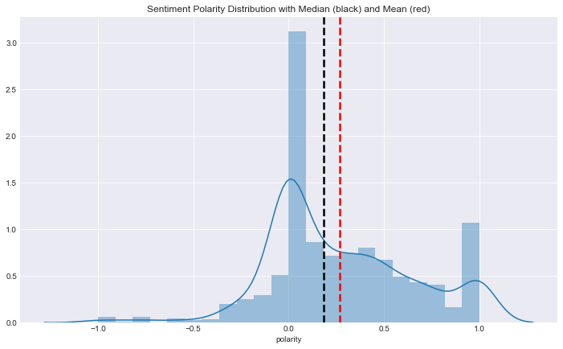
Still to do:
program
tips sentiment for Bacchanal Buffet
Bacchanal Buffet is a buffet located at Caesars Palace in Las Vegas. The buffet consists of nine show kitchens and over 500 daily dishes.
Top 15 positive tips
Best buffet in town!!
Best Vegas buffet with tons of variety!! Go, you won't regret it!!
Best place to eat brunch in Vegas Save room for all the delicious food.
Best buffet as of March 2014. Beats Wicked Spoon and others.
Awesome food. A must stop when in Vegas.
Best buffet in Vegas!
This places is the best buffet in LAS VEGAS
Awesome! Gotta go here!
Best buffet on earth!!!
No wonder why USA just named this place Best Buffet! You have to go!
Best buffet I had in Las Vegas.
I can't even explain how great this place is!! Recommended!
Halibut!! Awesome $42.98 per person before tax and tip
The best!!!

Slide 15
Still to do:
program
photo review for Bacchanal Buffet
Bacchanal Buffet is a buffet located at Caesars Palace in Las Vegas. The buffet consists of nine show kitchens and over 500 daily dishes.
Still to do: put pics here
predict quality of photos (using BB photos)

Slide 16
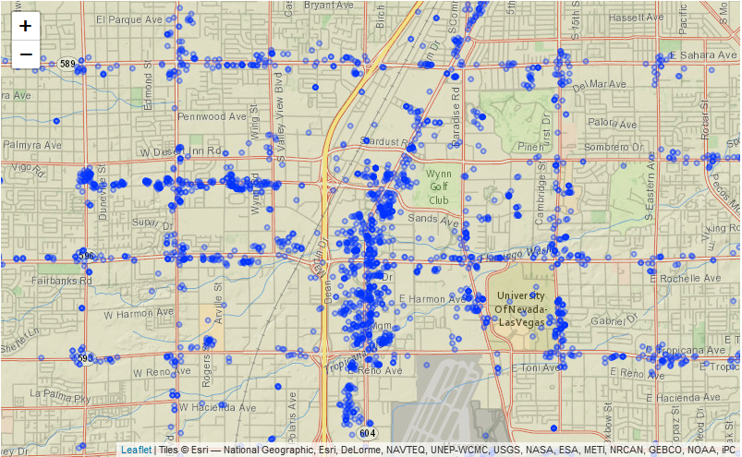
Still to do:
Wording/explain
Las Vegas 4+star restaurants

Slide 17
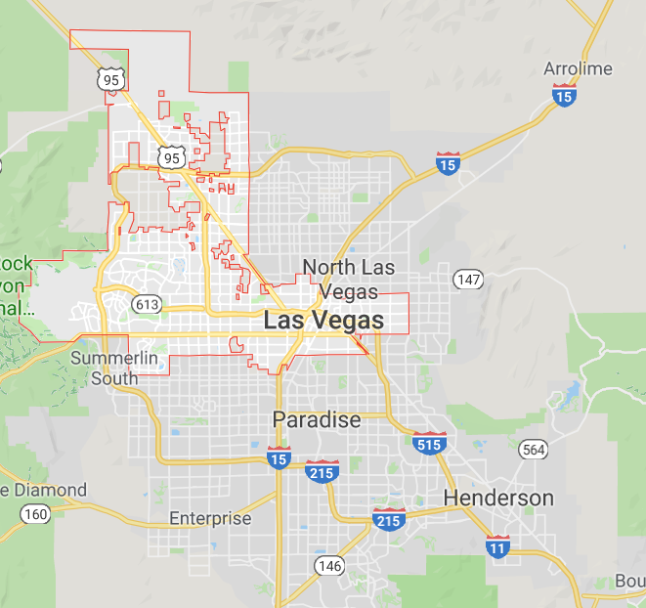
Do we need this?
metro map with business opportunities

Slide 18
appendix
https://www.yelp.com/dataset
https://www.kaggle.com/iarunava/imdb-movie-reviews-dataset
https://medium.com/@catherinelegros/yelp-profile-redesign-case-study-5d15f40235f3
https://nlpforhackers.io/topic-modeling/

