Slide 1


ist718 project presentation

Slide 2


conceptual data model
address
categories
checkins
attributes
business
geolocation
ratings
tips
users
reviews
financial
classification
photos
financial
wealth
growth

Slide 3
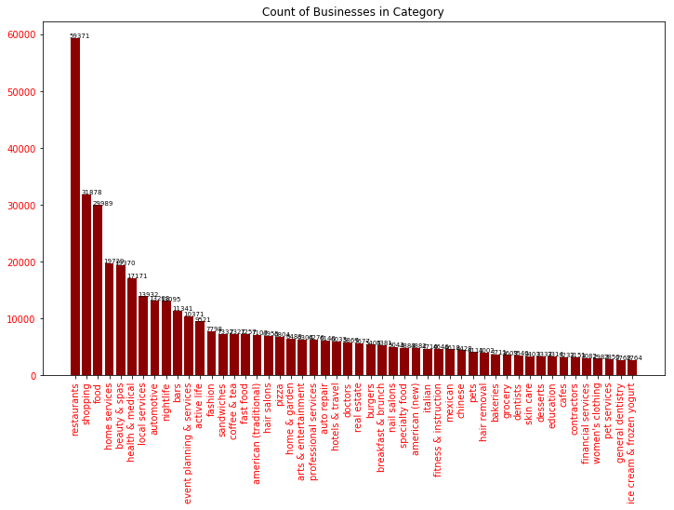
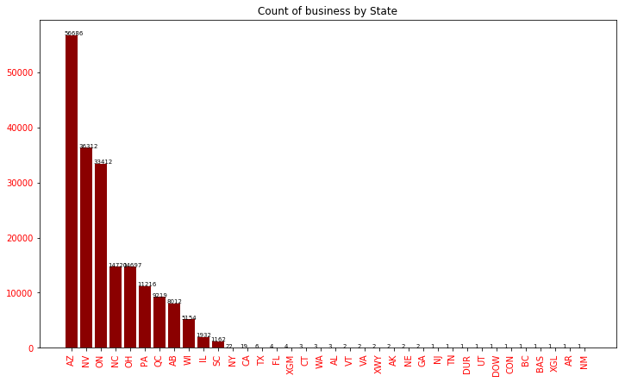
an overarching view into the data
1
source | datasets | Yelp count
yelp | businesses | 192,609
 | checkins | 161,950
 | reviews | 6,685,900
 | users | 1,637,138
 | photos | 200,000
 | tips | 1,223,094
D&B Hoovers | financial and category info | 27,524 (NV, AZ – Rest.)
Census/Tax | population, wealth, growth | 179,796
2
3
Businesses chosen for Analysis
4

Slide 4
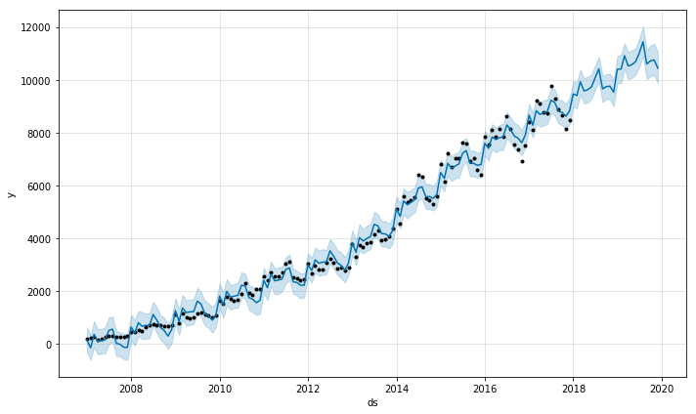
forecast # restaurant reviews NV; AZ
predict review counts
Actual reviews run from 01/01/2007 thru 12/31/2017
24 months predictions from 1/1/2018 thru 12/31/2019
Chart appears to show seasonal anomalies

Slide 5
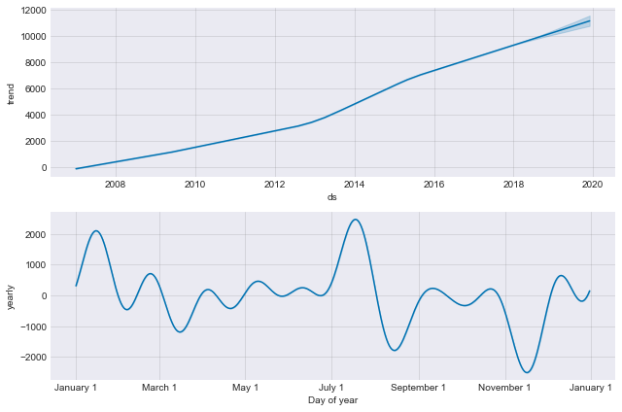
forecast # restaurant reviews NV; AZ
Is Seasonality at play?
Trend is upward - good
Seasonality shows a dip in reviews in March, August and November. Implication is that a dip in reviews equates to a dip in visitors.

Slide 6
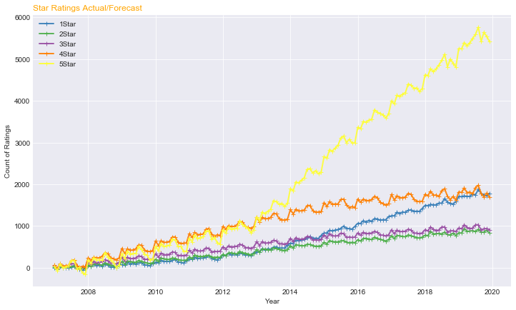
forecast reviews by star count
2013 is a pivotal year
Prior to 2013, the count of reviews per star rating appears to be proportionally consistent.
From 2013 on, 5-star ratings grew markedly.
From 2013 on, 1-star ratings also started growing.
Did the grading system change in 2013?

Slide 7
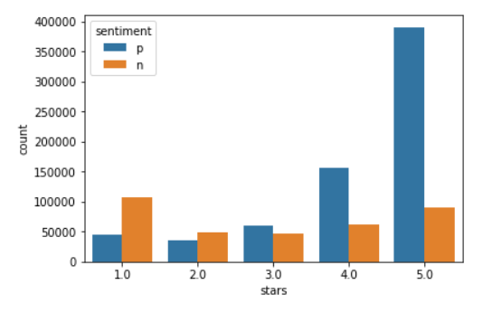
Still to do:
Wording/explain
sentiment of reviews
predict sentiment by review
The sentiment for a significant number of reviews appears to contradict the star rating that the corresponding user gave.
For reviews with 5-star ratings, approx. 20% of the reviews gave a negative sentiment.
Review with 4-star have approx. 1/3 as negative.
For reviews with 1-star ratings, approx. 1/3 have a positive sentiment.
For 2 and 3-star, the positive/negative mix appears appropriate.

Slide 8
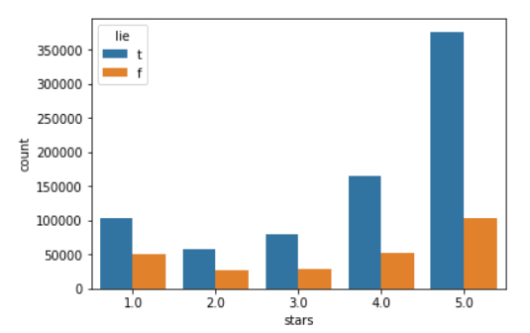
authenticity of reviews
predict authenticity of reviews
Each of the star grades shows that there is a set of users that are dishonest with the reviews that they write.
Approx 1/3 of 1-star reviews appear false. Similar to 2-star and 3-star reviews.
Proportionally, reviewers that give 4-star and 5-star grades appear to be more honest than those that give 1 to 3-start grades.

Slide 9
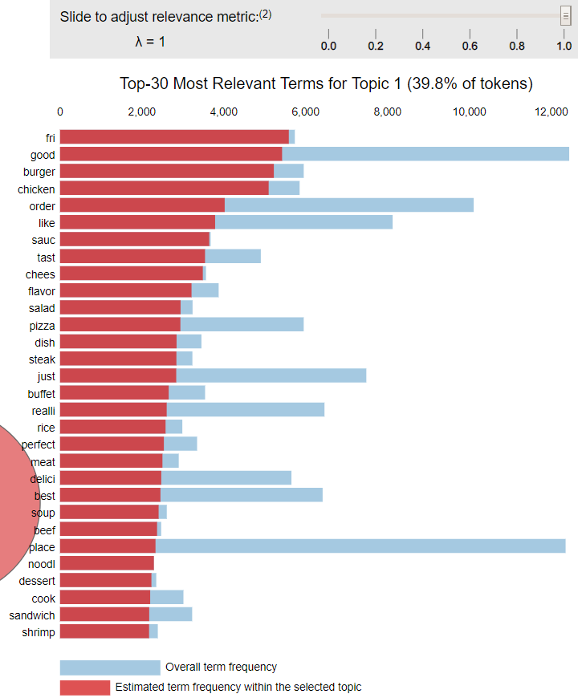
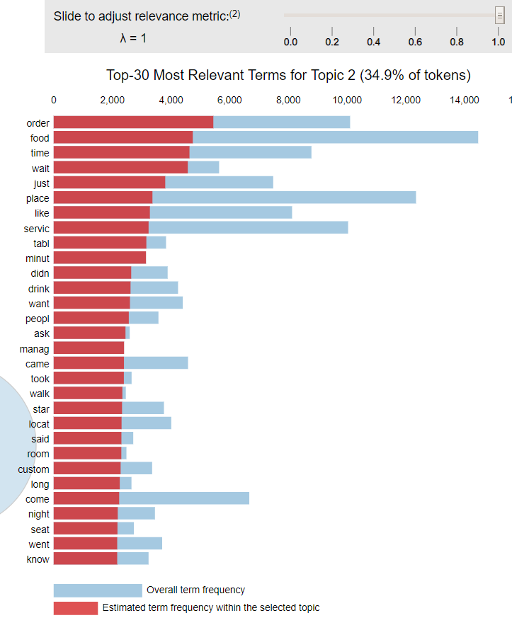
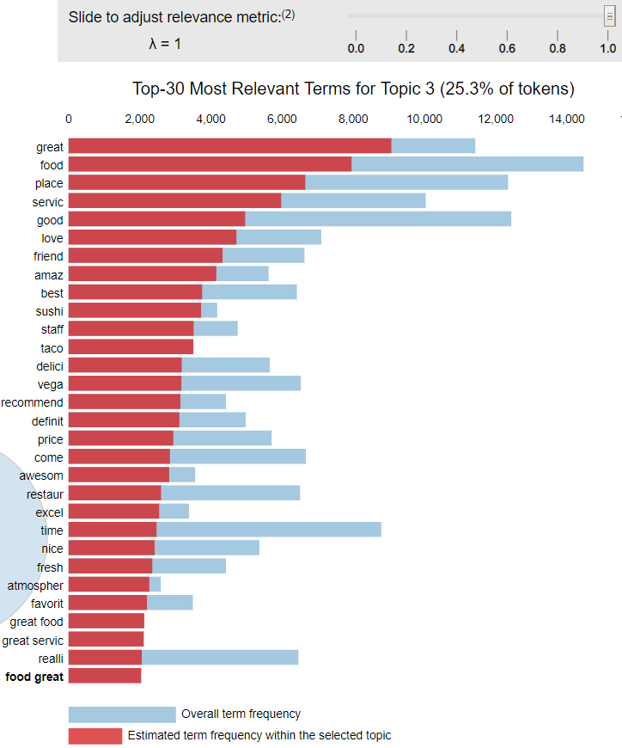
Still to do:
Wording/explain
topic modeling of reviews
topic 1: food
topic 2: service
topic 3: experience

Slide 10
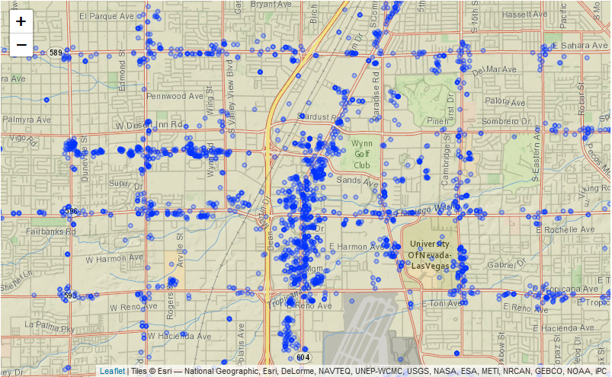
Still to do:
Wording/explain
concentration of restaurants

Slide 11
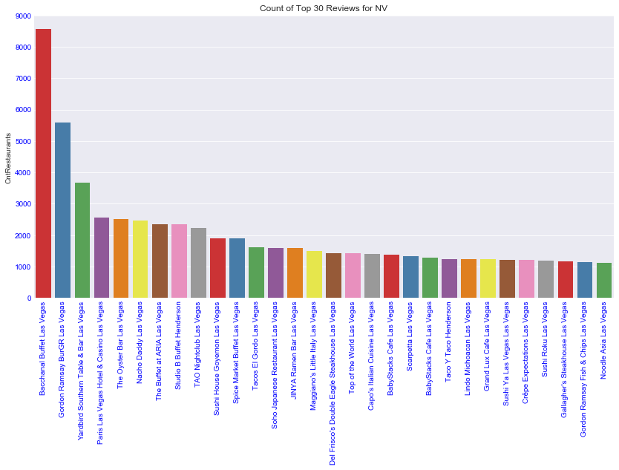
Still to do:
Wording/explain
Top 30 reviews for Nevada

Slide 12
Still to do:
Wording/explain
Las Vegas 4+star restaurants (+top30)

Slide 13
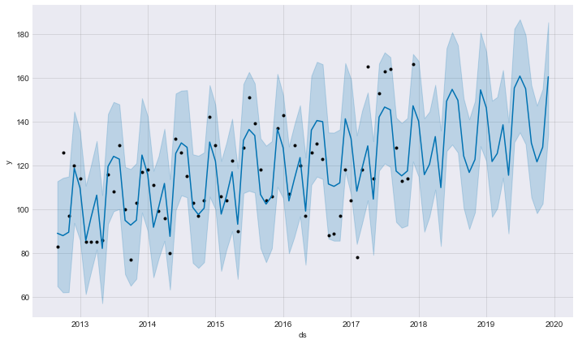
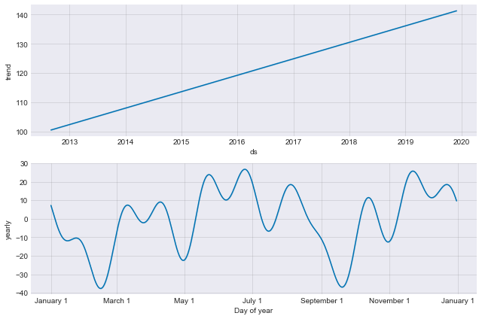
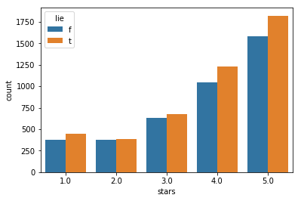
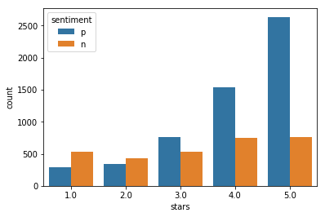
review dashboard for Bacchanal Buffet
Bacchanal Buffet is a buffet located at Caesars Palace in Las Vegas. The buffet consists of nine show kitchens and over 500 daily dishes.
3
6
Review topic and rating vs average
1
food
service
experience
4
7
Reviews 5 star
4 star
3 star
2 star
1 star
Number of users
Number of tips : 1264
Number of photos : 823
Number of checkins
5
2
Still to do: put BB version here
8

Slide 14
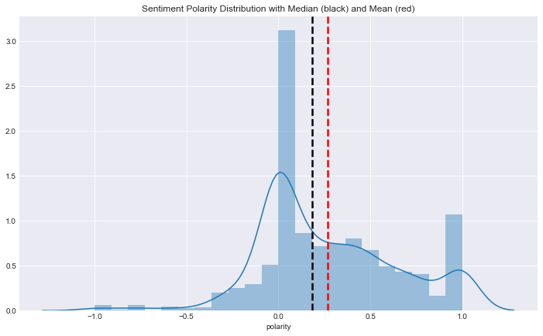
Still to do:
program
tips sentiment for Bacchanal Buffet
Bacchanal Buffet is a buffet located at Caesars Palace in Las Vegas. The buffet consists of nine show kitchens and over 500 daily dishes.
Top 15 positive tips
Best buffet in town!!
Best Vegas buffet with tons of variety!! Go, you won't regret it!!
Best place to eat brunch in Vegas Save room for all the delicious food.
Best buffet as of March 2014. Beats Wicked Spoon and others.
Awesome food. A must stop when in Vegas.
Best buffet in Vegas!
This places is the best buffet in LAS VEGAS
Awesome! Gotta go here!
Best buffet on earth!!!
No wonder why USA just named this place Best Buffet! You have to go!
Best buffet I had in Las Vegas.
I can't even explain how great this place is!! Recommended!
Halibut!! Awesome $42.98 per person before tax and tip
The best!!!

Slide 15
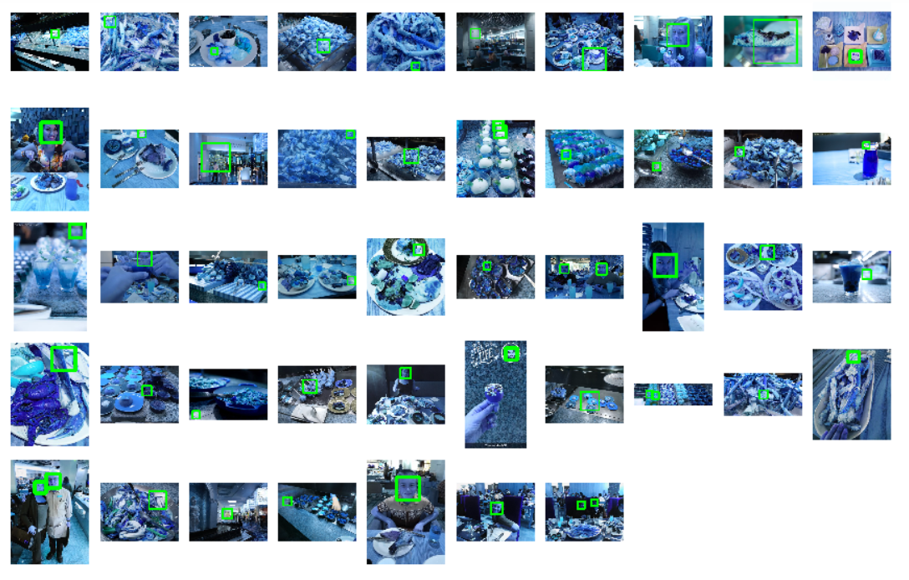
Still to do:
program
photo review for Bacchanal Buffet
Bacchanal Buffet is a buffet located at Caesars Palace in Las Vegas. The buffet consists of nine show kitchens and over 500 daily dishes.
predict quality of photos
823 photos
47 recognized with faces
Scale factor = 1.2

Slide 16
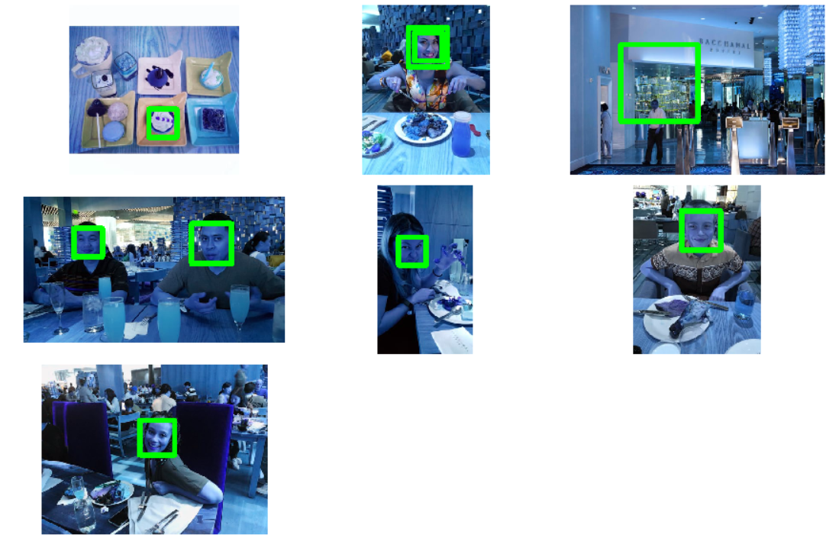
Still to do:
program
photo review for Bacchanal Buffet
Bacchanal Buffet is a buffet located at Caesars Palace in Las Vegas. The buffet consists of nine show kitchens and over 500 daily dishes.
predict quality of photos
823 photos
47 recognized with faces
Scale factor = 1.2
7 recognized with faces
- Scale factor = 1.4

Slide 17
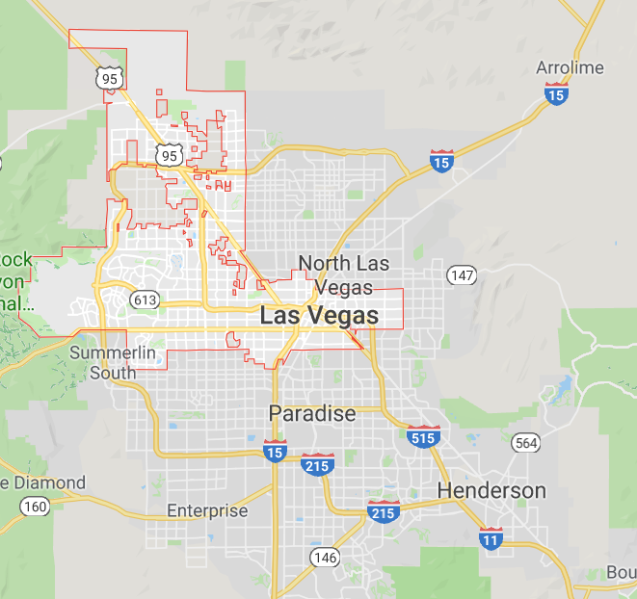
Do we need this?
metro map with business opportunities

Slide 18

model execution
predict sentiment by review
SVM
verify authenticity of reviews
Naïve Bayes
Topic modeling
LDA (Jensen)
quality and consistency of reviewer
predict quality of photos (Chinese or Italian)
Multilayer Perceptron
predict star ratings from reviews
opportunities for business improvement
association rules
AR; apriori
forecast number of reviews
Prophet; ARIMA

Slide 19
appendix
https://www.yelp.com/dataset
https://www.kaggle.com/iarunava/imdb-movie-reviews-dataset
https://medium.com/@catherinelegros/yelp-profile-redesign-case-study-5d15f40235f3
https://nlpforhackers.io/topic-modeling/

