Slide 1
IST 687 Project Final Presentation
Team A3
Debasis Chatterjee
Rod Koch
James Robertson

Slide 2
Introduction
Our hypothetical is that we are a data science consulting firm and we have been approached by an app developer with a data set regarding the India Google Play Store. They would like us to analyze the data and answer questions for them.

Slide 3
Business Questions
Which apps are downloaded the most? Which categories? Which age groups? Type (Paid vs. Free) Which are most popular in the last year? Which are growing in popularity? How can I make a “best selling”/highly downloaded app? Which categories have the highest ratings/liked the most? How can I get more people to download an app? What motivates people to write reviews? Which is more correlated with downloads, ratings or reviews?
Does size or installs have any effect on price?
Does price have any effect on size or installs?
Can we predict high total worth of an app with category, rating, reviews, size, pay type, and/or content rating?
Can we predict installs for a given category?

Slide 4
Business Questions
Can be answered
Which apps are downloaded the most? Which categories? Which age groups? Type (Paid vs. Free) How can I make a “best selling”/highly downloaded app? Which categories have the highest ratings?
Is price correlated with installs? Which is more correlated with installs, ratings or reviews?
Does size or installs have any effect on price?
Does price have any effect on size or installs?
Can we predict high total worth of an app with category, rating, reviews, size, pay type, and/or content rating?
Can we predict installs for a given category?
Can’t be answered
Which are most popular in the last year? Which are growing in popularity?
How can I get more people to download an app?
What motivates people to write reviews?

Slide 5
Data Cleansing and Hypothesis Testing
Data Cleaning:
Removed data if rating is more than 5
Replaced NaN with mean of Rating
Converted Reviews column to as numeric
Removed all Null/Na/NaN from the data set as it's creating problem for data manipulation
Replaced "Varies with device" with "0"
Changed download size 1.2M or 1.8k to double format
Removed all characters and space from Installs and convert factor to numeric data type
Removed '#' and ',' from Price and convert to numeric from Factor data type
Converted date format from 'January 07, 2018' to '2018-01-07' as Date type
Converted all Factors to Character type
Converted some specific column back to Factor from Character type
Hypothesis Testing:
Check if Size or Installation does have any effect on Price
Conclude :
The result shows that model 1 and 2 does not provide a significantly better fit to the data compared to model.
It means both of them Size and Installation does not have any significance on price.
Check if Price has any effect on Size or Installation
Conclude :
In first test P is 0.0211 (P < Alpha(0.05)). P is low Home must go. It means Price does not have any effect on Size.
In second test P is 0.2499 (P > Alpha(0.05)). In this case we could not reject Home. It means Price has effect on Installation.

Slide 6
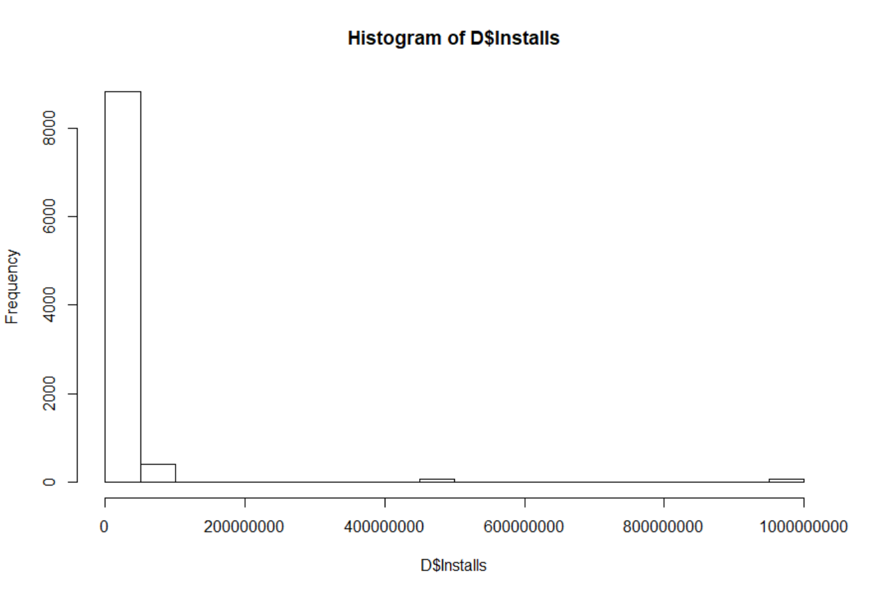

Slide 7
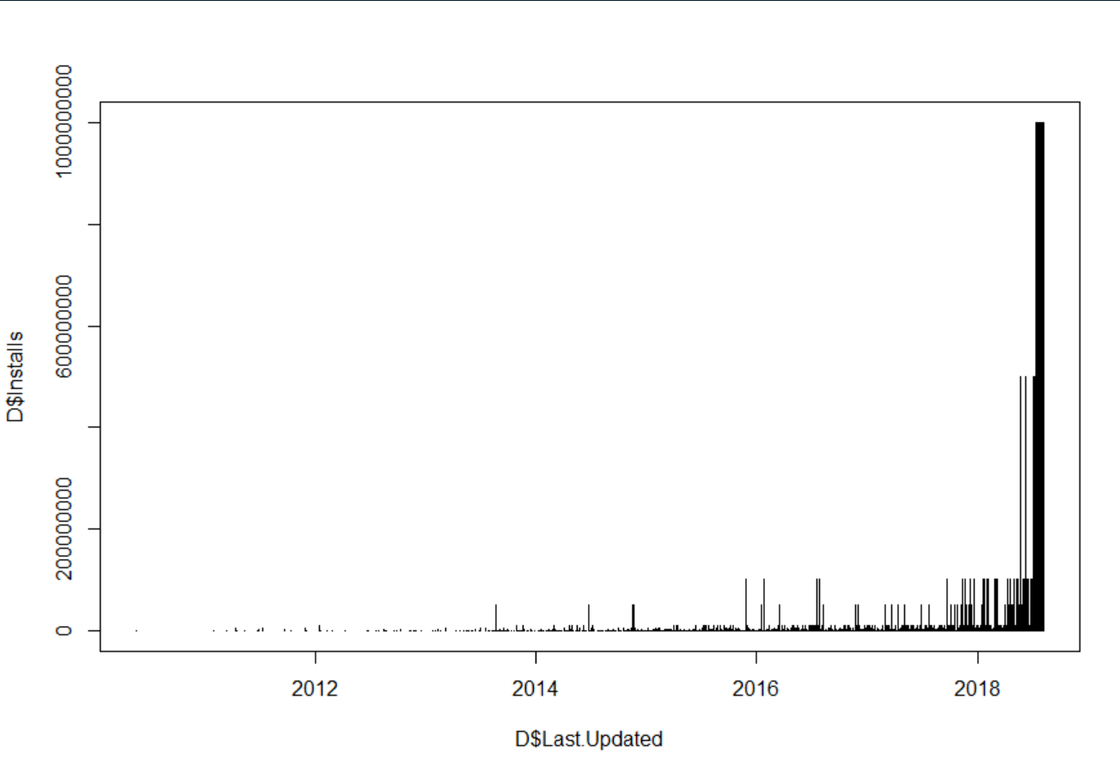

Slide 8
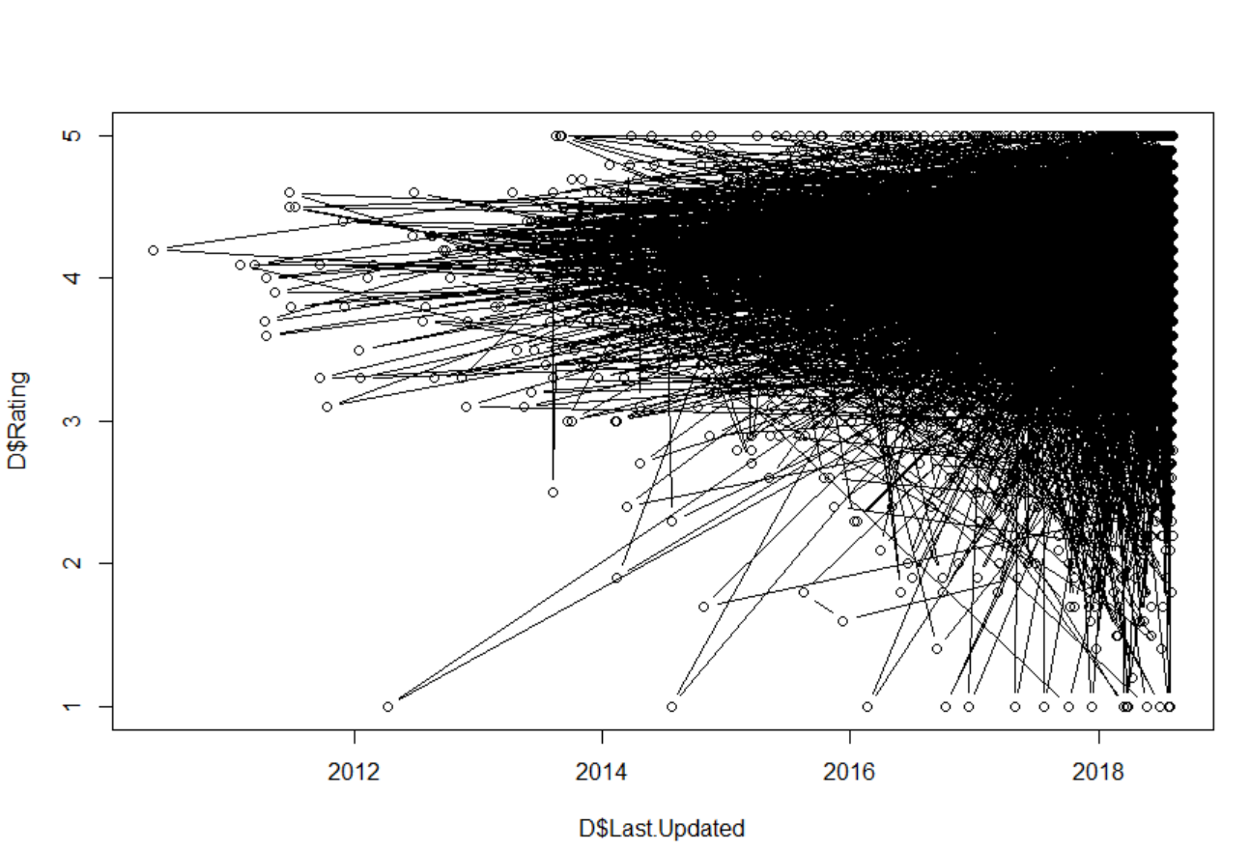

Slide 9
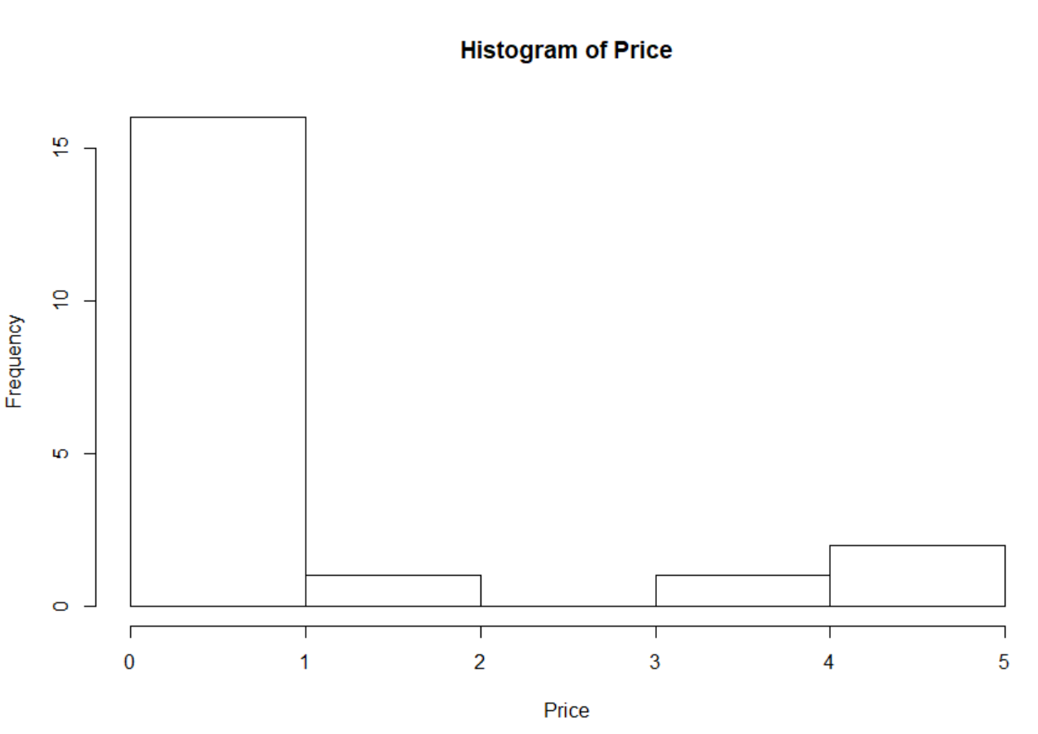

Slide 10
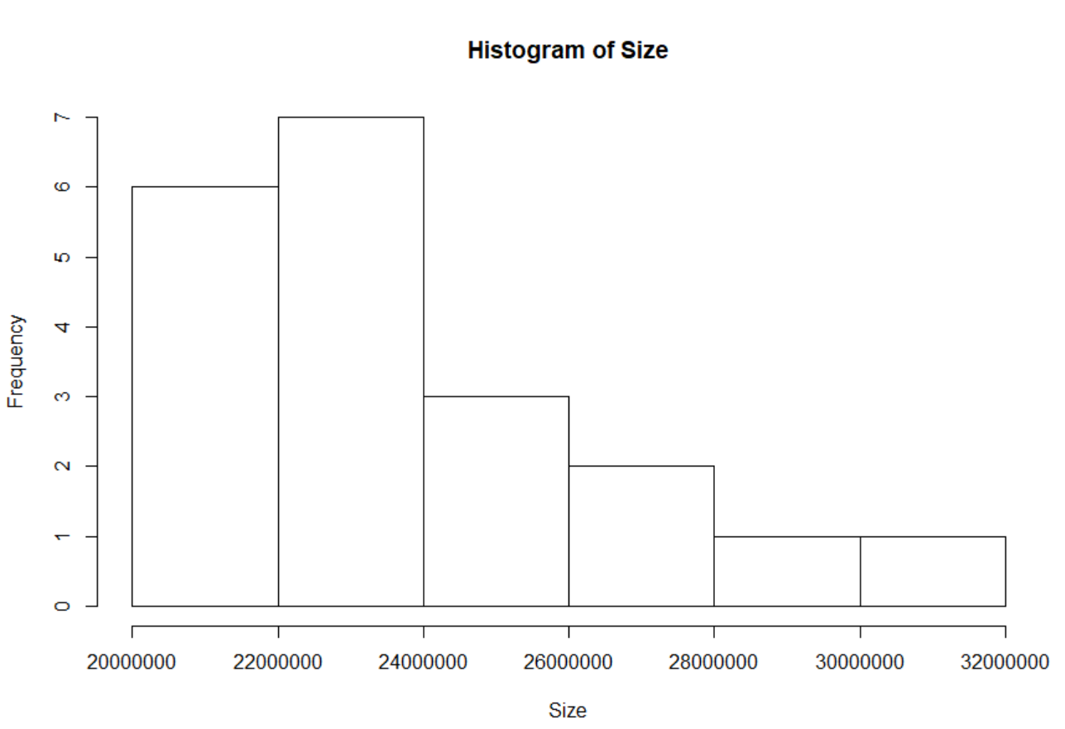

Slide 11
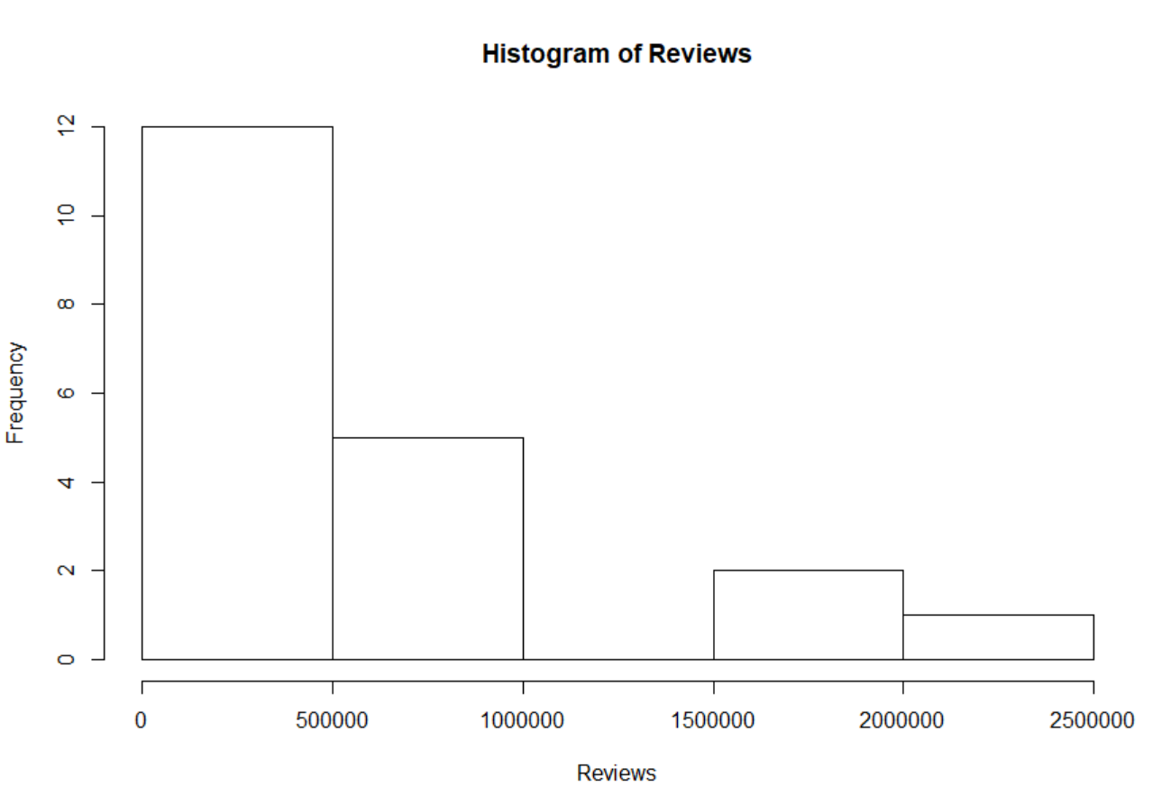

Slide 12
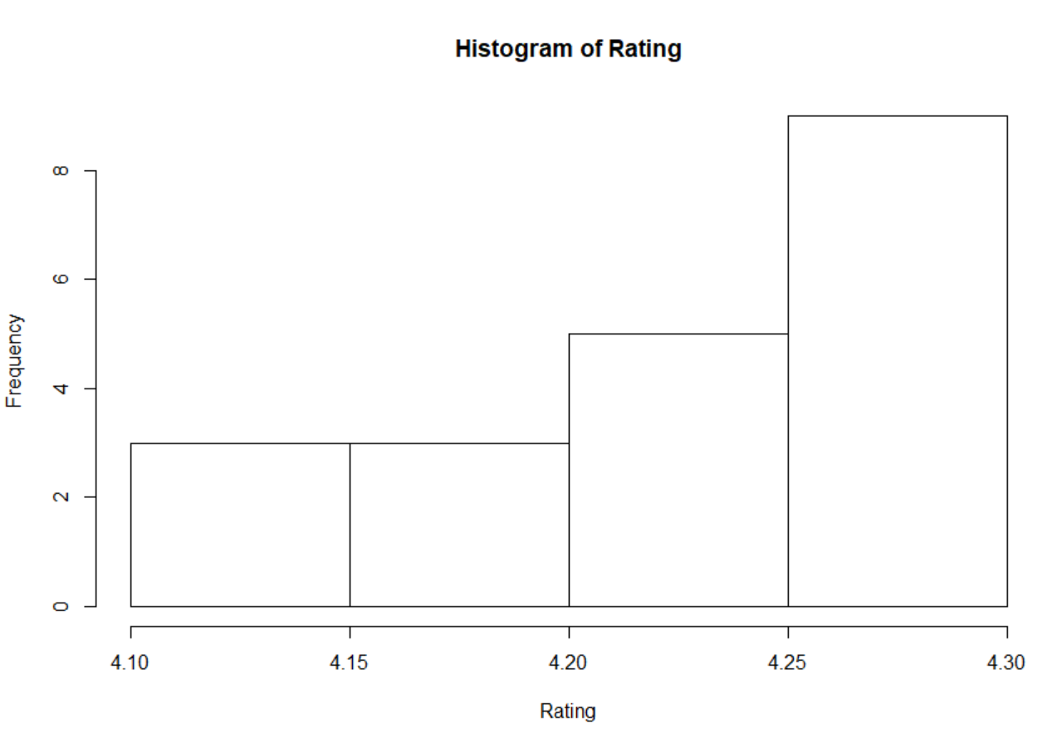

Slide 13
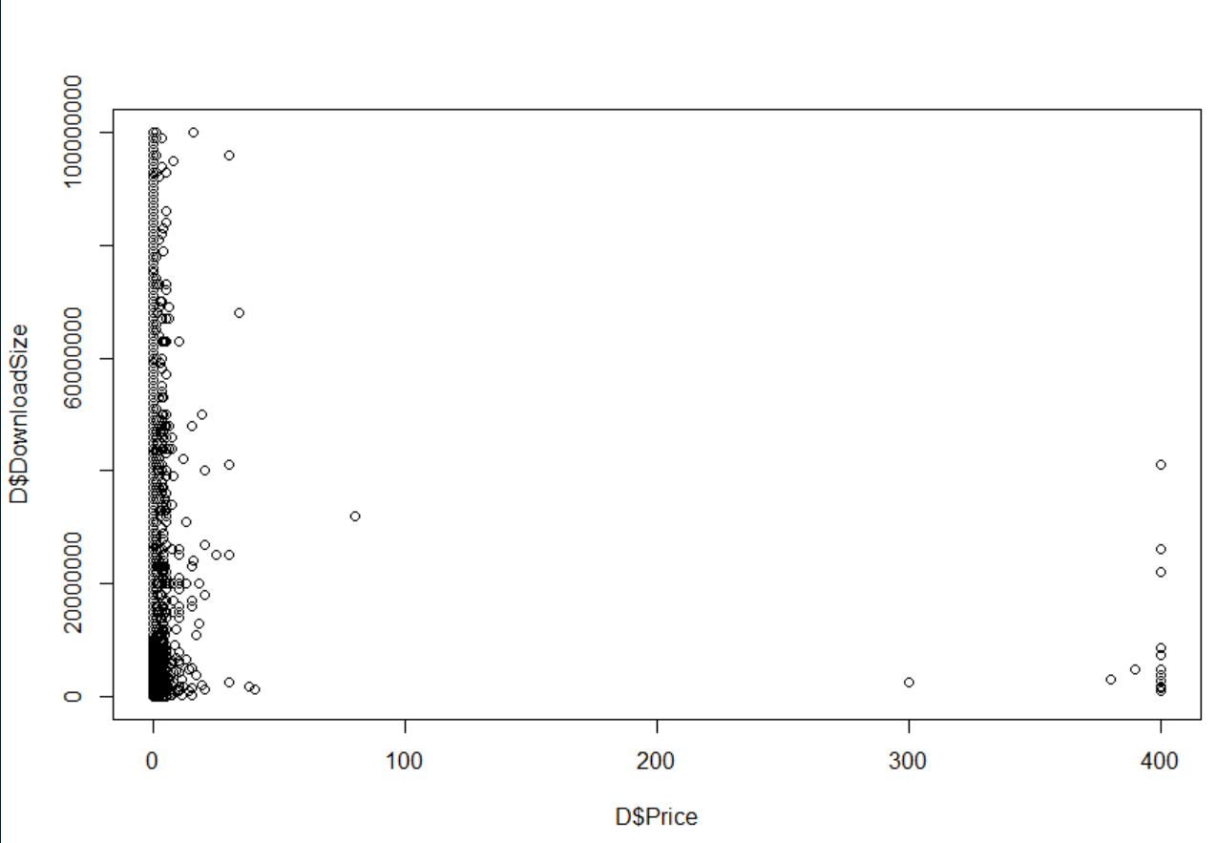

Slide 14
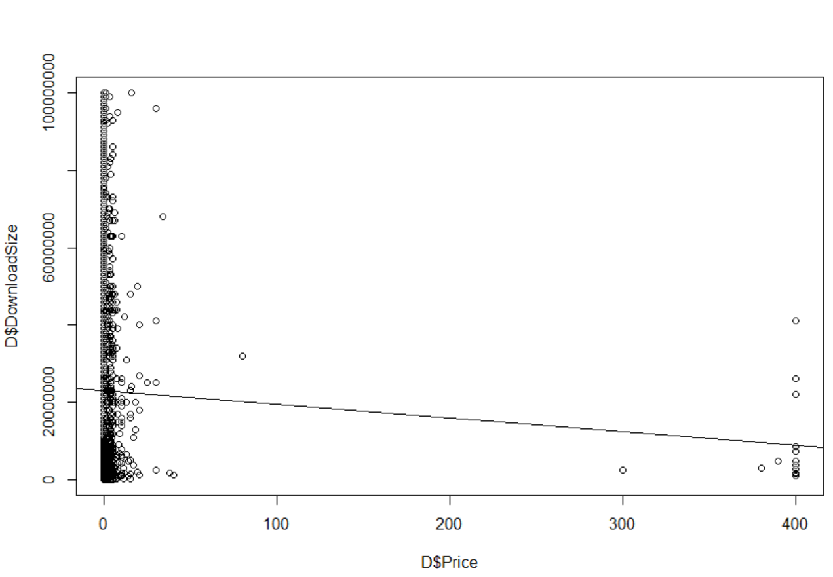

Slide 15
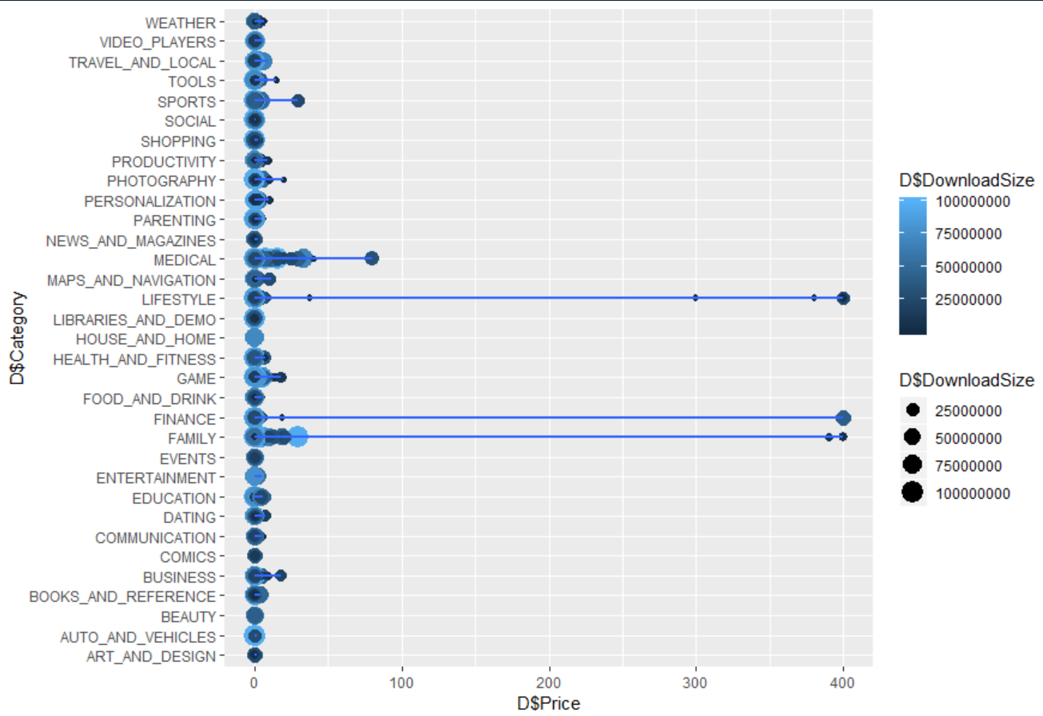

Slide 16
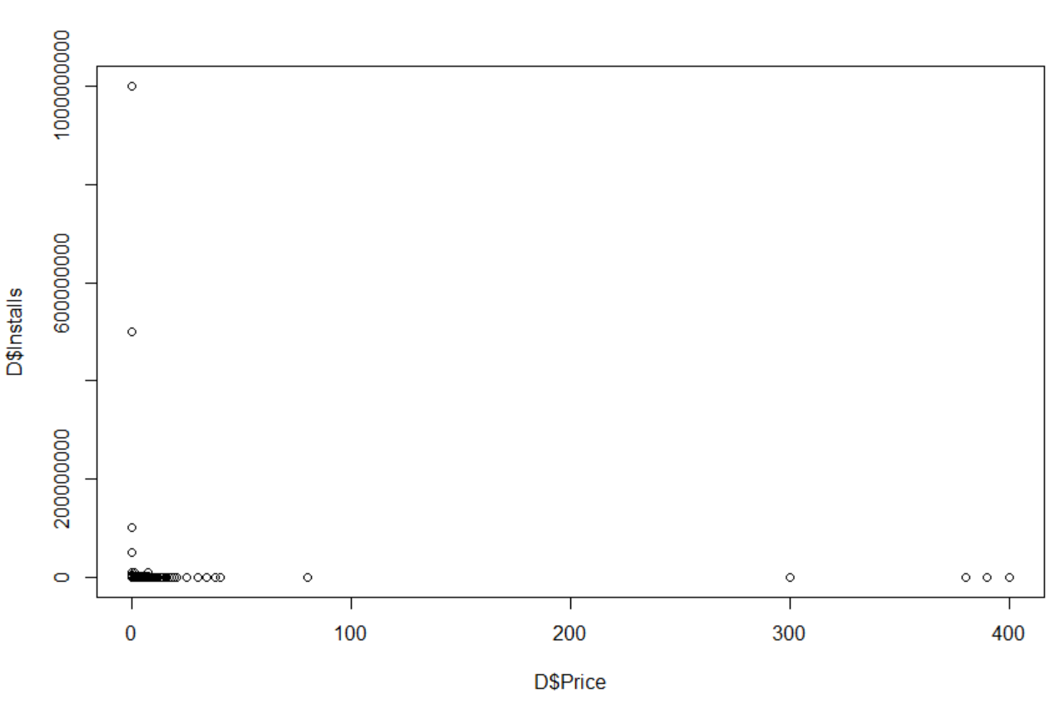

Slide 17
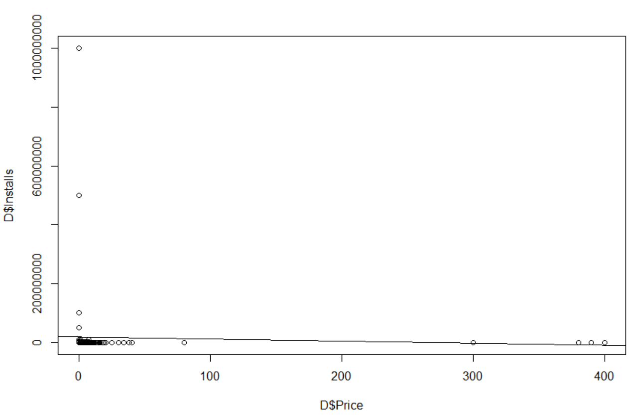

Slide 18
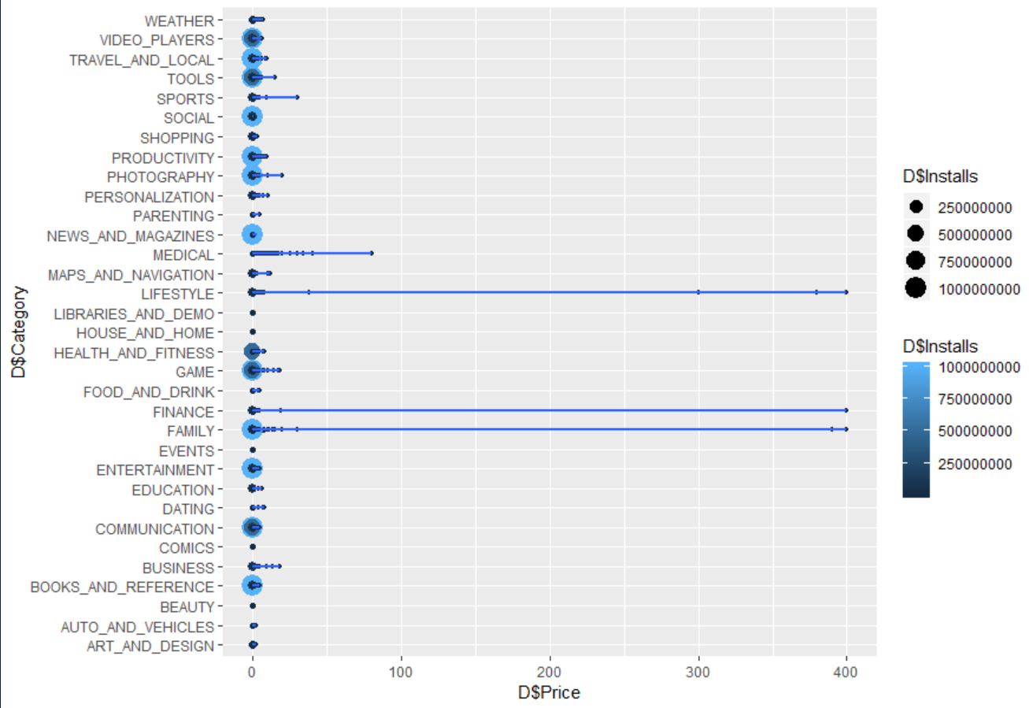

Slide 19
Machine Learning
We attempted to do analysis using the ksvm function in r.
ksvm stands for kernel support vector machine.data = trainData, # specify the data to use in the analysis
Our current understanding is that it is voodoo trickery and it can make predictions that rival Nostradamus when given the right data and asked the right questions.

Slide 20
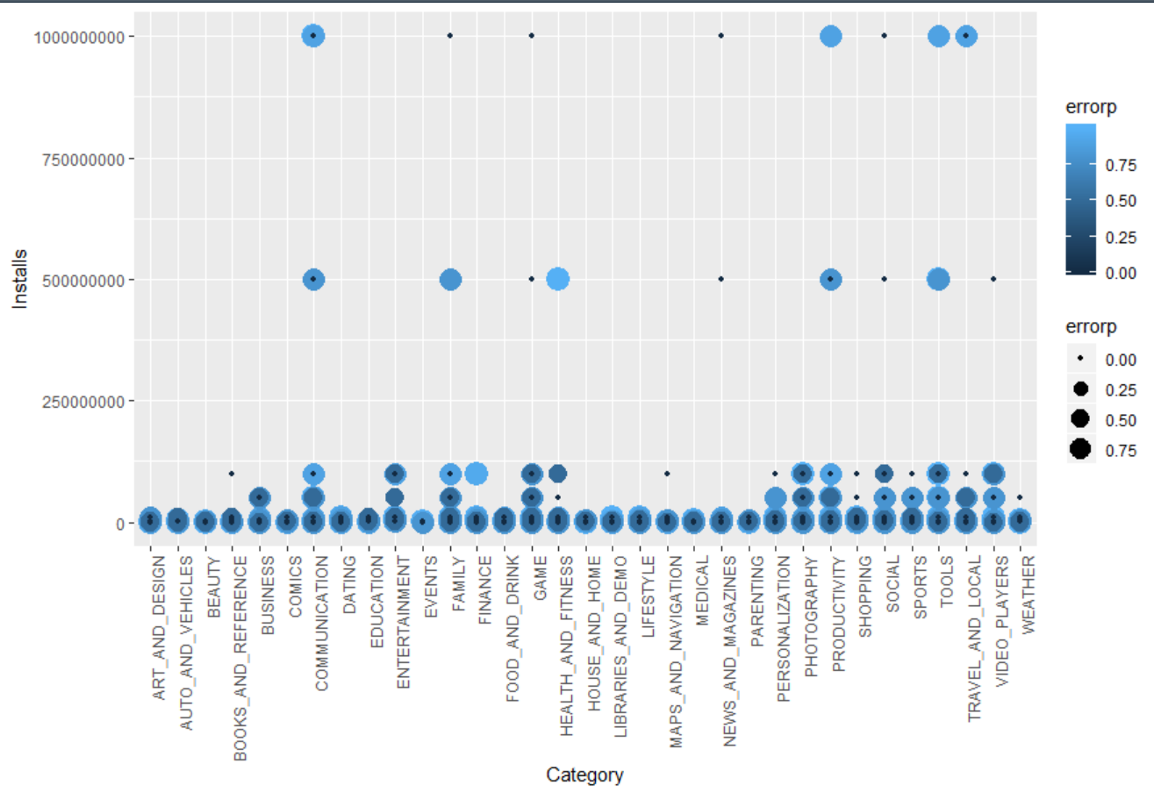

Slide 21
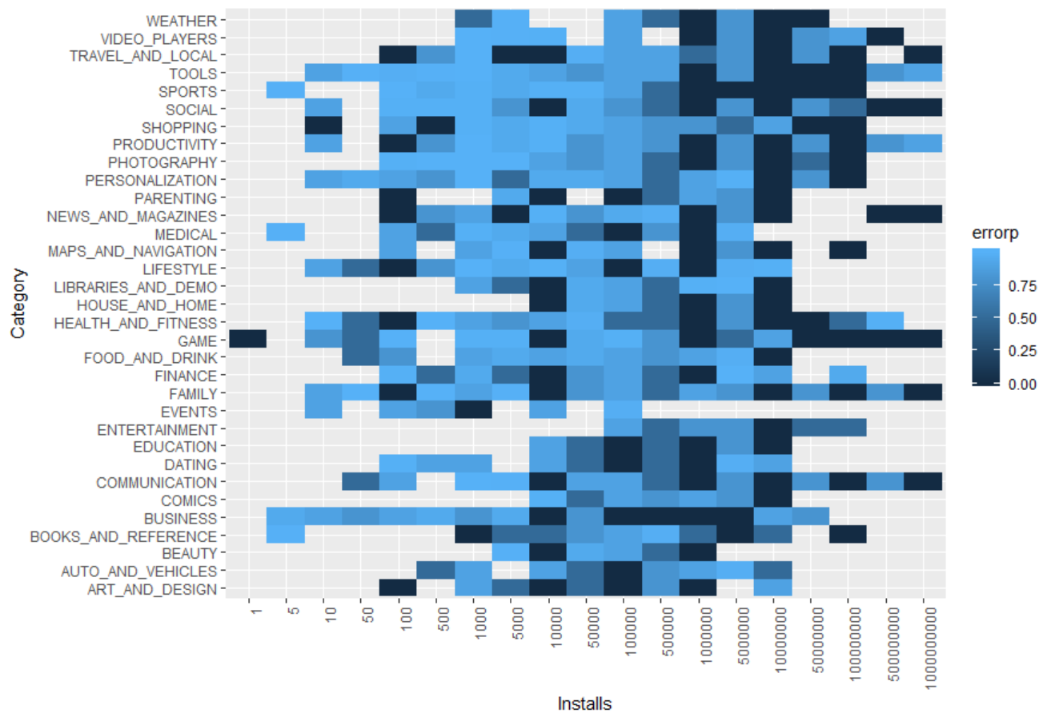

Slide 22
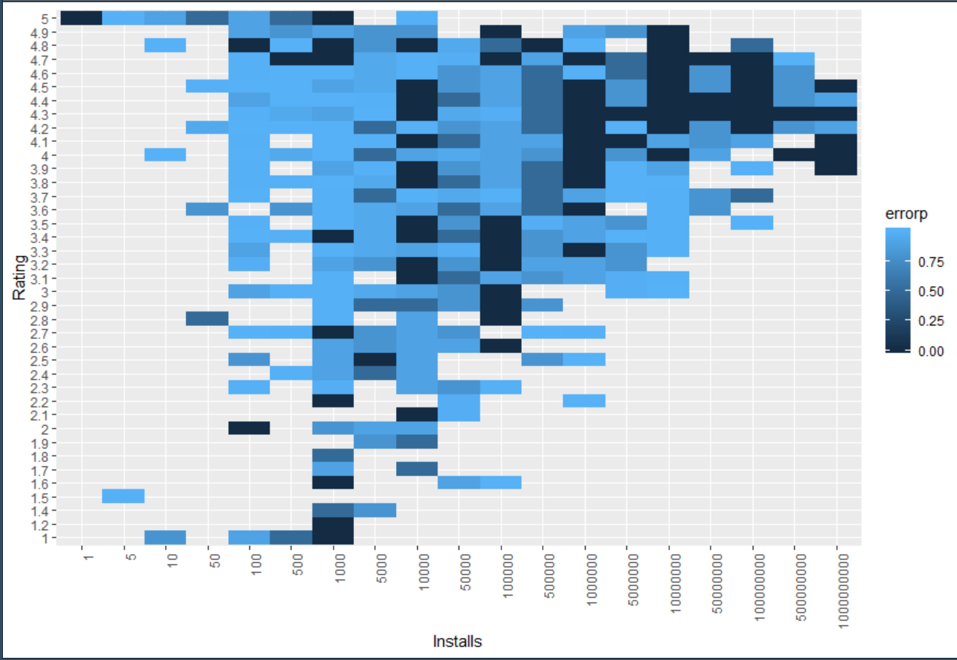

Slide 23
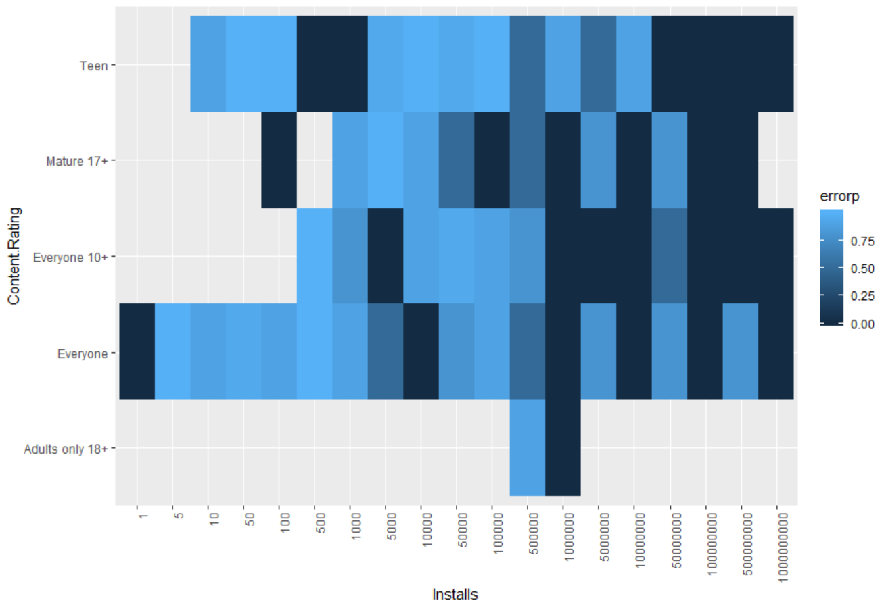

Slide 24
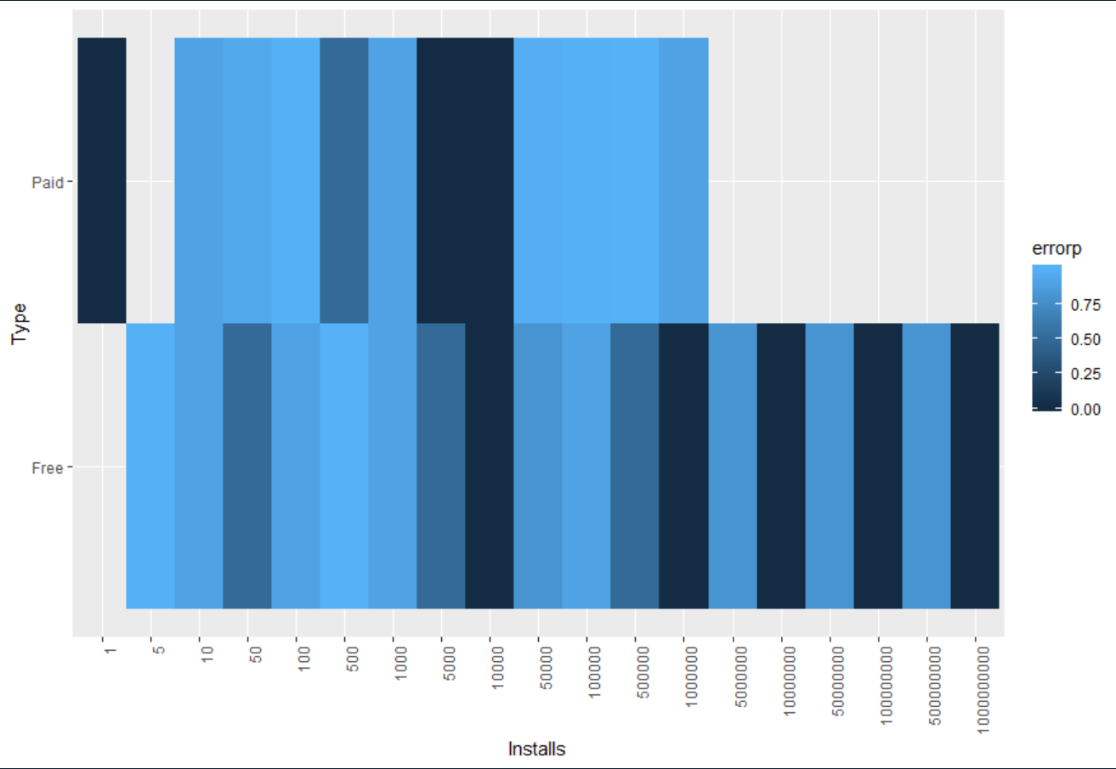

Slide 25
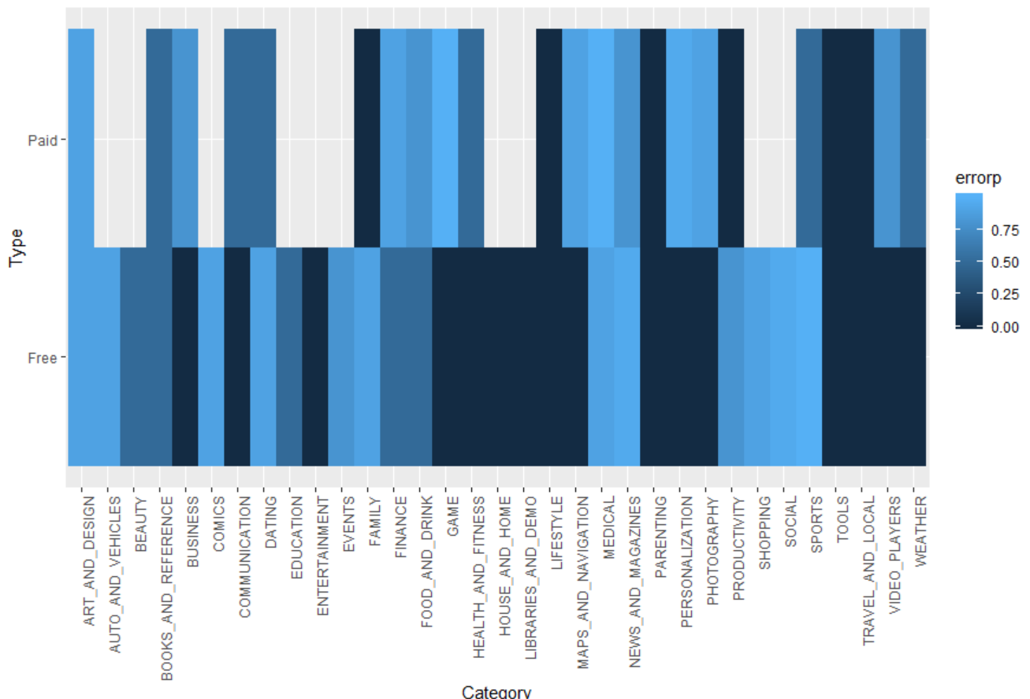

Slide 26
Machine Learning Conclusion
We found the best combinations of for our “C” and “cross” constraints was
C=100 and cross = 10 which yielded 36% accuracy
compared to
C=10 and cross=10 which yielded 35% accuracy
This is obviously not great.
The model consistently had better results predicting 1000 installs and 1,000,000 installs, but they still were not at a level worth investing in.
Can we predict installs for a given category? No.

Slide 27
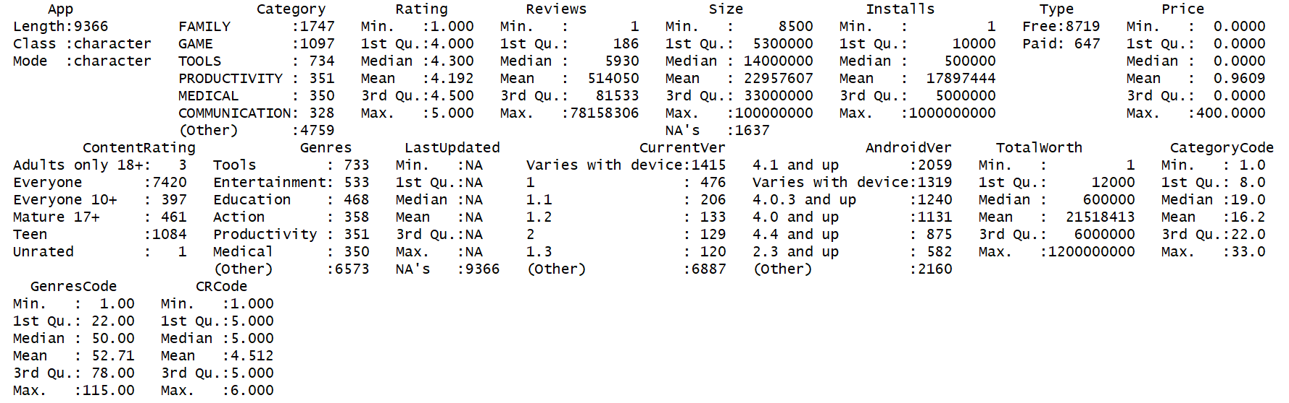
Some Descriptive Statistics

Slide 28
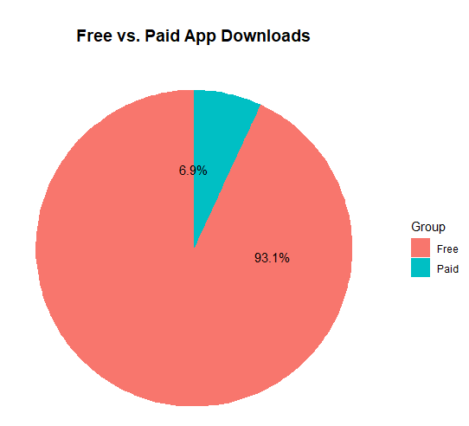
Paid vs. Free Apps

Slide 29
Top App Categories by Rating
Category Avg_Rating EVENTS 4.435556 EDUCATION 4.389032 ART_AND_DESIGN 4.358065 BOOKS_AND_REFERENCE 4.346067 PERSONALIZATION 4.335987 PARENTING 4.300000 GAME 4.286326 BEAUTY 4.278571 HEALTH_AND_FITNESS 4.277104 SHOPPING 4.259664

Slide 30
Most Installed Apps by Content Rating
Most downloaded apps by Content Rating
Content Rating ContentRating_Ct Everyone 7420 Teen 1084 Mature 17+ 461
Everyone 10+ 397
Adults only 18+ 3
Unrated 1

Slide 31
Paid Apps with the Highest Total Worth
Paid Apps with the highest Total Worth (Installs * Price)
App Total_Worth
Minecraft 69900000
I am rich 39999000
I Am Rich Premium 19999500
Hitman Sniper 9900000
Grand Theft Auto: San Andreas 6990000
Facetune - For Free 5990000
Sleep as Android Unlock 5990000
DraStic DS Emulator 4990000
I'm Rich - Trump Edition 4000000
I am Rich Plus 3999900

Slide 32
Linear Regression
Can we use linear regression to predict the total value of an app based on the fields in our data set?
Challenge: What is a “free” application worth?
Calculation of Total App Worth:
Used an estimated value of $1.20/user as per Quora discussion
https://www.quora.com/How-much-is-an-app-user-worth
TotalWorth = (Installs * Price) + (1.20 * Installs)

Slide 33
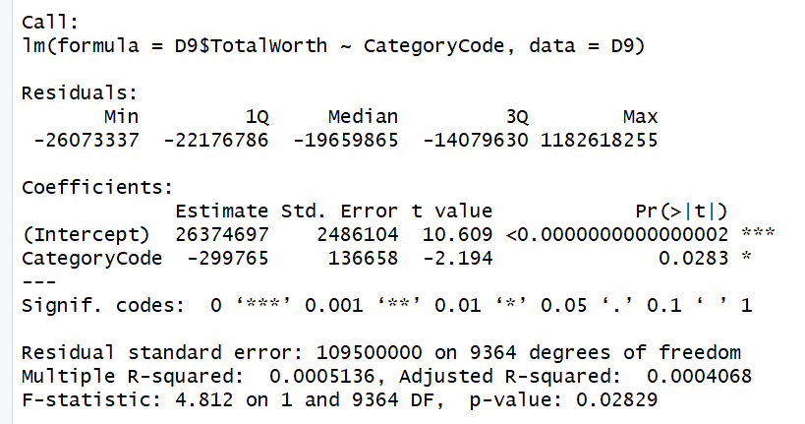

Slide 34
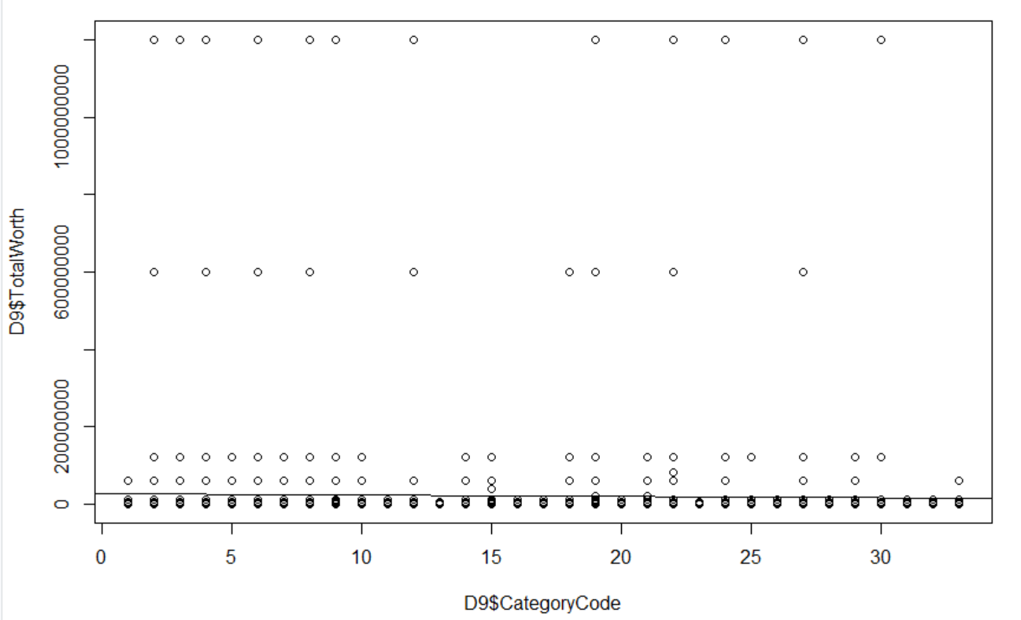

Slide 35
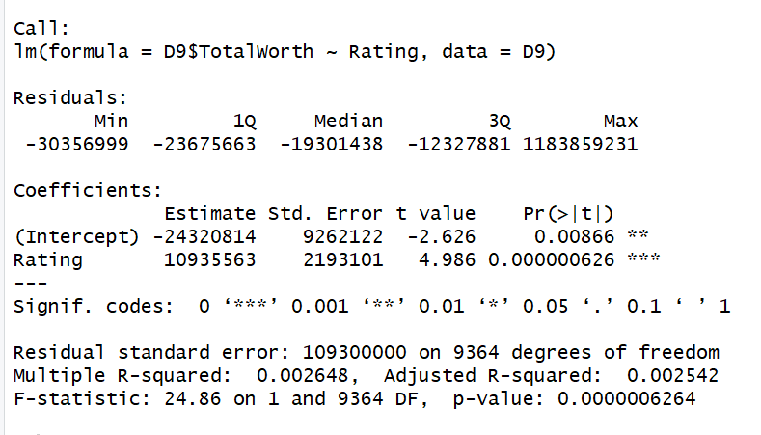

Slide 36
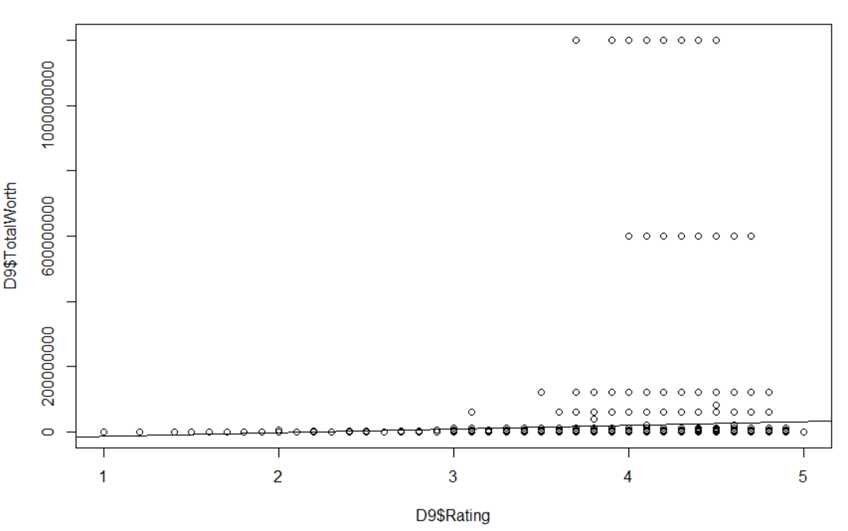

Slide 37
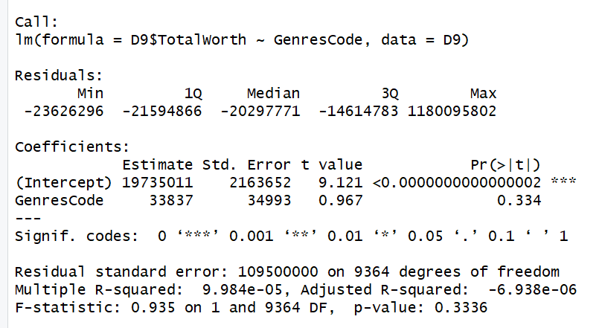

Slide 38
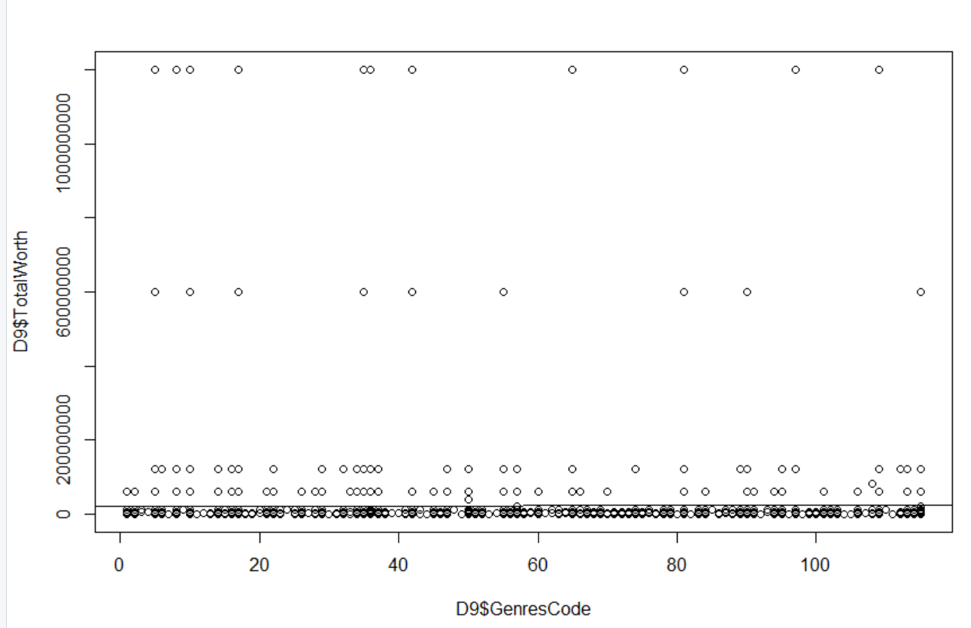

Slide 39
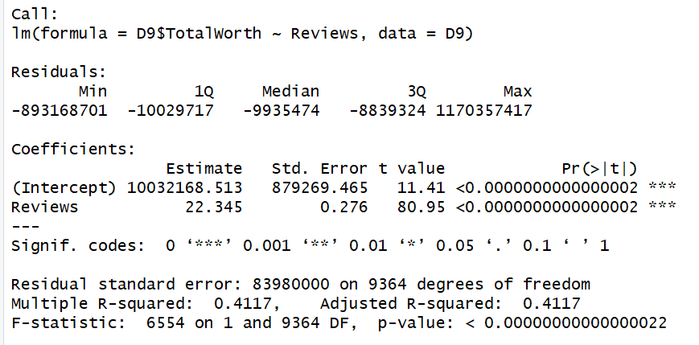

Slide 40
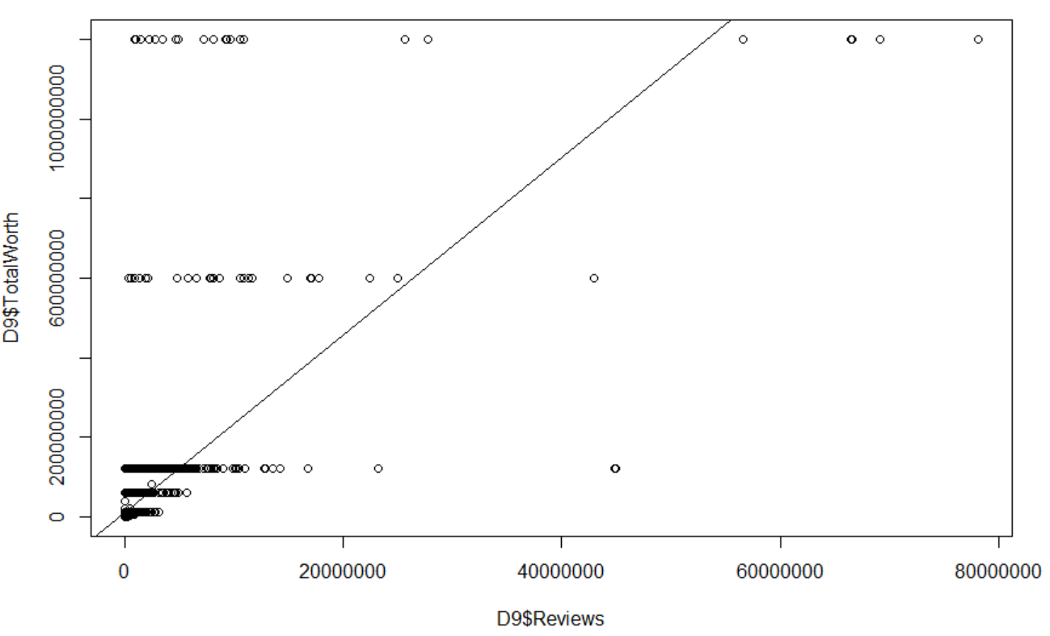

Slide 41
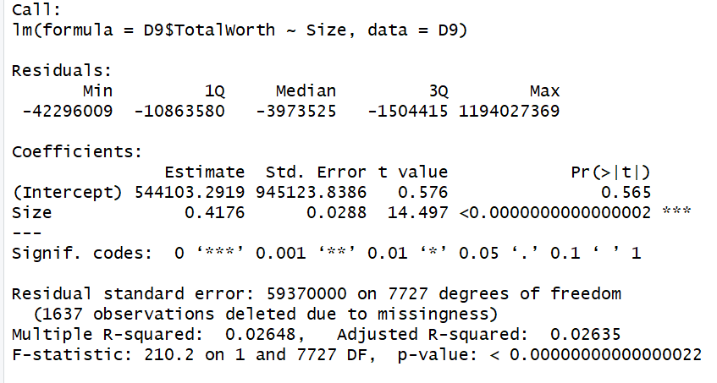

Slide 42
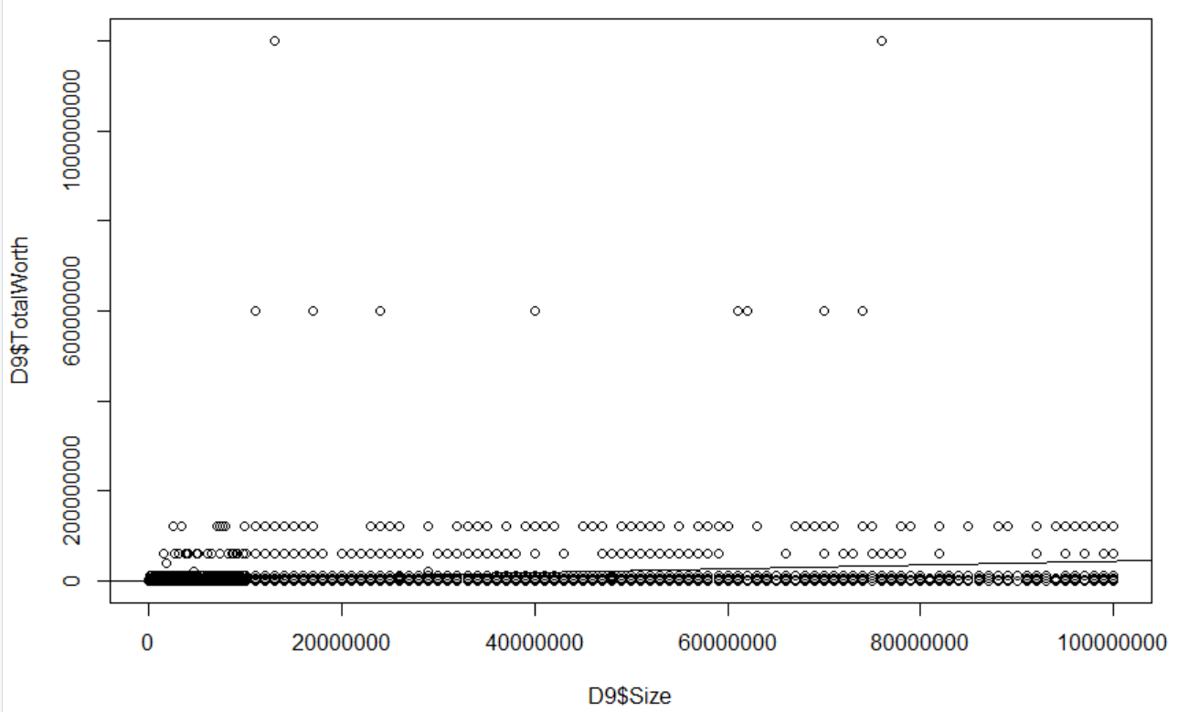

Slide 43
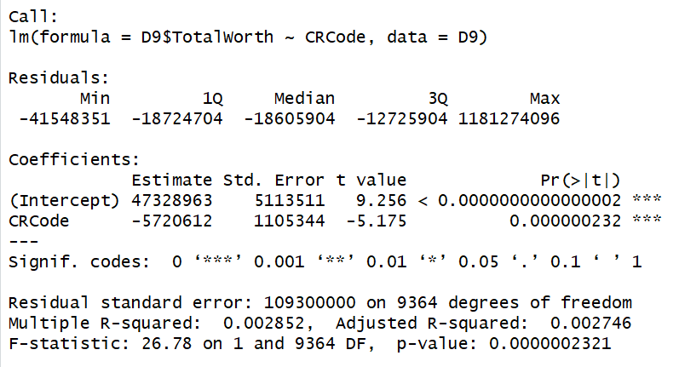

Slide 44
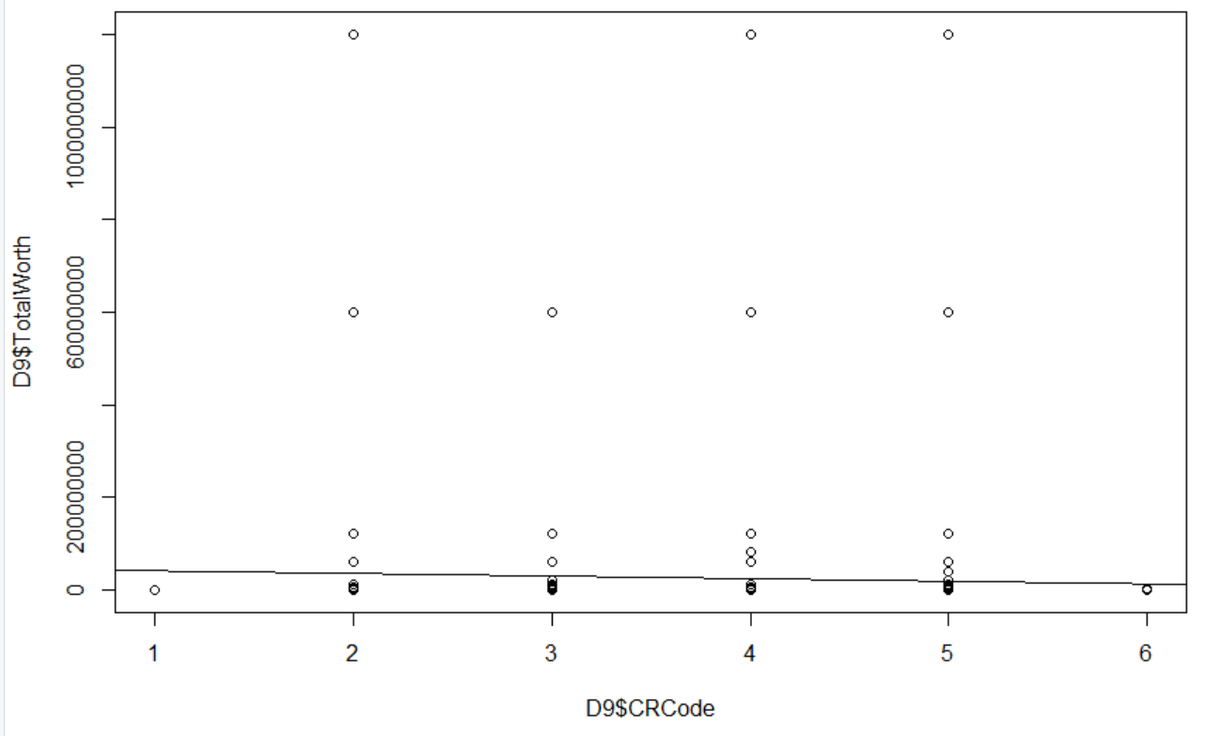

Slide 45
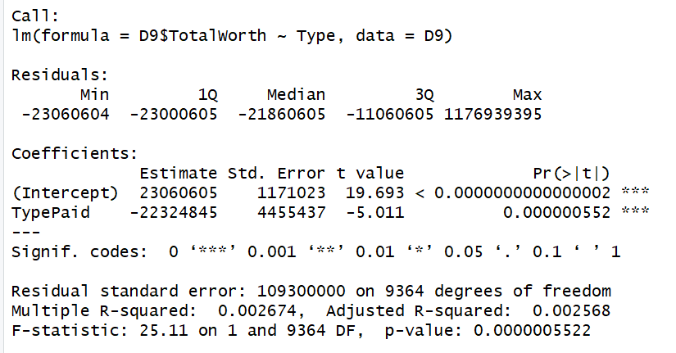

Slide 46
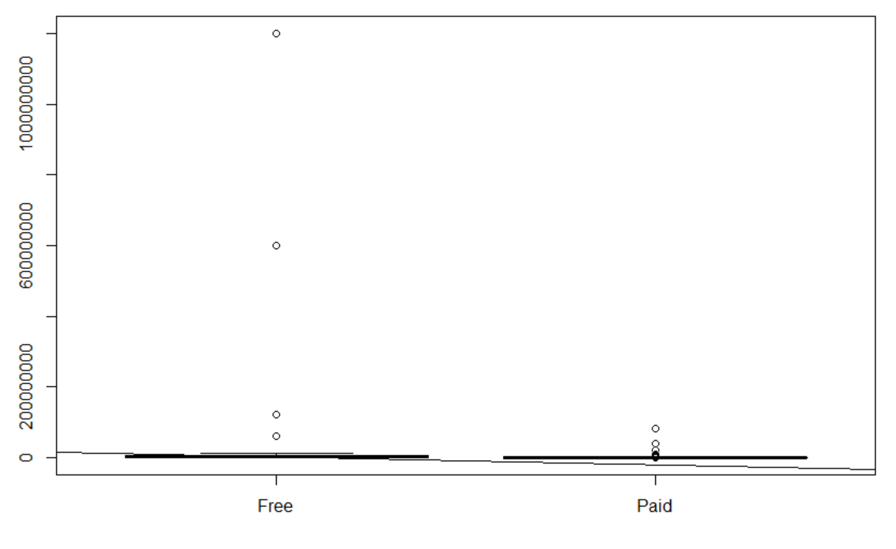

Slide 47
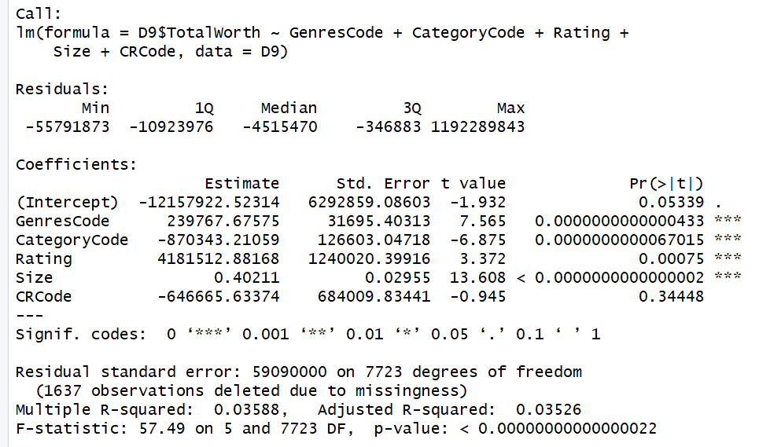

Slide 48
Linear Regression Conclusion
Can’t predict worth of an app based on any of independent variables
(R-squared is too low)
Reviews and Installs are too collinear with the Total Worth of the App to be used
Not able to predict the total worth

Slide 49
Conclusion
We conclude with the analysis done we can not offer any good recommendations to guarantee or improve download success from the data provided. It is possible with more and/or different data our results would be different.
We would encourage would be developers to create an app that they enjoy and disregard any hopes of grandeur and fame.
OR YOU COULD TRY THIS:

Slide 50
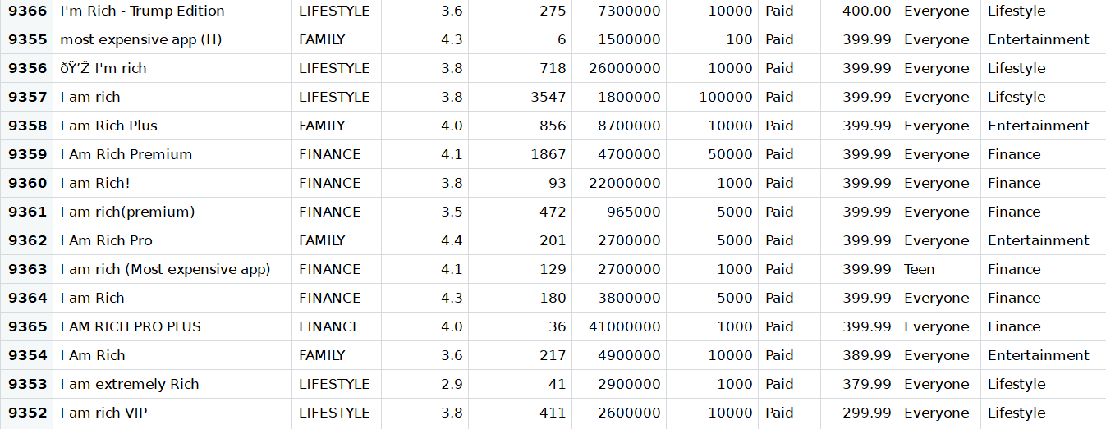
Conclusion

