Slide 1
AML Smart Contract Checks for Non-custodial Wallets
By
Dev

Slide 2
Problem Statement
Cryptocurrency transactions are vulnerable to money laundering & illicit activity.
Need for real-time AML (Anti-Money Laundering) checks integrated with blockchain smart contracts.
Current tools lack:
-Automated risk classification
-Integration with sanction lists (OFAC, etc.)
-Graph-based behavioral heuristics
-Human + AI analysis of data
-Risk rating mechanism
Hence, I have built a system that:
-Validates AML compliance
-Flag Non-Compliant Wallets
-Provide Risk rating (1-10)
-Provide tools to users to investigate the risk of a wallet

Slide 3





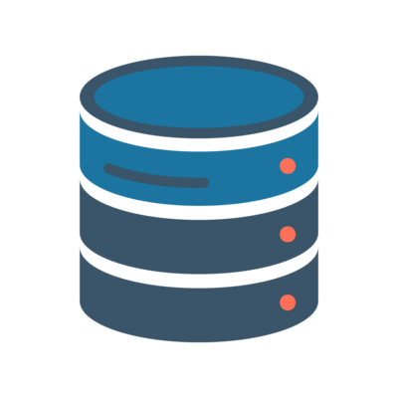
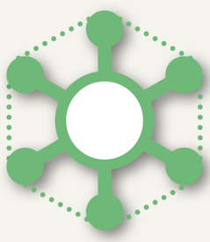
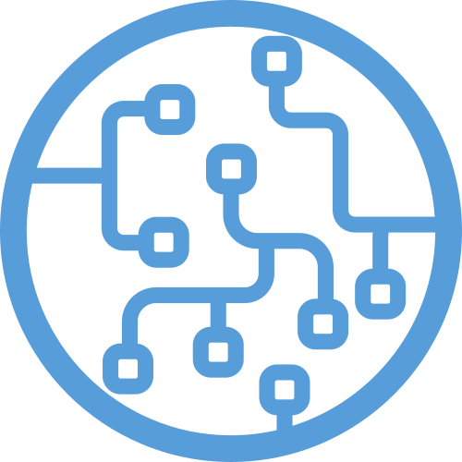
Architecture
Data Helper
Human performing analysis
User ( with Non-custodian Crypto Wallet)
OFAC Sanctions Data
Scheduler to update data
Uses Agent for AI aided forensic analysis
Third Party Sources
Known Mixers
Scamming
Phishing
Ransomware
Gambling
Tx Request
Returns tx details
AI Agent
AML Check Endpoint
Smart Contract
Heuristic Checks
Peeling
Structuring
Mixer pattens check
Radiating distance based risk (from graph algorithms)
Adds txn to pending checks
Process txn based on AML check
MCP
Flagged Wallets DB
Natural Language to database query converter
Graph Builder
Used to train ML model
Graph Database
Builds a database with each wallet as a node and each edge as a transaction between nodes, storing all details
Requests AML check
Human driven flagging
Oracle
Updates graph on successful transaction
GCN ML Model
Graph Visualizer
Visualizes the database into an interactive graph for human aided analysis
Human aided graph analysis
AML response

Slide 4
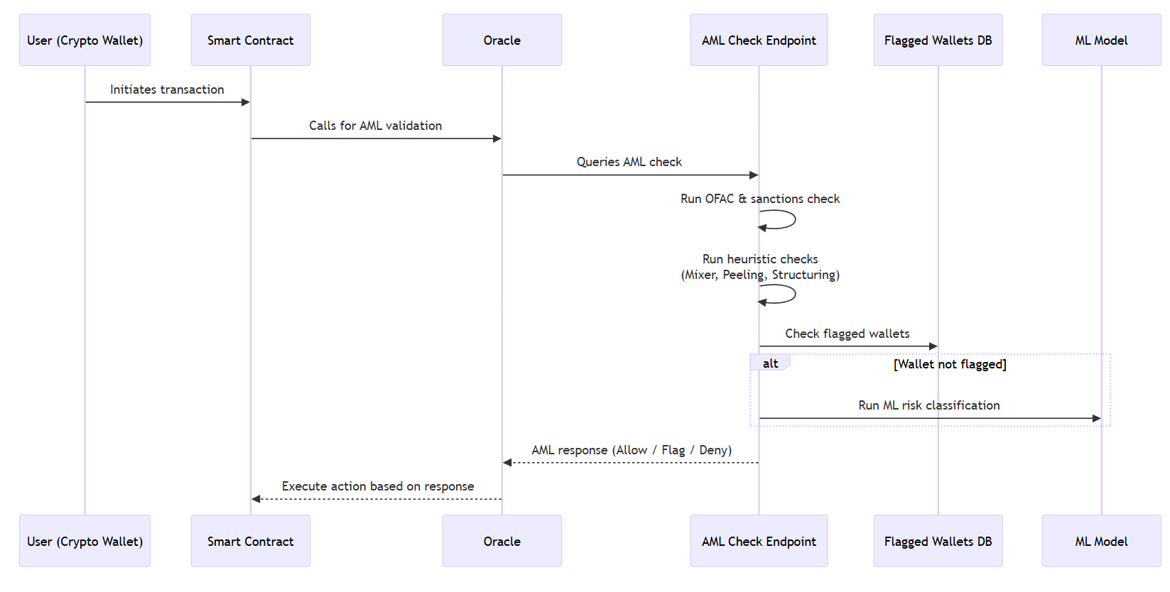
User case flow

Slide 5
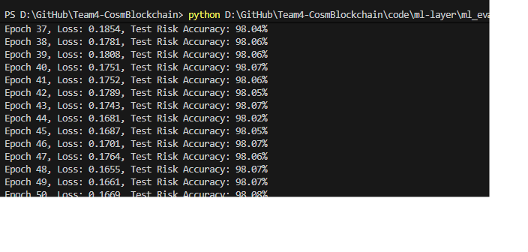
Machine Learning Layer
Training Phase
Input: Full wallet transaction graph (wallet_graph.pkl)
Nodes = Wallets
Edges = Transactions between wallets
Feature Extraction (per wallet):
Degree, in/out degree
Incoming/outgoing transaction count
Total sent / received amounts
Average transaction fee
Transaction volume
Neighbor aggregate risks (mean, max)
Model: 2-layer GCN + Linear classifier
Hidden size: 64, Dropout: 0.3
Output: Risk score (0–10 class labels)
Training:
Optimizer: Adam, LR = 0.01
Loss: CrossEntropy (supervised risk classification)
Split: 70% training, 30% testing
Evaluation metric: Accuracy on test nodes
Output: Saved model weights (wallet_gcn_model.pth)
Current Score:
Evaluation Phase
Input:
Sender & Recipient wallets
Transaction amount
Subgraph Extraction:
Up to 2-hop neighbors around the target wallet
Local subgraph keeps contextual transaction patterns
Feature Engineering: Same as training (scaled with MinMax)
Model Inference:
Load trained GCN
Forward pass on subgraph
Predict risk class for sender & recipient wallets
Output:
Risk score per wallet
JSON-like result:
{
"sender_wallet": {"risk_score": X},
"recipient_wallet": {"risk_score": Y}
}

Slide 6
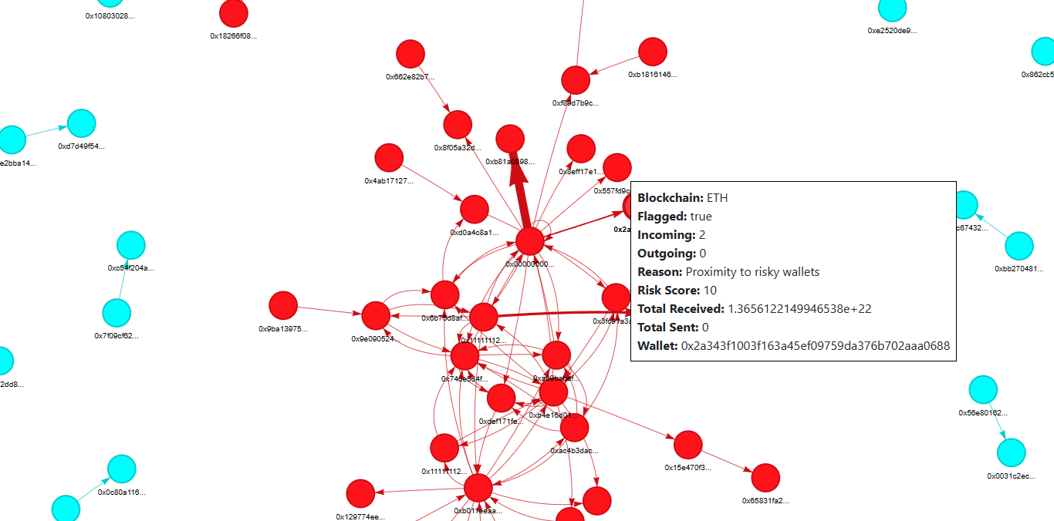
Graph Visualization
Graph Building
Source Data: Postgres DB (BTC, ETH transactions)
Nodes: Wallet addresses (with attributes)
Incoming/Outgoing counts
Total sent/received
Blockchain type (BTC/ETH/ERC20)
Flag status & reason
Edges: Transactions between wallets
Tx hash, value, timestamp, block number, fee, token type
Visualization (PyVis)
Subsample: 20 high-risk + 30 low-risk wallets → expand to connected components
Node color intensity = Risk Score (red = risky, blue = safe)
Interactive InfoBox (on click):
Wallet metadata (risk, blockchain, stats)
Edge metadata (transaction details)
Export as interactive HTML dashboard (wallet_graph.html)
Radiating Risk Metric (Proximity-Based Risk)
Start with flagged wallets (seed risk = MAX_RISK = 10)
Perform multi-hop BFS (up to 3 hops)
Propagate risk outward with decay:
Risk contribution = MAX_RISK / hop_distance
Closer wallets → higher inherited risk
Aggregate risk if connected to multiple risky sources
Ensures wallets in the “neighborhood” of risky wallets are flagged with proportional scores
Actual snippet from graph (notice clusters of high risk wallets – helps us recognize organized risky entities)

Slide 7
MCP
Highlights:
Designed for agentic workflows (agents can discover schema, then query).
Modular structure → easily extendable with new AML checks (heuristics, ML, etc.).
Purpose: Provides modular tools to interact with DB and wallet graph for AML checks.
Implemented Tools:
DB Schema Tool (db_schema)
Returns schema of AML database (tables + columns).
Ensures the agent knows what to query.
DB Query Tool (db_query)
Executes SQL queries (SELECT/INSERT/UPDATE/DELETE).
Returns results in JSON for easy consumption.
Graph Builder Tool (build_wallet_graph)
Loads pre-built wallet transaction graph (wallet_graph.pkl).
Extracts subgraph (neighbors up to N hops).
Visualizes using PyVis → generates interactive HTML graph.

Slide 8
Scheduler
Purpose
Ensure continuous refresh of AML data sources
Automate heuristic checks and sanctions list updates
Minimize manual intervention → always up-to-date intelligence
Scheduling Strategy
Heuristic Checks (Mixer, Peeling Chains, Structuring) ⏱ Runs every 6 hours
OFAC Sanctions List ⏱ Runs daily
Third-Party Data Sources ⏱ Runs every 12 hours
Implementation Highlights
Implemented with APScheduler (BlockingScheduler)
Scripts are run via subprocess (isolated execution)
Logs include:
[INFO] → job started
[SUCCESS] → job finished correctly
[ERROR] / [EXCEPTION] → debugging info
Benefits
Reliability: Jobs repeat on fixed intervals
Scalability: Easy to add new scripts to schedule
Auditability: Logged outputs aid debugging and monitoring
Integration: Feeds latest data into AML check endpoint and wallet graph
This ensures that your AML pipeline stays live, current, and trustworthy without requiring manual execution.

Slide 9
Future scope
Machine Learning (ML) Model
Scalability:
Move from local training → distributed training (GPU clusters, cloud ML pipelines)
Implement model serving using REST/gRPC with TensorFlow Serving / TorchServe
Integrate continuous learning from new flagged wallets and regulatory data
Graph Builder
Scalability:
Shift from NetworkX prototype → Neo4j / TigerGraph for production graph storage
Support real-time graph updates (streaming transactions)
Enable graph embeddings for faster risk scoring and anomaly detection
Heuristic Checks
Expansion:
Add more heuristics (e.g., layering, transaction velocity analysis, cross-chain swaps)
Integrate dynamic thresholds (adaptive based on recent network activity)
Automate with rule engine for flexible policy updates
🔹 System-Level Enhancements
Monitoring & Logging → Prometheus + Grafana dashboards
Scaling → Containerization (Docker) + orchestration (Kubernetes)
Data Pipelines → Apache Kafka for real-time ingestion from blockchain nodes
Security → Role-based access, encrypted storage of wallet data

