Slide 1
How to get good grades in Prof Moody’s Class
Sandhya Senthilkumar

Slide 2
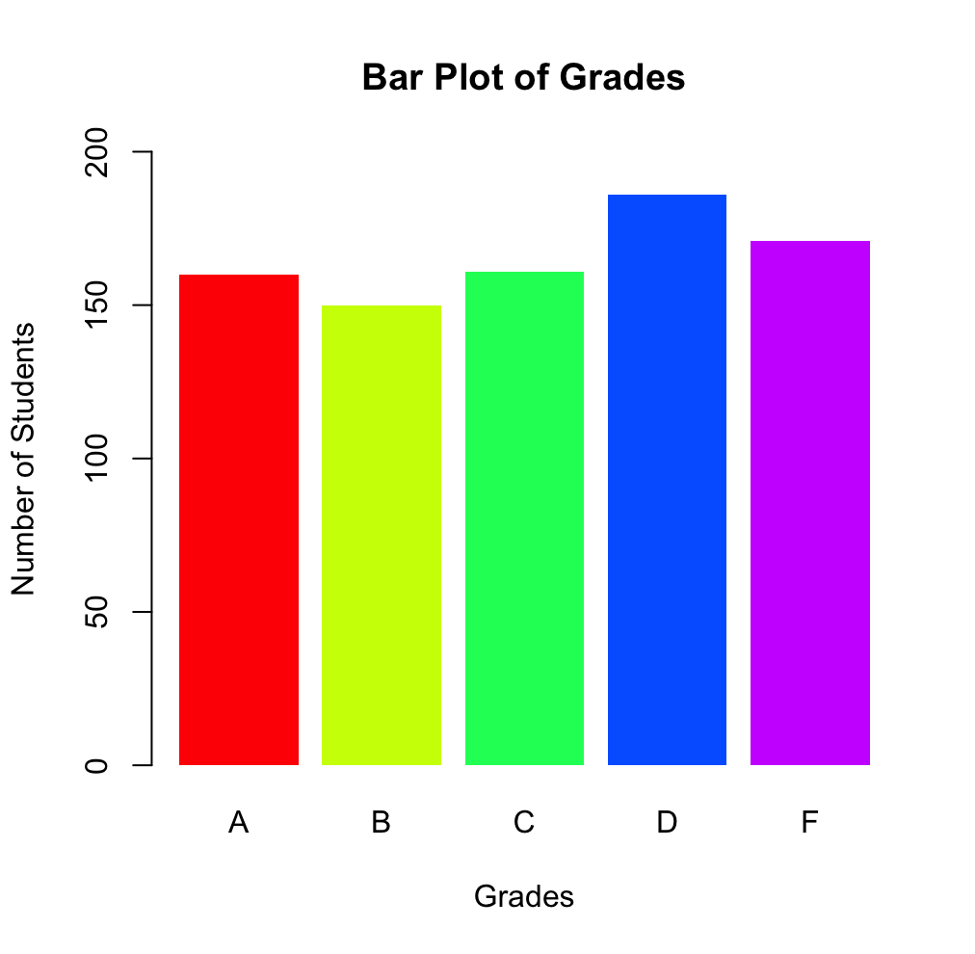
Grades Distribution
The overall grade distribution in the class without taking into account of specific factors is pretty evenly distributed, with just a handful more Ds and Fs in comparison to the As, Bs, and Cs that students took in the class.
barplot(table(moody$GRADE), col=rainbow(5), main="Bar Plot of Grades", xlab = "Grades", ylab = "Number of Students", border=NA, ylim=c(0, 200))

Slide 3
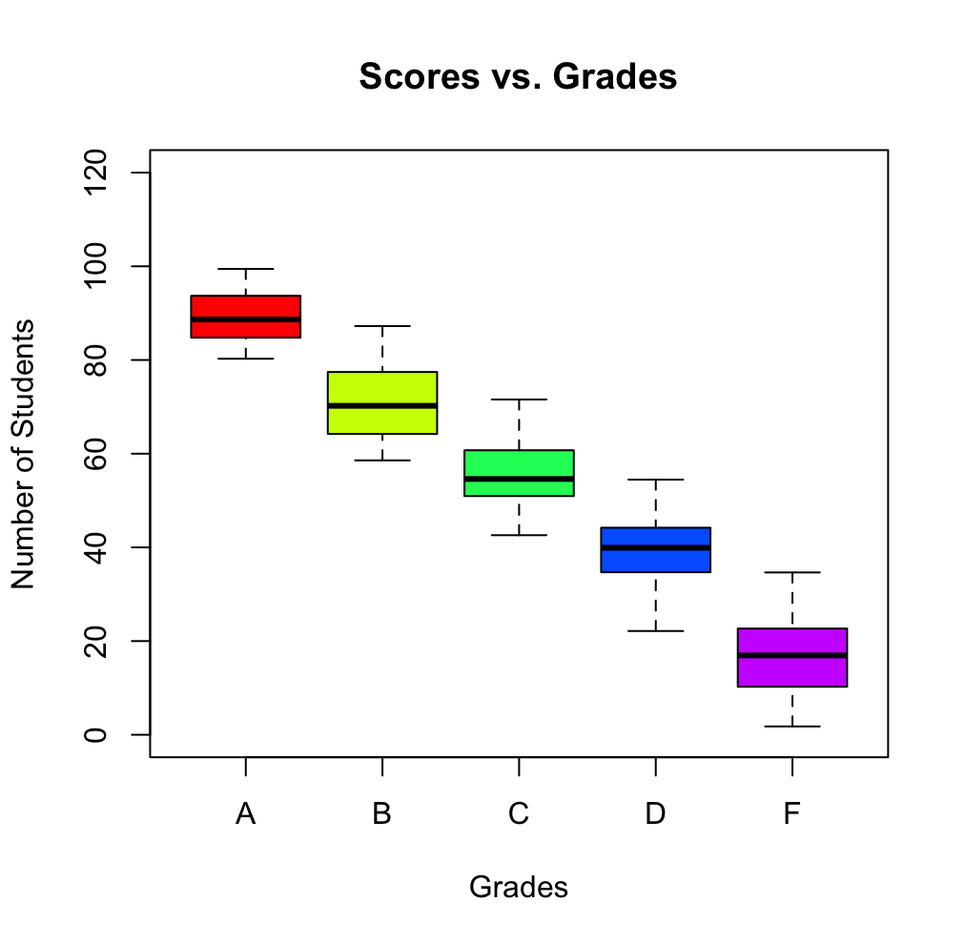
Scores and Grades
Taking a closer look at the distribution between the final grades and the actual numerical scores shows a very large overlap between the grades, which means that there are definitely some other factors affecting the students’ final grades outside of the actual scores.
boxplot(moody$PARTICIPATION~moody$GRADE, main = "Participation vs. Grade", xlab = "Participation", ylab = "Grade", col = rainbow(5))

Slide 4
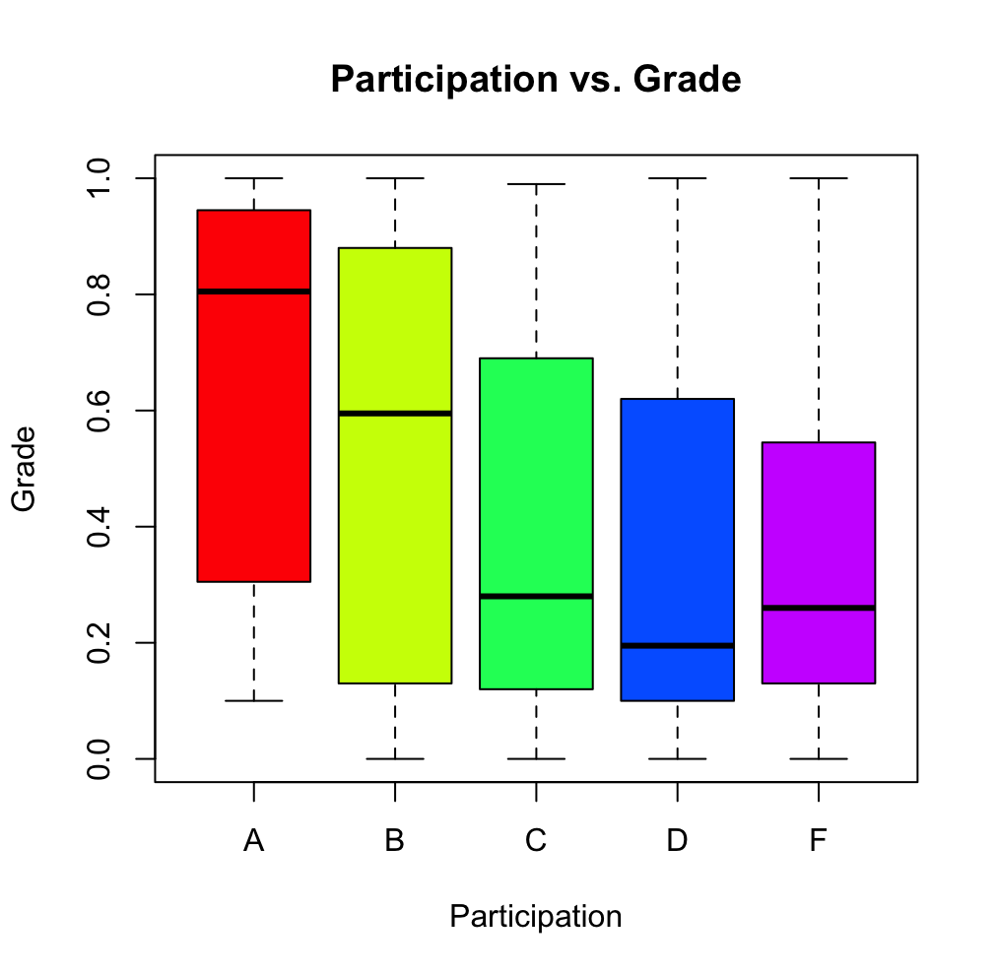
Participation and Grades
The first factor I took a look at was the participation number versus the grade. The participation seems to play a pretty important role in the overall grade, with a higher participation grade corresponding to a higher letter grade.
boxplot(moody$SCORE~moody$GRADE, main = "Scores vs. Grades", col = rainbow(5), xlab = "Grades", ylab = "Number of Students", ylim=c(0, 120))

Slide 5
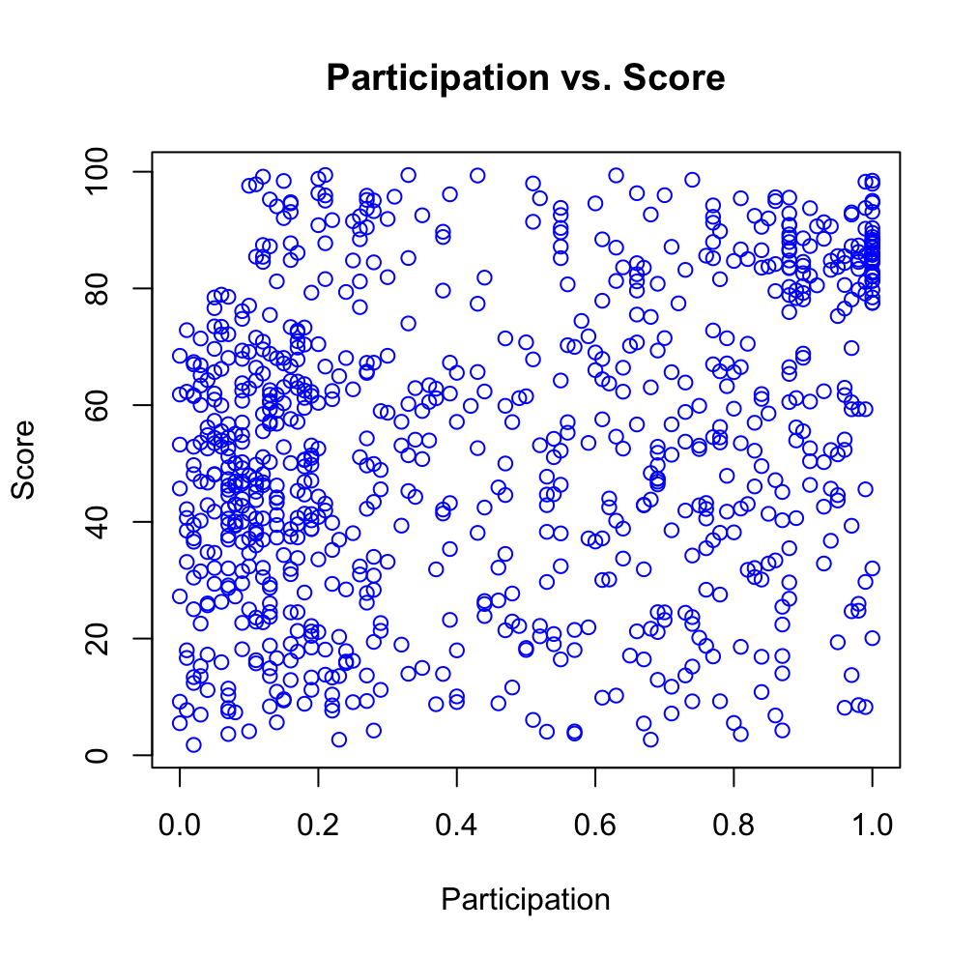
Participation and score
As clearly plotted in the scatter plot, there is no correlation between participation in class and your overall score, which means there are other factors that influence the overall participation score that a student receives in the class.
plot(moody$PARTICIPATION, moody$SCORE, main = "Participation vs. Score", xlab = "Participation", ylab = "Score", col = "blue")

Slide 6
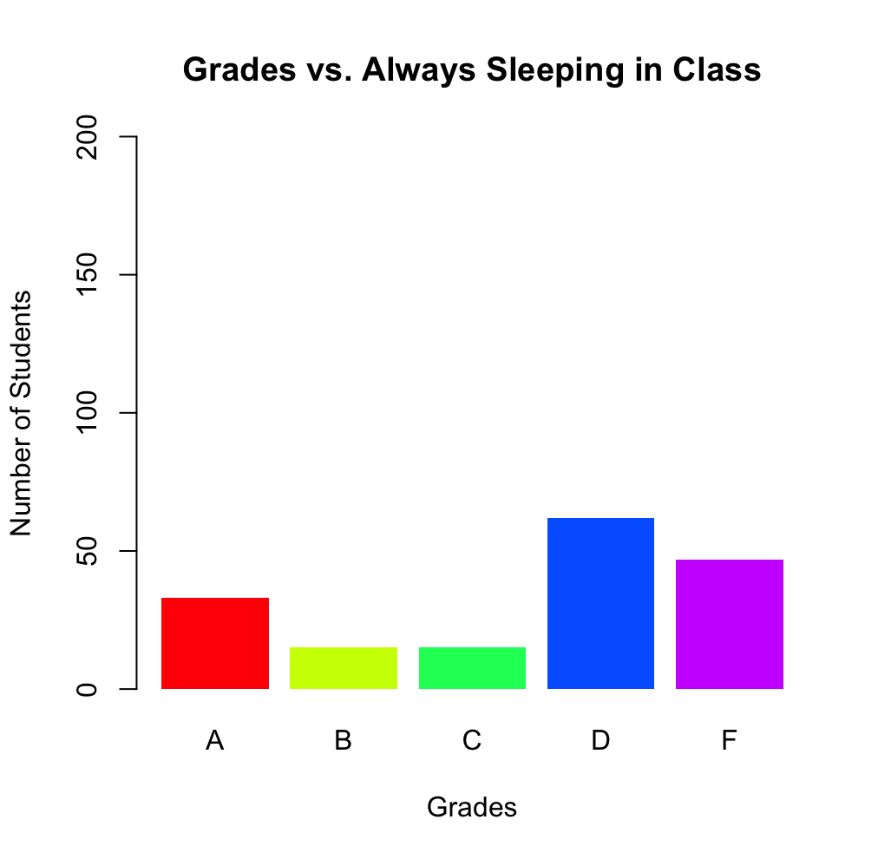
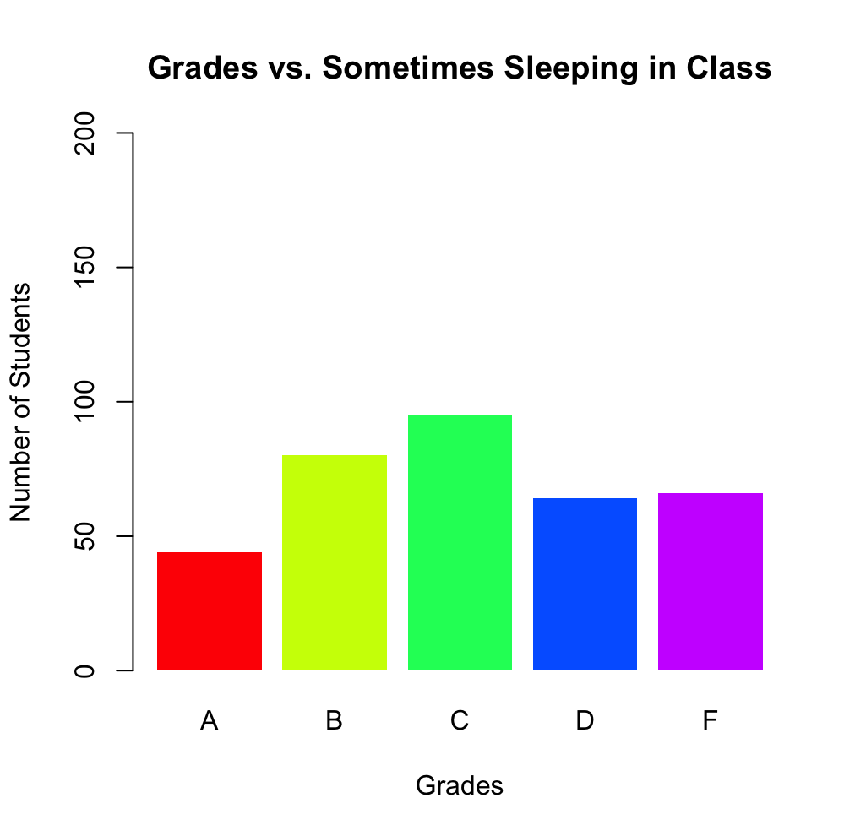
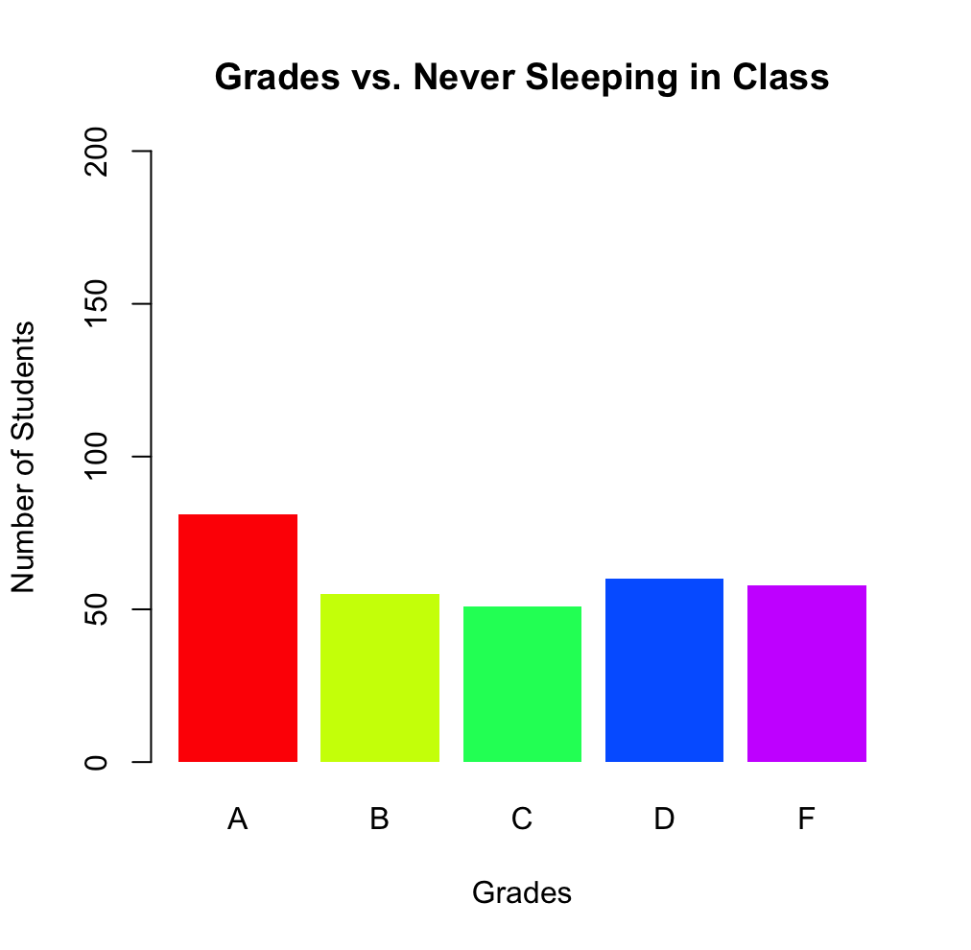
Grades and Sleeping in Class
Here, the amount of sleeping in class definitely affects the overall grade of the students in the class. The lower amount of sleeping corresponds to higher grades and more As and Bs compared to the students who always sleep in class, leading to more Ds and Fs. There is a clear correlation, where the more you sleep in class, the lower your grade is, as you can see a gradual decline in grades as the amount of sleeping in class increases.
barplot(table(moody$GRADE[moody$DOZES_OFF == "never"]), col=rainbow(5), main="Grades vs. Never Sleeping in Class", xlab = "Grades", ylab = "Number of Students", border=NA, ylim=c(0, 200))
barplot(table(moody$GRADE[moody$DOZES_OFF == "sometimes"]), col=rainbow(5), main="Grades vs. Sometimes Sleeping in Class", xlab = "Grades", ylab = "Number of Students", border=NA, ylim=c(0, 200))
barplot(table(moody$GRADE[moody$DOZES_OFF == "always"]), col=rainbow(5), main="Grades vs. Always Sleeping in Class", xlab = "Grades", ylab = "Number of Students", border=NA, ylim=c(0, 200))

Slide 7
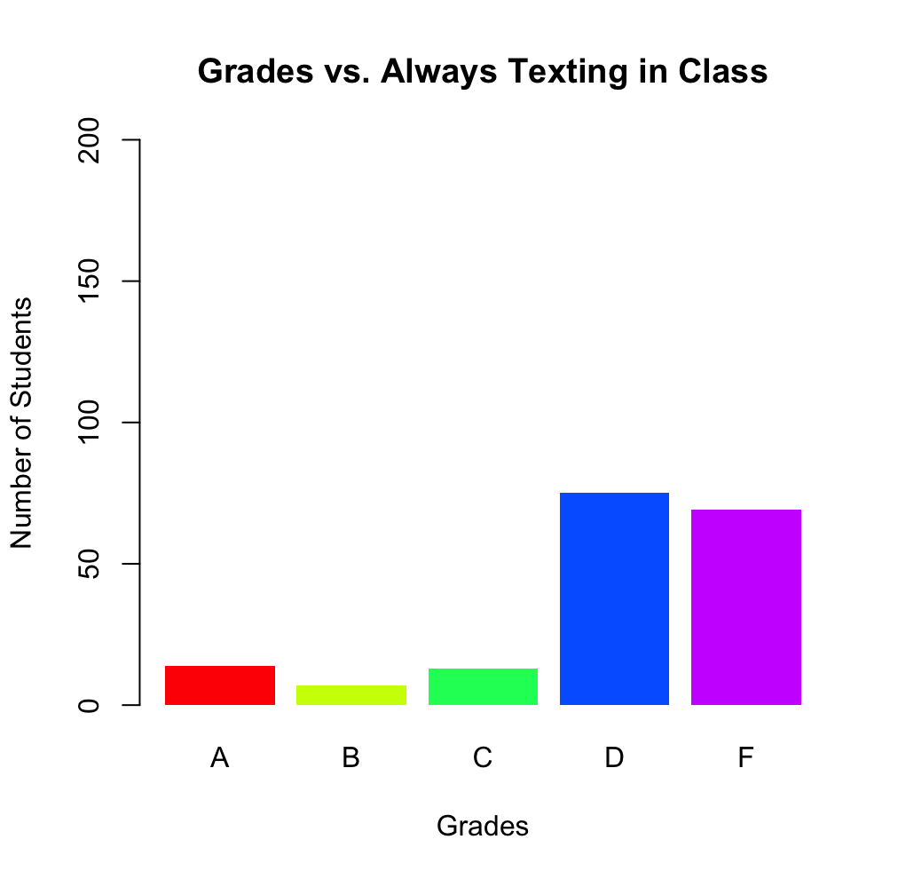
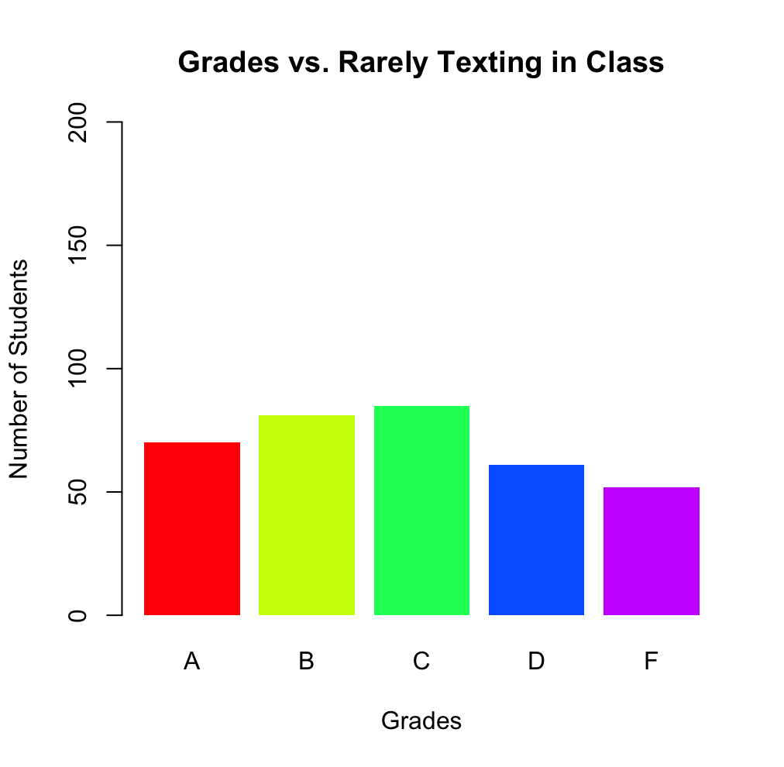
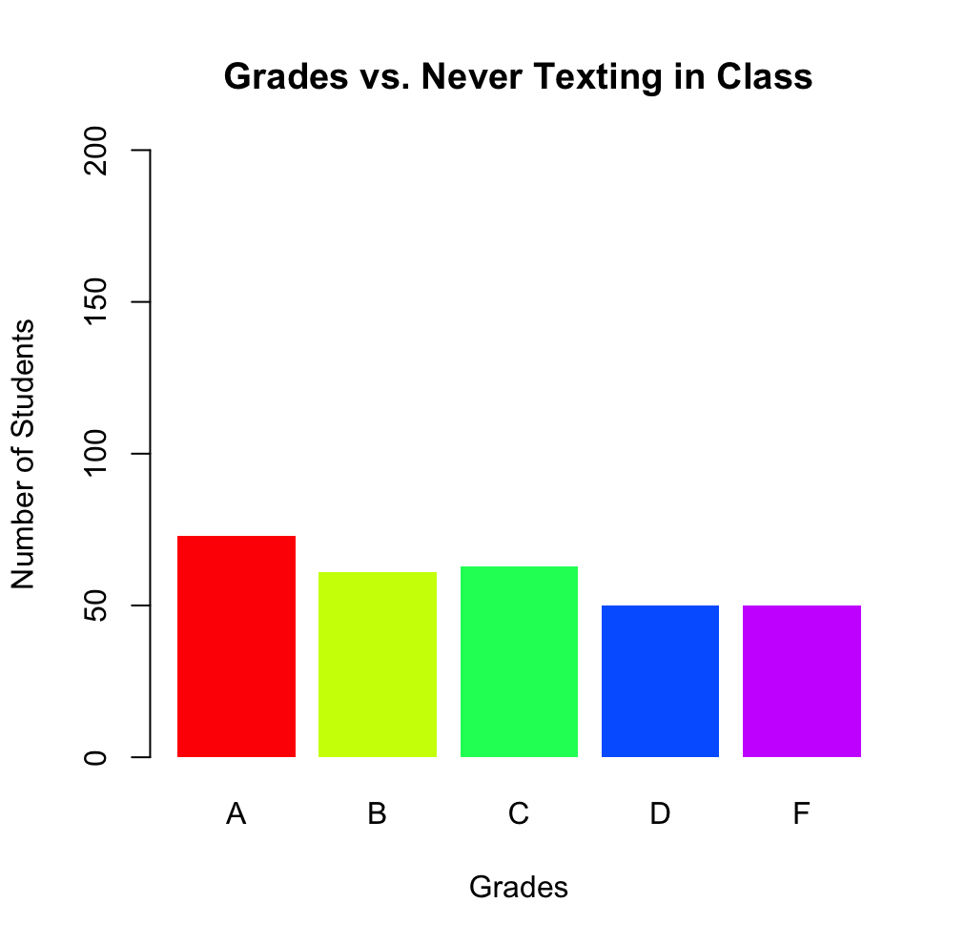
Grades and Texting in Class
The same pattern as the sleeping is found for the amount of texting done in class. As the amount of texting in the classroom increases, the lower the overall grades are. The students that never texted in class had more As and Bs, the students who texted rarely in class had more Bs and Cs, and the students that always texted in class had a significantly large amount of Ds and Fs.
barplot(table(moody$GRADE[moody$TEXTING_IN_CLASS == "never"]), col=rainbow(5), main="Grades vs. Never Texting in Class", xlab = "Grades", ylab = "Number of Students", border=NA, ylim=c(0, 200))
barplot(table(moody$GRADE[moody$TEXTING_IN_CLASS == "rarely"]), col=rainbow(5), main="Grades vs. Rarely Texting in Class", xlab = "Grades", ylab = "Number of Students", border=NA, ylim=c(0, 200))
barplot(table(moody$GRADE[moody$TEXTING_IN_CLASS == "always"]), col=rainbow(5), main="Grades vs. Always Texting in Class", xlab = "Grades", ylab = "Number of Students", border=NA, ylim=c(0, 200))

Slide 8

Final Advice
The best advice that can be given to students to do well in the class is:
Pay attention in class,
Do not text or sleep in class,
Participate in class.
The good grades will follow.

