Slide 1
Moody Data Puzzle – pattern I injected

Slide 2
moody1<-moody[moody$DOZES_OFF=='always'|moody$TEXTING_IN_CLASS=='always',]
boxplot(moody1$SCORE ~ moody1$GRADE, main = 'Distribution of Scores by Grade for sleepers and textters', ylab ='Score (out of 100)', xlab = 'Letter Grade', col = c("blue", "green", "yellow", "orange", "red"))
boxplot(moody$SCORE ~ moody$GRADE, main = 'Distribution of Scores by Grade for all', ylab ='Score (out of 100)', xlab = 'Letter Grade', col = c("blue", "green", "yellow", "orange", "red"))

Slide 3
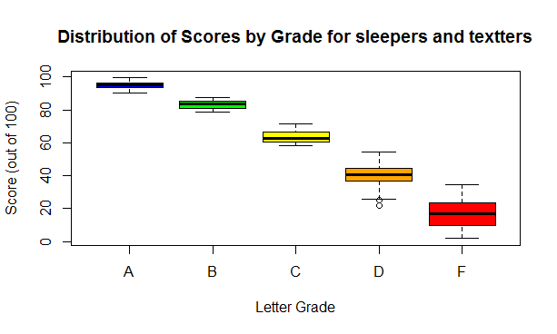
Sleepers and texters: boxes Separated. Higher cut points

Slide 4
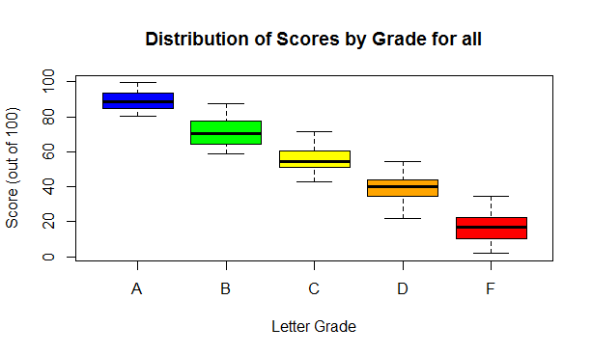
All: poor separation. Lower cut points

