Slide 1
All About Movies
By: Andrew Fasano

Slide 2

Our Main Focuses and Hypothesis
This presentation will focus on the three top categories that show the relation to IMDB scores:
Budget
Genre
Gross Pay
With evidence presented in the form of plots, it will be clear what categories influence good or bad IMDB scores

Slide 3
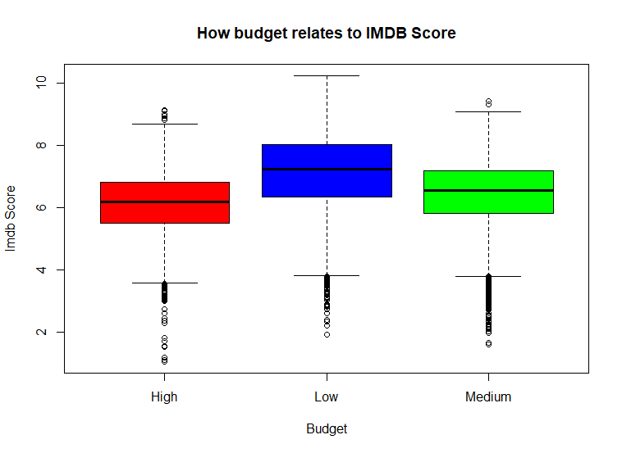
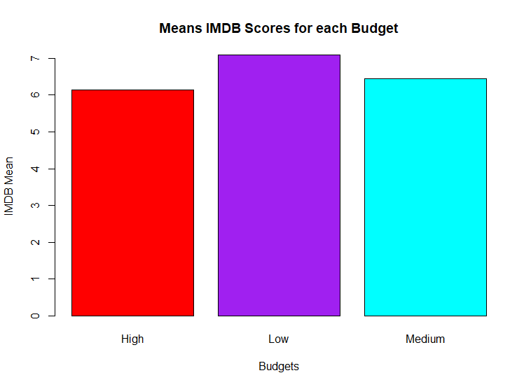
Breaking down Budget
From the plots shown we can see that having a high is always best for good IMDB scores
IMDB scores range from 1-10
Low budget movies have higher IMDB score ranges compared to the High and Medium Budget Movies
When the mean is calculated, the Low Budget Mean is still higher compared to the High and Medium Mean IMDB scores

Slide 4
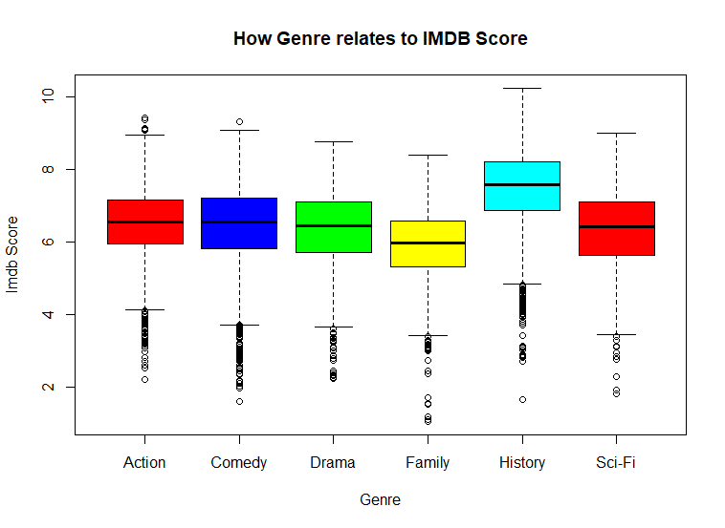
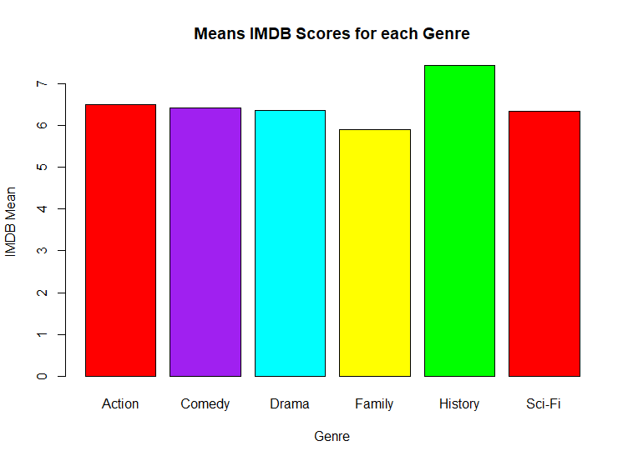
Breaking down Genre
Plots show the varying genres and how they ranges and mean IMDB score relate to each other
History Genre has the highest range of IMDB score compared to Action, Comedy, Drama, Family, and Sci-Fi.
History is the only Range that achieved any IMDB scores of 10
With Family have the lowest Mean and Range in IMDB scores, it correlates and shows that History is the best in terms of Mean IMDB score as well
All other Genres Average around the same Mean and Range of IMDB

Slide 5
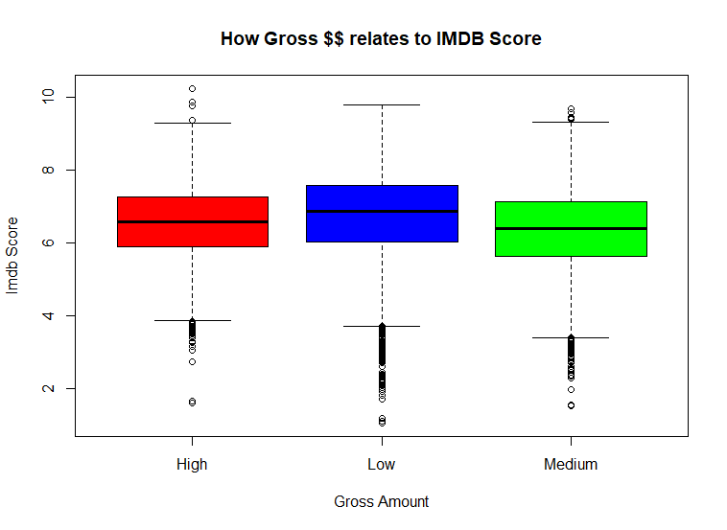
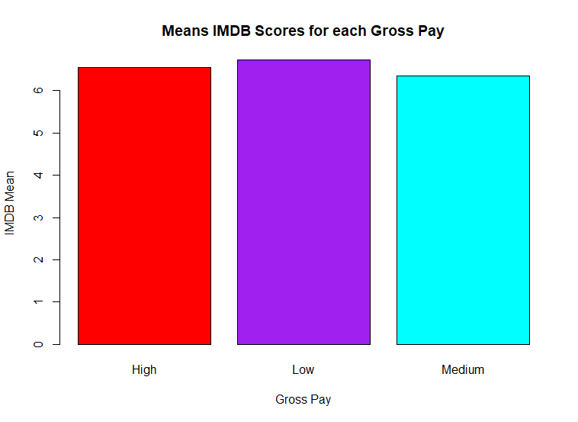
Breaking down Gross Sales
We see the ranges and mean IMDB scores of gross pay
Once again Low Gross Pay Movies get higher IMDB ranges and overall mean than the high and medium ranges and mean
Although, some High Gross movies do achieve a better IMDB score than the top of the Low Gross Pay Range.
But those small portion of High Gross movies isn’t enough to raise the mean and range passed the Low Gross mean and range

Slide 6
What Movies Have the Best IMDB Scores
These will be the alternate hypothesis that allow movies to have IMDB scores
Keeping a Low Budget! With a low budget the movie has a better chance to score in a higher IMDB range
Being in the History Genre! History was the leading genre for mean IMDB and achieved the highest score out of any other movie genre
If the Movie Gross Sales are Low, then the movie is more likely to score higher in the IMDB scale
With these three candidates, and the plots that prove that they preform better on the IMDB: it makes them the most promising alternative hypothesis

