Slide 1
What I can tell you about the movies
Joshua Sze

Slide 2

Introduction
Movies are a common source of entertainment for most people. Some are interested in the great storylines, and others are interested in the mindless action these movies provide. After watching a movie, they rank the enjoyment in the Internet Movie Database, more commonly known in its abbreviated form IMDb, so people would know whether they will enjoy the movie or not. Although it is mainly known to rank movies, it contains information on casting, trivia, and errors.
Despite this, this presentation will focus mainly on the rating aspects people give to the films. Factors that are considered in addition to the IMDb rating is the genre, the content rating, the country, the gross box office, and its budget. The aim of the presentation is to create hypotheses made from connections between respective box plots that graph the IMDb score to each of those factors.

Slide 3
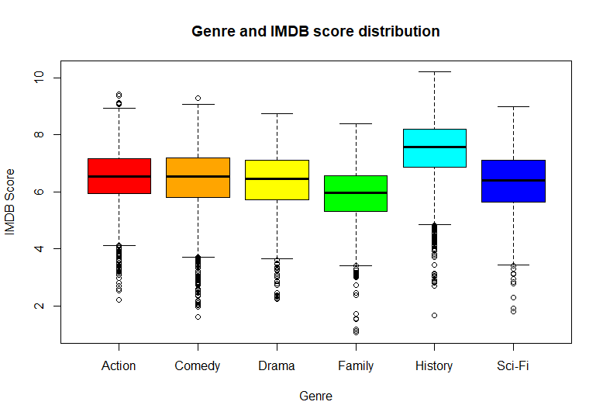
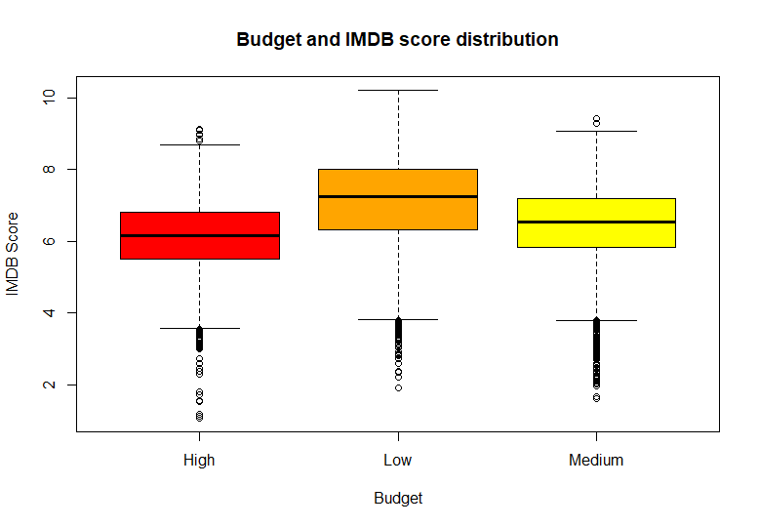
Hypothesis 1: Low-budget historical films have a higher IMDb average score than high-budget family films

Slide 4
Hypothesis 1: Justification and R code
Historical movies have a higher IMDb average rating than any other genre. Even its lowest outliers have a higher IMDb rating than a couple of genres. Low budget films have a higher IMDb average rating than any other budget amount. Family films and high-budget movies have a lower IMDb rating than any other genre and budget respectively. This can lead to the assumption that low-budget historical movies have a higher IMDb rating than high-budget family movies.
#Suppose you want to find the distribution of the IMDB score per movie budget. We use box plot for getting that.
boxplot(imdb_score~Budget,data=movies,xlab="Budget",ylab="IMDB Score", main="Budget and IMDB score distribution",col=colors,border="black")
#Suppose you want to find the distribution of the IMDB score per genre. We use box plot for getting that.
boxplot(imdb_score~genre,data=movies,xlab="Genre",ylab="IMDB Score", main="Genre and IMDB score distribution",col=colors,border="black")

Slide 5
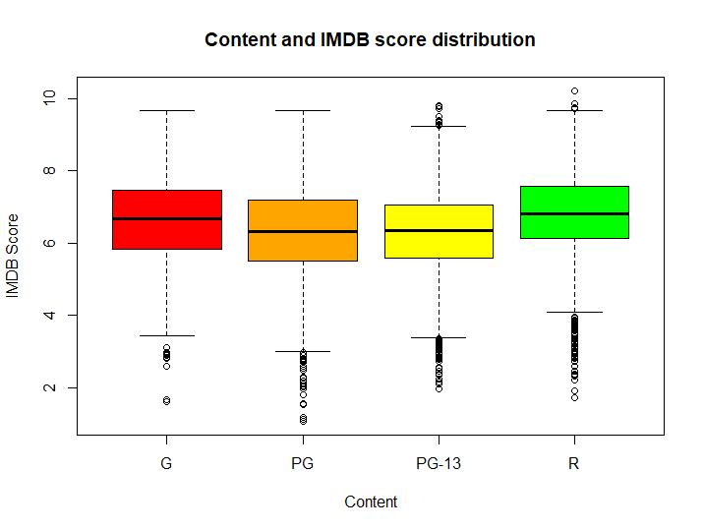
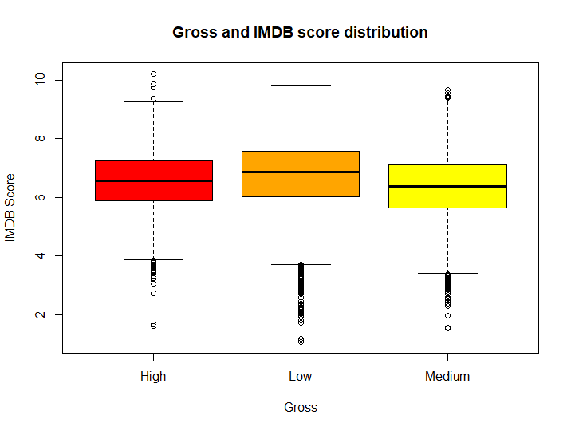
Hypothesis 2: Medium-grossing PG films have a lower IMDb average rating than low-grossing R-rated films

Slide 6
Hypothesis 2: Justification and R code
Medium-grossing movies have a lower IMDb average rating than films that have a high or low grossing box office. PG films have a lower IMDb average rating than any other content rating. Low grossing and R-rated movies have a higher IMDb rating than any other gross and content rating respectively. This can lead to the assumption that medium-grossing PG films have a lower IMDb average rating than low-grossing R-rated films.
#Suppose you want to find the distribution of the IMDB score per content rating. We use box plot for getting that.
boxplot(imdb_score~content,data=movies,xlab="Content",ylab="IMDB Score", main="Content and IMDB score distribution",col=colors,border="black")
#Suppose you want to find the distribution of the IMDB score per gross box office. We use box plot for getting that.
boxplot(imdb_score~Gross,data=movies,xlab="Gross",ylab="IMDB Score", main="Gross and IMDB score distribution",col=colors,border="black")

Slide 7
Hypothesis 3: High-grossing historical films have a higher IMDb average score than high-grossing drama films

Slide 8
Hypothesis 3: Justification and R code
Historical movies have a higher IMDb average rating than any other genre, including drama. Even its lowest outliers have a higher IMDb rating than a couple of genres. Since both genres that are high grossing are factored in, we can create the assumption that high-grossing historical movies have a higher IMDb average rating than high-grossing drama films.
#Suppose you want to find the distribution of the IMDB score per gross box office. We use box plot for getting that.
boxplot(imdb_score~Gross,data=movies,xlab="Gross",ylab="IMDB Score", main="Gross and IMDB score distribution",col=colors,border="black")
#Suppose you want to find the distribution of the IMDB score per genre. We use box plot for getting that.
boxplot(imdb_score~genre,data=movies,xlab="Genre",ylab="IMDB Score", main="Genre and IMDB score distribution",col=colors,border="black")

