Slide 1
Plots

Slide 2
CODE IS LIVE
In our active tutorial (code snippets)
All examples are there
PPTs – anything but code (with small exceptions sometimes)

Slide 3
Categorical, Numerical and Ordinal Variables…
CAT: Categorical: GRADE like A, B, C, D
NUM: Numerical: SCORE: like 89.64
ORD: Ordinal: ordered categorical: D<C<B<A

Slide 4
Which plot to use?
It all depends on the variables, CAT (categorical), NUM (numerical),
NUM x NUM scatter plot
CAT x CAT mosaic plot
CAT x NUM box plot
NUM box plot, histogram
CAT bargraph…..

Slide 5
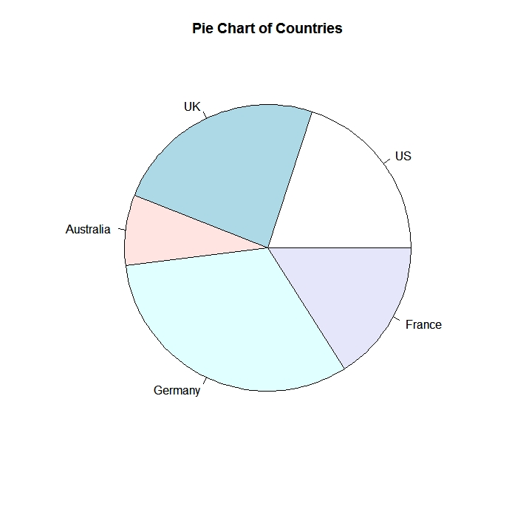
Piecharts TYPE: CAT

Slide 6
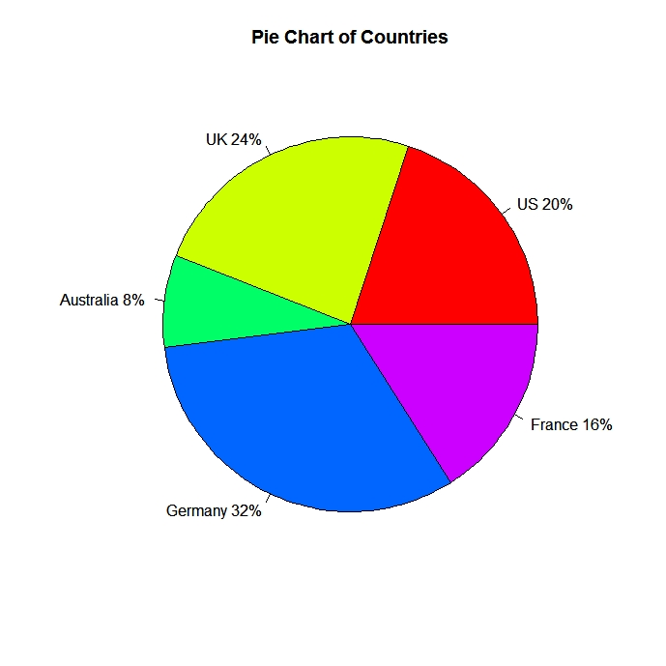
Piecharts

Slide 7
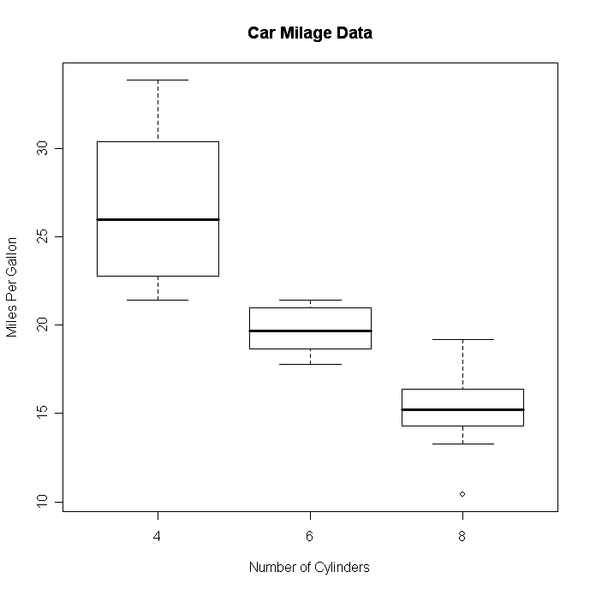
Boxplots TYPE: NUM x CAT

Slide 8
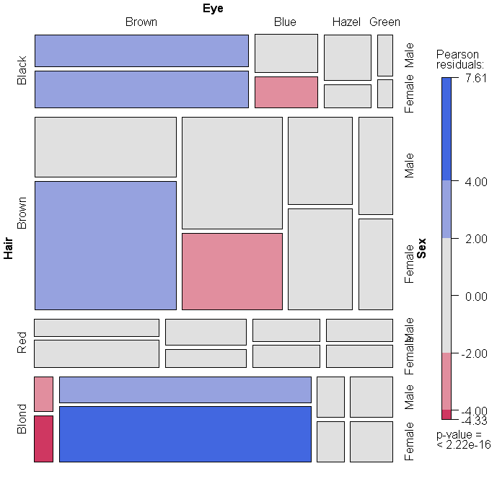
Mosaic Plot TYPE: CAT x CAT X CAT

Slide 9
What’s interesting?
Contradictory to our expectations? So called “Bayesian Prior”
Outliers
High Correlation
What are TOP K, Bottom K values

Slide 10
Do you know what I found? – can’t wait to show you…..
Salaries do not depend on education?
Salaries clearly are positively correlated with education
IF groom and bride are born under the same sign THEN marriage has much higher chance to survive

Slide 11
Interesting vs actionable
Wines from Montenegro are much more expensive than French wines
Californian wines are rated the highest
Sweden has the highest cost of living
Greatest basketball players are more than 6’ 7’’ tall

Slide 12
Interesting and/or actionable?
Honda has the best repair record
Vegetarians live 3 years longer
Lincoln tunnel traffic is higher than Holland tunnel traffic on weekends
Out of top 10 richest people in US, 7 of them are under 45

Slide 13
Why look for patterns, trends?
ACTIONABLE (we can do something based on the analysis which will benefit someone)
DATA CLEANING – biased data collection, errors, missing data
CURIOSITY (did you know that?)

Slide 14
How much R do I need to know?
ONE LINERS
student_performance <- read.csv("MOODY.csv")
boxplot(student_performance$SCORE, main='My first Boxplot’)
mosaicplot(moody$GRADE~moody$ON_SMARTPHONE) gradeTable <- table(student_performance$GRADE)
OBJECTIVE: SHORTEST PATH – how to plot/explore/predict/test hypotheses with MINIMAL PROGRAMMING

Slide 15
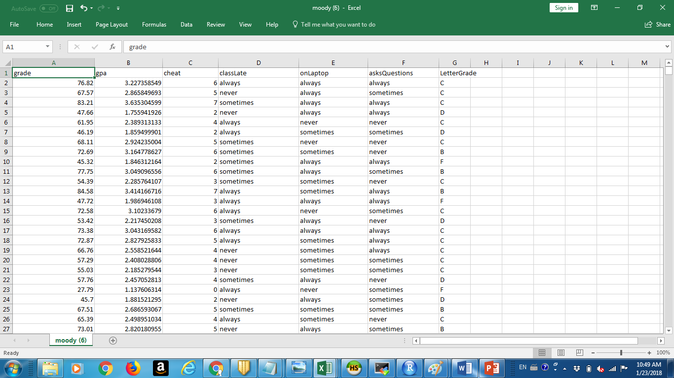
Professor Moody data set

Slide 16
Simple and more complex
DATA -> PLOT
DATA -> TRANSFORMATION ->PLOT

Slide 17
TRANSFORMATIONS on data frames.
Subsetting
Adding new columns
Aggregating (tapply, table)
Next class!

