Slide 1
Boundless Analytics
By:Anastasiya Chuchkova

Slide 2
The 4 best subsets I found
I went through the entire data set, skimming through every single slice, and the 4 most promising slices that I was able to find where:
Day =='Weekday' & Location =='Princeton' and SoftDrinks ='Cola' and anchor attribute is Snacks
Beer =='Lager' & Day=='Weekend' and Location ='New Brunswick' and anchor attribute is Snacks
Beer =='Lager' & Day=='Weekend' and Snacks ='None' and anchor attribute is Location
Day =='Weekday' & Location =='Princeton' and Snacks ='Popcorn' and anchor attribute is SoftDrinks

Slide 3
4 Alternative Hypothesis
I went through the entire data set, skimming through every single slice, and the 4 most promising slices that I was able to find where:
The Distribution of sales of Snacks is affected if we limit ourselves to transactions selling Cola in Princeton on the Weekdays.
The Distribution of sales of Snacks is affected if we limit ourselves to transactions selling Lager in New Brunswick on the Weekends.
The Distribution of sales based on Location is affected if we limit ourselves to transactions selling Lager with no snacks on the Weekends?
The Distribution of slayes Soft Drinks is affected if we limit ourselves to transactions selling Popcorn in Princeton on the Weekdays.

Slide 4
Bonferroni Correction
Because there are total of 652 slices aka 652 possible hypothesis, and I went through all of them looking for the “most interesting” ones, I did “p-value hunting” have to apply the Bonferroni Correction:
0.05/N, N being the number of Hypotheses
Since there are 652 Hypotheses we get 0.05/652=7.669e^-5 as our new critical value (p-value)

Slide 5
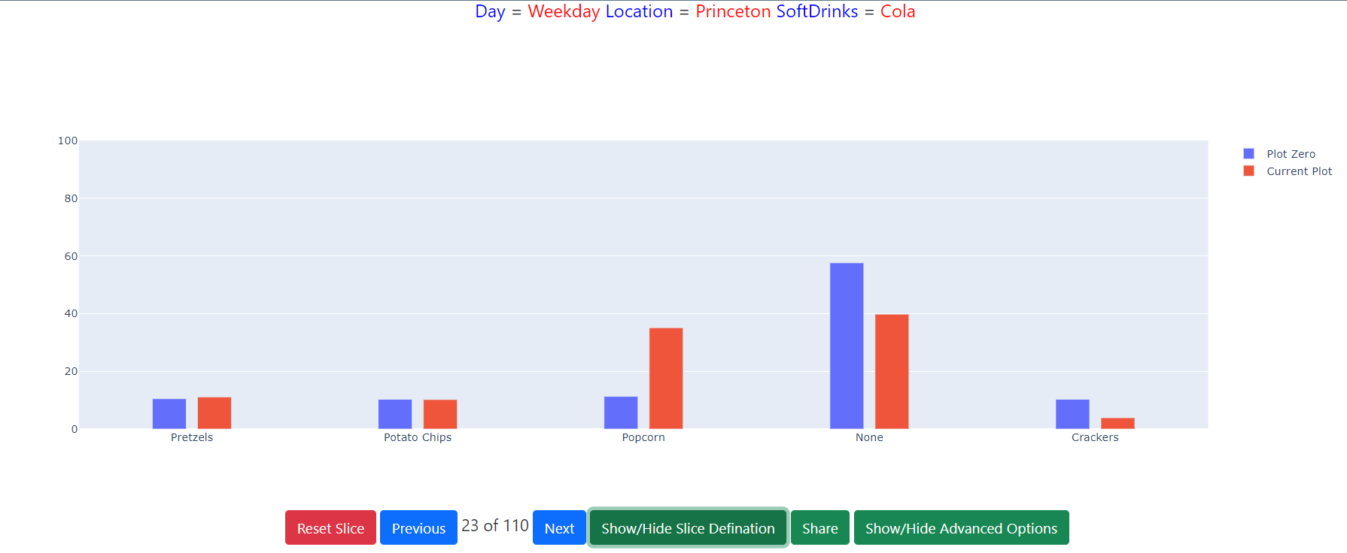
Is Distribution of Snacks affected if we limit ourselves to transactions selling Cola in Princeton on the Weekdays?

Slide 6
Is Distribution of Snacks affected if we limit ourselves to transactions selling Cola in Princeton on the Weekdays? Cont
Why I picked the slice:
From the picture of the slice in Boundless Analytics we saw significant differences between blue and red bar on “none” “popcorn” and “crackers” snacks. For popcorn the red bar was over twice as big as blue bar, and for Crackers the red bar was half the size of blue. This indicated that the Chiq value should be very large for this slice, thus it’s a very interesting finding
Code with Chiq value and p-value I got:
Explanation of Chiq value and p-value
Since the p-value of less then 2.2e^-16, which is much less than 7.669e^-5 , we REJECT, the null hypothesis. And I got a Chiq value 0f 400.8 which is very high, but I’ll test the other 3 slices to see if I can find anything better.

Slide 7
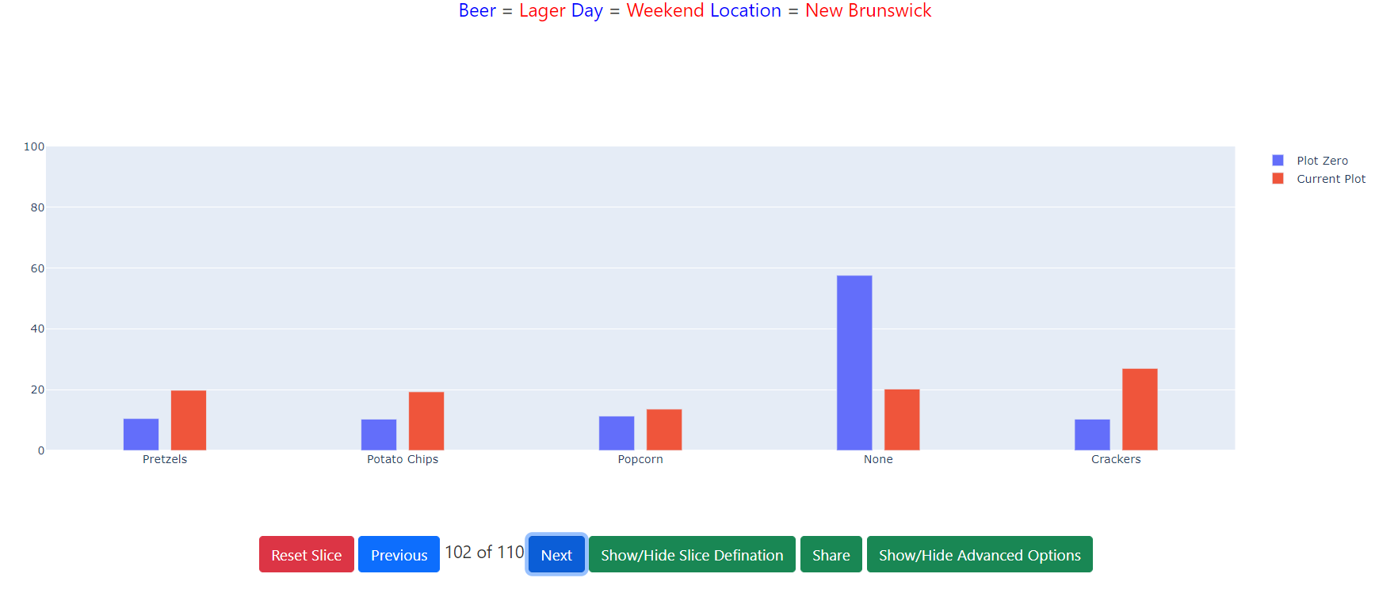
Is Distribution of Snacks affected if we limit ourselves to transactions selling Lager in New Brunswick on the Weekends?

Slide 8
Is Distribution of Snacks affected if we limit ourselves to transactions selling Lager in New Brunswick on the Weekends?Cont
Why I picked the slice:
From the picture of the slice in Boundless Analytics we saw significant differences between blue and red bar on all except “popcorn” snacks. The difference can be especially seen between blue and red bars for “none” snacks, the blue bar is almost 3 times as big as red bar (aprox.60% vs 20%)This indicated that the Chiq value should be very large for this slice, thus it’s a very interesting finding
Code with Chiq value and p-value I got:
Explanation of Chiq value and p-value
Since the p-value of less then 2.2e^-16, which is much less than 7.669e^-5 , we REJECT, the null hypothesis. And I got a Chiq value 0f 600.15 which is very high, but I still have 2 more subsets to test.

Slide 9
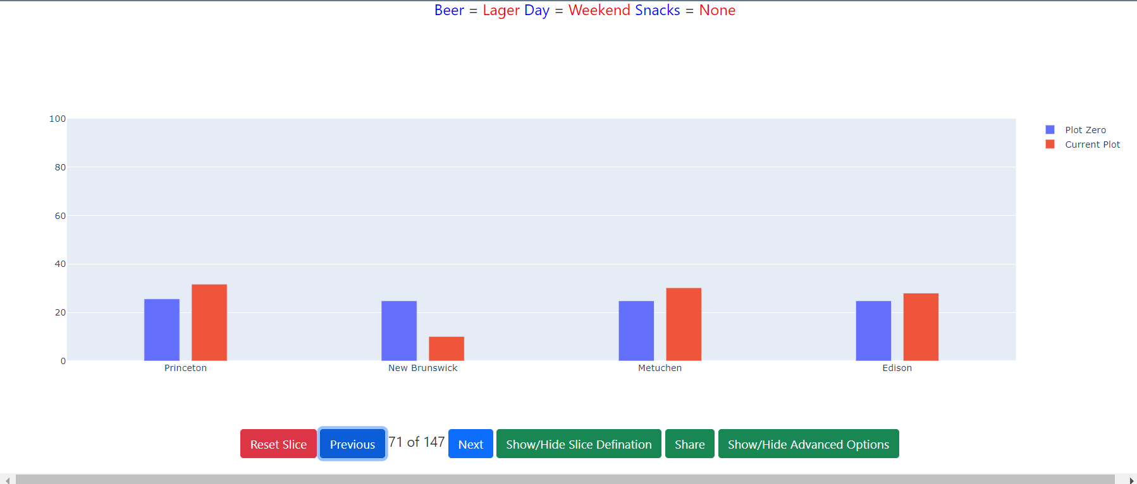
Is Distribution of Location affected if we limit ourselves to transactions selling Lager with no snacks on the Weekends?

Slide 10
Is Distribution of Snacks affected if we limit ourselves to transactions selling Lager in New Brunswick on the Weekends?Cont
Why I picked the slice:
From the picture of the slice in Boundless Analytics I saw significant differences between blue and red bar on the New Brunswick Location. It looked like the blue bar was more than twice as big as the red one, that's why I picked it. This indicated that the Chiq value should be large for this slice, thus it’s a very interesting finding
Code with Chiq value and p-value I got:
Explanation of Chiq value and p-value
Since the p-value of less then 2.2e^-16, which is much less than 7.669e^-5 , we REJECT, the null hypothesis. And I got a Chiq value 0f 214.36 which is pretty good, but sadly smaller than the previous 2, 400 and 600, so I allergy know this is not the “winning” slice.

Slide 11
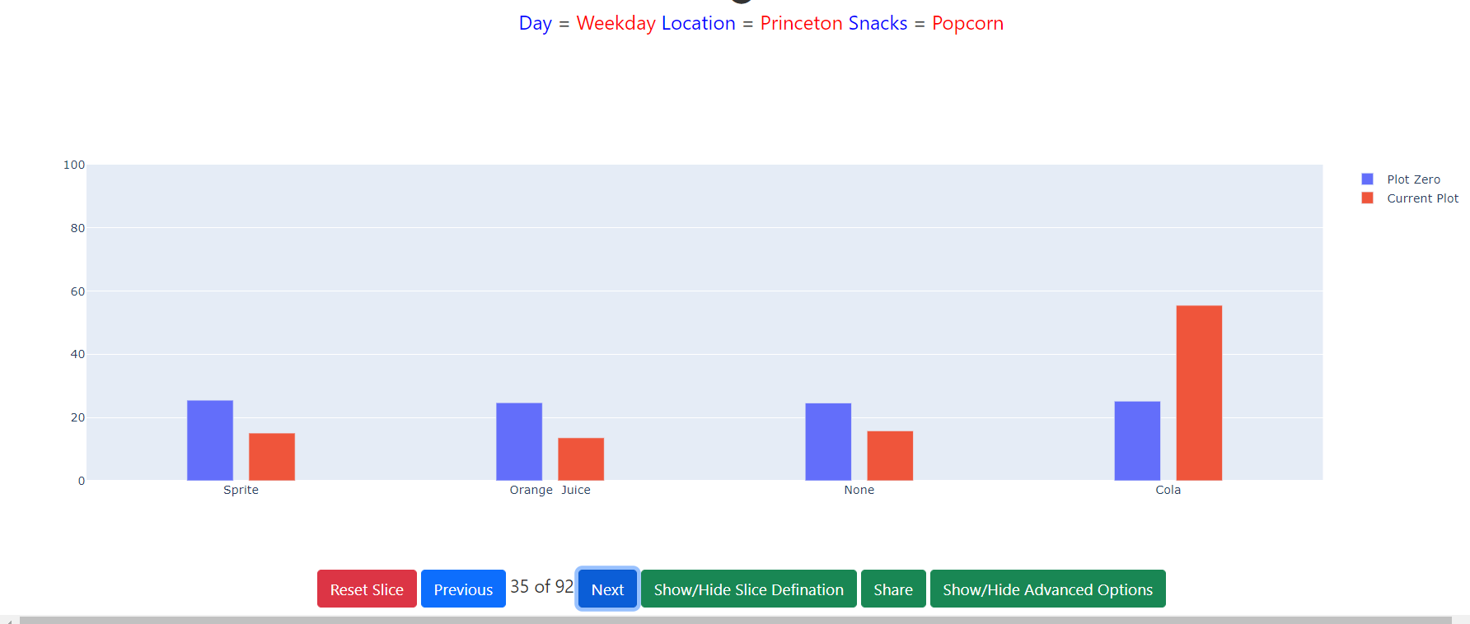
Is Distribution of Soft Drinks affected if we limit ourselves to transactions selling Popcorn in Princeton on the Weekdays?

Slide 12
Is Distribution of Snacks affected if we limit ourselves to transactions selling Lager in New Brunswick on the Weekends?Cont
Why I picked the slice:
From the picture of the slice in Boundless Analytics saw significant differences between blue and red bar on all soft drinks.However, the biggest difference was between the red and blue bar in Cola, the red bar was about twice as big as the blue bar. This indicated that the Chiq value should be large for this slice, thus it’s a very interesting finding
Code with Chiq value and p-value I got:
Explanation of Chiq value and p-value
Since the p-value of less then 2.2e^-16, which is much less than 7.669e^-5 , we REJECT, the null hypothesis. And I got a Chiq value 0f 205.31 which is pretty good, but sadly the smallest out of all 4 slices.

Slide 13
Conclusion
The p values that I got for all 4 slices where “less than 2.2e^16” , thus we rejected all of the null hypothesis, betwecause all 4 where below the critical value of 7.669e^-5 , and because all p values where the same ( as far as I know because rstudio just said they were below a certain value, and did not give the actual value), there was no preference to either of the 4 slices because of the p pavue.
4 chiq values that I got where, 400.8, 600.15, 214.36 and 205.31. Now here are the obvious huge differences, and ofcourse the slice with the chiq value of 600.15 was the most interesting and “won” in my findings. That was the slice where Beer =='Lager' & Day=='Weekend' and Location ='New Brunswick' and anchor attribute is Snacks

