Slide 1
Boundless Analytics - HW 12
Shreya Tiwari

Slide 2
Initial Steps
I quickly went through all the slices (just to see if there were any patterns between anchors or in the anchors themselves)
Since multiple hypotheses are being tested, we need to use Bonferroni Correction (α/N), or 0.05/(# of slices/subsets in specified anchor) since when looking at a specific anchor, only hypotheses within that anchor are being tested at once, not all 652 at once.

Slide 3
Initial Steps (Continued)
If all hypotheses (not taking anchor into account) were being tested at once, the p-value would come out to p having to be less than 0.00007669 or 7.669 × 10⁻⁵ for the slice to be significant with chi-square testing.
I decided to try to gather 4-5 interesting slices for each anchor attribute to mainly see how the chi-square values compare (and why they might be different)

Slide 4
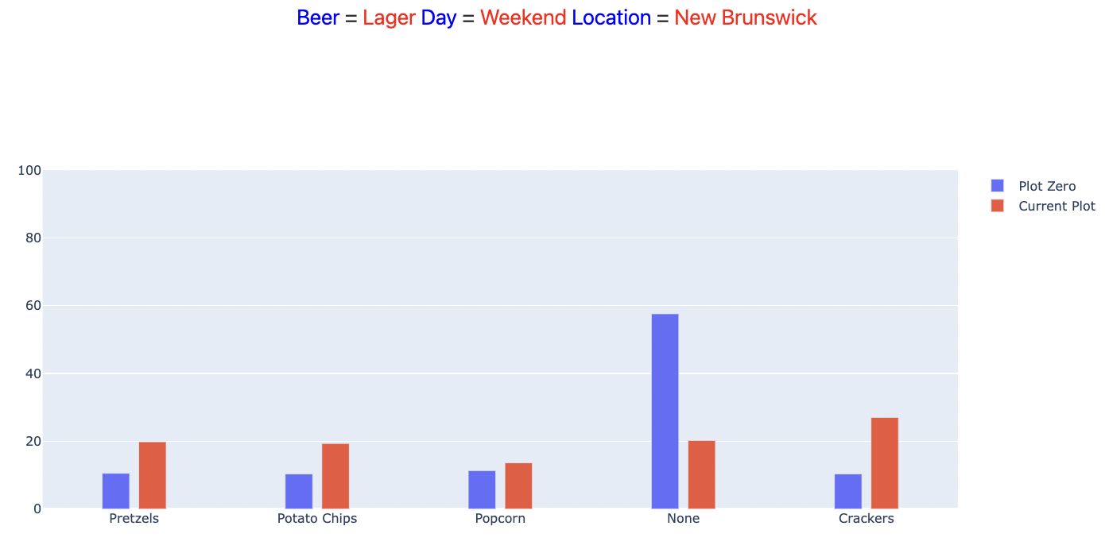
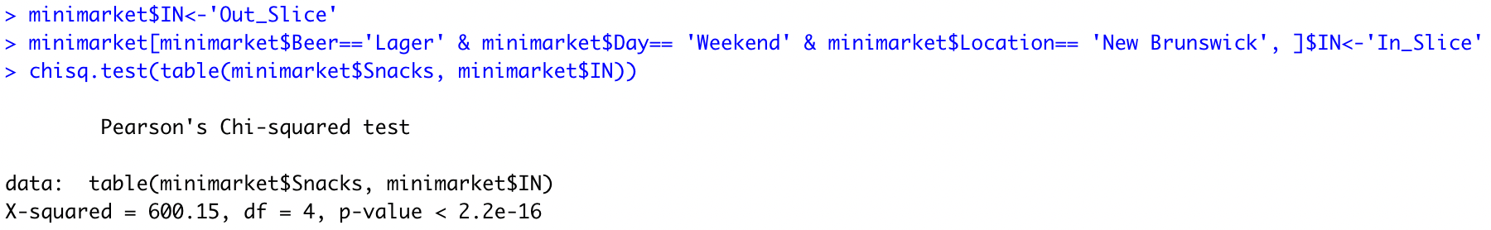
Most Interesting Slice
I nominated the following as the most interesting slice/subset since it has:
Pretty high chi-square value (600.15) according to the code below the plot
P-value that is below the p-value set with the Bonferroni Correction (2.2 × 10⁻¹⁶ < 4.5 × 10⁻⁴, which is the p-value with Bonferroni Correction for the snack anchor, which means we can reject the null hypothesis that there is no difference in the distributions with and without subsetting with the anchor attribute)
Visually also shows clear differences in bar sizes that align with my findings (as larger gaps between the blue and red bar indicate a larger chi-square value).

Slide 5
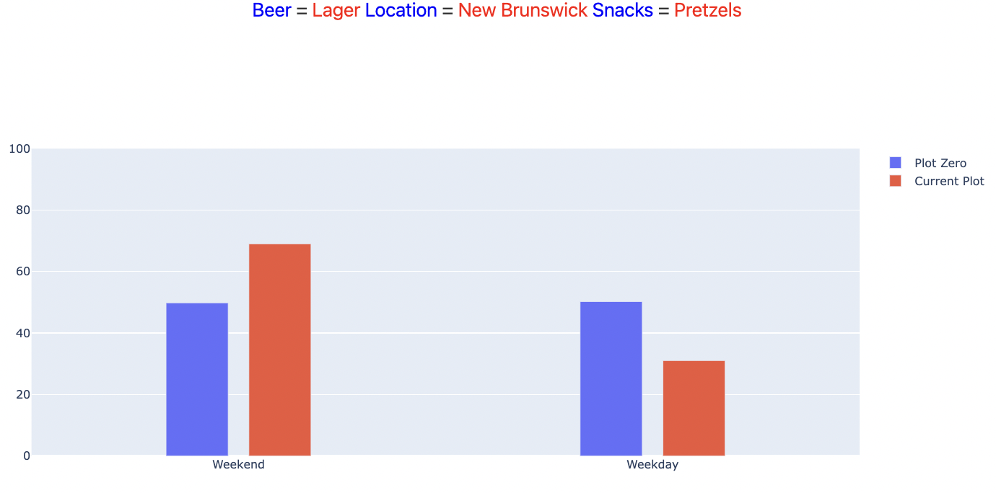
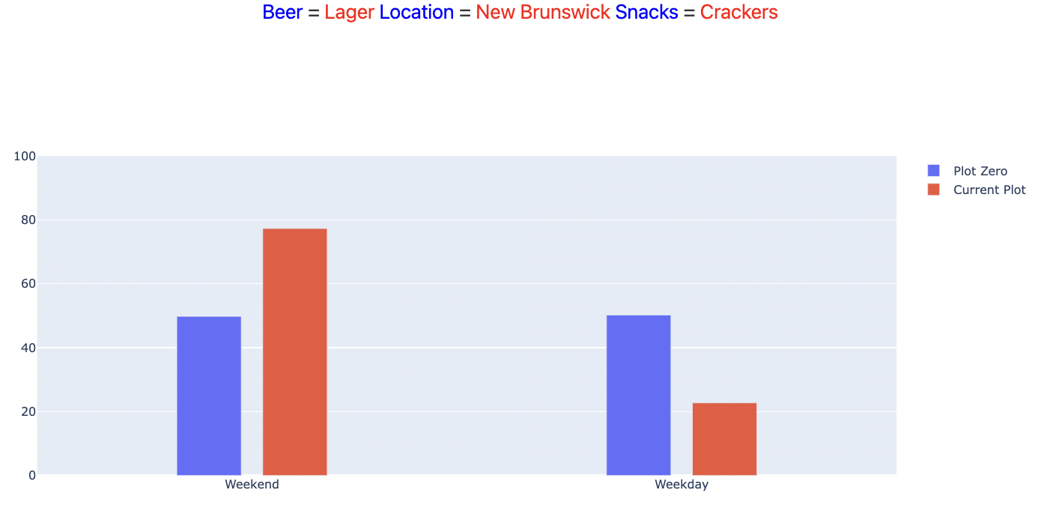
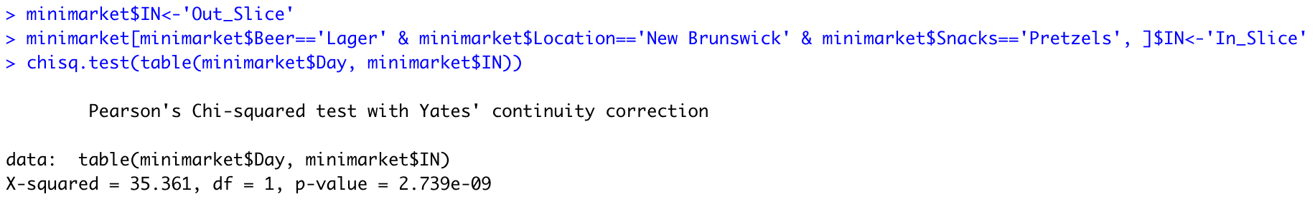
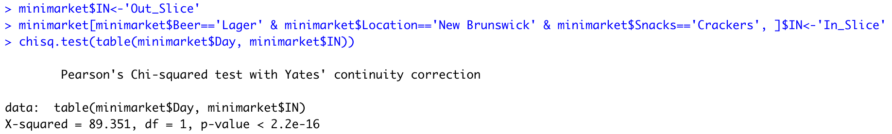
Other Interesting Slices
The two plots above have the same anchor attribute (Day), and mostly similar subsets (same Beer, same Location but different Snack). Upon first glance, since the differences among the bars for each plot looked to be not too different (maybe a .05-.07 difference maximum each), I did not think the chi-square values would be that different. But after running the code, I got 35.361 for the left plot and 89.351 for the right, which was a bigger difference than I thought, and these results are significant since they both fall under the p-value of 5.2 × 10⁻⁴, the corrected p-value for the Day anchor, so this prompted me to occasionally check chi-square values for plots where the bars looked like they barely changed from one slice to the next.

Slide 6
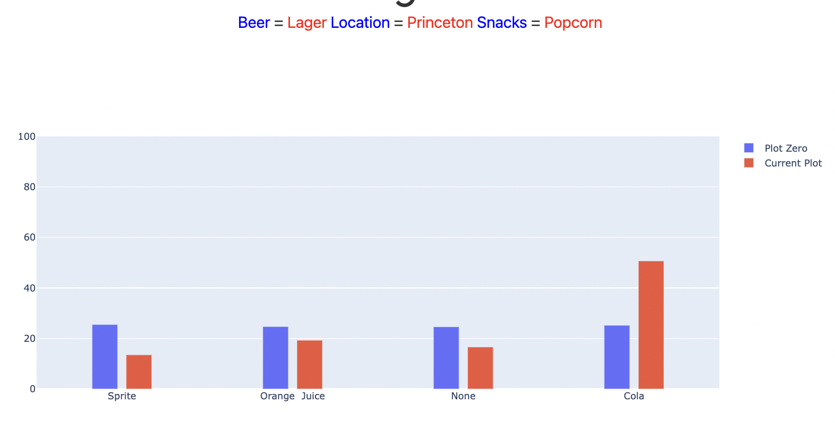
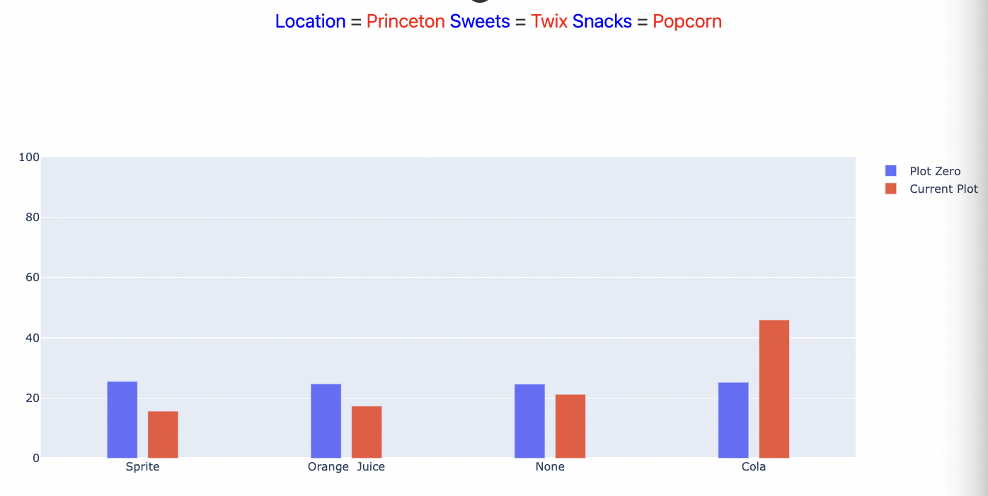
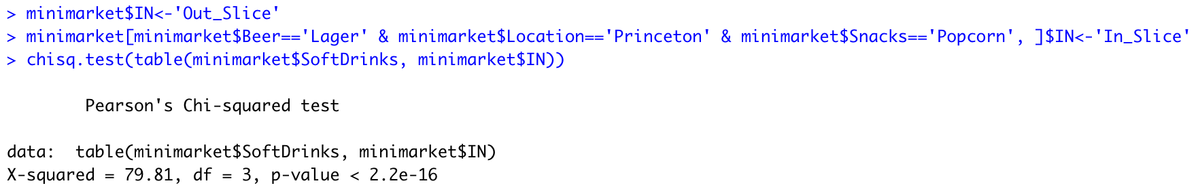
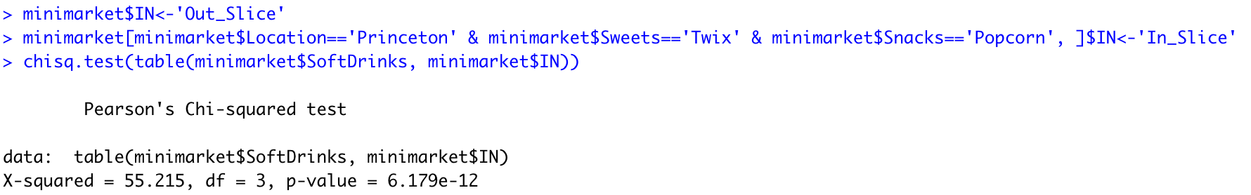
Other Interesting Slices
The two plots above have the same anchor attribute (Soft Drink), and pretty different subsets, but show the same general distribution. More notably, there is a considerable difference between each of the bars for each type of drink, which would normally be indicative of a high chi-square value. This is seen in slide 3, where most of the bars have around a .1 difference between them, and though most of the bars in these plots also have a similar difference, the chi-square values are much lower than that of slide 3, as shown. These results are still significant (enough to reject the null hypothesis) since the p-values are lower than the corrected p-value for multiple hypotheses for the Soft Drink anchor (0.05/92 = 5.4 × 10⁻⁴, which is greater than both the p-values above).

Slide 7
Other Generally Interesting Observations
Beer anchor - out of the slices with the highest chi-square values, New Brunswick was the Location and the Day was Weekends for the majority
Snack anchor - New Brunswick was the Location for nearly all the slices, as well as the one I chose to submit
Soft Drinks anchor - Despite New Brunswick being overrepresented in most of the other anchors, Princeton was the most common location for this anchor paired with the sale of Popcorn
For all the other anchors - Lager seemed to be the most common beer amongst slices with the highest chi-square values
*All of these observations are based on the slices for each anchor that I found to have high chi-square values*

