Slide 1

Boundless Analytics Test
George Basta
data101

Slide 2
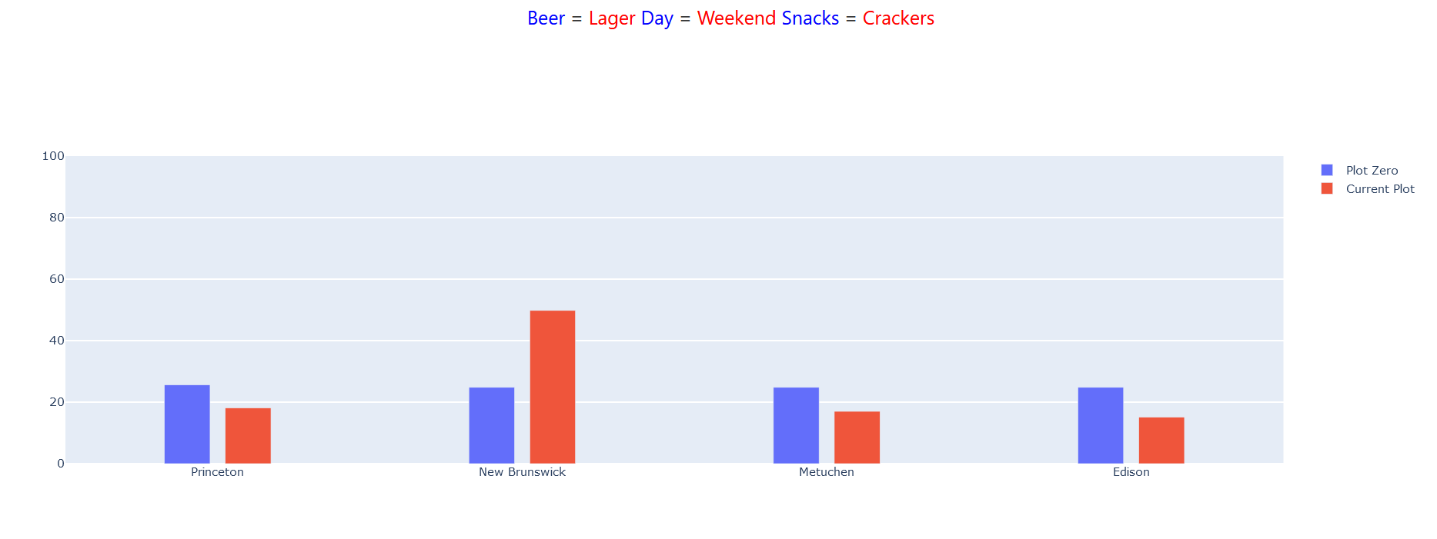
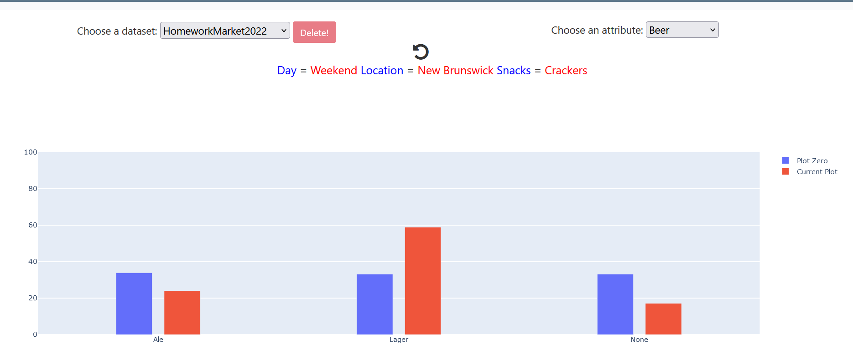
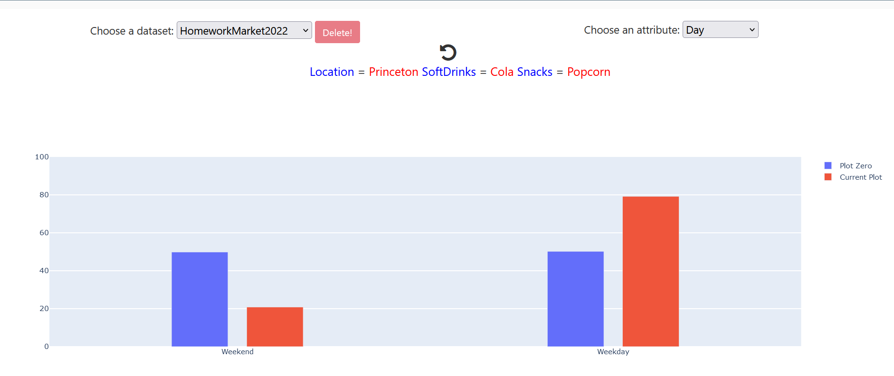
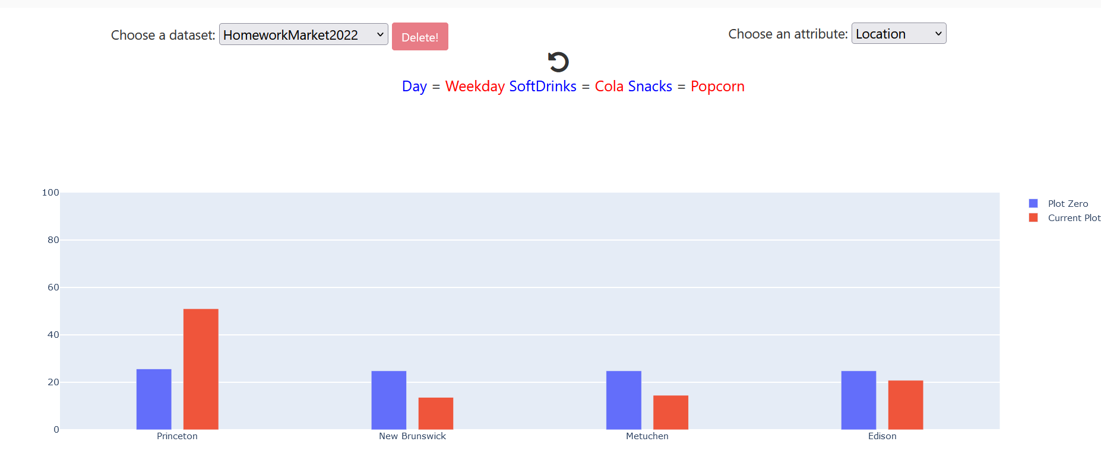
Nominating slices
I took the “Minimum Deviation” value and put it to the highest it can for each column and got these subsets as the most significant results with highest deviation from normal (these columns were pretty good, but not the best deviations)
For location: Princeton or New Brunswick for 2 different subsets (same deviation=25)
For beer: Lager with highest deviation (25) for this subset compared to all subsets
For day: Weekday with 29 deviation for this subset

Slide 3
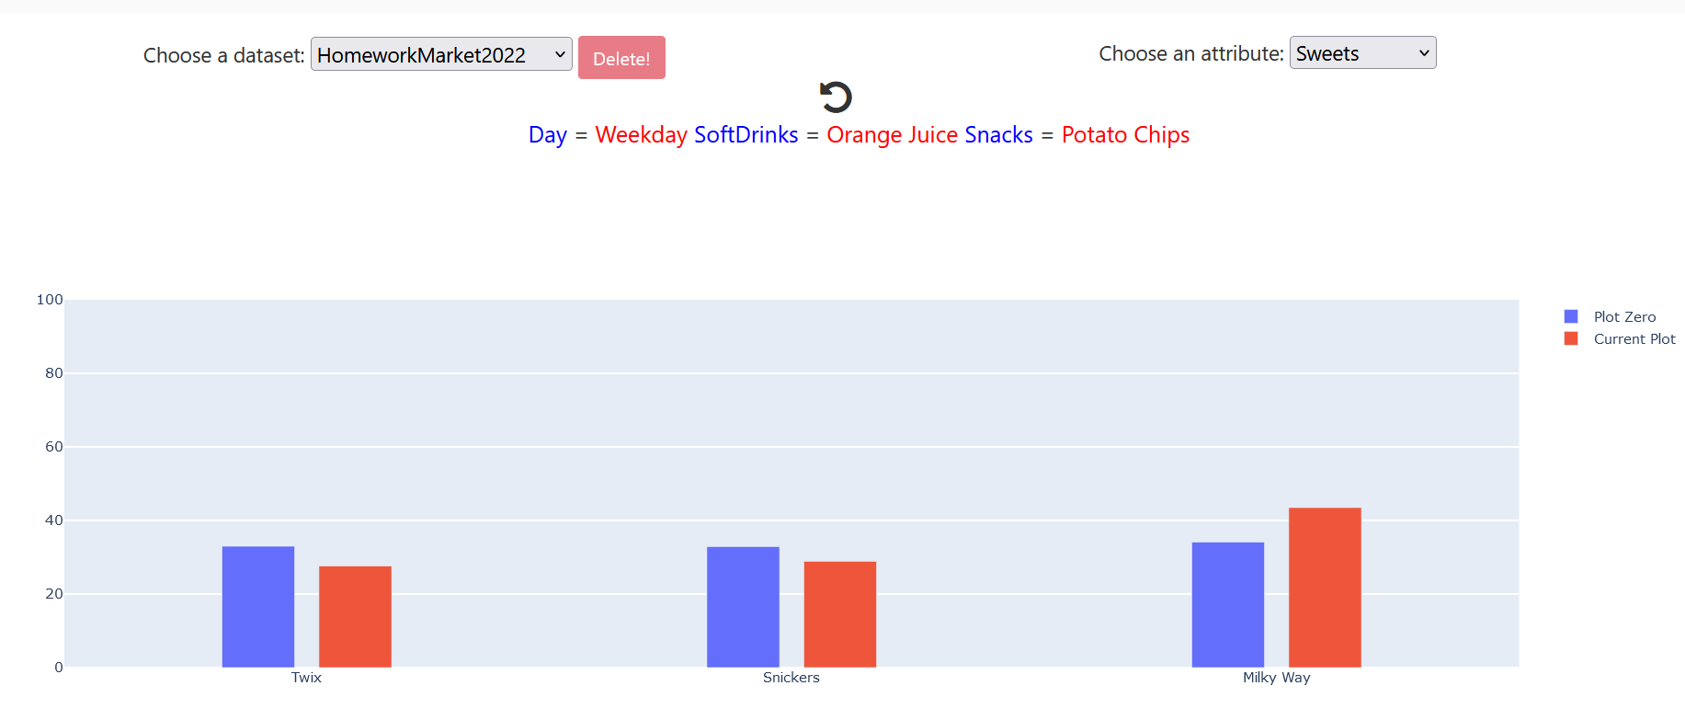
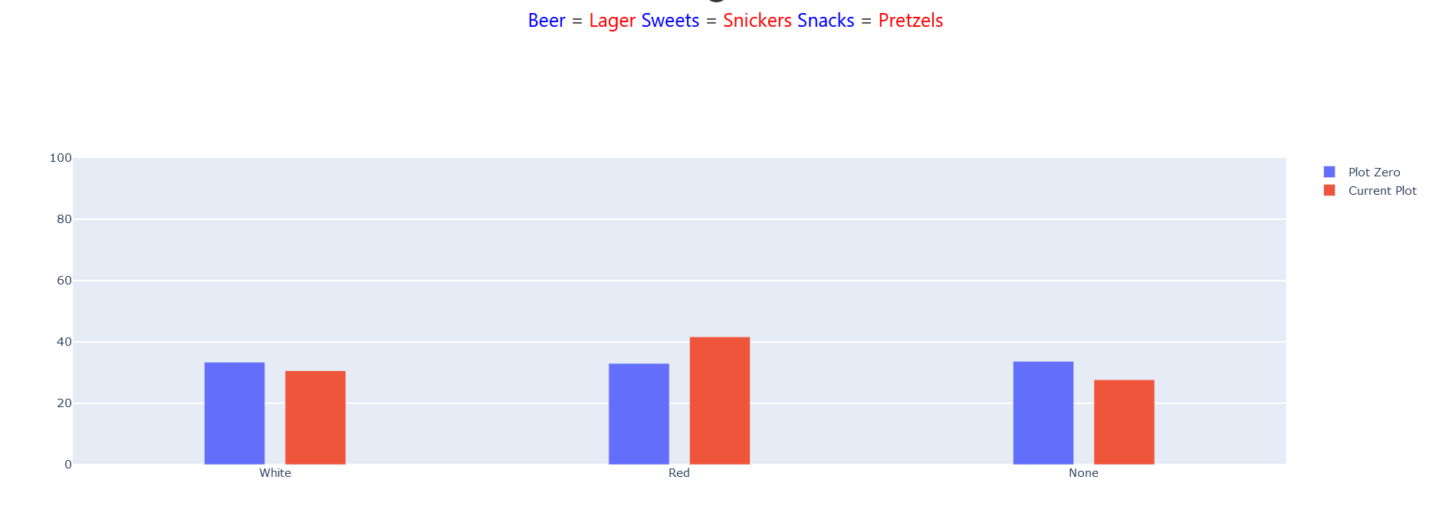
Nominating slides pt 2
The highest deviation from all subsets for sweets and wine were very low, so I’m not going to test these attributes for the highest chi sq
Sweets: Milky Way with deviation 9 max
For wine: Red with deviation 8 max

Slide 4
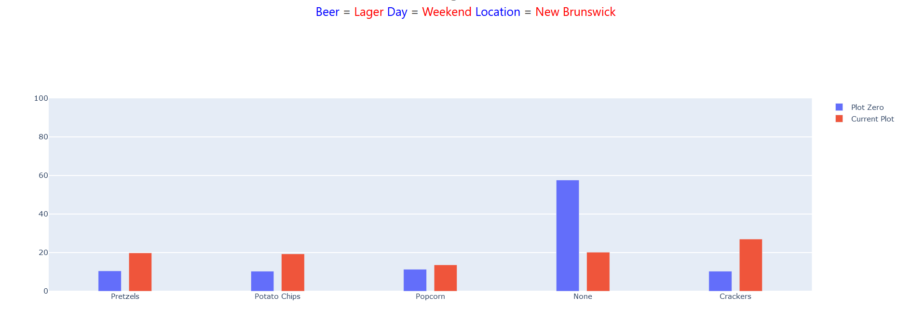
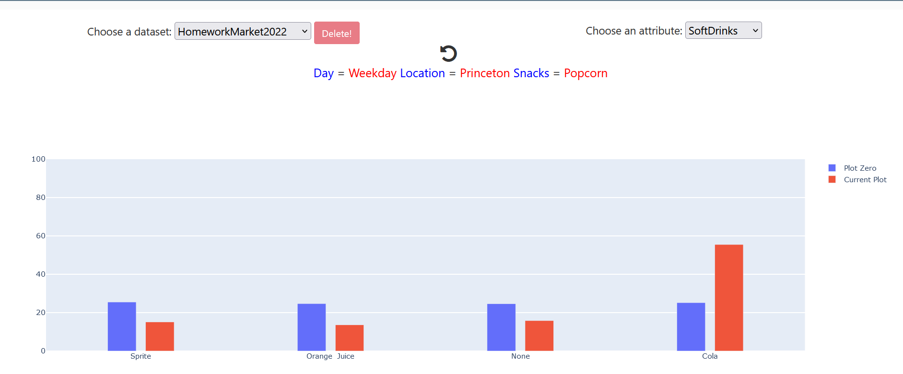
Nominating slides pt 3 (the ones I will test)
Snacks and SoftDrinks had the highest two deviations for all columns compared to all subsets, so I’m going to test these
For Snacks: None with highest deviation of 37 for this subset from all subsets
For SoftDrinks: Cola with 30 deviation from all subsets

Slide 5


Chi Squared testing for Snacks and Soft Drinks
Using the subsets that the boundless analytics showed as the highest deviation for these columns, I did a chi squared test on R and got
Using bonferonni correction with testing value .05, we did two hypothesis tests, so .05/2 =.025, and since both p-values are much lower than that, we can say there is a significant relationship for these two subsets
For the best subset in the Snacks column: 600.15 X-squared
For the best subset in Soft Drinks column: 205.32 X-squared
http://209.97.156.178:8082/?dataset=HomeworkMarket2022&first_attr=Snacks&user_filter=%5B%5B%22Beer%22%2C%22categorical%22%2C%5B%22Lager%22%5D%2Cnull%2Cnull%5D%2C%5B%22Day%22%2C%22categorical%22%2C%5B%22Weekend%22%5D%2Cnull%2Cnull%5D%2C%5B%22Location%22%2C%22categorical%22%2C%5B%22New+Brunswick%22%5D%2Cnull%2Cnull%5D%5D
http://209.97.156.178:8082/?dataset=HomeworkMarket2022&first_attr=SoftDrinks&user_filter=%5B%5B%22Day%22%2C%22categorical%22%2C%5B%22Weekday%22%5D%2Cnull%2Cnull%5D%2C%5B%22Location%22%2C%22categorical%22%2C%5B%22Princeton%22%5D%2Cnull%2Cnull%5D%2C%5B%22Snacks%22%2C%22categorical%22%2C%5B%22Popcorn%22%5D%2Cnull%2Cnull%5D%5D
So among the highest deviations, the subset in the snacks column, which has the attributes Beer=“Lager”, Day=“Weekend”, Location=“New Brunswick” has the highest chi squared that having these attributes makes it much more likely that no snacks will be bought (since df=4=none). – so I choose this one as the best subset with most significant results
Although Soft drinks with Day=‘Weekday’, Snacks =“Potato chips”, and location =“Princeton” has the exact same p-value (which is odd), I’m picking the snacks subset arbitrarily just because it has a higher X-squared

