Slide 1
Boundless Analytics Test
By Paul Kotys, pjk151

Slide 2

Applying the Bonferroni Correction
As the professor mentioned in class and in the videos, this assignment is essentially a p-value hunt.
Therefore, we need to use the Bonferroni Correction to account for testing multiple hypotheses. To count the total number of hypotheses, I realized that I could simply add the numbers displayed by the “Previous” and “Next” buttons in Boundless Analytics for each possible anchor.
This means that there are a total of
108 + 97 + 147 + 110 + 92 + 56 + 42 = 652 possible hypotheses. Given the standard value of 0.05, this means our p-value needs to be less than 0.00007669 (7.6 * 10^-5) to reject the null hypothesis.

Slide 3
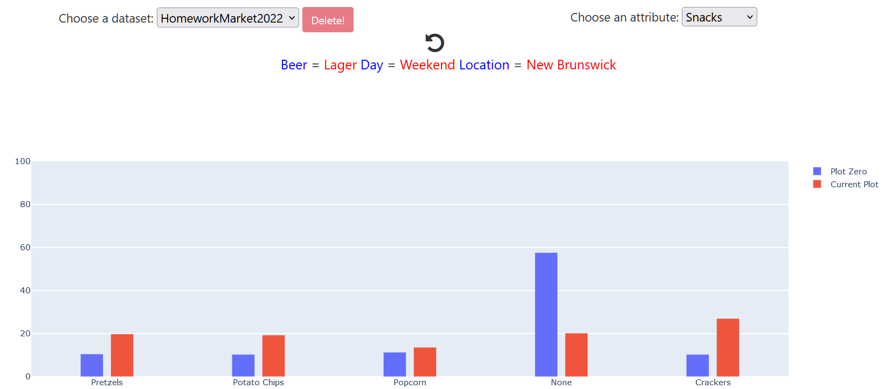
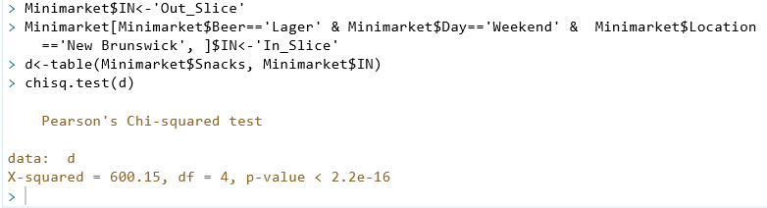
My Best Slice: Anchor=Snacks, Beer=“Lager”, Day=“Weekend”, Location=“New Brunswick”
The best subset that I was able to find was Beer=“Lager”, Day=“Weekend”, Location=“New Brunswick”, with the Anchor=Snacks.
With this subset, I was able to get an X-squared of 600.15, which is insanely high compared to my second-best X-squared of about 200. The p-value is also almost ten orders of magnitude smaller than what is needed to reject the null hypothesis with the Bonferroni Correction.

Slide 4
Anchor=Snacks, Beer=“Lager”, Day=“Weekend”, Location=“New Brunswick”
I will be submitting the slice I described on the previous slide. The link is rather long, so I decided to create a separate slide for it:
http://209.97.156.178:8082/?dataset=HomeworkMarket2022&first_attr=Snacks&user_filter=%5B%5B%22Beer%22%2C%22categorical%22%2C%5B%22Lager%22%5D%2Cnull%2Cnull%5D%2C%5B%22Day%22%2C%22categorical%22%2C%5B%22Weekend%22%5D%2Cnull%2Cnull%5D%2C%5B%22Location%22%2C%22categorical%22%2C%5B%22New+Brunswick%22%5D%2Cnull%2Cnull%5D%5D
The remaining slides in this PowerPoint show some other interesting slices that I found. All of them satisfy the Bonferroni Correction, but none had an X-Squared even half as high as the best slice.

Slide 5
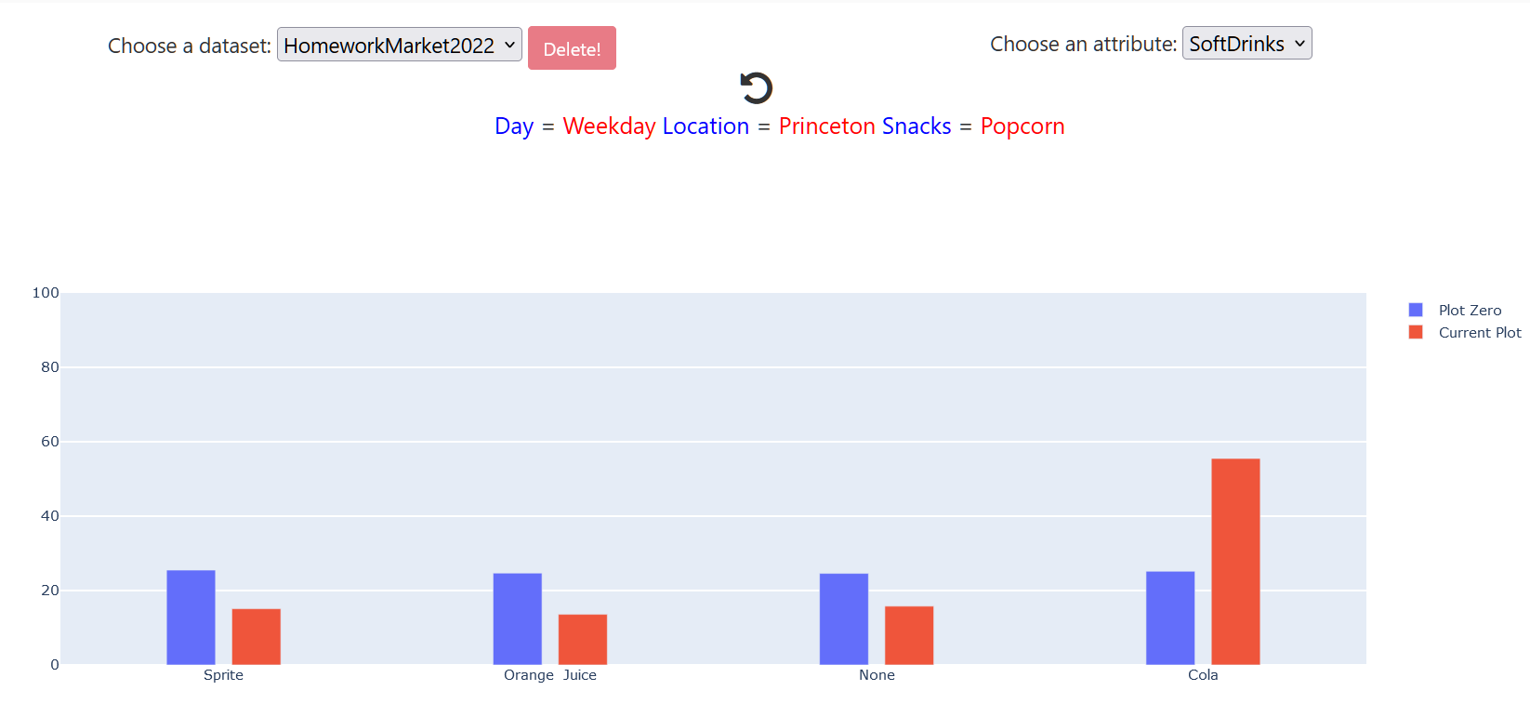
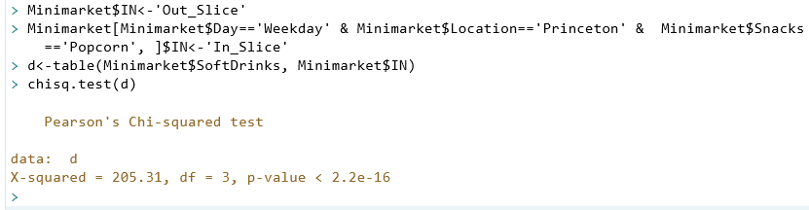
Anchor=SoftDrinks, Day=“Weekday”, Location=“Princeton”, Snacks=“Popcorn”

Slide 6
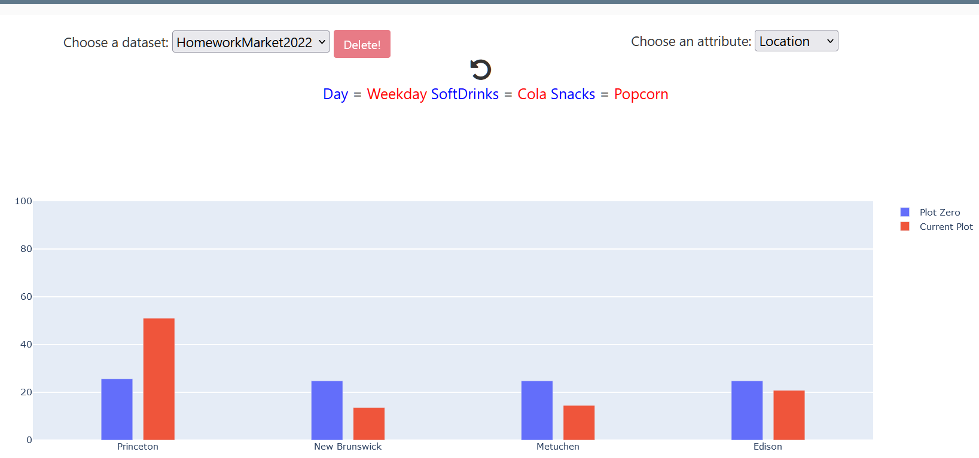
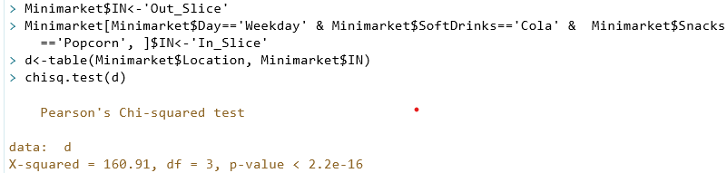
Anchor=Location, Day=“Weekday”, SoftDrinks=“Cola”, Snacks=“Popcorn”

Slide 7
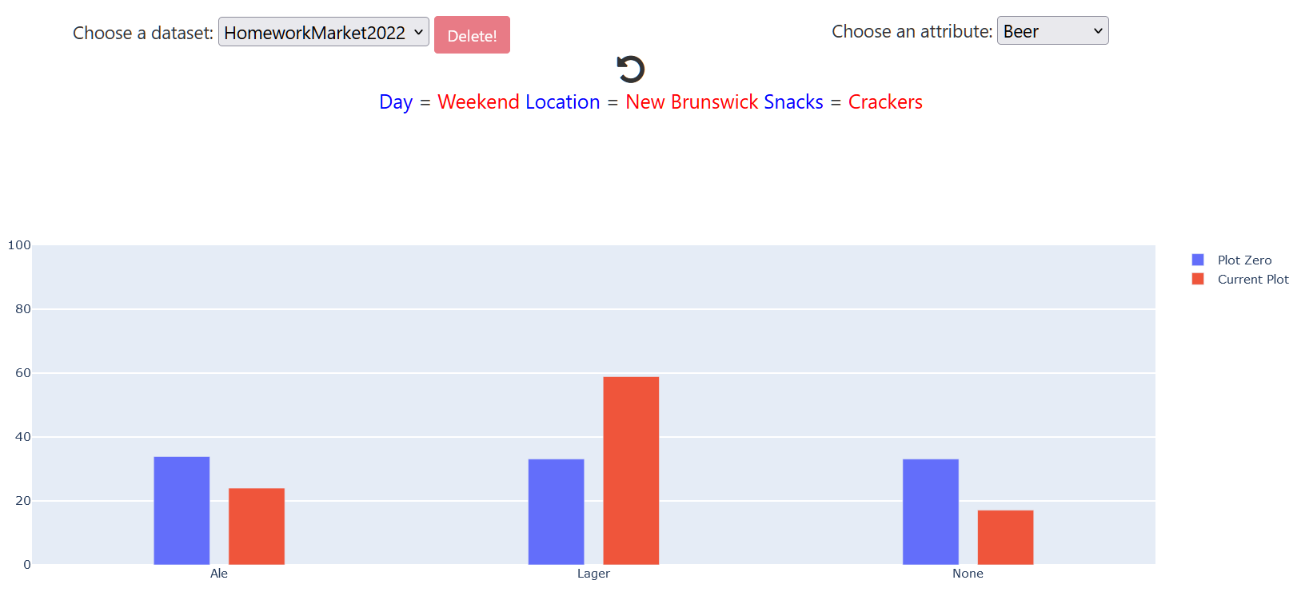
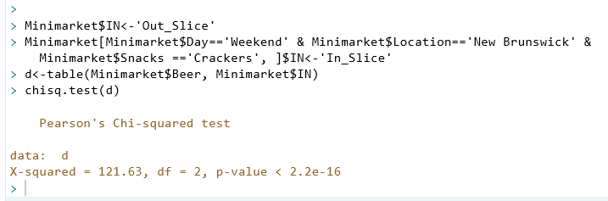
Anchor=Beer, Day=“Weekend”, Location=“New Brunswick”, Snacks=“Crackers”

Slide 8
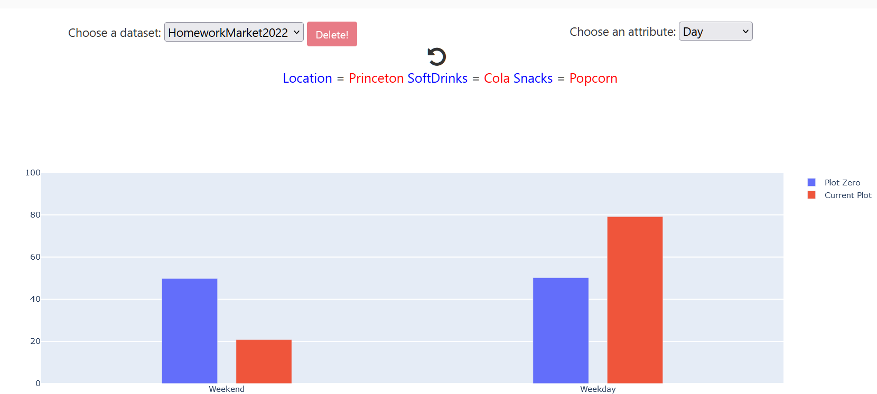
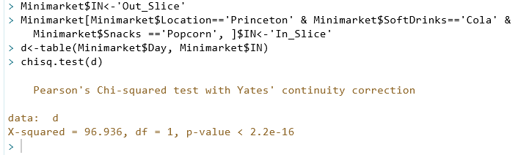
Anchor=Day, Location=“Princeton”, SoftDrinks=“Cola”, Snacks=“Popcorn”

