Slide 1
Boundless Analytics test
Selin Denise altiparmak

Slide 2
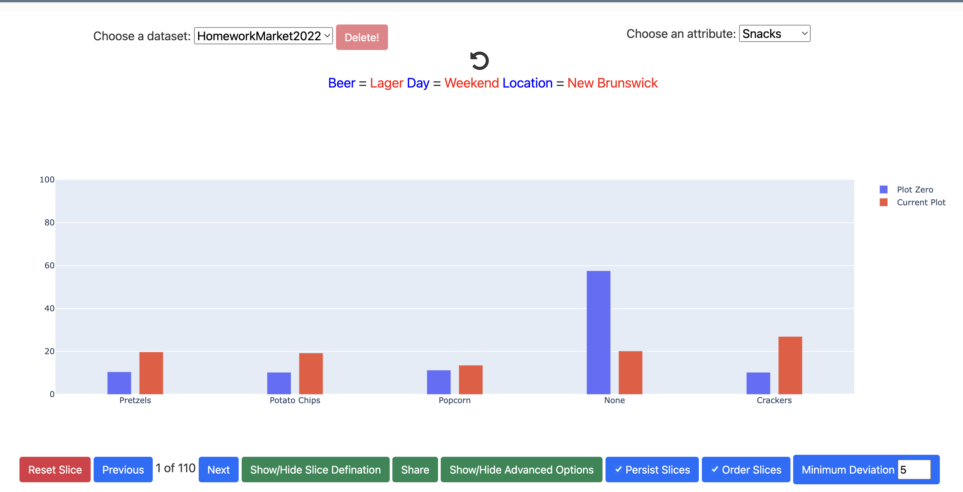
We are showing that the Chisq for this slice and the Snacks attribute to test if the distribution of Snacks is affected if we limit ourselves only to transactions selling Lager and locating in New Brunswick on Weekend.
It is an interesting slice-anchor attribute since it has the largest chisq test and lowest p-value according to this csv file.
Since this is independent, and we reject our hypothesis and we are withstanding with the multiples hypothesis correction.
The whole data distribution for each category mostly has a big difference to our limited transaction that we chose for Chisq test.
This shows that how much independent and how much interesting the data set is.
Minimarket$IN<-'Out_Slice'
Minimarket[Minimarket$Beer=='Lager' & Minimarket$Day=='Weekend' & Minimarket$Location =='New Brunswick', ]$IN<-'In_Slice'
d<-table(Minimarket$Snacks, Minimarket$IN)
chisq.test(d)
#data: d
#X-squared = 600.15, df = 4, p-value < 2.2e-16

Slide 3
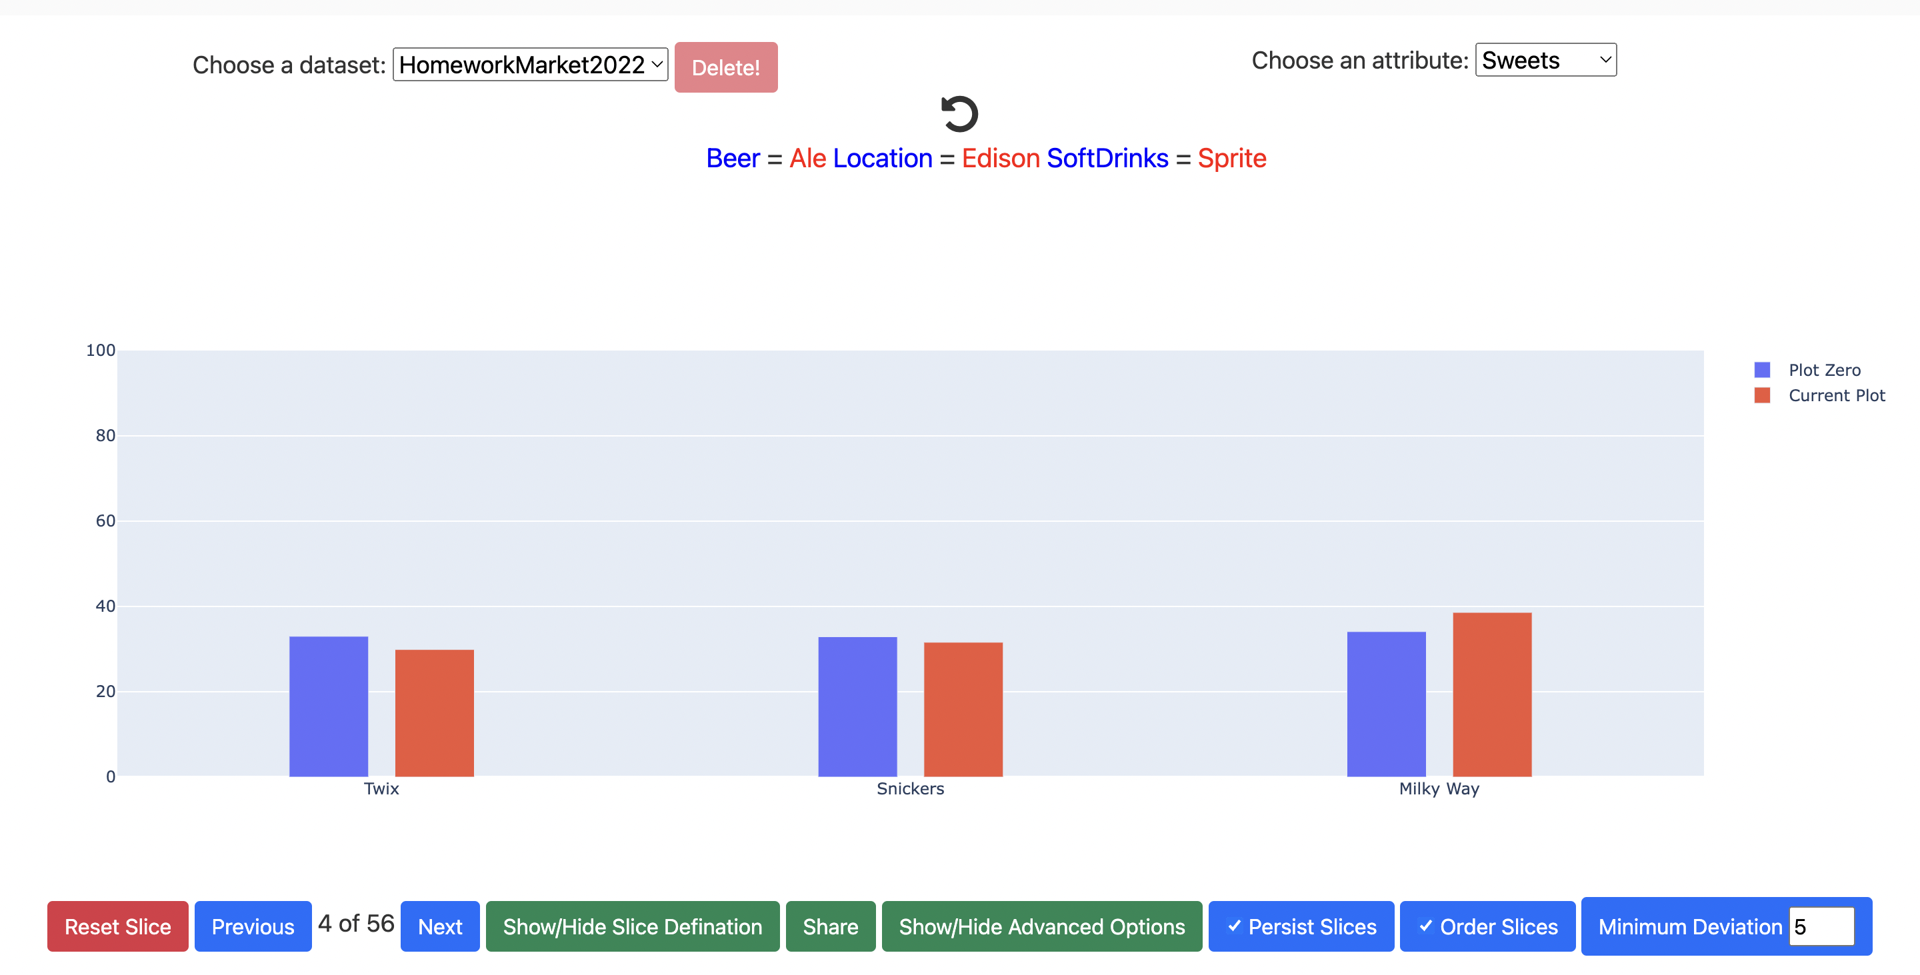
We are showing that the Chisq for this slice and the Sweets attribute to test if the distribution of Sweets is affected if we limit ourselves only to transactions selling Ale and locating in Edison and drinking Sprite.
It is an interesting slice-anchor attribute since it has the largest chisq test and lowest p-value according to this csv file.
Since this is dependent, and we failed to reject our hypothesis and we are not withstanding with the multiples hypothesis correction.
The whole data distribution is close to our limited transaction that we chose for Chisq test.
Minimarket$IN<-'Out_Slice'
Minimarket[Minimarket$Beer=='Ale' & Minimarket$Location=='Edison' & Minimarket$SoftDrinks =='Sprite', ]$IN<-'In_Slice'
d<-table(Minimarket$Sweets, Minimarket$IN)
chisq.test(d)
#data: d
#X-squared = 3.869, df = 2, p-value = 0.1445

Slide 4
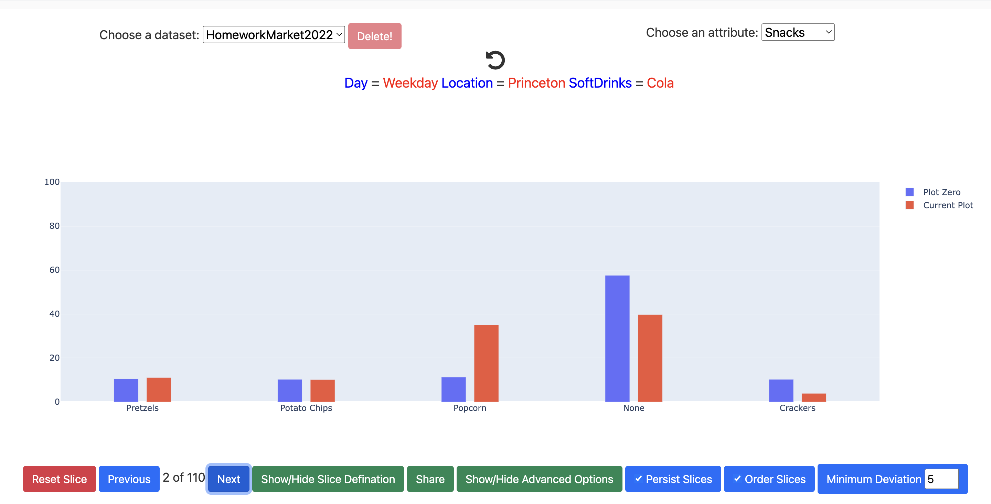
We are showing that the Chisq for this slice and the Snacks attribute to test if the distribution of Snacks is affected if we limit ourselves only to transactions selling Cola and locating in Princeton on Weekdays.
It is also another interesting slice-anchor attribute since it has the largest chisq test and lowest p-value according to this csv file.
Since this is independent, and we reject our hypothesis and we are withstanding with the multiples hypothesis correction.
The whole data distribution for each category mostly has a big difference to our limited transaction that we chose for Chisq test.
This shows that how much independent and how much interesting the data set is.
Minimarket$IN<-'Out_Slice'
Minimarket[Minimarket$Day=='Weekday' & Minimarket$Location=='Princeton' & Minimarket$SoftDrinks =='Cola', ]$IN<-'In_Slice'
d<-table(Minimarket$Snacks, Minimarket$IN)
chisq.test(d)
#data: d
#X-squared = 400.8, df = 4, p-value < 2.2e-16

