Slide 1
Lecture 3
Text and Image Compression
‹#›

Slide 2
Introduction
Compression: the process of coding that will effectively reduce the total number of bits needed to represent certain information.
Compression Principles
Source encoders and destination decoders
Lossless and lossy compression
Entropy encoding
Source encoding
‹#›

Slide 3
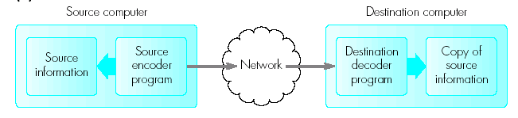
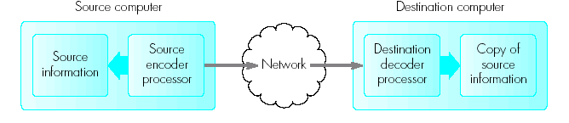
Compression Principles
By compression the volume of information to be transmitted can be reduced. At the same time a reduced bandwidth can be used
The application of the compression algorithm is the main function carried out by the encoder and the decompression algorithm is carried out by the destination decoder
‹#›

Slide 4
Compression Principles
Compressions algorithms can be classified as being either lossless (to reduce the amount of source information to be transmitted with no loss of information) – e.g transfer of text file over the network or
lossy (reproduced a version perceived by the recipient as a true copy) – e.g digitized images, audio and video streams
‹#›

Slide 5
Entropy Encoding - Run-length encoding -Lossless
Examples of run-length encoding are when the source information comprises long substrings of the same character or binary digit
In this the source string is transmitted as a different set of codewords which indicates only the character but also the number of bits in the substring
providing the destination knows the set of codewords being used, it simply interprets each codeword received and outputs the appropriate number of characters/bits
e.g. output from a scanner in a Fax Machine
000000011111111110000011 will be represented as 0,7 1,10 0,5 1,2
If we ensure first substring always 0, then string could be represented as 7,10,5,2
‹#›

Slide 6
Entropy Encoding –statistical encoding
A set of ASCII codewords are often used for the transmission of strings of characters
However, the symbols and hence the codewords in the source information does not occur with the same frequency. E.g A may occur more frequently than P which may occur more frequently than Q
The statistical coding uses this property by using a set of variable length codewords – the shortest being the one representing the most frequently appearing symbol
‹#›

Slide 7
Prefix property
It is necessary to ensure that a shorter codeword in the set does not form the start of a longer code word
otherwise the decoder will interpret the string on the wrong codeword boundaries.
A code word set that avoids this happening is said to process the prefix property
eg. Code words that have this property is Huffman encoding algorithm.
‹#›

Slide 8
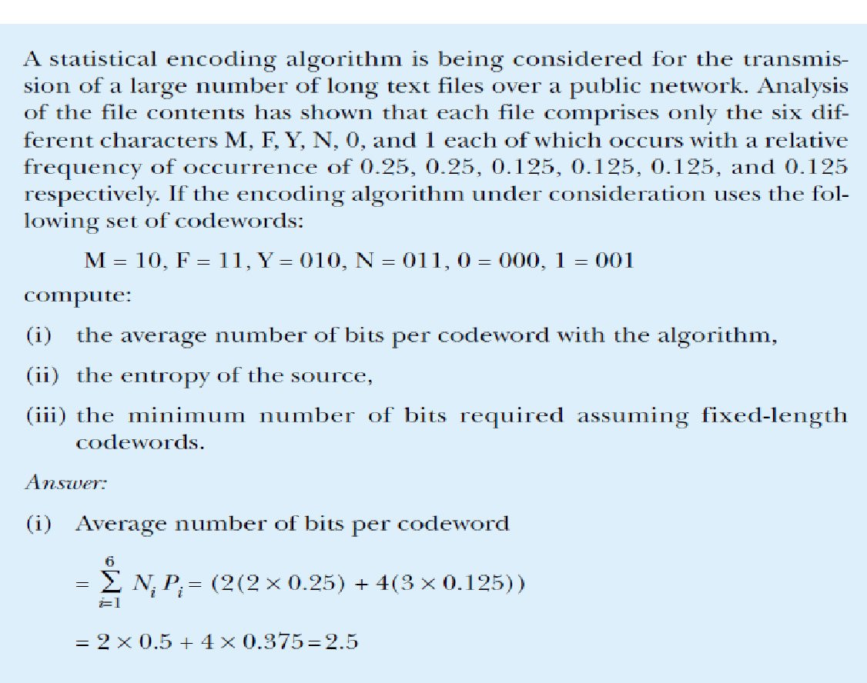
Ex 3.1
‹#›

Slide 9
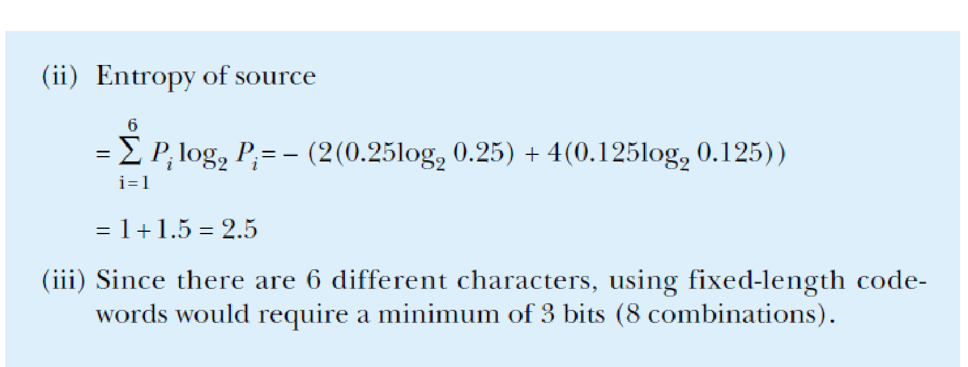
Entropy, where n is the number of different symbols in the stream and Pi is the probability of occurrence of symbol i.
‹#›

Slide 10
Source Encoding particular property of the source information to produce an alternative form of representation that is either a compressed version or more amenable to the application of compression. Differential encoding
Uses smaller codewords to represent the difference signals. Can be lossy or lossless
This type of coding is used where the amplitude of a signal covers a large range but the difference between successive values is small
Instead of using large codewords a set of smaller code words representing only the difference in amplitude is used
For example if the digitization of the analog signal requires 12 bits and the difference signal only requires 3 bits then there is a saving of 75% on transmission bandwidth
‹#›

Slide 11
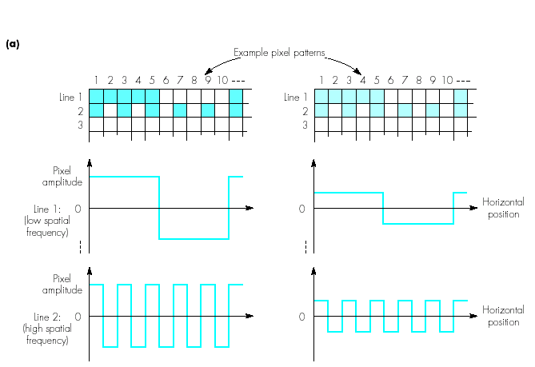
Compression Principles
Transform encoding involves transforming the source information from one form into another, the other form lending itself more readily to the application of compression
‹#›

Slide 12
Transform Encoding
As we scan across a set of pixel locations the rate of change in magnitude will vary from zero if all the pixel values remain the same to a low rate of change if say one half is different from the next half, through to a high rate of change if each pixel changes magnitude from one location to the next
The rate of change in magnitude as one traverses the matrix gives rise to a term known as the ‘spatial frequency’
Hence by identifying and eliminating the higher frequency components the volume of the information transmitted can be reduced
‹#›

Slide 13
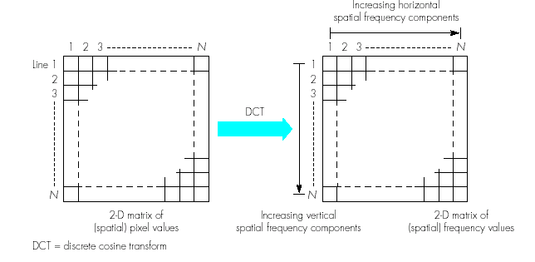
Transform coding: DCT transform principles
Discrete Cosine Transformation is used to transform a two-dimensional matrix of pixel values into an equivalent matrix of ‘spatial frequency components (coefficients)
At this point any frequency components with amplitudes below the threshold values can be dropped (lossy)
‹#›

Slide 14
Text compression
Huffman Compression
Huffman compression reduces the average code length used to represent the symbols of an alphabet.
Symbols of the source alphabet which occur frequently are assigned with short length codes.
The general strategy is to allow the code length to vary from character to character and to ensure that the frequently occurring character have shorter codes.
‹#›

Slide 15
Huffman compression is performed by constructing a binary tree using a simple example set.
This is done by arranging the symbols of the alphabets in descending order of probability.
Then repeatedly adding two lowest probabilties and resorting.
This process goes on until the sum of probabilities of the last two symbols is 1.
Once this process is complete, a Huffman binary tree can be generated.
If we do not obtain a probability of 1 in the last two symbols, most likely there is a mistake in the process.
This probability of 1 which forms the last symbol is the root of the binary tree.
The resultant codewords are then formed by tracing the tree path from the root node to the endnodes codewords after assigning 0s and 1s to the branches.
‹#›

Slide 16
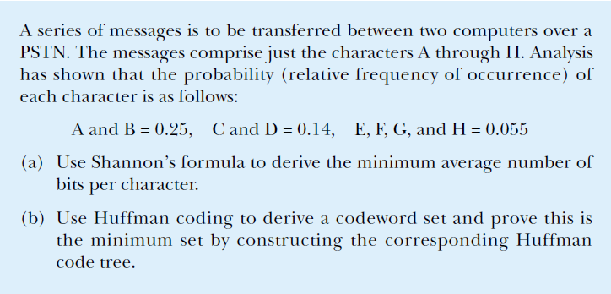
Ex 3.2
‹#›

Slide 17
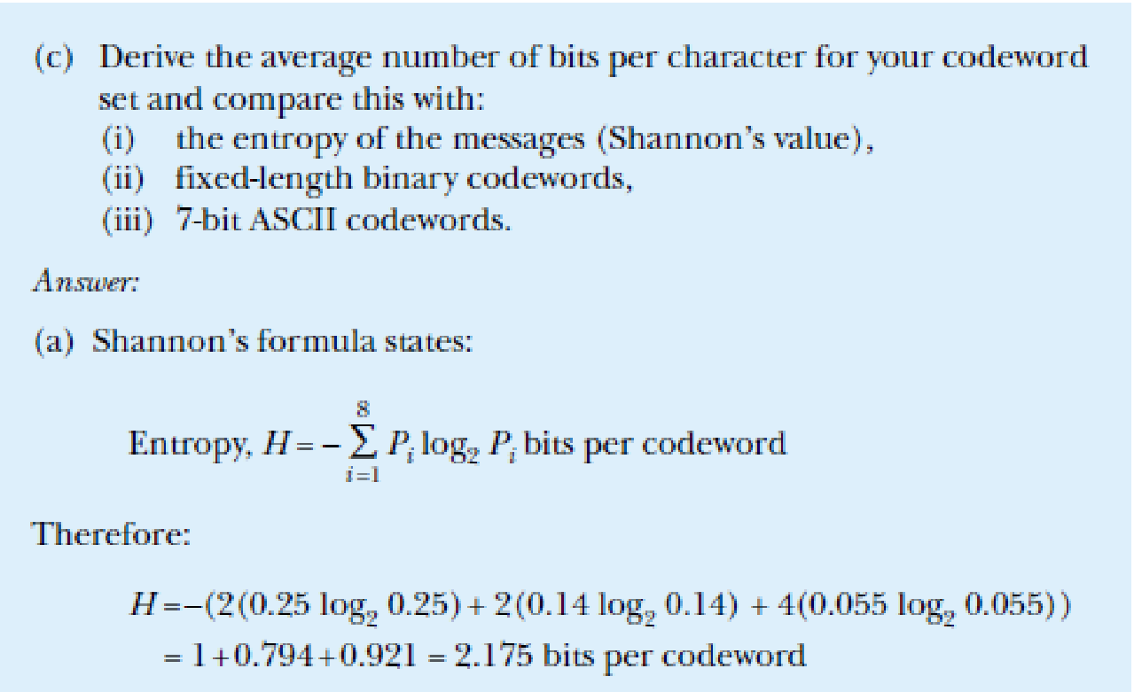
Ex 3.2
1+.794+.921= 2. 715 bits per codeword
‹#›

Slide 18
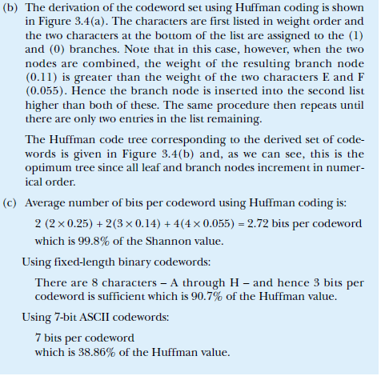
‹#›

Slide 19
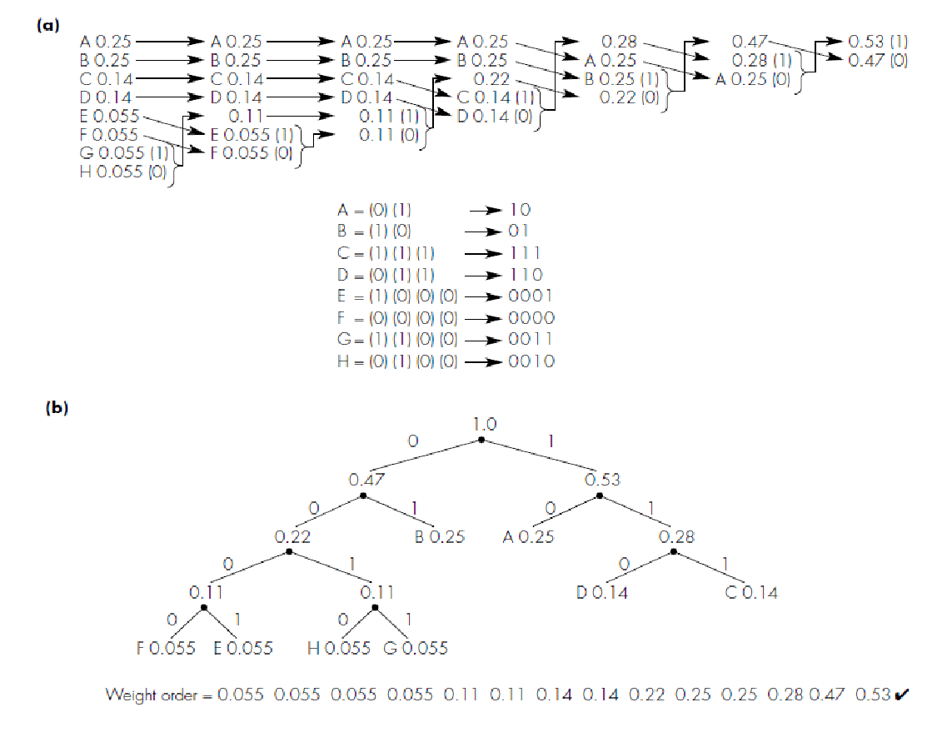
Ex 3.3
‹#›

Slide 20
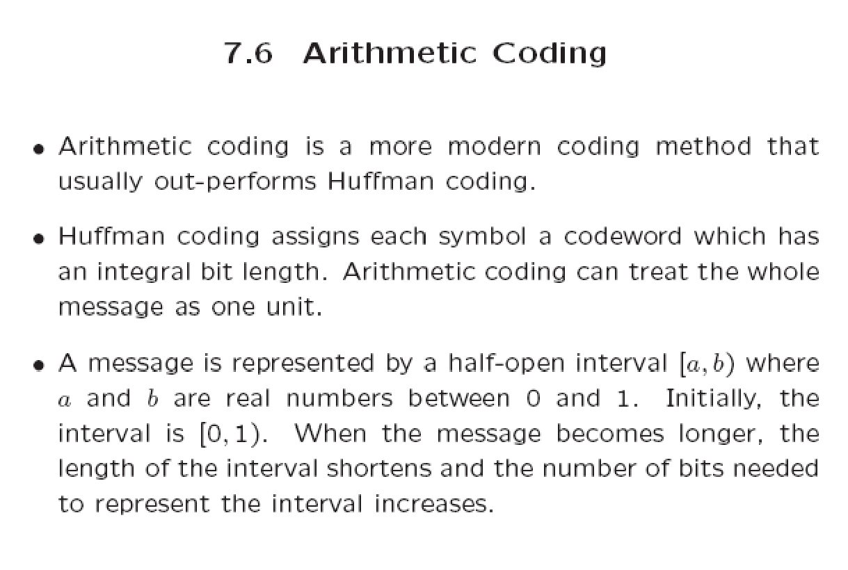
‹#›

Slide 21
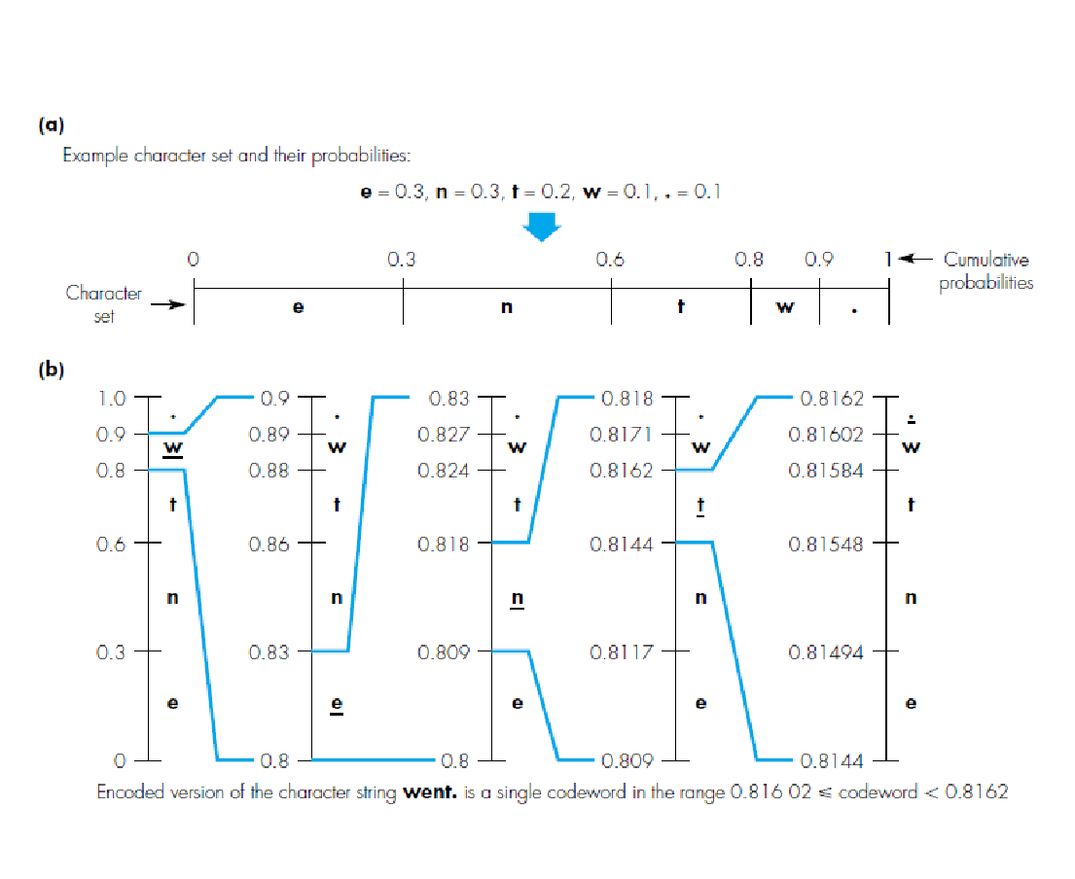
‹#›

Slide 22
First character -w range - .8 to .9
Segment for the character e is from .8 to .83
.8+.3 x .1
Second character- e range- .8 to .83
Segment for the character e is from .8 to .809
.8+ .3 x .03
‹#›

Slide 23
Dynamic Huffman coding
Basic Huffman coding requires both encoder and decoder should know the codeword .
But in dynamic encoder and decoder build the Huffman tree and hence the codeword dynamically as the characters are being transmitted
Both transmitter and receiver start with a tree that comprises the root node and a single empty leaf node
‹#›

Slide 24

‹#›

Slide 25

‹#›

Slide 26
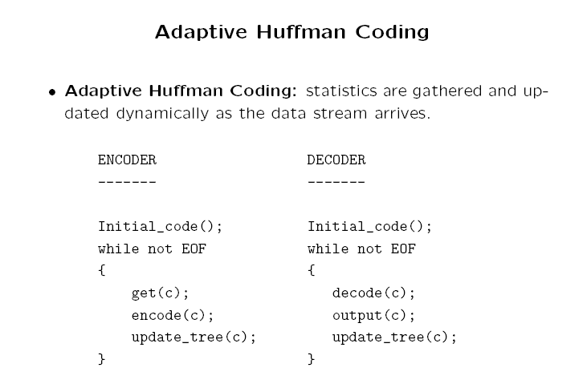
‹#›

Slide 27
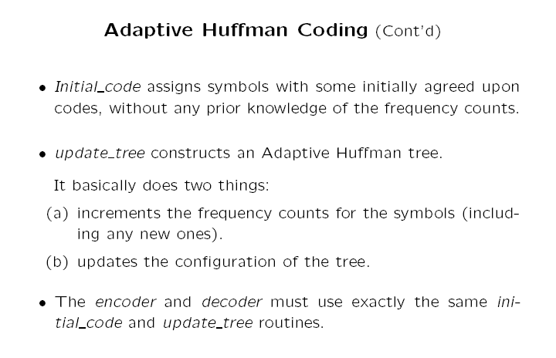
‹#›

Slide 28
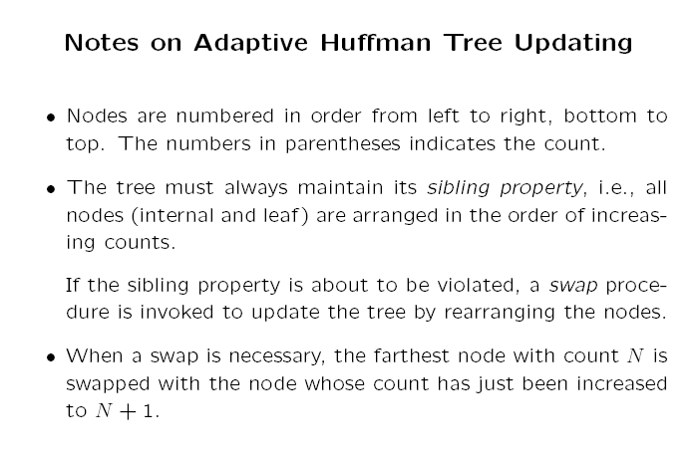
‹#›

Slide 29
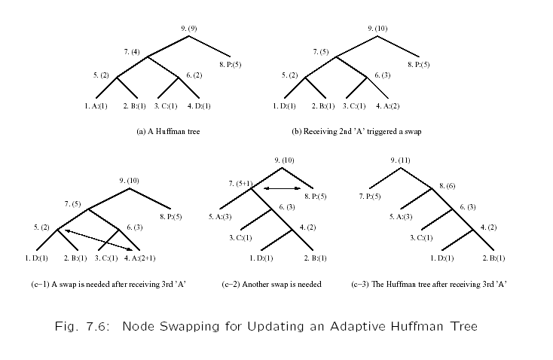
‹#›

Slide 30
Another Example: Adaptive Human Coding
This is to clearly illustrate more implementation details. We show exactly what bits are sent, as opposed to simply stating how the tree is updated.
An additional rule: if any character/symbol is to be sent the first time, it must be preceded by a special symbol, NEW.
The initial code for NEW is 0. The count for NEW is always kept as 0 (the count is never increased); hence it is always denoted as NEW:(0) in Fig. 7.7.
‹#›

Slide 31
Table 7.3: Initial code assignment for AADCCDD using
adaptive Human coding.
Initial Code
NEW: 0
A: 00001
B: 00010
C: 00011
D: 00100
. .
. .
. .
‹#›

Slide 32
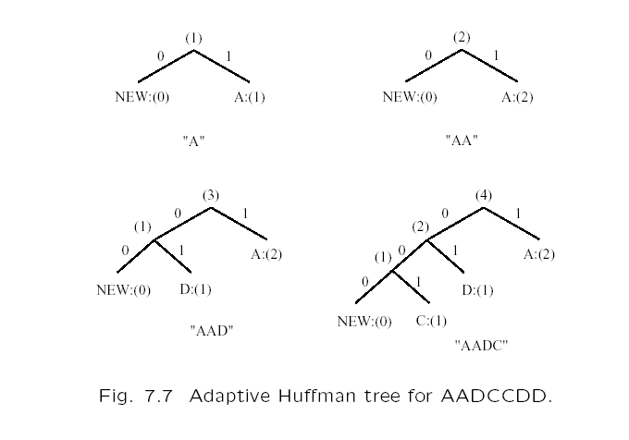
‹#›

Slide 33
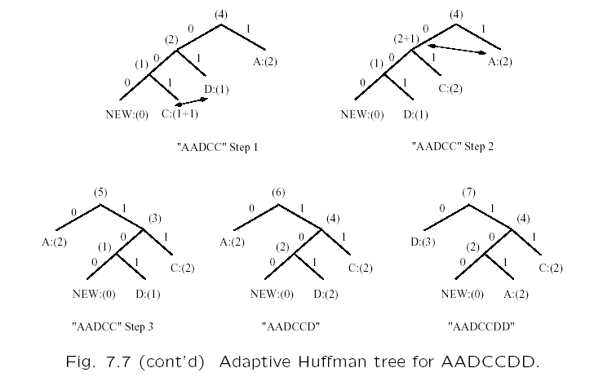
‹#›

Slide 34
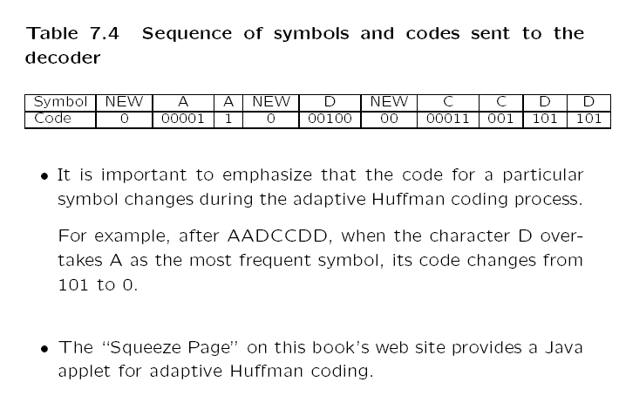
‹#›

Slide 35
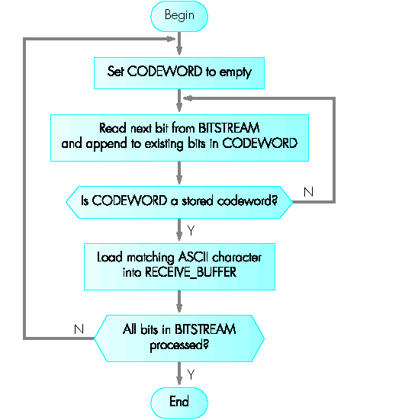
Text Compression – Flow chart of a suitable decoding algorithm
Decoding of received bitstream assuming codewords derived: decoding algorithm
‹#›

Slide 36
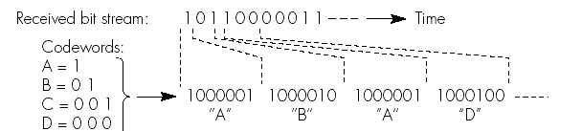
Text Compression – Example
The algorithm assumes a table of codewords is available at the receiver and this also holds the corresponding ASCII codeword
‹#›

Slide 37
Text Compression – Lampel-Ziv coding
The LZ algorithm uses strings of characters instead of single characters
For example for text transfer, a table containing all possible character strings are present in the encoder and the decoder
As each word appears instead of sending the ASCII code, the encoder sends only the index of the word in the table
This index value will be used by the decoder to reconstruct the text into its original form. This algorithm is also known as a dictionary-based compression
‹#›

Slide 38
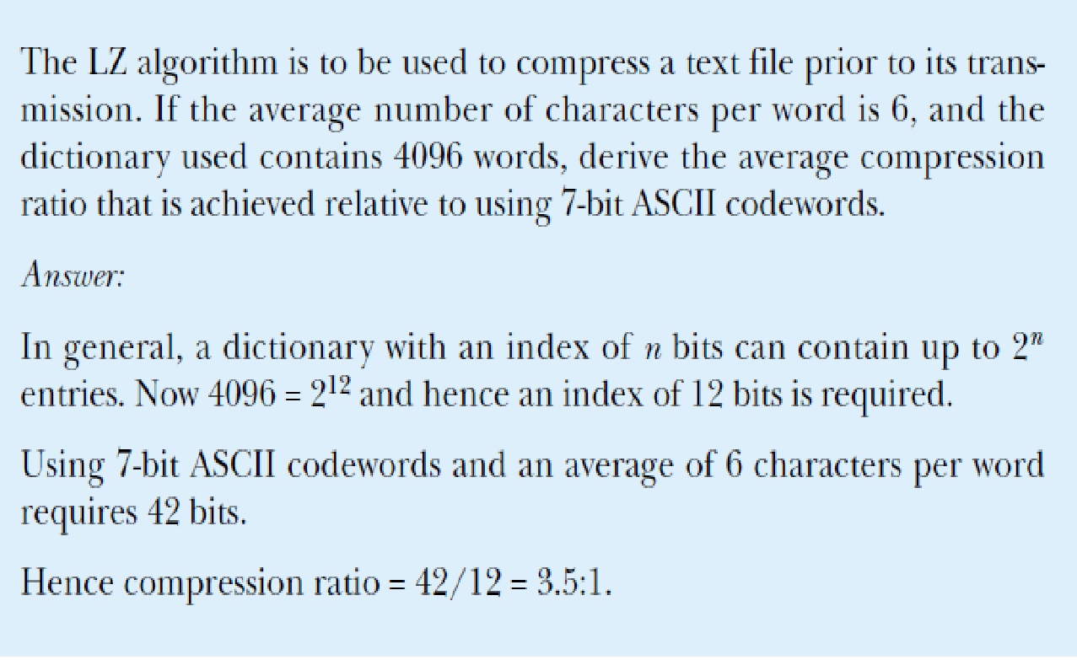
Ex 3.4
‹#›

Slide 39
Text Compression – LZW Compression
The principle of the Lempel-Ziv-Welsh coding algorithm is for the encoder and decoder to build the contents of the dictionary dynamically as the text is being transferred
Initially the decoder has only the character set – e.g ASCII. The remaining entries in the dictionary are built dynamically by the encoder and decoder
‹#›

Slide 40
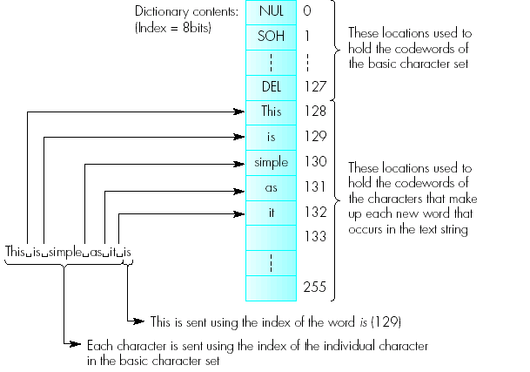
Text Compression – LZW Compression
‹#›

Slide 41
Text Compression – LZW coding
Initially the encoder sends the index of the four characters T, H, I, S and sends the space character which will be detected as a non alphanumeric character
It therefore transmits the character using its index as before but in addition interprets it as terminating the first word and this will be stored in the next free location in the dictionary
Similar procedure is followed by both the encoder and decoder
In applications with 128 characters initially the dictionary will start with 8 bits and 256 entries 128 for the characters and the rest 128 for the words
‹#›

Slide 42
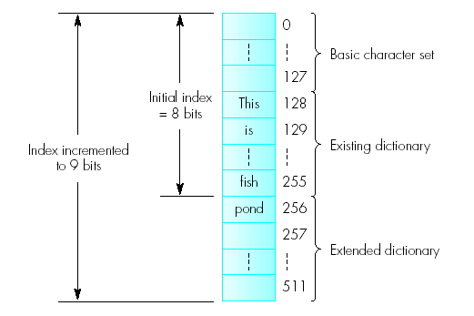
Text Compression – LZW Compression Algorithm
A key issue in determining the level of compression that is achieved, is the number of entries in the dictionary since this determines the number of bits that are required for the index
‹#›

Slide 43
DICTIONARY BASED CODING
Lempel-Ziv-Welch (LZW) ALGORITHM is adaptive dictionary based
Compression technique
Uses fixed length codewords
LZW encoder and decoder builds the same dictionary
LZW proceeds by placing longer and longer repeated entries into dictionary
If the element is already placed then it emits the code rather than the string
‹#›

Slide 44
The LZW algorithm is a very common compression technique.
.
LZW compression works best for files containing lots of repetitive data.
This is often the case with text and monochrome images.
Files that are compressed but that do not contain any repetitive information at all can even grow bigger!
LZW compression is fast.
LZW compression can be used in a variety of file formats:
TIFF files
GIF files
Problems:
Too many bits,
everyone needs a dictionary,
only works for English text
‹#›

Slide 45
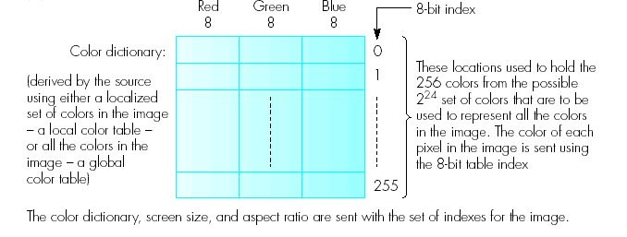
Image Compression – GIF compression Principles
The graphics interchange format is used extensively with the Internet for the representation and compression of graphical images
‹#›

Slide 46
Image Compression – GIF
Although colour images comprising 24-bit pixels are supported GIF reduces the number of possible colours that are present by choosing 256 entries from the original set of 2²⁴ colours that match closely to the original image
Hence instead of sending as 24-bit colour values only 8-bit index to the table entry that contains the closest match to the original is sent.This results in a 3:1 compression ratio
The contents of the table are sent in addition to the screen size and aspect ratio information
The image can also be transferred over the network using the interlaced mode
‹#›

Slide 47
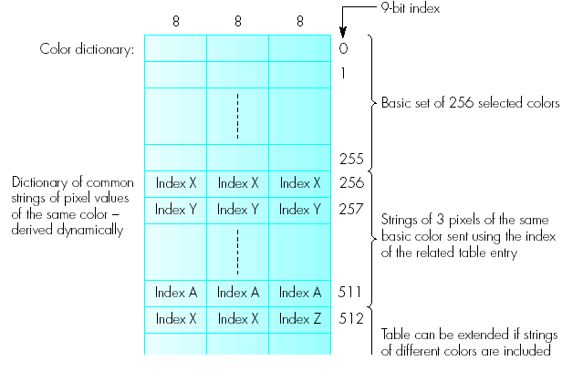
Image Compression – GIF Compression – Dynamic mode using LZW coding
‹#›
The LZW can be used to obtain further levels of compression

Slide 48
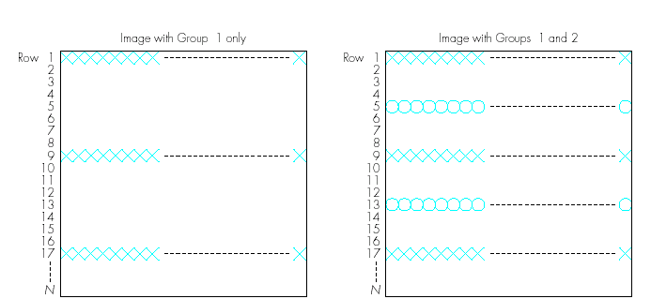
Image Compression – GIF interlaced mode
GIF also allows an image to be stored and subsequently transferred over the network in an interlaced mode; useful over either low bit rate channels or the Internet which provides a variable transmission rate
‹#›

Slide 49
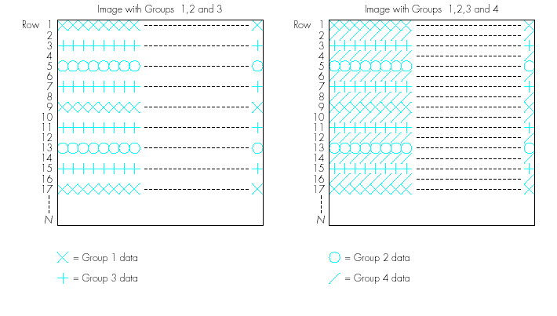
Image Compression – GIF interlaced mode
The compression image data is organized so that the decompressed image is built up in a progressive way as the data arrives
‹#›

Slide 50
Digitized Documents
Since FAX machines are used with public carrier networks, the ITU-T has produced standards relating to them
These are T2(Group1), T3 (Group2), T4 (Group3) (PSTN), and T6 (Group 4) (ISDN)
Both use data compression ratio in the range of 10:1
The resulting codewords are grouped into termination-codes table (white or black run-lengths from 0 to 63 pels in steps of 1) and the make-up codes table (contains in multiples of 64 pels)
Since this codeword uses two sets of codeword it is known as the modified Huffman codes
‹#›

Slide 51
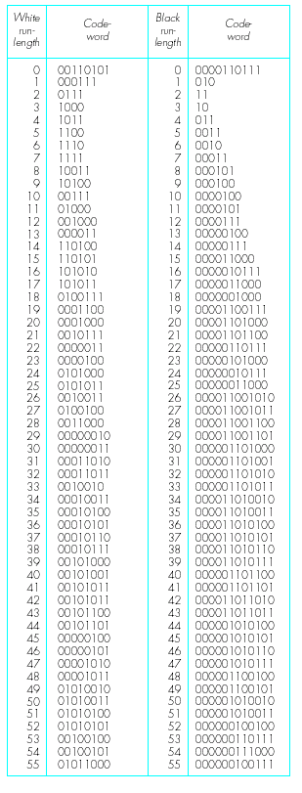
Image Compression – GIF interlaced mode
ITU –T Group 3 and 4 facsimile conversion codes: termination-codes
Termination code table
‹#›

Slide 52
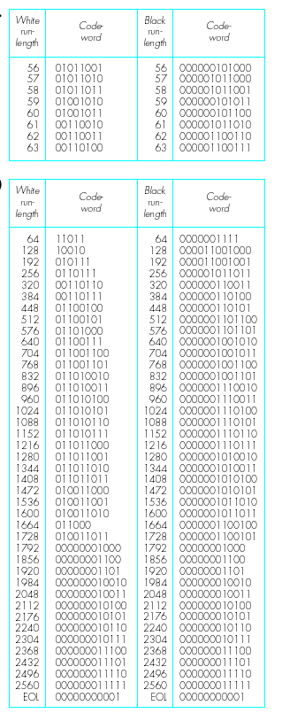
Image Compression – GIF interlaced mode
ITU –T Group 3 and 4 facsimile conversion codes: make-up codes
Make-up of 64 codewords
‹#›

Slide 53
Each scanned line is terminated with an EOL code. In this way the receiver fails to decode a word it starts to search for an EOL pattern
If it fails to decode an EOL after a preset number of lines it aborts the reception process and informs the sending machine
A single EOL precedes the end of each scanned line and six consecutive EOLs indicate the end of each page
The T4 coding is known as one-dimensional coding
‹#›

Slide 54
MMR coding (2 dimensional coding)
The modified-modified relative element address designate coding explores the fact that most scanned lines differ from the previous line by only a few pels
E.g. if a line contains a black-run then the next line will normally contain the same run pels plus or minus 3 pels
In MMR the run-lengths associated with a line are identified by comparing the line contents, known as the coding line (CL), relative to the immediately preceding line known as the reference line (RL)
The run lengths associated with a coding line are classified into three groups relative to the reference line
‹#›

Slide 55
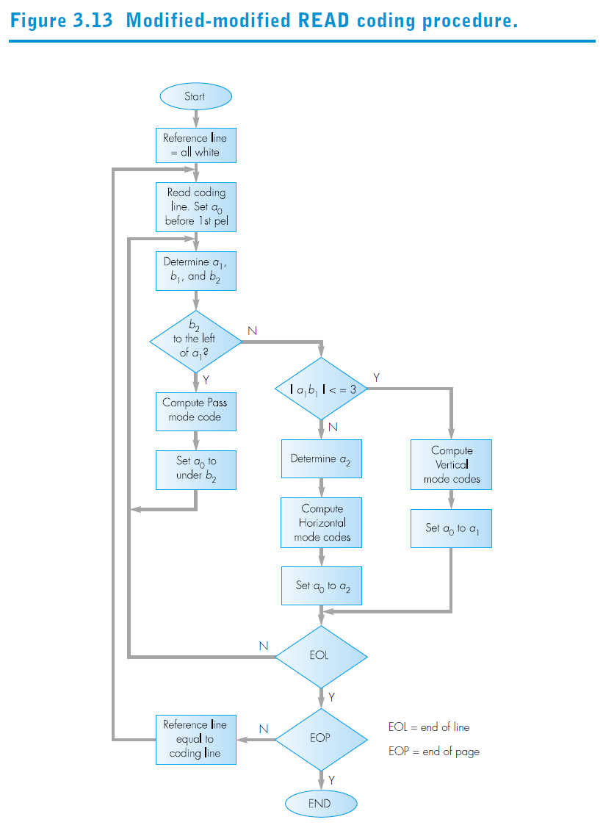
‹#›

Slide 56
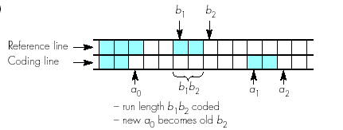
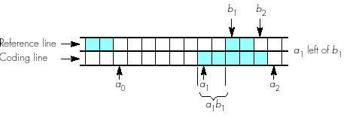
Image Compression – run-length possibilities: pass mode (a), vertical mode
Pass mode
This is the case when the run-length in the reference line(b₁b₂) is to the left of the next run-length in the coding line (a₁a₂), that is b₂ is to the left of a₁
Vertical mode
This is the case when the run-length in the reference line (b₁b₂) overlaps the next run-length in the coding line(a₁a₂) by a maximum of plus or minus 3 pels
‹#›

Slide 57
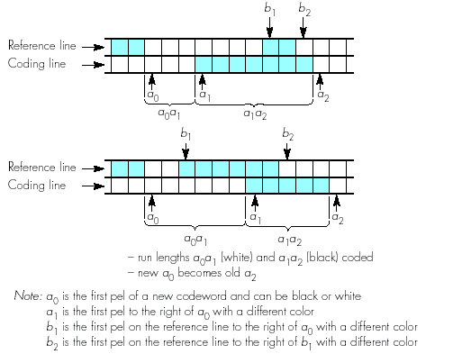
Image Compression – run-length possibilities: Horizontal mode
This is the case when the run-length in the reference line (b₁b₂) overlaps the run-length (a₁a₂) by more than plus or minus 3 pels
‹#›

Slide 58
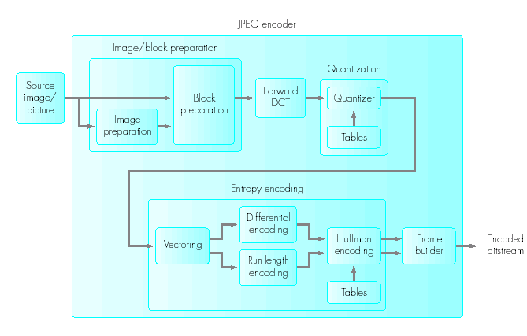
Image Compression – JPEG encoder schematic
The Joint Photographic Experts Group forms the basis of most video compression algorithms
‹#›

Slide 59
Image Compression – Image/block preparation
Source image is made up of one or more 2-D matrices of values
2-D matrix is required to store the required set of 8-bit grey-level values that represent the image
For the colour image if a CLUT is used then a single matrix of values is required
If the image is represented in R, G, B format then three matrices are required
If the Y, C_{r}, C_{b} format is used then the matrix size for the chrominance components is smaller than the Y matrix ( Reduced representation)
‹#›

Slide 60
Image Compression – Image/block preparation
Once the image format is selected then the values in each matrix are compressed separately using the DCT
In order to make the transformation more efficient a second step known as block preparation is carried out before DCT
In block preparation each global matrix is divided into a set of smaller 8X8 submatrices (block) which are fed sequentially to the DCT
‹#›

Slide 61
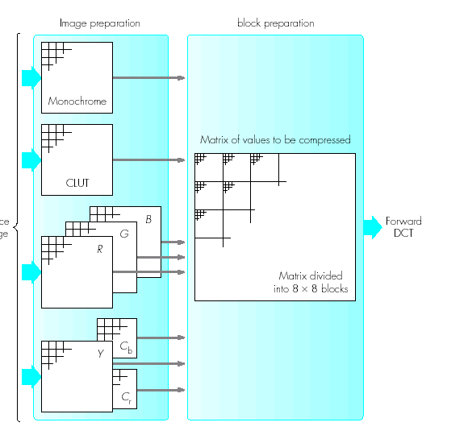
Image Compression – Image Preparation
Once the source image format has been selected and prepared (four alternative forms of representation), the set values in each matrix are compressed separately using the DCT)
‹#›

Slide 62
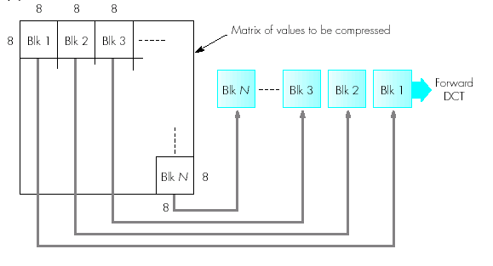
Image Compression – Image Preparation
Block preparation is necessary since to compute the transformed value for each position in a matrix requires the values in all the locations to be processed. It would be too time consuming to compute the DCT of the total matrix in a single step. So dive into set of smaller 8 x 8 sub matrices. And fed sequentially to DCT
‹#›

Slide 63

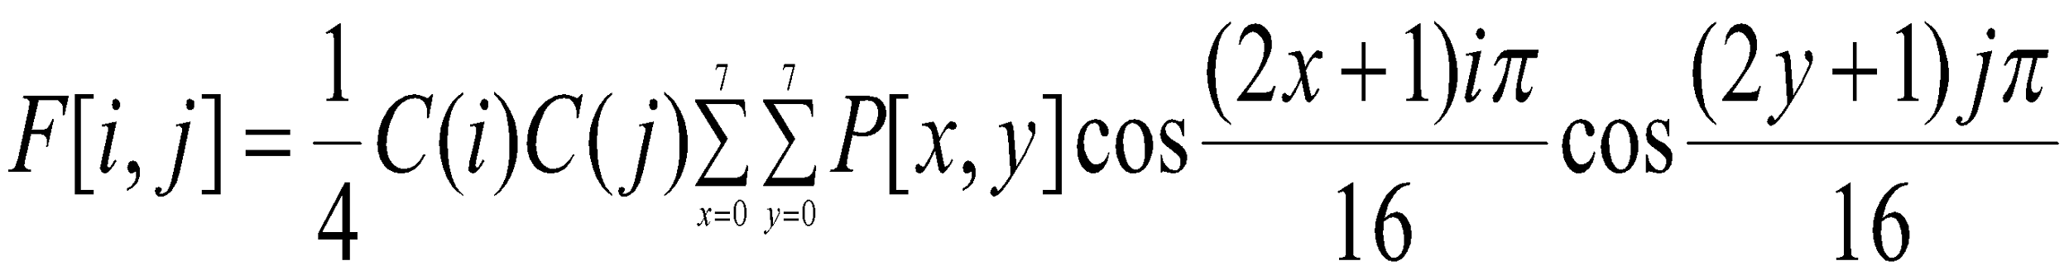
Image Compression – Forward DCT
Each pixel value is quantized using 8 bits which produces a value in the range 0 to 255 for the R, G, B or Y and a value in the range –128 to 127 for the two chrominance values C_{b} and C_{r}
If the input matrix is P[x,y] and the transformed matrix is F[i,j] then the DCT for the 8X8 block is computed using the expression:
where C(i) and C(J) = 1/ √2 for i,j=0
=1 for all other values of i and j
‹#›

Slide 64
Image Compression – Forward DCT
All 64 values in the input matrix P[x,y] contribute to each entry in the transformed matrix F[i,j]
For i = j = 0 the two cosine terms are 0 and hence the value in the location F[0,0] of the transformed matrix is simply a function of the summation of all the values in the input matrix
This is the mean of all 64 values in the matrix and is known as the DC coefficient
Since the values in all the other locations of the transformed matrix have a frequency coefficient associated with them they are known as AC coefficients
‹#›

Slide 65
Image Compression – Forward DCT
for j = 0 only the horizontal frequency coefficients are present
for i = 0 only the vertical frequency components are present
For all the other locations both the horizontal and vertical frequency coefficients are present
‹#›

Slide 66
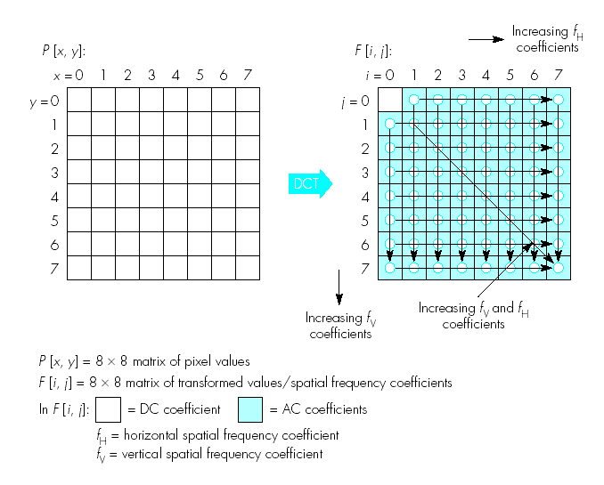
Image Compression – Image Preparation
‹#›

Slide 67
Image Compression – Quantization
Using DCT there is very little loss of information during the DCT phase
The losses are due to the use of fixed point arithmetic
The main source of information loss occurs during the quantization and entropy encoding stages where the compression takes place
The human eye responds primarily to the DC coefficient and the lower frequency coefficients (The higher frequency coefficients below a certain threshold will not be detected by the human eye)
This property is exploited by dropping the spatial frequency coefficients in the transformed matrix (dropped coefficients cannot be retrieved during decoding)
‹#›

Slide 68
Image Compression – Quantization
In addition to classifying the spatial frequency components the quantization process aims to reduce the size of the DC and AC coefficients so that less bandwidth is required for their transmission (by using a divisor)
The sensitivity of the eye varies with spatial frequency and hence the amplitude threshold below which the eye will detect a particular frequency also varies
The threshold values vary for each of the 64 DCT coefficients and these are held in a 2-D matrix known as the quantization table with the threshold value to be used with a particular DCT coefficient in the corresponding position in the matrix
‹#›

Slide 69
Image Compression – Quantization
The choice of threshold value is a compromise between the level of compression that is required and the resulting amount of information loss that is acceptable
JPEG standard has two quantization tables for the luminance and the chrominance coefficients. However, customized tables are allowed and can be sent with the compressed image
‹#›

Slide 70
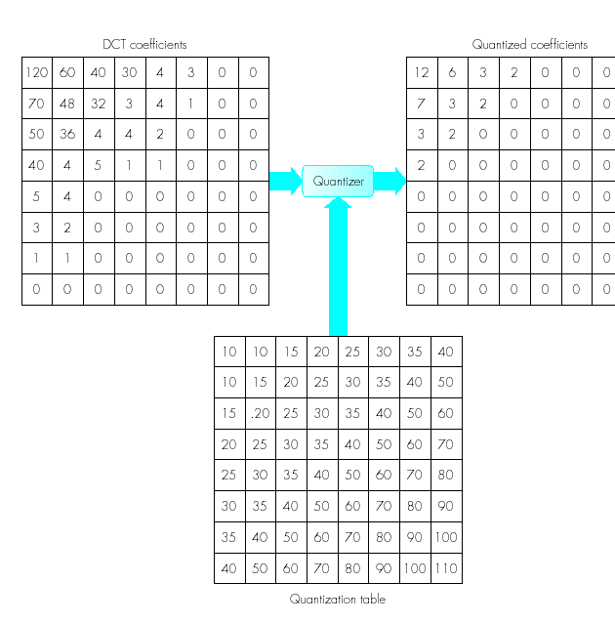
Image Compression – Example computation of a set of quantized DCT coefficients
‹#›

Slide 71
Image Compression – Quantization
From the quantization table and the DCT and quantization coefficents number of observations can be made:
- The computation of the quantized coefficients involves rounding the quotients to the nearest integer value
- The threshold values used, increase in magnitude with increasing spatial frequency
- The DC coefficient in the transformed matrix is largest
- Many of the higher frequency coefficients are zero
‹#›

Slide 72
Image Compression – Entropy Encoding
Entropy encoding consists of four stages
Vectoring – The entropy encoding operates on a one-dimensional string of values (vector). However the output of the quantization is a 2-D matrix and hence this has to be represented in a 1-D form. This is known as vectoring
Differential encoding – In this section only the difference in magnitude of the DC coefficient in a quantized block relative to the value in the preceding block is encoded. This will reduce the number of bits required to encode the relatively large magnitude
The difference values are then encoded in the form (SSS, value) SSS indicates the number of bits needed and actual bits that represent the value
e.g: if the sequence of DC coefficients in consecutive quantized blocks was: 12, 13, 11, 11, 10, --- the difference values will be 12, 1, -2, 0, -1
‹#›

Slide 73
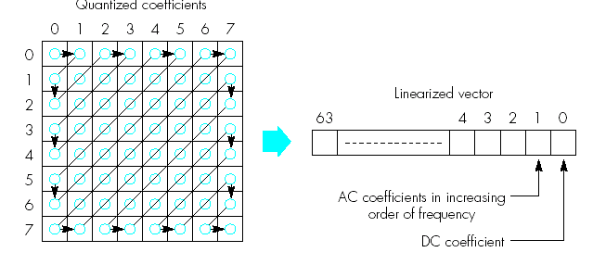
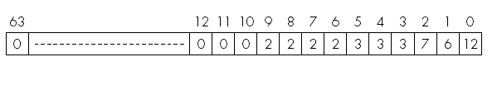
Image Compression – Vectoring using Zig-Zag scan
In order to exploit the presence of the large number of zeros in the quantized matrix, a zig-zag of the matrix is used
‹#›

Slide 74
Image Compression – run length encoding
The remaining 63 values in the vector are the AC coefficients
Because of the large number of 0’s in the AC coefficients they are encoded as string of pairs of values
Each pair is made up of (skip, value) where skip is the number of zeros in the run and value is the next non-zero coefficient
The above will be encoded as
(0,6) (0,7) (0,3)(0,3)(0,3) (0,2)(0,2)(0,2)(0,2)(0,0)
Final pair indicates the end of the string for this block
‹#›

Slide 75
Image Compression – Huffman encoding
Significant levels of compression can be obtained by replacing long strings of binary digits by a string of much shorter codewords
The length of each codeword is a function of its relative frequency of occurrence
Normally, a table of codewords is used with the set of codewords precomputed using the Huffman coding algorithm
‹#›

Slide 76
Image Compression – Frame Building
In order for the remote computer to interpret all the different fields and tables that make up the bitstream it is necessary to delimit each field and set of table values in a defined way
The JPEG standard includes a definition of the structure of the total bitstream relating to a particular image/picture. This is known as a frame
The role of the frame builder is to encapsulate all the information relating to an encoded image/picture
‹#›

Slide 77
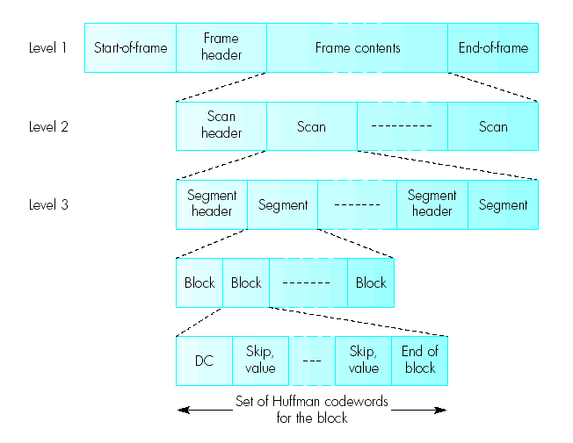
Image Compression – JPEG encoder
‹#›

Slide 78
Image Compression – Frame Building
At the top level the complete frame-plus-header is encapsulated between a start-of-frame and an end-of-frame delimiter which allows the receiver to determine the start and end of all the information relating to a complete image
The frame header contains a number of fields
- the overall width and height of the image in pixels
- the number and type of components (CLUT, R/G/B, Y/C_{b}/C_{r})
- the digitization format used (4:2:2, 4:2:0 etc.)
‹#›

Slide 79
Image Compression – Frame Building
At the next level a frame consists of a number of components each of which is known as a scan
The level two header contains fields that include:
- the identity of the components
- the number of bits used to digitize each component
- the quantization table of values that have been used to encode each component
Each scan comprises one or more segments each of which can contain a group of (8X8) blocks preceded by a header
This contains the set of Huffman codewords for each block
‹#›

Slide 80
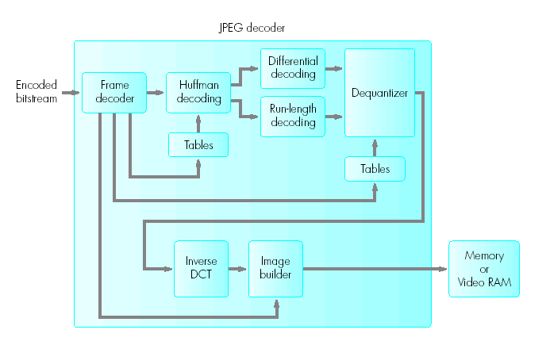
Image Compression – JPEG decoder
A JPEG decoder is made up of a number of stages which are simply the corresponding decoder sections of those used in the encoder
‹#›

Slide 81
JPEG decoding
The JPEG decoder is made up of a number of stages which are the corresponding decoder sections of those used in the encoder
The frame decoder first identifies the encoded bitstream and its associated control information and tables within the various headers
It then loads the contents of each table into the related table and passes the control information to the image builder
Then the Huffman decoder carries out the decompression operation using preloaded or the default tables of codewords
‹#›

Slide 82
JPEG decoding
The two decompressed streams containing the DC and AC coefficients of each block are then passed to the differential and run-length decoders
The resulting matrix of values is then dequantized using either the default or the preloaded values in the quantization table
Each resulting block of 8X8 spatial frequency coefficient is passed in turn to the inverse DCT which in turn transforms it back to their spatial form
The image builder then reconstructs the image from these blocks using the control information passed to it by the frame decoder
‹#›

Slide 83
JPEG Summary
Although complex using JPEG compression ratios of 20:1 can be obtained while still retaining a good quality image
This level (20:1) is applied for images with few colour transitions
For more complicated images compression ratios of 10:1 are more common
Like GIF images it is possible to encode and rebuild the image in a progressive manner. This can be achieved by two different modes – progressive mode and hierarchical mode
‹#›

Slide 84
JPEG Summary
Progressive mode – First the DC and low-frequency coefficients of each block are sent and then the high-frequency coefficients
hierarchial mode – in this mode, the total image is first sent using a low resolution – e.g 320 X 240 and then at a higher resolution 640 X 480
‹#›

Slide 85
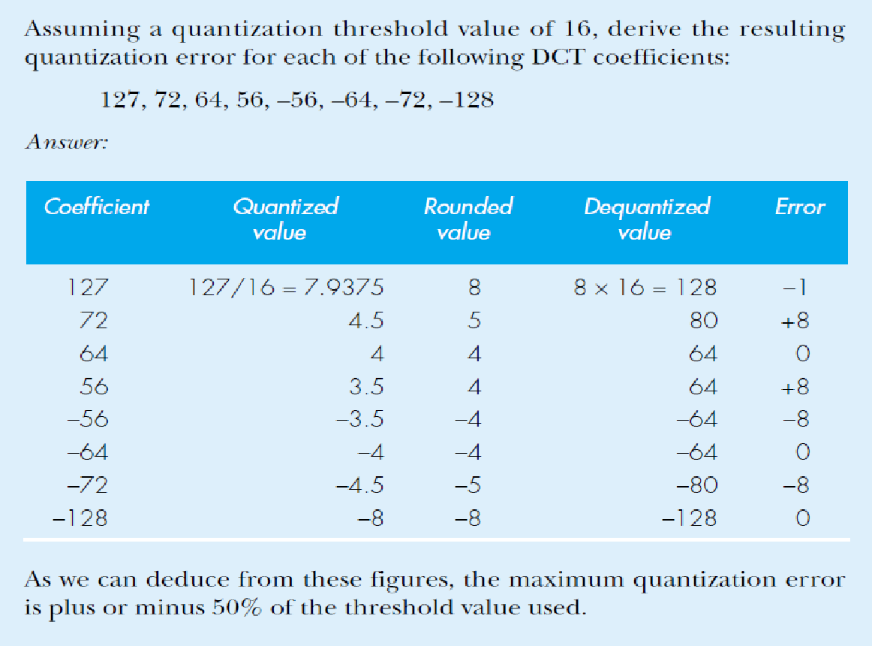
‹#›
Ex 3.5

Slide 86
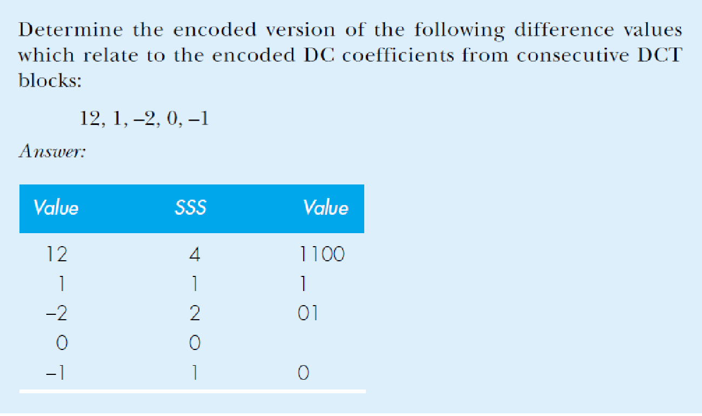
Ex 3.6
‹#›

Slide 87
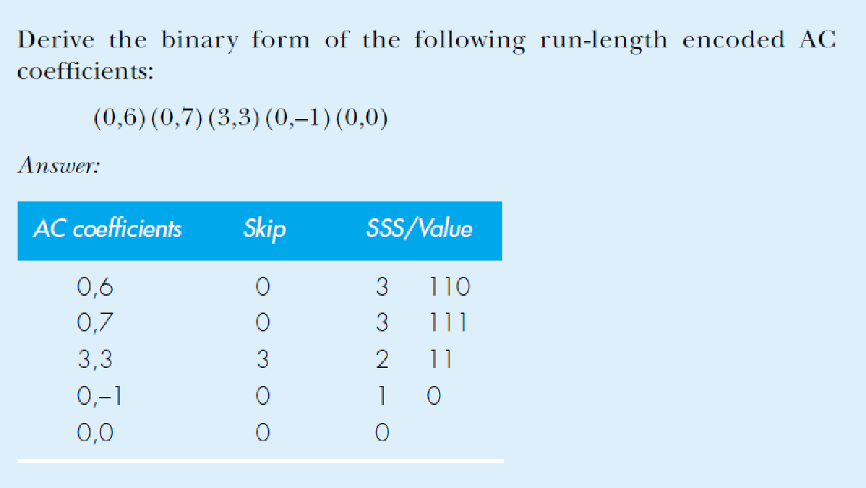
Ex 3.7
‹#›

Slide 88
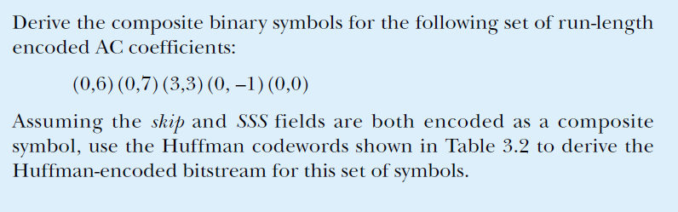
Ex 3.9
‹#›

Slide 89



