Slide 1
SOLID Principles

Slide 2
Introduction
The SOLID principles were introduced by Robert C. Martin in his 2000 paper “Design Principles and Design Patterns.” These concepts were later built upon by Michael Feathers, who introduced us to the SOLID acronym. And in the last 20 years, these five principles have revolutionized the world of object-oriented programming, changing the way that we write software.

Slide 3
Introduction
SOLID principles are the design principles that enable us manage most of the software design problems
The term SOLID is an acronym for five design principles intended to make software designs more understandable, flexible and maintainable
The principles are a subset of many principles promoted by Robert C. Martin
The SOLID acronym was first introduced by Michael Feathers
SOLID principles are class-level, object-oriented design concepts that, help you avoid code rot.

Slide 4
SOLID Acronym
S : Single Responsibility Principle (SRP)
O : Open closed Principle (OSP)
L : Liskov substitution Principle (LSP)
I : Interface Segregation Principle (ISP)
D : Dependency Inversion Principle (DIP)

Slide 5
Single Responsibility Principle
Robert C. Martin expresses the principle as, "A class should have only one reason to change”
Every module or class should have responsibility over a single part of the functionality provided by the software, and that responsibility should be entirely encapsulated by the class

Slide 6
Open/Closed Principle
“Software entities should be open for extension, but closed for modification”
The design and writing of the code should be done in a way that new functionality should be added with minimum changes in the existing code
The design should be done in a way to allow the adding of new functionality as new classes, keeping as much as possible existing code unchanged

Slide 7
Liskov Substitution Principle
Introduced by Barbara Liskov state that “objects in a program should be replaceable with instances of their sub-types without altering the correctness of that program”
If a program module is using a Base class, then the reference to the Base class can be replaced with a Derived class without affecting the functionality of the program module
We can also state that Derived types must be substitutable for their base types

Slide 8
Interface Segregation Principle
“Many client-specific interfaces are better than one general-purpose interface”
We should not enforce clients to implement interfaces that they don't use. Instead of creating one big interface we can break down it to smaller interfaces

Slide 9
Dependency Inversion Principle
One should “depend upon abstractions, [not] concretions"
Abstractions should not depend on the details whereas the details should depend on abstractions
High-level modules should not depend on low level modules

Slide 10
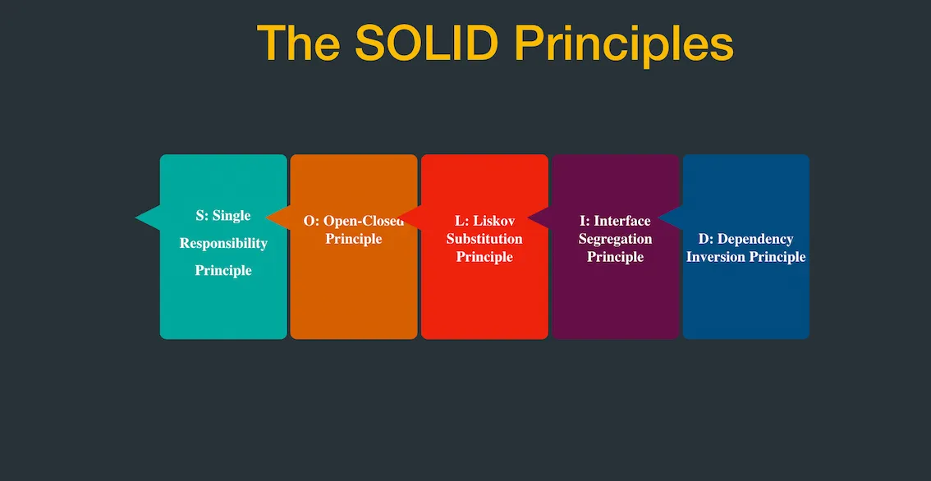
SOLID Principles by examples

Slide 11
Single Responsibility Principle
According to the single responsibility principle, there should be only one reason due to which a class has to be changed. It means that a class should have one task to do. This principle is often termed as subjective.
The principle can be well understood with an example. Imagine there is a class which performs following operations.
Connected to a database
Read some data from database tables
Finally, write it to a file.

Slide 12
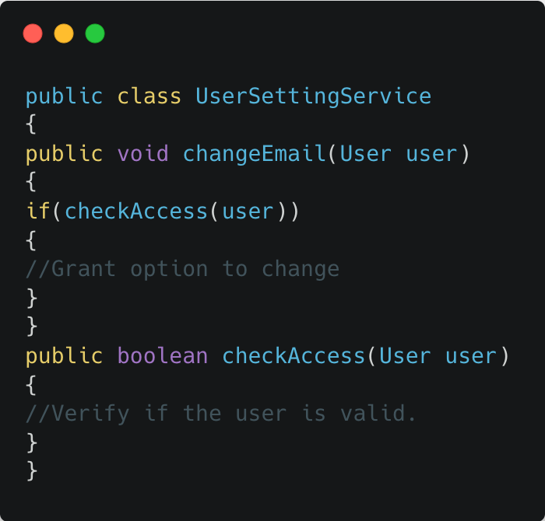
Single Responsibility Principle example
Suppose you are asked to implement a UserSetting service wherein the user can change the settings but before that the user has to be authenticated. One way to implement this would be:

Slide 13
Single Responsibility Principle example
Suppose you are asked to implement a UserSetting service wherein the user can change the settings but before that the user has to be authenticated. One way to implement this would be:
All looks good until you would want to reuse the checkAccess code at some other place OR you want to make changes to the way checkAccess is being done. In all 2 cases you would end up changing the same class and in the first case you would have to use UserSettingService to check for access as well.

Slide 14
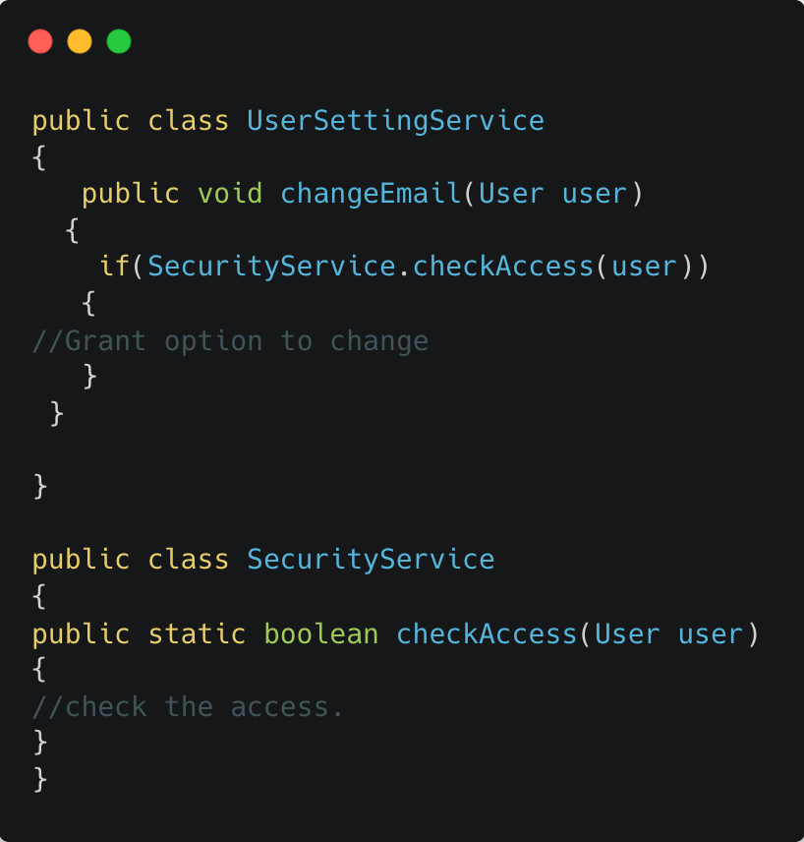
Single Responsibility Principle example
One way to correct this is to decompose the UserSettingService into UserSettingService and SecurityService. And move the checkAccess code into SecurityService.

Slide 15
Open Closed Principle
To be precise, according to this principle, a class should be written in such a manner that it performs its job flawlessly without the assumption that people in the future will simply come and change it. Hence, the class should remain closed for modification, but it should have the option to get extended. Ways of extending the class include:
Inheriting from the class
Overwriting the required behaviors from the class
Extending certain behaviors of the class

Slide 16
Open Closed Principle example
An excellent example of open-closed principle can be understood with the help of browsers. Do you remember installing extensions in your chrome browser?
Basic function of the chrome browser is to surf different sites. Do you want to check grammar when you are writing an email using chrome browser?If yes, you can simply use Grammarly extension, it provides you grammar check on the content.
This mechanism where you are adding things for increasing the functionality of the browser is an extension. Hence, the browser is a perfect example of functionality that is open for extension but is closed for modification. In simple words, you can enhance the functionality by adding/installing plugins on your browser, but cannot build anything new.

Slide 17
Open Closed Principle example
Lets say we need to calculate areas of various shapes. We start with creating a class for our first shape Rectangle which has 2 attributes length & width.
public class Rectangle
{
public double length;
public double width;
}
Next we create a class to calculate the area of this Rectangle which has a method calculateRectangleArea which takes the Rectangle as an input parameter and calculates its area.
public class AreaCalculator
{
public double calculateRectangleArea(Rectangle rectangle)
{
return rectangle.length *rectangle.width;
}
}

Slide 18
Open Closed Principle example
So far so good. Now let’s say we get our second shape circle. So we promptly create a new class Circle with a single attribute radius.
public class Circle
{
public double radius;
}
Then we modify Areacalculator class to add circle calculations through a new method calculateCircleaArea()
public class AreaCalculator
{
public double calculateRectangleArea(Rectangle rectangle){
return rectangle.length *rectangle.width;
}
public double calculateCircleArea(Circle circle){
return (22/7)*circle.radius*circle.radius;
}
}

Slide 19
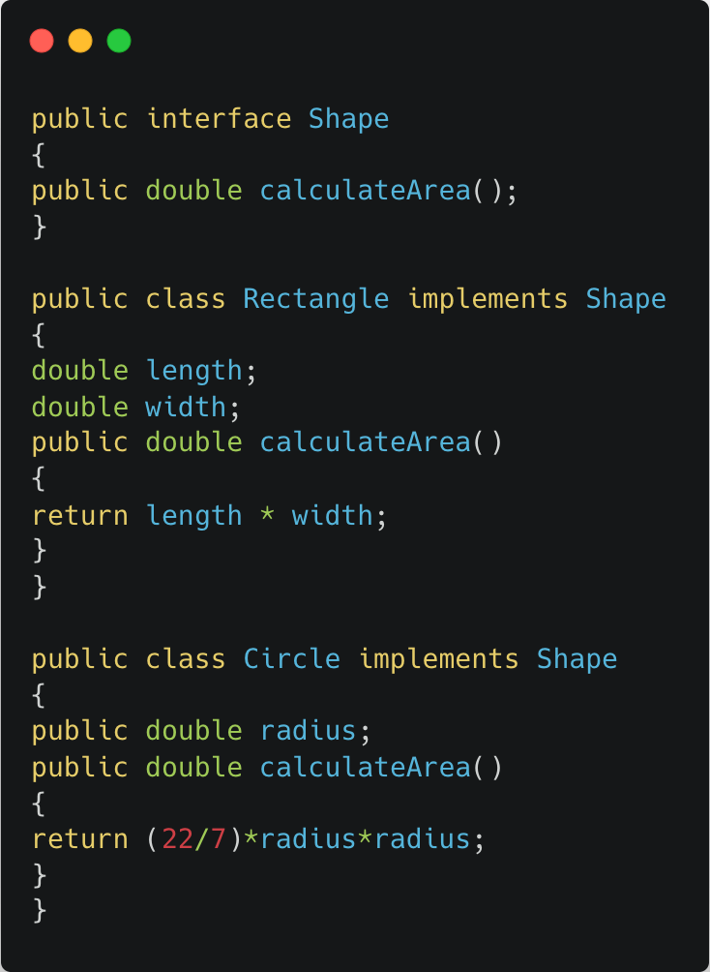
Open Closed Principle example
Lets say we have a new shape pentagon. In that case, we will again end up modifying the AreaCalculator class. As the types of shapes grows this becomes messier as AreaCalculator keeps on changing and any consumers of this class will have to keep on updating their libraries which contain AreaCalculator. As a result, AreaCalculator class will not be baselined(finalized) with surety as every time a new shape comes it will be modified. So, this design is not closed for modification.
Let us now see a more elegant design which solves the flaws in the above design by adhering to the Open/Closed Principle. We will first of all make the design extensible. For this we need to first define a base type Shape and have Circle & Rectangle implement Shape interface.

Slide 20
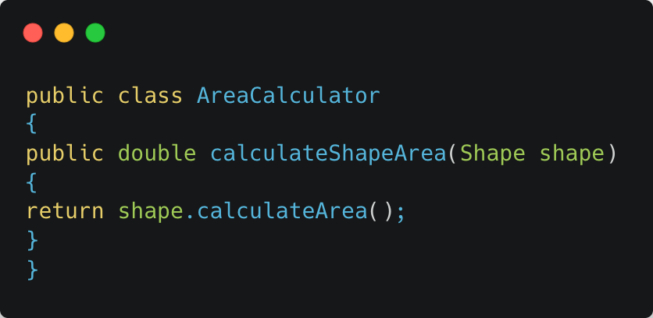
Open Closed Principle example
There is a base interface Shape. All shapes now implement the base interface Shape. Shape interface has an abstract method calculateArea(). Both circle & rectangle provide their own overridden implementation of calculateArea() method using their own attributes.
We have brought in a degree of extensibility as shapes are now an instance of Shape interfaces. This allows us to use Shape instead of individual classes
The last point above mentioned consumer of these shapes. In our case, the consumer will be the AreaCalculator class which would now look like this.

Slide 21
Liskov Substitution Principle
The Liskov Substitution Principle (LSP) applies to inheritance hierarchies, specifying that you should design your classes so that client dependencies can be substituted with subclasses without the client knowing about the change.
All subclasses must, therefore, operate in the same manner as their base classes. The specific functionality of the subclass may be different but must conform to the expected behavior of the base class. To be a true behavioral subtype, the subclass must not only implement the base class’s methods and properties, but also conform to its implied behavior.
A typical example that violates LSP is a Square class that derives from a Rectangle class. The Square class always assumes that the width is equal with the height. If a Square object is used in a context where a Rectangle is expected, unexpected behavior may occur because the dimensions of a Square cannot (or rather should not) be modified independently.

Slide 22
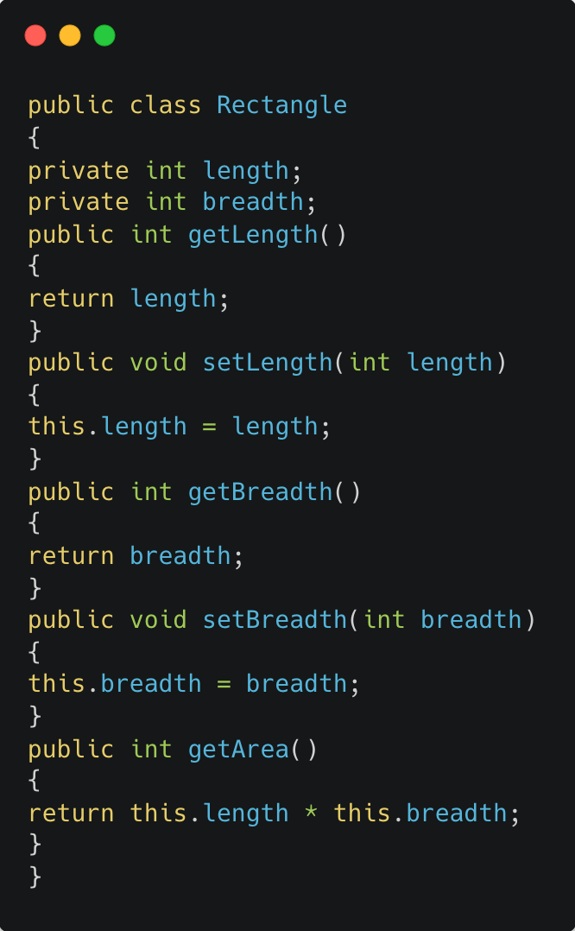
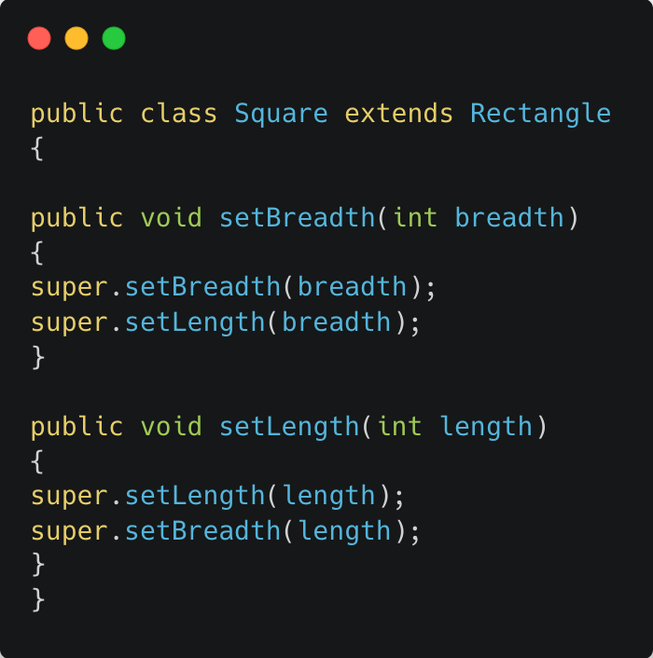
Liskov Substitution Principle example

Slide 23
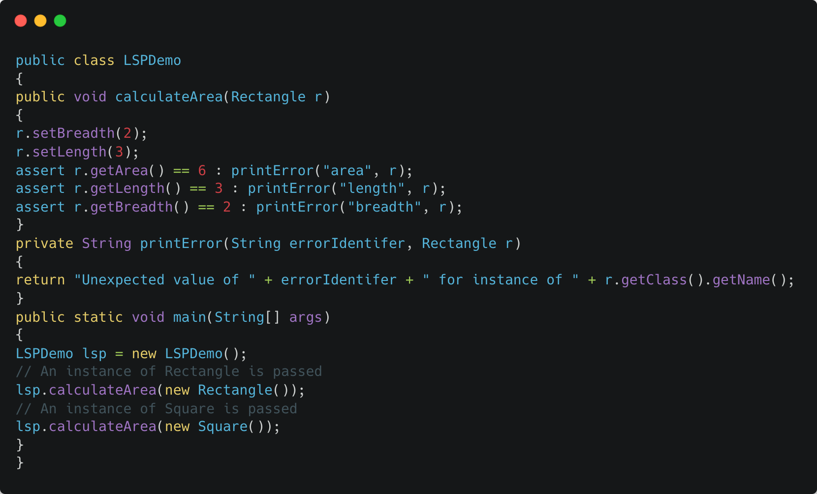
Liskov Substitution Principle example
Notes:
Here the assersion will fail and throw an error

Slide 24
Liskov Substitution Principle example
In case, we try to establish ISA relationship between Square and Rectangle such that we call “Square is a Rectangle”, above code would start behaving unexpectedly if an instance of Square is passed Assertion error will be thrown in case of check for area and check for breadth, although the program will terminate as the assertion error is thrown due to failure of Area check.
The Square class does not need methods like setBreadth or setLength. The LSPDemo class would need to know the details of derived classes of Rectangle (such as Square) to code appropriately to avoid throwing error and this will breake open closed principles.
Notes:
Here the assersion will fail and throw an error

Slide 25
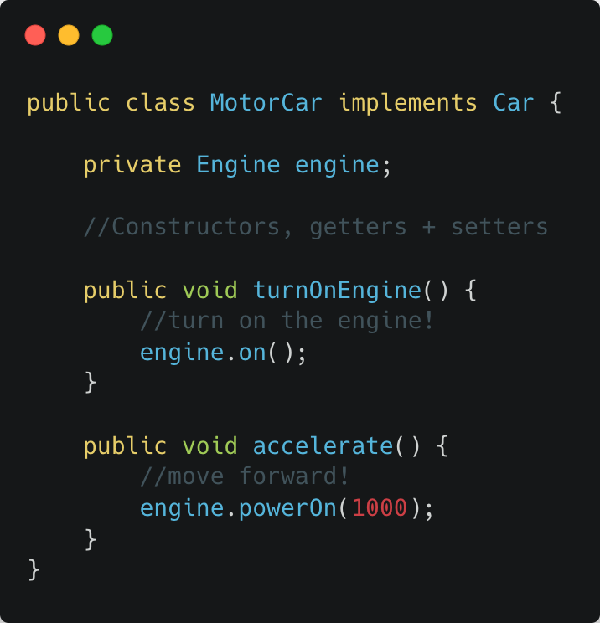
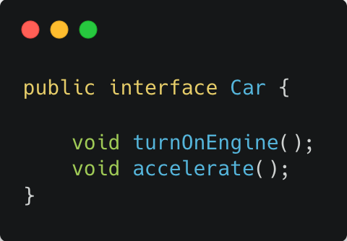
Liskov Substitution Principle example
Above, we define a simple Car interface with a couple of methods that all cars should be able to fulfill: turning on the engine and accelerating forward.
Let's implement our interface and provide some code for the methods:
Notes:
Here the assersion will fail and throw an error

Slide 26
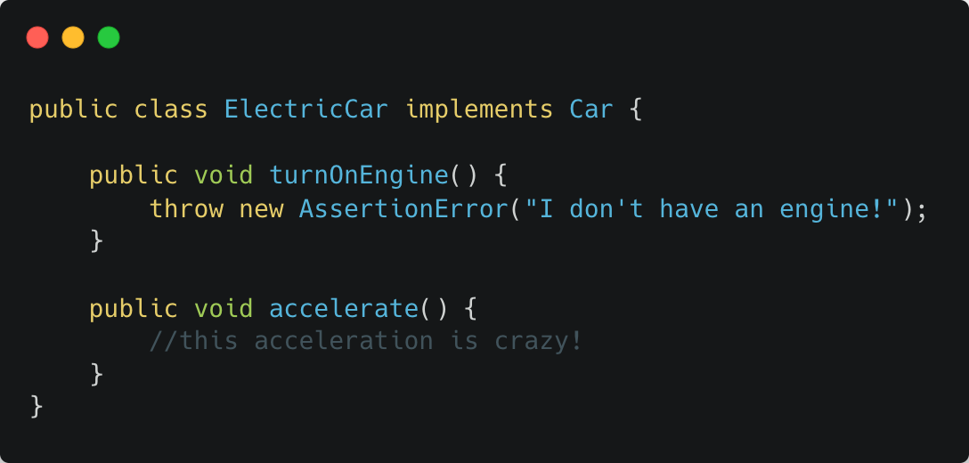
Liskov Substitution Principle example
By throwing a car without an engine into the mix, we are inherently changing the behavior of our program. This is a blatant violation of Liskov substitution and is a bit harder to fix than our previous two principles.
Notes:
Here the assersion will fail and throw an error

Slide 27
Interface Segregation Principle
Robert C. Martin describes it as clients should not be forced to implement unnecessary methods which they will not use.
According to Interface segregation principle a client, no matter what should never be forced to implement an interface that it does not use or the client should never be obliged to depend on any method, which is not used by them.So basically, the interface segregation principles as you prefer the interfaces, which are small but client specific instead of monolithic and bigger interface.In short, it would be bad for you to force the client to depend on a certain thing, which they don’t need.
Notes:
Here the assersion will fail and throw an error

Slide 28
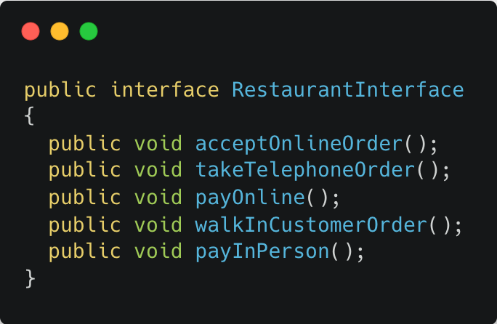
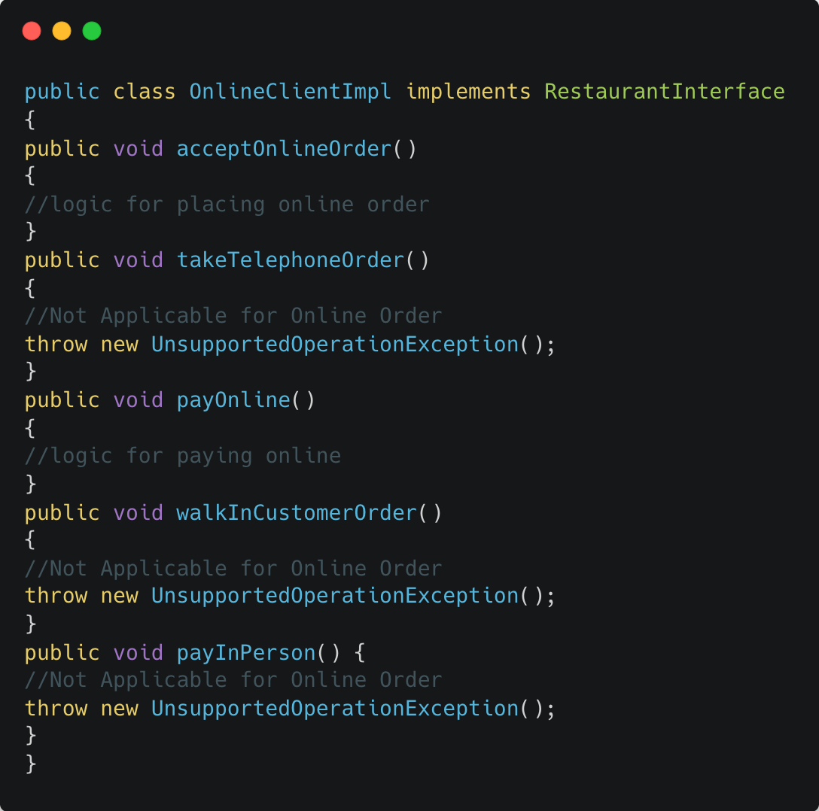
Interface Segregation Principle example
Let us say that there is a Restaurant interface which contains methods for accepting orders from online customers, dial-in or telephone customers and walk-in customers. It also contains methods for handling online payments (for online customers) and in-person payments (for walk-in customers as well as telephone customers when their order is delivered at home).
Notes:
Here the assersion will fail and throw an error

Slide 29
Interface Segregation Principle example
Since the above code(OnlineClientImpl.java) is for online orders, throw UnsupportedOperationException.
Online, telephonic and walk-in clients use the RestaurantInterface implementation specific to each of them.
The implementation classes for Telephonic client and Walk-in client will have unsupported methods.
Since the 5 methods are part of the RestaurantInterface, the implementation classes have to implement all 5 of them.
Any change in any of the methods of the RestaurantInterface will be propagated to all implementation classes. Maintenance of code then starts becoming really cumbersome and regression effects of changes will keep increasing.
RestaurantInterface.java breaks Single Responsibility Principle because the logic for payments as well as that for order placement is grouped together in a single interface.
Notes:
Here the assersion will fail and throw an error

Slide 30
Interface Segregation Principle example
To overcome the above mentioned problems , we apply Interface Segregation Principle to refactor the above design.
Separate out payment and order placement functionalities into two separate lean interfaces,PaymentInterface.java and OrderInterface.java.
Each of the clients use one implementation each of PaymentInterface and OrderInterface. For example – OnlineClient.java uses OnlinePaymentImpl and OnlineOrderImpl and so on.
Single Responsibility Principle is now attached as Payment interface(PaymentInterface.java) and Ordering interface(OrderInterface).
Change in any one of the order or payment interfaces does not affect the other. They are independent now.
Notes:
Here the assersion will fail and throw an error

Slide 31
Interface Segregation Principle example
Picture an ATM, which has a screen where we wish to display different messages. If you want to add a message on the ATM that appears only for withdrawal functionality, how would you solve it?
Perhaps you would add a method to the Messenger interface and be done with it. But this causes you to recompile all the users of this interface and almost all the system needs to be redeployed, which is in direct violation of OCP.
What happened here was that changing the withdrawal functionality caused changes to other totally unrelated functionalities as well, which is something we now know we don't want. How did this happen?
Actually, there is backwards dependency at play, where each functionality that uses this Messengers interface depends on methods it does not need but are needed by other functionalities. Here is what we want to avoid:
Notes:
Here the assersion will fail and throw an error

Slide 32
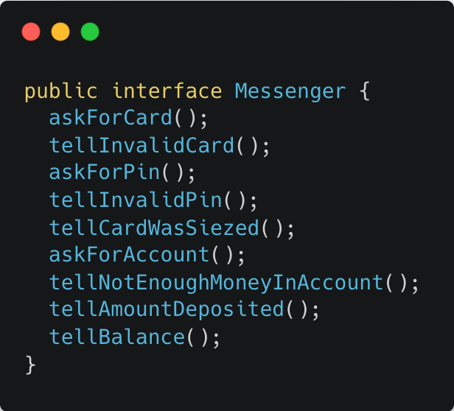
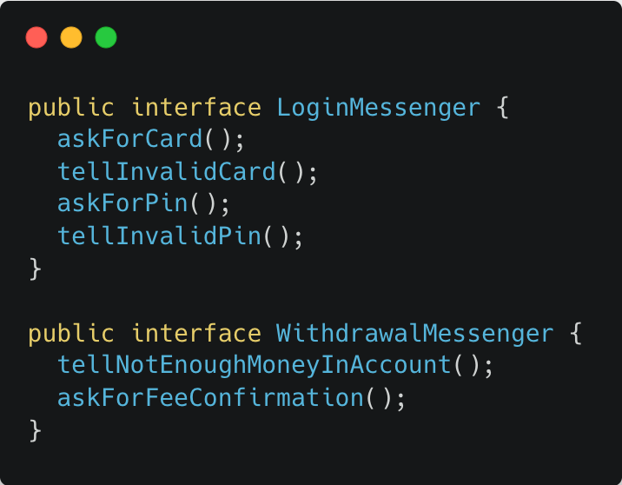
Interface Segregation Principle example
Notes:
Here the assersion will fail and throw an error

Slide 33
Dependency Inversion Principle
Robert C. Martin describes it as it depends on abstractions not on concretions.According to it, the high-level module must never rely on any low-level module . for example
You go to a local store to buy something, and you decide to pay for it by using your debit card. So, when you give your card to the clerk for making the payment, the clerk doesn’t bother to check what kind of card you have given.
Even if you have given a Visa card, he will not put out a Visa machine for swiping your card. The type of credit card or debit card that you have for paying does not even matter; they will simply swipe it. So, in this example, you can see that both you and the clerk are dependent on the credit card abstraction and you are not worried about the specifics of the card. This is what a dependency inversion principle is.
Notes:
Here the assersion will fail and throw an error

Slide 34
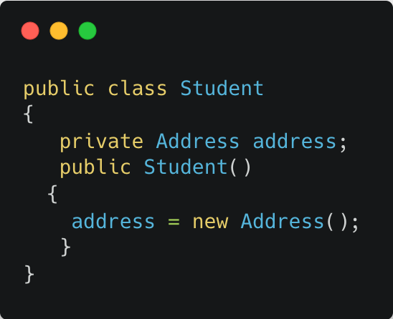
Dependency Inversion Principle
Why is that this principle is required?
It allows a programmer to remove hardcoded dependencies so that the application becomes loosely coupled and extendable.
In the above example, Student class requires an Address object and it is responsible for initializing and using the Address object. If Address class is changed in future then we have to make changes in Student class also. This makes the tight coupling between Student and Address objects. We can resolve this problem using the dependency inversion design pattern. i.e. Address object will be implemented independently and will be provided to Student when Student is instantiated by using constructor-based or setter-based dependency inversion.
Notes:
Here the assersion will fail and throw an error

Slide 35
If we don’t follow SOLID Principles
End up with tight or strong coupling of the code with many other modules/applications
Tight coupling causes time to implement any new requirement, features or any bug fixes and some times it creates unknown issues
End up with a code which is not testable
End up with duplication of code
End up creating new bugs by fixing another bug
End up with many unknown issues in the application development cycle
Notes:
Here the assersion will fail and throw an error

Slide 36
Following SOLID Principles helps us to
Achieve reduction in complexity of code
Increase readability, extensibility and maintenance
Reduce error and implement Reusability
Achieve Better testability
Reduce tight coupling
Notes:
Here the assersion will fail and throw an error

