Slide 1


Final Year Project Work Final Defense On
BET ON BETTER
Presented by:
Raju Tamang (20394/075)
Rohit Pela (20397/075)
Suraj Thapa (20412/075)
B.Sc. CSIT VII (Batch 2075)
May 2023
BET ON BETTER

Slide 2
BET ON BETTER

Slide 3
BET ON BETTER
PRESENTATION OUTLINE
ABOUT PROJECT
1ST
BRIEFING ABOUT THE PROJECT REGARDING ITS OBJECTIVES, SCOPE AND LIMITATIONS
SYSTEM ANALYSIS
FUNCTIONAL REQUIREMENTS, DATA MODELING TECHNIQUE AND PROCESS MODELING
2ND
SYSTEM DESIGN
3RD
CLASS DIAGRAM, SEQUENCE DIAGRAM, ACTIVITY DIAGRAM

Slide 4

SYSTEM IMPLEMENTATION
TOOLS USED, MODULES AND TESTING
4TH
CONCLUSION AND FUTURE ENHANCEMENTS
5TH
RESULTS, LIMITATIONS, FUTURE ENHANCEMENTS
APPENDIX
SNAPSHOTS AND SCREENSHOTS OF WORK
6TH

Slide 5
SYSTEM ANALYSIS
USE CASE DIAGRAM, COMPONENT DIAGRAM OF THE PROJECT
4TH
ABOUT THE PROJECT
TIME SCHEDULING
5TH
DETAILS ABOUT THE PLANNING AND SCHEDULING THROUGH GANTT CHART
About Project
Predicts the upcoming storms and floods by analyzing real-time data
Statement of Problem
Our country is prone to such disasters
No such efforts are made by the government
CONCLUSION
OVERALL CONCLUSION ABOUT THE PROJECT
6TH
APPENDIX
7TH
THANK YOU

Slide 6

SYSTEM ANALYSIS
USE CASE DIAGRAM, COMPONENT DIAGRAM OF THE PROJECT
4TH
ABOUT THE PROJECT
TIME SCHEDULING
5TH
DETAILS ABOUT THE PLANNING AND SCHEDULING THROUGH GANTT CHART
Objectives
To develop a system that predicts possible natural disasters like floods and storms
Scope and limitations:
Scope: -System is scalable and flexible to changes
Limitations: -Its reliability on the availability and accuracy of data
CONCLUSION
OVERALL CONCLUSION ABOUT THE PROJECT
6TH
APPENDIX
7TH
THANK YOU

Slide 7

LITERATURE REVIEW
S.K. Pokharel & S.K. Bhandari (2021)
The paper describes the challenges faced by the country in managing disasters, such as earthquakes, floods, and landslides, and discusses the various technologies and strategies used to mitigate their impact.

Slide 8

LITERATURE REVIEW
K. Sharma & N. Pandey (2020)
The authors describe the design and implementation of the system, which uses modern technologies such as IoT and cloud computing to improve disaster response and reduce the risk of loss of life and property.

Slide 9
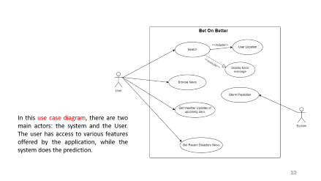
SYSTEM ANALYSIS
USE CASE DIAGRAM

Slide 10
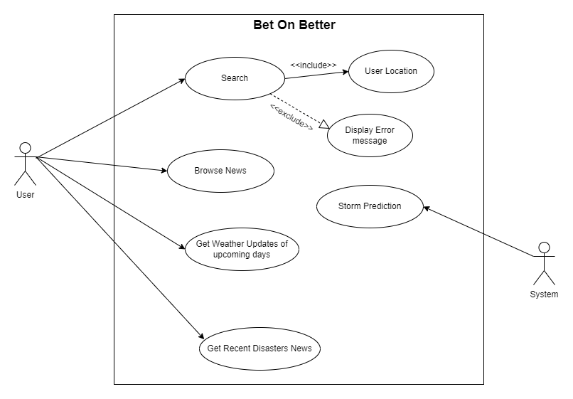

In this use case diagram, there are two main actors: the system and the User. The user has access to various features offered by the application, while the system does the prediction.

Slide 11

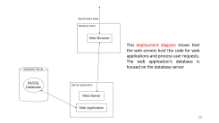
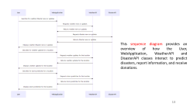
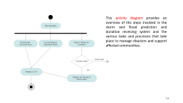
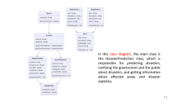
SYSTEM DESIGN
CLASS DIAGRAM
ACTIVITY DIAGRAM
SEQUENCE DIAGRAM
DEPLOYMENT DIAGRAM

Slide 12
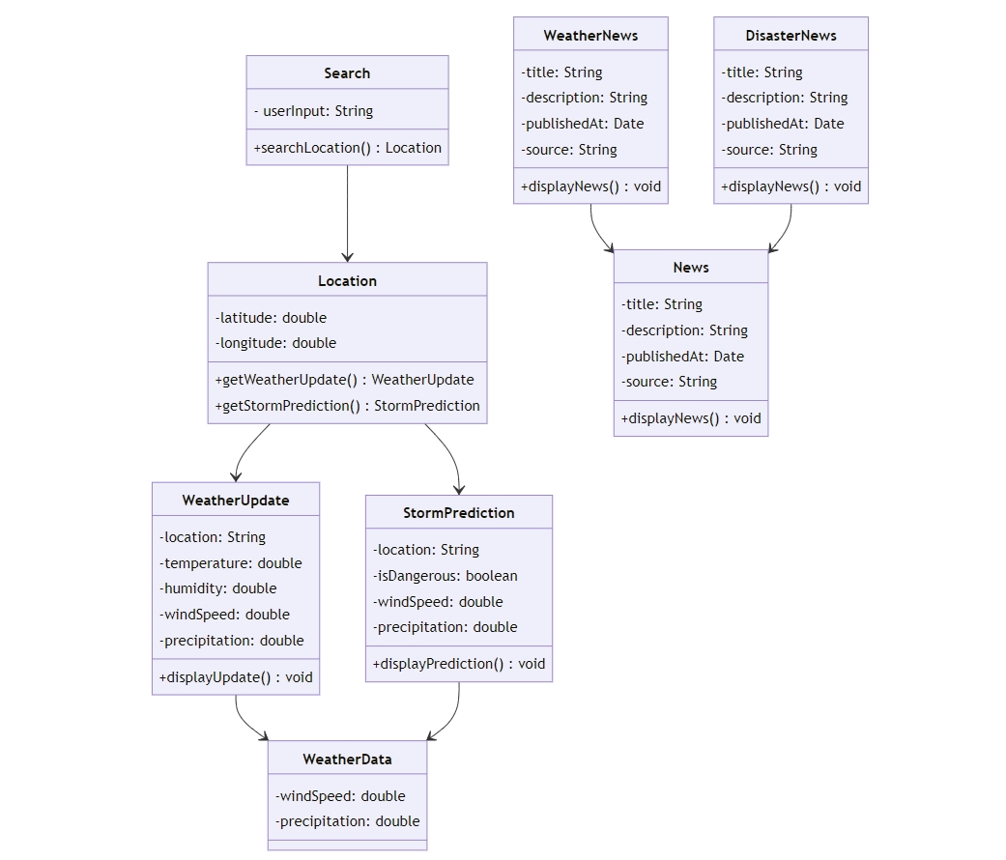
In this class diagram, the main class is the DisasterPrediction class, which is responsible for predicting disasters, notifying the government and the public about disasters, and getting information about affected areas and disaster statistics.

Slide 13
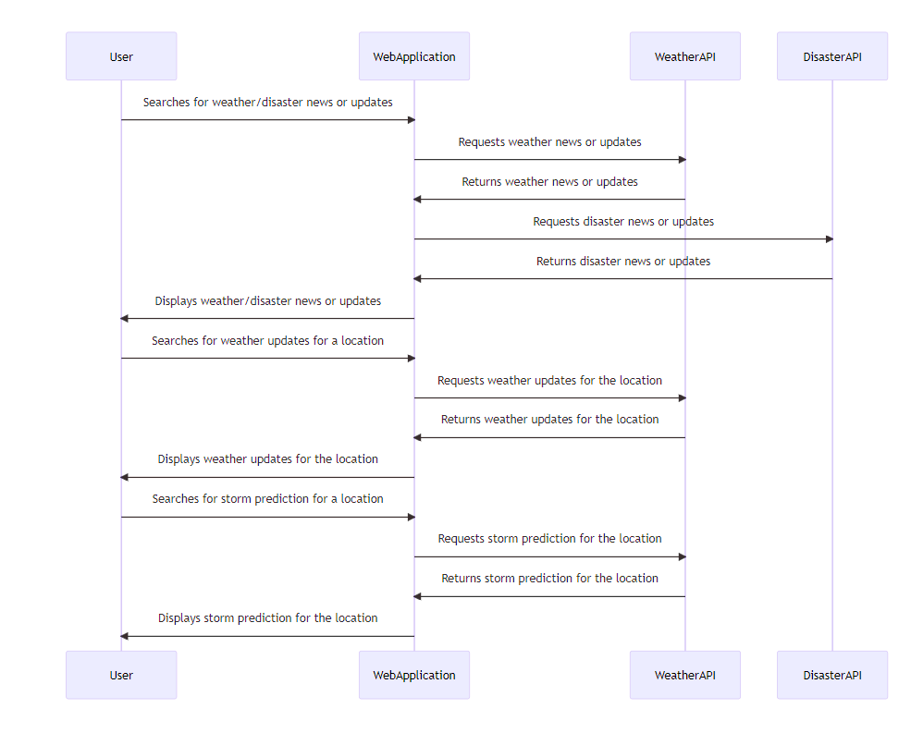
This sequence diagram provides an overview of how the User, WebApplication, WeatherAPI and DisasterAPI classes interact to predict disasters, report information, and receive donations.

Slide 14
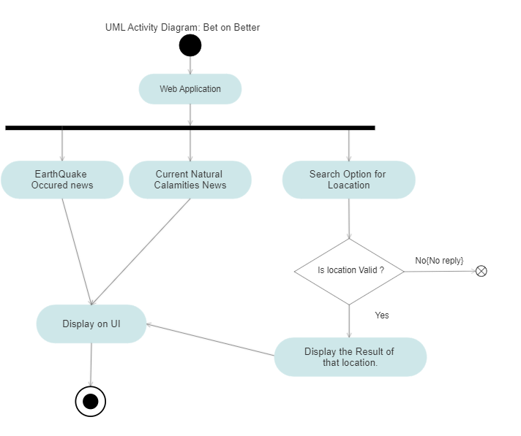
This activity diagram provides an overview of the steps involved in the storm and flood prediction and donation receiving system and the various tasks and processes that take place to manage disasters and support affected communities.

Slide 15
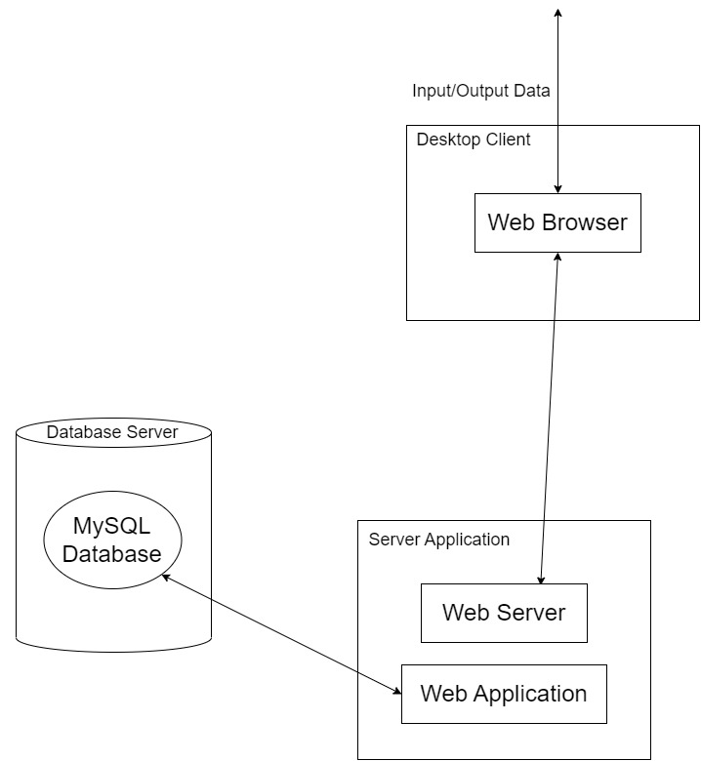

This deployment diagram shows that the web servers host the code for web applications and process user requests. The web application's database is housed on the database server.

Slide 16

SYSTEM IMPLEMENTATION
Tools used
Front End: HTML, CSS, JavaScript
Backend: Python(Flask)

Slide 17
SYSTEM IMPLEMENTATION
Linear Regression Algorithm
Linear regression can be expressed mathematically as:
y= β0+ β 1x+ ε
Here,
• Y= Dependent Variable
• X= Independent Variable
• β 0= intercept of the line
• β1 = Linear regression coefficient (slope of the line)
• ε = random error

Slide 18
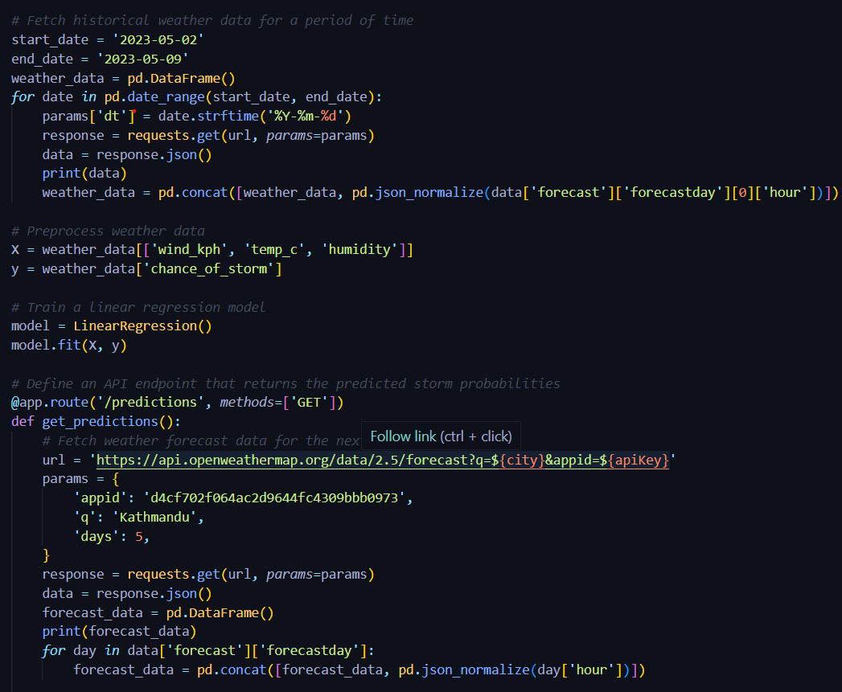
SYSTEM IMPLEMENTATION
Important module
Fetching historical weather data
Preprocessing weather data
Training a linear regression model
Defining an weather API

Slide 19

SYSTEM IMPLEMENTATION
Test Case Description | Test Data | Expected Result | Test Result
Alert data: | "type": "storm", "wind speed": 90, "location": "Nepal" | Valid Alert status | Valid Alert status was found
Alert rules: | "type": "storm", "wind speed":">80" | Valid Alert status | Valid Alert status was found
Alert metadata: | "source": "Nepal Meteorological Department", "timestamp": "2023-05-06T13:00:00Z" | Valid Alert status | Valid Alert status was found
Unit Testing
Unit testing is an important aspect of software development that ensures individual units or components of the software are functioning correctly. Here are some examples of unit tests for our system:
Test Case for Valid Alert Status

Slide 20
SYSTEM IMPLEMENTATION
Test Case Description | Test Data | Expected Result | Test Result
Alert data: | "type": "storm", "severity": "High", "location": "Nepal" | Display the information about the chances of storm or not. | Display the result.
Alert rules: | "type": "storm", "severity": ">Medium" | Display the information about the chances of storm or not. | Display the result
Alert metadata: | "source": "Nepal Meteorological Department", "timestamp": "2023-05-06T16:30:00Z"
Integration Testing
Fetching historical weather data
Preprocessing weather data
Training a linear regression model
Defining an weather API
Test Case for Alert validation and Notification Integration System

Slide 21
CONCLUSION AND FINAL ENHANCEMENTS
Final Outcome
A system that is able to make prediction of the upcoming natural disasters such as floods and storms.
Limitations
The system has limited feature set of predicting storms only.

Slide 22


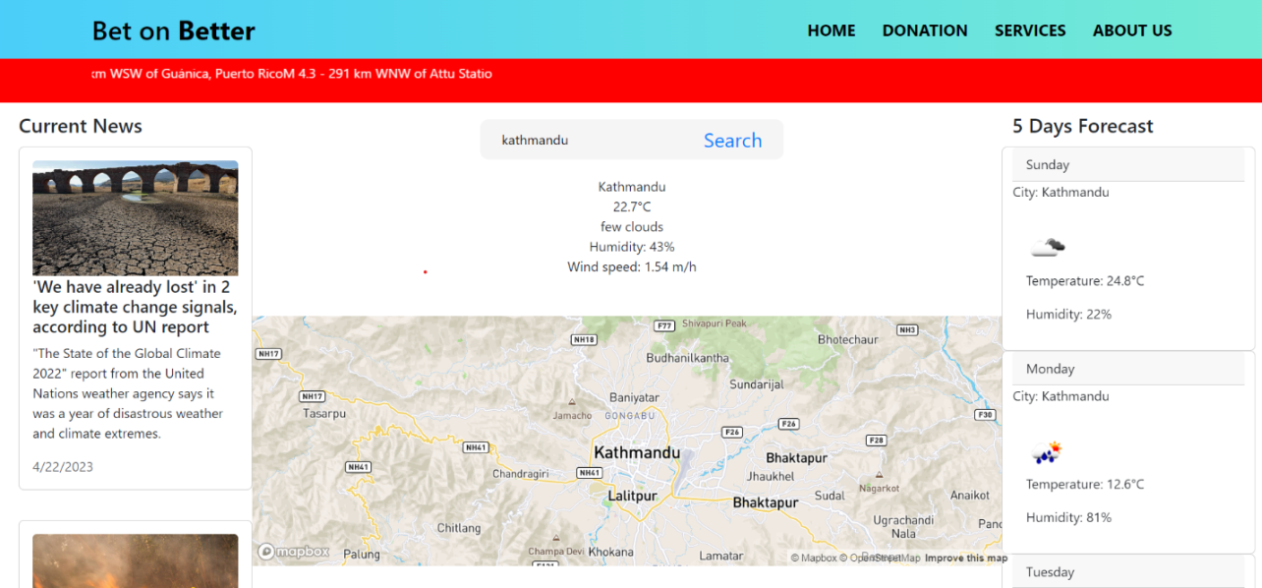
APPENDIX
Figure: UI of Homepage
Figure: UI of Info Page

Slide 23

THANK YOU!
ANY QUERY?

