Slide 1


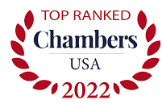
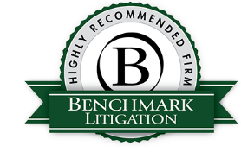
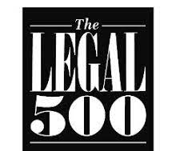


contact: Karen King kking@maglaw.com
Telegram: @Karen_R_King
“The first port of call for many corporations and individuals for their most high profile litigation matters.” – Chambers & Partners USA
“They are the best at what they do. And that word has gotten around well beyond New York.” - Benchmark Litigation
The Morvillo firm is highly regarded as an elite litigation boutique, known for unparalleled trial experience, smart lawyering, and effective strategies. We are at the forefront of advising companies and individuals on criminal, regulatory, and commercial disputes.
Our lawyers practice in federal and state courts across the U.S., with experience in all phases of criminal and civil proceedings. Most of our partners are former government prosecutors and chiefs of their units. In addition to handling high profile white-collar cases, complex civil trials, and arbitrations, we also handle sensitive internal investigations, serve as independent counsel for boards of directors, and help clients deal with government and regulatory investigations.
Our presence in a case signals that our client is not afraid to take the case to trial, and will litigate aggressively. We are resolutely forward-looking in assessing options and managing risks. We also place a premium on responsiveness and efficiency. Our size and expertise provide flexibility to best serve our clients’ needs.
www.maglaw.com
Band 1 in White-Collar Crime & Government Investigations (2003-present )
Tier 1 in White-Collar Crime/Enforcement/ Investigations (2008-present); “Firm of the Year” in 2015
Tier 1 in Corporate Investigations & White Collar Defense, Advice to Individuals (2008-present)
Tier 1 in Criminal Defense: White-Collar (National), Commercial and Bet-the-Company Litigation (NYC) (2014-present)
Global Investigations Review: Selected for GIR 100 (2015-present)

