Slide 1
Enhanced Object Detection Using HDR
ECE532 Digital Systems Design, Group 6

Slide 2
Background
Cameras have limited dynamic range
HDR combines multiple images into one image with range similar to human eye
Brings out details in very dark/bright areas
Can be used to detect objects against similar backgrounds

Slide 3
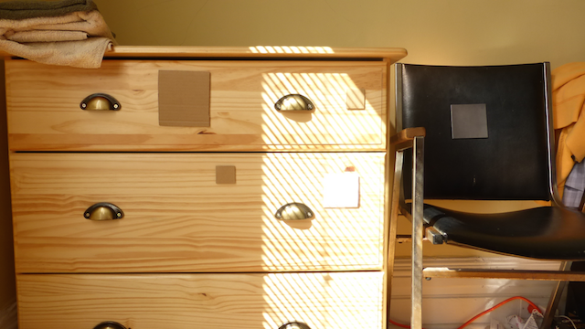
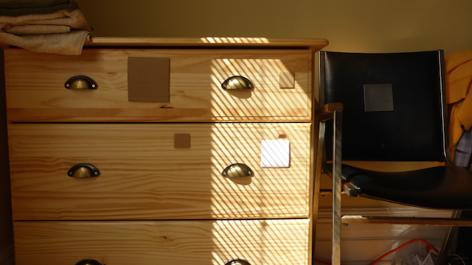
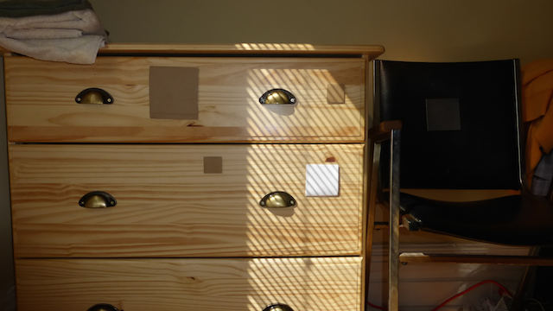
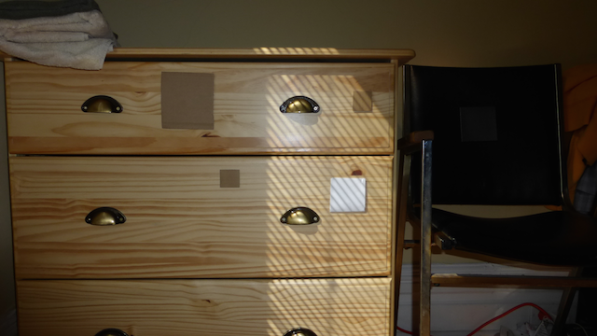
1. Original images

Slide 4
2. Camera response function
CRF calculated from 3 sets of images at 8 exposures each

Slide 5
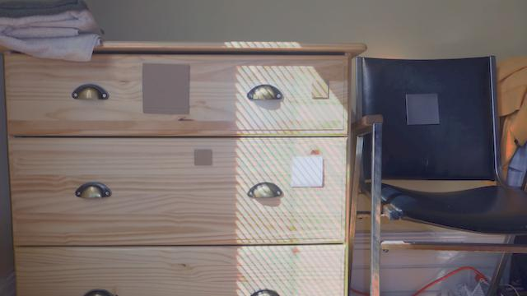
3. Tone-mapped HDR composite

Slide 6
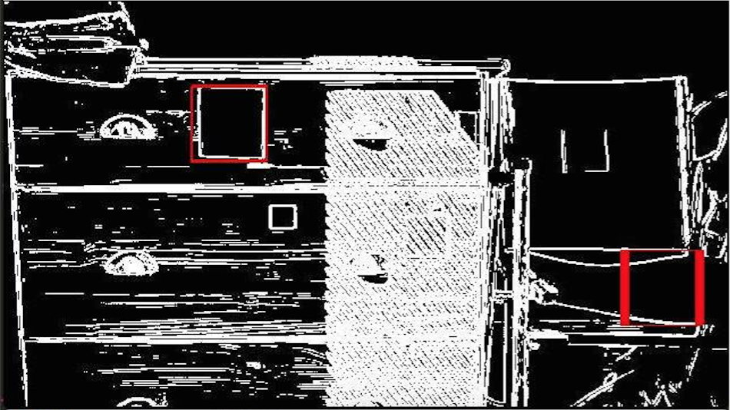
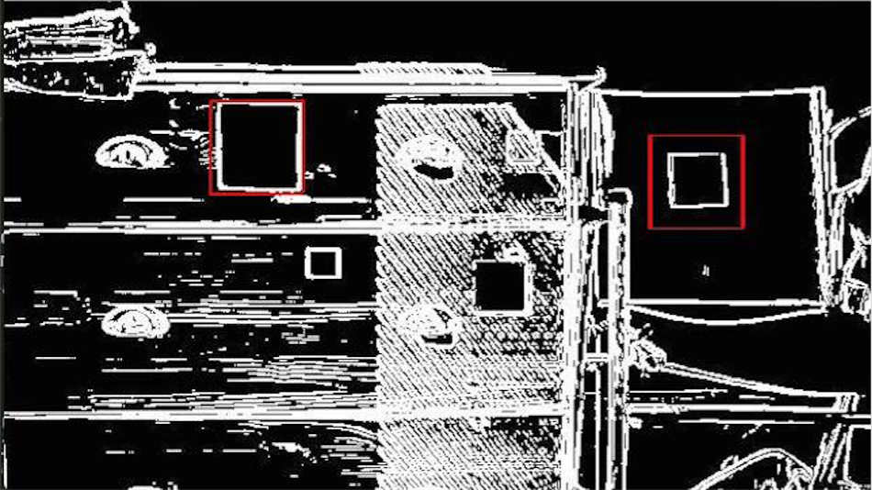
4. Square detection
Square detection on original 1/125 exposure image
Square detection on HDR image

Slide 7
System Overview
Transfer from SDCard to DDR
Stream one row from each image
Combine into one row of HDR image
Gamma compression
Convert to greyscale (YCbCr)
Edge detection on greyscale image
Convert to RGB
Stream into frame buffer
Display on VGA monitor

Slide 8
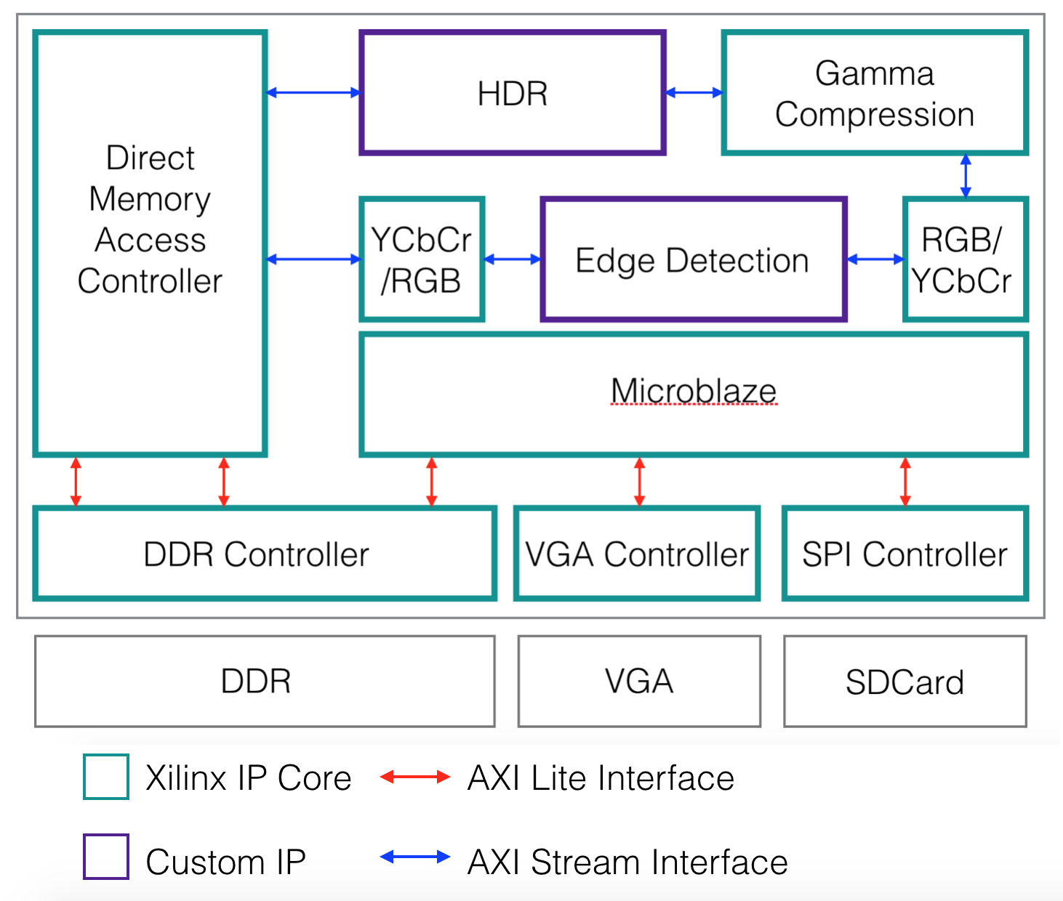
System Overview

Slide 9
Design Process
Software
Matlab/Python
Hardware
Behavioural simulation
Integration
Integrate one component at a time
Initialization values
Calibration
Post-synthesis simulation
Calibration

Slide 10
Challenges
RGB888 processing -> RGB444 VGA display
Rounding errors
SDCard to DDR speed
Interfacing with DMA & SPI
Unstable camera

