Slide 1
Chapter 11: Indexing and Hashing

Slide 2
Chapter 12: Indexing and Hashing
Basic Concepts
Ordered Indices
B⁺-Tree Index Files
B-Tree Index Files -- skipping
Static Hashing
Dynamic Hashing -- skipping
Comparison of Ordered Indexing and Hashing
Index Definition in SQL
Multiple-Key Access

Slide 3
Basic Concepts
Indexing mechanisms used to speed up access to desired data.
  E.g., author catalog in library
Search Key - attribute to set of attributes used to look up records in a file.
An index file consists of records (called index entries) of the form
Index files are typically much smaller than the original file
Two basic kinds of indices:
  Ordered indices: search keys are stored in sorted order
  Hash indices: search keys are distributed uniformly across “buckets” using a “hash function”.
search-key
pointer

Slide 4
Index Evaluation Metrics
Access types supported efficiently. E.g.,
  records with a specified value in the attribute
  or records with an attribute value falling in a specified range of values.
Access time
Insertion time
Deletion time
Space overhead

Slide 5
Ordered Indices
In an ordered index, index entries are stored sorted on the search key value. E.g., author catalog in library.
Primary index: in a sequentially ordered file, the index whose search key specifies the sequential order of the file.
  Also called clustering index
  The search key of a primary index is usually but not necessarily the primary key.
Secondary index: an index whose search key specifies an order different from the sequential order of the file. Also called
non-clustering index.
Index-sequential file: ordered sequential file with a primary index.

Slide 6
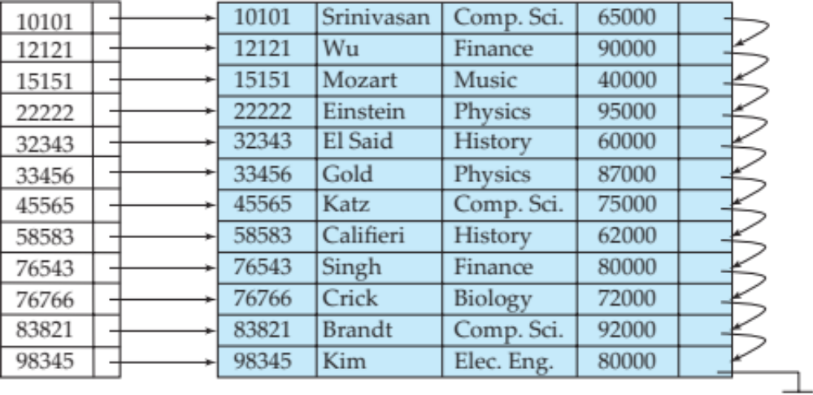
Dense Index Files
Dense index — Index record appears for every search-key value in the file.
E.g. index on ID attribute of instructor relation

Slide 7
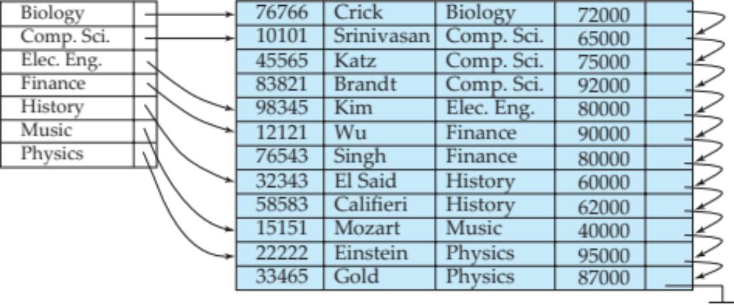
Dense Index Files (Cont.)
Dense index on dept_name, with instructor file sorted on dept_name

Slide 8
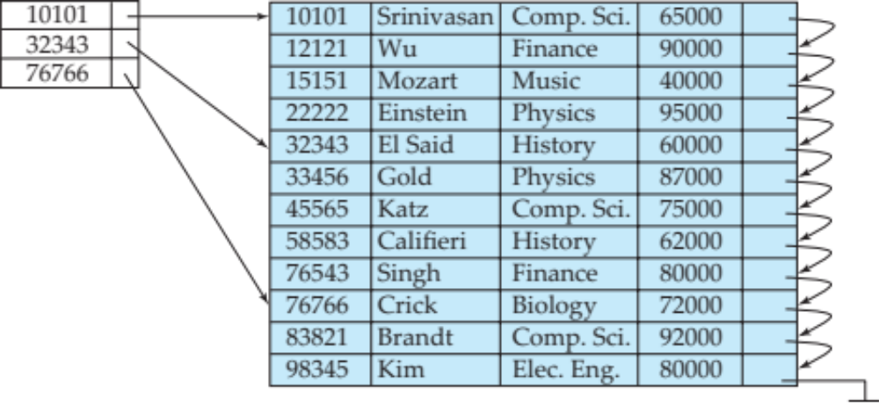
Sparse Index Files
Sparse Index: contains index records for only some search-key values.
  Applicable when records are sequentially ordered on search-key
To locate a record with search-key value K we:
  Find index record with largest search-key value < K
  Search file sequentially starting at the record to which the index record points

Slide 9
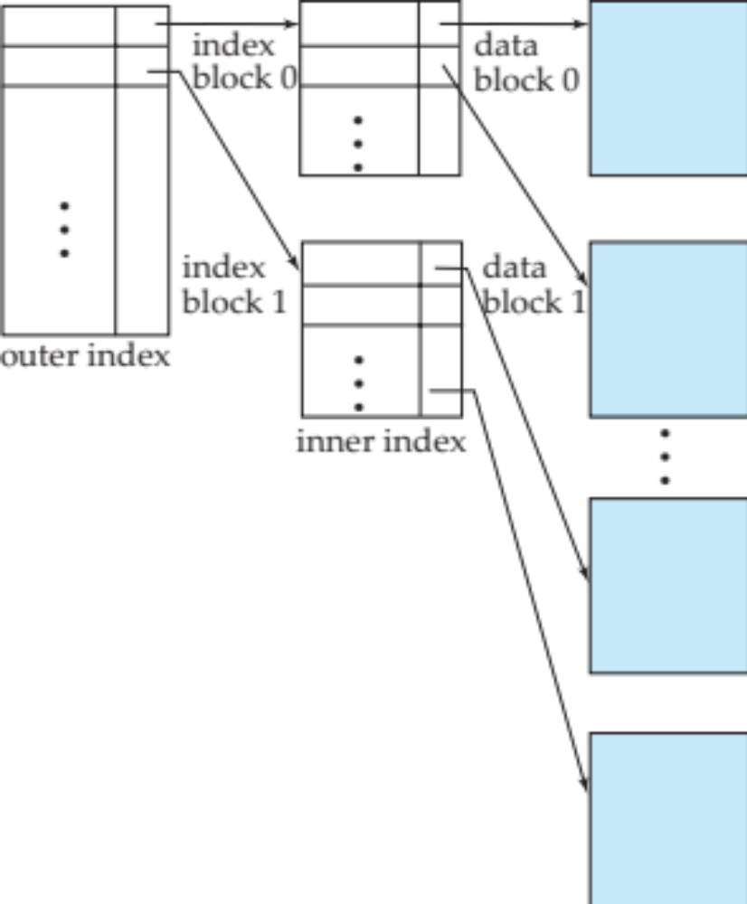
Sparse Index Files (Cont.)
Compared to dense indices:
  Less space and less maintenance overhead for insertions and deletions.
  Generally slower than dense index for locating records.
Good tradeoff: sparse index with an index entry for every block in file, corresponding to least search-key value in the block.

Slide 10
Multilevel Index
If primary index does not fit in memory, access becomes expensive.
Solution: treat primary index kept on disk as a sequential file and construct a sparse index on it.
  outer index – a sparse index of primary index
  inner index – the primary index file
If even outer index is too large to fit in main memory, yet another level of index can be created, and so on.
Indices at all levels must be updated on insertion or deletion from the file.

Slide 11
Multilevel Index (Cont.)

Slide 12
Index Update: Deletion
If deleted record was the only record in the file with its particular search-key value, the search-key is deleted from the index also.
Single-level index entry deletion:
  Dense indices – deletion of search-key is similar to file record deletion.
  Sparse indices –
    if an entry for the search key exists in the index, it is deleted by replacing the entry in the index with the next search-key value in the file (in search-key order).
    If the next search-key value already has an index entry, the entry is deleted instead of being replaced.

Slide 13
Index Update: Insertion
Single-level index insertion:
  Perform a lookup using the search-key value appearing in the record to be inserted.
  Dense indices – if the search-key value does not appear in the index, insert it.
  Sparse indices – if index stores an entry for each block of the file, no change needs to be made to the index unless a new block is created.
    If a new block is created, the first search-key value appearing in the new block is inserted into the index.
Multilevel insertion and deletion: algorithms are simple extensions of the single-level algorithms

Slide 14
Secondary Indices
Frequently, one wants to find all the records whose values in a certain field (which is not the search-key of the primary index) satisfy some condition.
  Example 1: In the instructor relation stored sequentially by ID, we may want to find all instructors in a particular department
  Example 2: as above, but where we want to find all instructors with a specified salary or with salary in a specified range of values
We can have a secondary index with an index record for each search-key value

Slide 15

Secondary Indices Example
Secondary index on salary field of instructor
Index record points to a bucket that contains pointers to all the actual records with that particular search-key value.
Secondary indices have to be dense

Slide 16
Primary and Secondary Indices
Indices offer substantial benefits when searching for records.
BUT: Updating indices imposes overhead on database modification --when a file is modified, every index on the file must be updated,
Sequential scan using primary index is efficient, but a sequential scan using a secondary index is expensive
  Each record access may fetch a new block from disk
  Block fetch requires about 5 to 10 milliseconds, versus about 100 nanoseconds for memory access

Slide 17
B⁺-Tree Index Files
B⁺-tree indices are an alternative to indexed-sequential files.
Disadvantage of indexed-sequential files
  performance degrades as file grows, since many overflow blocks get created.
  Periodic reorganization of entire file is required.
Advantage of B⁺-tree index files:
  automatically reorganizes itself with small, local, changes, in the face of insertions and deletions.
  Reorganization of entire file is not required to maintain performance.
(Minor) disadvantage of B⁺-trees:
  extra insertion and deletion overhead, space overhead.
Advantages of B⁺-trees outweigh disadvantages
  B⁺-trees are used extensively

Slide 18
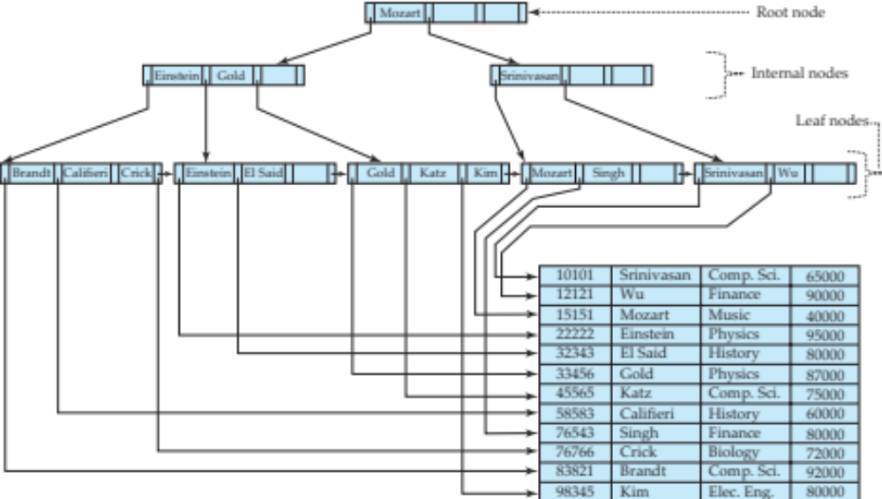
Example of B⁺-Tree

Slide 19
B+ Tree Exercise
Left side of room:
  Give yourself unique numbers: row 1, choose numbers between 10 and 15, … row k between 10*k – 10*k + 5
  Write LEAF and your numbers (in order) on one card per table
  Write DATA, your number, your name, and something about yourself on the other card (one per person)
Right side of room:
  Row 1: 20, 30, 40
  Row 2: 60, 70, 80
  Row 3: ROOT 50
Shuffle and redistribute “node” cards to right side of room.

Slide 20
B⁺-Tree Index Files (Cont.)
A B⁺-tree is a rooted tree satisfying the following properties:
All paths from root to leaf are of the same length
Each node that is not a root or a leaf has between ⎡n/2⎤ and n children.
A leaf node has between ⎡(n–1)/2⎤ and n–1 values
Special cases:
  If the root is not a leaf, it has at least 2 children.
  If the root is a leaf (that is, there are no other nodes in the tree), it can have between 0 and (n–1) values.

Slide 21
B⁺-Tree Node Structure
Typical node
  K_{i} are the search-key values
  P_{i} are pointers to children (for non-leaf nodes) or pointers to records or buckets of records (for leaf nodes).
The search-keys in a node are ordered
K₁ < K₂ < K₃ < . . . < K_{n–1}
(Initially assume no duplicate keys, address duplicates later)

Slide 22
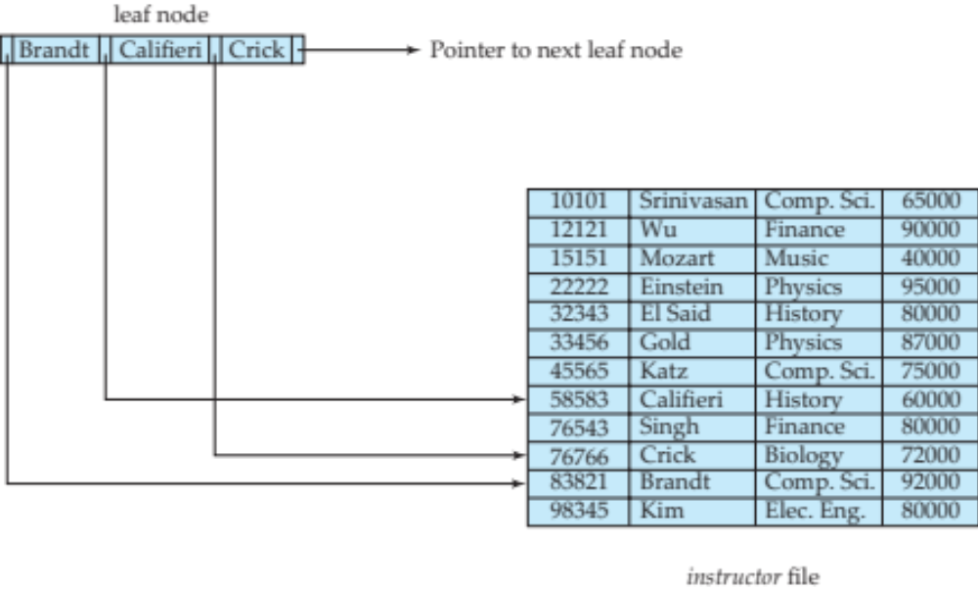
Leaf Nodes in B⁺-Trees
Properties of a leaf node:
For i = 1, 2, . . ., n–1, pointer P_{i} points to a file record with search-key value K_{i},
If L_{i}, L_{j} are leaf nodes and i < j, L_{i}’s search-key values are less than or equal to L_{j}’s search-key values
P_{n} points to next leaf node in search-key order

Slide 23
Non-Leaf Nodes in B⁺-Trees
Non leaf nodes form a multi-level sparse index on the leaf nodes. For a non-leaf node with m pointers:
  All the search-keys in the subtree to which P₁ points are less than K₁
  For 2 ≤ i ≤ n – 1, all the search-keys in the subtree to which P_{i} points have values greater than or equal to K_{i–1} and less than K_{i}
  All the search-keys in the subtree to which P_{n} points have values greater than or equal to K_{n–1}

Slide 24
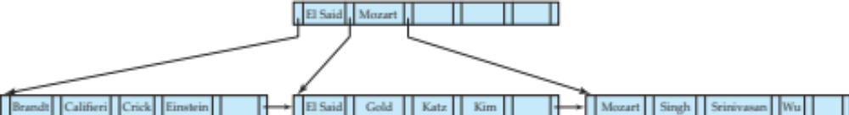
Example of B⁺-tree
B⁺-tree for instructor file (n = 6)
Leaf nodes must have between 3 and 5 values
(⎡(n–1)/2⎤ and n –1, with n = 6).
Non-leaf nodes other than root must have between 3 and 6 children (⎡(n/2⎤ and n with n =6).
Root must have at least 2 children.

Slide 25
Observations about B⁺-trees
Since the inter-node connections are done by pointers, “logically” close blocks need not be “physically” close.
The non-leaf levels of the B⁺-tree form a hierarchy of sparse indices.
The B⁺-tree contains a relatively small number of levels
    Level below root has at least 2* ⎡n/2⎤ values
    Next level has at least 2* ⎡n/2⎤ * ⎡n/2⎤ values
    .. etc.
  If there are K search-key values in the file, the tree height is no more than ⎡ log_{⎡n/2⎤}(K)⎤
  thus searches can be conducted efficiently.
Insertions and deletions to the main file can be handled efficiently, as the index can be restructured in logarithmic time (as we shall see).

Slide 26
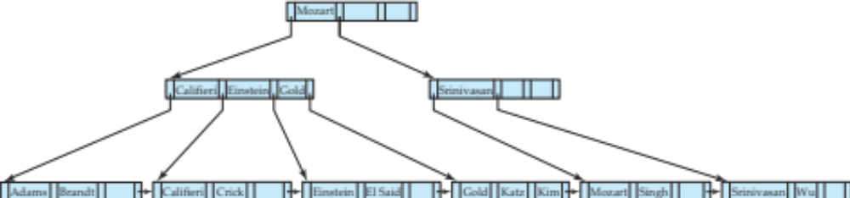
Queries on B⁺-Trees
Find record with search-key value V.
  C=root
  While C is not a leaf node {
    Let i be least value s.t. V ≤ K_{i}.
    If no such exists, set C = last non-null pointer in C
    Else { if (V= K_{i} ) Set C = P_{i +1} else set C = P_{i}}
    }
  Let i be least value s.t. K_{i} = V
  If there is such a value i, follow pointer P_{i} to the desired record.
  Else no record with search-key value k exists.

Slide 27
Handling Duplicates
With duplicate search keys
  In both leaf and internal nodes,
    we cannot guarantee that K₁ < K₂ < K₃ < . . . < K_{n–1}
    but can guarantee K₁ ≤ K₂ ≤ K₃ ≤ . . . ≤ K_{n–1}
  Search-keys in the subtree to which P_{i} points
    are ≤ K_{i,}, but not necessarily < K_{i,}
    To see why, suppose same search key value V is present in two leaf node L_{i} and L_{i+1}. Then in parent node K_{i} must be equal to V

Slide 28
Handling Duplicates
We modify find procedure as follows
  traverse P_{i} even if V = K_{i}
  As soon as we reach a leaf node C check if C has only search key values less than V
    if so set C = right sibling of C before checking whether C contains V
Procedure printAll
  uses modified find procedure to find first occurrence of V
  Traverse through consecutive leaves to find all occurrences of V
** Errata note: modified find procedure missing in first printing of 6th edition

Slide 29
Queries on B⁺⁻Trees (Cont.)
If there are K search-key values in the file, the height of the tree is no more than ⎡log_{⎡n/2⎤}(K)⎤.
A node is generally the same size as a disk block, typically 4 kilobytes
  and n is typically around 100 (40 bytes per index entry).
With 1 million search key values and n = 100
  at most log₅₀(1,000,000) = 4 nodes are accessed in a lookup.
Contrast this with a balanced binary tree with 1 million search key values — around 20 nodes are accessed in a lookup
  above difference is significant since every node access may need a disk I/O, costing around 20 milliseconds

Slide 30
Updates on B⁺-Trees: Insertion
Find the leaf node in which the search-key value would appear
If the search-key value is already present in the leaf node
  Add record to the file
  If necessary add a pointer to the bucket.
If the search-key value is not present, then
  add the record to the main file (and create a bucket if necessary)
  If there is room in the leaf node, insert (key-value, pointer) pair in the leaf node
  Otherwise, split the node (along with the new (key-value, pointer) entry) as discussed in the next slide.

Slide 31
Updates on B⁺-Trees: Insertion (Cont.)
Splitting a leaf node:
  take the n (search-key value, pointer) pairs (including the one being inserted) in sorted order. Place the first ⎡n/2⎤ in the original node, and the rest in a new node.
  let the new node be p, and let k be the least key value in p. Insert (k,p) in the parent of the node being split.
  If the parent is full, split it and propagate the split further up.
Splitting of nodes proceeds upwards till a node that is not full is found.
  In the worst case the root node may be split increasing the height of the tree by 1.
Result of splitting node containing Brandt, Califieri and Crick on inserting Adams
Next step: insert entry with (Califieri,pointer-to-new-node) into parent

Slide 32
B⁺-Tree Insertion
B⁺-Tree before and after insertion of “Adams”

Slide 33
Insertion in B⁺-Trees (Cont.)
Splitting a non-leaf node: when inserting (k,p) into an already full internal node N
  Copy N to an in-memory area M with space for n+1 pointers and n keys
  Insert (k,p) into M
  Copy P₁,K₁, …, K _{⎡n/2⎤-1},P _{⎡n/2⎤} from M back into node N
  Copy P_{⎡n/2⎤+1},K _{⎡n/2⎤+1},…,K_{n},P_{n+1} from M into newly allocated node N’
  Insert (K _{⎡n/2⎤},N’) into parent N
Read pseudocode in book!
Califieri
Adams Brandt Califieri Crick
Adams Brandt
Crick

Slide 34
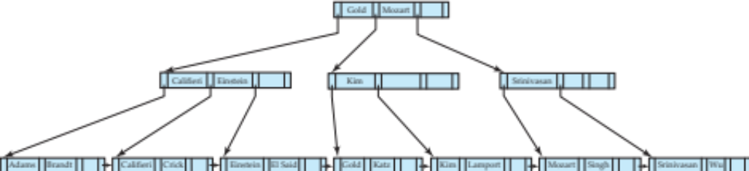
B⁺-Tree Insertion
B⁺-Tree before and after insertion of “Lamport”

Slide 35
Updates on B⁺-Trees: Deletion
Find the record to be deleted, and remove it from the main file and from the bucket (if present)
Remove (search-key value, pointer) from the leaf node if there is no bucket or if the bucket has become empty
If the node has too few entries due to the removal, and the entries in the node and a sibling fit into a single node, then merge siblings:
  Insert all the search-key values in the two nodes into a single node (the one on the left), and delete the other node.
  Delete the pair (K_{i–1}, P_{i}), where P_{i} is the pointer to the deleted node, from its parent, recursively using the above procedure.

Slide 36
Updates on B⁺-Trees: Deletion
Otherwise, if the node has too few entries due to the removal, but the entries in the node and a sibling do not fit into a single node, then redistribute pointers:
  Redistribute the pointers between the node and a sibling such that both have more than the minimum number of entries.
  Update the corresponding search-key value in the parent of the node.
The node deletions may cascade upwards till a node which has ⎡n/2⎤ or more pointers is found.
If the root node has only one pointer after deletion, it is deleted and the sole child becomes the root.

Slide 37
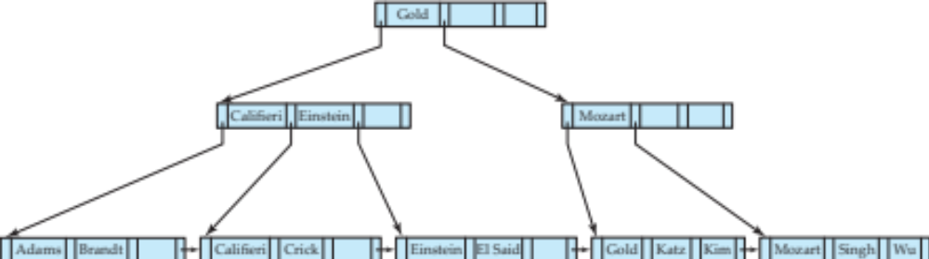
Examples of B⁺-Tree Deletion
Before and after deleting “Srinivasan”
Deleting “Srinivasan” causes merging of under-full leaves, then redistribution of pointers of internal nodes.

Slide 38
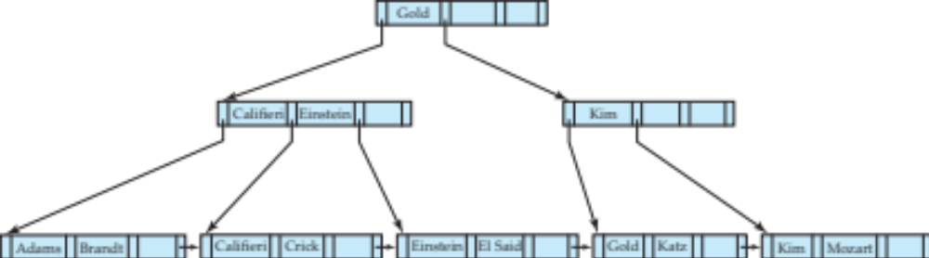
Examples of B⁺-Tree Deletion (Cont.)
Deletion of “Singh” and “Wu” from result of previous example
Leaf containing Singh and Wu became underfull, and borrowed a value Kim from its left sibling
Search-key value in the parent changes as a result

Slide 39
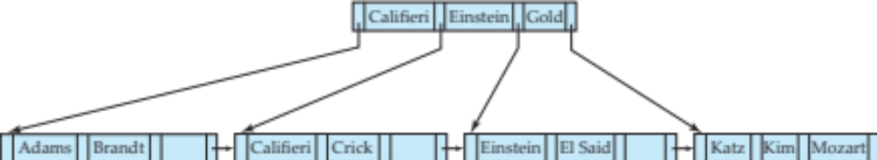
Example of B⁺-tree Deletion (Cont.)
Before and after deletion of “Gold” from earlier example
Node with Gold and Katz became underfull, and was merged with its sibling
Parent node becomes underfull, and is merged with its sibling
  Value separating two nodes (at the parent) is pulled down when merging
Root node then has only one child, and is deleted

Slide 40
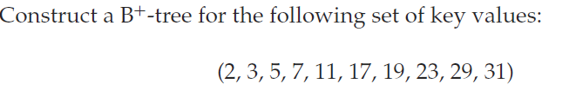
Practice B+ Tree
n = 4

Slide 41
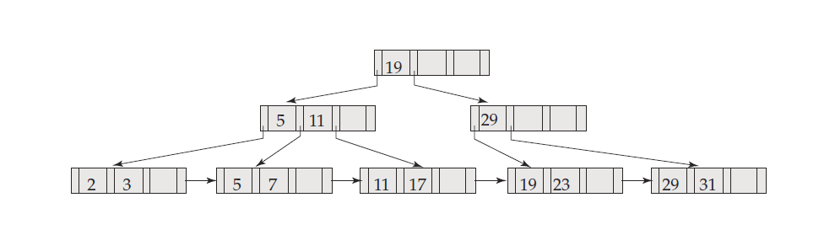
Practice B+ Tree
n = 4

Slide 42
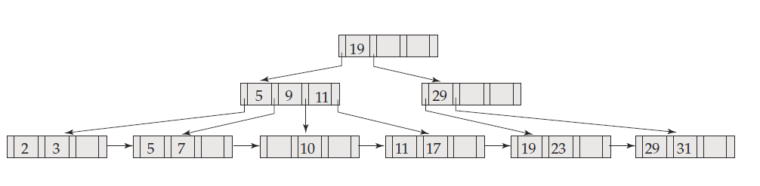
Practice B+ Tree
After Inserting 9, 10, 8
8
9

Slide 43
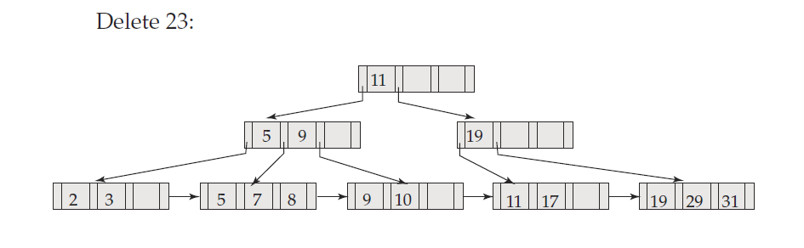
Practice B+ Tree
8
9

Slide 44
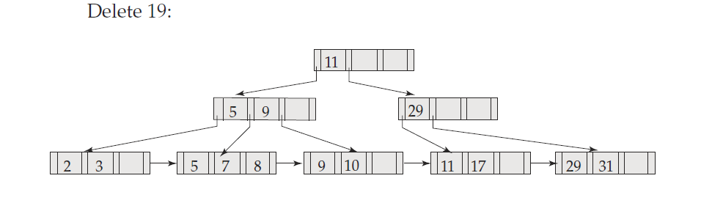
Practice B+ Tree

Slide 45
B⁺-Tree File Organization
Index file degradation problem is solved by using B⁺-Tree indices.
Data file degradation problem is solved by using B⁺-Tree File Organization.
The leaf nodes in a B⁺-tree file organization store records, instead of pointers.
Leaf nodes are still required to be half full
  Since records are larger than pointers, the maximum number of records that can be stored in a leaf node is less than the number of pointers in a nonleaf node.
Insertion and deletion are handled in the same way as insertion and deletion of entries in a B⁺-tree index.

Slide 46
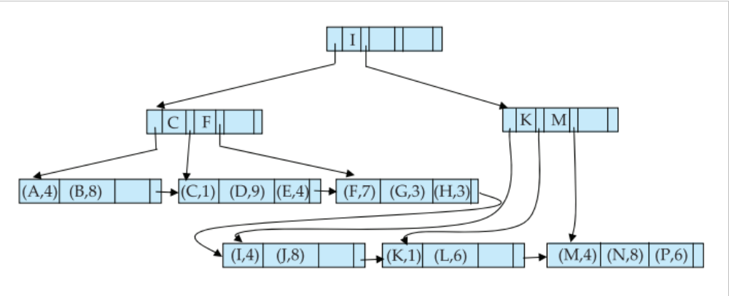

B⁺-Tree File Organization (Cont.)
Example of B⁺-tree File Organization
Good space utilization important since records use more space than pointers.
To improve space utilization, involve more sibling nodes in redistribution during splits and merges
  Involving 2 siblings in redistribution (to avoid split / merge where possible) results in each node having at least entries

Slide 47
Other Issues in Indexing
Record relocation and secondary indices
  If a record moves, all secondary indices that store record pointers have to be updated
  Node splits in B⁺-tree file organizations become very expensive
  Solution: use primary-index search key instead of record pointer in secondary index
    Extra traversal of primary index to locate record
      Higher cost for queries, but node splits are cheap
    Add record-id if primary-index search key is non-unique

Slide 48
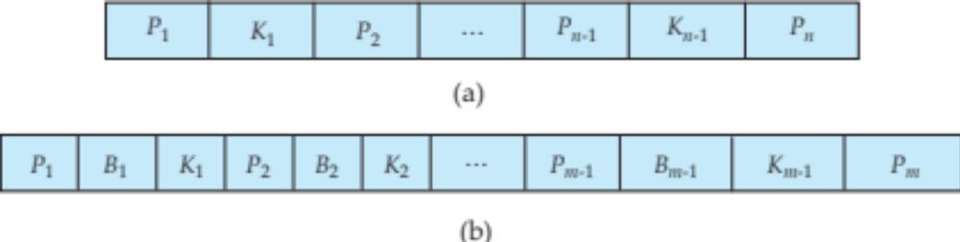
B-Tree Index Files
Similar to B+-tree, but B-tree allows search-key values to appear only once; eliminates redundant storage of search keys.
Search keys in nonleaf nodes appear nowhere else in the B-tree; an additional pointer field for each search key in a nonleaf node must be included.
Generalized B-tree leaf node
Nonleaf node – pointers Bi are the bucket or file record pointers.

Slide 49
Multiple-Key Access
Use multiple indices for certain types of queries.
Example:
  select ID
  from instructor
  where dept_name = “Finance” and salary = 80000
Possible strategies for processing query using indices on single attributes:
  1. Use index on dept_name to find instructors with department name Finance; test salary = 80000
  2. Use index on salary to find instructors with a salary of $80000; test dept_name = “Finance”.
  3. Use dept_name index to find pointers to all records pertaining to the “Finance” department. Similarly use index on salary. Take intersection of both sets of pointers obtained.

Slide 50
Indices on Multiple Keys
Composite search keys are search keys containing more than one attribute
  E.g. (dept_name, salary)
Lexicographic ordering: (a₁, a₂) < (b₁, b₂) if either
  a₁ < b₁, or
  a₁=b₁ and a₂ < b₂

Slide 51
Indices on Multiple Attributes
Suppose we have an index on combined search-key
(dept_name, salary).
With the where clause
where dept_name = “Finance” and salary = 80000
the index on (dept_name, salary) can be used to fetch only records that satisfy both conditions.
  Using separate indices in less efficient — we may fetch many records (or pointers) that satisfy only one of the conditions.
Can also efficiently handle
where dept_name = “Finance” and salary < 80000
But cannot efficiently handle
where dept_name < “Finance” and balance = 80000
  May fetch many records that satisfy the first but not the second condition

Slide 52
Other Features
Covering indices
  Add extra attributes to index so (some) queries can avoid fetching the actual records
    Particularly useful for secondary indices
      Why?
  Can store extra attributes only at leaf

Slide 53
Hashing

Slide 54
Static Hashing
A bucket is a unit of storage containing one or more records (a bucket is typically a disk block).
In a hash file organization we obtain the bucket of a record directly from its search-key value using a hash function.
Hash function h is a function from the set of all search-key values K to the set of all bucket addresses B.
Hash function is used to locate records for access, insertion as well as deletion.
Records with different search-key values may be mapped to the same bucket; thus entire bucket has to be searched sequentially to locate a record.

Slide 55
Example of Hash File Organization
Hash file organization of instructor file, using dept_name as key
(See figure in next slide.)
There are 8 buckets,
The binary representation of the ith character is assumed to be the integer i.
The hash function returns the sum of the binary representations of the characters modulo 8
  E.g. h(Music) = 1 h(History) = 2
  h(Physics) = 3 h(Elec. Eng.) = 3

Slide 56

Example of Hash File Organization
Hash file organization of instructor file, using dept_name as key (see previous slide for details).

Slide 57
Hash Functions
Worst hash function maps all search-key values to the same bucket; this makes access time proportional to the number of search-key values in the file.
An ideal hash function is uniform, i.e., each bucket is assigned the same number of search-key values from the set of all possible values.
Ideal hash function is random, so each bucket will have the same number of records assigned to it irrespective of the actual distribution of search-key values in the file.
Typical hash functions perform computation on the internal binary representation of the search-key.
  For example, for a string search-key, the binary representations of all the characters in the string could be added and the sum modulo the number of buckets could be returned. .

Slide 58
Handling of Bucket Overflows
Bucket overflow can occur because of
  Insufficient buckets
  Skew in distribution of records. This can occur due to two reasons:
    multiple records have same search-key value
    chosen hash function produces non-uniform distribution of key values
Although the probability of bucket overflow can be reduced, it cannot be eliminated; it is handled by using overflow buckets.

Slide 59
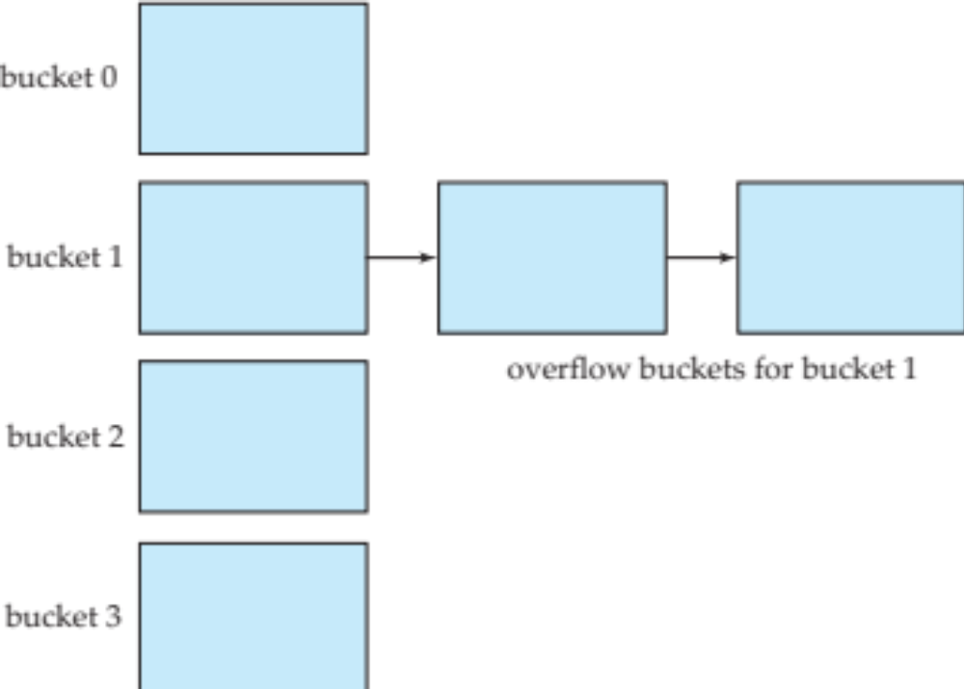
Handling of Bucket Overflows (Cont.)
Overflow chaining – the overflow buckets of a given bucket are chained together in a linked list.
Above scheme is called closed hashing.
  An alternative, called open hashing, which does not use overflow buckets, is not suitable for database applications.

Slide 60
Hash Indices
Hashing can be used not only for file organization, but also for index-structure creation.
A hash index organizes the search keys, with their associated record pointers, into a hash file structure.
Strictly speaking, hash indices are always secondary indices
  if the file itself is organized using hashing, a separate primary hash index on it using the same search-key is unnecessary.
  However, we use the term hash index to refer to both secondary index structures and hash organized files.

Slide 61
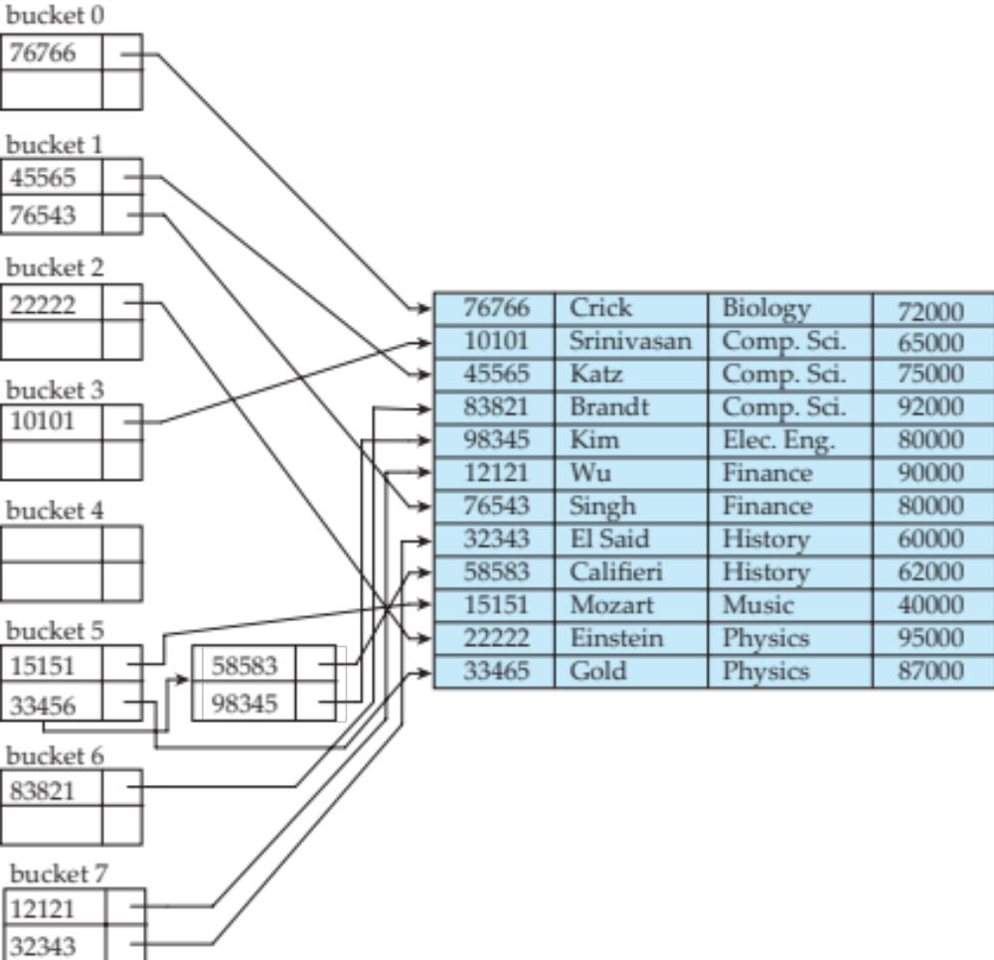
Example of Hash Index
hash index on instructor, on attribute ID

Slide 62
Deficiencies of Static Hashing
In static hashing, function h maps search-key values to a fixed set of B of bucket addresses. Databases grow or shrink with time.
  If initial number of buckets is too small, and file grows, performance will degrade due to too much overflows.
  If space is allocated for anticipated growth, a significant amount of space will be wasted initially (and buckets will be underfull).
  If database shrinks, again space will be wasted.
One solution: periodic re-organization of the file with a new hash function
  Expensive, disrupts normal operations
Better solution: allow the number of buckets to be modified dynamically.

Slide 63
Comparison of Ordered Indexing and Hashing
Cost of periodic re-organization
Relative frequency of insertions and deletions
Is it desirable to optimize average access time at the expense of worst-case access time?
Expected type of queries:
  Hashing is generally better at retrieving records having a specified value of the key.
  If range queries are common, ordered indices are to be preferred
In practice:
  PostgreSQL supports hash indices, but discourages use due to poor performance
  Oracle supports static hash organization, but not hash indices
  SQLServer supports only B⁺-trees

Slide 64
Bitmap Indices
Bitmap indices are a special type of index designed for efficient querying on multiple keys
Records in a relation are assumed to be numbered sequentially from, say, 0
  Given a number n it must be easy to retrieve record n
    Particularly easy if records are of fixed size
Applicable on attributes that take on a relatively small number of distinct values
  E.g. gender, country, state, …
  E.g. income-level (income broken up into a small number of levels such as 0-9999, 10000-19999, 20000-50000, 50000- infinity)
A bitmap is simply an array of bits

Slide 65
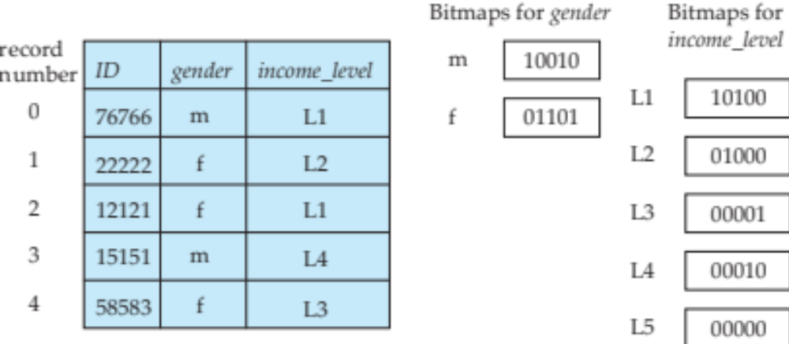
Bitmap Indices (Cont.)
In its simplest form a bitmap index on an attribute has a bitmap for each value of the attribute
  Bitmap has as many bits as records
  In a bitmap for value v, the bit for a record is 1 if the record has the value v for the attribute, and is 0 otherwise

Slide 66
Bitmap Indices (Cont.)
Bitmap indices are useful for queries on multiple attributes
  not particularly useful for single attribute queries
Queries are answered using bitmap operations
  Intersection (and)
  Union (or)
  Complementation (not)
Each operation takes two bitmaps of the same size and applies the operation on corresponding bits to get the result bitmap
  E.g. 100110 AND 110011 = 100010
  100110 OR 110011 = 110111
  NOT 100110 = 011001
  Males with income level L1: 10010 AND 10100 = 10000
    Can then retrieve required tuples.
    Counting number of matching tuples is even faster

Slide 67
Bitmap Indices (Cont.)
Bitmap indices generally very small compared with relation size
  E.g. if record is 100 bytes, space for a single bitmap is 1/800 of space used by relation.
    If number of distinct attribute values is 8, bitmap is only 1% of relation size
Deletion needs to be handled properly
  Existence bitmap to note if there is a valid record at a record location
  Needed for complementation
    not(A=v): (NOT bitmap-A-v) AND ExistenceBitmap
Should keep bitmaps for all values, even null value
  To correctly handle SQL null semantics for NOT(A=v):
    intersect above result with (NOT bitmap-A-Null)

Slide 68
Index Definition in SQL
Create an index
  create index <index-name> on <relation-name>
  (<attribute-list>)
  E.g.: create index b-index on branch(branch_name)
Use create unique index to indirectly specify and enforce the condition that the search key is a candidate key is a candidate key.
  Not really required if SQL unique integrity constraint is supported
To drop an index
  drop index <index-name>
Most database systems allow specification of type of index, and clustering.

