Slide 1
Chapter 14: Transactions

Slide 2
Chapter 14: Transactions
Transaction Concept
Transaction State
Concurrent Executions
Serializability [skipping view serializability]
Recoverability
Implementation of Isolation
Transaction Definition in SQL
Testing for Serializability.

Slide 3
Transaction Concept
A transaction is a unit of program execution that accesses and possibly updates various data items.
E.g. transaction to transfer $50 from account A to account B:
  1. read(A)
  2. A := A – 50
  3. write(A)
  4. read(B)
  5. B := B + 50
  6. write(B)
  Each transaction has its own in-memory copy of data; this can lead to problems
Two main issues to deal with:
  Failures of various kinds, such as hardware failures and system crashes
  Concurrent execution of multiple transactions

Slide 4
Example of Fund Transfer
Transaction to transfer $50 from account A to account B:
  1. read(A)
  2. A := A – 50
  3. write(A)
  4. read(B)
  5. B := B + 50
  6. write(B)
Atomicity requirement
  if the transaction fails after step 3 and before step 6, money will be “lost” leading to an inconsistent database state
    Failure could be due to software or hardware
  the system should ensure that updates of a partially executed transaction are not reflected in the database
Durability requirement — once the user has been notified that the transaction has completed (i.e., the transfer of the $50 has taken place), the updates to the database by the transaction must persist even if there are software or hardware failures.

Slide 5
Example of Fund Transfer (Cont.)
Transaction to transfer $50 from account A to account B:
  1. read(A)
  2. A := A – 50
  3. write(A)
  4. read(B)
  5. B := B + 50
  6. write(B)
Consistency requirement in above example:
  the sum of A and B is unchanged by the execution of the transaction
In general, consistency requirements include
    Explicitly specified integrity constraints such as primary keys and foreign keys
    Implicit integrity constraints
      e.g. sum of balances of all accounts, minus sum of loan amounts must equal value of cash-in-hand
  A transaction must see a consistent database.
  During transaction execution the database may be temporarily inconsistent.
  When the transaction completes successfully the database must be consistent
    Erroneous transaction logic can lead to inconsistency

Slide 6
Example of Fund Transfer (Cont.)
Isolation requirement — if between steps 3 and 6, another transaction T2 is allowed to access the partially updated database, it will see an inconsistent database (the sum A + B will be less than it should be).
T1 T2
  1. read(A)
  2. A := A – 50
  3. write(A)
  read(A), read(B), print(A+B)
  4. read(B)
  5. B := B + 50
  write(B)
Each transaction has its own copy of each variable
Isolation can be ensured trivially by running transactions serially
  that is, one after the other.
However, executing multiple transactions concurrently has significant benefits, as we will see later.

Slide 7
ACID Properties
A transaction is a unit of program execution that accesses and possibly updates various data items.To preserve the integrity of data the database system must ensure:
Atomicity. Either all operations of the transaction are properly reflected in the database or none are.
Consistency. Execution of a transaction in isolation preserves the consistency of the database.
Isolation. Although multiple transactions may execute concurrently, each transaction must be unaware of other concurrently executing transactions. Intermediate transaction results must be hidden from other concurrently executed transactions.
  That is, for every pair of transactions T_{i} and T_{j}, it appears to T_{i} that either T_{j}, finished execution before T_{i} started, or T_{j} started execution after T_{i} finished.
Durability. After a transaction completes successfully, the changes it has made to the database persist, even if there are system failures.

Slide 8
Transaction State
Active – the initial state; the transaction stays in this state while it is executing
Partially committed – after the final statement has been executed.
Failed -- after the discovery that normal execution can no longer proceed.
Aborted – after the transaction has been rolled back and the database restored to its state prior to the start of the transaction. Two options after it has been aborted:
  restart the transaction
    can be done only if no internal logical error
  kill the transaction
Committed – after successful completion.

Slide 9
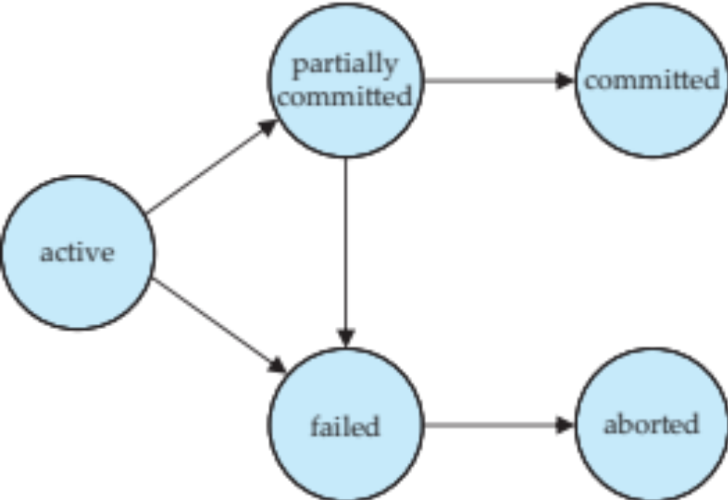
Transaction State (Cont.)

Slide 10
Concurrent Executions
Multiple transactions are allowed to run concurrently in the system. Advantages are:
  increased processor and disk utilization, leading to better transaction throughput
    E.g. one transaction can be using the CPU while another is reading from or writing to the disk
  reduced average response time for transactions: short transactions need not wait behind long ones.
Concurrency control schemes – mechanisms to achieve isolation
  that is, to control the interaction among the concurrent transactions in order to prevent them from destroying the consistency of the database
    Will study in Chapter 16, after studying notion of correctness of concurrent executions.

Slide 11
Schedules
Schedule – a sequences of instructions that specify the chronological order in which instructions of concurrent transactions are executed
  a schedule for a set of transactions must consist of all instructions of those transactions
  must preserve the order in which the instructions appear in each individual transaction.
A transaction that successfully completes its execution will have a commit instructions as the last statement
  by default transaction assumed to execute commit instruction as its last step
A transaction that fails to successfully complete its execution will have an abort instruction as the last statement

Slide 12
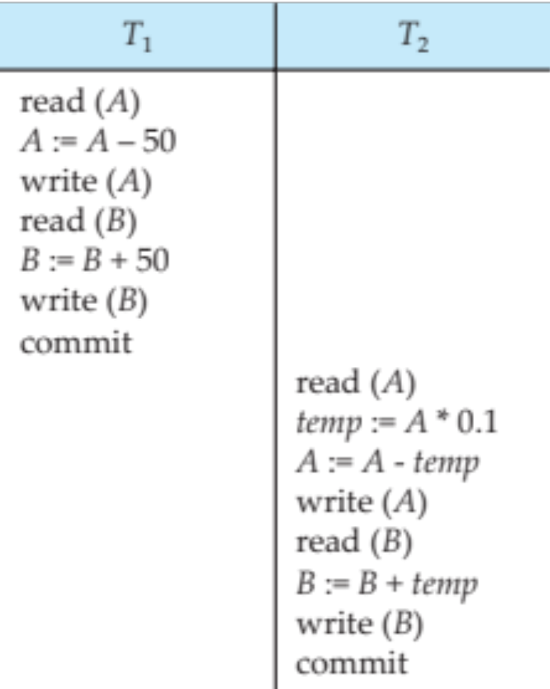
Schedule 1
Let T₁ transfer $50 from A to B, and T₂ transfer 10% of the balance from A to B.
A serial schedule in which T₁ is followed by T₂ :
Notes:
Suppose the current values of accounts A and B are $1000 and $2000, respectively.
The final values of accounts A and B, after the
execution in Figure 14.2 takes place, are $855 and $2145, respectively. Thus, the
total amount ofmoney in accounts A and B—that is, the sumA + B—is preserved
after the execution of both transactions.

Slide 13
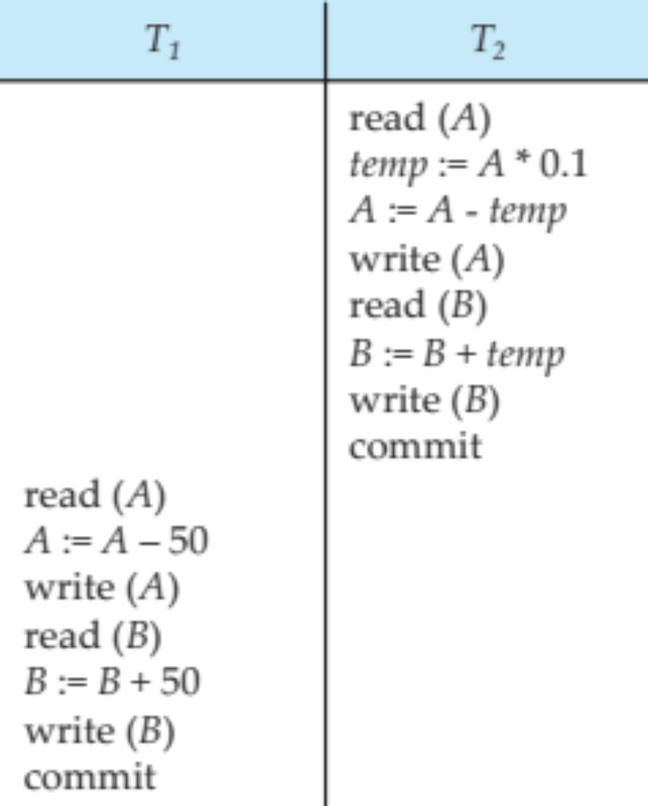
Schedule 2
A serial schedule where T₂ is followed by T₁
Notes:
Suppose the current values of accounts A and B are $1000 and $2000, respectively.
Again, as
expected, the sum A + B is preserved, and the final values of accounts A and B
are $850 and $2150, respectively.

Slide 14
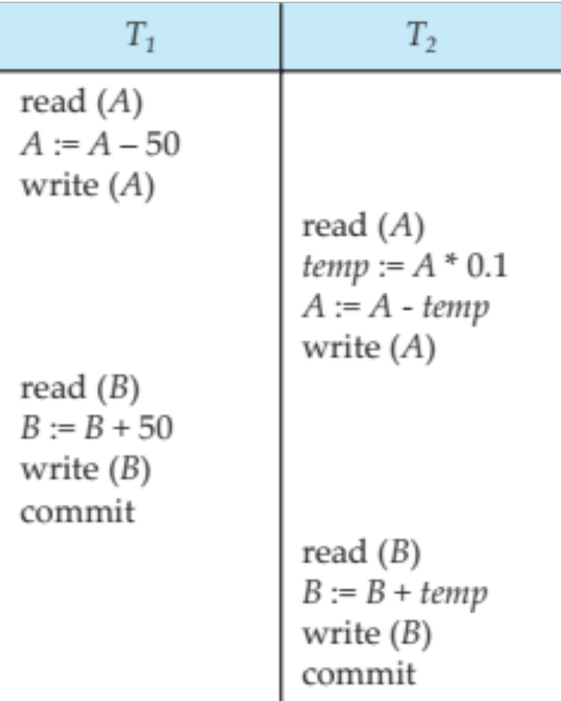
Schedule 3
Let T₁ and T₂ be the transactions defined previously. The following schedule is not a serial schedule, but it is equivalent to Schedule 1.
In Schedules 1, 2 and 3, the sum A + B is preserved.
Notes:
One possible schedule appears in Figure 14.4. After this
execution takes place, we arrive at the same state as the one in which the transactions
are executed serially in the order T1 followed by T2. The sumA + B is indeed
preserved.
The final values of accounts A and B, after the
execution in Schedule takes place, are $855 and $2145, respectively. Thus, the
total amount of money in accounts A and B—that is, the sum A + B—is preserved
after the execution of both transactions.

Slide 15
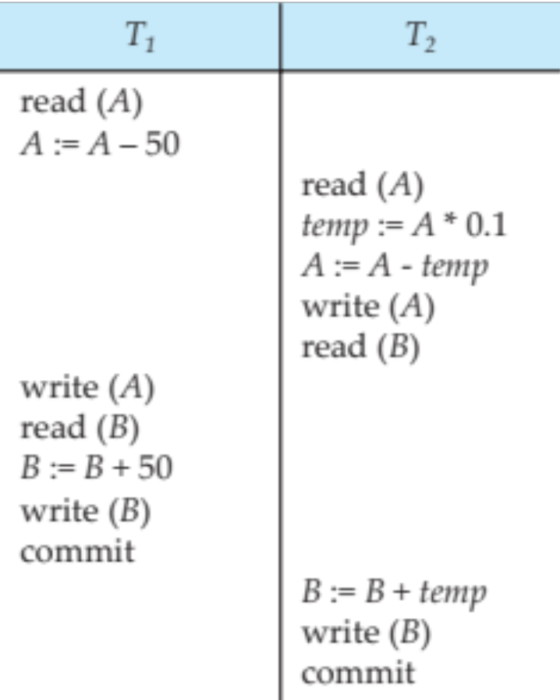
Schedule 4
The following concurrent schedule does not preserve the value of (A + B ).
Notes:
Not all concurrent executions result in a correct state. To illustrate, consider
the schedule 4. After the execution of this schedule, we arrive at a
state where the final values of accounts A and B are $950 and $2100, respectively.
This final state is an inconsistent state, since we have gained $50 in the process of
the concurrent execution. Indeed, the sum A + B is not preserved by the execution
of the two transactions.
If control of concurrent execution is left entirely to the operating system, many
possible schedules, including ones that leave the database in an inconsistent state,
such as the one just described, are possible. It is the job of the database system to
ensure that any schedule that is executed will leave the database in a consistent
state. The concurrency-control component of the database system carries out this
task.

Slide 16
Serializability
Basic Assumption – Each transaction preserves database consistency.
Thus serial execution of a set of transactions preserves database consistency.
A (possibly concurrent) schedule is serializable if it is equivalent to a serial schedule. Different forms of schedule equivalence give rise to the notions of:
  1. conflict serializability
  2. view serializability
Notes:
We can ensure consistency of the database under concurrent execution by
making sure that any schedule that is executed has the same effect as a schedule
that could have occurred without any concurrent execution. That is, the schedule
should, in some sense, be equivalent to a serial schedule. Such schedules are
called serializable schedules.

Slide 17
Simplified view of transactions
  We ignore operations other than read and write instructions
  We assume that transactions may perform arbitrary computations on data in local buffers in between reads and writes.
  Our simplified schedules consist of only read and write instructions.

Slide 18
Conflicting Instructions
Instructions l_{i} and l_{j} of transactions T_{i} and T_{j} respectively, conflict if and only if there exists some item Q accessed by both l_{i} and l_{j}, and at least one of these instructions wrote Q.
1. l_{i} = read(Q), l_{j} = read(Q). l_{i} and l_{j} don’t conflict.
2. l_{i} = read(Q), l_{j} = write(Q). They conflict.
3. l_{i} = write(Q), l_{j} = read(Q). They conflict
4. l_{i} = write(Q), l_{j} = write(Q). They conflict
Intuitively, a conflict between l_{i} and l_{j} forces a (logical) temporal order between them.
  If l_{i} and l_{j} are consecutive in a schedule and they do not conflict, their results would remain the same even if they had been interchanged in the schedule.
Notes:
2. I = read(Q), J = write(Q). If I comes before J , then Ti does not read the value
of Q that is written by Tj in instruction J . If J comes before I, then Ti reads
the value of Q that is written by Tj. Thus, the order of I and J matters.
Same reasons as 2
4. I = write(Q), J = write(Q). Since both instructions are write operations, the
order of these instructions does not affect either Ti or Tj . However, the value
obtained by the next read(Q) instruction of S is affected, since the result of
only the latter of the two write instructions is preserved in the database. If
there is no other write(Q) instruction after I and J in S, then the order of I
and J directly affects the final value of Q in the database state that results
from schedule S.

Slide 19
Conflict Serializability
If a schedule S can be transformed into a schedule S´ by a series of swaps of non-conflicting instructions, we say that S and S´ are conflict equivalent.
We say that a schedule S is conflict serializable if it is conflict equivalent to a serial schedule

Slide 20
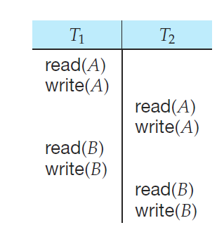
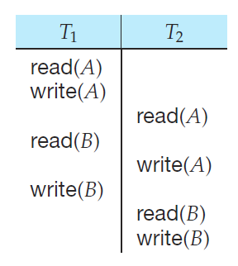
Schedule 5 got Schedule 3
Schedule 3 Schedule 5
Notes:
Since the write(A) instruction of T2 in schedule 3 of Figure 14.6 does not conflict
with the read(B) instruction of T1, we can swap these instructions to generate an
equivalent schedule, schedule 5,
Regardless of the initial system
state, schedules 3 and 5 both produce the same final system state.

Slide 21
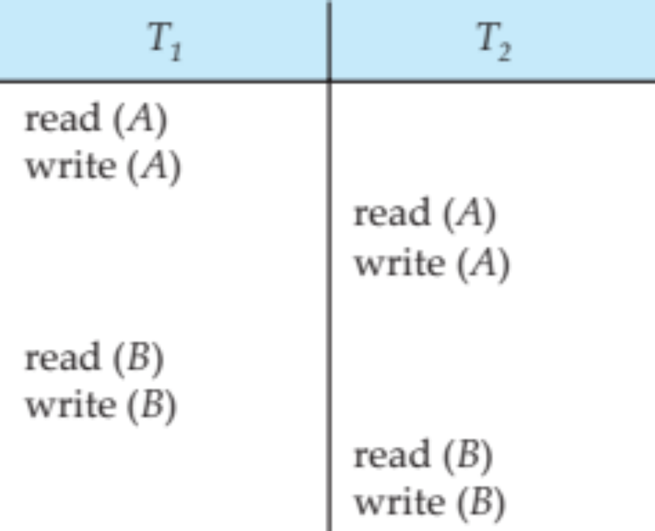
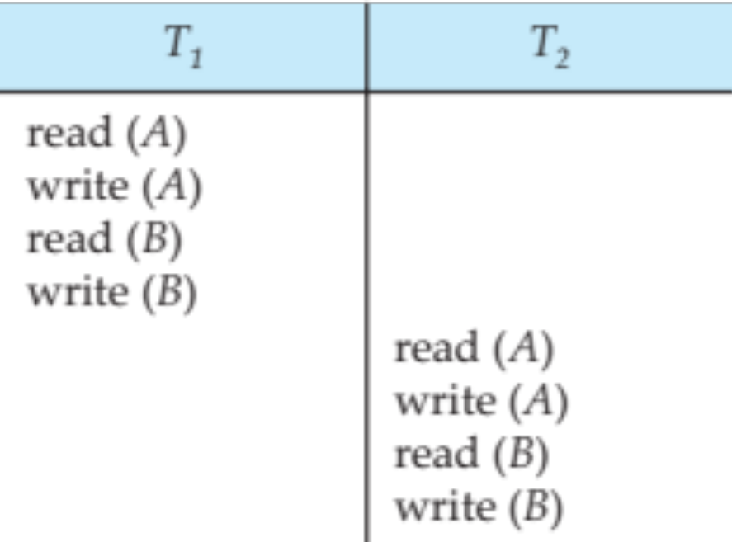
Conflict Serializability (Cont.)
Schedule 3 can be transformed into Schedule 6, a serial schedule where T₂ follows T₁, by series of swaps of non-conflicting instructions. Therefore Schedule 3 is conflict serializable.
Schedule 3
Schedule 6
Notes:
write(A) instruction of T2 in schedule 3 of Figure 14.6 does not conflict
with the read(B) instruction of T1, we can swap these instructions
Swap the read(B) instruction of T1 with the read(A) instruction of T2.
• Swap the write(B) instruction of T1 with the write(A) instruction of T2.
• Swap the write(B) instruction of T1 with the read(A) instruction of T2.

Slide 22
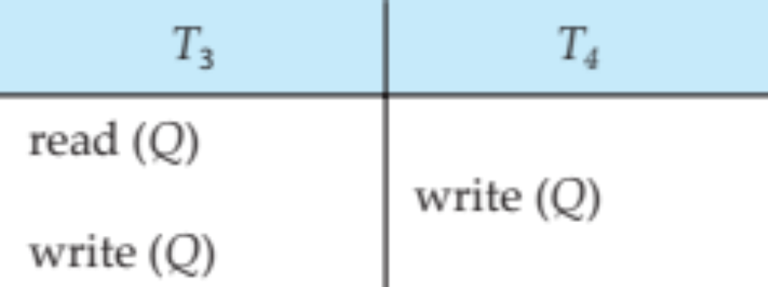
Conflict Serializability (Cont.)
Example of a schedule that is not conflict serializable:
We are unable to swap instructions in the above schedule to obtain either the serial schedule < T₃, T₄ >, or the serial schedule < T₄, T₃ >.
Notes:
Not all serial schedules are conflict equivalent to each other. For example,
schedules 1 and 2 are not conflict equivalent.

Slide 23
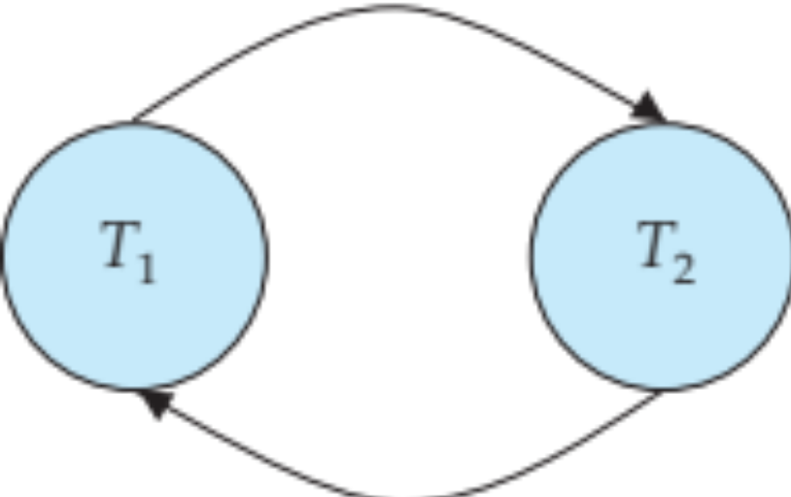
Testing for Serializability
Consider some schedule of a set of transactions T₁, T₂, ..., T_{n}
Precedence graph — a direct graph where the vertices are the transactions (names).
We draw an arc from T_{i} to T_{j} if the two transaction conflict, and T_{i} accessed the data item on which the conflict arose earlier.
We may label the arc by the item that was accessed.
Example 1
Notes:
Ti →Tj for which one of three conditions holds:
1. Ti executes write(Q) before Tj executes read(Q).
2. Ti executes read(Q) before Tj executes write(Q).
3. Ti executes write(Q) before Tj executes write(Q).
If an edge Ti → Tj exists in the precedence graph, then, in any serial schedule S
equivalent to S, Ti must appear before Tj .

Slide 24
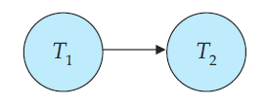
Precedence Graph for Schedule 1
A serial schedule in which T₁ is followed by T₂ :
Notes:
For example, the precedence graph for schedule 1 in Figure 14.10a contains
the single edge T1 → T2, since all the instructions of T1 are executed before the
first instruction of T2 is executed.

Slide 25
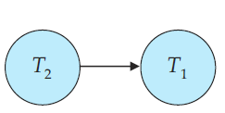
Precedence Graph for Schedule 2
A serial schedule where T₂ is followed by T₁
Notes:
Similarly, Figure 14.10b shows the precedence
graph for schedule 2 with the single edge T2 →T1, since all the instructions of T2
are executed before the first instruction of T1 is executed.

Slide 26
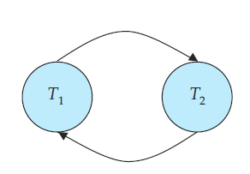
Precedence Graph for Schedule 4
The following concurrent schedule does not preserve the value of (A + B ).
Notes:
The precedence graph for schedule 4 appears in Figure 14.11. It contains
the edge T1 →T2, because T1 executes read(A) before T2 executes write(A). It also
contains the edge T2→T1, because T2 executes read(B) before T1 executes write(B).
If the precedence graph for S has a cycle, then schedule S is not conflict serializable.
If the graph contains no cycles, then the schedule S is conflict serializable.

Slide 27
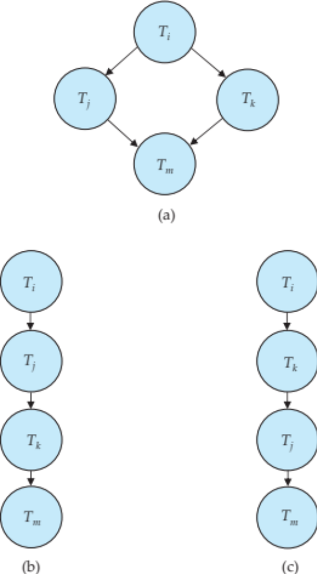
Test for Conflict Serializability
A schedule is conflict serializable if and only if its precedence graph is acyclic.
Cycle-detection algorithms exist which take order n² time, where n is the number of vertices in the graph.
  (Better algorithms take order n + e where e is the number of edges.)
If precedence graph is acyclic, the serializability order can be obtained by a topological sorting of the graph.
  This is a linear order consistent with the partial order of the graph.

Slide 28
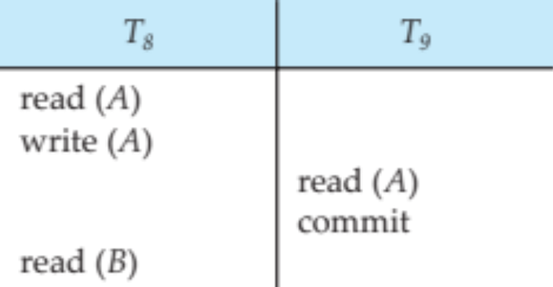
Recoverable Schedules
Need to address the effect of transaction failures on concurrently
running transactions.
Recoverable schedule — if a transaction T_{j} reads a data item previously written by a transaction T_{i} , then the commit operation of T_{i} appears before the commit operation of T_{j}.
The following schedule (Schedule 11) is not recoverable if T₉ commits immediately after the read
If T₈ should abort, T₉ would have read (and possibly shown to the user) an inconsistent database state. Hence, database must ensure that schedules are recoverable.

Slide 29
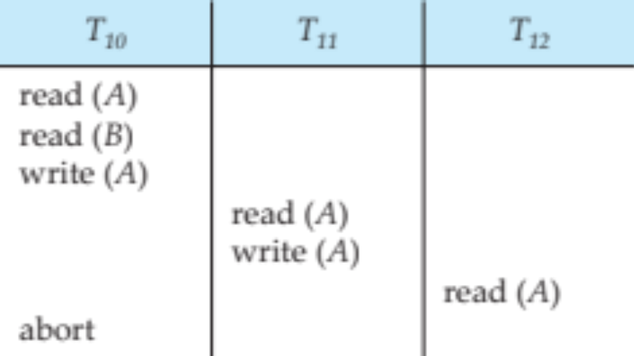
Cascading Rollbacks
Cascading rollback – a single transaction failure leads to a series of transaction rollbacks. Consider the following schedule where none of the transactions has yet committed (so the schedule is recoverable)
If T₁₀ fails, T₁₁ and T₁₂ must also be rolled back.
Can lead to the undoing of a significant amount of work

Slide 30
Cascadeless Schedules
Cascadeless schedules — cascading rollbacks cannot occur; for each pair of transactions T_{i} and T_{j} such that T_{j} reads a data item previously written by T_{i}, the commit operation of T_{i} appears before the read operation of T_{j}.
It is desirable to restrict the schedules to those that are cascadeless, but doing so may reduce the amount of concurrency
Recall: Recoverable schedule — if a transaction T_{j} reads a data item previously written by a transaction T_{i} , then the commit operation of T_{i} appears before the commit operation of T_{j}.
Every cascadeless schedule is also recoverable
It is necessary to restrict the schedules to those that are recoverable

Slide 31
Concurrency Control
A database must provide a mechanism that will ensure that all possible schedules are
  either conflict or view serializable, and
  are recoverable and preferably cascadeless
A policy in which only one transaction can execute at a time generates serial schedules, but provides a poor degree of concurrency
  Are serial schedules recoverable/cascadeless?
Testing a schedule for serializability after it has executed is a little too late!
Goal – to develop concurrency control protocols that will assure serializability.

Slide 32
Concurrency Control (Cont.)
Schedules must be conflict or view serializable, and recoverable, for the sake of database consistency, and preferably cascadeless.
A policy in which only one transaction can execute at a time generates serial schedules, but provides a poor degree of concurrency.
Concurrency-control schemes tradeoff between the amount of concurrency they allow and the amount of overhead that they incur.
Some schemes allow only conflict-serializable schedules to be generated, while others allow view-serializable schedules that are not conflict-serializable.
We are only going to study conflict-serializability.

Slide 33
Concurrency Control vs. Serializability Tests
Concurrency-control protocols allow concurrent schedules, but ensure that the schedules are conflict/view serializable, and are recoverable and cascadeless .
Concurrency control protocols generally do not examine the precedence graph as it is being created
  Instead a protocol imposes a discipline that avoids nonseralizable schedules.
  We study such protocols in Chapter 16.
Different concurrency control protocols provide different tradeoffs between the amount of concurrency they allow and the amount of overhead that they incur.
Tests for serializability help us understand why a concurrency control protocol is correct.

Slide 34
Weak Levels of Consistency
Some applications are willing to live with weak levels of consistency, allowing schedules that are not serializable
  E.g. a read-only transaction that wants to get an approximate total balance of all accounts
  E.g. database statistics computed for query optimization can be approximate (why?)
  Such transactions need not be serializable with respect to other transactions
Tradeoff accuracy for performance

Slide 35
Transaction Definition in SQL
Data manipulation language must include a construct for specifying the set of actions that comprise a transaction.
In SQL, a transaction begins implicitly.
A transaction in SQL ends by:
  Commit work commits current transaction and begins a new one.
  Rollback work causes current transaction to abort.
In almost all database systems, by default, every SQL statement also commits implicitly if it executes successfully
  Implicit commit can be turned off by a database directive
    E.g. in JDBC, connection.setAutoCommit(false);

