Slide 1
Chapter 16 : Concurrency Control
(Chapter 15 in 6th edition)

Slide 2
Chapter 16: Concurrency Control
Lock-Based Protocols
  2PL
  Strict 2PL
  2PL with lock upgrades
  Tree-based protocol
Timestamp-Based Protocols – skipping generalities
Validation-Based Protocols
Multiple Granularity – skipping
Multiversion Schemes – skipping
Insert and Delete Operations
Concurrency in Index Structures – skipping

Slide 3
Lock-Based Protocols
A lock is a mechanism to control concurrent access to a data item
Data items can be locked in two modes :
1. exclusive (X) mode. Data item can be both read as well as
written. X-lock is requested using lock-X instruction.
2. shared (S) mode. Data item can only be read. S-lock is
requested using lock-S instruction.
Lock requests are made to concurrency-control manager. Transaction can proceed only after request is granted.

Slide 4

Lock-Based Protocols (Cont.)
Lock-compatibility matrix
A transaction may be granted a lock on an item if the requested lock is compatible with locks already held on the item by other transactions
Any number of transactions can hold shared locks on an item,
  but if any transaction holds an exclusive on the item no other transaction may hold any lock on the item.
If a lock cannot be granted, the requesting transaction is made to wait till all incompatible locks held by other transactions have been released. The lock is then granted.

Slide 5
Lock-Based Protocols (Cont.)
Example of a transaction performing locking:
T₂: lock-S(A);
read (A);
unlock(A);
T1: gets locks and writes A and B
lock-S(B);
read (B);
unlock(B);
display(A+B)
Locking as above is not sufficient to guarantee serializability — if A and B get updated in-between the read of A and B, the displayed sum would be wrong.
A locking protocol is a set of rules followed by all transactions while requesting and releasing locks. Locking protocols restrict the set of possible schedules.

Slide 6
The Two-Phase Locking Protocol
This is a protocol which ensures conflict-serializable schedules.
Phase 1: Growing Phase
  transaction may obtain locks
  transaction may not release locks
Phase 2: Shrinking Phase
  transaction may release locks
  transaction may not obtain locks
The protocol assures serializability. It can be proved that
  Any schedule produced by 2PL protocol has an acyclic precedence graph (see next page)
  the transactions can be serialized in the order of their lock points (i.e. the point where a transaction acquired its final lock).

Slide 7
Sketch of Proof that 2PL => conflict serializable
Proof by contradiction: Suppose there are transactions that follow 2PL and yield a schedule that is not conflict serializable.
The precedence graph, G, of such a schedule has a cycle, T1 -> T2-> …->Tn-> T1. (We’ll just consider n=2, but same idea works in general.) There are conflicts between T1 and T2 on data items A and B, where and T1 accesses A first and T2 accesses B first in the given schedule.
Constraints on the schedules (Denote “happens before” by <):
From precedence graph + lock semantics
  T1:unlock(A) < T2.lock(A)
  T2.unlock(B) < T1:lock(B)
From 2PL
  T2:lock(A) < T2:unlock(B)
  T1:lock(B) < T1:unlock(A)
T1:unlock(A) < T2.lock(A) < T2:unlock(B) < T1:lock(B) <T1:unlock(A).
Contradiction. So we conclude that 2PL => conflict serializable.

Slide 8
The Two-Phase Locking Protocol (Cont.)
Two-phase locking does not ensure freedom from deadlocks
Cascading roll-back is possible under two-phase locking. To avoid this, follow a modified protocol called strict two-phase locking. Here a transaction must hold all its exclusive locks till it commits/aborts.
Rigorous two-phase locking is even stricter: here all locks are held till commit/abort. In this protocol transactions can be serialized in the order in which they commit.

Slide 9
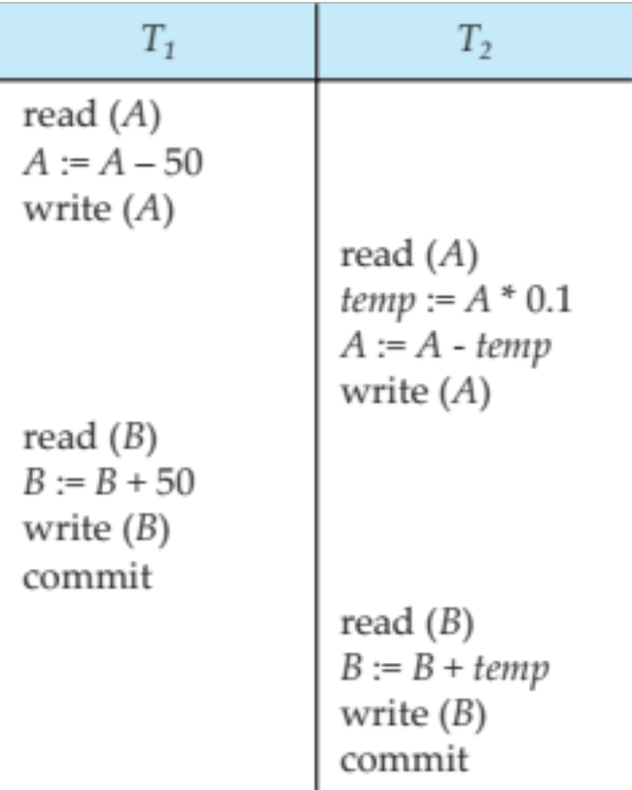
Schedule 3
Can this arise using 2PL? If so, where do the locks/unlocks go?

Slide 10
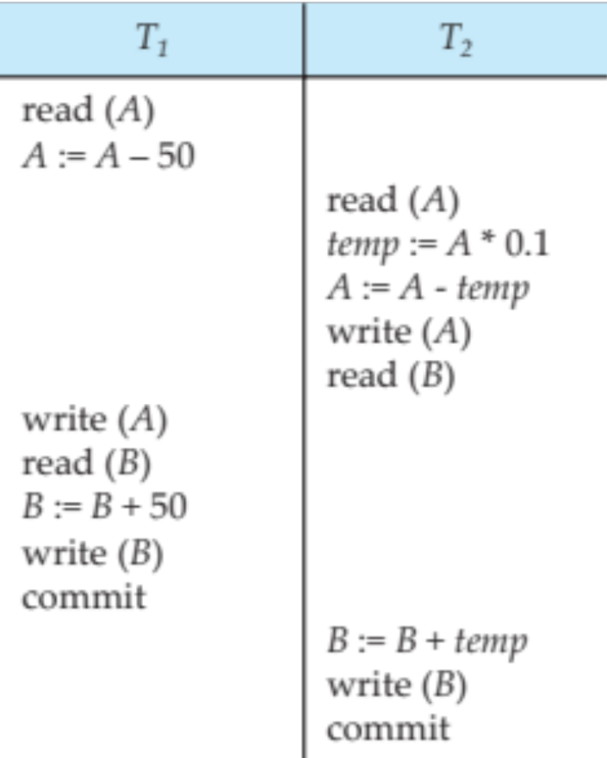
Schedule 4
Can this arise with 2PL?
No, not conflict-serializable

Slide 11
The Two-Phase Locking Protocol (Cont.)
There can be conflict serializable schedules that cannot be obtained if two-phase locking is used.
However, in the absence of extra information (e.g., ordering of access to data), two-phase locking is needed for conflict serializability in the following sense:
Given a transaction T_{i} that does not follow two-phase locking, we can find a transaction T_{j} that uses two-phase locking, and a schedule for T_{i} and T_{j} that is not conflict serializable.

Slide 12
Lock Conversions
Two-phase locking with lock conversions:
– First Phase:
  can acquire a lock-S on item
  can acquire a lock-X on item
  can convert a lock-S to a lock-X (upgrade)
– Second Phase:
  can release a lock-S
  can release a lock-X
  can convert a lock-X to a lock-S (downgrade)
This protocol assures serializability. But still relies on the programmer to insert the various locking instructions.

Slide 13
Automatic Acquisition of Locks
A transaction T_{i} issues the standard read/write instruction, without explicit locking calls.
The operation read(D) is processed as:
if T_{i} has a lock on D
then
read(D)
else begin
if necessary wait until no other
transaction has a lock-X on D
grant T_{i} a lock-S on D;
read(D)
end

Slide 14
Automatic Acquisition of Locks (Cont.)
write(D) is processed as:
if T_{i} has a lock-X on D
then
write(D)
else begin
if necessary wait until no other trans. has any lock on D,
if T_{i} has a lock-S on D
then
upgrade lock on D to lock-X
else
grant T_{i} a lock-X on D
write(D)
end;
All locks are released after commit or abort

Slide 15
Implementation of Locking
A lock manager can be implemented as a separate process to which transactions send lock and unlock requests
The lock manager replies to a lock request by sending a lock grant messages (or a message asking the transaction to roll back, in case of a deadlock)
The requesting transaction waits until its request is answered
The lock manager maintains a data-structure called a lock table to record granted locks and pending requests
The lock table is usually implemented as an in-memory hash table indexed on the name of the data item being locked

Slide 16

Lock Table
Black rectangles indicate granted locks, white ones indicate waiting requests
Lock table also records the type of lock granted or requested
New request is added to the end of the queue of requests for the data item, and granted if it is compatible with all earlier locks
Unlock requests result in the request being deleted, and later requests are checked to see if they can now be granted
If transaction aborts, all waiting or granted requests of the transaction are deleted
  lock manager may keep a list of locks held by each transaction, to implement this efficiently
Granted
Waiting

Slide 17

Pitfalls of Lock-Based Protocols
Consider the partial schedule
Neither T₃ nor T₄ can make progress — executing lock-S(B) causes T₄ to wait for T₃ to release its lock on B, while executing lock-X(A) causes T₃ to wait for T₄ to release its lock on A.
Such a situation is called a deadlock.
  To handle a deadlock one of T₃ or T₄ must be rolled back
  and its locks released.

Slide 18
Pitfalls of Lock-Based Protocols (Cont.)
The potential for deadlock exists in most locking protocols. Deadlocks are a necessary evil.
Starvation is also possible if concurrency control manager is badly designed. For example:
  A transaction may be waiting for an X-lock on an item, while a sequence of other transactions request and are granted an S-lock on the same item.
  The same transaction is repeatedly rolled back due to deadlocks.
Concurrency control manager can be designed to prevent starvation.

Slide 19
Graph-Based Protocols
Graph-based protocols are an alternative to two-phase locking
Impose a partial ordering → on the set D = {d₁, d₂ ,..., d_{h}} of all data items.
  If d_{i} → d_{j} then any transaction accessing both d_{i} and d_{j} must access d_{i} before accessing d_{j}.
  Implies that the set D may now be viewed as a directed acyclic graph, called a database graph.
The tree-protocol is a simple kind of graph protocol.

Slide 20

Tree Protocol
Only exclusive locks are allowed.
The first lock by T_{i} may be on any data item. Subsequently, a data Q can be locked by T_{i} only if the parent of Q is currently locked by T_{i}.
Data items may be unlocked at any time.
A data item that has been locked and unlocked by T_{i} cannot subsequently be relocked by T_{i}

Slide 21
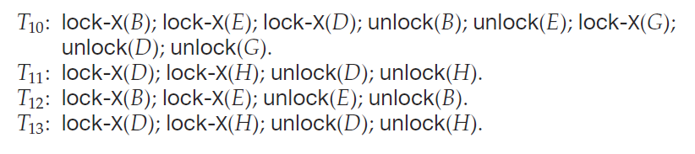

Slide 22
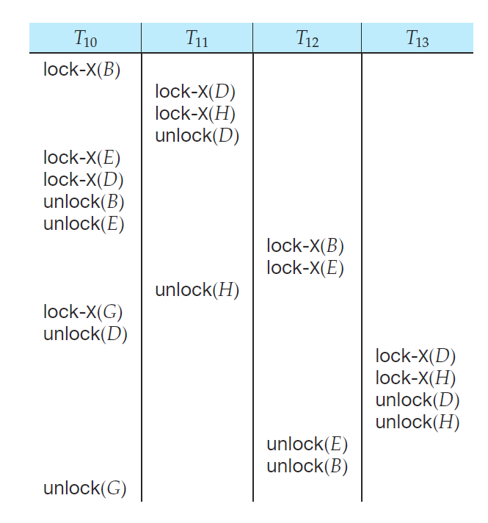

Slide 23
Example
T1 | T2
Lock-X(C)
Lock-X(A)
Read(A)
Write(A)
Unlock(A)
Lock-X(B)
Unlock(C)
 | Lock-X(C)
 | Lock-X(A)
Read(B)
 | Read(A)
… | …
T1: transfer $50 from A to B
T2: transfer 10% from A to B
Suppose C is the least common ancestor of A and B in the tree
T1 and T2 each need X-locks on both A and B.
  T1 and T2 each must get lock on C before first
  Assume T1 gets lock C first
  T1 can’t release C until it has locked B [note – this prevents deadlock if T2 accesses B and A in the other order]
  T1’s update of B can proceed concurrently with T2’s update of A
  Cascading rollback may occur ☹

Slide 24
Graph-Based Protocols (Cont.)
The tree protocol ensures conflict serializability as well as freedom from deadlock.
Unlocking may occur earlier in the tree-locking protocol than in the two-phase locking protocol.
  shorter waiting times, and increase in concurrency
  protocol is deadlock-free, no rollbacks are required
Drawbacks
  Protocol does not guarantee recoverability or cascade freedom
    Need to introduce commit dependencies to ensure recoverability
  Transactions may have to lock data items that they do not access.
    increased locking overhead, and additional waiting time
    potential decrease in concurrency
Some schedules not possible under two-phase locking are possible under tree protocol, and vice versa.

Slide 25
Deadlock Handling
Consider the following two transactions:
T₁: write (X) T₂: write(Y)
write(Y) write(X)
Schedule with deadlock
T₁
T₂
lock-X on X
write (X)
lock-X on Y
write (Y)
wait for lock-X on X
wait for lock-X on Y

Slide 26
Deadlock Handling
System is deadlocked if there is a set of transactions such that every transaction in the set is waiting for another transaction in the set.
Deadlock prevention protocols ensure that the system will never enter into a deadlock state. Some prevention strategies :
  Require that each transaction locks all its data items before it begins execution (predeclaration).
  Impose partial ordering of all data items and require that a transaction can lock data items only in the order specified by the partial order (graph-based protocol).

Slide 27
More Deadlock Prevention Strategies
Following schemes use transaction timestamps for the sake of deadlock prevention alone.
wait-die scheme — non-preemptive
  older transaction may wait for younger one to release data item. Younger transactions never wait for older ones; they are rolled back instead.
  a transaction may die several times before acquiring needed data item
wound-wait scheme — preemptive
  older transaction wounds (forces rollback) of younger transaction instead of waiting for it. Younger transactions may wait for older ones.
  may be fewer rollbacks than wait-die scheme.

Slide 28
Deadlock prevention (Cont.)
Both in wait-die and in wound-wait schemes, a rolled back transactions is restarted with its original timestamp. Older transactions thus have precedence over newer ones, and starvation is hence avoided.
Timeout-Based Schemes :
  a transaction waits for a lock only for a specified amount of time. After that, the wait times out and the transaction is rolled back.
  thus deadlocks are not possible
  simple to implement; but starvation is possible. Also difficult to determine good value of the timeout interval.

Slide 29
Deadlock Detection
Deadlocks can be described as a wait-for graph, which consists of a pair G = (V,E),
  V is a set of vertices (all the transactions in the system)
  E is a set of edges; each element is an ordered pair T_{i} →T_{j}.
If T_{i} → T_{j} is in E, then there is a directed edge from T_{i} to T_{j}, implying that T_{i} is waiting for T_{j} to release a data item.
When T_{i} requests a data item currently being held by T_{j}, then the edge T_{i} T_{j} is inserted in the wait-for graph. This edge is removed only when T_{j} is no longer holding a data item needed by T_{i}.
The system is in a deadlock state if and only if the wait-for graph has a cycle. Must invoke a deadlock-detection algorithm periodically to look for cycles.

Slide 30


Deadlock Detection (Cont.)
Wait-for graph without a cycle
Wait-for graph with a cycle

Slide 31
Deadlock Recovery
When deadlock is detected :
  Some transaction will have to rolled back (made a victim) to break deadlock. Select that transaction as victim that will incur minimum cost.
  Rollback -- determine how far to roll back transaction
    Total rollback: Abort the transaction and then restart it.
    More effective to roll back transaction only as far as necessary to break deadlock.
  Starvation happens if same transaction is always chosen as victim. Include the number of rollbacks in the cost factor to avoid starvation

Slide 32
Validation-Based Protocol
Execution of transaction T_{i} is done in three phases.
1. Read and execution phase: Transaction T_{i} writes only to
temporary local variables
2. Validation phase: Transaction T_{i} performs a ``validation test''
to determine if local variables can be written without violating
serializability.
3. Write phase: If T_{i} is validated, the updates are applied to the
database; otherwise, T_{i} is rolled back.
The three phases of concurrently executing transactions can be interleaved, but each transaction must go through the three phases in that order.
  Assume for simplicity that the validation and write phase occur together, atomically and serially
    I.e., only one transaction executes validation/write at a time.
Also called as optimistic concurrency control since transaction executes fully in the hope that all will go well during validation

Slide 33
Validation-Based Protocol (Cont.)
Each transaction T_{i} has 3 timestamps
  Start(T_{i}) : the time when T_{i} started its execution
  Validation(T_{i}): the time when T_{i} entered its validation phase
  Finish(T_{i}) : the time when T_{i} finished its write phase
Serializability order is determined by timestamp given at validation time, to increase concurrency.
  Thus TS(T_{i}) is given the value of Validation(T_{i}).
This protocol is useful and gives greater degree of concurrency if probability of conflicts is low.
  because the serializability order is not pre-decided, and
  relatively few transactions will have to be rolled back.

Slide 34
Validation Test for Transaction T_{j}
If for all T_{i} with TS (T_{i}) < TS (T_{j}) either one of the following condition holds:
  finish(T_{i}) < start(T_{j})
  start(T_{j}) < finish(T_{i}) < validation(T_{j}) and the set of data items written by T_{i} does not intersect with the set of data items read by T_{j}.
then validation succeeds and T_{j} can be committed. Otherwise, validation fails and T_{j} is aborted.
Justification: Either the first condition is satisfied, and there is no overlapped execution, or the second condition is satisfied and
  the writes of T_{j} do not affect reads of T_{i} since they occur after T_{i} has finished its reads.
  the writes of T_{i} do not affect reads of T_{j} since T_{j} does not read any item written by T_{i}.

Slide 35
Schedule Produced by Validation
Example of schedule produced using validation
T₁₄
T₁₅
read(B)
read(B)
B:= B-50
read(A)
A:= A+50
read(A)
(validate)
display (A+B)
(validate)
write (B)
write (A)

Slide 36
Insert and Delete Operations
If two-phase locking is used :
  A delete operation may be performed only if the transaction deleting the tuple has an exclusive lock on the tuple to be deleted.
  A transaction that inserts a new tuple into the database is given an X-mode lock on the tuple
Insertions and deletions can lead to the phantom phenomenon.
  A transaction that scans a relation
    (e.g., find sum of balances of all accounts in Perryridge)
    and a transaction that inserts a tuple in the relation
    (e.g., insert a new account at Perryridge)
    (conceptually) conflict in spite of not accessing any tuple in common.
  If only tuple locks are used, non-serializable schedules can result
    E.g. the scan transaction does not see the new account, but reads some other tuple written by the update transaction

Slide 37
Insert and Delete Operations (Cont.)
The transaction scanning the relation is reading information that indicates what tuples the relation contains, while a transaction inserting a tuple updates the same information.
  The information should be locked.
One solution:
  Associate a data item with the relation, to represent the information about what tuples the relation contains.
  Transactions scanning the relation acquire a shared lock in the data item,
  Transactions inserting or deleting a tuple acquire an exclusive lock on the data item. (Note: locks on the data item do not conflict with locks on individual tuples.)
Above protocol provides very low concurrency for insertions/deletions.
Index locking protocols provide higher concurrency while
preventing the phantom phenomenon, by requiring locks
on certain index buckets.

Slide 38
Weak Levels of Consistency in SQL
SQL allows non-serializable executions
  Serializable: is the default
  Repeatable read: allows only committed records to be read, and repeating a read should return the same value (so read locks should be retained)
    However, the phantom phenomenon need not be prevented
      T1 may see some records inserted by T2, but may not see others inserted by T2
  Read committed: same as degree two consistency, but most systems implement it as cursor-stability
  Read uncommitted: allows even uncommitted data to be read
In many database systems, read committed is the default consistency level
  has to be explicitly changed to serializable when required
    set isolation level serializable

