Slide 1
Why and how of big data
Anula Choudhary

Slide 3






Big Data.. ??
Notes:
What is big data.
- Companies collect tons and tons of data in their day to day operations
- (google search, youtube videos, tweets, facebook pictures, amazon, etc). Because of the size of data, traditional databases do not work and scale well.
Big data as a concept started because of these Internet and web scale data stores.
Companies now have data in order of Petabytes!!

Slide 4
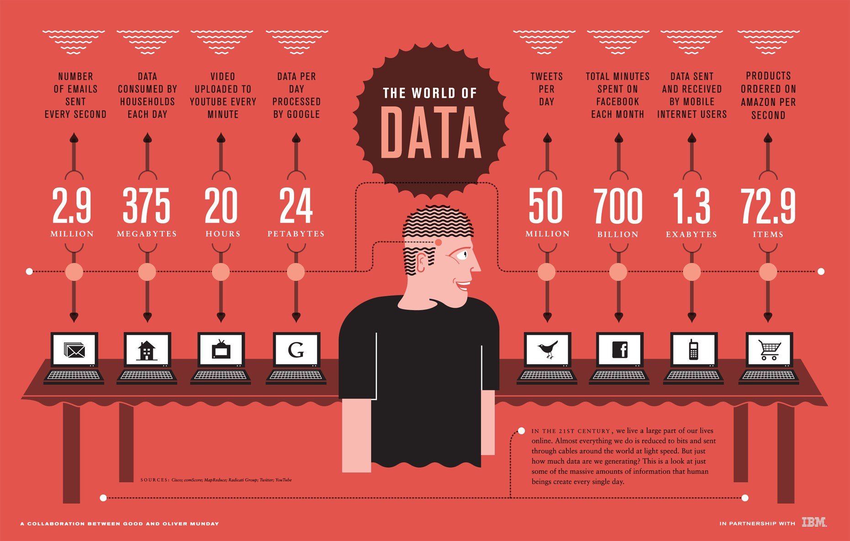
Notes:
50 million tweets per day
24 PB of data processed per day by Google

Slide 5
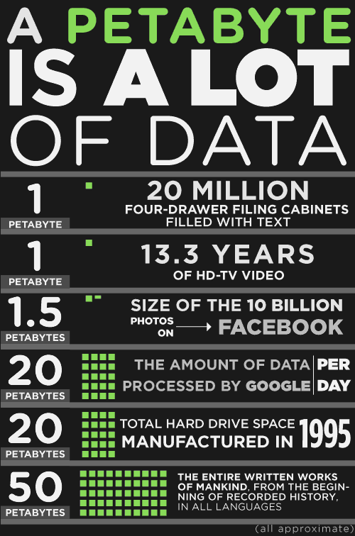
Notes:
What is a peta byte?
Companies typically store hundreds of petabytes of data.. And in that data is hidden knowledge and intelligence.

Slide 6
Unique challenges
We need special systems to manage so much data.
We need to filter out unwanted data.
Finally we need to build intelligent reports on this data.

Slide 7

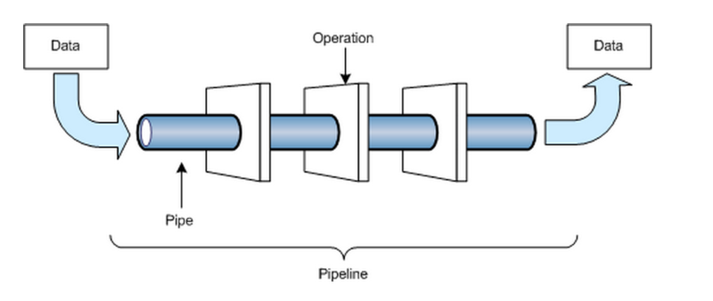

Data warehouse
PYTHON!! YAAAY!
ETL pipeline
Visualization
Notes:
What is data warehouse
- SQL, NoSQL,
What is ETL
- PYTHON!!!
What is visualization
- Tableau, Micro strategy

Slide 8
Benefits
Learn about past patterns in business.
Future trends can be guessed by applying data science algorithms on data.
Targeted marketing by looking at past user behaviors
Better medical research

Slide 9


Amazon, Umbrellas and Weather
Notes:
Today we are going to look into a hypothetical example of how Amazon will make smart business decisions based on shopping data collected.
We are going to check into umbrellas bought on Amazon and see if there is a relation with the weather changes.

Slide 10

OrderId | ProductId | UserId | Date | …..
FulfillmentId | OrderId | ShipZipcode | …
UserId | FirstName | LastName | …
PaymentId | OrderId | …
Notes:
When we shop on Amazon, a ton of things are happening in the background!!!!
- Amazon is creating and saving lots of data about the activities
- It creates an entry into the Orders table : to record details about your order such as the product, user, date of transaction
It will create an entry into Fulfillment table – that stores fulfillment details about the order, zip code, date etc.
It will update the user table to indicate what product was bought
It will create entry in payments table to track all the payment information!!!

Slide 11
Data warehouse
Data warehouse is made up of multiple databases – all connected to each other.
Custom schemas like Star and Snowflake schemas are used for manage relations.
Notes:
A data warehouse as the name suggests is a huge collection of tables and data with it.
These tables are connected to each other via various relations and use special schemas – Star and Snowflake.
Amazon will make sure all important data is easily accessible
A warehouse will help aggregate data and keep important stuff ready to access

Slide 12
ETL for umbrella orders
Get purchase information, user and date + time
Aggregate zip code, date, and purchases
Get shipping location
Notes:
ETL – extract transform load is a process of picking data and converting it into a form that we want.
In this process some data can be
- Removed,
- merged
- cleansed
In our example we will read data about umbrella purchases and get the user and date time information from some tables.
We will then get the shipping zip code and other information from other tables.
Finally we will create a new table that contains useful information about location, date+time of purchase
We CAN WRITE ALL THIS CODE IN PYTHON

Slide 13
ETL for umbrella orders - 2
API
Get weather information for required date + time and zip code
Aggregate weather, location, date + time and orders

Slide 14
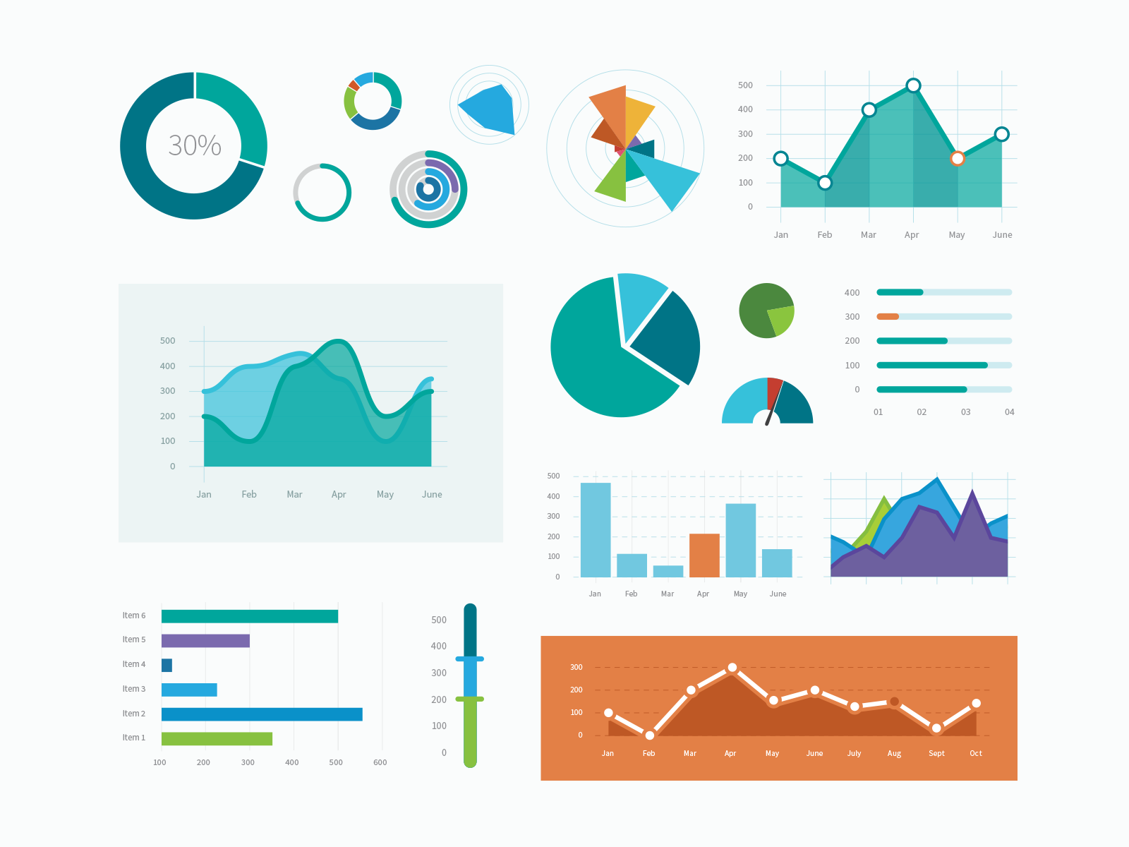
Intelligent reports

Slide 15
Business Intelligence
What season do people buy umbrellas?
How long do people wait after first rain to buy umbrellas?
How long do people wait before peak rainfall to buy umbrellas?
What else do same people buy in same season?
What other zip codes have similar weather patterns?
Notes:
Once we have all the data we care of in one place, now intelligent data science and machine learning algorithms can be run on this.
This we can start building reports and trends.
Amazon will want to understand and build GTM strategies based on these trends and plans…

Slide 16
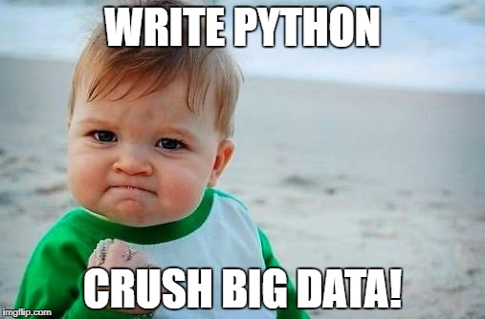
Notes:
Once we have all the data we care of in one place, now intelligent data science and machine learning algorithms can be run on this.
This we can start building reports and trends.
Amazon will want to understand and build GTM strategies based on these trends and plans…

Slide 17
Thank you!

