Slide 1
GraphQL + Oracle DB = ☺

Slide 2


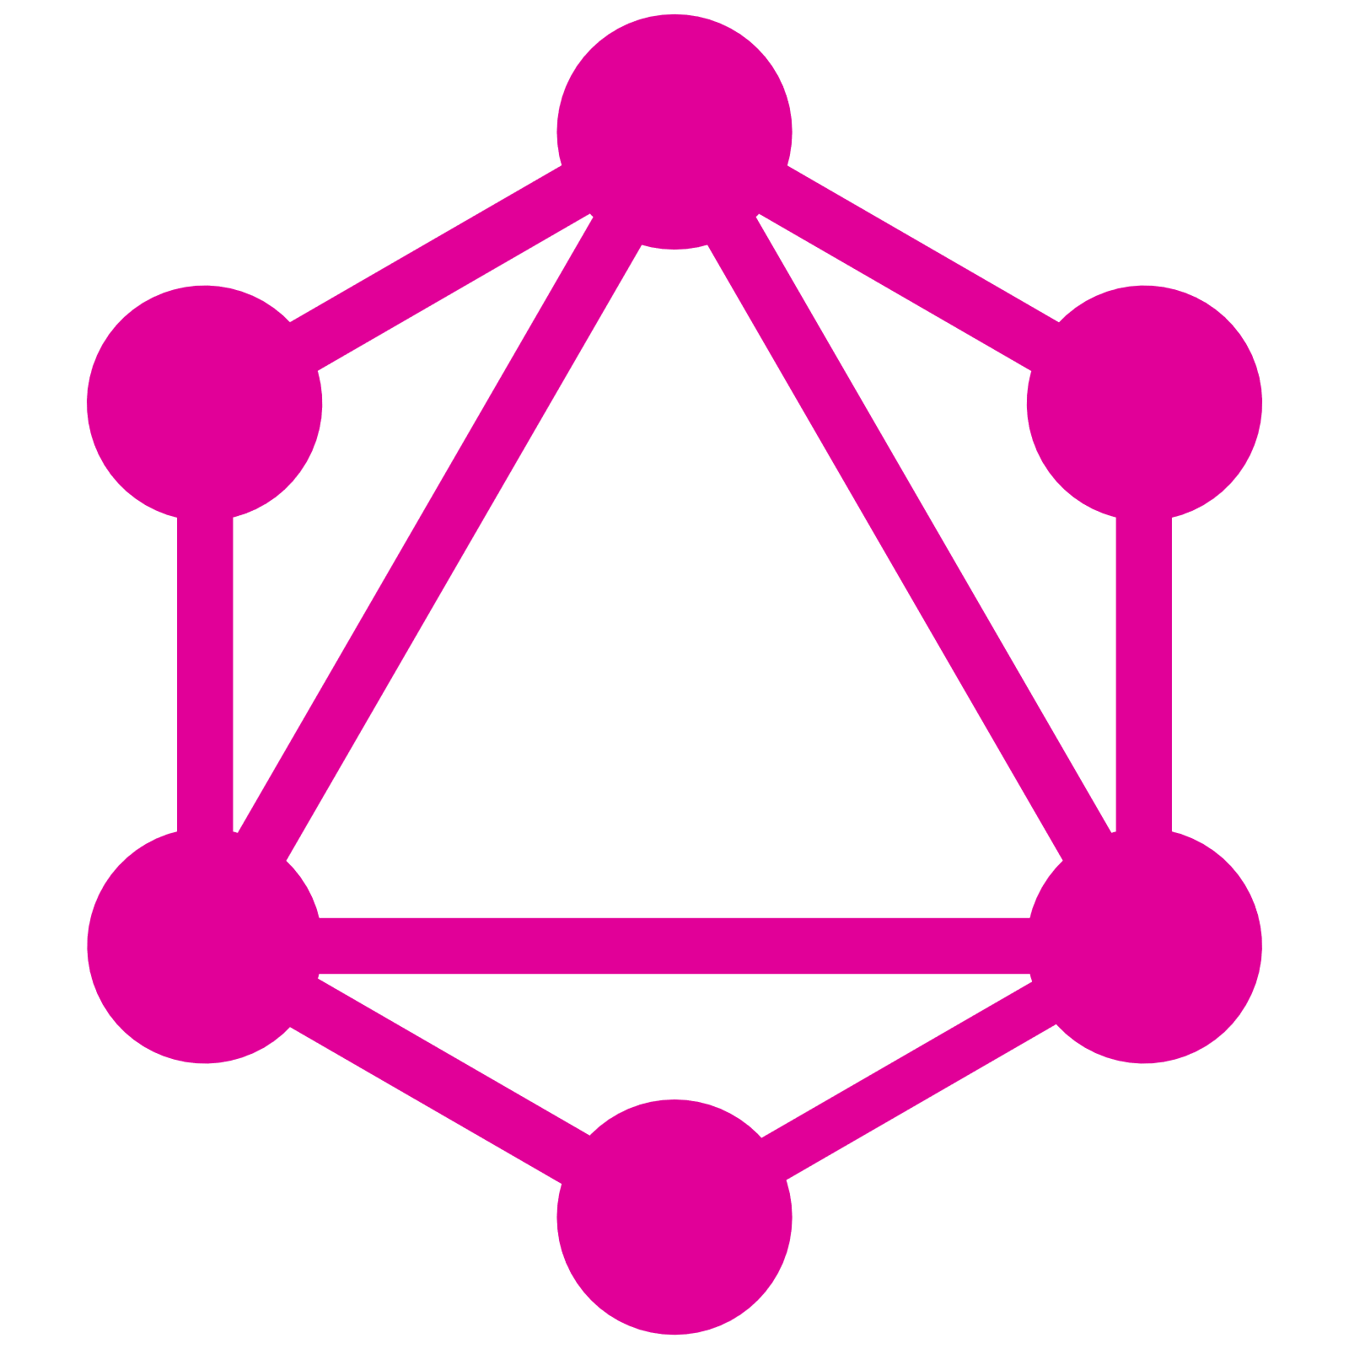
DMZ/Perimeter Network
Data Warehouse
Data Warehouse
Data Warehouse

Slide 3
DMZ/Perimeter Network
Data Warehouse
Data Warehouse
Data Warehouse

Slide 4
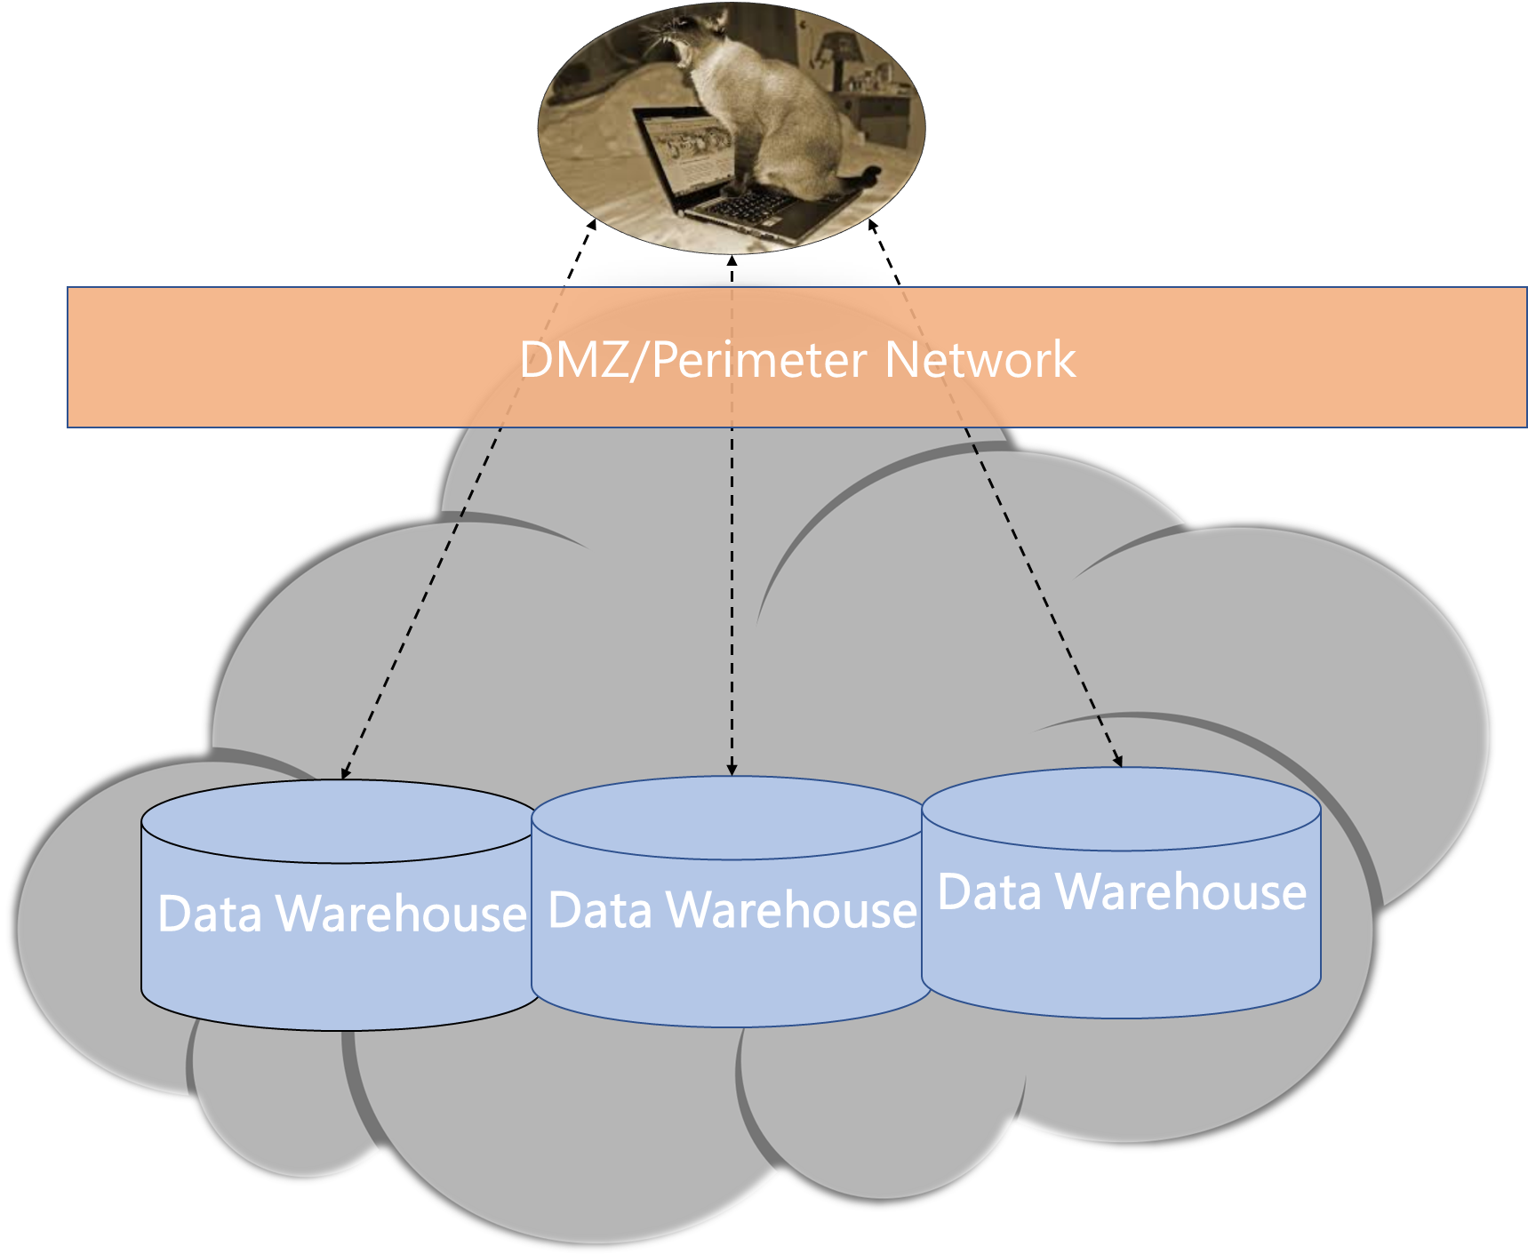
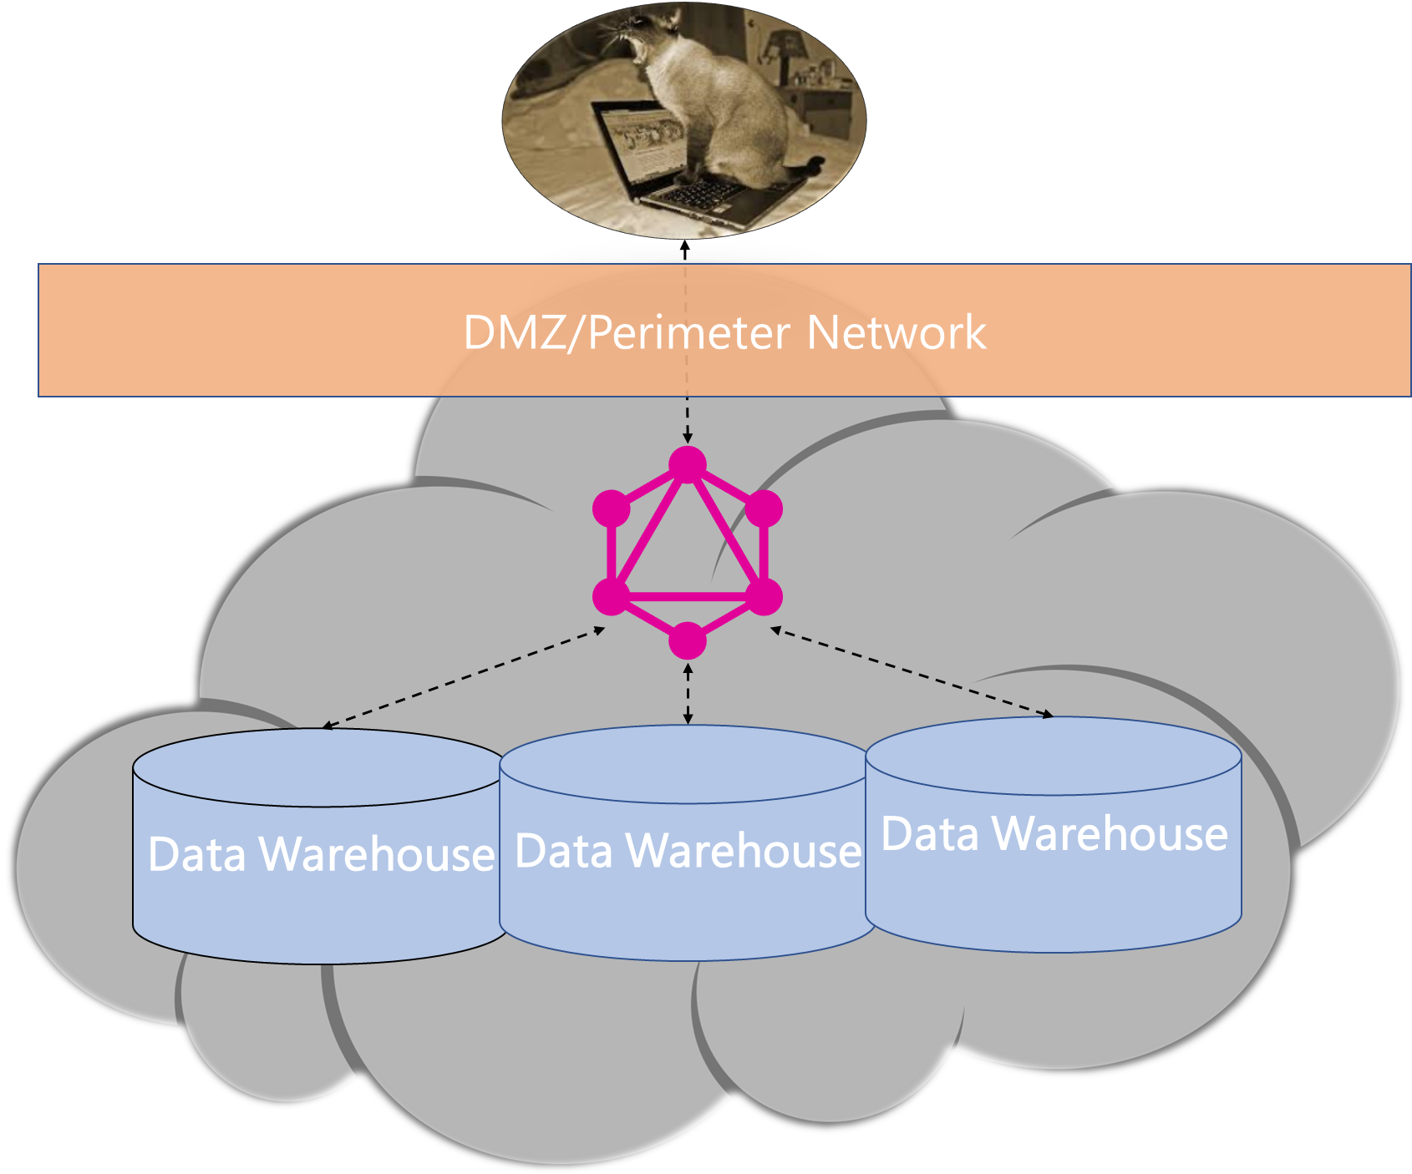

Typical REST
GraphQL
Users
Backend
Systems

