Slide 1
Pokemon Game
Class Name: K25ISTG01 2.0
Group Name: Nha Bui
Members: Bui Dang Nha

Slide 2
OBJECTIVES
Project Introduction
Customer Requirement
Use Cases
Activities Diagram
Class Diagram
Sequence Diagram
Database Design (ERD)
UI Design
Testing (Unit Test)
Advantages and Disadvantages of Project

Slide 3
INTRODUCTION TO PROJECT
Project Name: Pokemon Game
Project Description: This is a turn-based Pokémon console game where players can register, log in, and choose a starter Pokémon. Players explore the world, encounter wild Pokémon, battle NPCs and other players (PvP), catch and train Pokémon, level up, evolve, and manage their team and inventory. The game features a story mode, a Pokémon League challenge, and a Hall of Fame. All core mechanics—battling, catching, healing, and progression—are implemented with a focus on clean architecture and modular design.
Technologies:
  Programming language: C# (.NET 9.0)
  Database: MySQL

Slide 4
CUSTOMER REQUIREMENTS
Players can register and log in to their accounts.
Players can catch and train Pokémon.
The game supports both PvE (player vs environment) and PvP (player vs player) battle modes.
The game must allow players to challenge each other in real-time PvP battles, where each player selects their team of Pokémon and takes turns choosing moves. The system should handle matchmaking, turn order, and display battle results, including win/loss and experience gained.

Slide 5
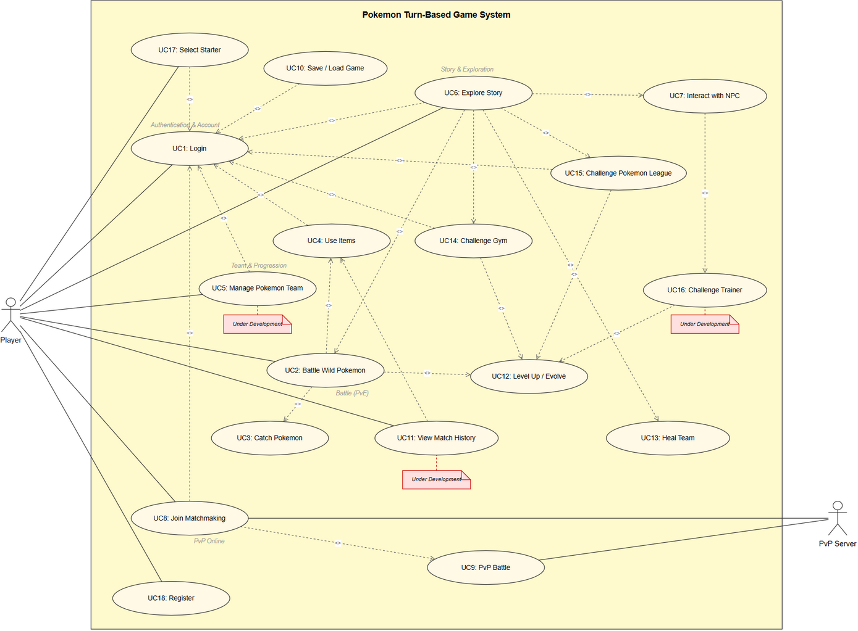
USE CASE
Use case list Use case diagram
  Register Account
  Login
  Catch Pokémon
  Train Pokémon
  Battle Wild Pokémon (PvE)
  Battle Other Players (PvP)
  Use Items
  View Inventory
  Save/Load Game Progress

Slide 6
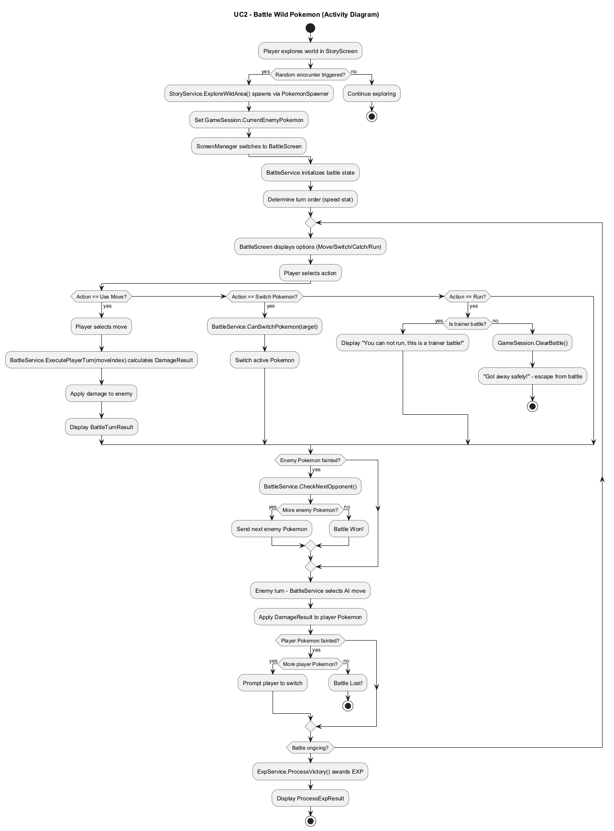
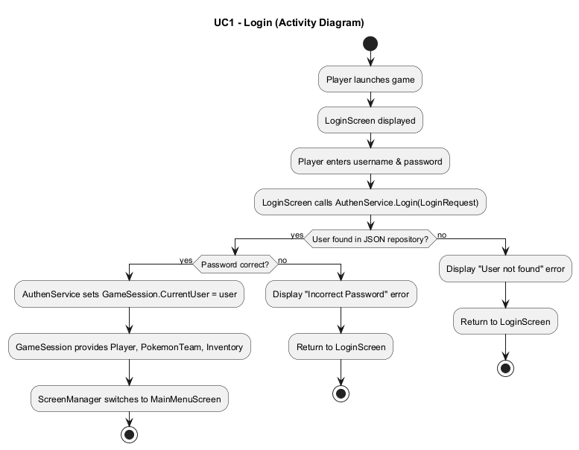
ACTIVITY DIAGRAM

Slide 7
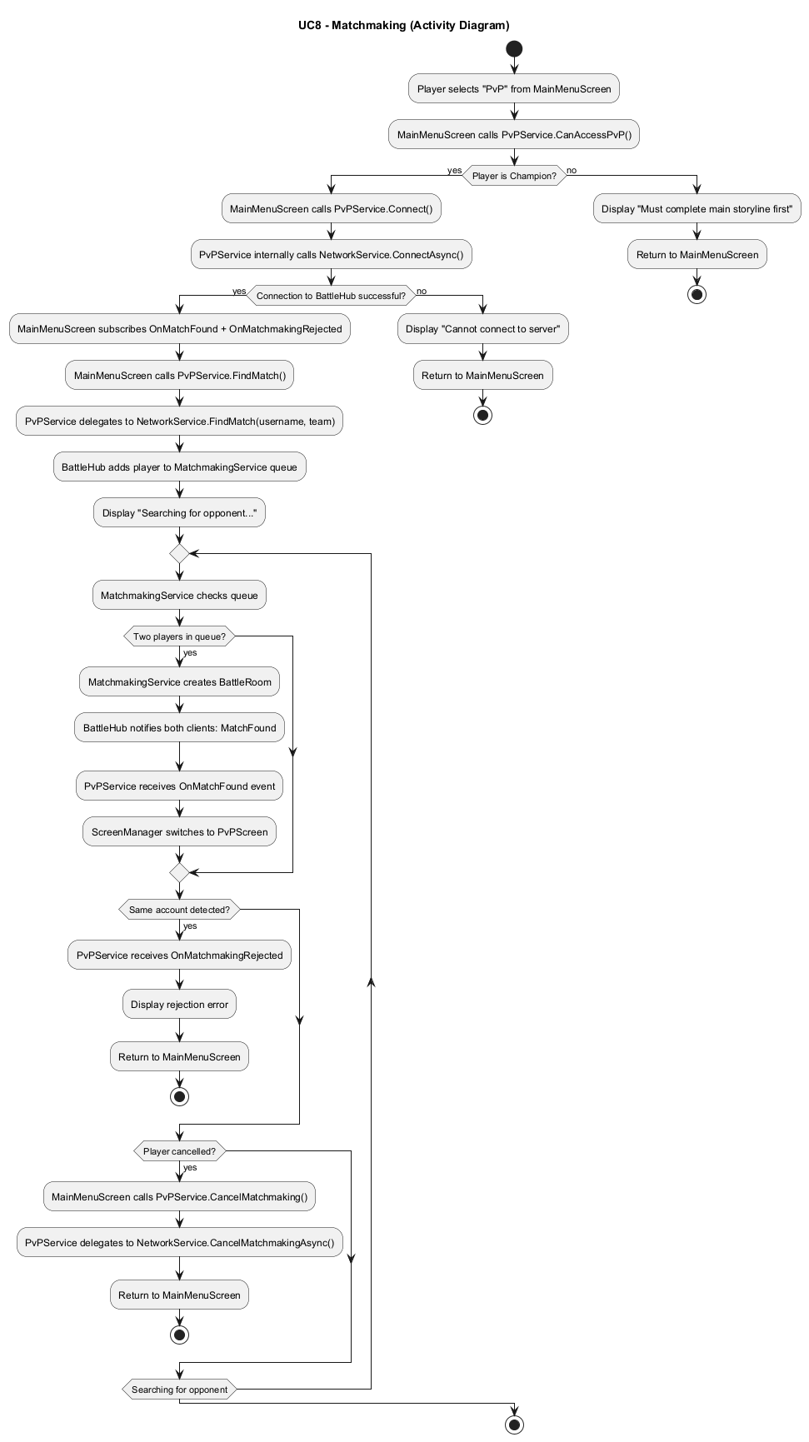
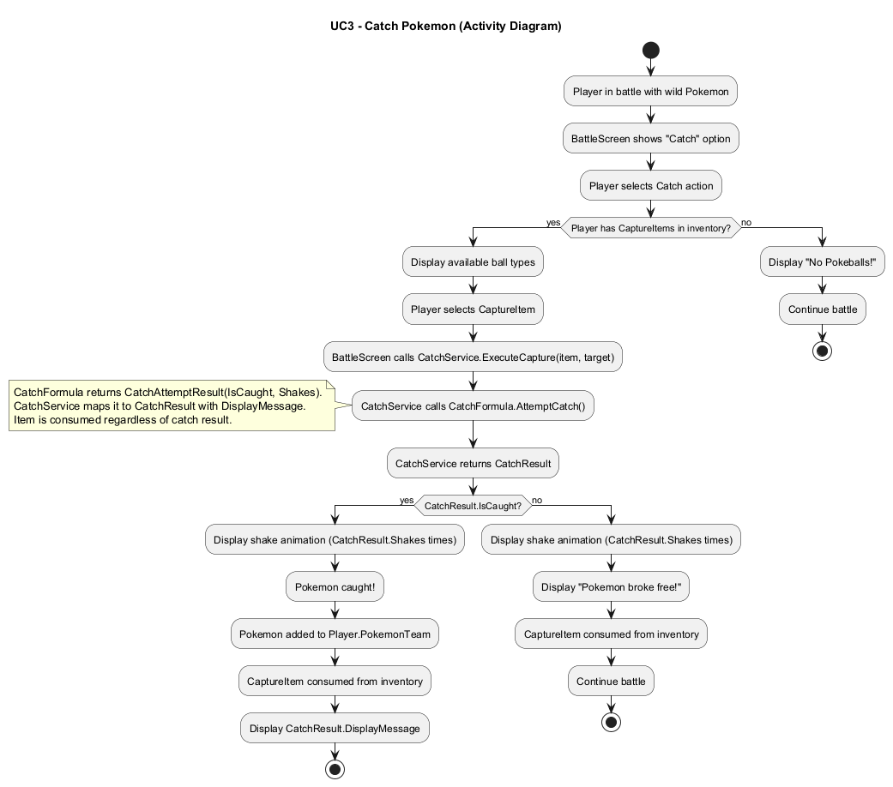
ACTIVITY DIAGRAM

Slide 8
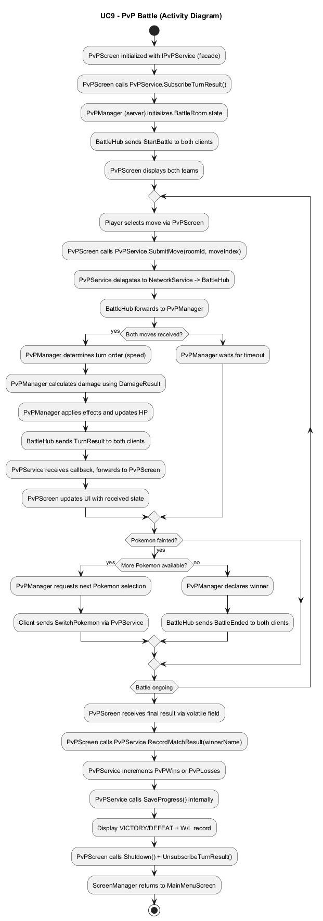
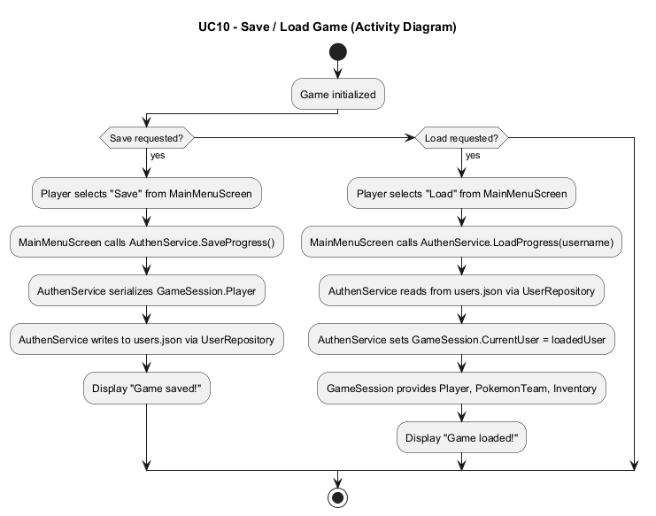
ACTIVITY DIAGRAM
UC9 PvP Battle UC10 Save/Load Game

Slide 9
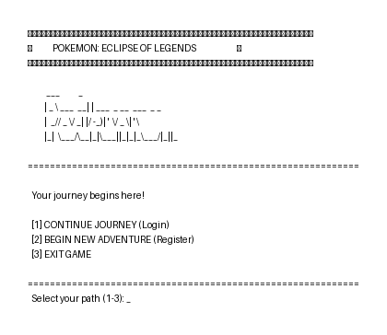
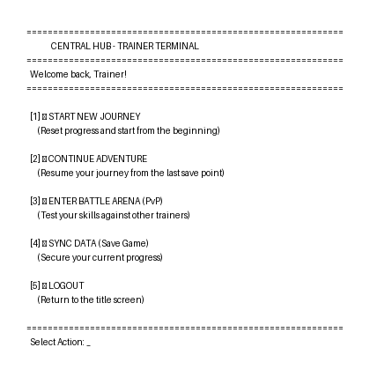
UI DESIGN
Login MainMenu

Slide 10
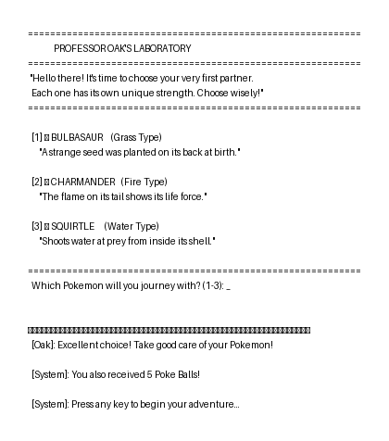
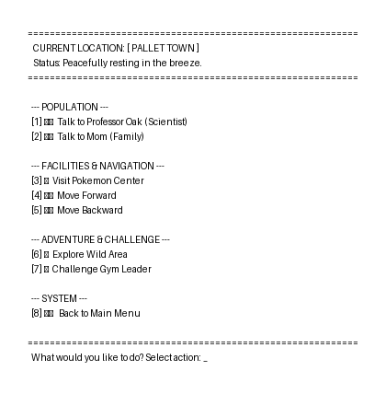
UI DESIGN
Starter Pokemon Selection Story Menu

Slide 11
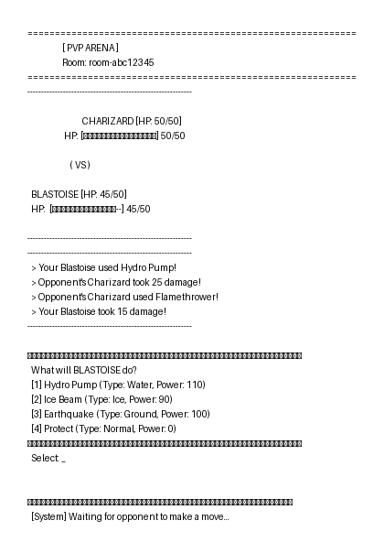
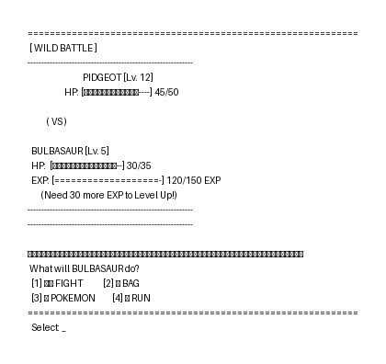
UI DESIGN
Pokemon Battle (PvE) Pokemon Battle (PvP)

Slide 12
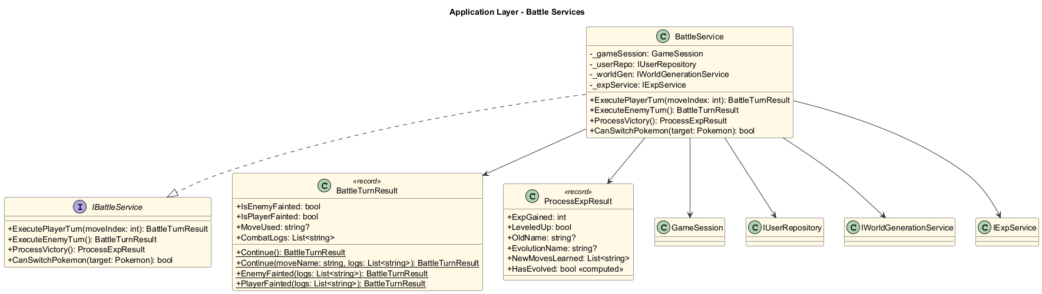
CLASS DIAGRAM
BattleService

Slide 13
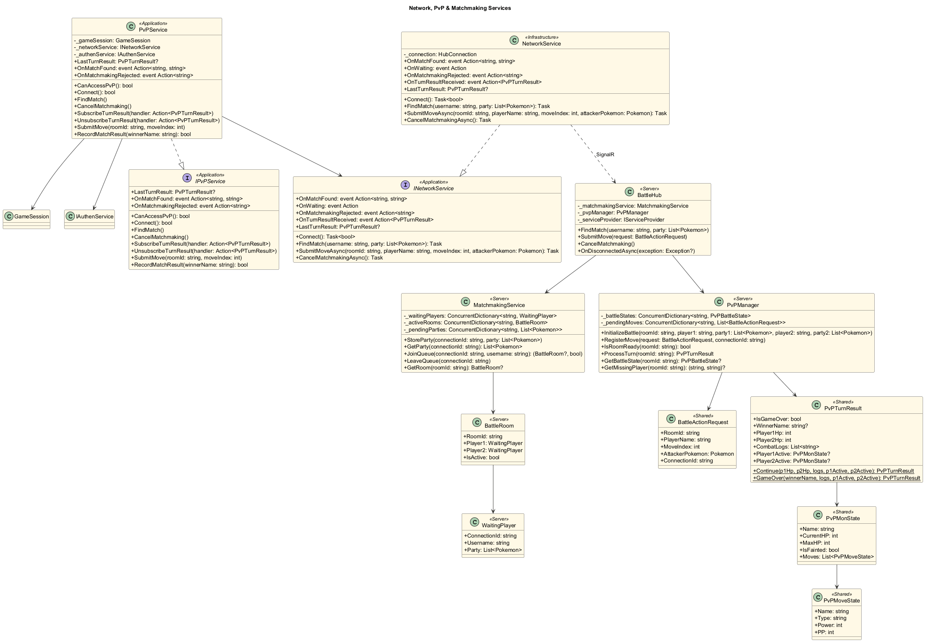
CLASS DIAGRAM
PvP And Matchmaking

Slide 14
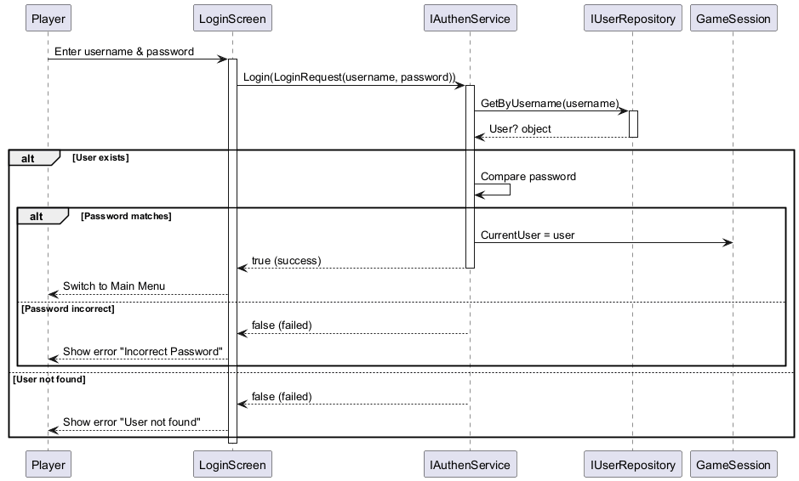
SEQUENCE DIAGRAM
Login

Slide 15
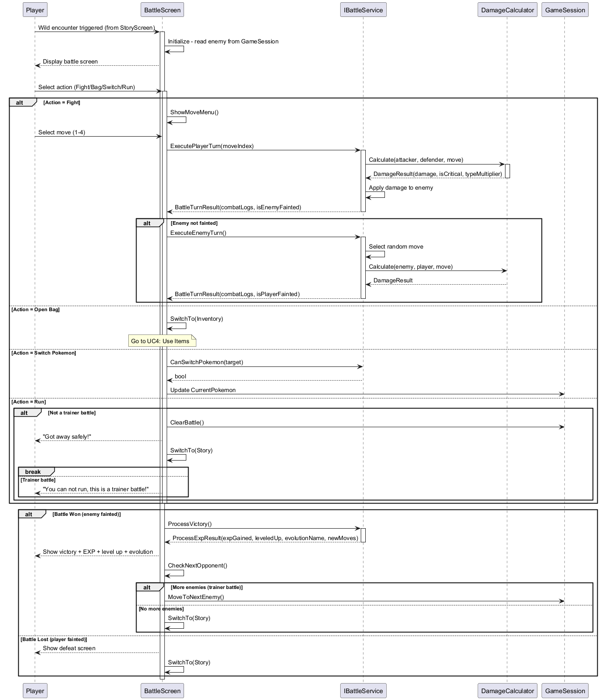
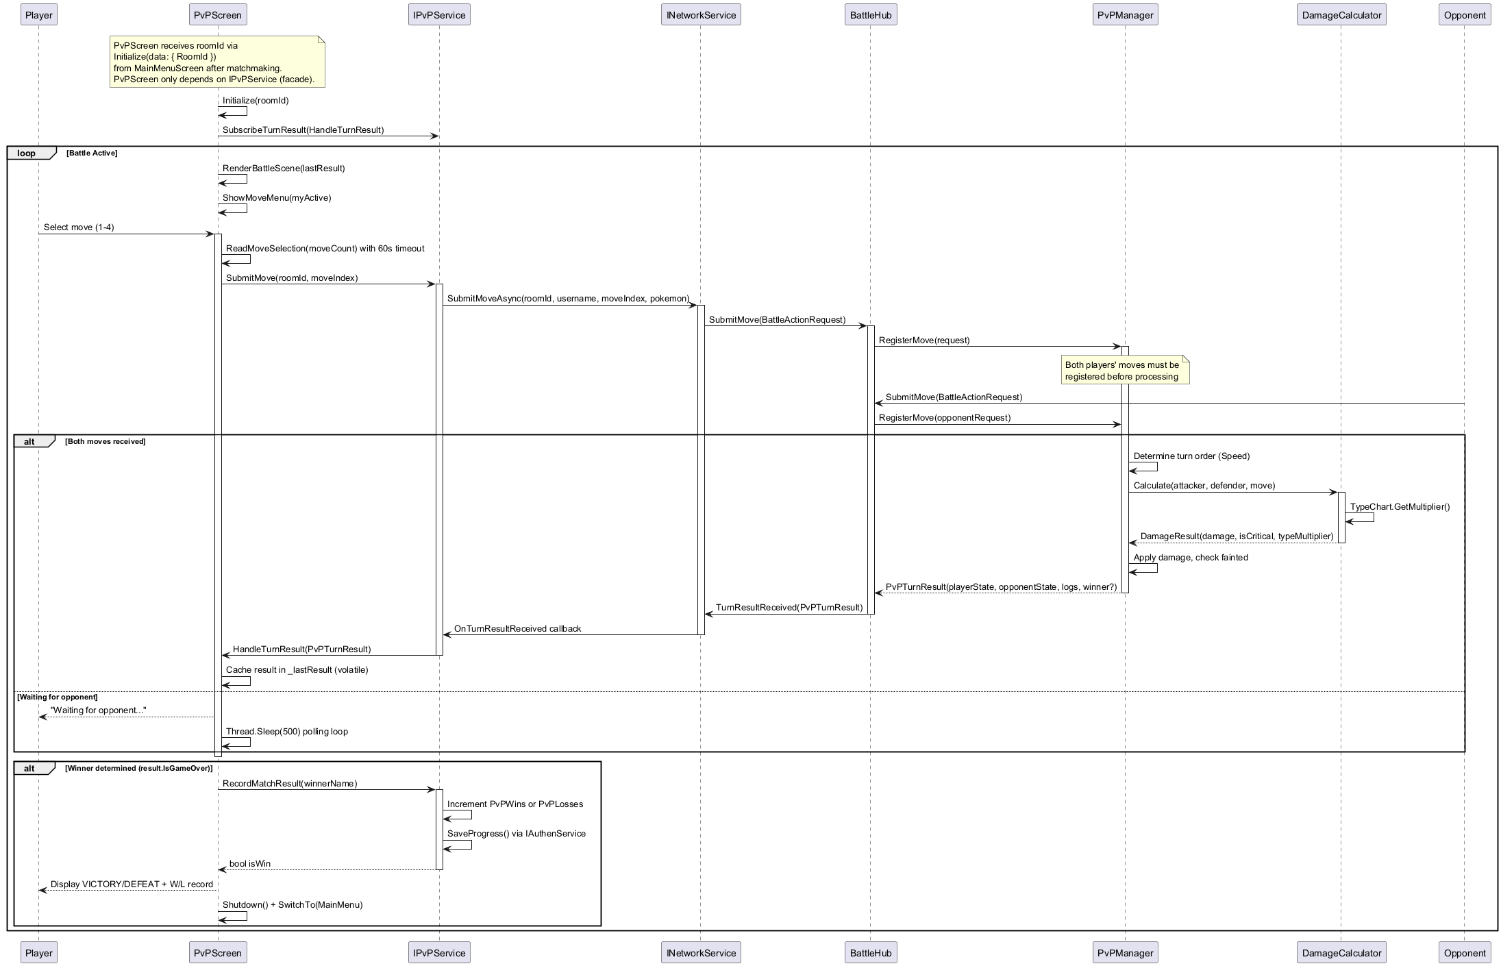
SEQUENCE DIAGRAM
Wild Battle PvP Battle

Slide 16
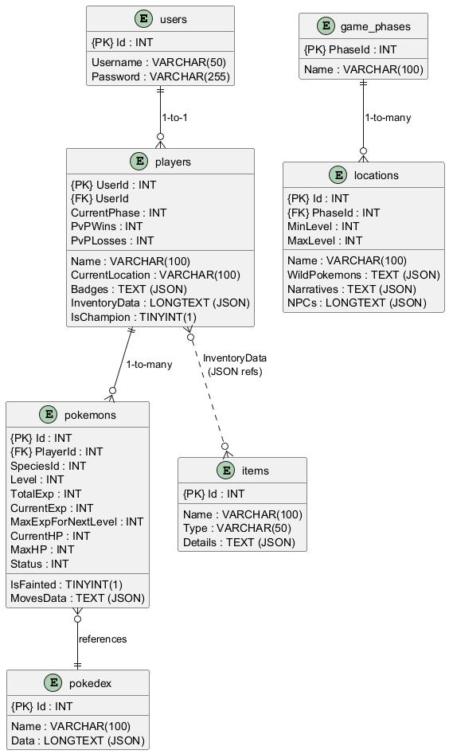
DATABASE TABLE RELATIONSHIP
Database Table

Slide 17
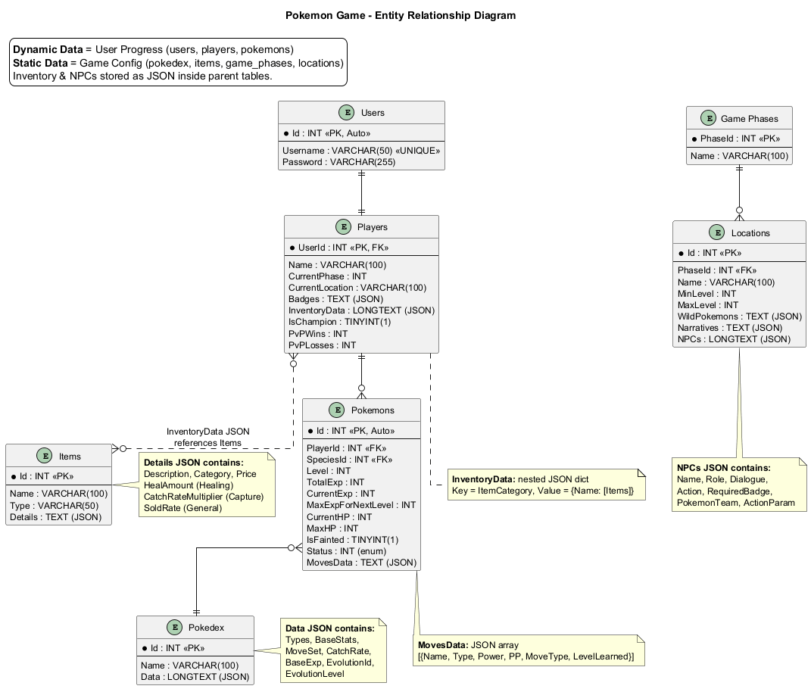
ENTITY RELATIONSHIP DIAGRAM
Entity Relationship Diagram

Slide 18
TASK ASSIGNMENT (TO EACH GROUP MEMBER)
Tasks in each working week
Week 1 (x - y): Doing something
Week 2….

Slide 19
EXPERIENCE LEARNED
Good thing
Bad thing

Slide 20


Slide 21
Q & A

