Slide 1
Project Report

Slide 2
No general requirement image found

Slide 3
I. Project introduction
Overview
This system is a Pokémon turn‑based game supporting player account management, story exploration, Pokémon collection and team management, turn‑based battles (PvE and PvP), and game persistence (save/load). Two primary actor roles are Player and PvP Server (for online matches). The system must reliably maintain game state, protect player data, and provide consistent battle mechanics.
Key features
  Player account: register/login
  Story and exploration: encounter wild Pokémon, interact with NPCs
  Pokémon management: catch, heal, level up, evolve, manage team
  Battles: wild encounters (PvE) and player-vs-player (PvP)
  Matchmaking: join PvP queue and play online matches
  Persistence: save and load game progress, view match history
  Admin/Server-side: coordinate PvP matches and persistence

Slide 4
Proposed system
Implement game logic for players to explore, battle, catch, and manage Pokémon.
Implement server-side match coordination for PvP and persistence for saves and match history.
Project scope
Primary actors: Player, PvP Server (and optionally NPC/AI).
Scope: client-side gameplay flows (exploration, battles, inventory/team management), and backend capabilities for matchmaking and persistence.
System name
Pokémon Turn-Based Game System (or TurnBasedPokemon)
Deployment environment
Windows, Linux, macOS (desktop). Backend/services compatible with Linux servers.
Development tools
Visual Studio Code
PlantUML / draw.io for diagrams
Python/.NET/your chosen runtime for game logic
MySQL / SQLite or other DB for persistence
python-pptx / other tooling for generating reports (optional)
Customer requirements (high-level)
Player registration and login
Display Pokémon list and details
Start and participate in battles (wild & trainer/PvP)
Catch Pokémon and manage team
Use items and heal team
Save and load game progress
View match history
Join matchmaking and play PvP
Select starter Pokémon
Register new players
II. System requirements analysis (brief)
Purpose: provide a polished turn‑based Pokémon experience where players can progress, collect Pokémon, and compete. The system must reliably handle game state (transactions for saves and battle outcomes), enforce game rules for battles and captures, and protect player accounts/data. The backend must coordinate PvP matches and provide persistence for saves and match history.

Slide 5
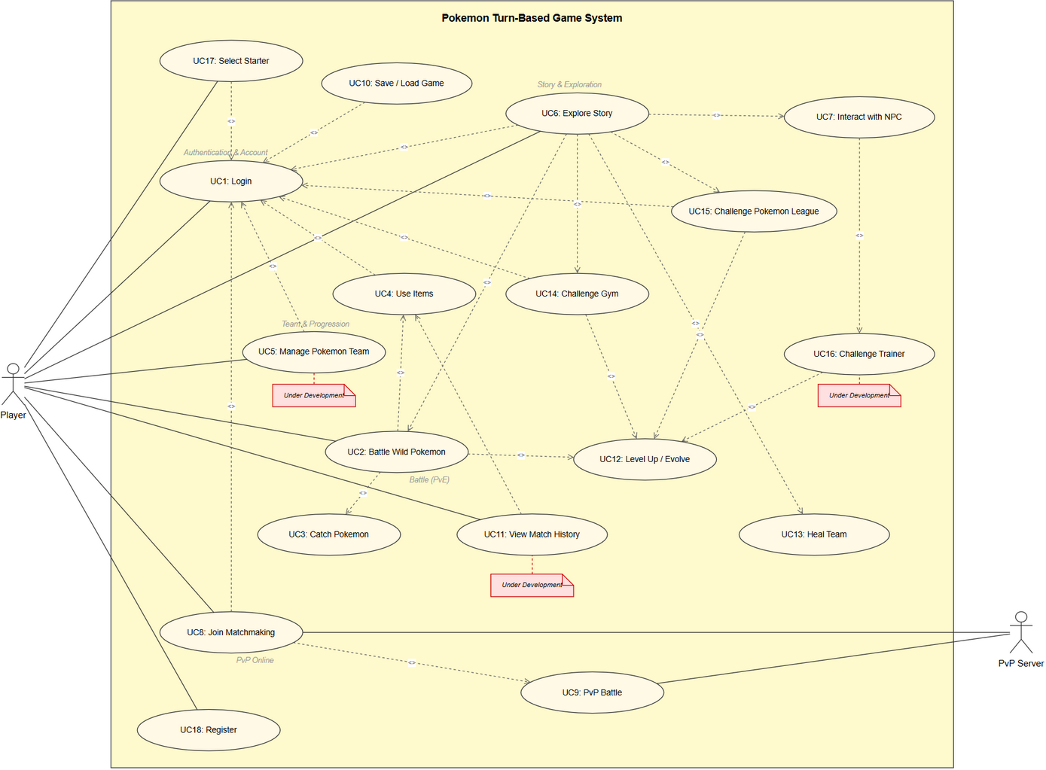

Slide 6
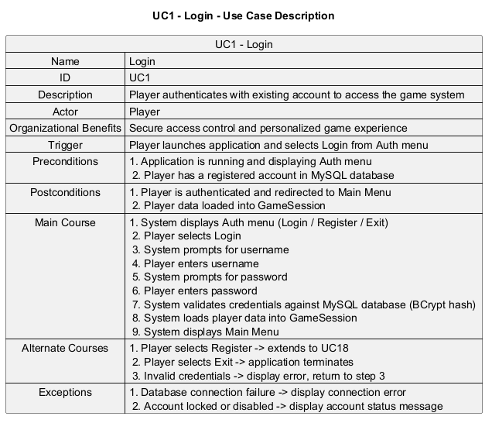

Slide 7
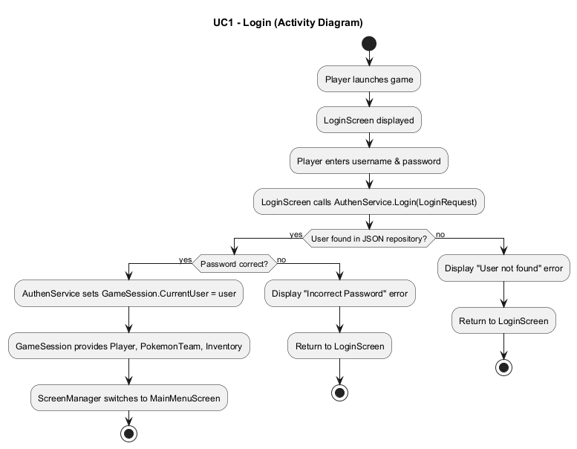

Slide 8
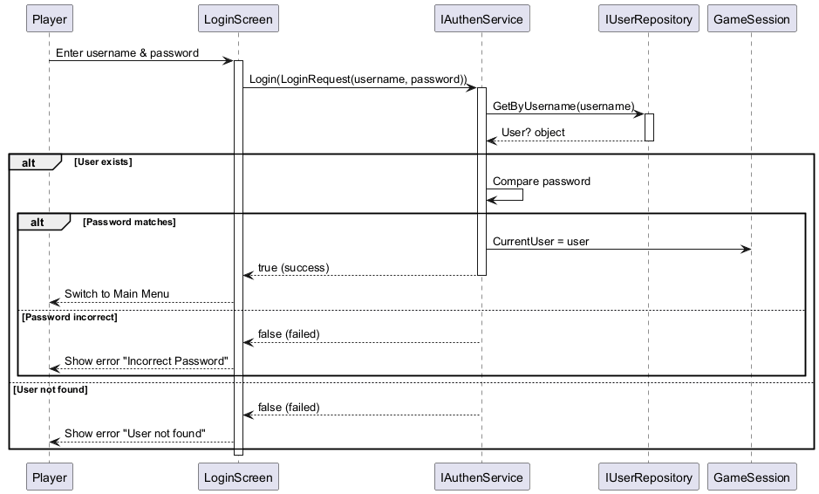

Slide 9
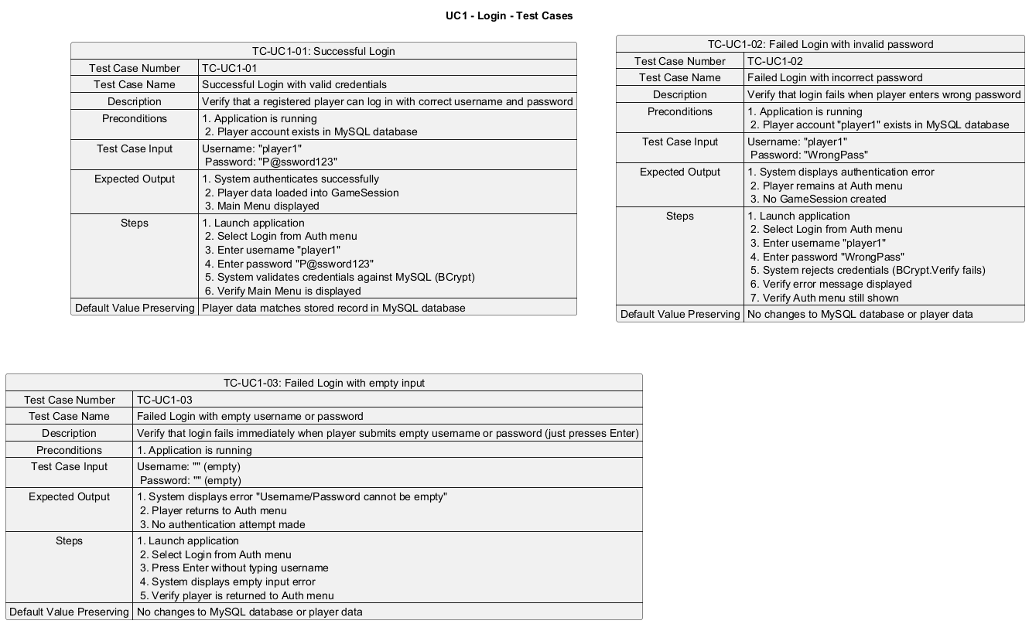

Slide 10
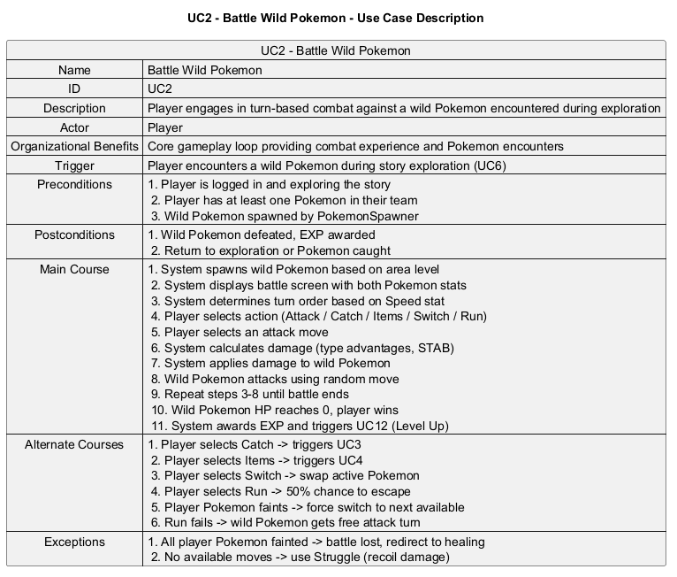

Slide 11
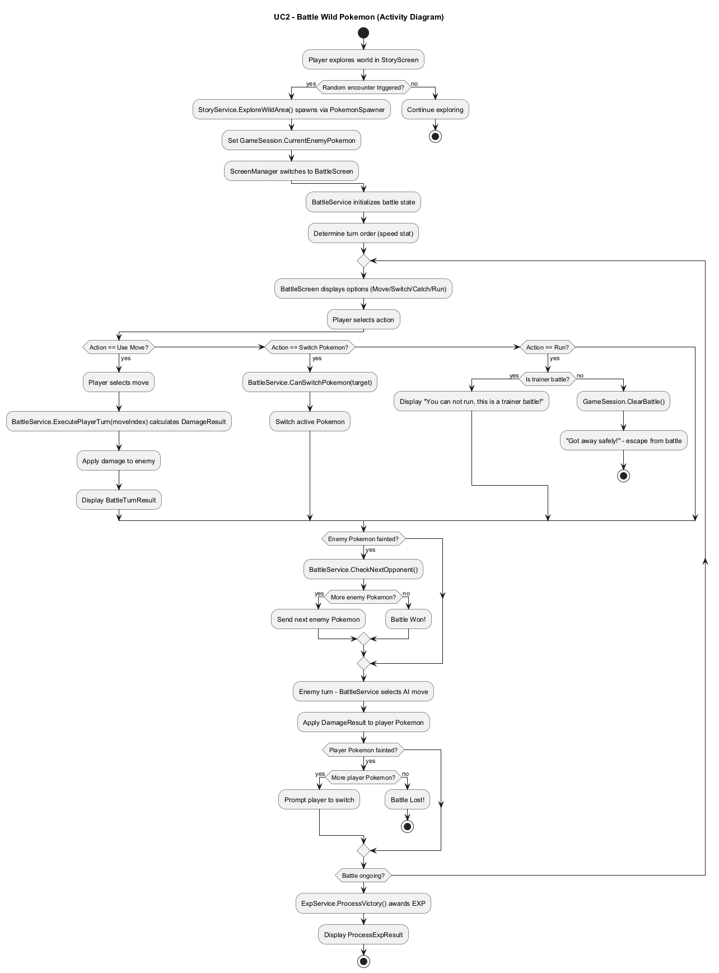

Slide 12
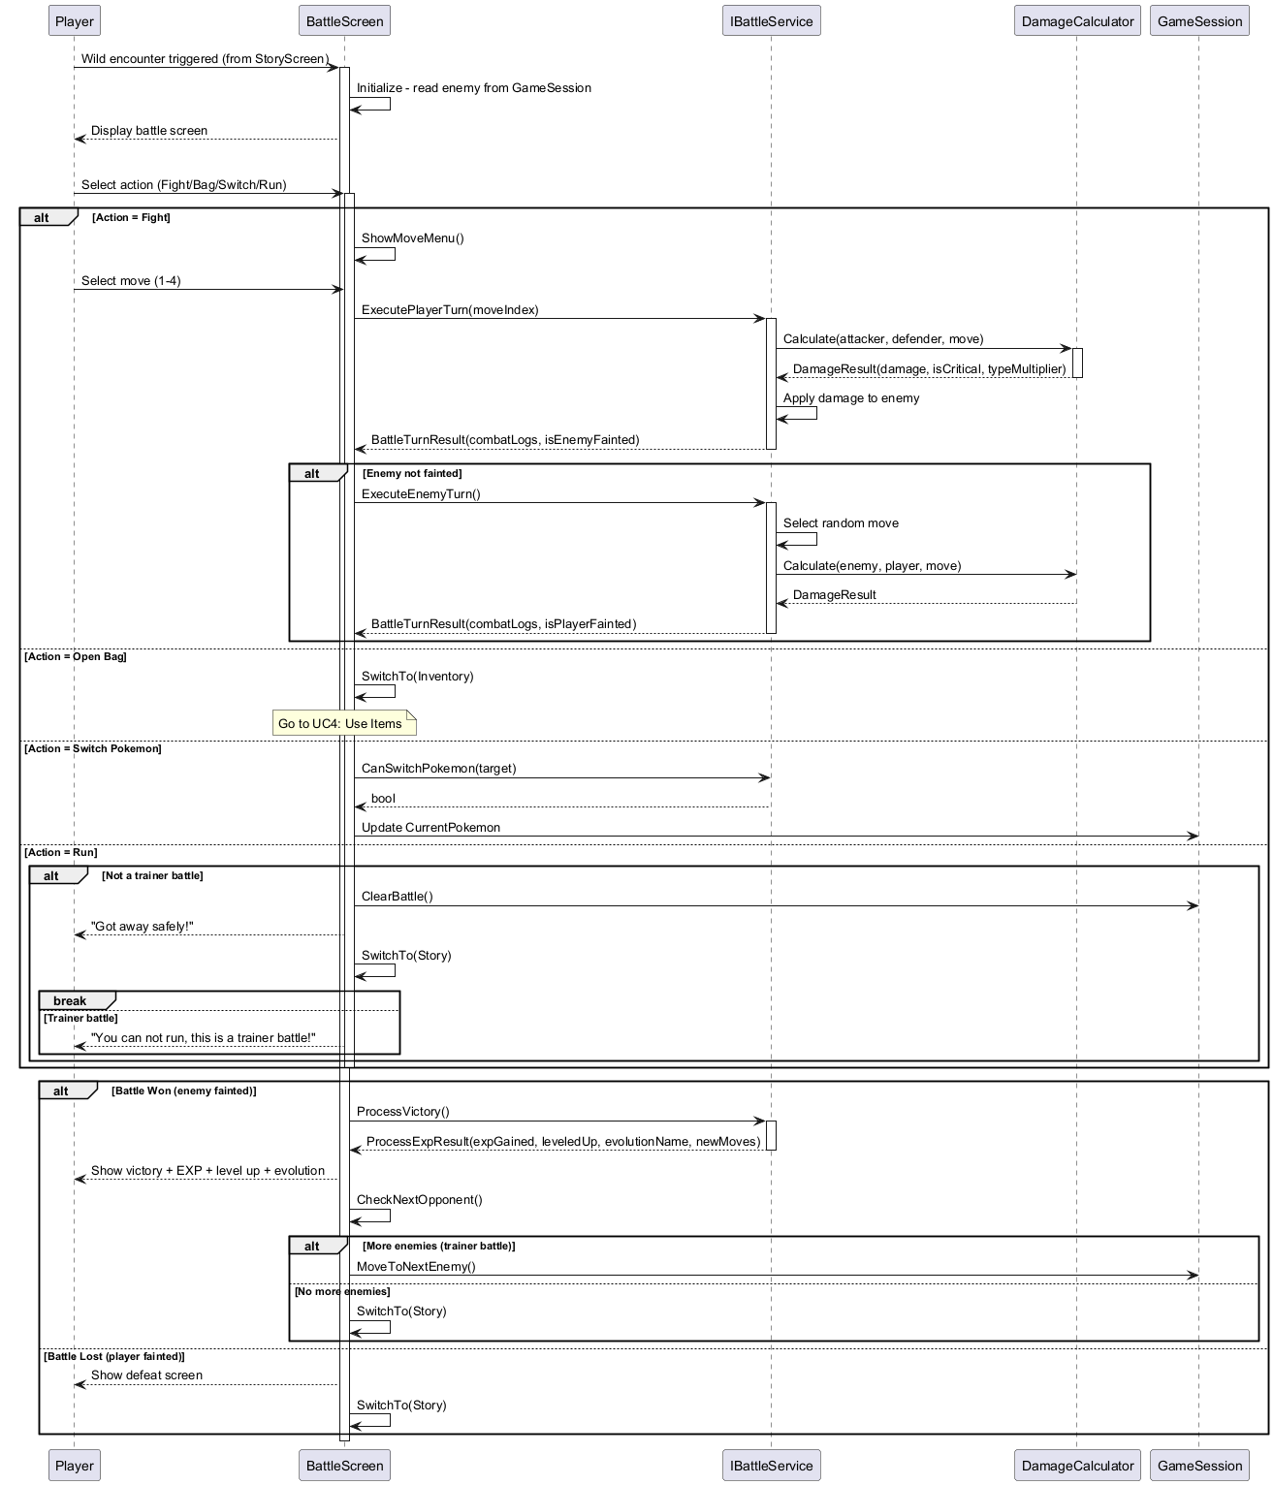

Slide 13
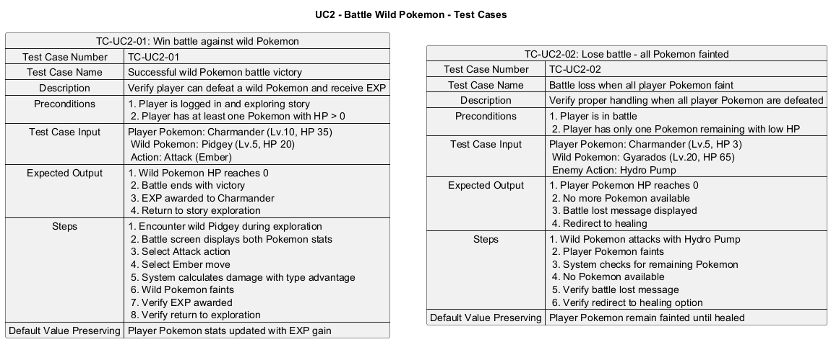

Slide 14
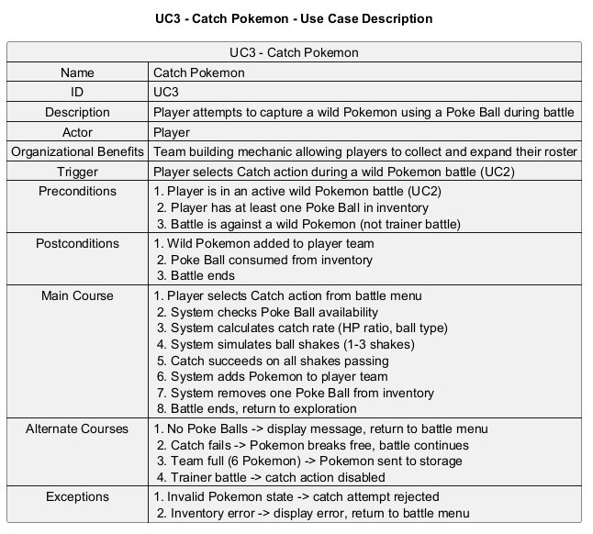

Slide 15
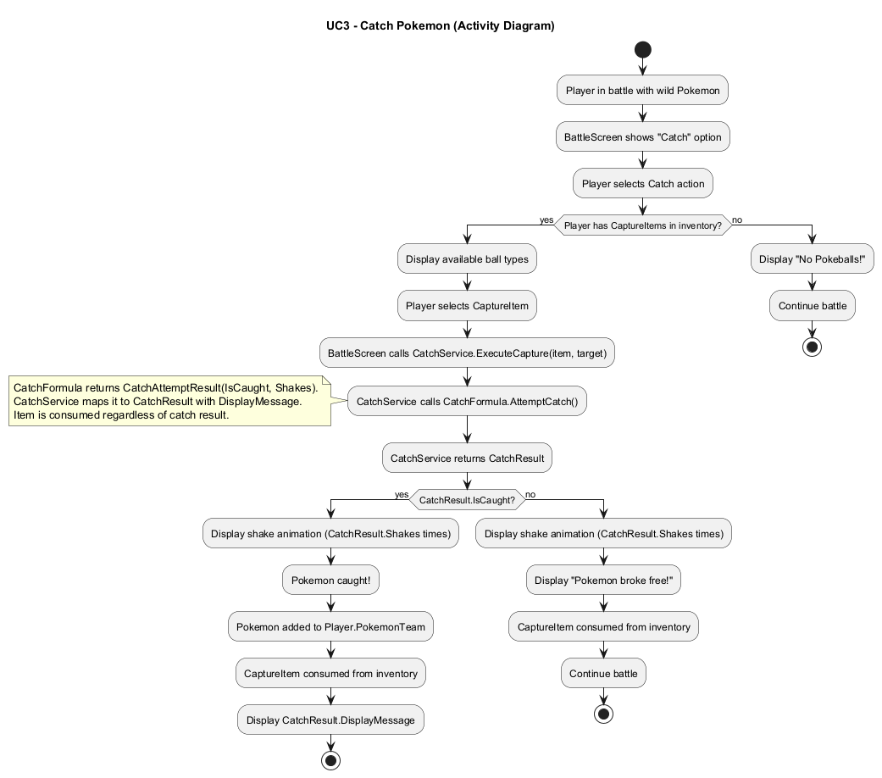

Slide 16
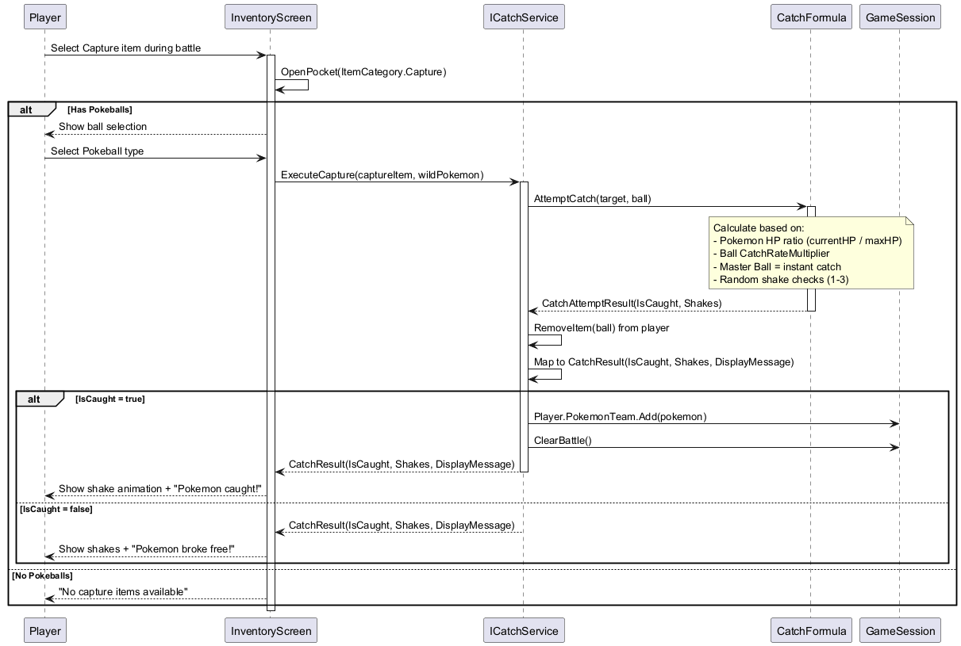

Slide 17
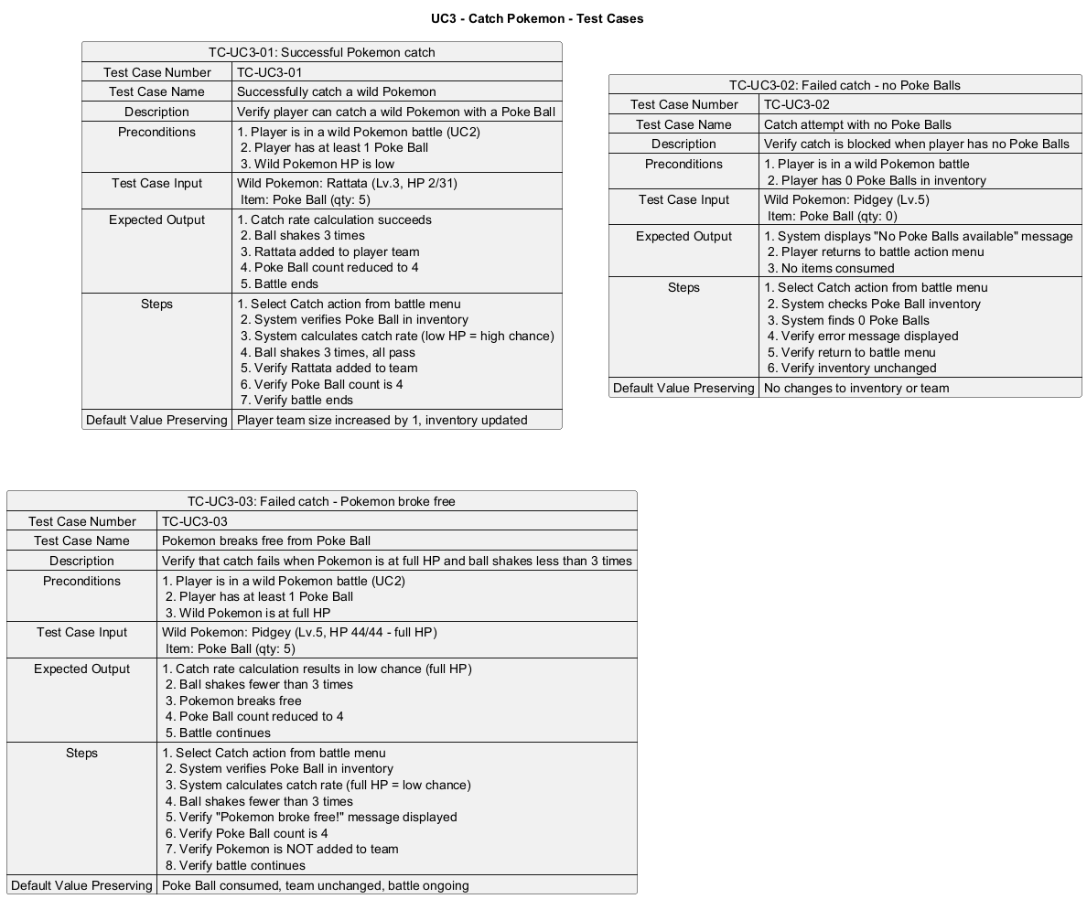

Slide 18
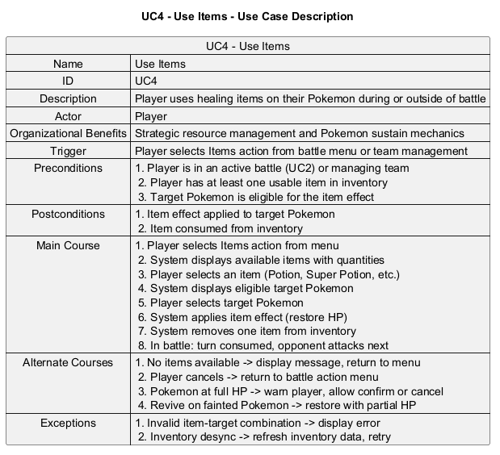

Slide 19
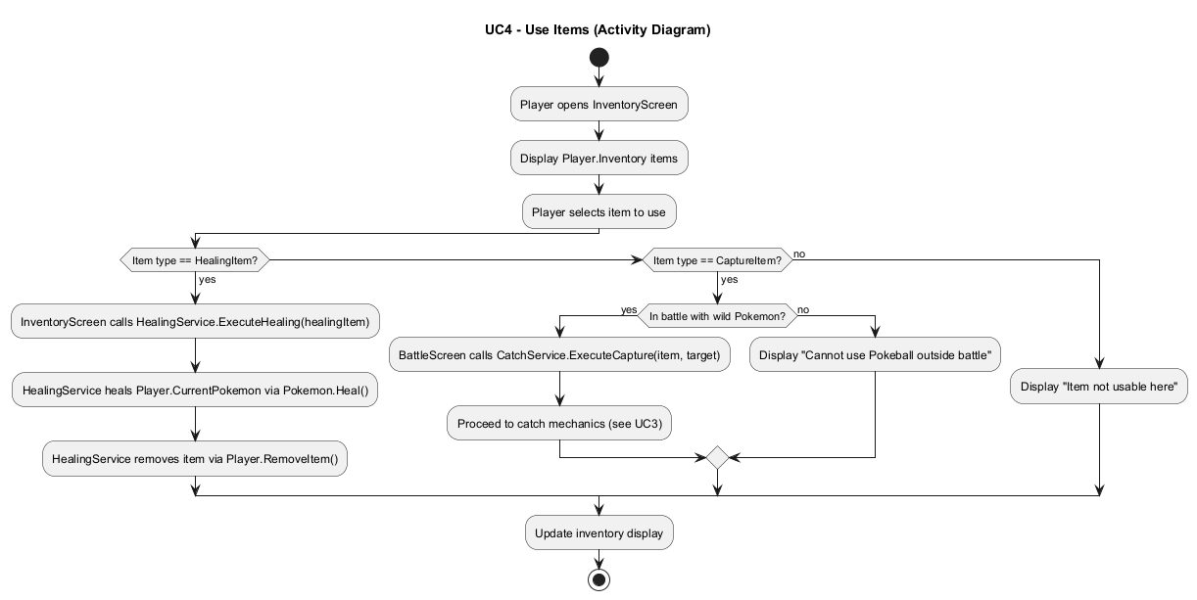

Slide 20
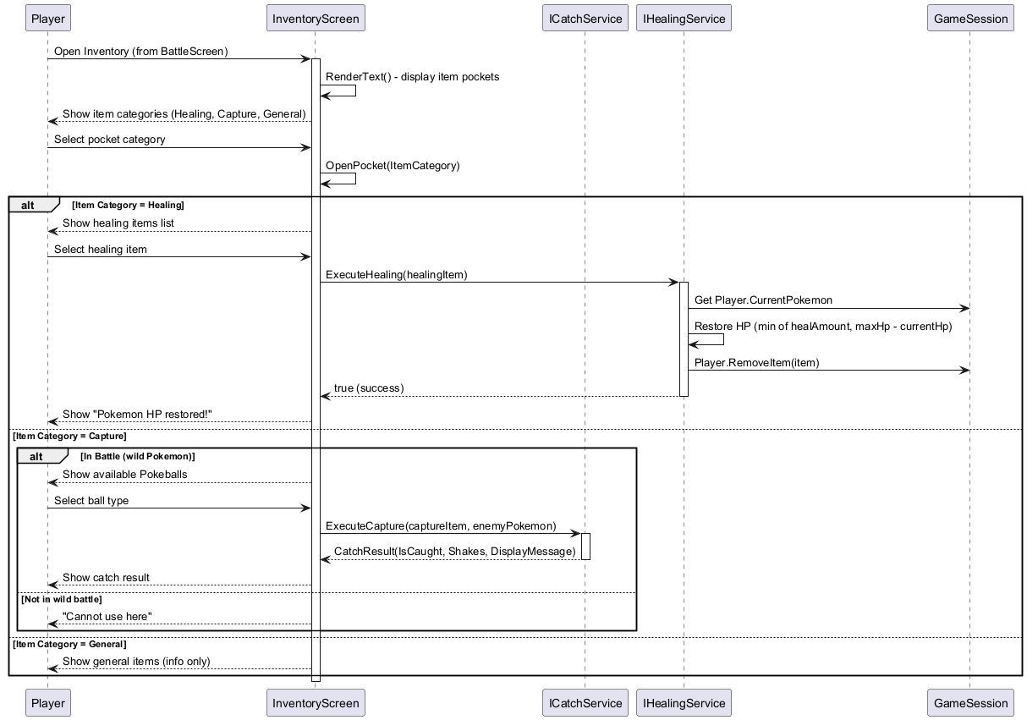

Slide 21
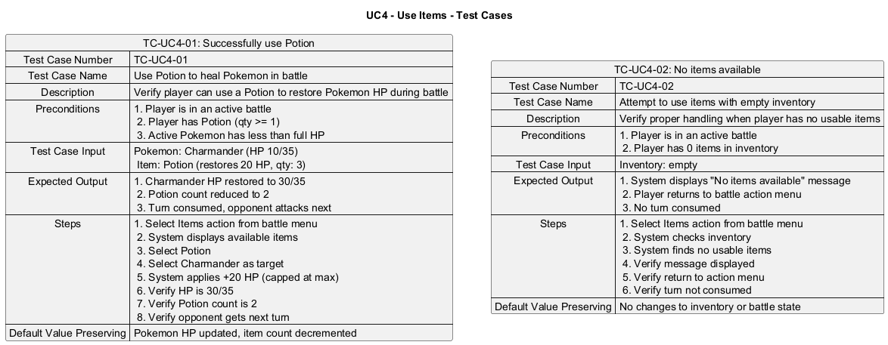

Slide 22
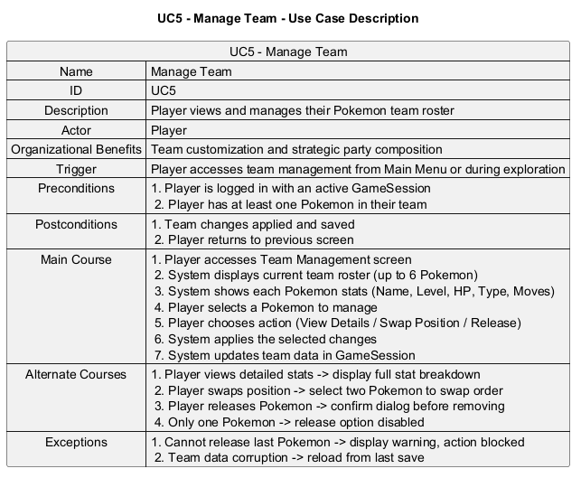

Slide 23
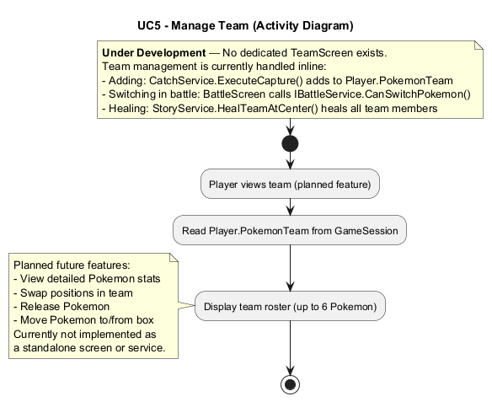

Slide 24
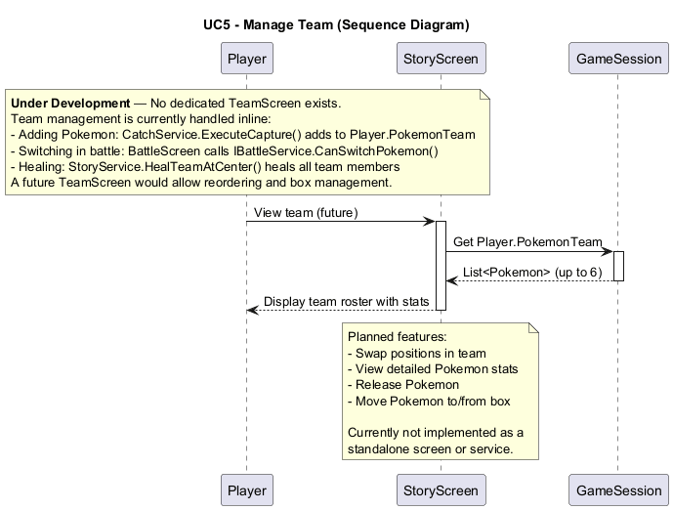

Slide 25
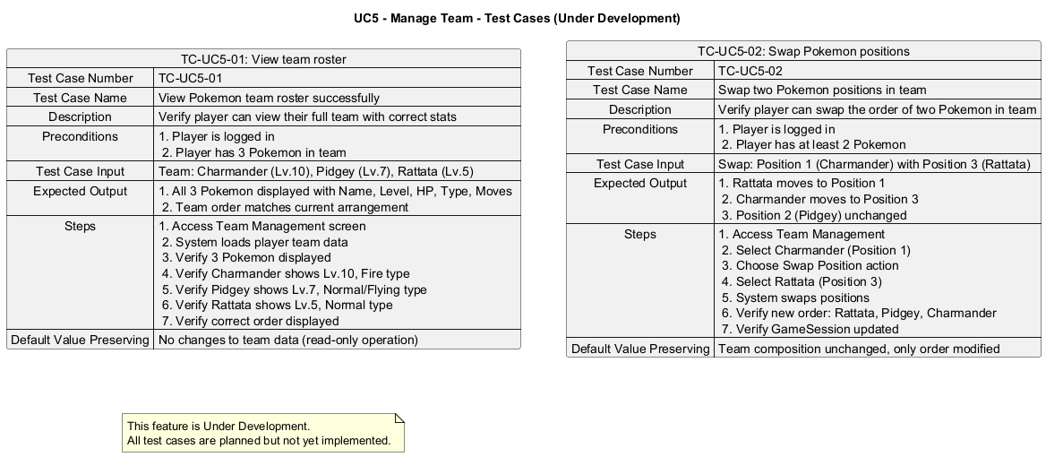

Slide 26
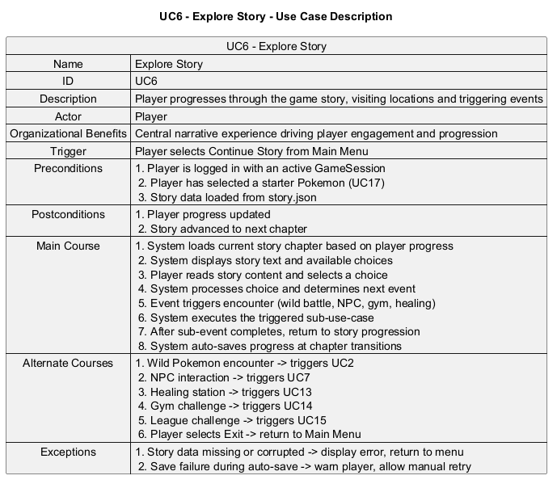

Slide 27
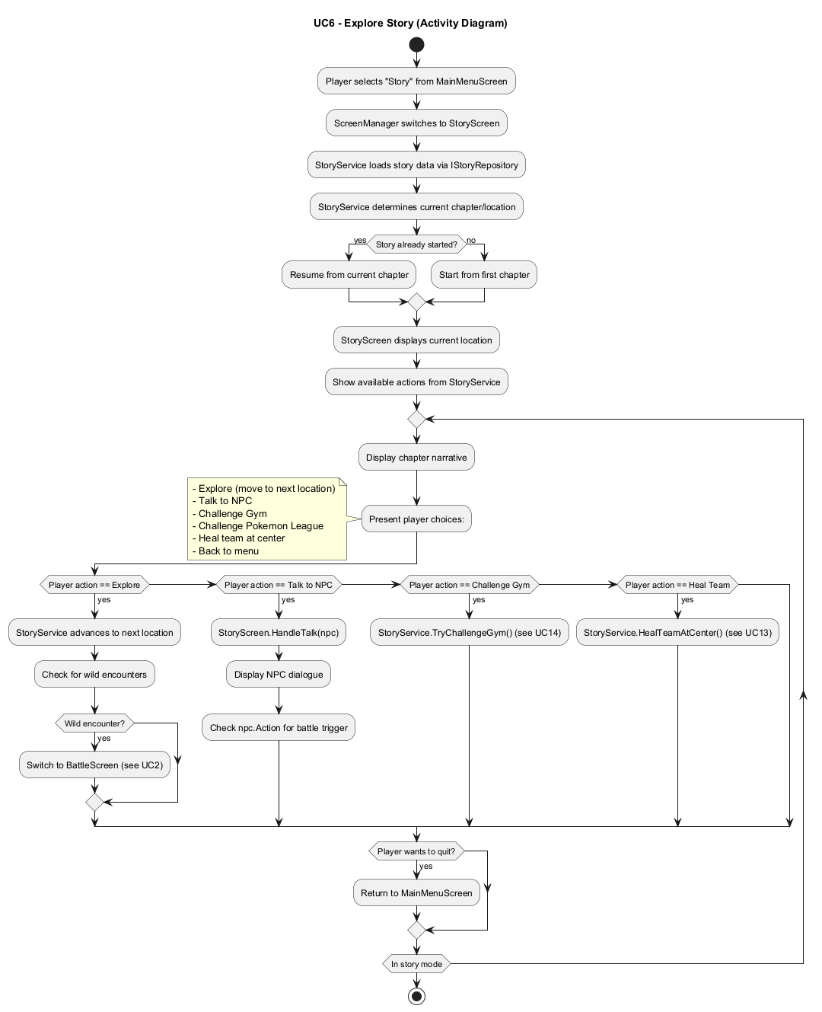

Slide 28
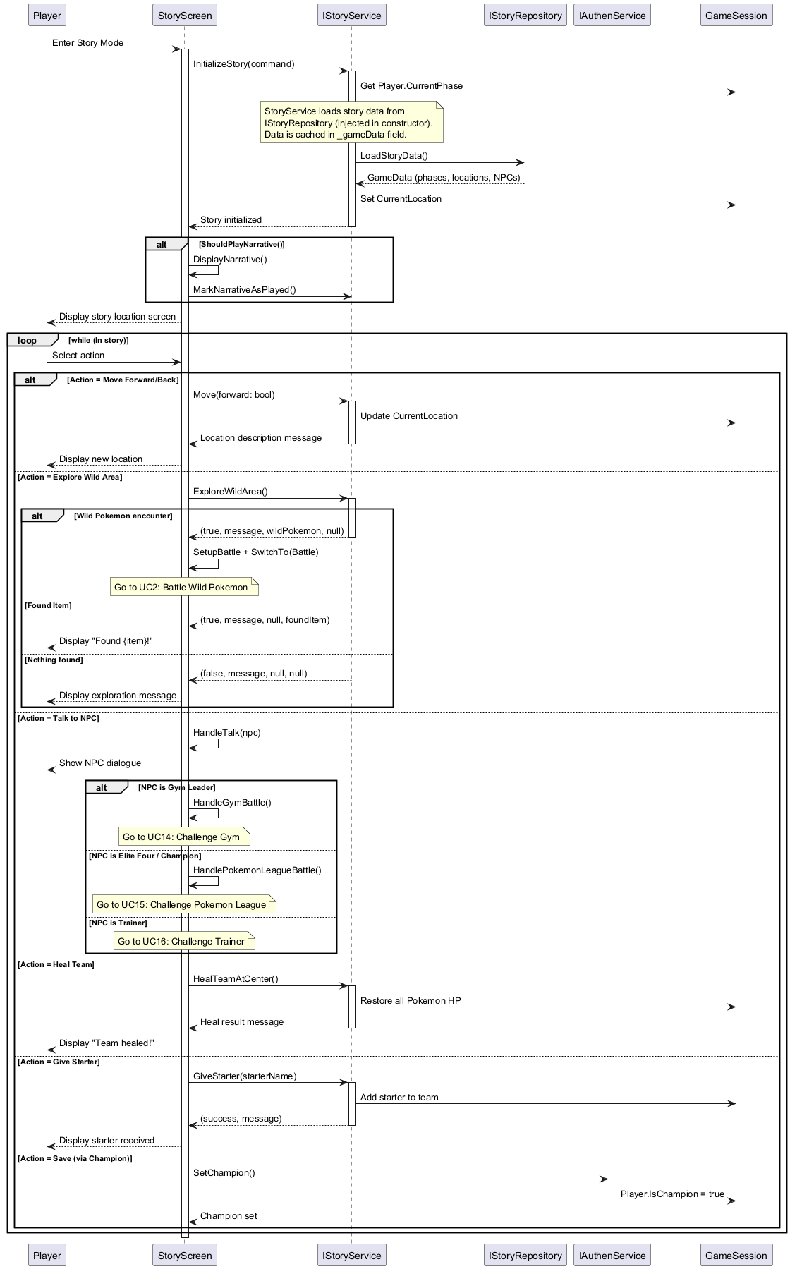

Slide 29
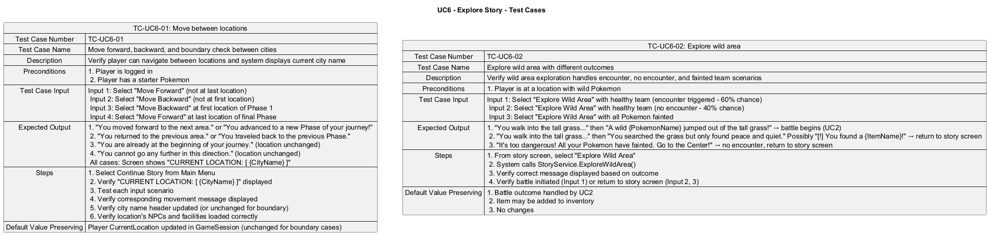

Slide 30
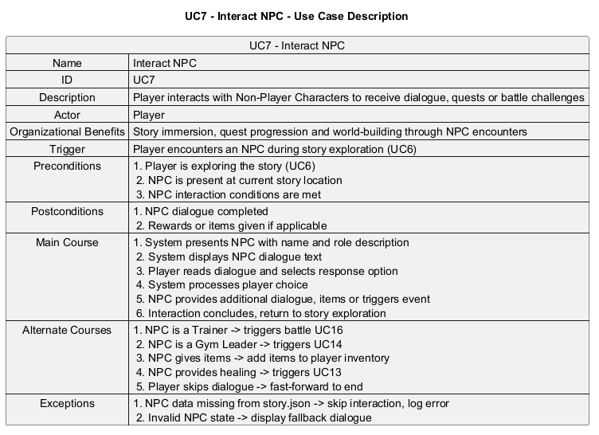

Slide 31
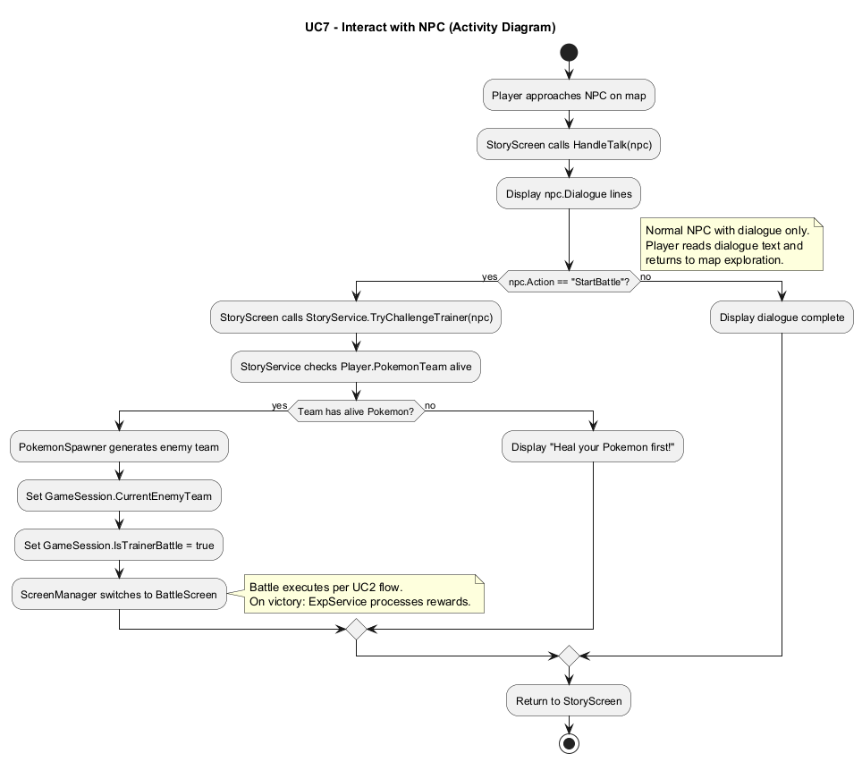

Slide 32
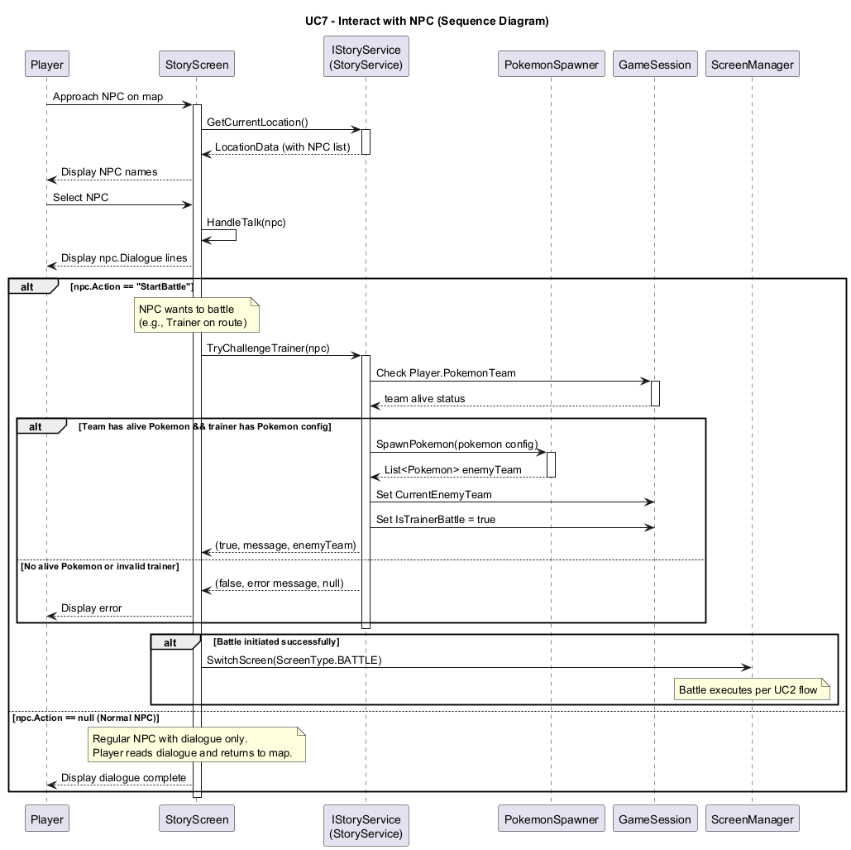

Slide 33
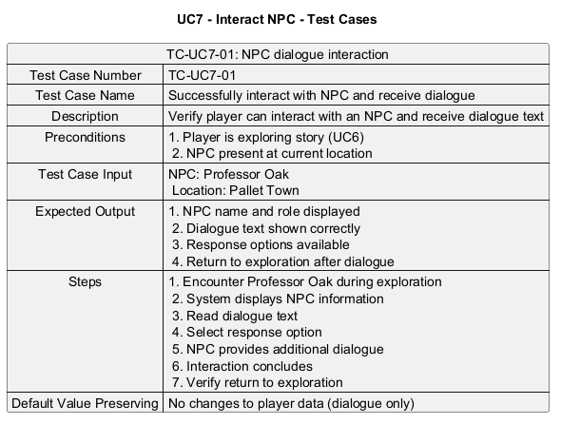

Slide 34
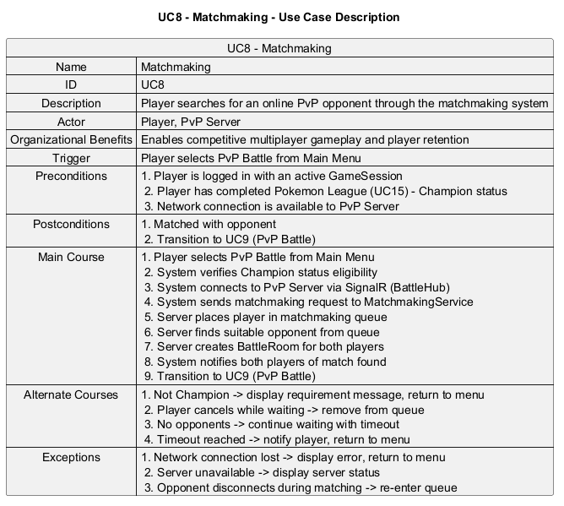

Slide 35
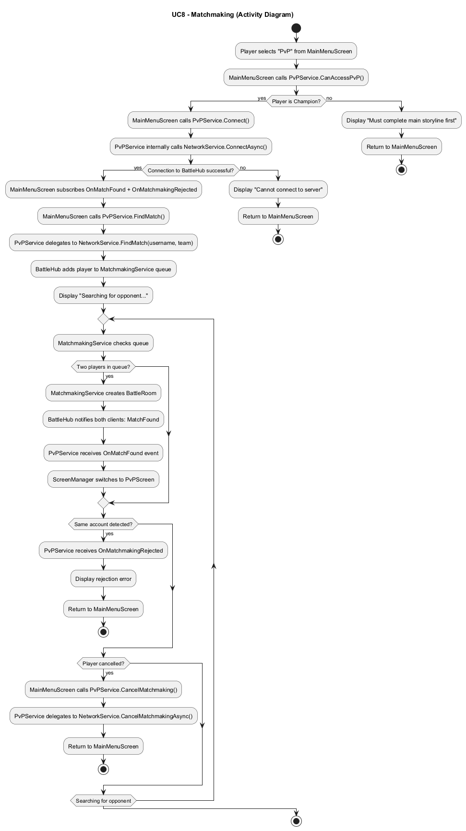

Slide 36
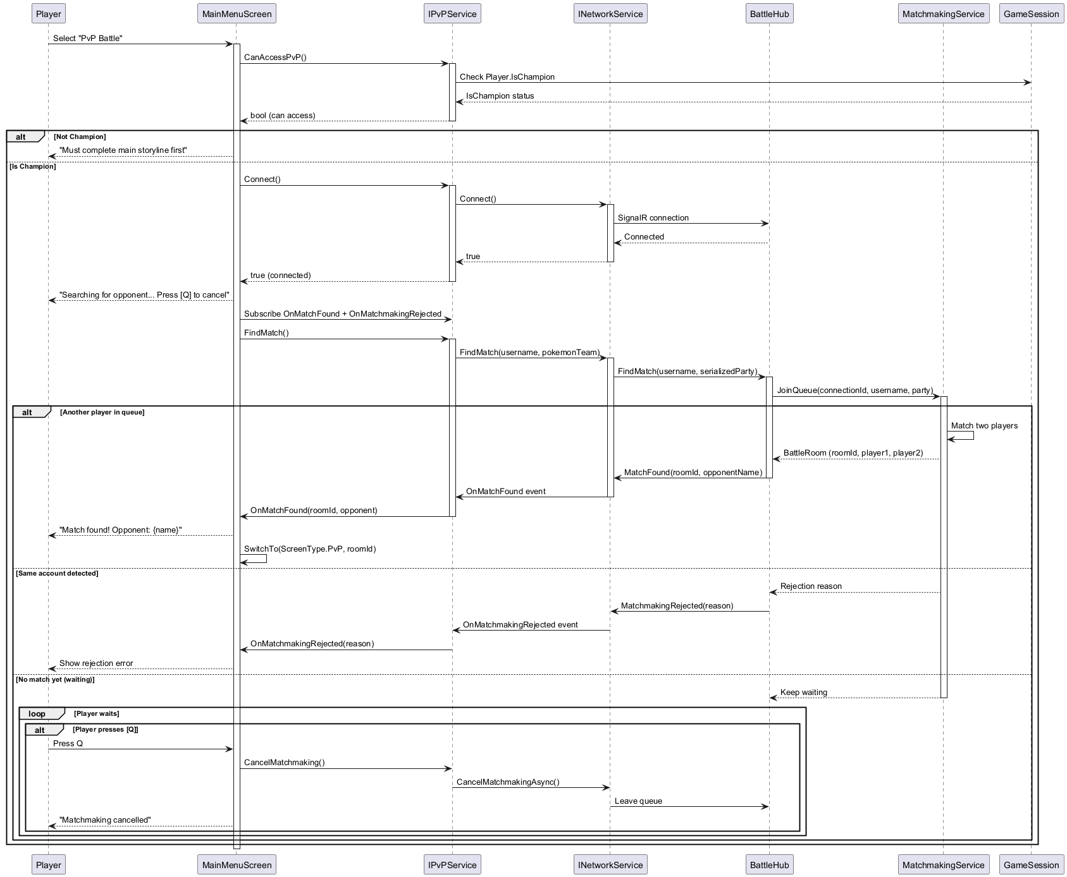

Slide 37
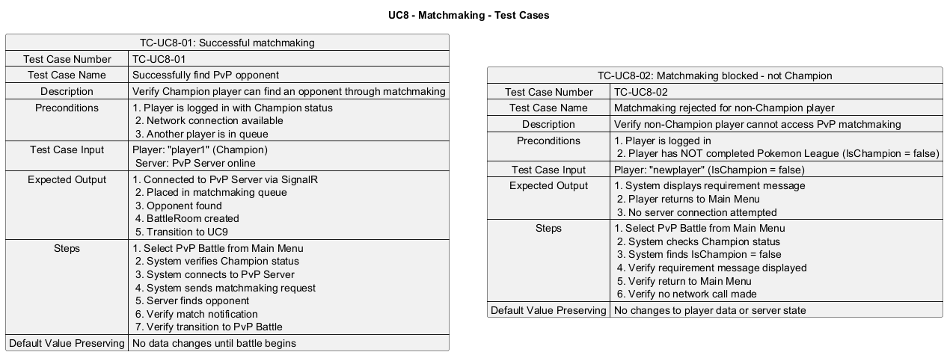

Slide 38
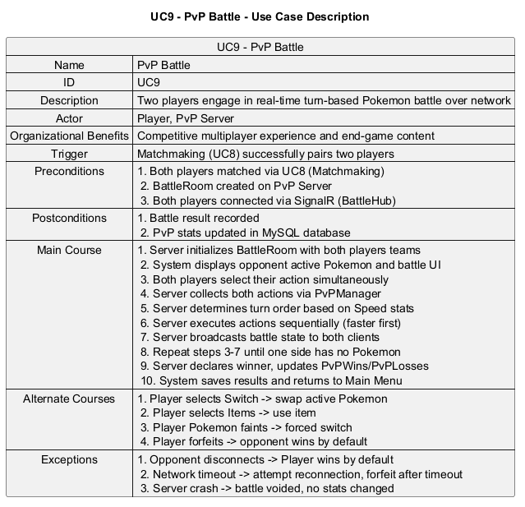

Slide 39
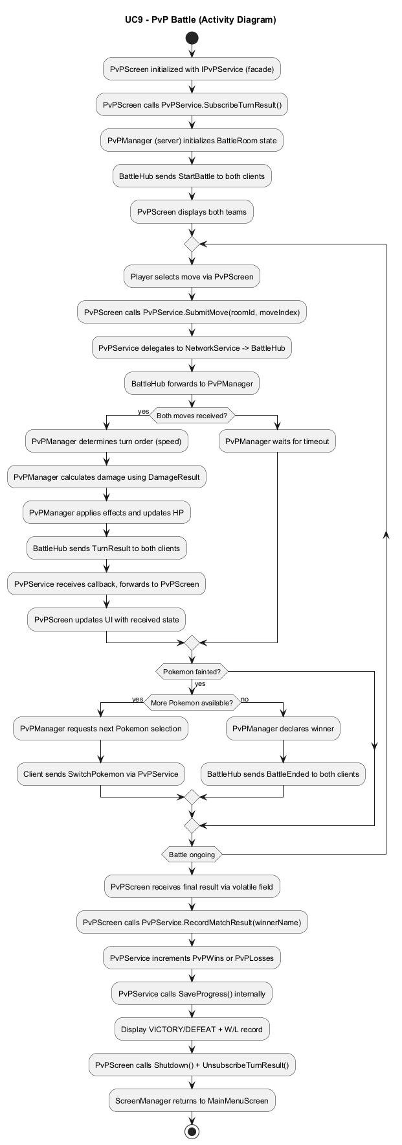

Slide 40
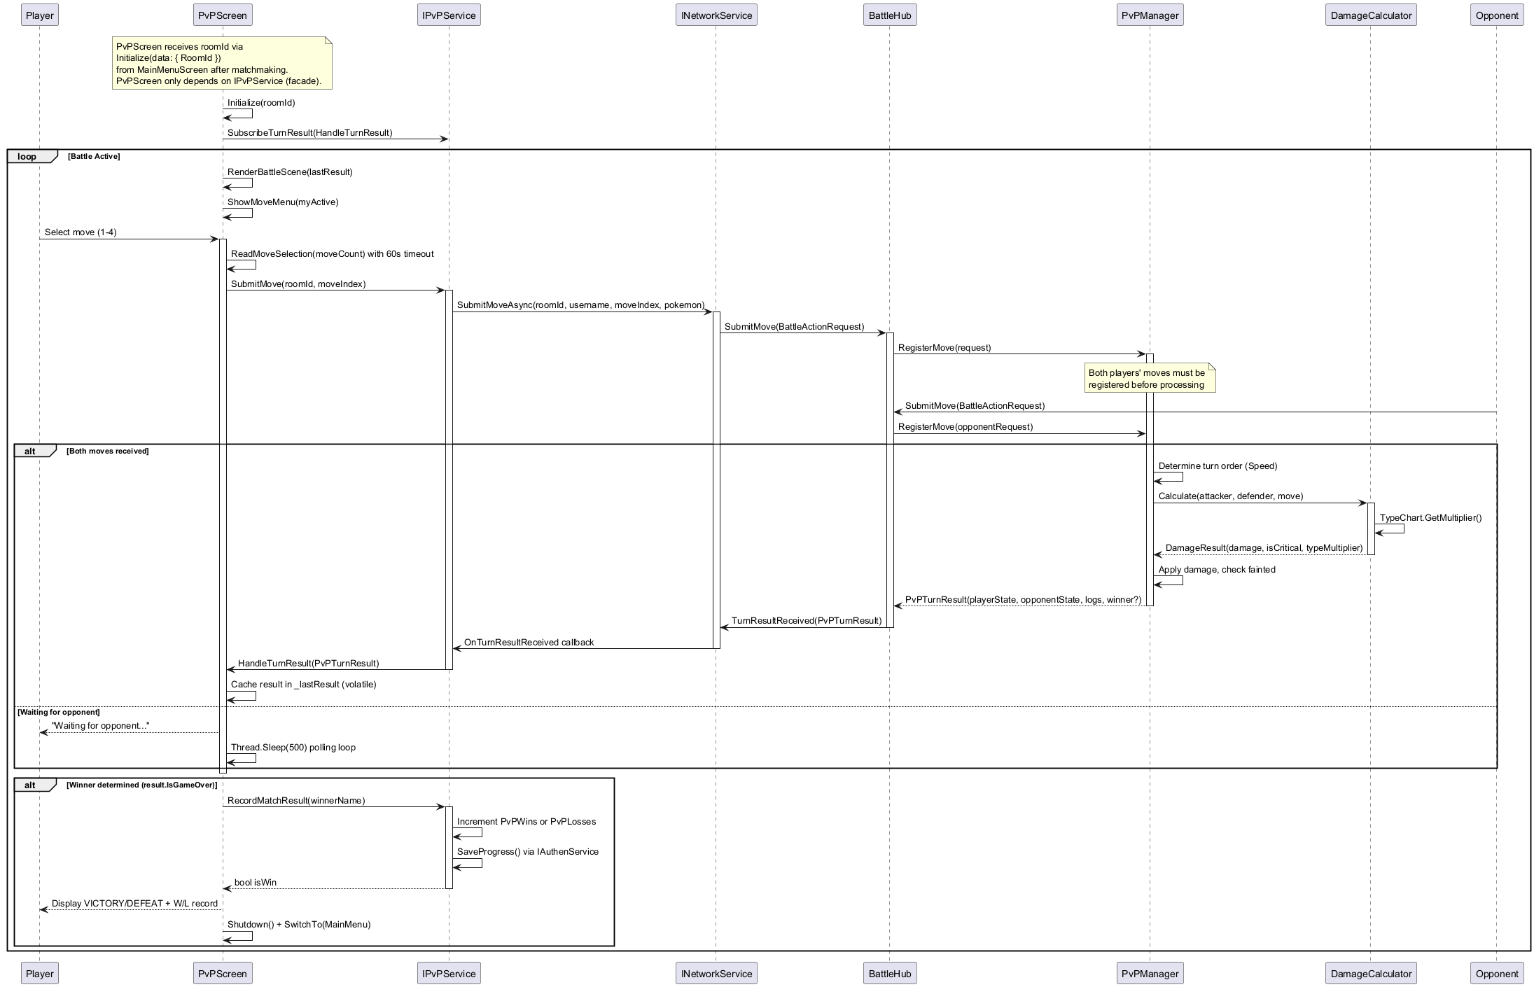

Slide 41
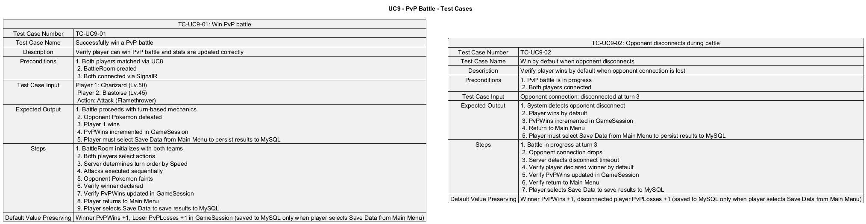

Slide 42
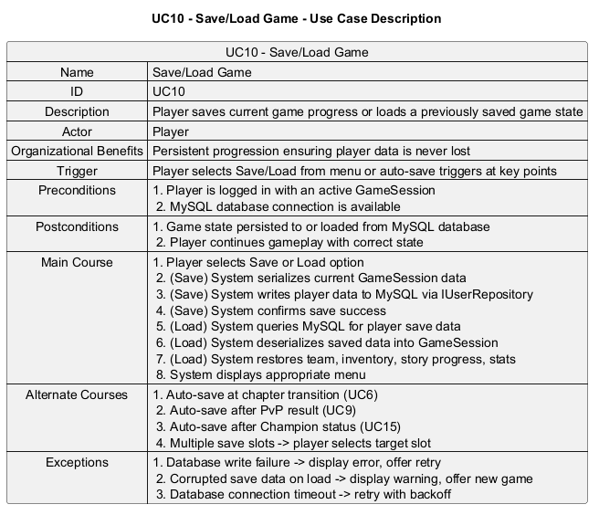

Slide 43
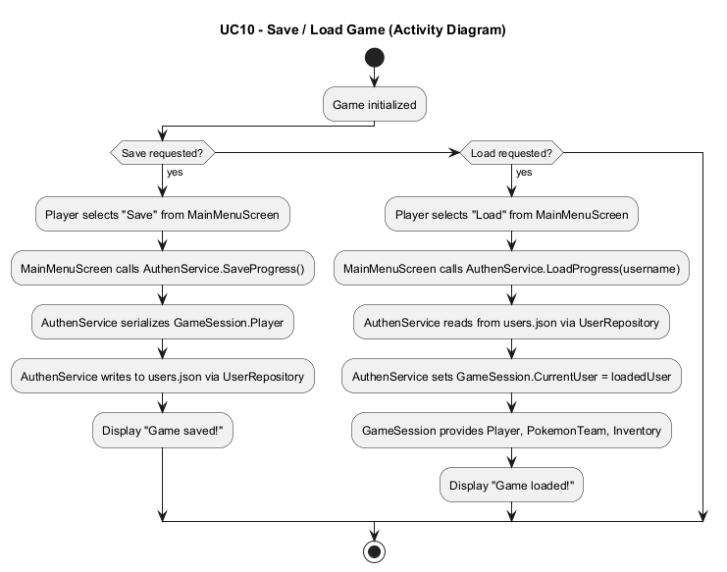

Slide 44
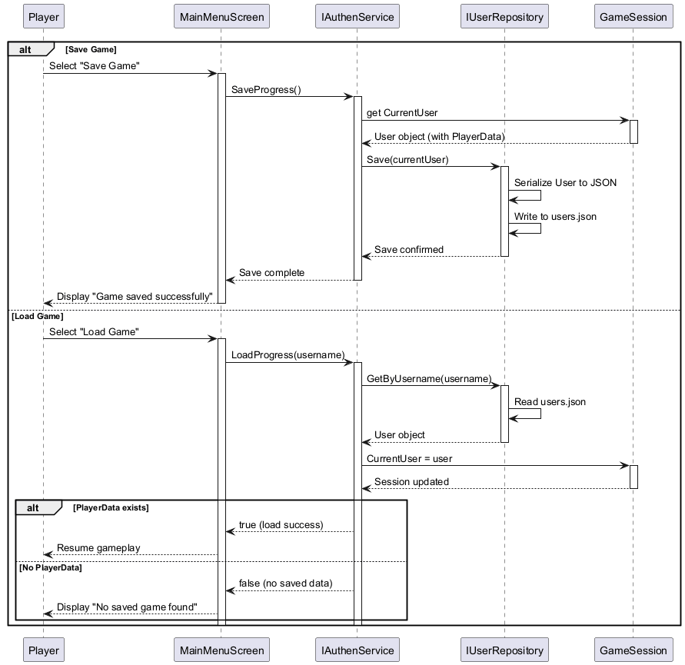

Slide 45
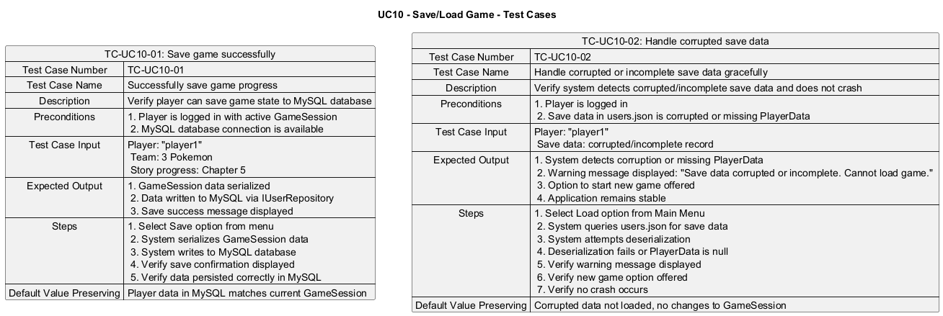

Slide 46
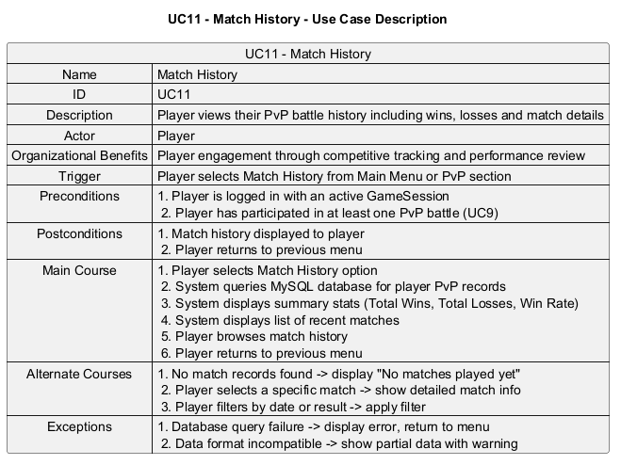

Slide 47
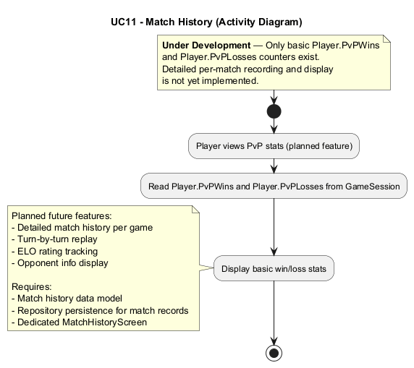

Slide 48
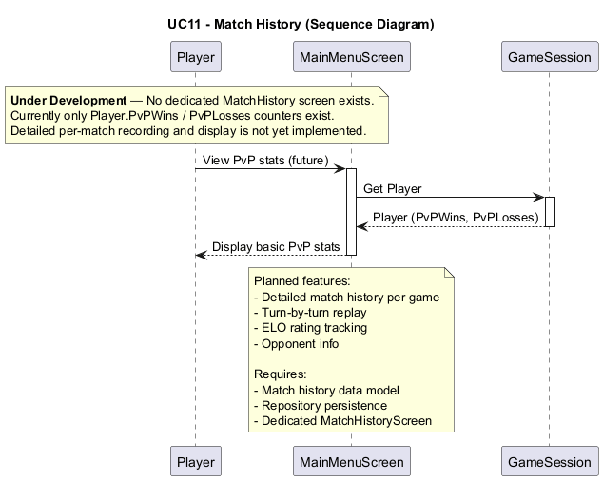

Slide 49
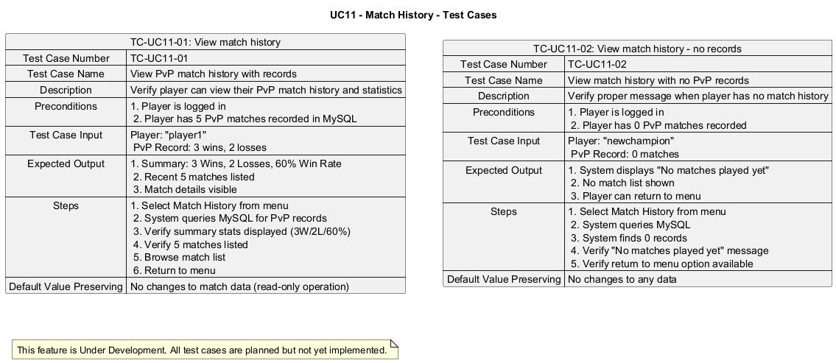

Slide 50
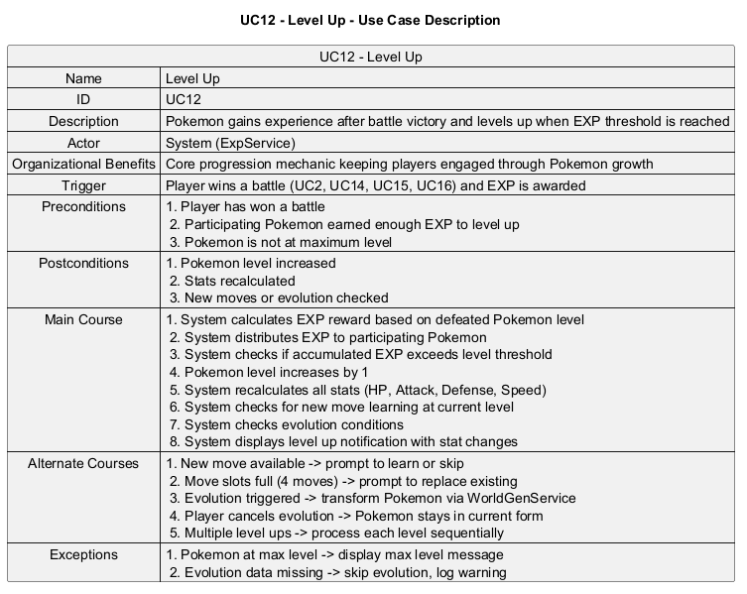

Slide 51
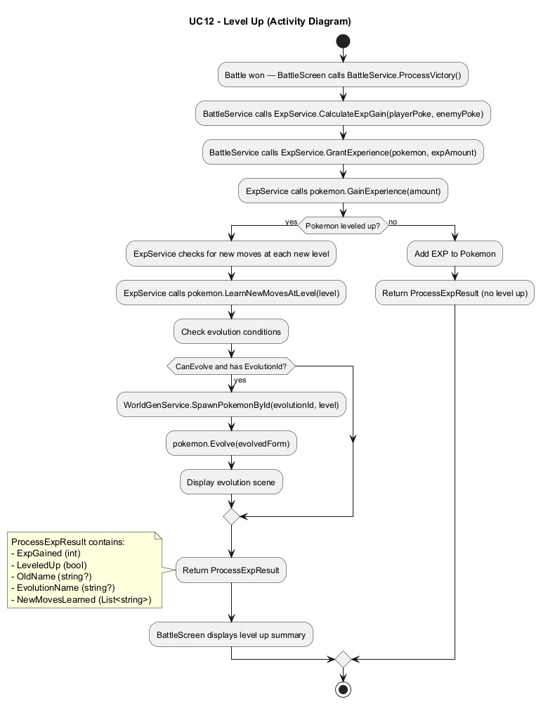

Slide 52
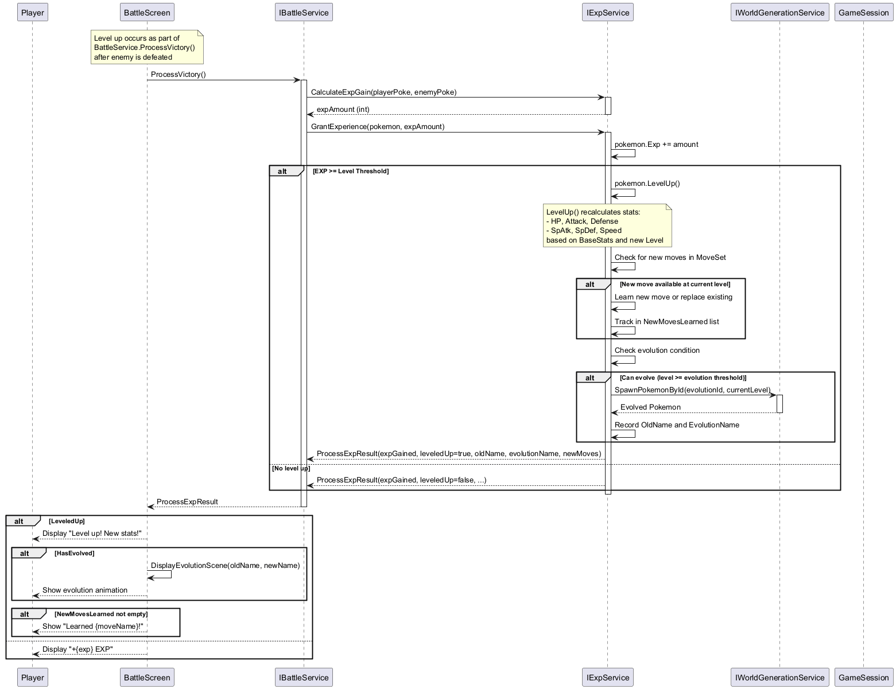

Slide 53
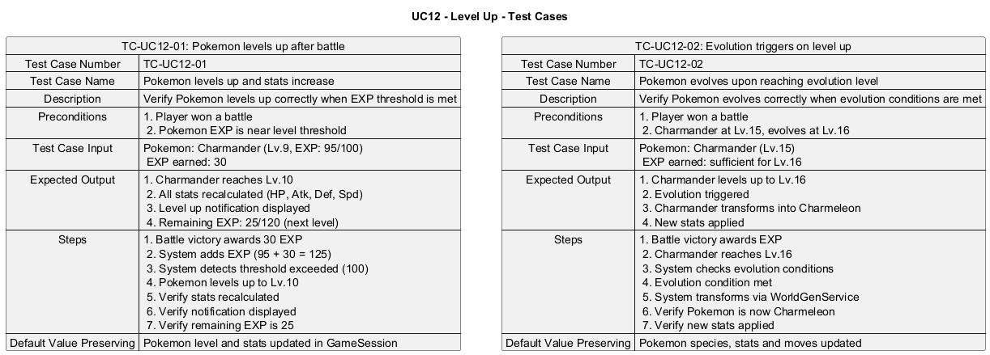

Slide 54
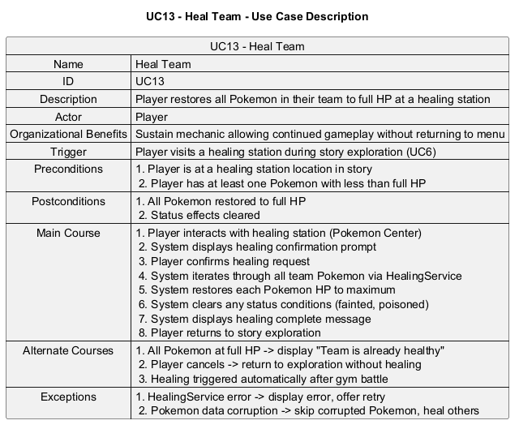

Slide 55


Slide 56


Slide 57


Slide 58


Slide 59


Slide 60


Slide 61


Slide 62


Slide 63


Slide 64


Slide 65


Slide 66


Slide 67


Slide 68


Slide 69


Slide 70


Slide 71


Slide 72


Slide 73


Slide 74


Slide 75


Slide 76


Slide 77


Slide 78


Slide 79


Slide 80


Slide 81


Slide 82


Slide 83


Slide 84


Slide 85


Slide 86


Slide 87


Slide 88


Slide 89


Slide 90


Slide 91


