Slide 1

CHiRP

Slide 2

CHiRP

Slide 3

CHiRP

Slide 4
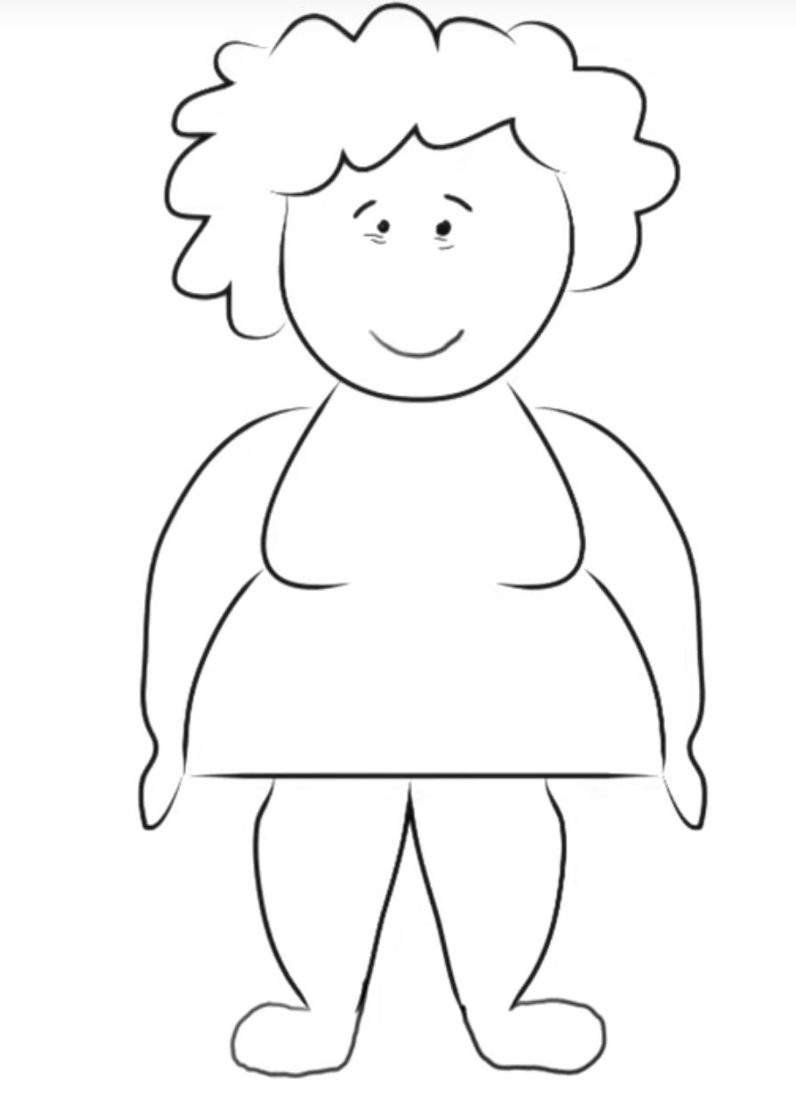
Patient: Marla Georges
FHIR Data

Slide 5
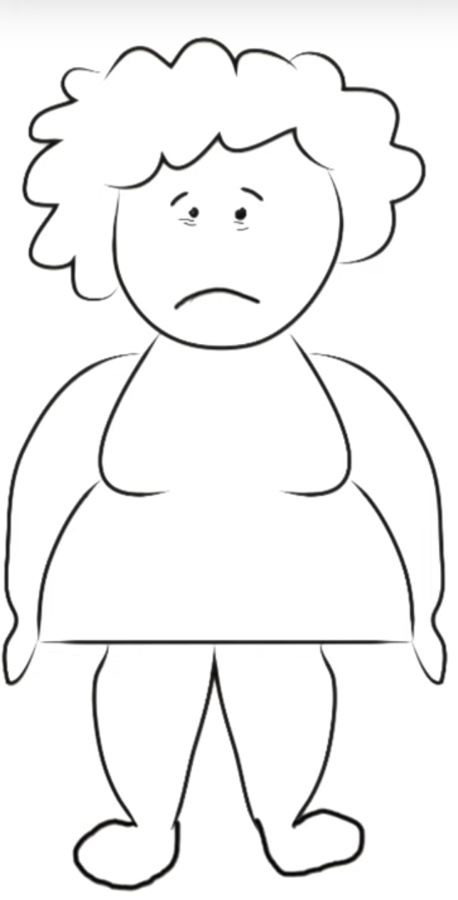
Patient: Marla Georges
Diabetes
Hypertension
Lung Disease (COPD)
Heart Disease

Slide 6
Patient: Marla Georges
10 Specialists
No Primary Care Physician
COVID-19 Positive
Isolated & Immobile

Slide 7
Marla uses CHiRP
FHIR Data

Slide 8
Marla’s Primary Care Physician
FHIR Data

Slide 9
CHiRP’s Population Health Dashboard
FHIR Data

Slide 10
How Does CHiRP Work?
FHIR Data

Slide 11
Care for Your Patients with CHiRP
FHIR Data

